Slide 1
CTT526 - Kiến trúc phần mềm Mẫu thiết kế Structural Patterns
Trường Đại học Khoa Học Tự Nhiên
Khoa Công Nghệ Thông Tin
Bộ môn Công Nghệ Phần Mềm
PGS.TS. Trần Minh Triết
tmtriet@fit.hcmus.edu.vn
Version 1.0

Slide 2
Mẫu thiết kế trong nhóm Structural Pattern
Mẫu Adapter
Mẫu Bridge
Mẫu Composite
Mẫu Decorator
Mẫu Facade
Mẫu Flyweight
Mẫu Proxy
[Erich Gamma, Richard Helm, Ralph Johnson, John Vlissides (1995). Design Patterns - Elements of Reusable Object-Oriented Software, Addison-Wesley]
[Christopher G. Lasater (2007). Design Patterns, Wordware Publishing, Inc.]

Slide 3
Mẫu Adapter
[Christopher G. Lasater (2007). Design Patterns, Wordware Publishing, Inc.]

Slide 4
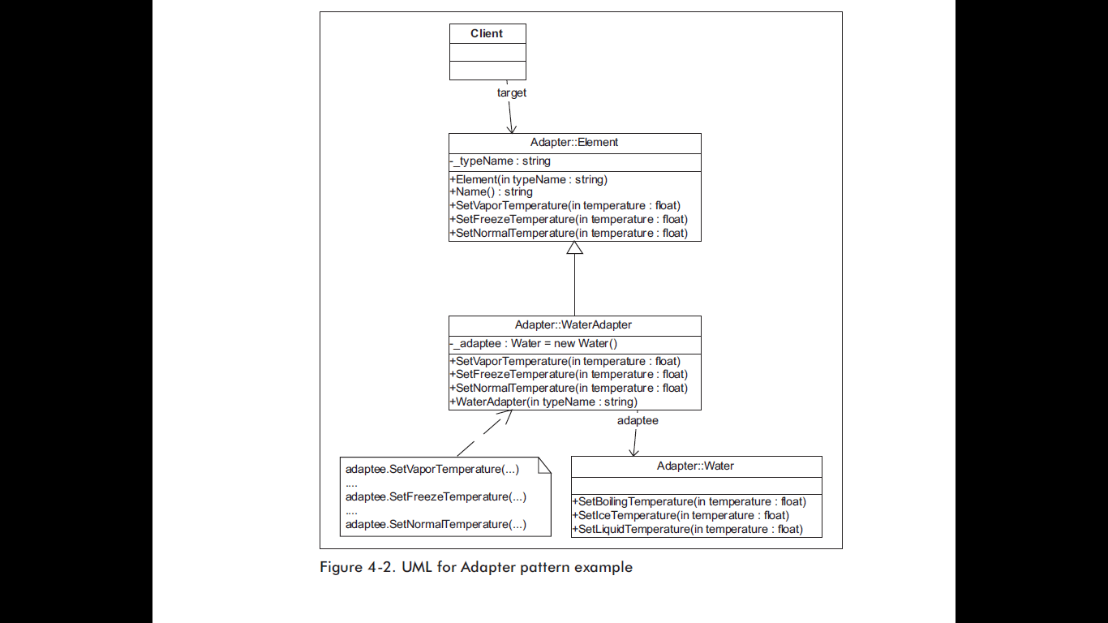
Mẫu Adapter
[Christopher G. Lasater (2007). Design Patterns, Wordware Publishing, Inc.]

Slide 5
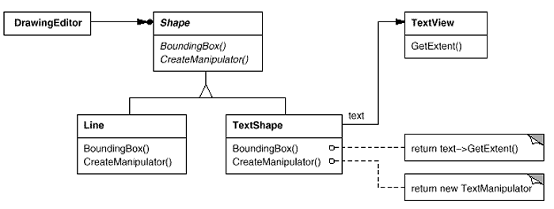
Mẫu Adapter
[Christopher G. Lasater (2007). Design Patterns, Wordware Publishing, Inc.]

Slide 6
Mẫu Adapter
[Erich Gamma, Richard Helm, Ralph Johnson, John Vlissides (1995).
Design Patterns - Elements of Reusable Object-Oriented Software, Addison-Wesley]

Slide 7
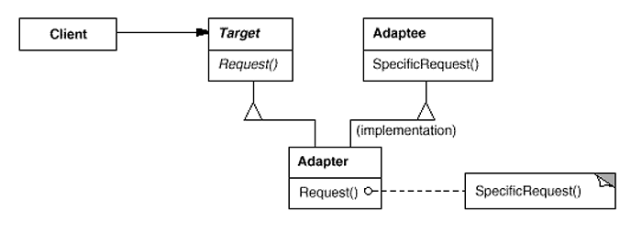
Mẫu Adapter
[Erich Gamma, Richard Helm, Ralph Johnson, John Vlissides (1995).
Design Patterns - Elements of Reusable Object-Oriented Software, Addison-Wesley]

Slide 8
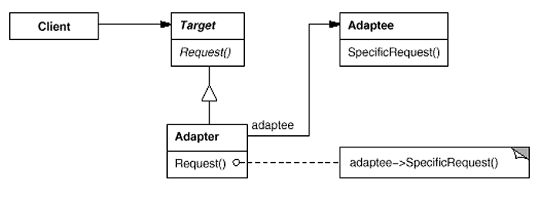
Mẫu Adapter
[Erich Gamma, Richard Helm, Ralph Johnson, John Vlissides (1995).
Design Patterns - Elements of Reusable Object-Oriented Software, Addison-Wesley]

Slide 9
Mẫu Adapter
Thảo luận
Bản chất của mẫu Adapter?
Những tình huống sử dụng
So sánh với các mẫu liên quan
Bridge pattern
Decorator pattern
Facade pattern
Proxy pattern
Template pattern
Visitor pattern
?

Slide 10
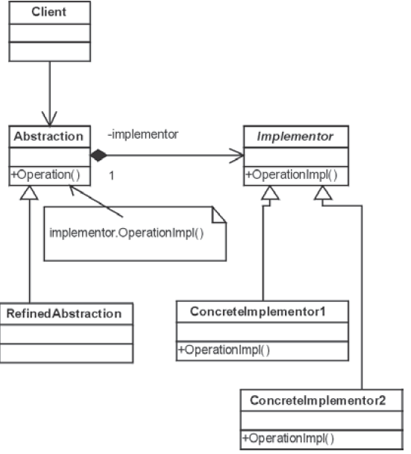
Mẫu Bridge
[Christopher G. Lasater (2007). Design Patterns, Wordware Publishing, Inc.]

Slide 11
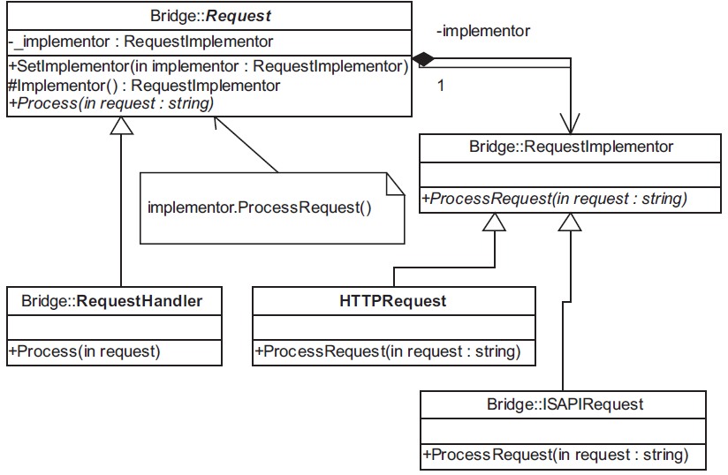
Mẫu Bridge
[Christopher G. Lasater (2007). Design Patterns, Wordware Publishing, Inc.]

Slide 12

Mẫu Bridge
[Christopher G. Lasater (2007). Design Patterns, Wordware Publishing, Inc.]

Slide 13
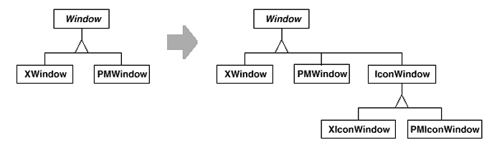
Mẫu Bridge
[Erich Gamma, Richard Helm, Ralph Johnson, John Vlissides (1995).
Design Patterns - Elements of Reusable Object-Oriented Software, Addison-Wesley]

Slide 14
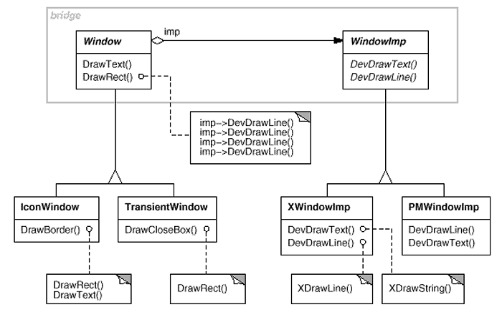
Mẫu Bridge
[Erich Gamma, Richard Helm, Ralph Johnson, John Vlissides (1995).
Design Patterns - Elements of Reusable Object-Oriented Software, Addison-Wesley]

Slide 15
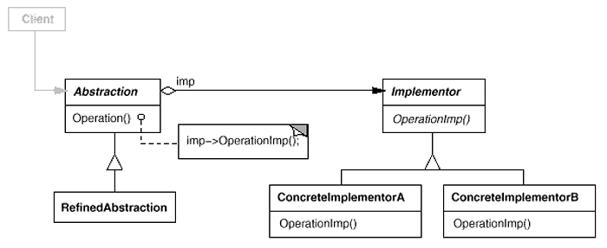
Mẫu Bridge
[Erich Gamma, Richard Helm, Ralph Johnson, John Vlissides (1995).
Design Patterns - Elements of Reusable Object-Oriented Software, Addison-Wesley]

Slide 16
Mẫu Bridge
Thảo luận
Bản chất của mẫu Bridge?
Những tình huống sử dụng
So sánh với các mẫu liên quan
Adapter pattern
Facade pattern
Proxy pattern
Template pattern
?

Slide 17
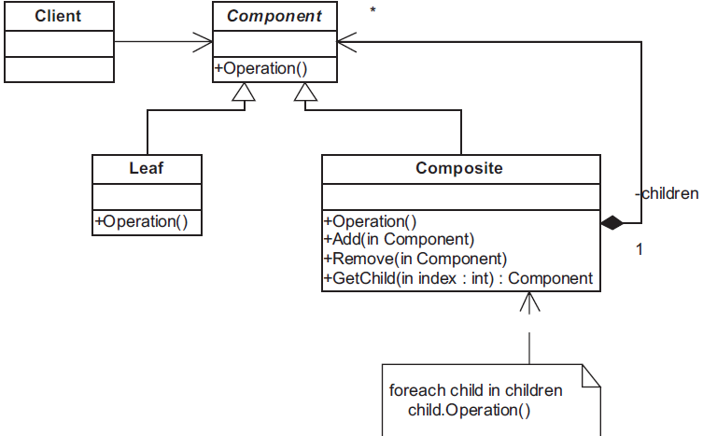
Mẫu Composite
[Christopher G. Lasater (2007). Design Patterns, Wordware Publishing, Inc.]

Slide 18
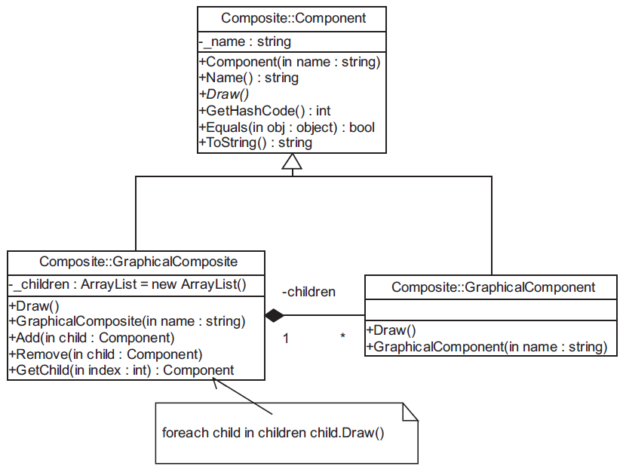
Mẫu Composite
[Christopher G. Lasater (2007). Design Patterns, Wordware Publishing, Inc.]

Slide 19
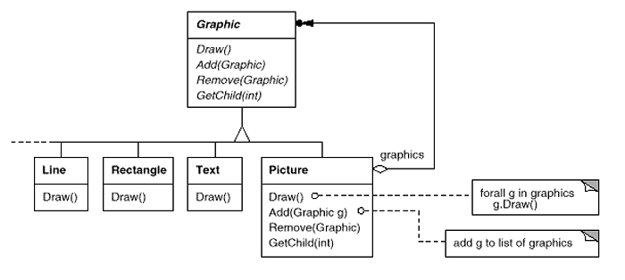
Mẫu Composite
[Erich Gamma, Richard Helm, Ralph Johnson, John Vlissides (1995).
Design Patterns - Elements of Reusable Object-Oriented Software, Addison-Wesley]

Slide 20
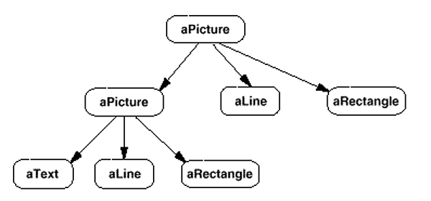
Mẫu Composite
[Erich Gamma, Richard Helm, Ralph Johnson, John Vlissides (1995).
Design Patterns - Elements of Reusable Object-Oriented Software, Addison-Wesley]

Slide 21
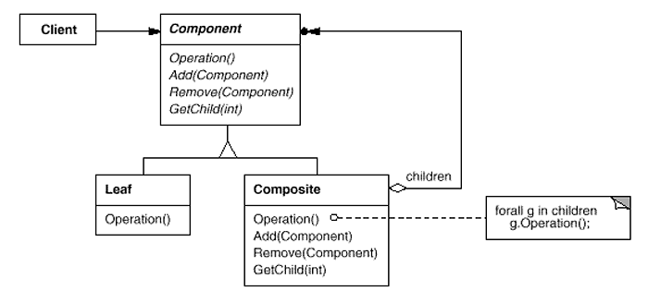
Mẫu Composite
[Erich Gamma, Richard Helm, Ralph Johnson, John Vlissides (1995).
Design Patterns - Elements of Reusable Object-Oriented Software, Addison-Wesley]

Slide 22
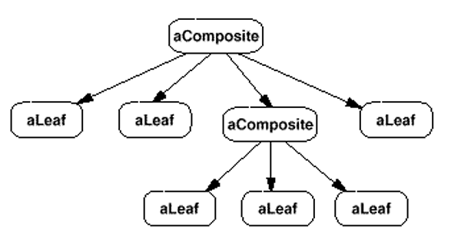
Mẫu Composite
[Erich Gamma, Richard Helm, Ralph Johnson, John Vlissides (1995).
Design Patterns - Elements of Reusable Object-Oriented Software, Addison-Wesley]

Slide 23
Mẫu Composite
Thảo luận
Bản chất của mẫu Composite?
Những tình huống sử dụng
So sánh với các mẫu liên quan
Chain of Responsibility pattern
Command pattern
Decorator pattern
Flyweight pattern
Iterator pattern
Visitor pattern
?

Slide 24
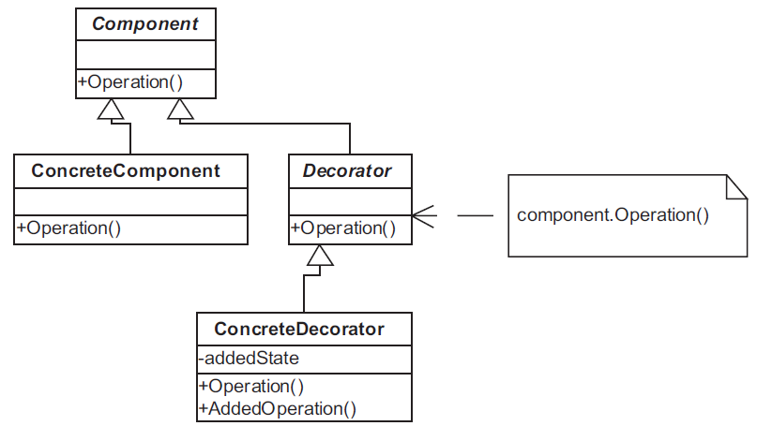
Mẫu Decorator
[Christopher G. Lasater (2007). Design Patterns, Wordware Publishing, Inc.]

Slide 25
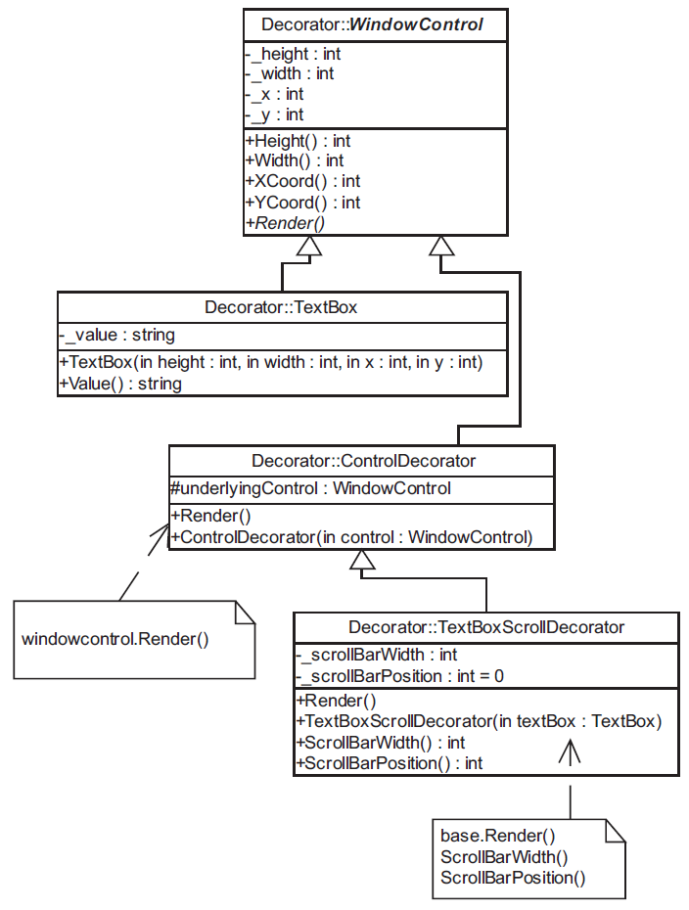
Mẫu Decorator
[Christopher G. Lasater (2007). Design Patterns, Wordware Publishing, Inc.]

Slide 26
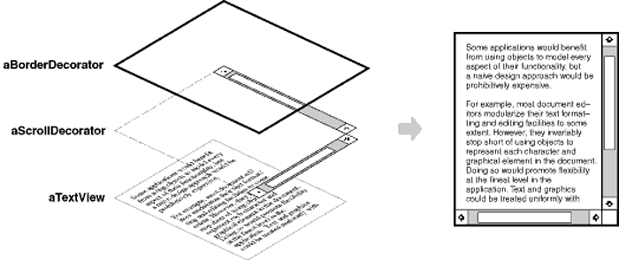
Mẫu Decorator
[Erich Gamma, Richard Helm, Ralph Johnson, John Vlissides (1995).
Design Patterns - Elements of Reusable Object-Oriented Software, Addison-Wesley]

Slide 27
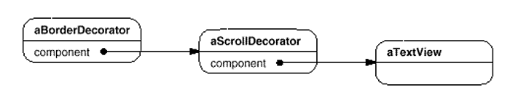
Mẫu Decorator
[Erich Gamma, Richard Helm, Ralph Johnson, John Vlissides (1995).
Design Patterns - Elements of Reusable Object-Oriented Software, Addison-Wesley]

Slide 28
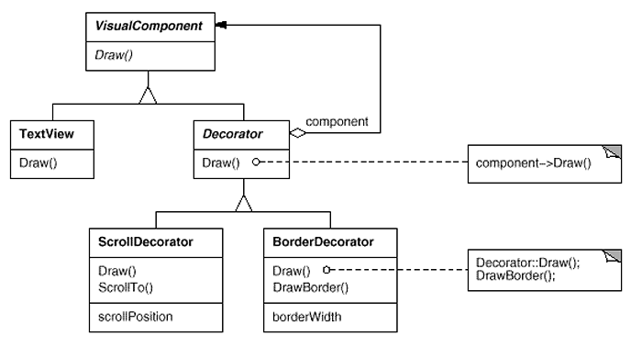
Mẫu Decorator
[Erich Gamma, Richard Helm, Ralph Johnson, John Vlissides (1995).
Design Patterns - Elements of Reusable Object-Oriented Software, Addison-Wesley]

Slide 29
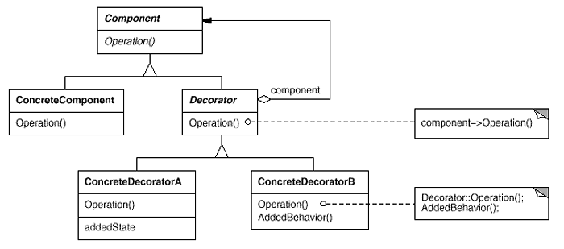
Mẫu Decorator
[Erich Gamma, Richard Helm, Ralph Johnson, John Vlissides (1995).
Design Patterns - Elements of Reusable Object-Oriented Software, Addison-Wesley]

Slide 30
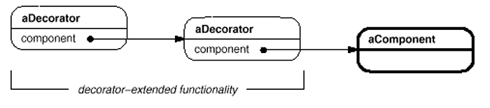
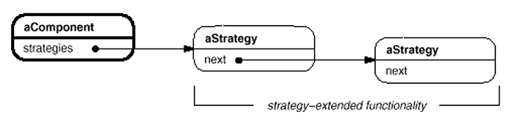
Mẫu Decorator
[Erich Gamma, Richard Helm, Ralph Johnson, John Vlissides (1995).
Design Patterns - Elements of Reusable Object-Oriented Software, Addison-Wesley]

Slide 31
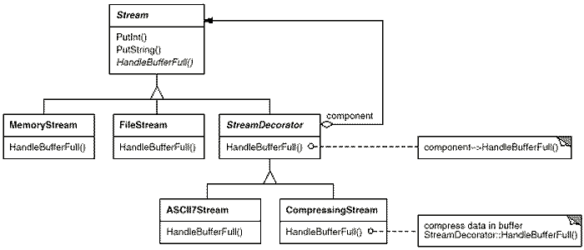
Mẫu Decorator
[Erich Gamma, Richard Helm, Ralph Johnson, John Vlissides (1995).
Design Patterns - Elements of Reusable Object-Oriented Software, Addison-Wesley]

Slide 32
Mẫu Decorator
Thảo luận
Bản chất của mẫu Decorator?
Những tình huống sử dụng
So sánh với các mẫu liên quan
Adapter pattern
Composite pattern
Visitor pattern
?

Slide 33
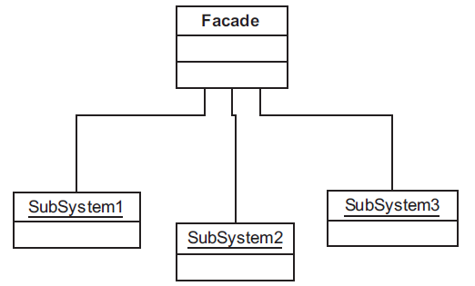
Mẫu Facade
[Christopher G. Lasater (2007). Design Patterns, Wordware Publishing, Inc.]

Slide 34
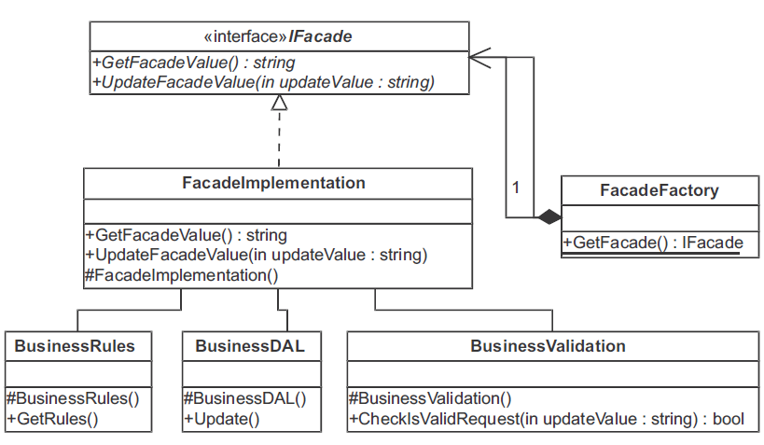
Mẫu Facade
[Christopher G. Lasater (2007). Design Patterns, Wordware Publishing, Inc.]

Slide 35
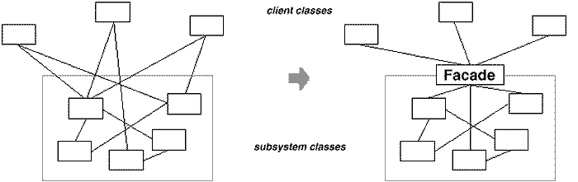
Mẫu Facade
[Erich Gamma, Richard Helm, Ralph Johnson, John Vlissides (1995).
Design Patterns - Elements of Reusable Object-Oriented Software, Addison-Wesley]

Slide 36
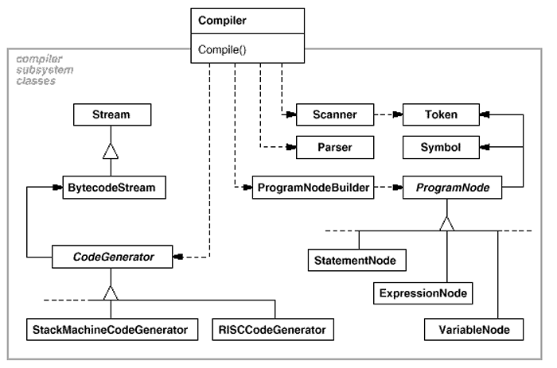
Mẫu Facade
[Erich Gamma, Richard Helm, Ralph Johnson, John Vlissides (1995).
Design Patterns - Elements of Reusable Object-Oriented Software, Addison-Wesley]

Slide 37
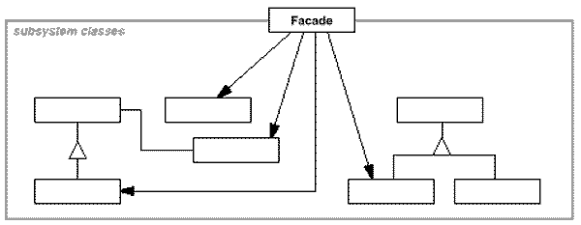
Mẫu Facade
[Erich Gamma, Richard Helm, Ralph Johnson, John Vlissides (1995).
Design Patterns - Elements of Reusable Object-Oriented Software, Addison-Wesley]

Slide 38
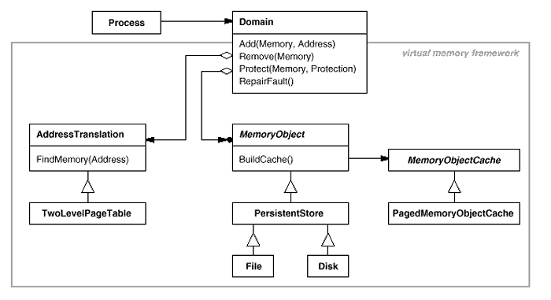
Mẫu Facade
[Erich Gamma, Richard Helm, Ralph Johnson, John Vlissides (1995).
Design Patterns - Elements of Reusable Object-Oriented Software, Addison-Wesley]

Slide 39
Mẫu Facade
Thảo luận
Bản chất của mẫu Facade?
Những tình huống sử dụng
So sánh với các mẫu liên quan
Adapter pattern
Bridge pattern
Proxy pattern
?

Slide 40
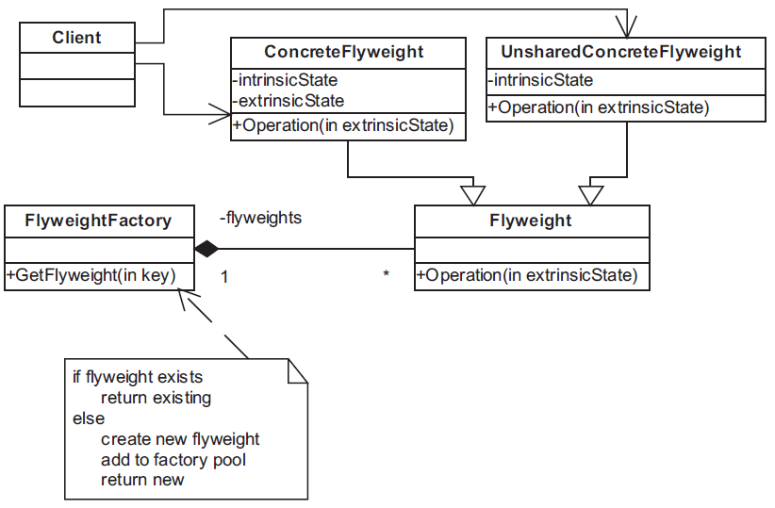
Mẫu Flyweight
[Christopher G. Lasater (2007). Design Patterns, Wordware Publishing, Inc.]

Slide 41
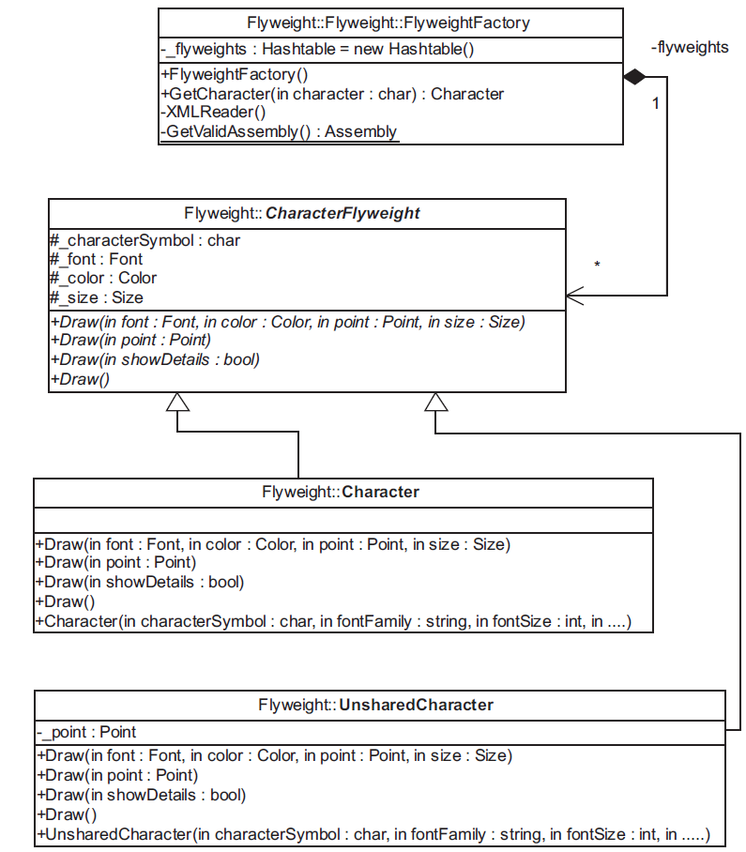
Mẫu Flyweight
[Christopher G. Lasater (2007). Design Patterns, Wordware Publishing, Inc.]

Slide 42
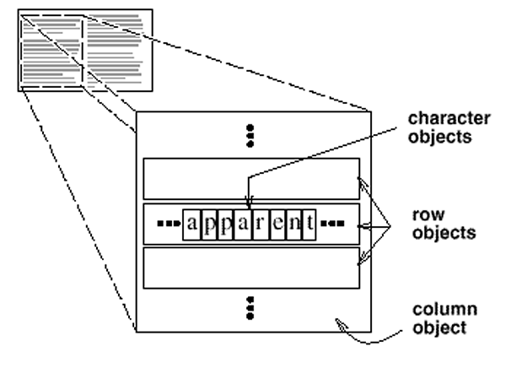
Mẫu Flyweight
[Erich Gamma, Richard Helm, Ralph Johnson, John Vlissides (1995).
Design Patterns - Elements of Reusable Object-Oriented Software, Addison-Wesley]

Slide 43
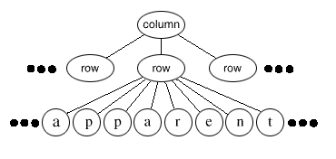
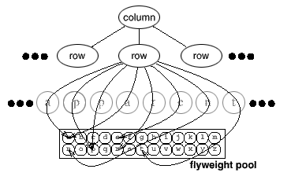
Mẫu Flyweight
[Erich Gamma, Richard Helm, Ralph Johnson, John Vlissides (1995).
Design Patterns - Elements of Reusable Object-Oriented Software, Addison-Wesley]

Slide 44
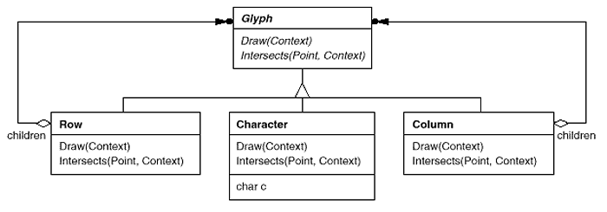
Mẫu Flyweight
[Erich Gamma, Richard Helm, Ralph Johnson, John Vlissides (1995).
Design Patterns - Elements of Reusable Object-Oriented Software, Addison-Wesley]

Slide 45
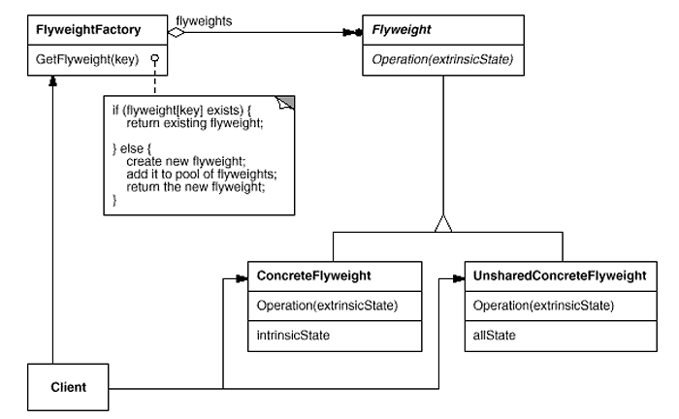
Mẫu Flyweight
[Erich Gamma, Richard Helm, Ralph Johnson, John Vlissides (1995).
Design Patterns - Elements of Reusable Object-Oriented Software, Addison-Wesley]

Slide 46
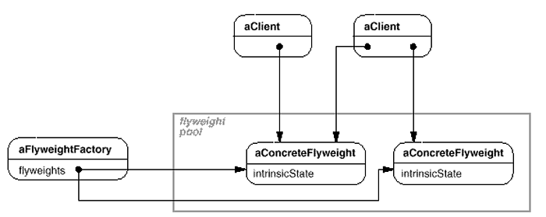
Mẫu Flyweight
[Erich Gamma, Richard Helm, Ralph Johnson, John Vlissides (1995).
Design Patterns - Elements of Reusable Object-Oriented Software, Addison-Wesley]

Slide 47
Mẫu Flyweight
Thảo luận
Bản chất của mẫu Flyweight?
Những tình huống sử dụng
So sánh với các mẫu liên quan
Composite pattern
Factory pattern
Interpreter pattern
State pattern
Strategy pattern
Template pattern
?

Slide 48
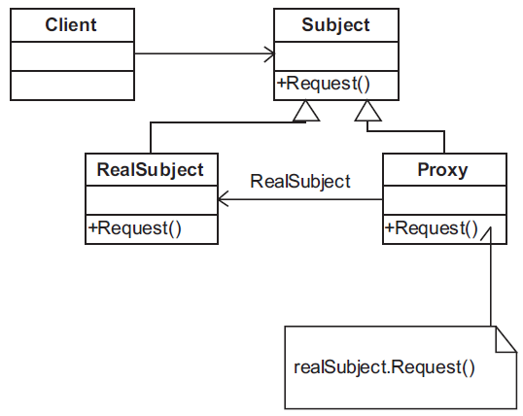
Mẫu Proxy
[Christopher G. Lasater (2007). Design Patterns, Wordware Publishing, Inc.]

Slide 49
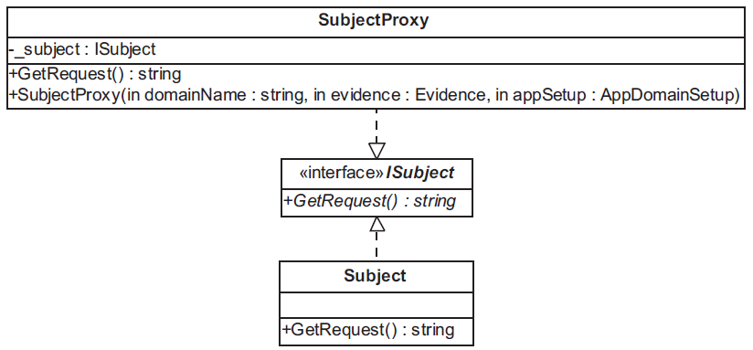
Mẫu Proxy
[Christopher G. Lasater (2007). Design Patterns, Wordware Publishing, Inc.]

Slide 50
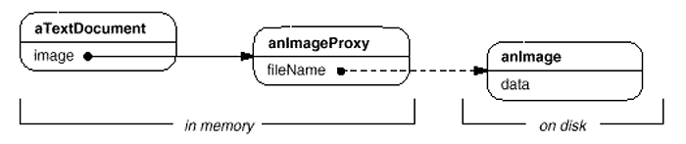
Mẫu Proxy
[Erich Gamma, Richard Helm, Ralph Johnson, John Vlissides (1995).
Design Patterns - Elements of Reusable Object-Oriented Software, Addison-Wesley]

Slide 51
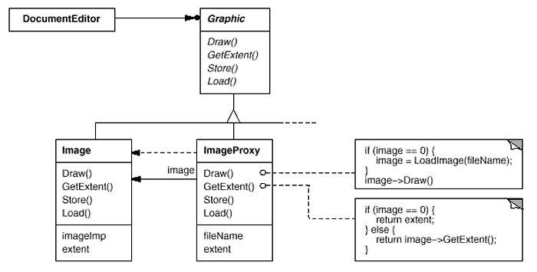
Mẫu Proxy
[Erich Gamma, Richard Helm, Ralph Johnson, John Vlissides (1995).
Design Patterns - Elements of Reusable Object-Oriented Software, Addison-Wesley]

Slide 52
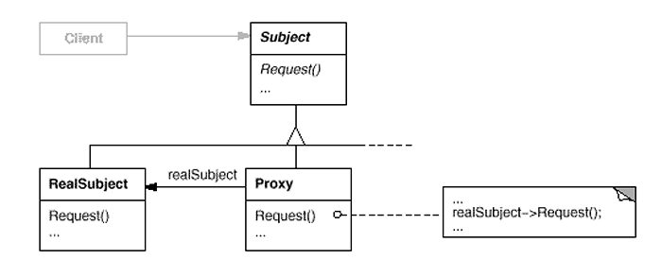
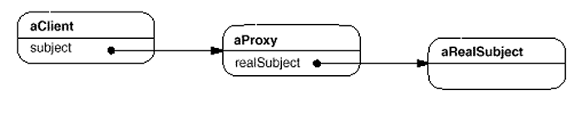
Mẫu Proxy
[Erich Gamma, Richard Helm, Ralph Johnson, John Vlissides (1995).
Design Patterns - Elements of Reusable Object-Oriented Software, Addison-Wesley]

Slide 53
Mẫu Proxy
Thảo luận
Bản chất của mẫu Proxy?
Những tình huống sử dụng
So sánh với các mẫu liên quan
Adapter pattern
Bridge pattern
Facade pattern
?

