Slide 1
CTT526 - Kiến trúc phần mềm Middleware
Trường Đại học Khoa Học Tự Nhiên
Khoa Công Nghệ Thông Tin
Bộ môn Công Nghệ Phần Mềm
PGS.TS. Trần Minh Triết
tmtriet@fit.hcmus.edu.vn
Version 1.0

Slide 2
Nội dung của bài giảng sử dụng:
Session 4:
A Guide to Middleware Architectures and Technologies
trong bộ slide Software Architecture Essential
của GS. Ian Gorton
Software Engineering Institute
Carnegie Mellon University

Slide 3
Introduction
Middleware is the plumbing or wiring of IT applications
Provides applications with fundamental services for distributed computing
Insulates applications from underlying platform (OS, DBMS, etc) APIs
Lots of middleware exists
Different purposes
Different vendors
Different standards and proprietary technologies

Slide 4
Middleware Classification
Business Process Orchestrators
BizTalk, TIBCO StaffWare, ActiveBPEL
Message Brokers
BizTalk, WebSphere Message Broker, SonicMQ
Application Servers
J2EE, CCM, .NET
Transport
Message-Oriented Middleware, Distributed Objects Systems

Slide 5
Outline
CORBA
Message-oriented middleware
J2EE
Message brokers
Business process orchestrators

Slide 6
CORBA
Venerable distributed object technology
Still widely used in telecomms, defense
Many different implementations
Client
Server
Object Reference
request
Servant
reply
client ORB
server ORB
Network

Slide 7
CORBA Code Example
module ServerExample
{
interface MyObject { string isAlive(); };
};
CORBA IDL
class MyServant extends _MyObjectImplBase
{ public String isAlive() { return "\nLooks like it…\n"; }
}
Server
ORB orb = ORB.init(args, null);
MyServant objRef = new MyServant();
orb.connect(objRef);
ORB orb = ORB.init(args, null);
// Lookup is a wrapper that actually access the CORBA Naming
// Service directory – details omitted for simplicity
MyServant servantRef = lookup(“Myservant”)String
reply = servantRef.isAlive();
Client

Slide 8
CORBA – Some Thoughts
Many associated services, eg
Naming
Notification
Transactions
Synchronous technology, client-server relatively tightly coupled
Remote calls can/will fail
State management in server objects creates ‘interesting’ recovery issues

Slide 9
Messaging - MOM
Basic Message Oriented Middleware (MOM) provides features like:
Asynchronous communications between processes, applications and systems
Send-and-forget
Delivering messages despite failures
Transactional Messaging
Deliver all messages in a transaction, or none
Persistence
Messages can be logged at the server and hence survive server failure

Slide 10
Basic Messaging
Send (queue, message)
Put message onto queue
Receive (queue, message)
Get message from queue
No dependency on state of receiving application on message send
send
receive
queue

Slide 11
Persistence
queue
send
receive
Receipt of message at queue implies message is written to disk log
Removal of message from queue deletes message from disk log
Trade-off performance versus reliability

Slide 12
MOM Server
MOM Server
Senders
Receivers
Sending
Applications
Sending
Applications
Message
Handler Thread Pool
Peer-to-peer MOM technologies are the alternative design

Slide 13
MOM Transactions

Slide 14
MOM Transactions
Sender and receiver do *not* share a transaction
Rollback on receiver does not affect the sender (already committed)
‘Synchronous’ operations are not atomic
Request/response is 3 transactions not 1
Put to request queue
Get from request queue, put to response queue
Get from response queue
Request queue
send
receive
receive
send
Response queue

Slide 15
Scaling MOM
MOM Server
ApplicationQ
Senders
Receivers
MOM Server
ApplicationQ

Slide 16
Messaging – Some thoughts
Highly attractive asynchronous technology
Supports loosely-coupled, dynamic applications
Scales well, high throughput possible
Many implementations, various qualities of service
caveat emptor

Slide 17
Publish-Subscribe Messaging
Extension of MOM to provide 1-to-N, N-to-1, and N-to-N communications
Messages are ‘published’ to logical subjects or topics
Subscribers receive all messages from subjects they subscribe to
Sub
Create/
Publish
Pub
Subject
Register/
Subscribe
Sub
Sub

Slide 18
Publish-Subscribe with Multicast
Based on
TIBCO
Rendezvous

Slide 19
Performance

Slide 20
Subject/Topic Naming
Sydney
DevGroup
SupportGroup
Information
Information
work
gossip
work
gossip
Sydney
Sydney/DevGroup
Sydney/DevGroup/Information
Sydney/DevGroup/Information/work
Sydney/DevGroup/Information/gossip
Sydney/SupportGroup
Sydney/SupportGroup/Information
Sydney/SupportGroup/Information/work
Sydney/SupportGroup/Information/gossip
Sydney/*/Information
Sydney/DevGroup/*/*
Sydney/DevGroup/**

Slide 21
Publish-Subscribe – Some Thoughts
Highly decoupled messaging style
Publishers don’t know about subscribers
Subscribers don’t know who is publishing
Publishers and Subscribers can dynamically appear and disappear
Issues –
Reliability
Transactions
Security
Performance

Slide 22
J2EE Overview

Slide 23
J2EE Application Server
In J2EE, the application server container provides the execution environment for the J2EE-specific components
EJBs
Message-driven beans
Connectors
Container provides additional services for hosted components
Transactions
Security
Directory
Threading
Connection pooling

Slide 24
EJB Container
Application Server
EJB Container
EJB Pool
Transaction
Service
Directory
Service
Lifecycle Management
Persistence
Connection Pool
Security
Service
Thread Pool

Slide 25
Beans and State
state
EJB Container
Stateless bean pool
state
state
state
EJB
Clients
state
state
Stateful beans
state

Slide 26
Deployment Descriptors
<ejb-jar>
<enterprise-beans>
<session>
<ejb-name>EntityStock.BrokerHome</ejb-name>
<home>db.entitystock.BrokerHome</home>
<remote>db.entitystock.Broker</remote>
<ejb-class>db.entitystock.BrokerBean</ejb-class>
<session-type>Stateless</session-type>
<transaction-type>Container</transaction-type>
</session>
</enterprise-beans>
<assembly-descriptor>
<container-transaction>
<method>
<ejb-name>EntityStock.BrokerHome</ejb-name>
<method-intf>Remote</method-intf>
<method-name>*</method-name>
</method>
<trans-attribute>Required</trans-attribute>
</container-transaction>
</assembly-descriptor>
</ejb-jar>

Slide 27
J2EE – Some Thoughts
Standards-based, multiple vendors, portable
Good open source technology available
Quality of implementations varies considerably
Java only, wide platform support
Performance is good, but varies between suppliers
Scalable, fail over support through clustering
Good integration with web technologies
Supports various design patterns, flexible but more complex (e.g. stateful beans/scalability, entity beans)
Standards evolving, need to monitor

Slide 28
Message Brokers - Motivation
Key:
Message =
Web
Component
In-format
In-format
In-format
In-format
In-format
Legacy
System #1
Legacy
System #2
Legacy
System #3
Legacy
System #4
Queue
Read
API
call
Message
Transform
In-format
Legacyformat

Slide 29
What if …
the common In-format message format changes?
any legacy system API changes?
any of the transformations needs modifying?

Slide 30
Alternative Solution
Key:
Message =
Web
Component
Transformations in broker
Simplified endpoints
Decouples Web and legacy components
In-format
Message
Broker
L1-format
L2-format
L3-format
L4-format
Legacy
System #1
Legacy
System #2
Legacy
System #3
Legacy
System #4

Slide 31
Message Brokers
Developed specifically for Enterprise Application Integration (EAI)
Add new layers of functionality to MOM
Message transformation
Rules engine
Intelligent routing
Adapters
Typically (but not necessarily) built on top of a MOM layer

Slide 32
Message Broker Features
Message transformation – transform between different source/target formats
Graphical message format definition and mapping tools
High performance transformation engines
Message format repositories
Intelligent routing
Route messages based on message content
Rules Engine
Scripting language, built-in functions
Application programming environment

Slide 33
Message Brokers
Hub and Spoke Architecture
Input Messages
Output Messages
Transformation
Routing
Rules Processing

Slide 34
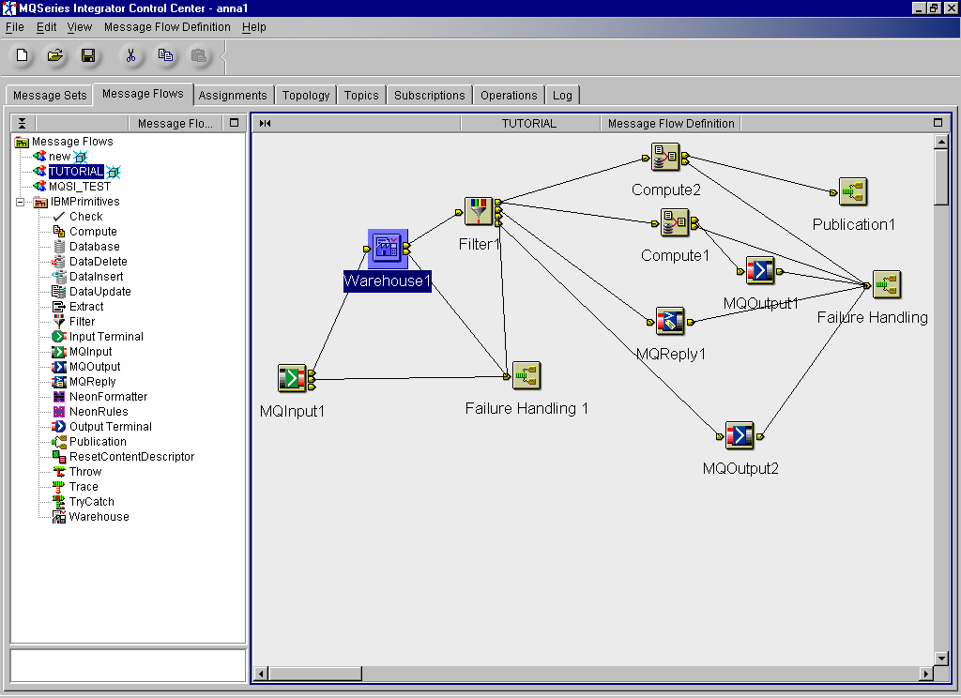
Example - WMQI

Slide 35
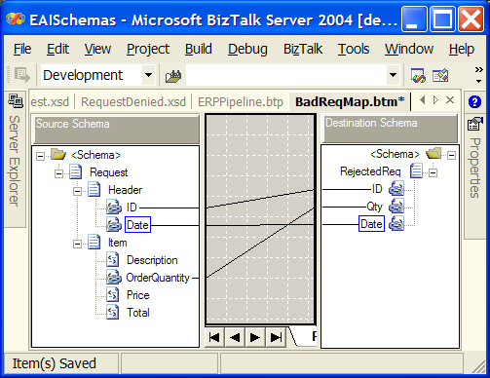
BizTalk Mapping Tool

Slide 36
Adapters
An adapter is a component that resides between the message broker and the source/target systems
Simplify complexity of end system interface through an abstraction layer
Thin adapters - simple wrappers
Thick adapters
Programmable
Abstract representation of services and meta-data
Centralized adapters co-located with broker
Distributed adapters execute in own process and may be located with source/target system

Slide 37
Message Brokers – Some Thoughts
Embeds transformations/routing in broker
Can get complex
Possible scaling issues
Need to replicate brokers
Failure handling
Lightweight, rarely designed to recover from failure
Often proprietary technology
Good open source, standards-based like Mule now available

Slide 38
Business Process Orchestration
Commonly known as workflow
Aim is to automate business processes which need to access data and business logic across disparate back-end applications
Builds on EAI to ensure business processes are executed in the defined order using the required data
Builds on middleware providing:
Process execution engine
Visual process definition tools
Process monitoring tools

Slide 39
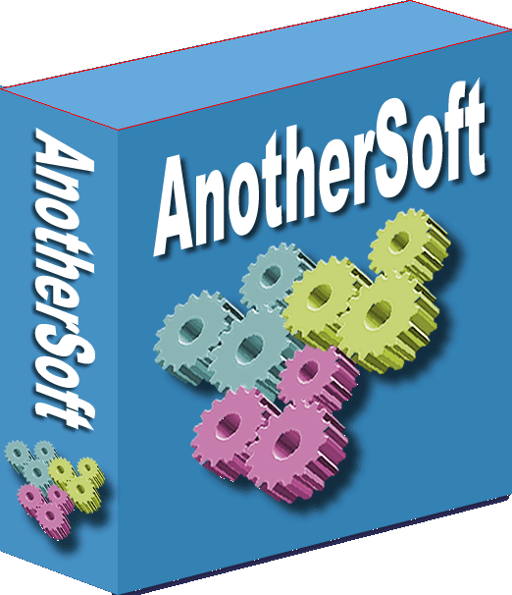
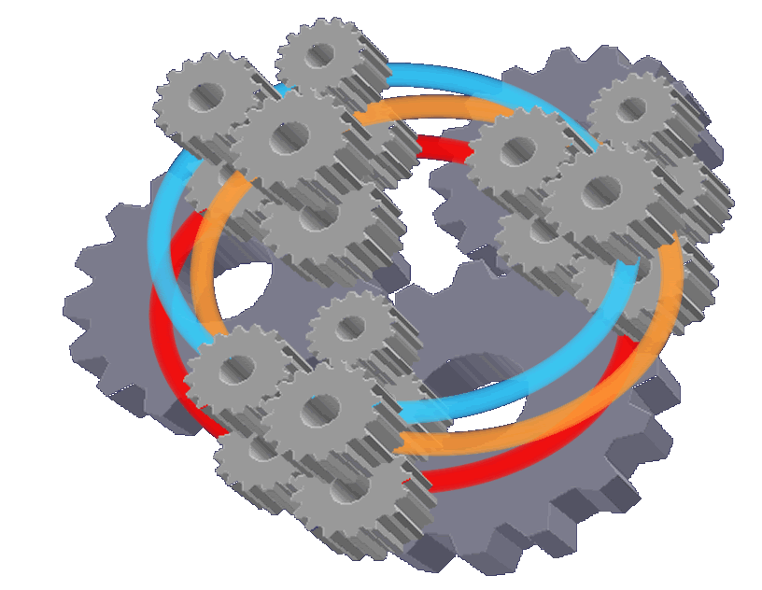

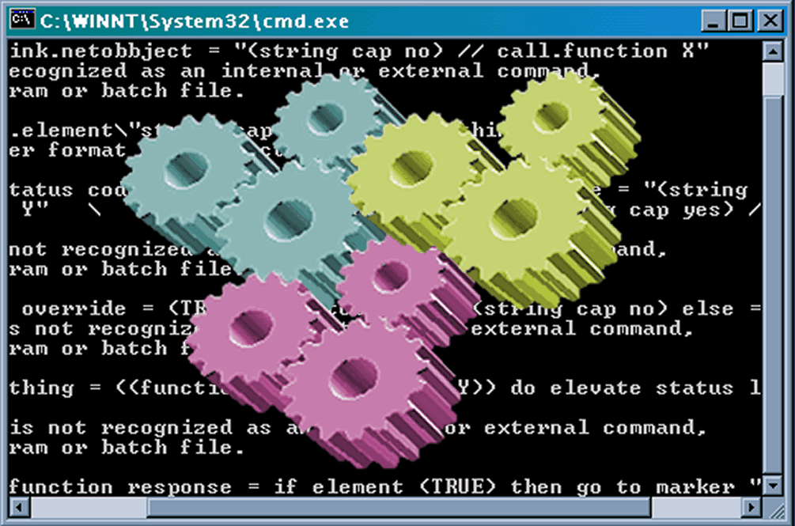

Typical Scenario
Business process automation
Credit
Validation
Accounts
Payable
Customer
Purchasing
Siebel
Shipping
Sales desk
Accounts
Receivable
Oracle
SAP
Customer Receiving
Notes:
Extract from: http://www.webmethods.com/PDF/Enterprise_Performance_and_Scalability.pdf
Business Process Automation
Business process projects typically involve the addition of new business logic between or in front of the corporate databases and applications. These are effectively new business applications. Issues for these integration projects vary widely:
o Reliability and in-order delivery requirements vary widely in these projects. Required transaction rates are typically low (generally 500 per minute or less), but some require much higher transaction rates. Performance and Scalability of webMethods Enterprise
o Some processes are long-lived—spanning hours, days or even weeks, so many processes may be in progress at a given time.

Slide 40
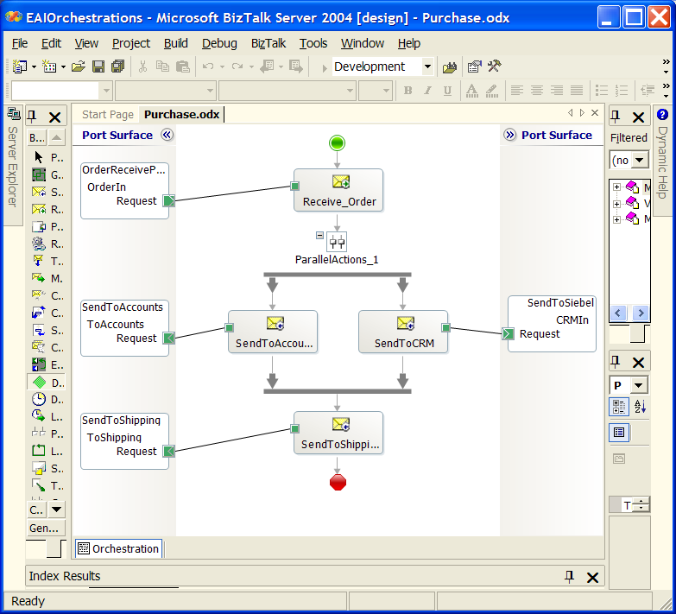
Example - BizTalk

Slide 41
BPO Architecture
Message Broker
Adapter
Adapter
Adapter

Slide 42
BPEL
Web Services standard for describing workflows
Many design and execution tools
Eg ActiveBPEL
Version 2.0 is a significant improvement

Slide 43
Integration Issues – Point-to-Point
Point-to-Point evolution
Spaghetti architecture, hard to modify potentially (N²-N) interfaces
1 business process =
4 interfaces
5 business processes =
20 interfaces

Slide 44
Broker Spaghetti
No free lunch …
Just relocates the spaghetti
message broker

Slide 45
Enterprise Data Model
Source sends message to target with common message format as payload.
Target receives message and transforms common format into its own local data representation.
2xN transformations, no broker needed
Getting agreement is the tough bit …
Enterprise
Data Model

Slide 46
Summary
Middleware:
makes building complex, distributed, concurrent applications simpler.
institutionalizes proven design practices by supporting them in off-the-shelf middleware technologies.
Architect’s job is to ‘mix n’match’ technologies to create appropriate solutions
Analyze trade-offs
Open-minded (no hammer/nail thinking)
No good/evil, its just technology

