Slide 1
REVISION
Nguyen Thanh Hy
22520593
Group 16
CS112

Slide 2
Plan
Introduction
Warm up
Problem
Summary
1
2
3
4

Slide 3
Introduction
What algorithms design methods have we learned?

Slide 4
Warm up
Shadow area

Slide 5
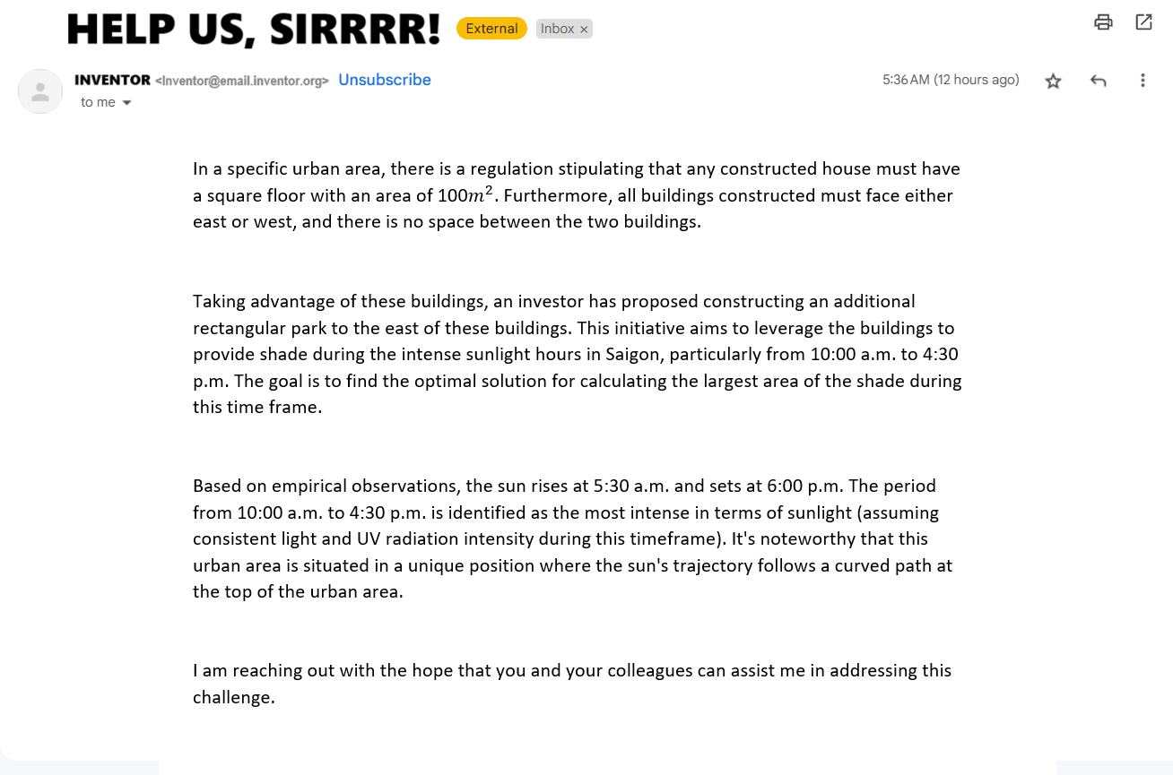
Largest Shade

Slide 6
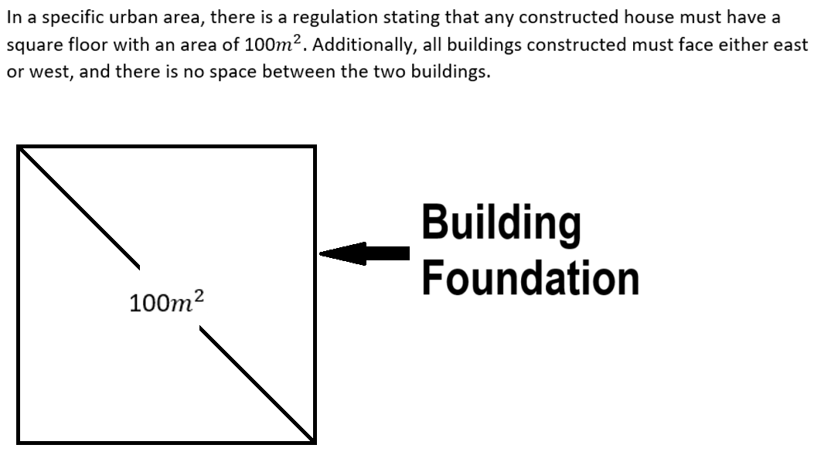
Largest Shade
Buildings must face
either east or west
No space between
two buildings

Slide 7
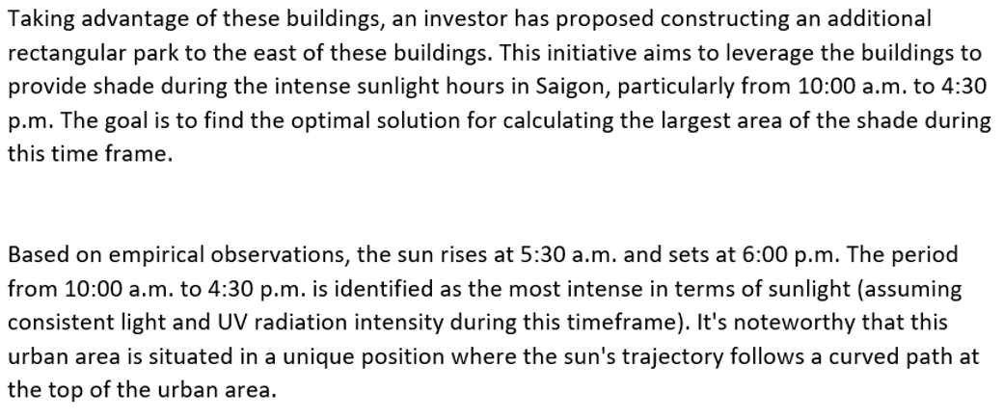
Largest Shade
Sunrise at 5:30 A.M and
sets at 6:00 P.M
High noon time: 10:00 A.M
to 4.30 P.M.
Build a park to the east.
Find the largest shade created by sunlight and buildings.

Slide 8
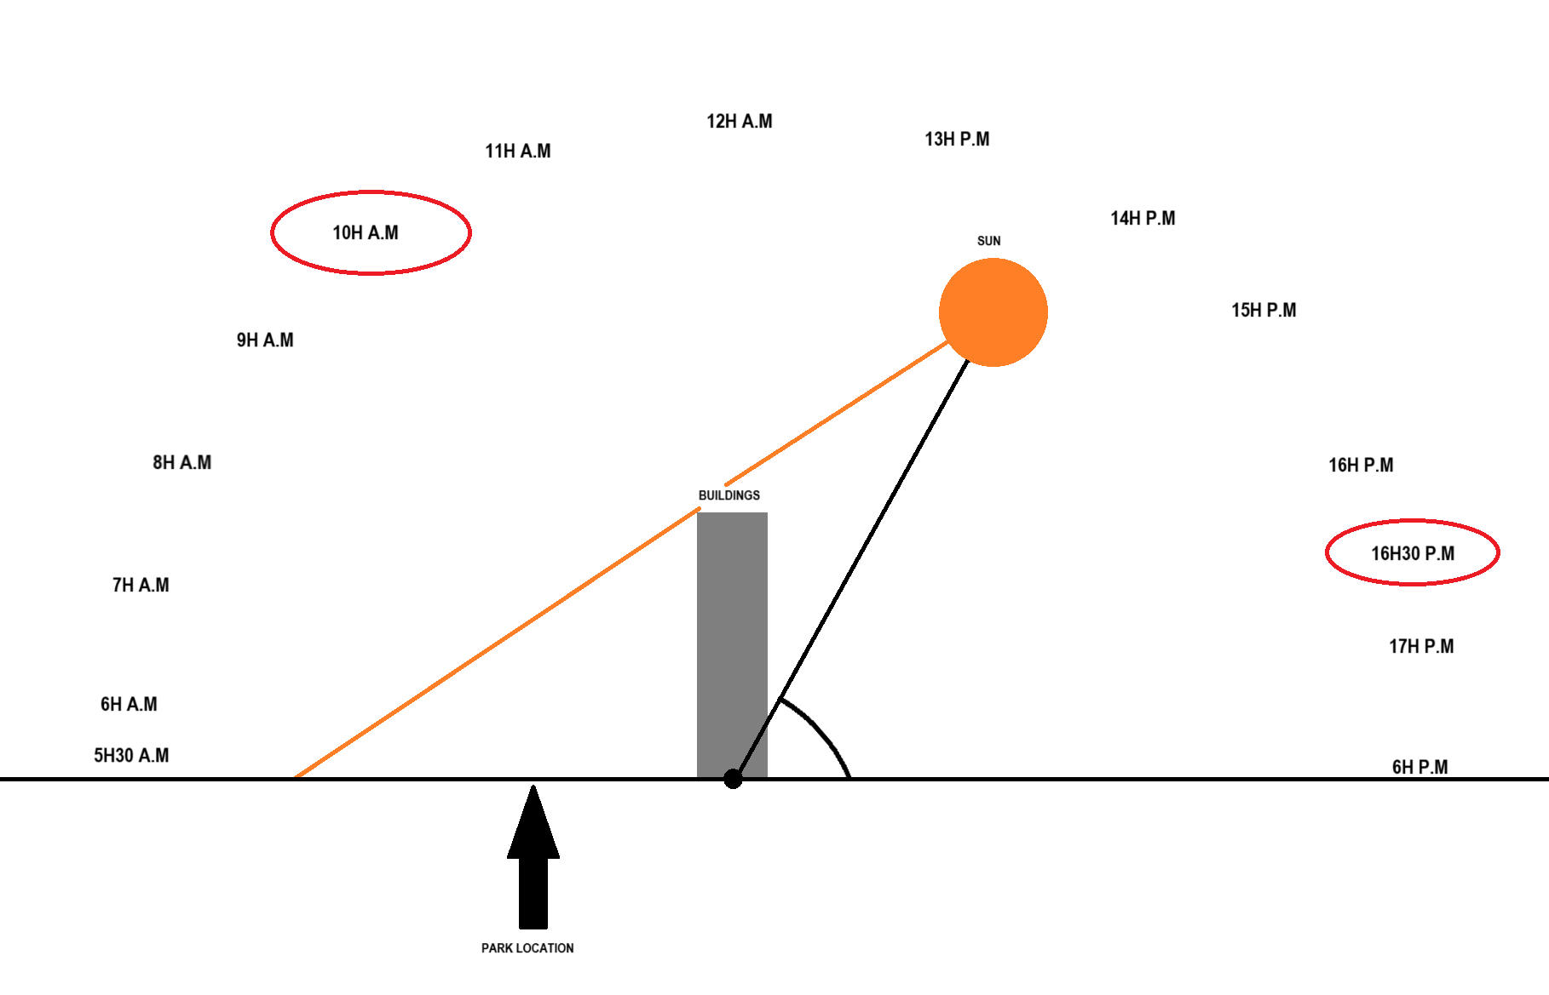
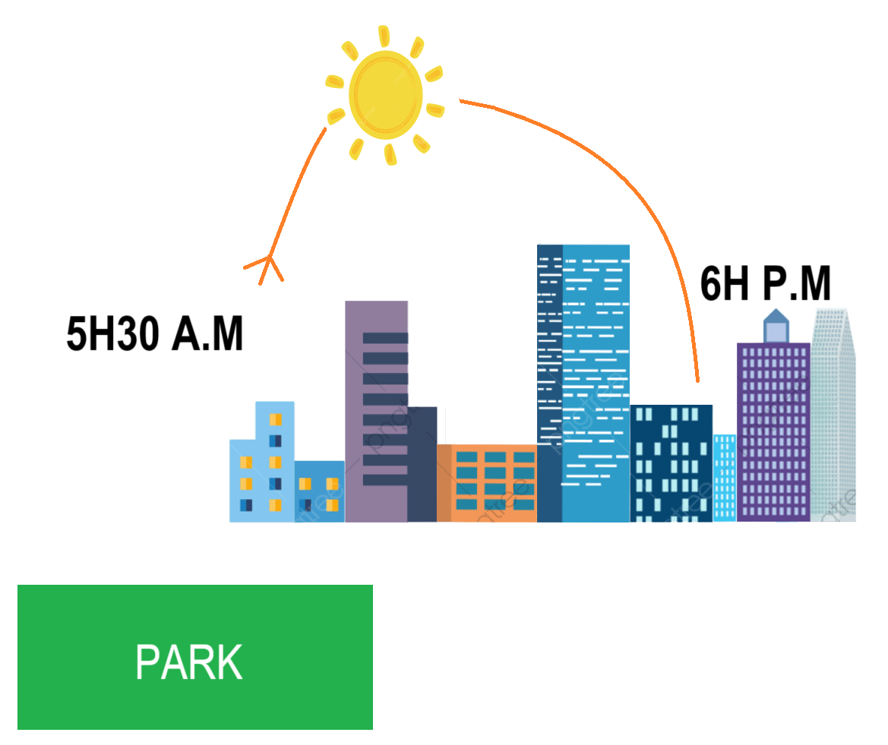
Largest Shade

Slide 9
Largest Shade
Input:
Angles of 26 different times.
Heights of each building.
Output:
Area of largest shade.

Slide 10
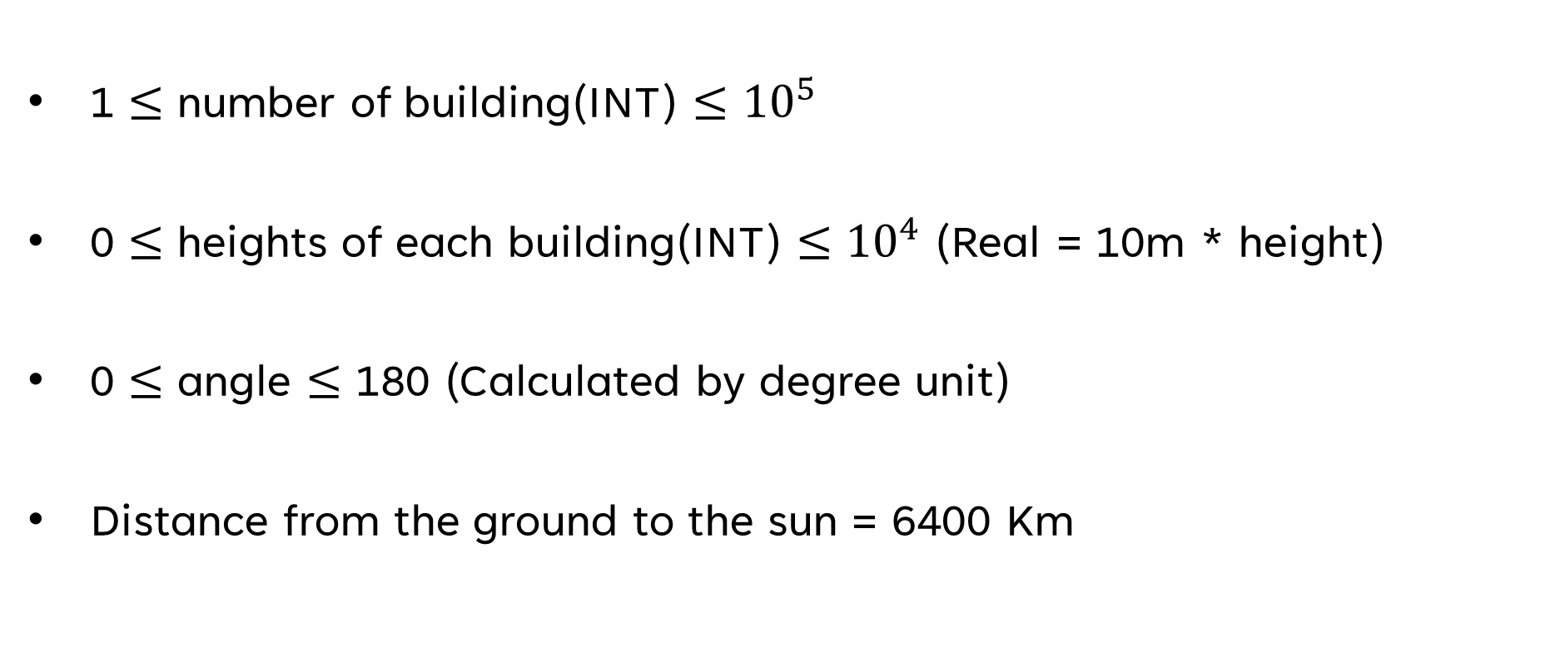
Constraint
1 $≤$ number of building(INT) $≤$ ${10}^{5}$
0 $≤$ heights of each building(INT) $≤$ ${10}^{4}$ (Real = 10m * height)
0 $≤$ angle $≤$ 180 (Calculated by degree unit)
Distance from the ground to the sun = 6400 Km

Slide 11
Decomposition
Find real height and determine the time when the building's shadow extends toward the park.
Determine the length of each building's shadow
Calculate the size of the largest shadow.

Slide 12
FIRST STEP
“
Find real height and determine the time
when the building's shadow extends toward the park.
”

Slide 13
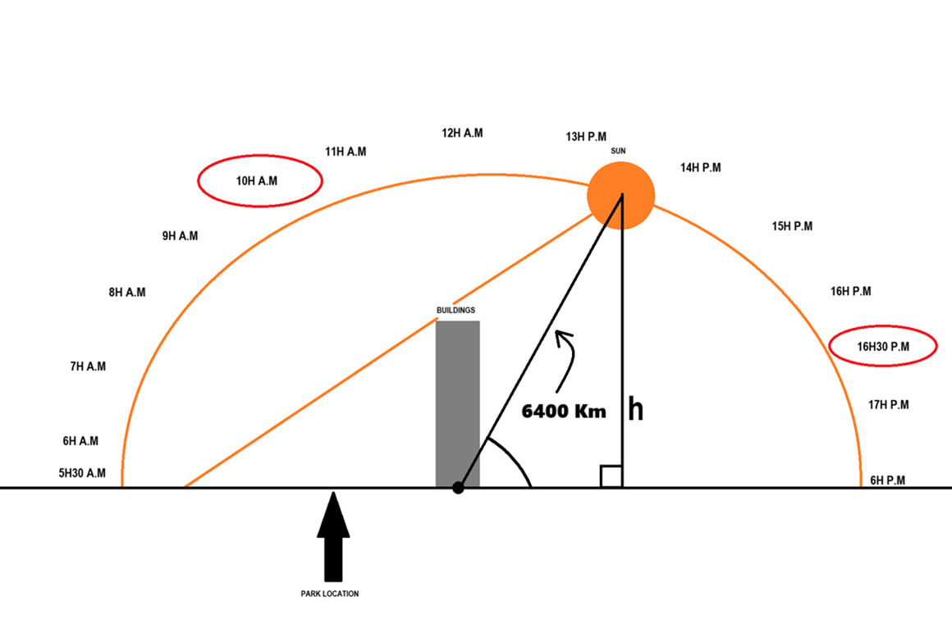
First Step
We do not consider the case where the shade is infinite
We only need the sun of the last time which
h > building height !

Slide 14
First Step
building_height_set <- height * 10
R <- 6400
Max_height_building <- max(building_height_set)
Time <- 0
for 4h:30 -> 10h:
h <- R * sin(alpha_at_this_time)
if h > Max_height_building:
Time <- this_time
beak

Slide 15
First Step
Time complexity: O(n).
Space complexity: Some variables depending on installation.

Slide 16
SECOND STEP
“
Determine the length of each building's shadow
”

Slide 17
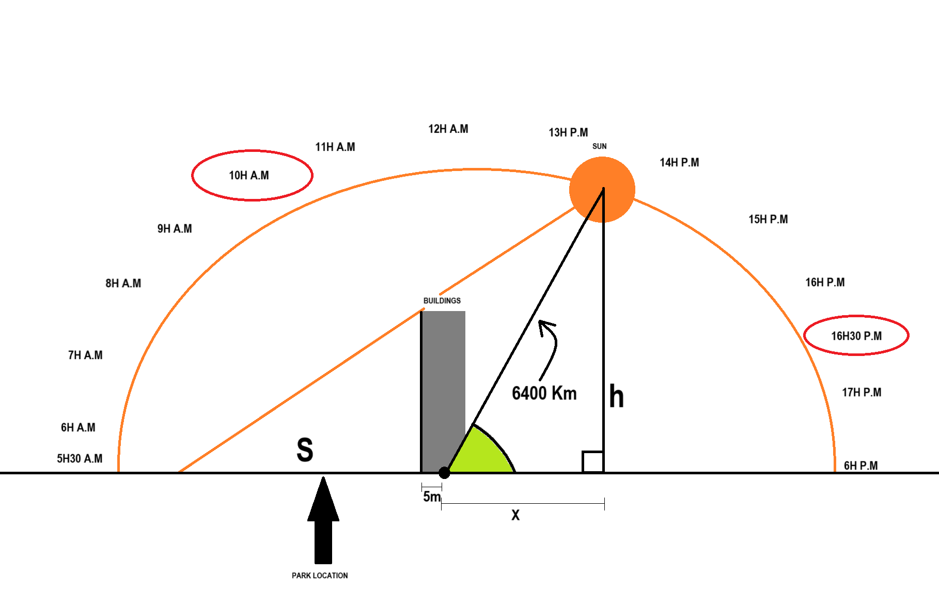
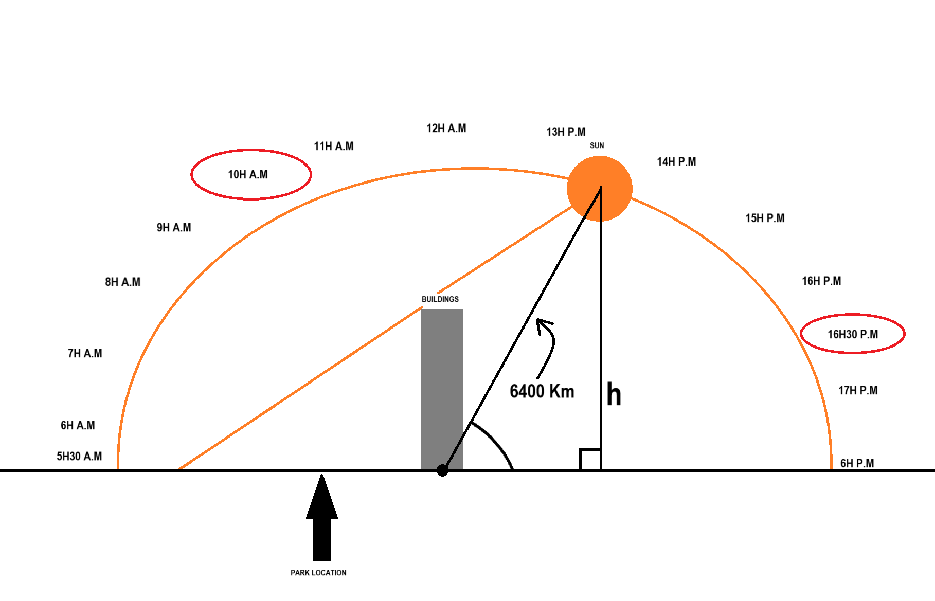
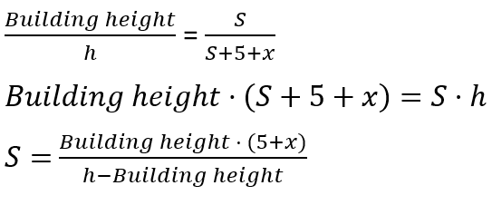
Second Step
Follow Thales’ s Theorem

Slide 18
Second Step
alpha <- alpha_at_time_in_first_step
h <- 6400 * sin(alpha)
x <- 6400 * cos(alpha)
shadow <- []
For height in heights:
shadow.append((5 + x)*heights / (h - heights))

Slide 19
Second Step
Time complexity: O(n).
Space complexity: O(n).

Slide 20
THIRD STEP
“
Calculate the size of the largest shadow.
”

Slide 21
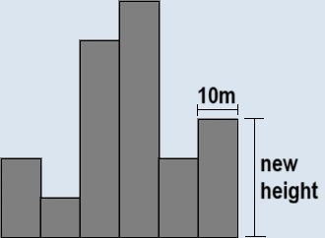
Third Step
We calculate the area of the shadow by summing the shadow of each building
return sum(shadow)
(with shadow is list in second step)
Time complexity: O(n).

Slide 22
Conclusion
Complexity of the whole problem:
Time complexity: O(n).
Space complexity: O(n).

Slide 23
Question
“
”
What algorithms design method we used in warm up problem ?

Slide 24

Received email

Slide 25
New Problem
Largest Rectangle

Slide 26
Decomposition
We already have the results of the building shadow before.
We only need to change third step to:
Calculate the size of the largest rectangle shadow.

Slide 27
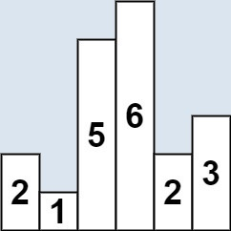
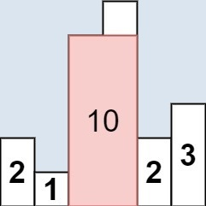
Largest Rectangle

Slide 28



Largest Rectangle

Slide 29
Constraint
1 $≤$ number of building(INT) $≤$ ${10}^{5}$
0 $≤$ heights of each building(INT) $≤$ ${10}^{4}$ (Real = 10m * height)
0 $≤$ angle $≤$ 180 (Calculated by degree unit)
Distance from the ground to the sun = 6400 Km

Slide 30
Question
“
”
After looking at this problem, what is the most obvious method can we use?

Slide 31
Brute Force
Assign variable max_area = 0
Use a loop for go through all the rectangles.
Use another loop go from current to the end.
Calculating each rectangle area and update max_area.

Slide 32
Brute Force
Max_area <- 0
for i from 0 -> len(heights):
for j from i to len(heights):
area <- min(heights[i : j+1]) * (j – i + 1) * 10
Max_area <- max(Max_area, area)

Slide 33

Brute Force
Time complexity: O($n^{2}$)
Pros:
Easy to install!
Cons:
Too slow!

Slide 34
How to optimize?
“
”

Slide 35
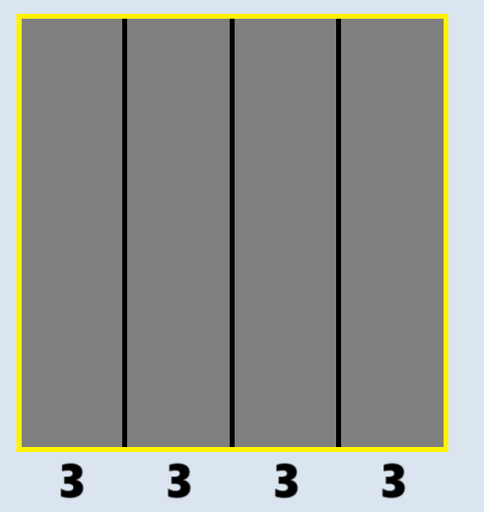
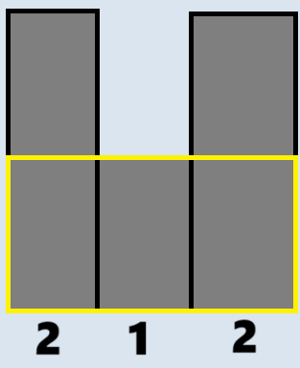
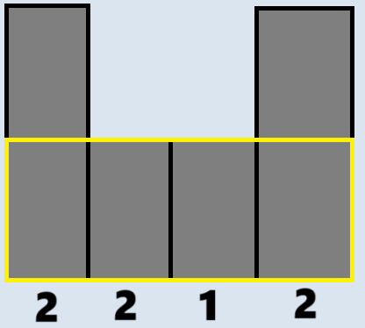
Fist Idea
For each largest rectangular area, there exists at least one intact sub-rectangle

Slide 36
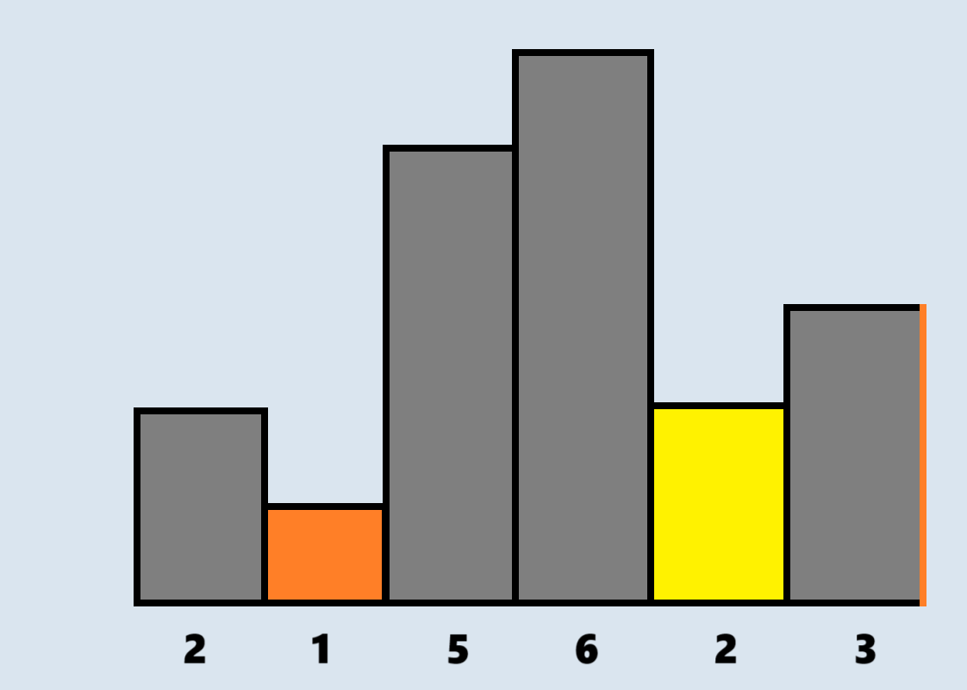
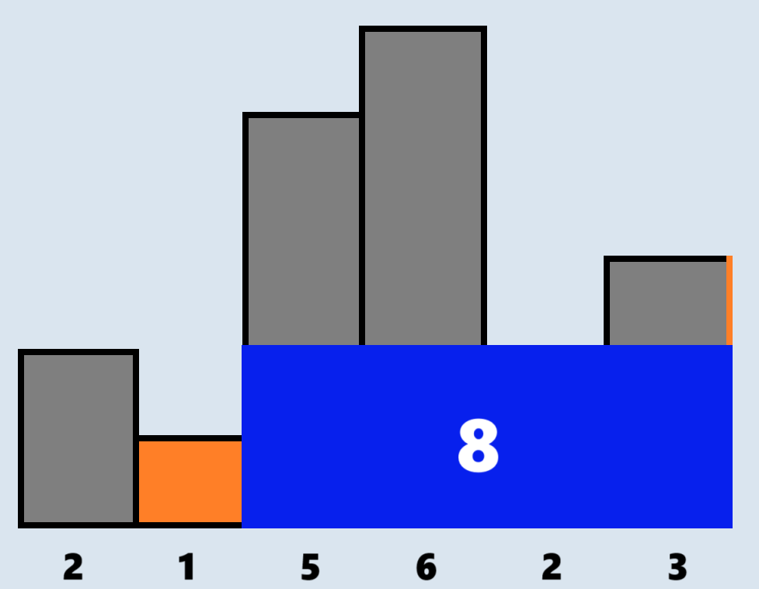
Strategy

Slide 37
Strategy
We can see, we do not need to calculate all cases of area with each specific bar based on the idea: "The largest area will contain at least one intact bar".
-> Greedy

Slide 38
Strategy
Find the largest rectangle including each bar one by one.
Take maximum of all areas found

Slide 39
Sub-problem
Step 1: Find the largest rectangle including each bar one by one.
For each specific height, how to find the largest rectangle that contains them ?

Slide 40
Sub-problem
Find left and right limitation of each bar.
We realize that the border of a bar is the lower bar closest to it
Use a stack and 2 array.
2 array are used for saving left and right border

Slide 41
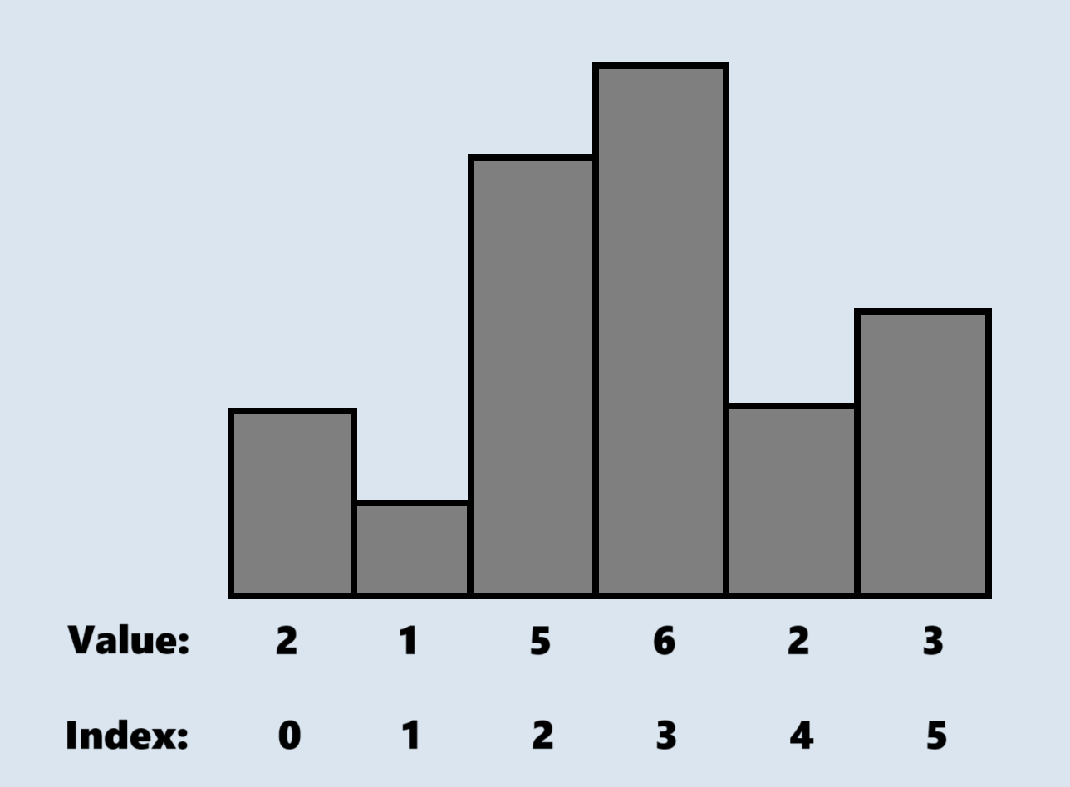
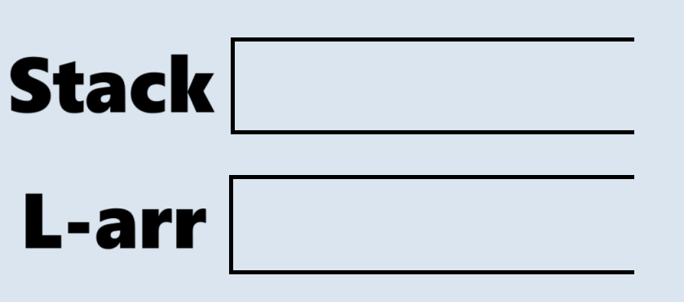
Sub-problem
LEFT

Slide 42
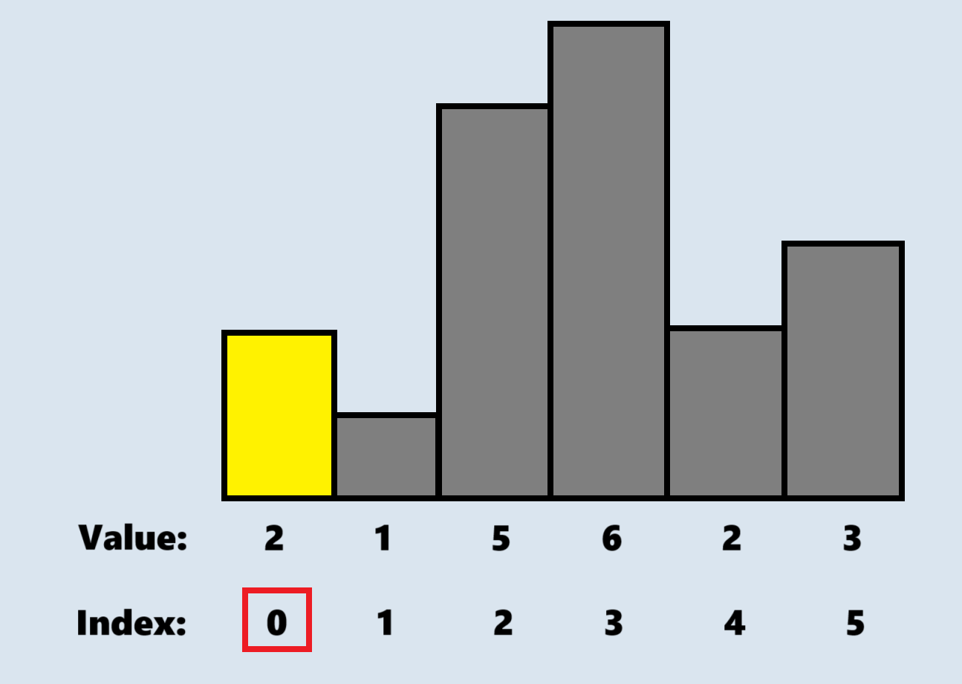
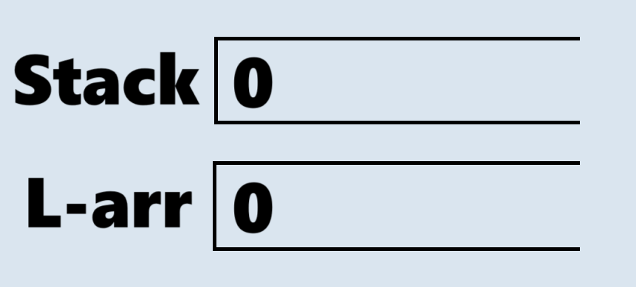
Sub-problem
LEFT
If stack is empty:
- Push current index into stack
- Push 0 into array

Slide 43
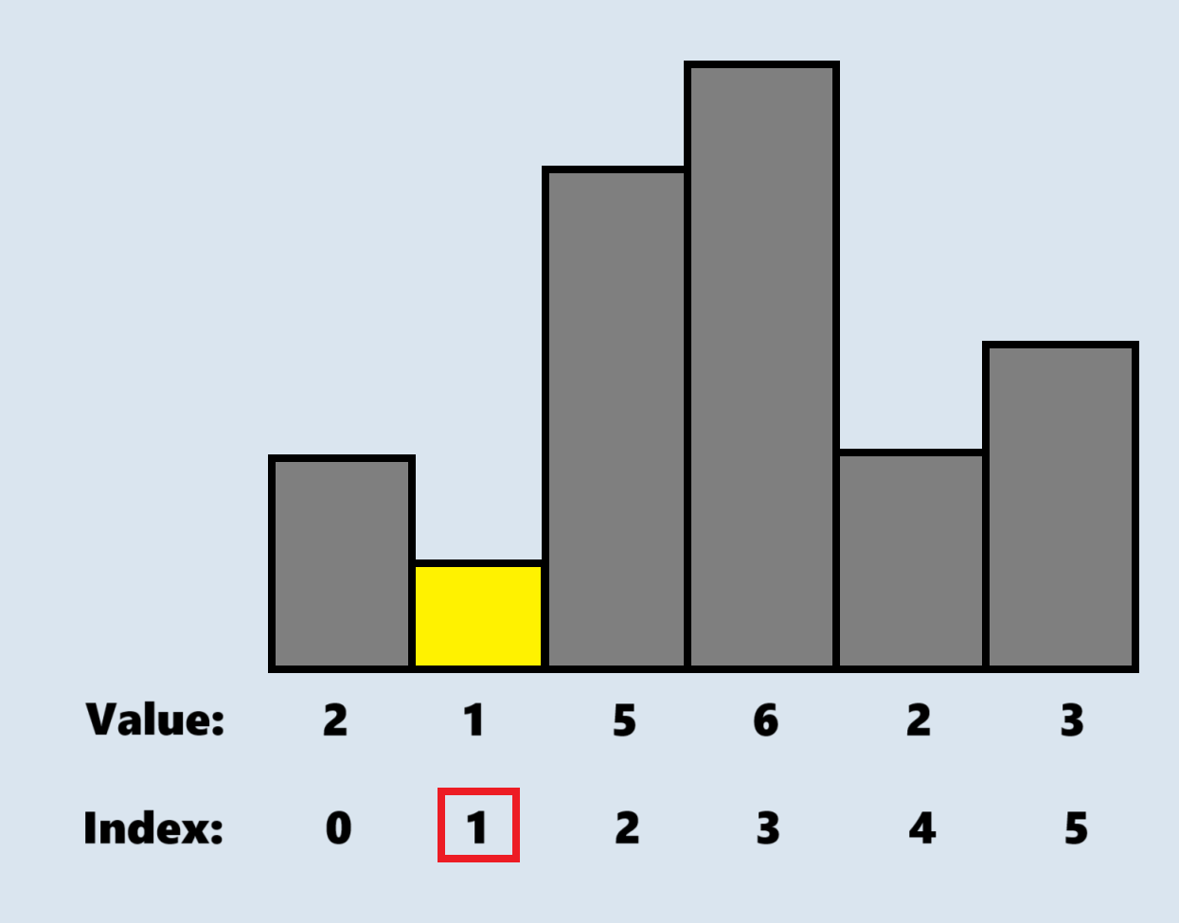
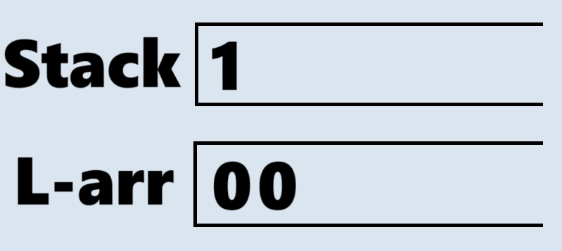
Sub-problem
Compare current value with top-stack value
(if top-stack value > current value -> pop)
until finding successful or empty stack.
If stack is empty: return previous
Otherwise:
- Push top-stack + 1 into array.
- Push current index into stack.
LEFT

Slide 44
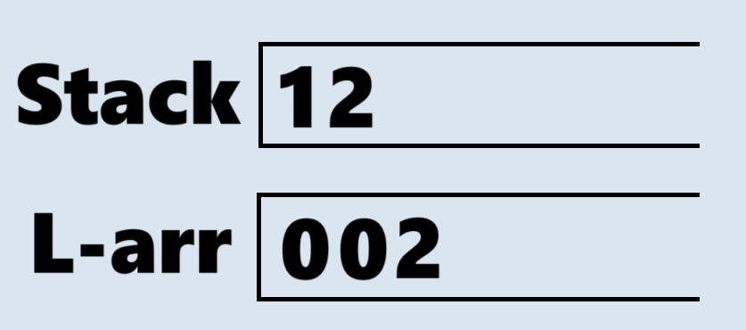
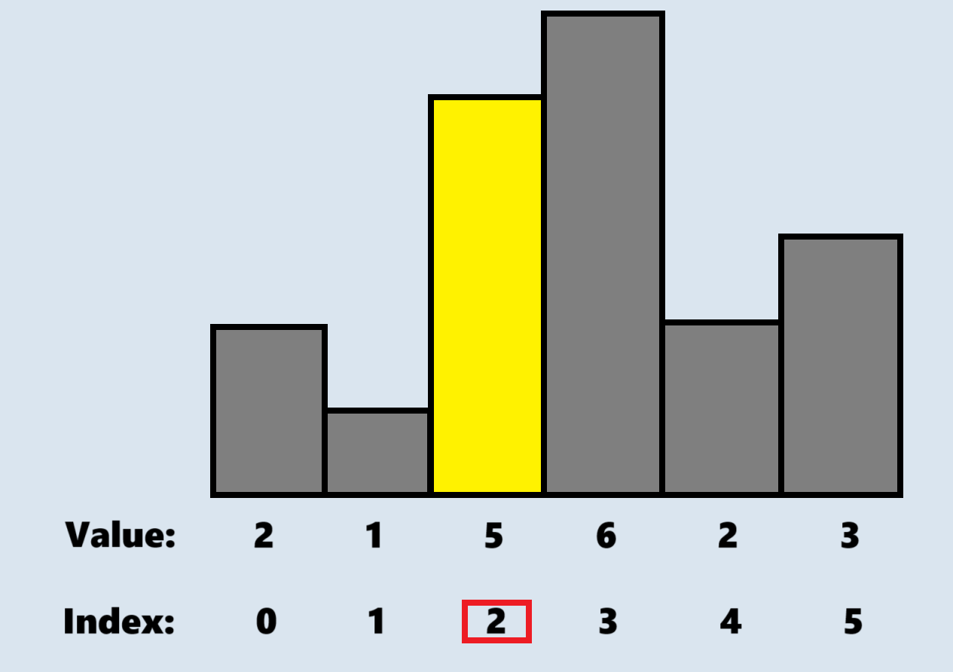
Sub-problem
Compare current value with top-stack value
(if top-stack value > current value -> pop)
until finding successful or empty stack.
If stack is empty: return previous
Otherwise:
- Push top-stack + 1 into array.
- Push current index into stack.
LEFT

Slide 45
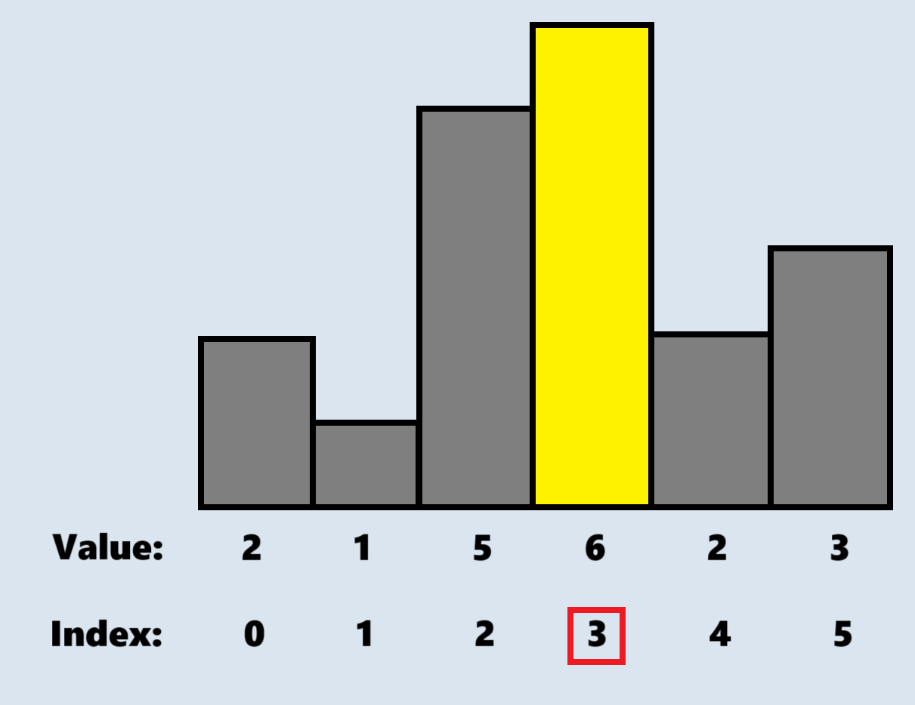
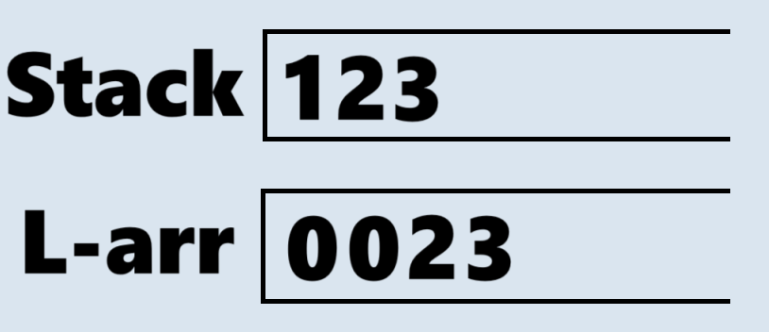
Sub-problem
Compare current value with top-stack value
(if top-stack value > current value -> pop)
until finding successful or empty stack.
If stack is empty: return previous
Otherwise:
- Push top-stack + 1 into array.
- Push current index into stack.
LEFT

Slide 46
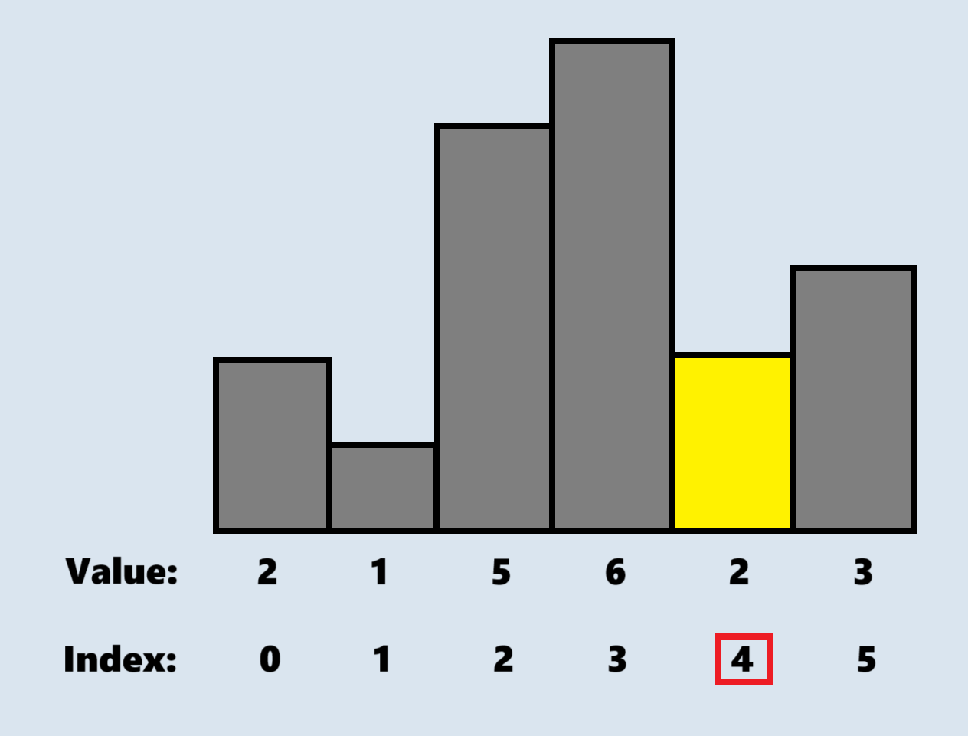
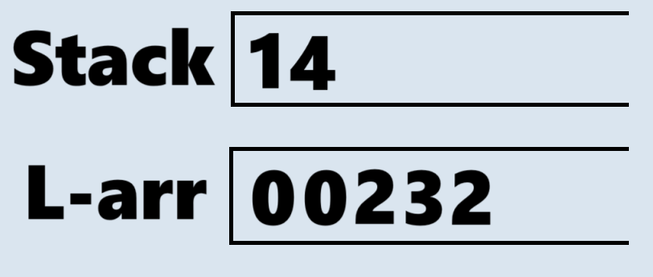
Sub-problem
Compare current value with top-stack value
(if top-stack value > current value -> pop)
until finding successful or empty stack.
If stack is empty: return previous
Otherwise:
- Push top-stack + 1 into array.
- Push current index into stack.
LEFT

Slide 47
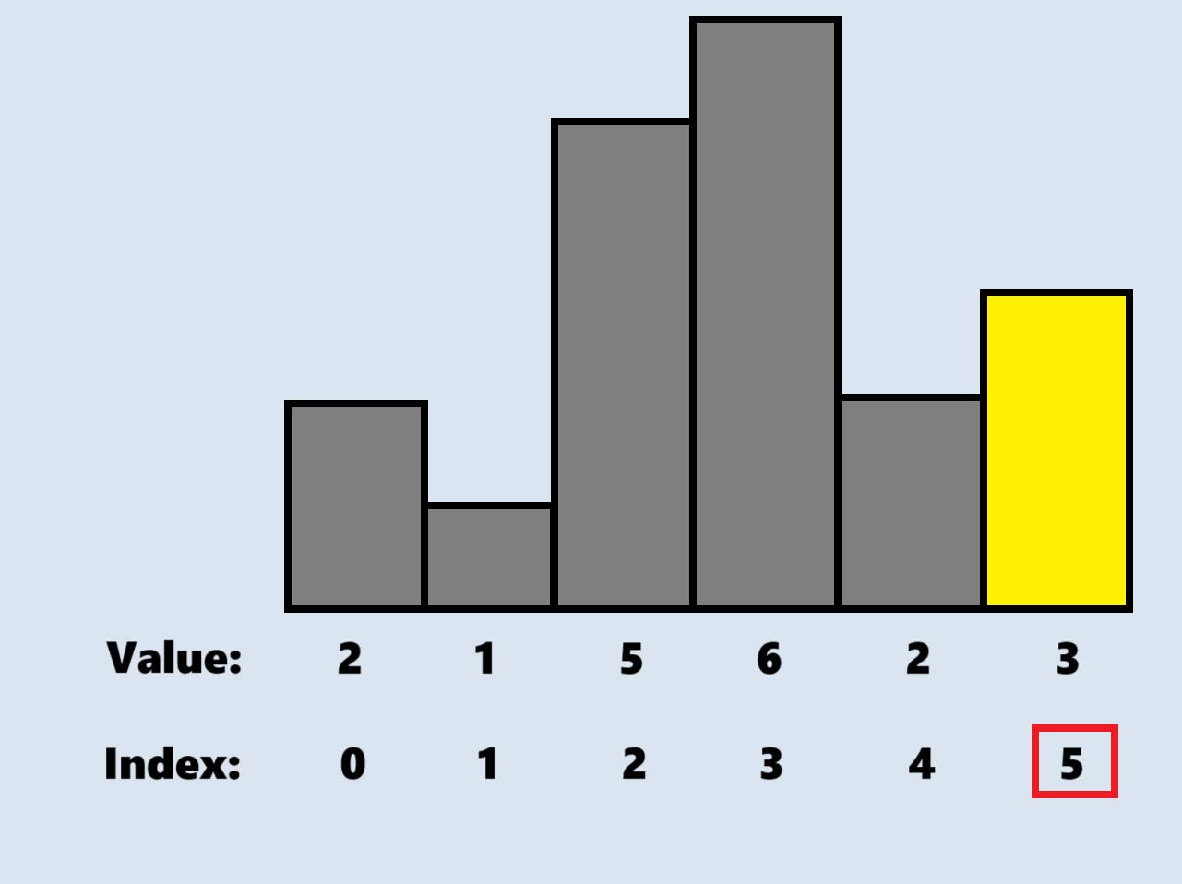
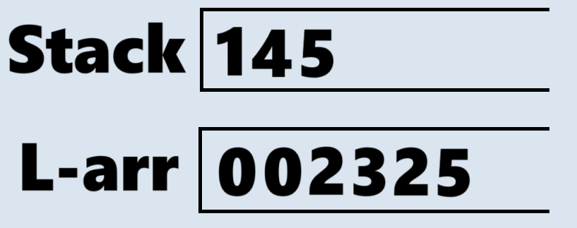
Sub-problem
Compare current value with top-stack value
(if top-stack value > current value -> pop)
until finding successful or empty stack.
If stack is empty: return previous
Otherwise:
- Push top-stack + 1 into array.
- Push current index into stack.
LEFT

Slide 48
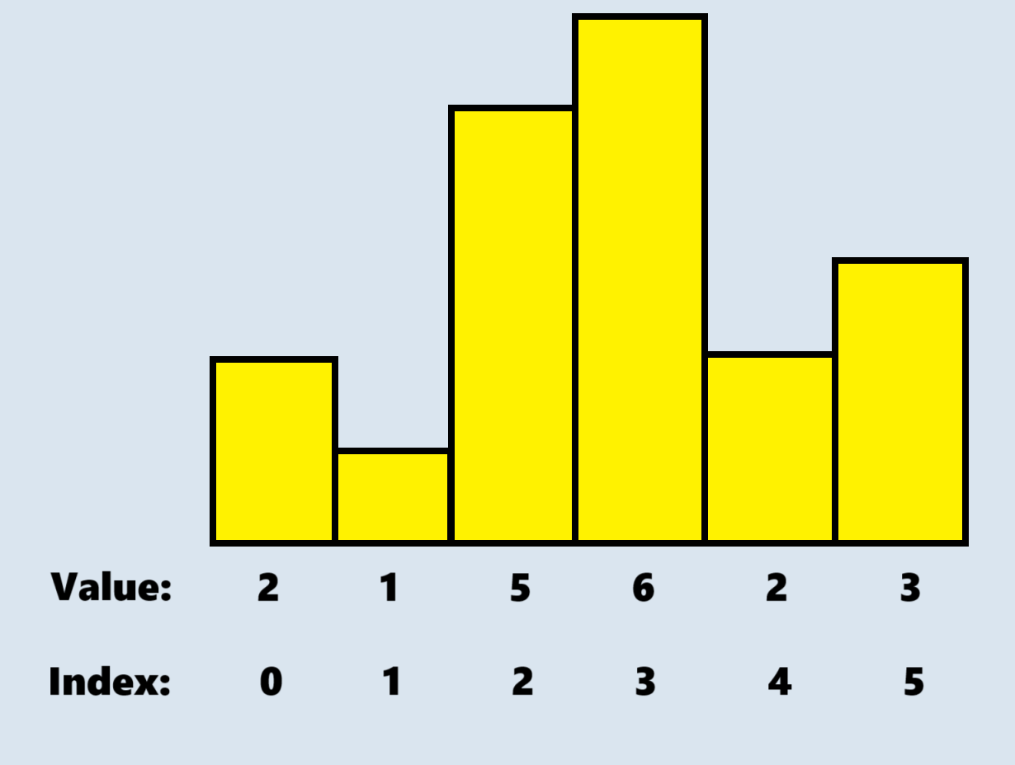
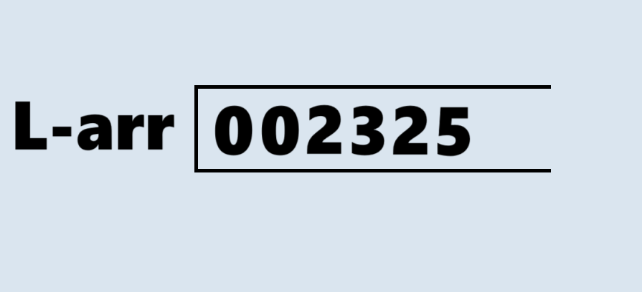
Sub-problem
Compare current value with top-stack value
(if top-stack value > current value -> pop)
until finding successful or empty stack.
If stack is empty: return previous
Otherwise:
- Push top-stack + 1 into array.
- Push current index into stack.
LEFT

Slide 49
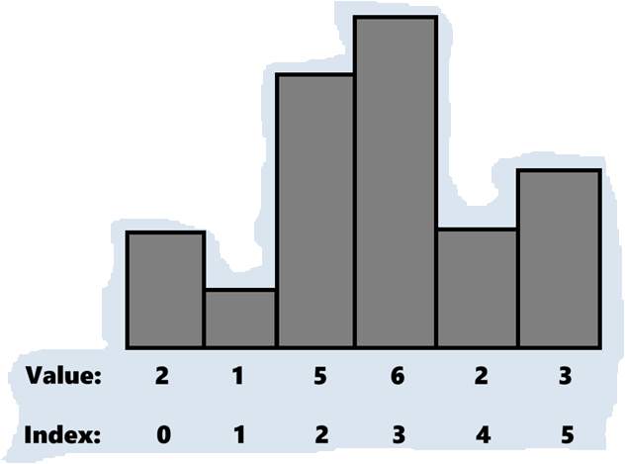
Sub-problem
Your turn!
RIGHT
If stack is empty:
- Push current index into stack
- Push the max index into array
Else: Compare current value with top-stack value
(if top-stack value > current value -> pop)
until finding successful or empty stack.
If stack is empty: return previous
Otherwise:
- Push top-stack -1 into array.
- Push current index into stack.

Slide 50
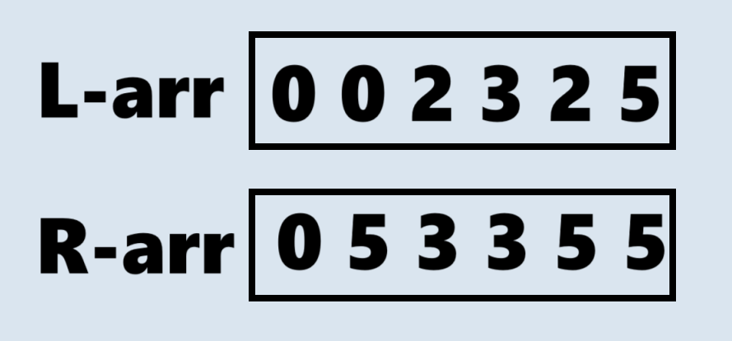

Sub-problem
AREA
= (R – L + 1) * current_height

Slide 51
Complexity
Time:
Left: O(n)
Right: O(n)
Space: O(n)

Slide 52
Sub-problem
Step 2: Take maximum of all areas found
max(area_list)
Complexity:
Time: O(n)
Space: O(1)

Slide 53
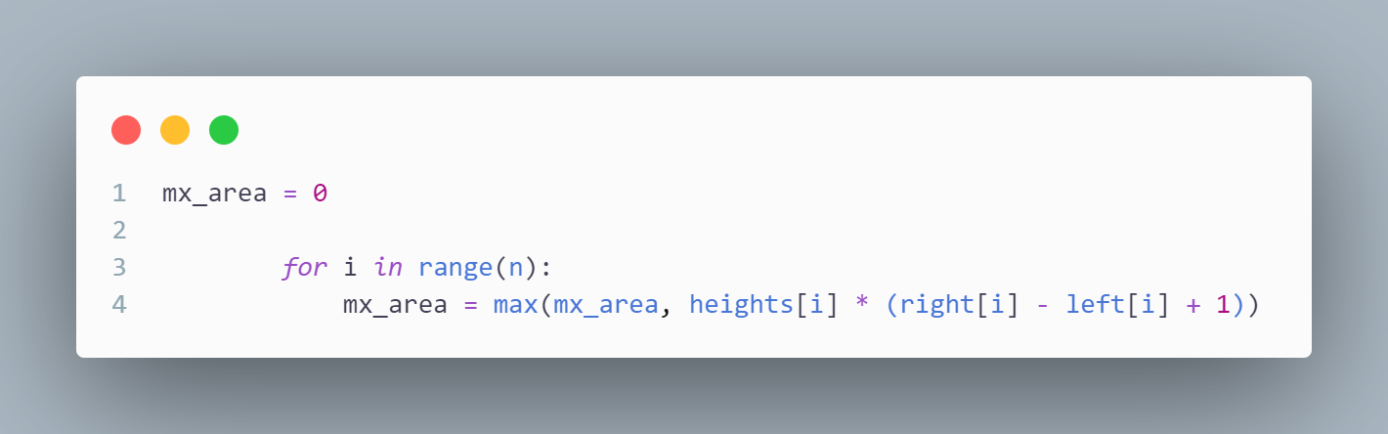
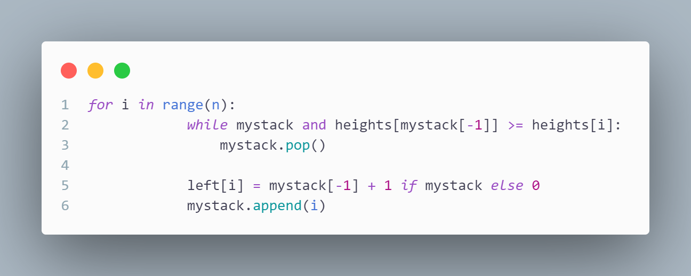
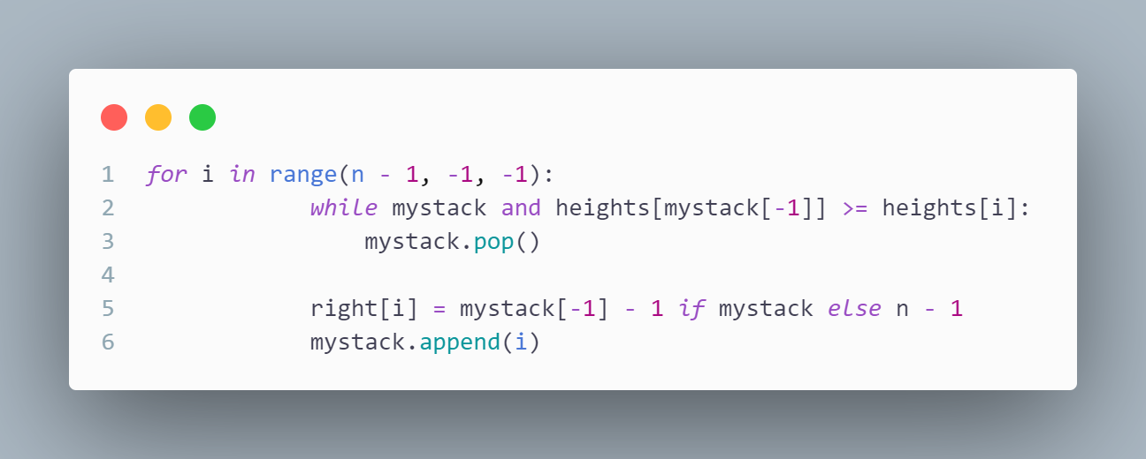
Problem
Example code:
Right
Area
Left

Slide 54
Problem
Complexity:
Time: O(n)
Space: O(n)

Slide 55
Summary
After two problem, we are learned about “Find maximum rectangle in histogram” problem and known how to analysis and design algorithms for this problem.
And that's all I brought to today's presentation.
Thank for listening!

Slide 56
Thank you
Won Jeong Hee
job.bkth@gmail.com
University of Information and Technology

