Slide 1

DEFAULT EXCLUDE 4PL FOR NEW CUSTOMER L’ OREAL
Business Owner: Luong Ngoc Truong, HEC Sales Manager Process Owner: Tran Quang Thuan, IT CSSC Vietnam Technical Owner: Nguyen Vu Thanh, IT CSSC Vietnam
SAP
HCMC, 10 Aug 2026

Slide 2





Process Overview
1
2
3
4
Get New Customer Code
Raise Nova Ticket
Install SAP Exclude
Closing Nova Ticket
Nightly batch job
No approval needed
Per Nova ticket
By CIT
AUTOMATED
AUTOMATED
AUTOMATED
MANUAL
End-to-end automated pipeline — only Step 4 requires manual action.

Slide 3
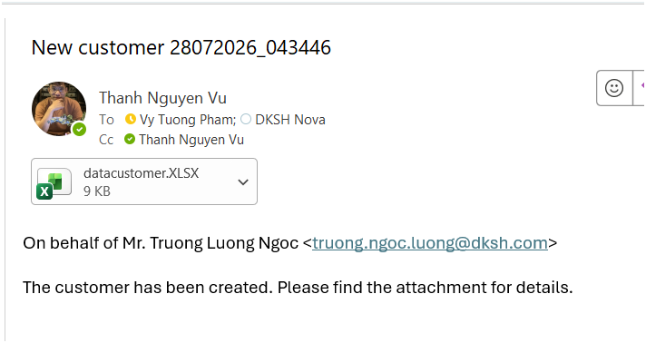
Auto get new customer code
1
System job runs automatically every night (outside business hours).
Scans and retrieves the list of New Customer Codes created during the day.
No manual trigger required — output list feeds directly into Step 2 (Raise Nova Ticket).
STEP 1 · Nightly Data Pull
AUTOMATED

Slide 4
Auto raise Nova Ticket – exclude request
2
NOVA-88213
Nova ticket is created automatically for the new customer codes from Step 1.
No approval required per ticket — confirmed by Mr. Luong Ngoc Truong via email.
Ticket content: "on behalf of Mr. Truong Luong Ngoc, truong.ngoc.luong@dksh.com"
OPEN
Type: Exclude Request
On behalf of: Mr. Truong Luong Ngoc
truong.ngoc.luong@dksh.com
No approval required
STEP 2 · Auto Ticket Request
AUTOMATED

Slide 5
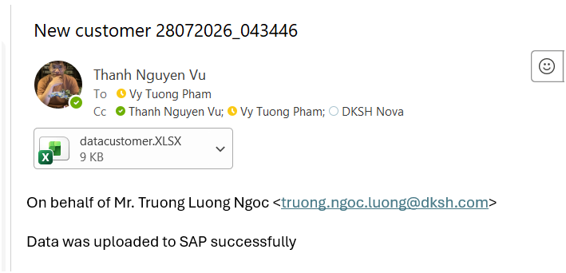
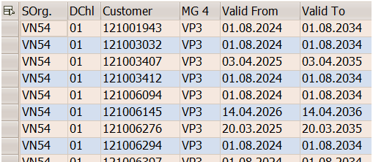
Auto install SAP exclude
3
System reads the customer codes from the Nova ticket raised in Step 2.
Exclude configuration is installed automatically on SAP for each customer code.
Keeps the Nova ticket and the SAP configuration fully in sync.
STEP 3 · SAP Configuration
AUTOMATED

Slide 6
Closing Nova ticket
4
NOVA-88213
Automated process control is needed in the process.
Tickets will be reviewed and closed manually by CIT.
The notification will be sent to Mr. Truong Luong Ngoc- requester via Nova System.
CLOSED
Reviewed & closed
By CIT
Frequency: Daily ticket review
Last checkpoint in the flow
STEP 4 · Human Verification
MANUAL

Slide 7

Roles & Responsibilities Summary
Only 1 manual step: Step 4
Step | Action | Owner | Mode
1 | Get new customer code | System | Auto – nightly
2 | Raise Nova ticket, no approval needed | System | Auto
3 | Install SAP exclude per Nova ticket | System | Auto
4 | Close Nova ticket, daily review | CIT | Manual

Slide 8

Thank you for your attention

