Slide 1
Open Library Client
Mobile Application Development
Class 1 – Group 13

Slide 2
Members
Nguyễn Thành Nam - 22BI13325
Trần Trọng Nghĩa - 22BI13332
Trần Đức Dương - 22BI13117
Nguyễn Tuấn Dũng - 22BI13107
Trương Đại An - 22BI13008
Vũ Hùng Anh - 22BI13045

Slide 3
Table of contents
01.
02.
Introduction
Architecture
03.
04.
Activities
Demo & Conclusion
>
<
>
<
<
<

Slide 4
01
Introduction

Slide 5
Introduction
What does our app do?
Searching for books and publications based on titles, authors, genres, ...
Add books and book info to the library.
Reading books.

Slide 6
Introduction
Why do we have this app?
Convenience & accessibility.
Enhanced user experience. Better UI.
Improved search & discovery.
Enhanced privacy & security.
Interactive features.

Slide 7
02
Architecture

Slide 8
Main components
Home
Search
Bookshelf
User
The main screen
Searching book’s title, author, category
User personal library
User’s interface

Slide 9
03
Activities

Slide 10
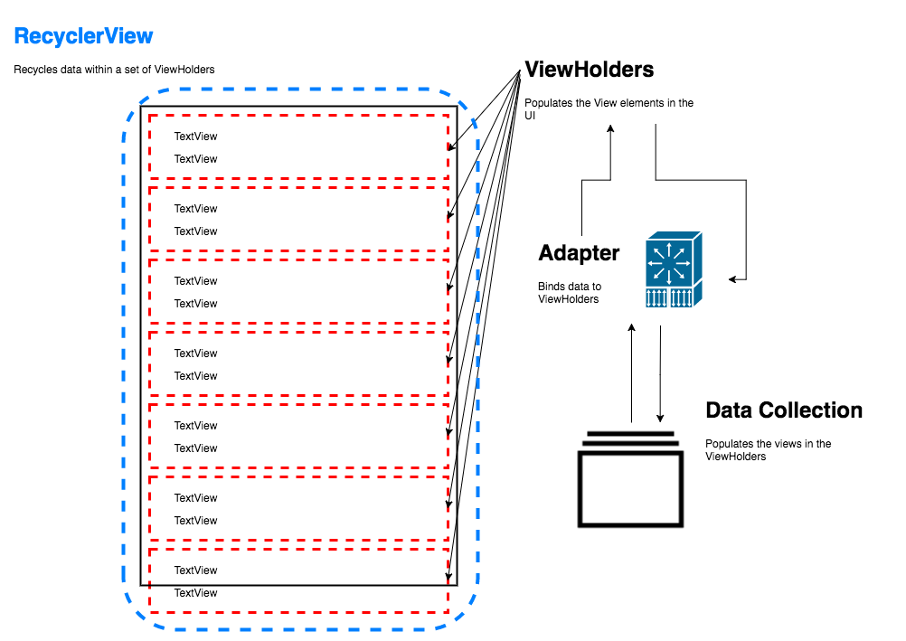
RecyclerView
RecyclerViewHorizontal
Storing books in category and easy to update
Optimization the data in the Category
RecyclerViewVertical
Storing each category and easy to update
Optimization the data in the Home, Bookshelf,…

Slide 11

Search filter recycler
Searching books
Searching base on book’s title.
Searching base on book’s author.
Searching base on book’s category.
Each separate by “#”

Slide 12

DataBase
SQLite database
Manages user data, book details, categories, authors, etc.
Utilizes MyDatabaseHelper for CRUD operations.
Tables include users, books, authors, categories, and more for efficient data retrieval and storage

Slide 13
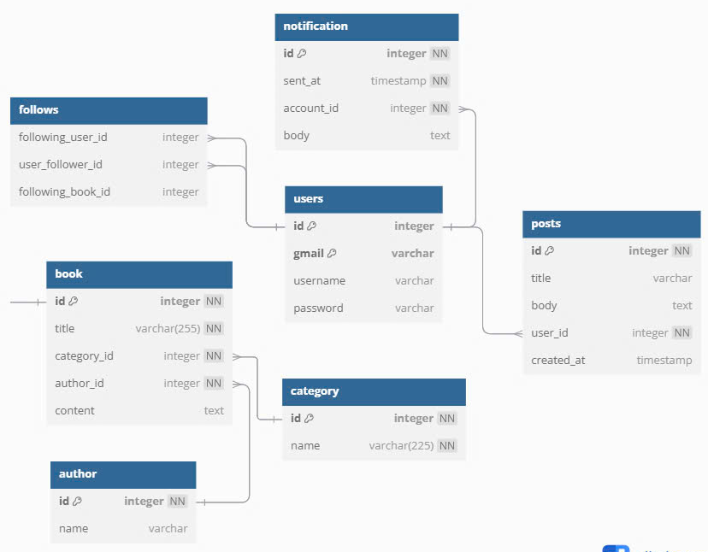
DataBase schema

Slide 14
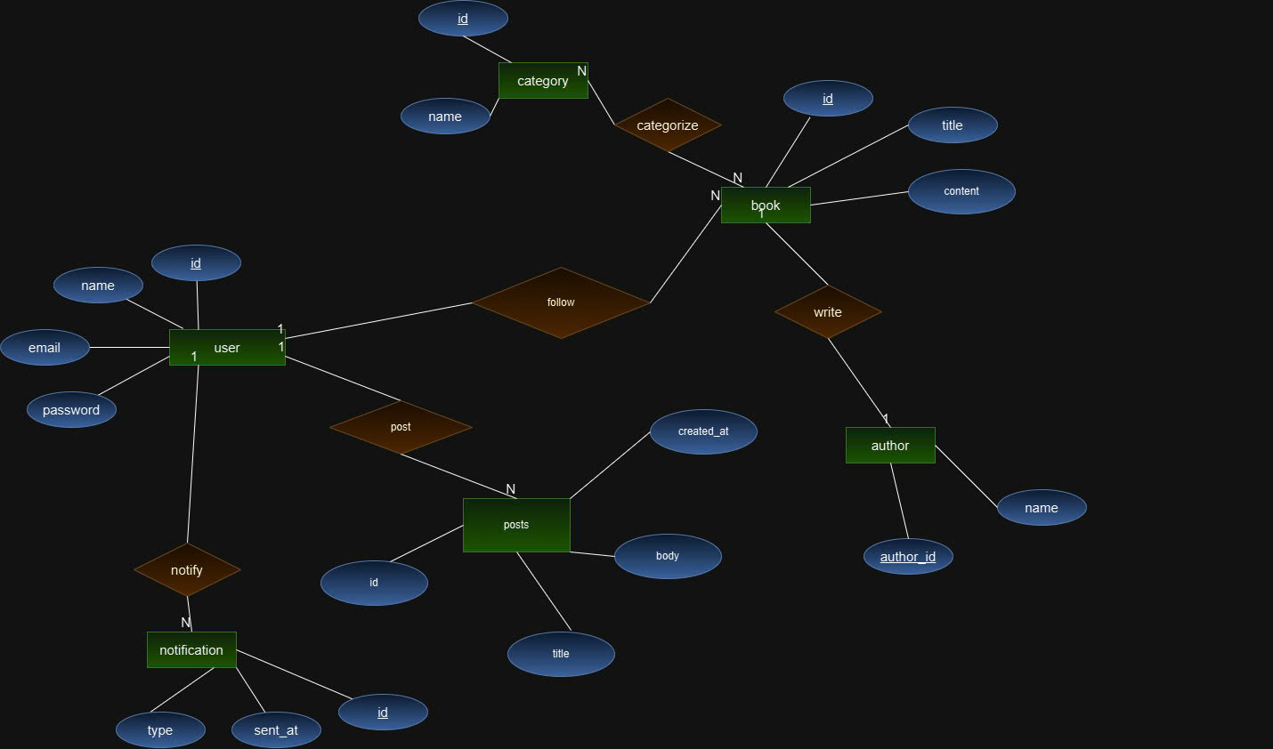
Diagram

Slide 15

Login
Login activity
Allows users to authenticate using a username and password.
Validates credentials against the database using MyDatabaseHelper.
On successful login, users navigate to the main activity

Slide 16
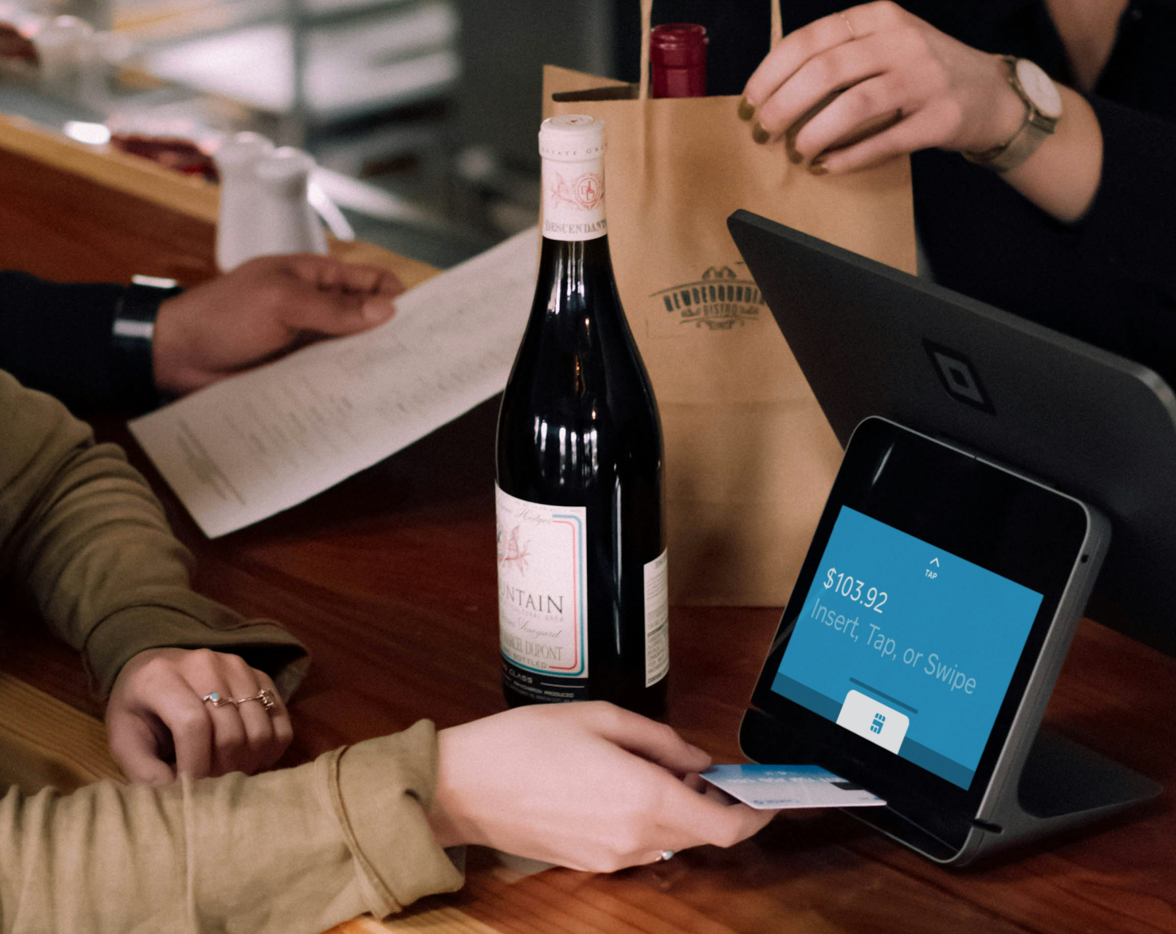
Register
Register Activity
Enables new users to create an account.
Collects username, email, and password.
Inserts user data into the database.
Provides feedback on registration success or failure

Slide 17

AddBook
Addbook activity
Allows users to add new books to the library.
Inputs include title, author, category, and content.
Interacts with the database to insert new book entries.

Slide 18
Demo & Conclusion
04

Slide 19
Demo

Slide 20
Conclusion
An app for reading, searching books.
Using RecyclerView for reduce the data, can searching by many ways.
Not completed all the button, will be fix and optimize more the others.

Slide 21
Thank you for listening!
Do you have any questions?

