Slide 1
Open Library Client
Mobile Application Development
Class 1 – Group 13

Slide 2
Members
Nguyễn Thành Nam - 22BI13325
Trần Trọng Nghĩa - 22BI13332
Trần Đức Dương - 22BI13117
Nguyễn Tuấn Dũng - 22BI13107
Trương Đại An - 22BI13008
Vũ Hùng Anh - 22BI13045

Slide 3
Table of contents
01.
02.
Introduction
Architecture
03.
04.
Activities
Demo & Conclusion
>
<
>
<
<
<

Slide 4
01
Introduction

Slide 5
Introduction
What does our app do?
- Searching for books, publications based on titles, authors, genres, ... - Reading books in online mode.

Slide 6
Introduction
Why we have this app?
- Convenience & accessibility. - Enhanced user experience. - Better UI. - Improved search & discovery. - Enhanced privacy & security. - Interactive features.

Slide 7
02
Architecture

Slide 8
Main components
Home
Search
Bookshelf
User
Login
User’s login screen
The main screen
Searching book’s title, author, category
User personal library
User’s interface

Slide 9
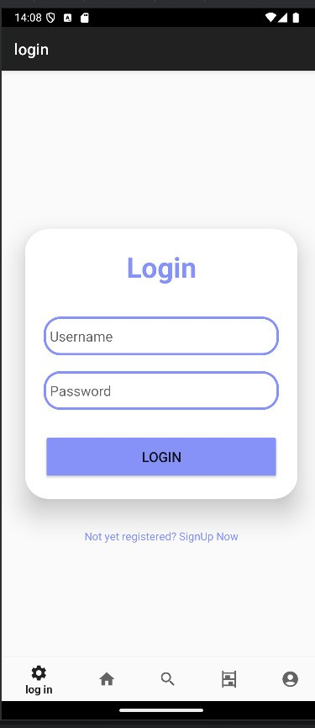
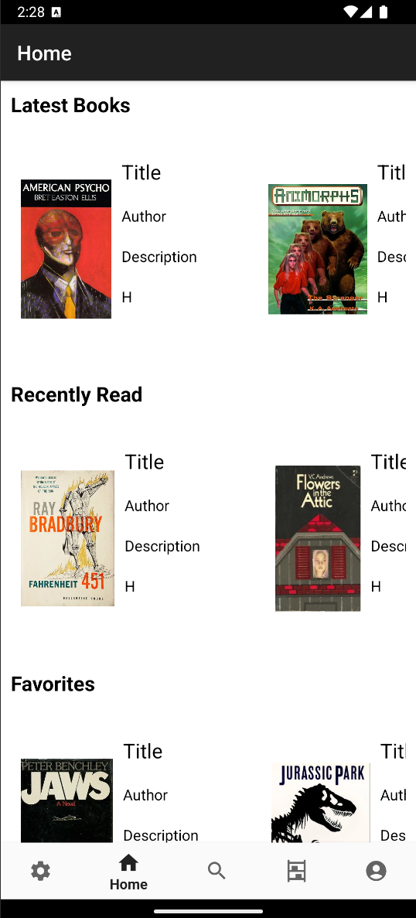
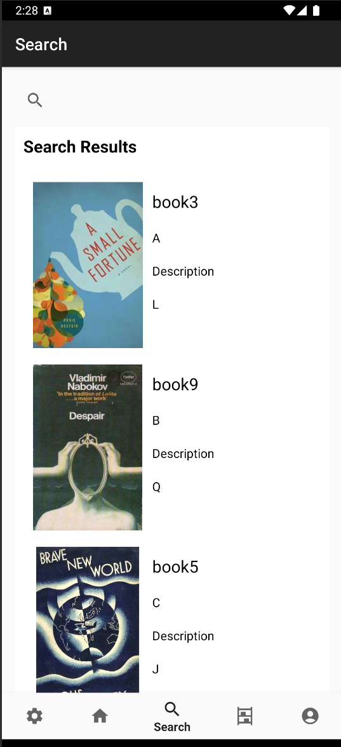

Slide 10
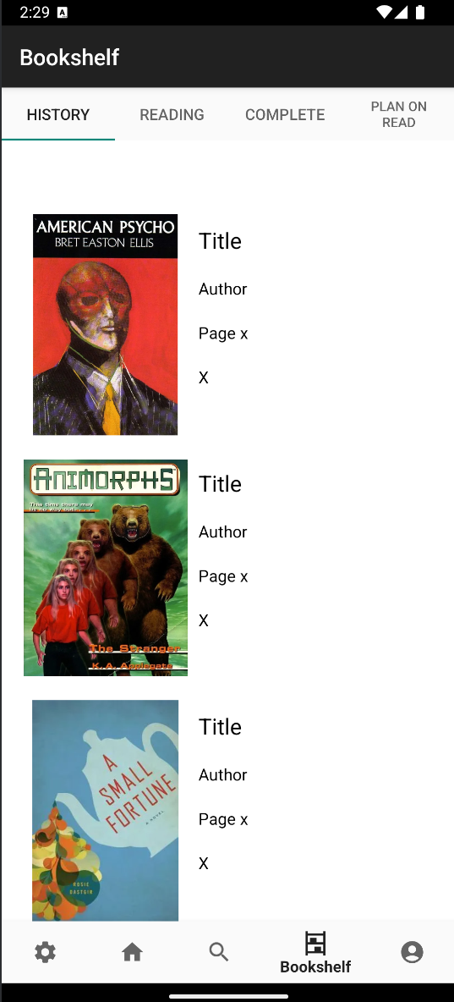
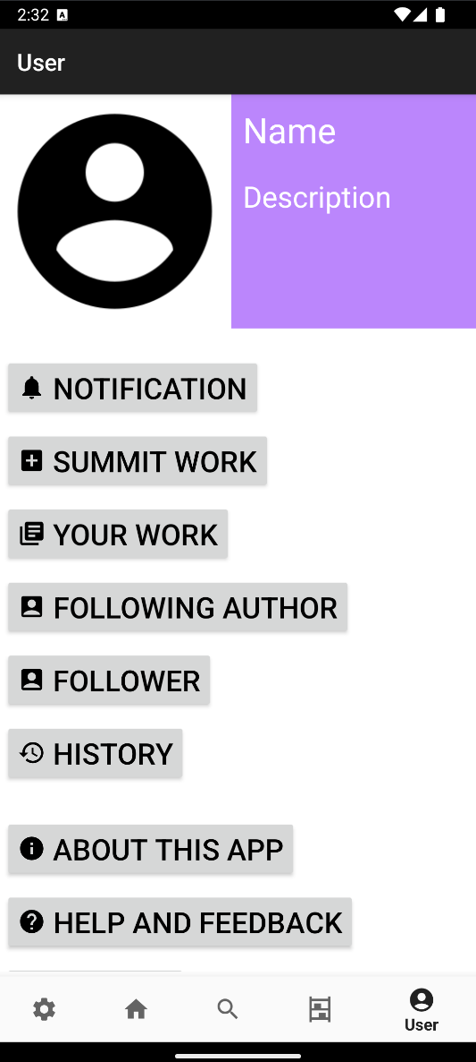

Slide 11
03
Activities

Slide 12
RecyclerView
RecyclerViewHorizontal
Storing books in category and easy to update
Optimization the data in the Category
RecyclerViewVertical
Storing each category and easy to update
Optimization the data in the Home, Bookshelf,…

Slide 13
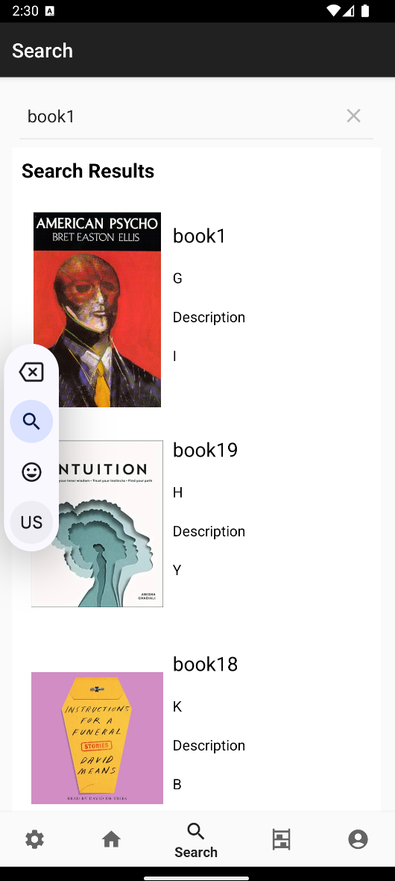
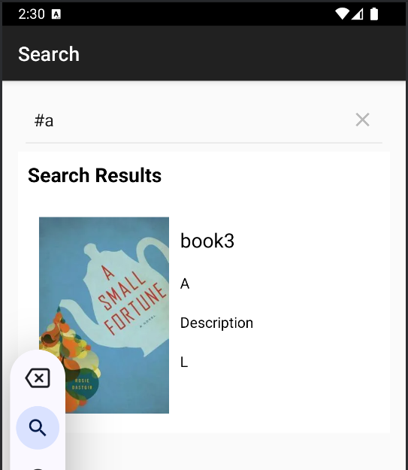
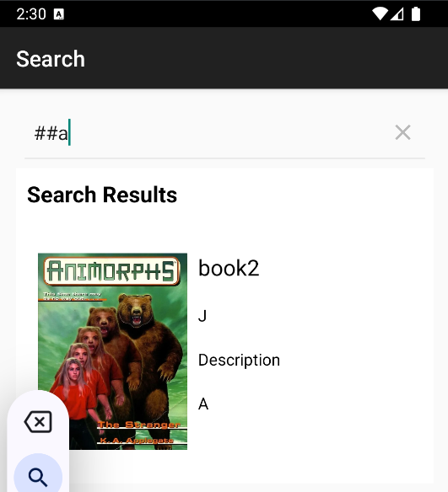
Search filter recycler
Searching books
Searching base on book’s title.
Searching base on book’s author.
Searching base on book’s category.
Each separate by “#”

Slide 14
Demo & Conclusion
04

Slide 15
Demo

Slide 16
Conclusion
An app for reading, searching books.
Using RecyclerView for reduce the data, can searching by many ways.
Not completed all the button, will be fix and optimize more the others.

Slide 17
Thank you for listening!
Do you have any questions?

