Slide 1

A Restaurant Recommendation System for Yelp
Location-based Collaborative Filtering and Frequent Itemset
Thanh Tung Nguyen (ID: 40042891) & Huy Nguyen (ID: 40023289) @ April 12, 2019

Slide 2
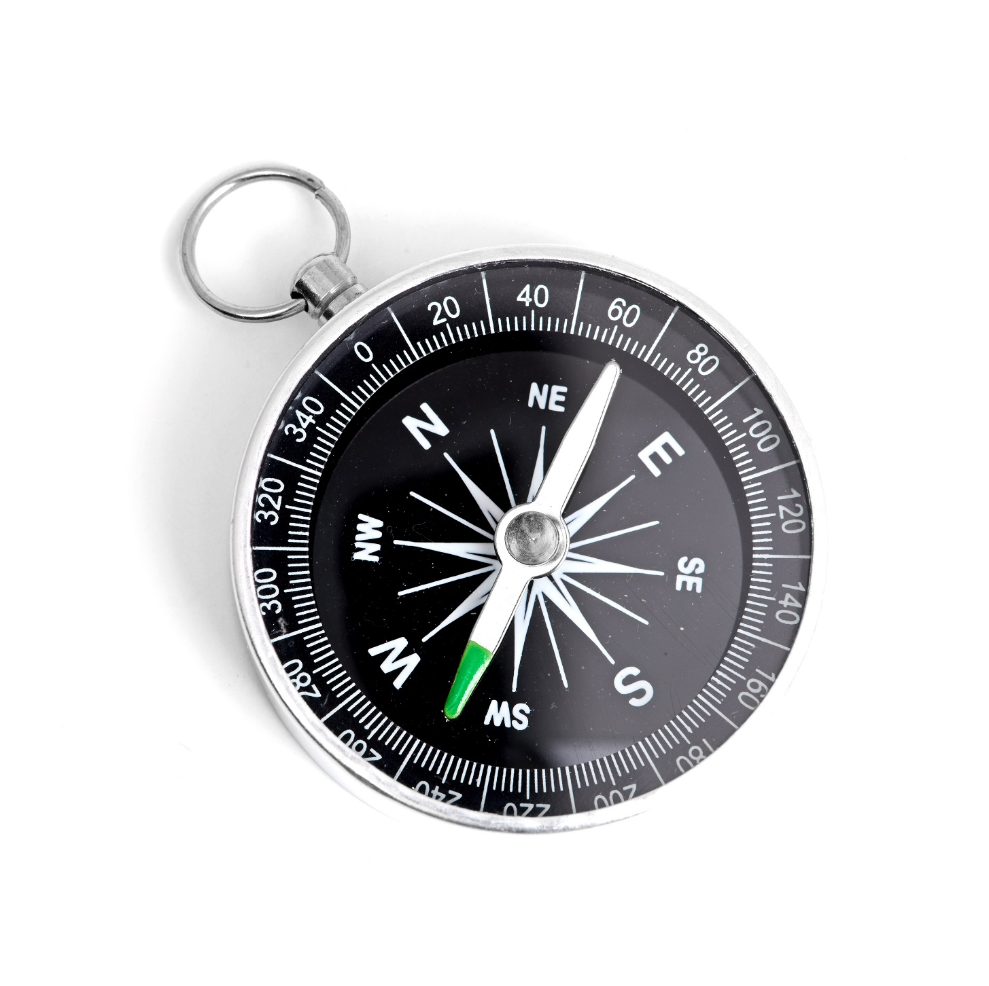
Agenda
Project Overview 3
Dataset & Methods Used 4
Algorithm & App Result 5
Issue Explanations 7
Conclusion 8

Slide 3
Project Overview
Project Introduction & Related Works
PROJECT IntroductioN
RELATED WORKS
What we try to achieve:
To help Yelp users make better choices of restaurants, we use techniques and principles of recommendation systems to create an application which makes predictions based on the user similarities
Develop an enhanced collaborative filtering using location (postal codes) as a key criterion for generating recommendations (Scope of Work: Canada)
Methods we use:
Collaborative Filtering
Frequent Itemset
How we evaluate the results
Use Root metrics Mean Squared Error (RMSE)
User Mean Absolute Error (MAE)
Using location for personalized POI recommendations in mobile environments:
By Tzvetan Horozov, Nitya Narasimhan, Venu Vasudevan
Discussion of GeoWhiz, a real-world deployment of our restaurant recommender system for location-based points of interest (POI).
Collaborative Filtering using Weighted BiPartite Graph Projection - A Recommendation System for Yelp
By Sumedh Sawant
Recommendation system on the Yelp Dataset Challenge dataset using the network-based-inference collaborative filtering algorithm
Same Yelp dataset was used (2013 version)
Project Overview
Dataset & Methods Used
Progress Status
Time & Effort Consumption
Metric Visualization
Findings
Next Steps

Slide 4
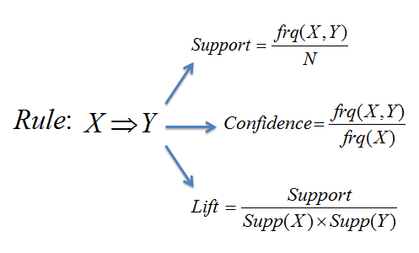
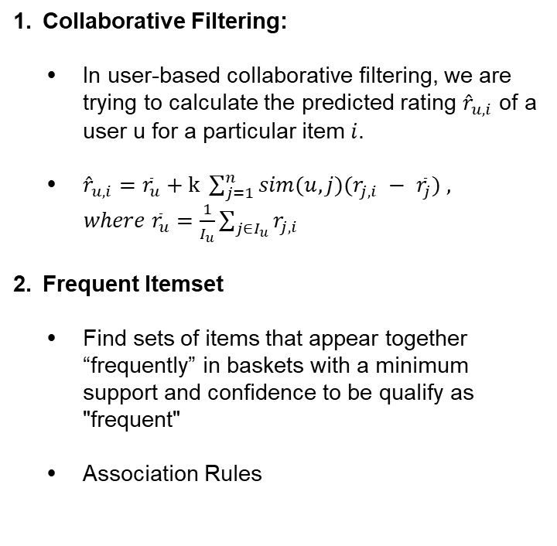
Dataset & Methods Used
Yelp Dataset and Collaborative Filtering & Frequent Itemset
Yelp DataseT
Methods Used
Source of Data:
Yelp Dataset - Yelp's businesses - 4 GB - www.kaggle.com/yelp-dataset/yelp-dataset
Canadian Postal Codes - Google Fusion Tables - 49 MB - https://fusiontables.google.com/
Dataset overview:
Original Dataset
Number of businesses 192,609
Number of review 6,685,900
Number of users 1,637,138
Canada
Number of Canadian businesses 50,644
Number of Canadian reviews. 1,063,142
Canadian Postal Codes
Number of postal codes 889,320
Collaborative Filtering:
In user-based collaborative ﬁltering, we are trying to calculate the predicted rating ${\hat{r}}_{u,i}$ of a user u for a particular item $i$.
${\hat{r}}_{u,i}={\overline{r}}_{u}+k \sum_{j=1}^{n}{sim(u,j)(r_{j,i} − }$ ${\overline{r}}_{j}) ,$
$where {\overline{r}}_{u}=\frac{1}{I_{u}}\sum_{j∈I_{u}}{r_{j,i}}$
Frequent Itemset
Find sets of items that appear together “frequently” in baskets with a minimum support and confidence to be qualify as "frequent"
Association Rules
Project Overview
Dataset & Methods Used
Progress Status
Time & Effort Consumption
Metric Visualization
Findings
Next Steps

Slide 5
Algorithms & App Results
Algorithms & Results
SN | Algorithms | Result
Step 1 | In order to get a user with good history profile, we sort top 100 users with the greatest number of reviews in Canada, then take 5 random users and select one. | Top 100 users → → tWBLn4k1M7PLBtAtwAg73g
Step 2 | To make sure the user’s rating history and their restaurant choices are relevant, we find the base city AND top most reviewed postal codes of the user based on their rating history. We then prompt the user input their location (select one of the top postal codes).
Step 3 | Find all postal codes and their associated businesses located within a 5-km radius from the chosen postal code
Step 4 | Use Pyspark MLlib ALS library to do recommendation, sorting out top 10 restaurants with the highest predicted ratings. Prompt user to select one restaurant
Step 5 | Use FP-Growth Library in Pyspark to perform Frequent Itemset listing out top 5 most frequently chosen items
Project Canvas
Dataset Introduction
Progress Status
Time & Effort Consumption
Metric Visualization
Findings
Next Steps

Slide 6
Project Canvas
Present Project Progress
Project Canvas
Key Information Security Metrics
Progress Status
1
Time & Effort Consumption
2
Metric Visualization
Prepare the data collection
Identify metrics in scope: review existing and develop new =
Findings
3
Next Steps
Collect data and analyze the results
Collect metrics data
Cons
Identify corrective actions
Determin

Slide 7
Key Information Security Metrics
First Priority Metrics (2/2)
ID | METRIC NAME | DIMENSIONS | PURPOSE | SOURCE
SM-03-02 | Virus Control | Number of Viruses Detected: - by data center | • Evaluating the maturity of the virus detection and mitigation process across data centers | AV
Project Canvas
Key Information Security Metrics
Progress Status
Time & Effort Consumption
Metric Visualization
Findings
Next Steps

Slide 8
Progress Status of Metrics
First Priority Metrics (1/2)
ID | METRIC NAME | SOURCE | STATUS | NOTES
SM-01-01 | Asset Coverage | SIEM
 |  | AV | COMPLETE
 |  | VM FIM
SM-01-03 | Age of Vulnerability Scans | VM
 |  |  | COMPLETE
SM-01-04A SM-01-04B | Age of the Antimalware - Updates - Scans
 |  | AV | COMPLETE
 |  |  | PENDING | There is no available features to pull the last-scan information from Bitdefender but manually check scan log for each asset
SM-03-01 | Vulnerability Control
 |  | VM | COMPLETE | Provided by Rapid 7’s Product Owner
Project Canvas
Key Information Security Metrics
Progress Status
Time & Effort Consumption
Metric Visualization
Findings
Next Steps

Slide 9
Progress Status of Metrics
First Priority Metrics (2/2)
ID | METRIC NAME | SOURCE | STATUS | NOTES
SM-03-02 | Virus Control
 |  | AV | PENDING | There is no reports for virus scan information in convenient format shown in Bitdefender Dashboard
SM-01-02 | Service Availability | SIEM
 |  | AV | PENDING | Searching for ways to get data from Zabbix, Dynatrace and other monitoring tools. Currently, there is no features available to extract data from these tools
 |  | FIM
SM-04-01 | Security Incident Management
 |  | BCP | COMPLETE
SM-05-01 | Change Management | SPC
 |  | BCP | COMPLETE
 |  | JIRA
Project Canvas
Key Information Security Metrics
Progress Status
Time & Effort Consumption
Metric Visualization
Findings
Next Steps

Slide 10
Time & Effort Consumption
First Phrase: Manual Data Access and Collection
Time & Effort Spent by Metrics (data cleansing and visualization are done by Python and Excel)
Project Canvas
Accessing
Data
Collecting
Data
Cleansing
Data
Visualizing
Data
Key Information Security Metrics
SM-01-01 Asset Coverage | Manual 1 hour | Manual 4 hours | Semi-Auto 8 hours | Semi-Auto 2 hour
Progress Status
Time & Effort Consumption
Metric Visualization
Findings
Next Steps

Slide 11
Metric Visualization
SM-01-01 >> Asset Coverage
Data Center | Amount
FR | 6,434
MA | 7,236
MO2 | 825
NS1 | 379
RO1 | 1,826
SH3 | 755
SY2 | 742
UNKNOWN | 2,008
TOTAL | 20,205
Project Canvas
Key Information Security Metrics
Progress Status
Time & Effort Consumption
Metric Visualization
Findings
Next Steps

Slide 12
Metric Visualization
SM-01-01 >> Asset Coverage – Breakdown for Bitdefender
 | FR | MA | MO2 | NS1 | RO1 | SH3 | SY2 | Grand Total
Unmanged | 99 | 668 | 370 | 102 | 230 | 107 | 245 | 1,821
Managed | 1,129 | 1,303 | 160 | 243 | 1,522 | 533 | 382 | 5,272
Total | 1,228 | 1,971 | 530 | 345 | 1,752 | 640 | 627 | 7,093
Project Canvas
Key Information Security Metrics
Progress Status
Time & Effort Consumption
Metric Visualization
Findings
Next Steps

Slide 13
Metric Visualization
SM-01-03 >> Age of Vulnerability Scans
Row Labels | FR | MA | MO2 | NS1 | RO1 | SH3 | SY2 | UNKNOWN | Grand Total
0_30_DAYS | 5,762 | 6,144 | 453 | 288 | 1,418 | 612 | 569 | 1,193 | 16,439
31_60_DAYS | 105 | 33 | 6 | - | 154 | - | 18 | 244 | 560
Grand Total | 5,874 | 6,252 | 648 | 288 | 1,586 | 613 | 592 | 2,051 | 17,904
Project Canvas
Key Information Security Metrics
Progress Status
Time & Effort Consumption
Metric Visualization
Findings
Next Steps

Slide 14
Findings
Splunk
Finding 1 | Missing assets
Observation | Host Listing Reports were extracted from Splunk on 13 Mar 2019 for Security Data Integrity Review and any finding will be reported.
Project Canvas
Key Information Security Metrics
Progress Status
Time & Effort Consumption
Metric Visualization
Findings
Next Steps

Slide 15
Next Steps
Action Plan
Follow up on integrating ISMP to SAP Analytics Cloud (Plan A)
Continue following up IEG & Delivery – DE team to integrate our tools with SAC and build ISMP Dashboard for our team
Coordinate with James Gu to find opportunities to incorporate our project with James’ current SAC initiatives
Project Canvas
Key Information Security Metrics
Keep building our own reporting tool (Plan B)
Look in to our available resources and find solutions to develop a tool to automate and centralize ISMP
Progress Status
Time & Effort Consumption
Metric Visualization
Work with Product Owners to remedy the gaps found
Communicate gaps found with Tool Owners
Discover opportunities to remedy the gaps
Agree action plans and execute the
Findings
Next Steps
Improve current metric reporting activities
Increase accuracy and completeness of current metrics
Rationalize metric reporting activities and process to improve efficiency

Slide 16

Contacts & Reference Documentation
Overview ISMP Documentation and contacts for support.
Information | ISMP - S02 -
Project detailed document | Docume
ISMP - | ISMP -
Project | Project
Project Canvas
Key Information Security Metrics
Progress Status
Time & Effort Consumption
Metric Visualization
Findings
Next Steps
Thanh Tung Nguyen

Slide 17
Thank you.

