Slide 1

A Restaurant Recommendation System for Yelp
Location-based Collaborative Filtering and Frequent Itemset
Thanh Tung Nguyen (ID: 40042891) & Huy Nguyen (ID: 40023289) @ April 12, 2019

Slide 2
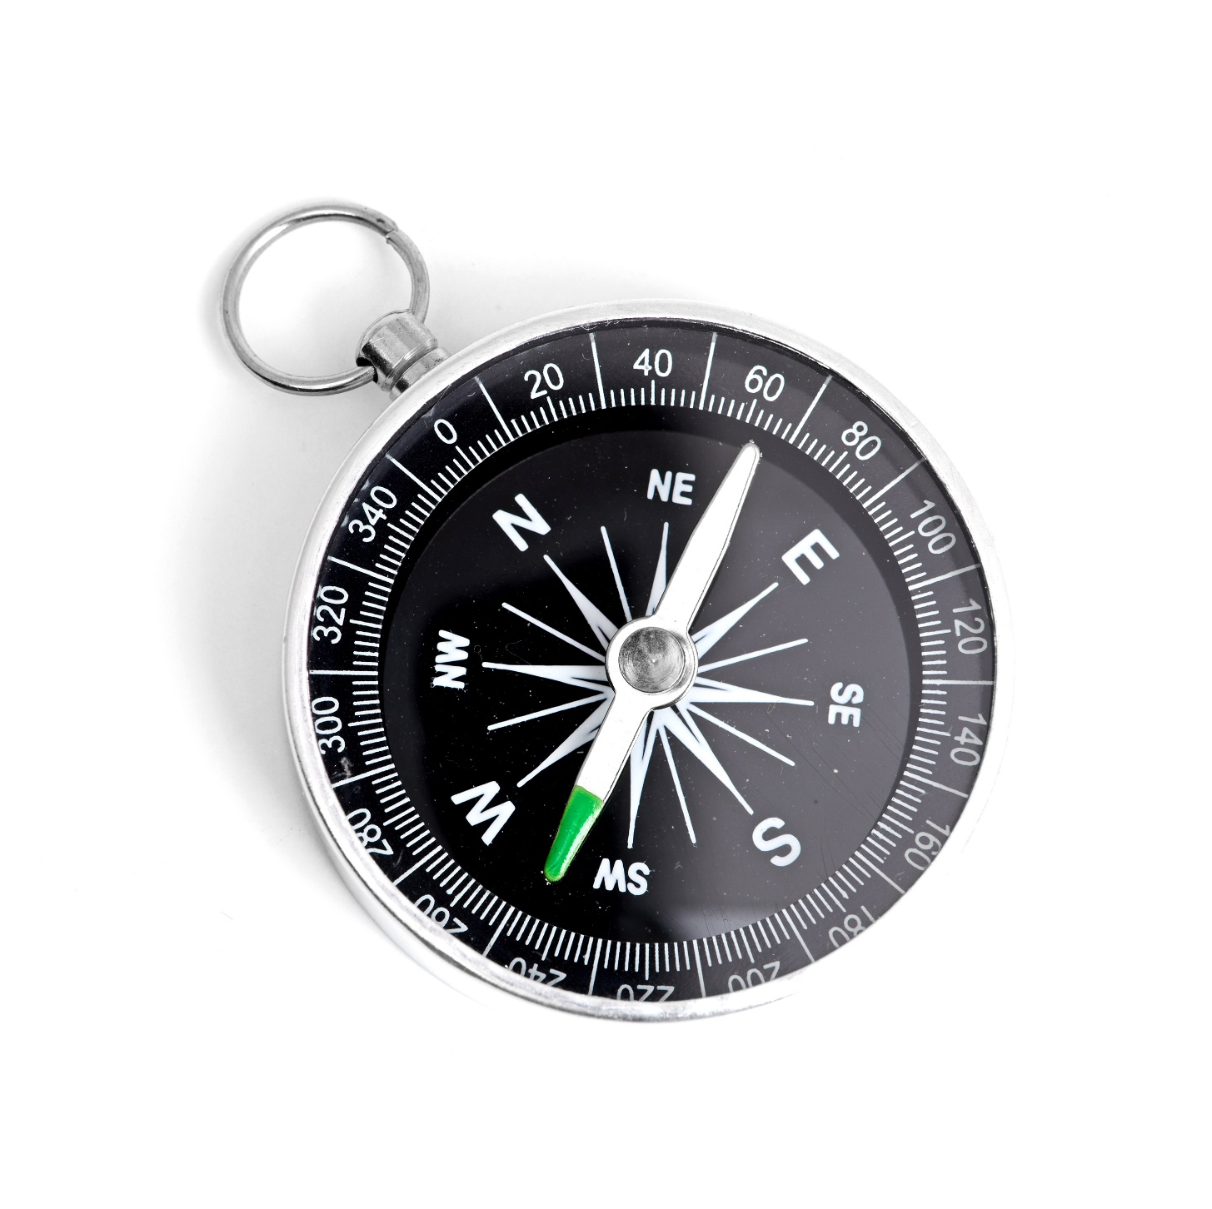
Agenda
Project Overview 3
Dataset & Methods Used 4
Algorithm & App Result 5
Issue Explanations 7
Conclusion 8

Slide 3
Project Overview
Project Introduction & Related Works
PROJECT IntroductioN
RELATED WORKS
What we try to achieve:
To help Yelp users make better choices of restaurants, we use techniques and principles of recommendation systems to create an application which makes predictions based on the user similarities
Develop an enhanced collaborative filtering using location (postal codes) as a key criterion for generating recommendations (Scope of Work: Canada)
Methods we use:
Collaborative Filtering
Frequent Itemset
How we evaluate the results
Use Root metrics Mean Squared Error (RMSE)
User Mean Absolute Error (MAE)
Using location for personalized POI recommendations in mobile environments:
By Tzvetan Horozov, Nitya Narasimhan, Venu Vasudevan
Discussion of GeoWhiz, a real-world deployment of our restaurant recommender system for location-based points of interest (POI).
Collaborative Filtering using Weighted BiPartite Graph Projection - A Recommendation System for Yelp
By Sumedh Sawant
Recommendation system on the Yelp Dataset Challenge dataset using the network-based-inference collaborative filtering algorithm
Same Yelp dataset was used (2013 version)
Project Overview
Dataset & Methods Used
Algorithm & App Result
Issue Explanations
Conclusion

Slide 4
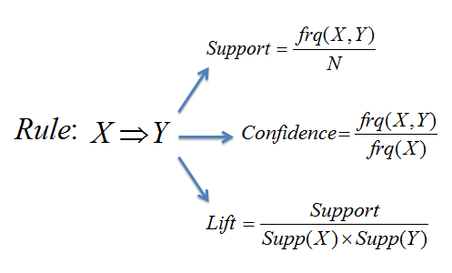
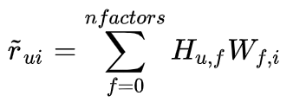
Dataset & Methods Used
Yelp Dataset and Collaborative Filtering & Frequent Itemset
Yelp DataseT
Methods Used
Source of Data:
Yelp Dataset - Yelp's businesses - 4 GB - www.kaggle.com/yelp-dataset/yelp-dataset
Canadian Postal Codes - Google Fusion Tables - 49 MB - https://fusiontables.google.com/
Dataset overview:
Original Dataset
Number of businesses 192,609
Number of review 6,685,900
Number of users 1,637,138
Canada
Number of Canadian businesses 50,644
Number of Canadian reviews. 1,063,142
Canadian Postal Codes
Number of postal codes 889,320
Collaborative Filtering :
Collaborative filtering is a method of making automatic predictions (filtering) about the interests of a user by collecting preferences or taste information from many users (collaborating). Matrix factorization is a good solution for sparse data problem.
where H is user matrix, W is item matrix
Frequent Itemset
Find sets of items that appear together ‘frequently’ in baskets with a minimum support and confidence to be qualify as ‘frequent’
Association Rules
Project Overview
Dataset & Methods Used
Algorithm & App Result
Issue Explanations
Conclusion

Slide 5
Algorithms & App Results
Algorithms & Results
SN | Algorithms | Result
Step 1 | In order to get a user with good history profile, we sort top 100 most review users in Canada, then take 5 random users and select one.
Step 2 | To make sure the user’s rating history and their restaurant choices are relevant, we find the base city AND top most reviewed postal codes of the user based on their rating history. We then prompt the user input their location (select one of the top postal codes).
Step 3 | Find all postal codes and their associated businesses located within a 3-km radius from the chosen postal code
Project Overview
SN | Item Description
1. | 65yB0ydGXOZ_-T6J_GbKfw
2. | jnB_saJqNfOmVoCWquhAzg
3. | iRQ_YKpCBdaCwvc2X8_3NQ
4. | tWBLn4k1M7PLBtAtwAg73g
5. | Wu0yySWcHQ5tZ_59HNiamg
Dataset & Methods Used
Algorithm & App Result
Issue Explanations
Conclusion
SN | Item Description
1. | M8X 1E9
2. | M5A 2L2
3. | M6K 1L4
4. | M5T 2W6
5. | M5V 3M4
 | 3 km | 5 km | 10 km
Number of postal codes | 2,835 | 6,731 | 21,050
Number of businesses | 582 | 1,506 | 8,005

Slide 6
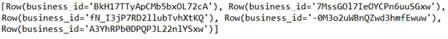
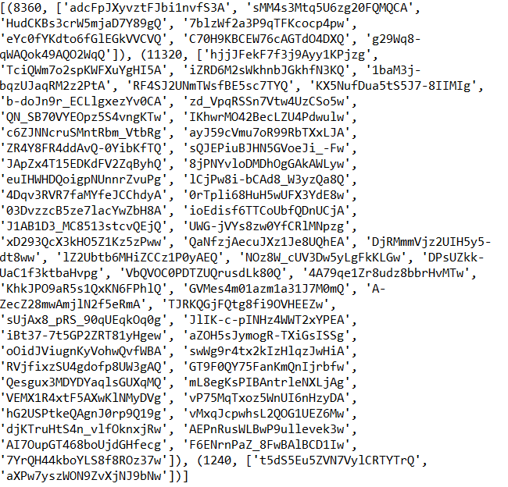


Algorithms & App Results
Algorithms & Results
SN | Algorithms | Result
Step 3 | Use Pyspark MLlib ALS library to do basic ALS recommender, as well as global average recommender. Compute RMSE and MAE for both approach and take recommend from the lower RMSE approach
Step 4 | Use FP-Growth Library in Pyspark to perform Frequent Itemset listing out top 5 most frequently chosen items. Selected Confidence and Support values are 0.4 and 0.4 respectively
Project Overview
Dataset & Methods Used
 | RMSE | MAE
Basic ALS Recommender | 2.147847095 | 1.722178277
Global Average Recommender | 1.435300565 | 1.242512298
Algorithm & App Result
Issue Explanations
Conclusion

Slide 7
Issue Explanations
Issues Encountered & Explanations
SN | Issue Description | Solution & Explanation
Issue 1 | Global Average RMSE is better than ALS RMSE Increase search radius and add biases to ALS do not make it better | Test 1: Increase search radius from 3 to 5 and to 10 km Test 2: Switch the metric from ALS to ALS + Biases Perhaps there are many latent factors that are not in the dataset itself to compute a more accurate matrix factorization. Perhaps there is not many “similar” users who rate one or more businesses like each other in our narrow distance.
Issue 2 | FP-Growth gives out empty result even when confidence and support value are are lowered down to 0.1 | Test 1: Increase search radius from 3 to 5 and to 10 km ▶︎ Still gives empty RDD Test 2: Reduce confidence and support value from 0.4 to 0.1 ▶︎ Still gives empty RDD There is no similarity frequent itemset within small-distance localities
Project Overview
 | 3 km (RMSE) | 5 km (RMSE) | 10 km (RMSE)
Basic ALS Recommender RMSE | 2.127391175 | 2.147847095 | 1.852597978
Global Average Recommender RMSE | 1.435300565 | 1.435300565 | 1.329057787
Dataset & Methods Used
Algorithm & App Result
Issue Explanations
 | RMSE | MAE
Bias ALS Recommender | 3.042489076 | 2.554701563
Global Average Recommender | 1.435300565 | 1.242512298
Conclusion

Slide 8
Conclusion
Our Conclusion, Future Work, and Q&A
CONCLUSION
FUTURE WORKS
Yelp official open dataset is not suitable for small scale locality recommendation as there is a low possibility of similar-rating restaurant sets among users
This also means that frequent itemset method might not be applicable since there is low possibility of frequent patterns in a small scale.
Look for alternative way to do recommendation, such as Cluster Weighted BiPartite Projection or Multi-Step Random Walks. For example, the project performed by Sawant - “Collaborative Filtering using Weighted BiPartite GraphProjection - A Recommendation System for Yelp” shows remarkable improvement.
Additional data attributes and information from Yelp could be taken into account, such as type of restaurant and its price range to improve algorithm, in order to give a more precise result.
Find out the real correlation between the issues and actual restaurant business natures.
Project Overview
Dataset & Methods Used
Algorithm & App Result
Issue Explanations
Conclusion
Questions
& Answers
Thank you.

