Slide 1

A Restaurant Recommendation System for Yelp
Location-based Collaborative Filtering and Frequent Itemset
Thanh Tung Nguyen (ID: 40042891) & Huy Nguyen (ID: 40023289) @ April 12, 2019

Slide 2

Agenda
Project Overview 3
Dataset & Methods Used 4
Algorithm & App Result 5
Issue Explanations 7
Conclusion 8

Slide 3
Project Overview
Project Introduction & Related Works
PROJECT IntroductioN
RELATED WORKS
What we try to achieve:
To help Yelp users make better choices of restaurants, we use techniques and principles of recommendation systems to create an application which makes predictions based on the user similarities
Develop an enhanced collaborative filtering using location (postal codes) as a key criterion for generating recommendations (Scope of Work: Canada)
Methods we use:
Collaborative Filtering
Frequent Itemset
How we evaluate the results
Use Root metrics Mean Squared Error (RMSE)
User Mean Absolute Error (MAE)
Using location for personalized POI recommendations in mobile environments:
By Tzvetan Horozov, Nitya Narasimhan, Venu Vasudevan
Discussion of GeoWhiz, a real-world deployment of our restaurant recommender system for location-based points of interest (POI).
Collaborative Filtering using Weighted BiPartite Graph Projection - A Recommendation System for Yelp
By Sumedh Sawant
Recommendation system on the Yelp Dataset Challenge dataset using the network-based-inference collaborative filtering algorithm
Same Yelp dataset was used (2013 version)
Project Overview
Dataset & Methods Used
Algorithm & App Result
Issue Explanations
Conclusion

Slide 4
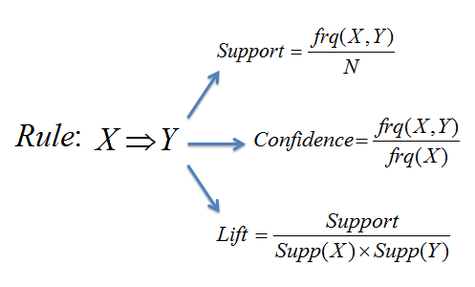
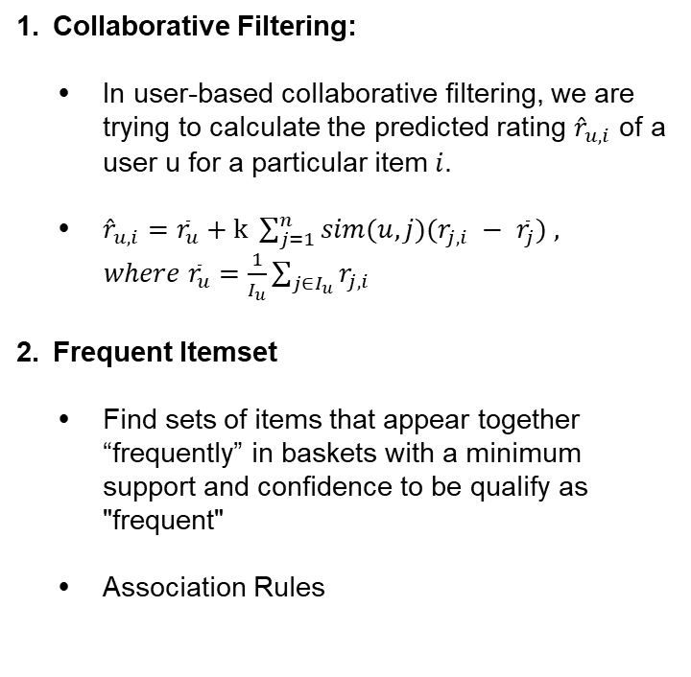
Dataset & Methods Used
Yelp Dataset and Collaborative Filtering & Frequent Itemset
Yelp DataseT
Methods Used
Source of Data:
Yelp Dataset - Yelp's businesses - 4 GB - www.kaggle.com/yelp-dataset/yelp-dataset
Canadian Postal Codes - Google Fusion Tables - 49 MB - https://fusiontables.google.com/
Dataset overview:
Original Dataset
Number of businesses 192,609
Number of review 6,685,900
Number of users 1,637,138
Canada
Number of Canadian businesses 50,644
Number of Canadian reviews. 1,063,142
Canadian Postal Codes
Number of postal codes 889,320
Collaborative Filtering:
In user-based collaborative ﬁltering, we are trying to calculate the predicted rating ${\hat{r}}_{u,i}$ of a user u for a particular item $i$.
${\hat{r}}_{u,i}={\overline{r}}_{u}+k \sum_{j=1}^{n}{sim(u,j)(r_{j,i} − }$ ${\overline{r}}_{j}) ,$
$where {\overline{r}}_{u}=\frac{1}{I_{u}}\sum_{j∈I_{u}}{r_{j,i}}$
Frequent Itemset
Find sets of items that appear together “frequently” in baskets with a minimum support and confidence to be qualify as "frequent"
Association Rules
Project Overview
Dataset & Methods Used
Algorithm & App Result
Issue Explanations
Conclusion

Slide 5
Algorithms & App Results
Algorithms & Results
SN | Algorithms | Result
Step 1 | In order to get a user with good history profile, we sort top 100 users with the greatest number of reviews in Canada, then take 5 random users and select one. | Top 100 users → → tWBLn4k1M7PLBtAtwAg73g
Step 2 | To make sure the user’s rating history and their restaurant choices are relevant, we find the base city AND top most reviewed postal codes of the user based on their rating history. We then prompt the user input their location (select one of the top postal codes).
Step 3 | Find all postal codes and their associated businesses located within a 5-km radius from the chosen postal code
Step 4 | Use Pyspark MLlib ALS library to do recommendation, sorting out top 10 restaurants with the highest predicted ratings. Prompt user to select one restaurant
Step 5 | Use FP-Growth Library in Pyspark to perform Frequent Itemset listing out top 5 most frequently chosen items
Project Overview
Dataset & Methods Used
Algorithm & App Result
Issue Explanations
Conclusion

Slide 6
Algorithms & App Results
The Erroneous Results & Solutions
SN | Algorithms | Result
Step 1 | In order to get a user with good history profile, we sort top 100 users with the greatest number of reviews in Canada, then take 5 random users and select one. | Top 100 users → → tWBLn4k1M7PLBtAtwAg73g
Step 2 | To make sure the user’s rating history and their restaurant choices are relevant, we find the base city AND top most reviewed postal codes of the user based on their rating history. We then prompt the user input their location (select one of the top postal codes).
Step 3 | Find all postal codes and their associated businesses located within a 5-km radius from the chosen postal code
Step 4 | Use Pyspark MLlib ALS library to do recommendation, sorting out top 10 restaurants with the highest predicted ratings. Prompt user to select one restaurant | List of restaurants found Selected restaurant
Step 5 | Use FP-Growth Library in Pyspark to perform Frequent Itemset listing out top 5 most frequently chosen items
Project Overview
Dataset & Methods Used
Algorithm & App Result
Issue Explanations
Conclusion

Slide 7
Issue Explanations
Issues Encountered & Explanations
SN | Issue Description | Explanation
Issue 1 | we proceed to continue trying FP-growth at min support and confidence at 0.5. However, it return empty df. Hence, we keep on lowering mins and min c until 0.1. At this point, we highly | Top 100 users → → tWBLn4k1M7PLBtAtwAg73g
Issue 2 | we proceed to continue trying FP-growth at min support and confidence at 0.5. However, it return empty df. Hence, we keep on lowering min s and min c until 0.1. At this point, we highly suspect that our dataset suffers from data spareness. So we try lower to 0. Unfortunately, after waiting for 15 minutes with my CPU working at 100% most of the time, it still not give back result so I stop it.
Issue 3 | From this, we tried to look for others who work on the same dataset who also use collab filtering like us and we found one. Perhaps lucky for us, the paper from Standford University has the same conclusion as us that the Yelp dataset suffers from data spareness.
 | RMSE Cua ALS recommender no cao? Expectation duoi 1.5 (Tai sao? 1.4 Global average better performance max 1.2 – 1.4) Ket qua 2.13 (initial input 3 km (data size: postal code) Thay input thi ket qua the nao? Doi location with more history? Improvement? Tai sao em lai tang len nhu vay? Conclusion la gi?
Project Overview
Dataset & Methods Used
Algorithm & App Result
Issue Explanations
Conclusion

Slide 8
Conclusion
Our Conclusion, Future Work, and Q&A
CONCLUSION
FUTURE WORKS
Using location for personalized POI recommendations in mobile environments:
By Tzvetan Horozov, Nitya Narasimhan, Venu Vasudevan
Discussion of GeoWhiz, a real-world deployment of our restaurant recommender system for location-based points of interest (POI).
Using location for personalized POI recommendations in mobile environments:
By Tzvetan Horozov, Nitya Narasimhan, Venu Vasudevan
Discussion of GeoWhiz, a real-world deployment of our restaurant recommender system for location-based points of interest (POI).
Project Overview
Dataset & Methods Used
Algorithm & App Result
Issue Explanations
Conclusion
Questions
& Answers
Thank you.

Slide 9
Algorithms & App Results
Algorithms & Results
SN | Algorithms | Result
Step 1 | In order to get a user with good history profile, we sort top 100 most review users in Canada, then take 5 random users and select one.
Step 2 | To make sure the user’s rating history and their restaurant choices are relevant, we find the base city AND top most reviewed postal codes of the user based on their rating history. We then prompt the user input their location (select one of the top postal codes).
Project Overview
1. 65yB0ydGXOZ_-T6J_GbKfw
2. jnB_saJqNfOmVoCWquhAzg
3. iRQ_YKpCBdaCwvc2X8_3NQ
4. tWBLn4k1M7PLBtAtwAg73g
5. Wu0yySWcHQ5tZ_59HNiamg
Dataset & Methods Used
Algorithm & App Result
Issue Explanations
Conclusion
1. M8X 1E9
2. M5A 2L2
3. M6K 1L4
4. 89109
5. 89101

Slide 10
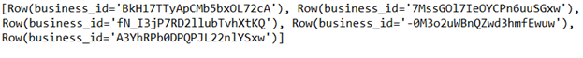
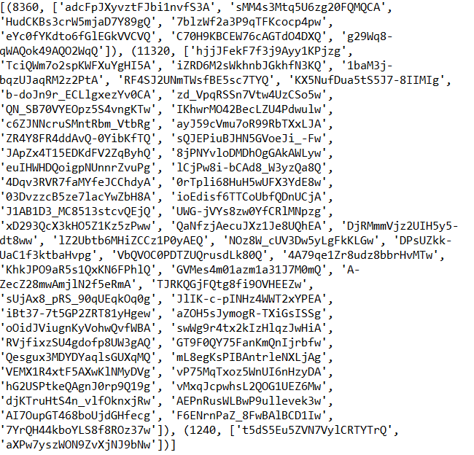

Algorithms & App Results
Algorithms & Results
SN | Algorithms | Result
Step 3 | Use Pyspark MLlib ALS library to do baisc ALS recommender, as well as global average recommender. Compute RMSE and MAE for both approach and take recommend from the lower RMSE approach
Step 4 | Use FP-Growth Library in Pyspark to perform Frequent Itemset listing out top 5 most frequently chosen items
 | RMSE | MAE
basic als recommender | 2.127391175 | 1.722178277
global average recommende | 1.435300565 | 1.242512298
Project Overview
Dataset & Methods Used
Algorithm & App Result
Issue Explanations
Conclusion

Slide 11
Algorithms & App Results
The Erroneous Results & Solutions
SN | Algorithms | Result
Step 1 | In order to get a user with good history profile, we sort top 100 users with the greatest number of reviews in Canada, then take 5 random users and select one. | Top 100 users → → tWBLn4k1M7PLBtAtwAg73g
Step 2 | To make sure the user’s rating history and their restaurant choices are relevant, we find the base city AND top most reviewed postal codes of the user based on their rating history. We then prompt the user input their location (select one of the top postal codes).
Step 3 | Find all postal codes and their associated businesses located within a 5-km radius from the chosen postal code
Step 4 | Use Pyspark MLlib ALS library to do recommendation, sorting out top 10 restaurants with the highest predicted ratings. Prompt user to select one restaurant | List of restaurants found Selected restaurant
Step 5 | Use FP-Growth Library in Pyspark to perform Frequent Itemset listing out top 5 most frequently chosen items
Project Overview
Dataset & Methods Used
Algorithm & App Result
Issue Explanations
Conclusion

Slide 12
Issue Explanations
Issues Encountered & Explanations
SN | Issue Description | Explanation
Issue 1 | Global average rmse is better than ALS rmse | Perhaps there is many latten factor that is not in the dataset itself to compute a more accurate matrix factorization. Perhaps there is not many “similar” users who rate one or more businesses like each other in our narrow distance.
Issue 2 | FP-Growth gives out empty result even when confidence and support value are 0.1 | There is no similarity frequent itemset within small distance
Project Overview
Dataset & Methods Used
Algorithm & App Result
Issue Explanations
Conclusion

Slide 13
Conclusion
Our Conclusion, Future Work, and Q&A
CONCLUSION
FUTURE WORKS
Yelp official open dataset is not suitable for locality small scale recommendation as there is low possibility of similar set of users
This also means frequent itemset is not applicable since there is low possibility of frequent patterns in a small scale
Look for alternative way to do recommendation, such as Cluster Weighted BiPartite Projection or Multi-Step Random Walks, which as done in “Collaborative Filtering using Weighted BiPartite GraphProjectionA Recommendation System for Yelp” shows remarkable improvement
As this is the official open dataset from Yelp, we would ask for Yelp permission to have a more relevant dataset that includes information, such as type of restaurant and its price range to improve algorithm.
Project Overview
Dataset & Methods Used
Algorithm & App Result
Issue Explanations
Conclusion
Questions
& Answers
Thank you.

