Slide 1

Writing unit test faster and more efficiently

Slide 2
Why are we here?
1

Slide 3
Developers who don’t write tests!
We don’t have time to write tests!
Unit tests are waste of time. They slow you down and decrease your productivity!
I don’t know how to write unit tests!

Slide 4
SHARING AGENDA
I. What? Why you should Unit Test?
II. How can we write unit test faster and efficiently?
III. Tips and tricks
IV. Demo and Q&A

Slide 5
What is Unit Test?
2

Slide 6
What is Unit Test
A way of testing the smallest piece of code referred to as a unit that can be logically isolated in a system.
Focus on the functional correctness of standalone modules.

Slide 7
Why should developers write Unit Test?
3

Slide 8
Developers should write unit tests
Test your code frequently and in less time.
Catch more bugs before deploying.
Deploy your application with more confidence.
Refactor your code with confidence.
Write cleaner and maintainable code

Slide 9
How can we write unit tests faster and more efficiently?
5

Slide 10
Prerequisites of Effective Unit Tests
Clean code
Testable design
Context-aware
Understanding of unit testing

Slide 11
Qualities of Effective Unit Tests
Clean and simple
High value
Flexible

Slide 12
Naming a unit test
[MethodUnderTest]_[Scenario]_[ExpectedResult]
MethodUnderTest is the name of the method you are testing.
Scenario is the condition under which you test the method.
ExpectedResult is what you expect the method under test to do in the current scenario

Slide 13
Test Organization
Mock and Stub
Arrange, act, assert
Fluent assertions

Slide 14
AAA pattern
All unit tests should follow the AAA pattern: arrange, act, assert. If a test has multiple arrange, act, or assert sections, that’s a sign that the test verifies multiple units of behavior at once. If this test is meant to be a unit test, split it into several tests one per each action.

Slide 15
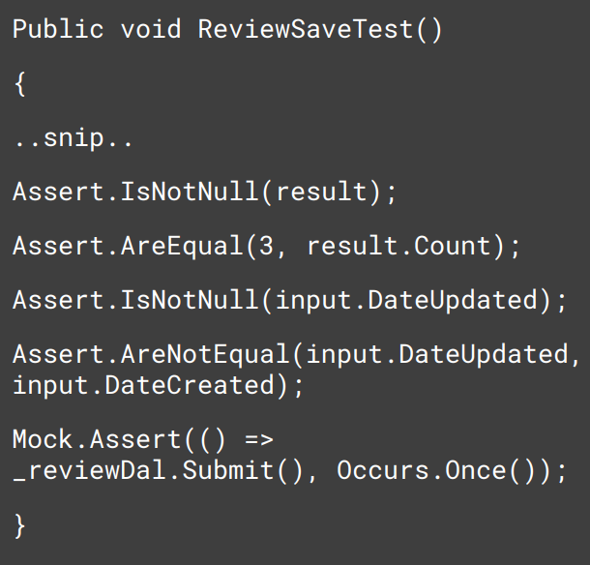
AAA pattern
Asserting too many expectations makes it harder to find why the test actually failed.

Slide 16
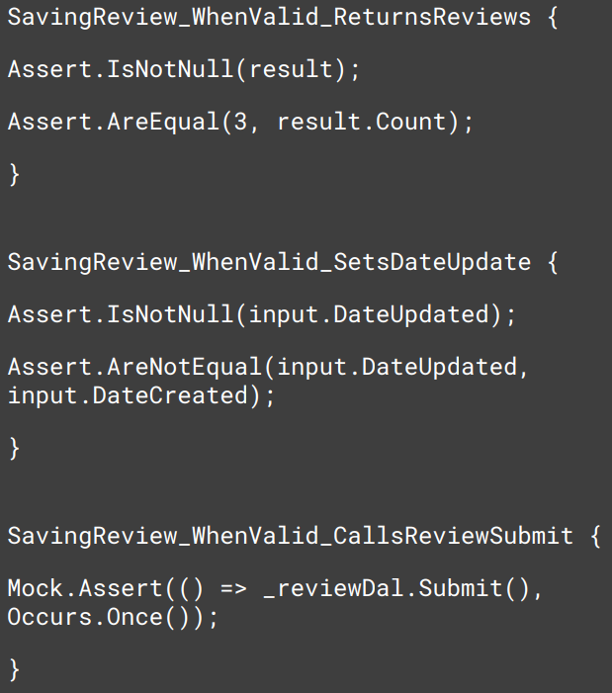
AAA pattern
Three separate tests improve precision.

Slide 17
High Precision
Test one expectation per test
Multiple asserts on same object can be OK
Test should point to
precise location of
problem

Slide 18
Improved readability of test source code
Using an Assertion library to further improve test readability.
[Subject] [action] [object]
Better, more descriptive failure messages may prevent the need for debugging through the test.

Slide 19
Improved readability of test source code
Reuse test fixture initialization.
Parameterized tests help reduce the amount of code needed for similar tests.

Slide 20
Tips and Tricks
6

Slide 21
What to Test?
In programing, we have two types of functions
Query functions
Command functions

Slide 22
What to Test?
Query functions
You should write a test and verify that your function is returning the right value
You might have multiple execution paths in that function. In that case, you should test all the execution paths and make sure that each execution path results in the right value.

Slide 23
What to Test?
Command functions
If the outcome is to change the state of an object in memory, you should test that the given object now in the right state.
If the outcome is to talk about an external resource like a database or webservice, you should verify that the class on the test, is making the right call to these external dependencies

Slide 24
What not to Test?
Language feature (C# Microsoft lib)
3rd-party code
No logic, No allowed (if, else, foreach …)
Don’t test dead code (If the uncovered code isn’t being used, this is likely some extraneous code left after a refactoring. It’s best to delete this code.)

Slide 25
Writing test faster
Save time to coding/typing to create unit test code with xUnit Code Snippets
Auto-mocking with AutoFixture
Private methods and insufficient coverage, you should be extracted into a separate class

Slide 26
Writing test faster
Let's practice with it for 10,000 hours

Slide 27
Reference
https://github.com/Moq/moq4/wiki/Quickstart
https://xunit.net/
https://andrewlock.net/creating-strongly-typed-xunit-theory-test-data-with-theorydata/
https://andrewlock.net/creating-parameterised-tests-in-xunit-with-inlinedata-classdata-and-memberdata/

Slide 28

Thanks!
foreach (...) {}
Thanks!
Any questions?
Any questions?
You can find me at:
@username
user@mail.me
You can find me at:
@tungnt
tungnt@mti-tech.vn

