Slide 1
SWE 205: Software Usability
Introduction
Paul Ammann
http://www.cs.gmu.edu/~pammann

Slide 2
Software Usability
Why this class is important
What this class will do to you
Things you should do:
Read the syllabus
Do your homework
Come to class, and come prepared
Engage with your classmates

Slide 3

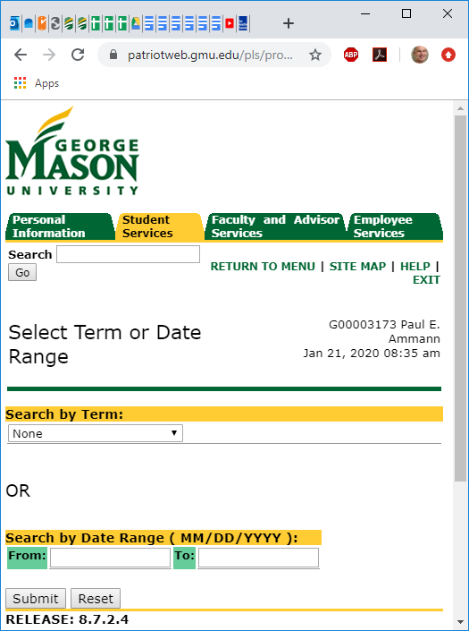
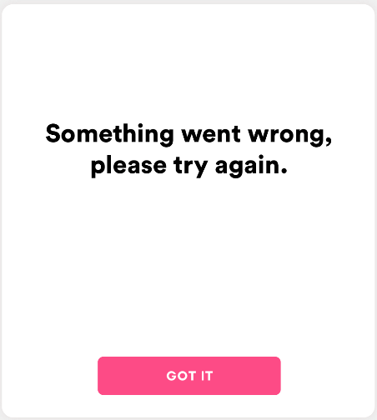
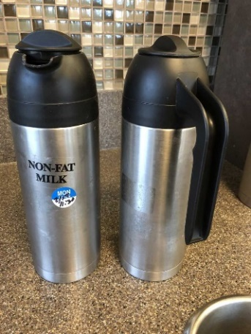
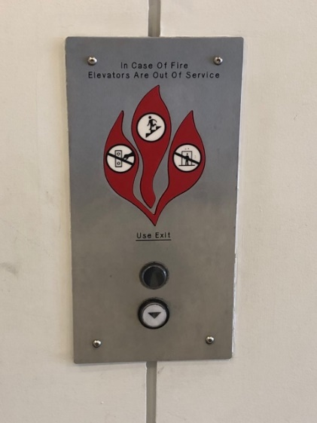
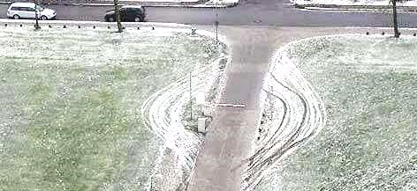
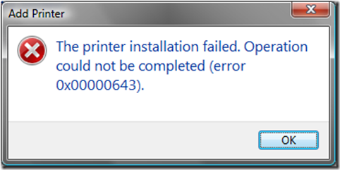
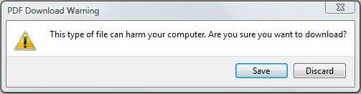
Are these “wrong”? Why or why not?

