Slide 1
Ko Chapter 3 What Interfaces Mediate
From User Interface Software and Technology
Amy Ko, University of Washington
https://faculty.washington.edu/ajko/books/uist/mediation.html
Slides by Paul Ammann, George Mason University

Slide 2
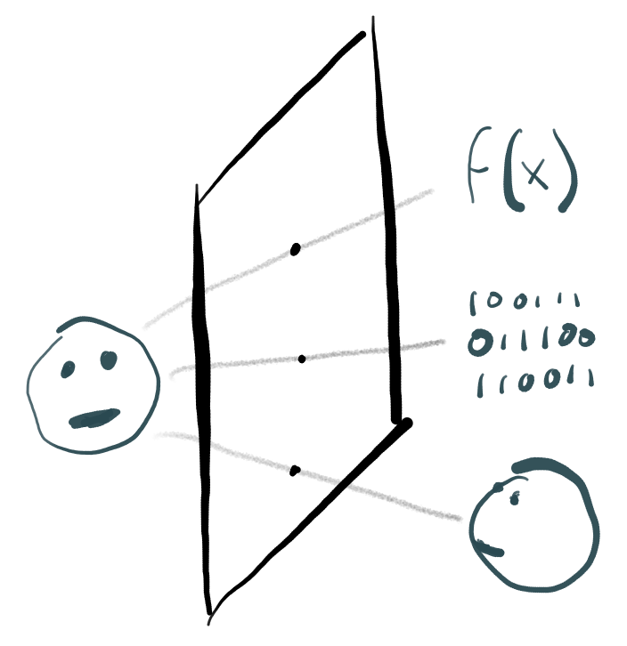
Mediation: A Sociocultural Perspective on User Interfaces
Mediating Automation
User learns what computation is possible and how to interpret results. (API!)
Mediating Information
User learns a metadata language that conveys what information exists
Mediating Communication
User learns new cues for social context that mirror or replace those in the real world.

Slide 3
Mediating Automation Examples
Calculator
“1”, “+”, “1”, “=“: API for
add(1,1)
Camera
Open app, point, click: API for
capture(focusPoint, sensorData); save(imageFile)
Driverless Car
Entering destination is API for
while(!atDestination() { drive(destination, location, environment);}

Slide 4
Mediating Information Examples
Prior to computing, people mediated access
Ask your friend
Find an expert
Consult a librarian
Now, computers dominate mediation
Browsing
Creating information
Organizing information
Common ideas
Metadata, documents, search, browse, index, etc.

Slide 5
Mediating Communication Examples
Messaging apps, email, Slack, video chat, discussion boards, chat rooms, wikis, social networks, virtual worlds, etc.
Key difference: requires social context
Online != Physical interaction (at least so far…)
What happens to multi-channel communication, identity, shared local contex, non-verbal cues (gaze, gesture, non-verbal speech, spatial reference)?
Missing context make computer-mediated communication more dysfunctional

