Slide 1
Krug Chapter 1 Don’t Make Me Think!
Paul Ammann
https://www.cs.gmu.edu/~pammann/
SWE 205
Software Usability and Design

Slide 2
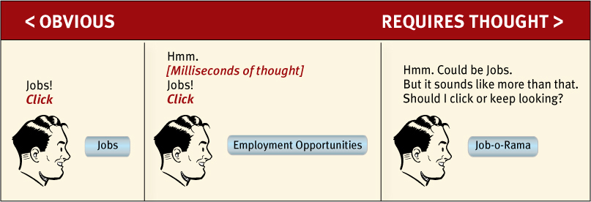
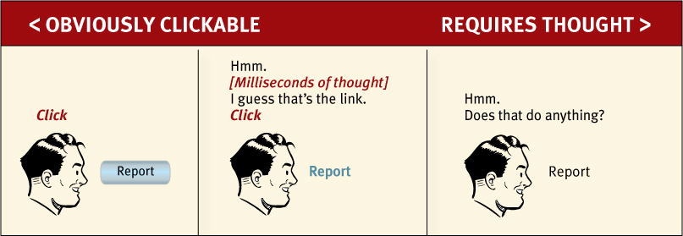
Krug’s First Law of Usability

Slide 3
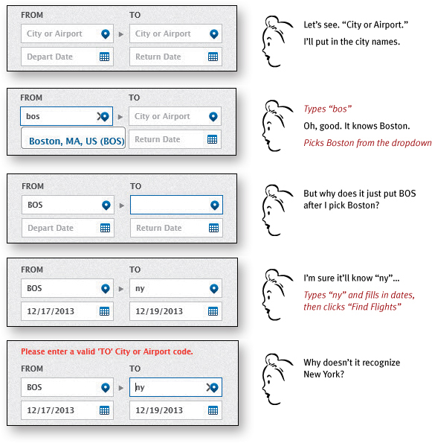
Krug’s First Law of Usability

Slide 4
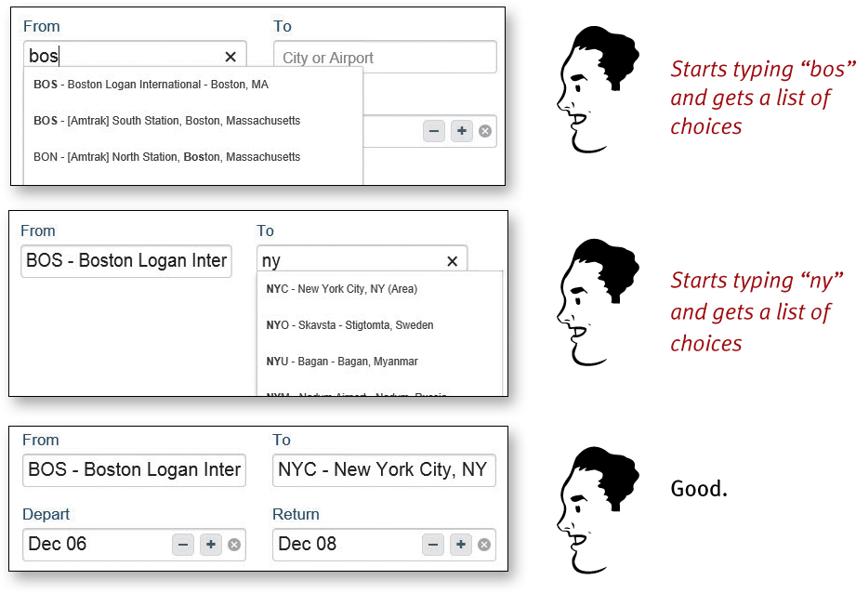
Krug’s First Law of Usability

Slide 5
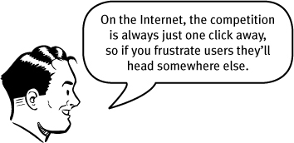
Why It Matters
Common Answer:
Krug’s Answer:
Making every page or screen just makes everything seem better.
Most people are going to spend far less time looking at the pages we design than we’d like to imagine!
If Web pages are going to be effective, they have to work most of their magic at a glance.

