Slide 1
Krug Chapter 12 Accessibility
Paul Ammann
https://www.cs.gmu.edu/~pammann/
SWE 205
Software Usability and Design

Slide 2
Topics
What is accessibility?
Accommodating variances in people’s (dis)abilities
Not about variances in devices, connectivity, etc.
Some solutions do address both concerns
What developers and designers fear
The truth is, it can be complicated
The four things you can do right now

Slide 3
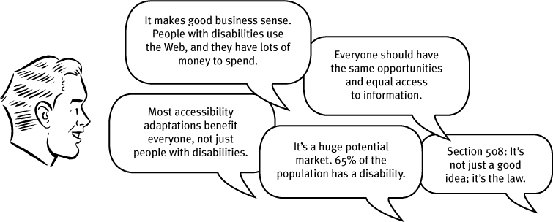
What developers and designers hear
_% of the population has a disability
Making things accessible benefits everyone
It’s the right thing to do
Blind people with a computer can now read almost anything in their own language. Imagine that!

Slide 4
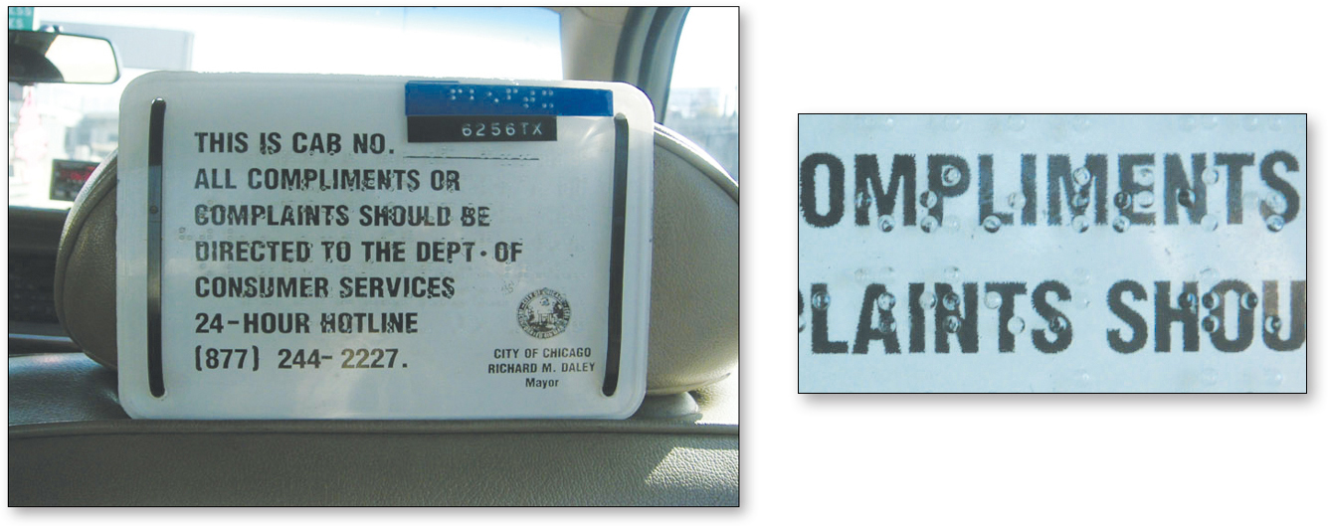
What developers and designers fear
More work
More stuff added to an impossible project schedule?
Compromised design
Buttered cats?
Can accessible design and good design converge?

Slide 5
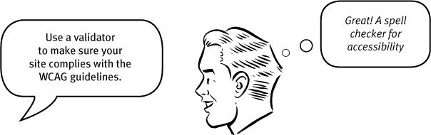
The truth is, it can be complicated
It’s more than just a validator
It is harder than it should be
Better tools are coming?

Slide 6
Four things you can do right now
Fix the usability problems that confuse everyone
Fixing usability problems is one of the most effective ways of making sites accessible!
Read an article
Krug cites Theofanos
Screen readers scan with their ears
Read a book
Go for the low-hanging fruit
alt tags, correct heading use, test forms with screen readers, “Skip to main content” at beginning, make everything accessible with the keyboard, use contrast, use accessible templates

