Slide 1
Krug Chapter 2 How We Really Use the Web and Web Site Design
Jeff Offutt, modified by Paul Ammann
https://www.cs.gmu.edu/~pammann/
SWE 205
Software Usability and Design

Slide 2
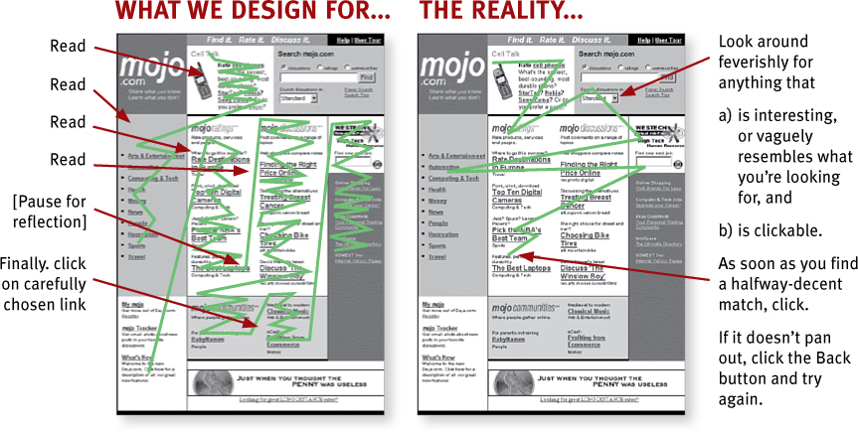
Designers vs. Reality

Slide 3
Fact 1: We don’t read pages. We scan them.
Web page authors want users to study web sites
No … users :
Glance at a page
Scan some text
Click on the first link that looks interesting
Web page authors …
Should not think in terms of telling a story
Should think in terms of a sign on a busy highway

Slide 4
Users Scan Web Pages
Why?
We’re on a mission
We know we don’t need to read everything
We’re good at it
The obvious exception?
Web documents
News stories
Reports
Product descriptions
Even then, there’s a lot of scanning going on

Slide 5
Fact 2: We don’t make optimal choices. We satisfice (= satisfy + suffice).
Humans do not make optimal decisions
We take the first option that looks reasonable
Even critical decision makers do this!
Why do we compromise ?
We’re in a hurry
We usually don’t lose much for guessing wrong
Comparing options doesn’t lead to better decisions
Comparing options is hard work and no fun

Slide 6
Fact 3: We don’t figure out how things work. We muddle through.
Few users fully understand systems before use
Or even after use!
Engineers expect users to understand
We don’t. And we won’t! So there!
Users usually waste time and make mistakes
Why do we muddle through?
It’s not important to us
If we find something that works, we stick with it.

