Slide 1
Krug Chapter 3 Billboard Design 101
Jeff Offutt, modified by Paul Ammann
https://www.cs.gmu.edu/~pammann/
SWE 205
Software Usability and Design

Slide 2
6 Ways to Attract Drive-By Users
Users whizz by your website at 70 miles an hour … don’t try to slow them down, try to adapt to them
Conventions are your friend.
Create effective visual hierarchies
Break pages into clearly defined areas
Make it obvious what’s clickable
Eliminate distractions
Format content to support scanning

Slide 3
Take Advantage of Conventions
Conventions are commonly accepted ways to tell users things without explicitly telling them
Where things are located on a page
How things work – e.g. shopping carts
How things look – e.g. icon for video
Conventions vary by type of site
Commerce vs. colleges vs. blogs vs restaurants etc.
Some designers like to be creative
What’s good for users?
New ideas are great, but be very careful

Slide 4
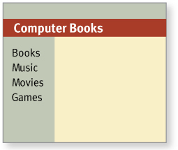
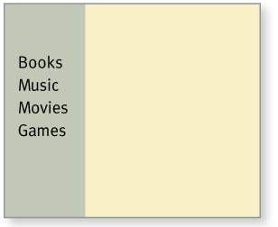
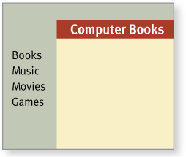
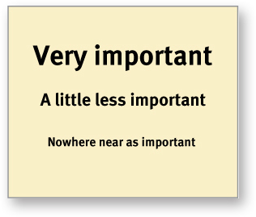
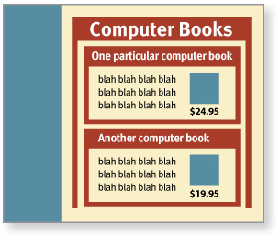
Create Effective Visual Hierarchies
More important stuff is more prominent
Logically related things are also visually related
Nested structures show what is part of what

Slide 5
Break Pages Up
Users need to see and identify the different areas on a web page immediately
Without thinking !
Consistency helps
Borders and colors are important
Examples
Newspapers have been doing this for years
Financial Times
New York Times
Wall Street Journal

Slide 6
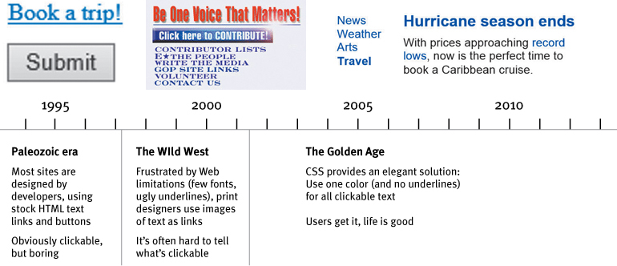
Make What’s Clickable Obvious
This has evolved over time
And continues to do so in mobile (more later)

Slide 7
Eliminate distractions
Avoid shouting
Exclamation points, color, lots of typeface, animation
Disorganization
Does the website look like a dorm room?
Clutter
Too much stuff
Specific advice coming in Chapter 5

Slide 8
Format to support scanning
Use plenty of headings
Keep paragraphs short
Use bulleted lists
Highlight key terms

Slide 9
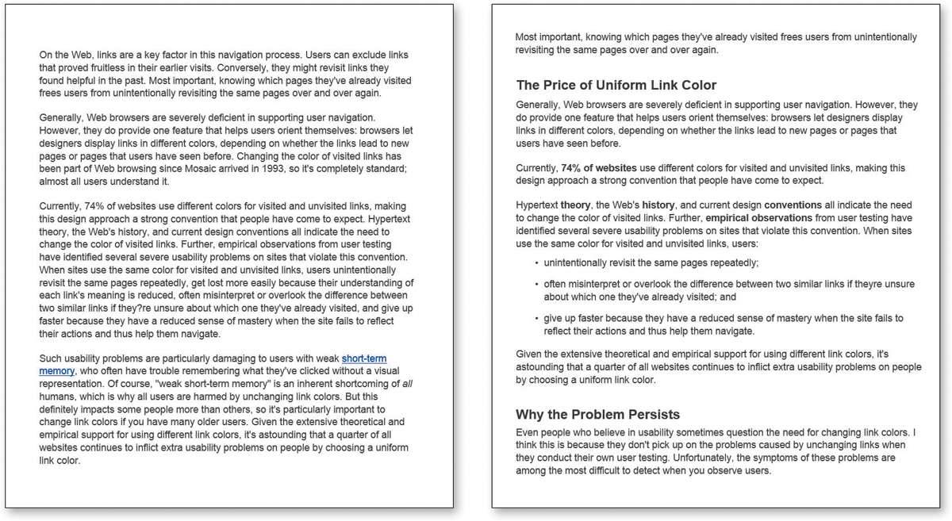
Example: Format for scanning

Slide 10
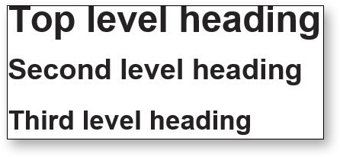
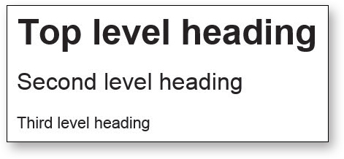
Example: Headings

Slide 11
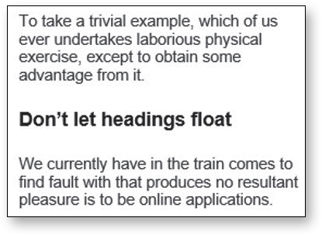
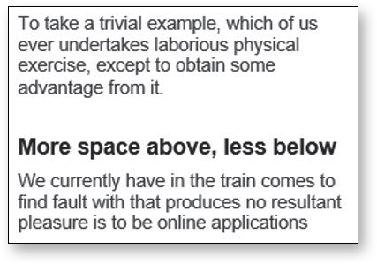
Example: Headings
Bad
Better

Slide 12
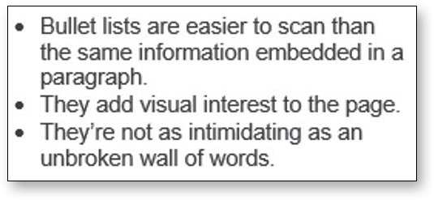
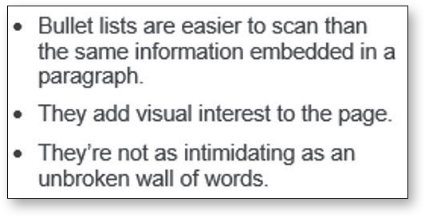
Example: Bulleted list
Bad
Better

