Slide 1
Krug 4 Animal, Mineral, or Vegetable
Jeff Offutt, modified by Paul Ammann
https://www.cs.gmu.edu/~pammann/
SWE 205
Software Usability and Design

Slide 2

Counting Clicks
On the web, speed of use is mostly about clicking :
How many clicks
How hard each click is
Krug’s rule
three mindless clicks equals one click requiring thought
What about your office in your home?

Slide 3
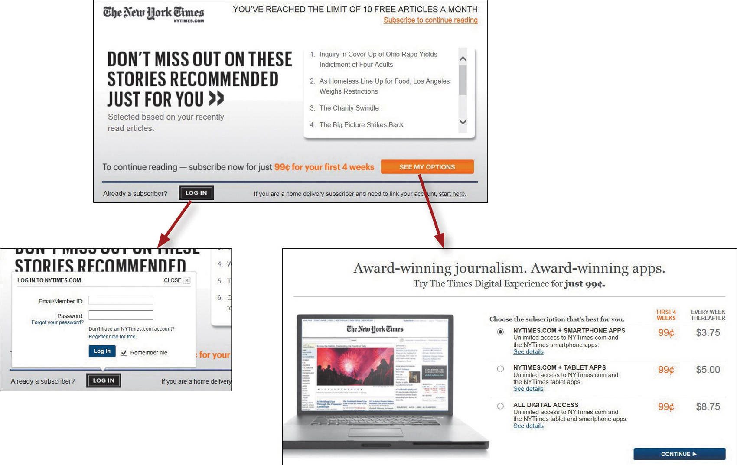
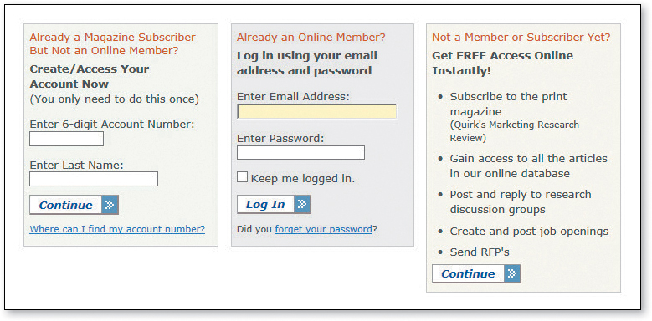
Example: paywalls

Slide 4
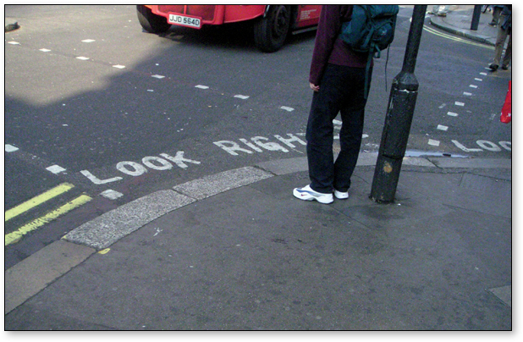
Some Assistance May Be Required
When you have to give the user a complex choice
Be brief
Be timely
Make sure the user notices
“What’s this” links are a good example

