Slide 1
Krug Chapter 5 Omit Needless Words
Jeff Offutt, modified by Paul Ammann
https://www.cs.gmu.edu/~pammann/
SWE 205
Software Usability and Design

Slide 2
Omit Needless Words
E. B. Strunk, The Elements of Style
Vigorous writing is concise
A sentence should contain no unnecessary words, a paragraph no unnecessary sentences
Many words on web pages will never be read
Get rid of half the words
Then get rid of half of what’s left!

Slide 3
Editing Is Hard
“There are no great writers, just great editors”
Chris Offutt, author
Sometimes I ask him to check something I write
He cuts at least 25%, and the paper says MORE, not less
Why is editing our writing so hard?
When we first wrote a word, we thought it had a purpose in the sentence
Cutting somebody else’s excess verbiage is easier than cutting our own words
This slide is verbose!

Slide 4
Editing Takes Discipline
“There are no great writers, just great editors”
Chris Offutt, author
Sometimes I ask him to check something I write
He cuts at least 25%, and the paper says MORE, not less
Why is editing our writing so hard?
When we first wrote a word, we thought it had a purpose in the sentence
Cutting somebody else’s excess verbiage is easier than cutting our own words
he
s
my
ing

Slide 5
Editing Helps Clarity
“There are no great writers, just great editors”
Chris Offutt, author
Sometimes he checks my writing
He cuts 25% and the paper says MORE
Why is editing so hard?
When we wrote a word, we thought it had a purpose
Cutting somebody else’s excess verbiage is easier
Much better!
30% shorter

Slide 6
Happy Talk Must Die
If you’re not sure what it is, Krug has a test:
Read the text
Listen carefully
Do you hear “blah, blah, blah”?
Happy talk is often small talk
Sociable, but web users don’t have time
Home pages are often full of happy talk
“We’re great!”
“And here’s where stuff is!”

Slide 7
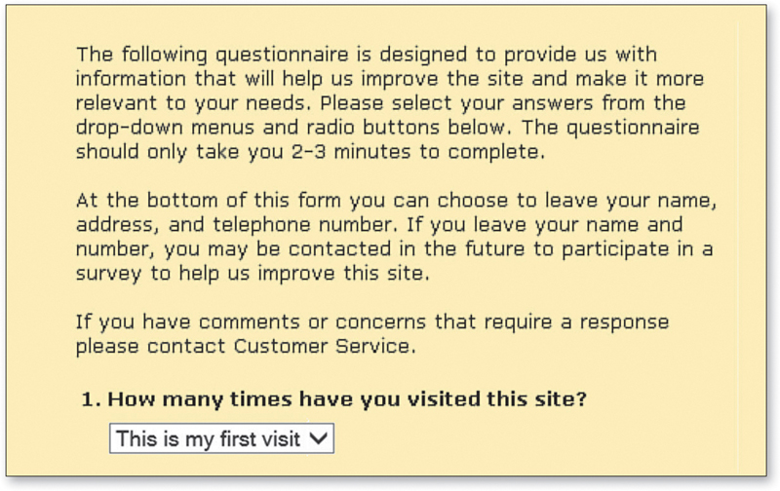
Instructions Must Die
If we need instructions, interface has already failed

