Slide 1
Krug Chapter 6 Street signs and Breadcrumbs
Jeff Offutt, modified by Paul Ammann
https://www.cs.gmu.edu/~pammann/
SWE 205
Software Usability and Design

Slide 2
Outline
Scene from a mall
Web navigation 101
The unbearable lightness of browsing
The overlooked purposes of navigation
Web navigation conventions
A way to search
Secondary, tertiary, and whatever comes next
Page names, etc.
Tabs
Trunk test

Slide 3
Help Users Find Your Stuff
People won’t use your website if they can’t find things
Shoppers usually look for something specific
Stores provide clues to help find things
Organization that makes sense – TO CUSTOMERS
Signs that provide useful information
If customers have to ask for help, has the store failed?

Slide 4
Buying a chainsaw at Sears*
Department names
Tools, Housewares, Lawn and Garden
Could be first or last…
Try One (say, Tools)
Power Tools, Hand Tools, Sanding and Grinding
Choose again, down to aisle level
Scan individual products
Backtrack on failure
* Bankrupt in 2018, but not dead yet…

Slide 5
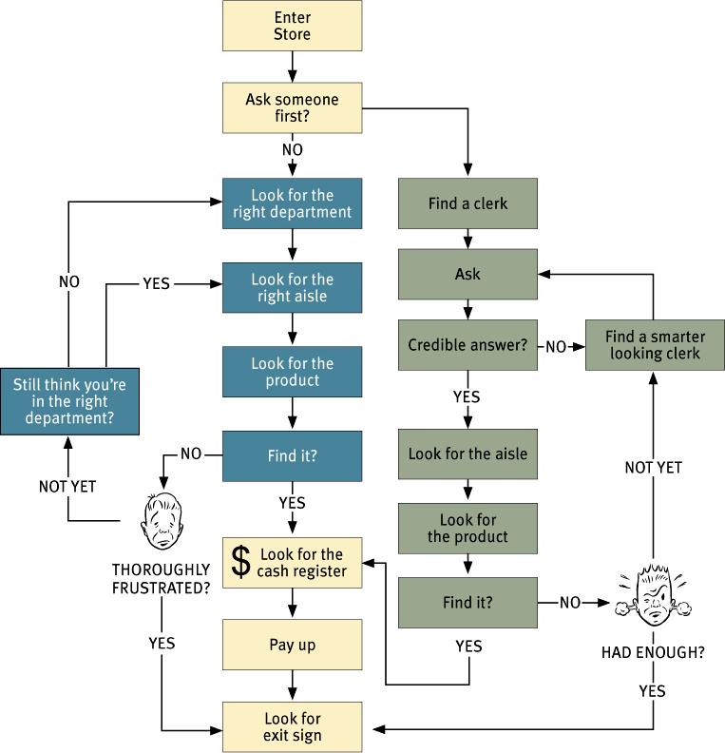
Buying a chainsaw at Sears*

Slide 6
Web Navigation 101
You are usually trying to find something
Decide on strategy
Browse-first (“Link-dominant users”)
Rely on main sections, subsections, etc.
Similar to signs in a department store
Search first (“Search-dominant users”)
Similar to asking a clerk for help
But no social stigma ☺
Frustration translates to leaving
Really easy to leave web sites!

Slide 7
Unbearable lightness of browsing
No sense of scale
We can look up and around to see how big Home Depot is
On the web, we don’t know how much we’ve seen
When do we stop ?
No sense of direction
No left, right, up, down … just a partial hierarchy
No sense of location
Where are we in relation to the rest of the store?

Slide 8
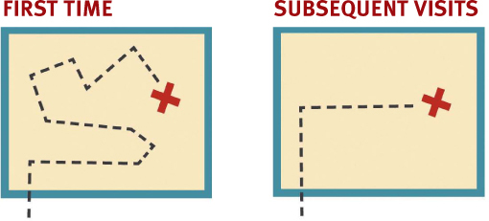
Unbearable lightness of browsing
What happens in a store?
On the web, your feet never hit the ground
Web navigation is conceptual, not physical
We never talk about “dept store navigation”
Generic navigation has two parts
Getting from one place to another
Figuring out where you are
Web navigation needs to do more

Slide 9
UIs Must Help Users Navigate
No mental model to navigate web sites
No physical sense of location
Bookmarks become important
Back button is essential
Home pages give users comfort
Navigation must be very good !
Generational Differences
I wonder if people born in the 21st century have a different mental model for navigating on the web

Slide 10
Benefits of Navigation
Beyond finding stuff and telling us where we are, web navigation has to do 3 more things:
Tell users what’s there
Tell users how to use the web site
Tell users whether to trust the builders of the web site

Slide 11
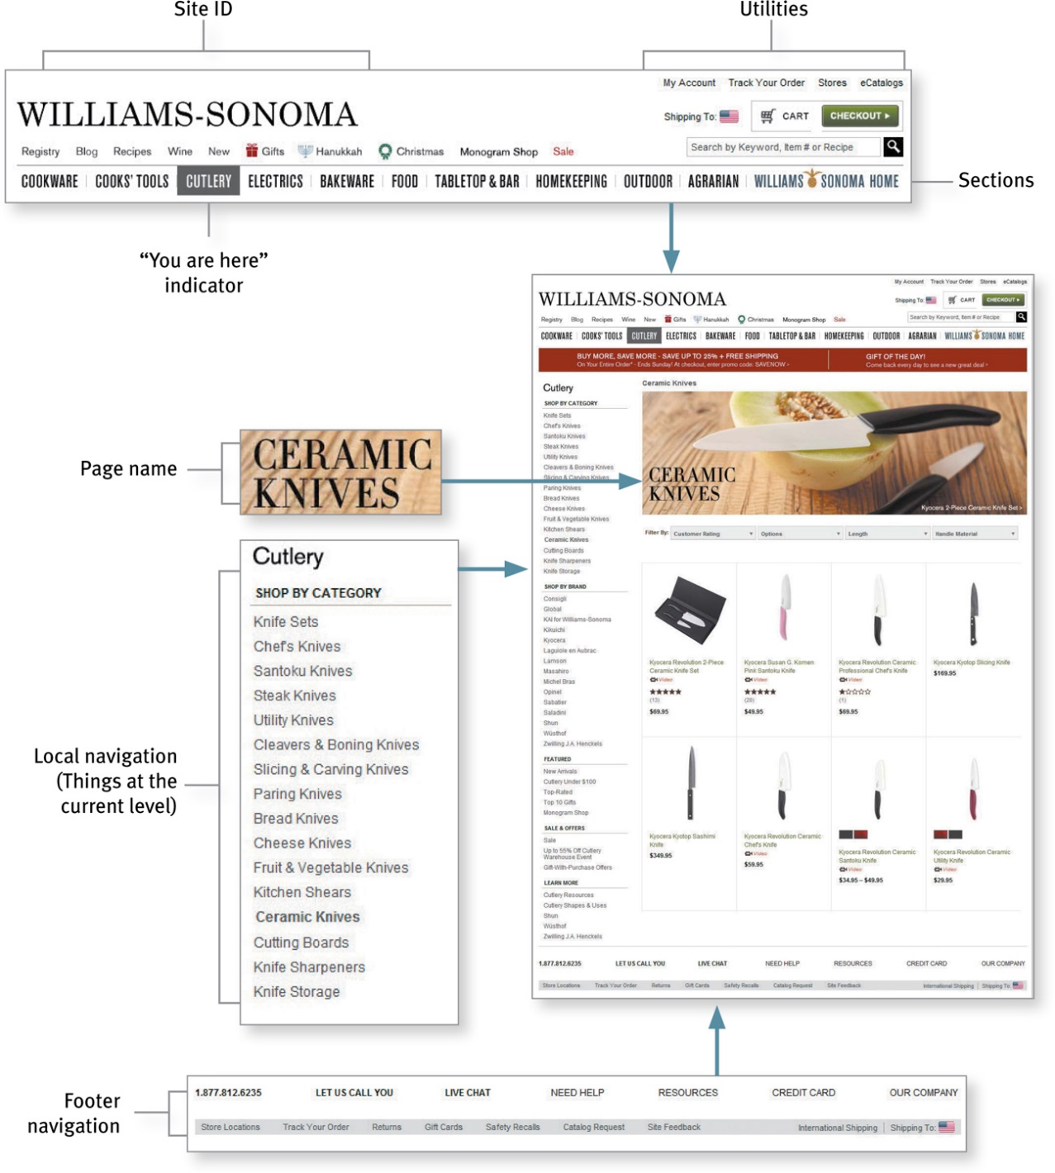
Common Conventions

Slide 12
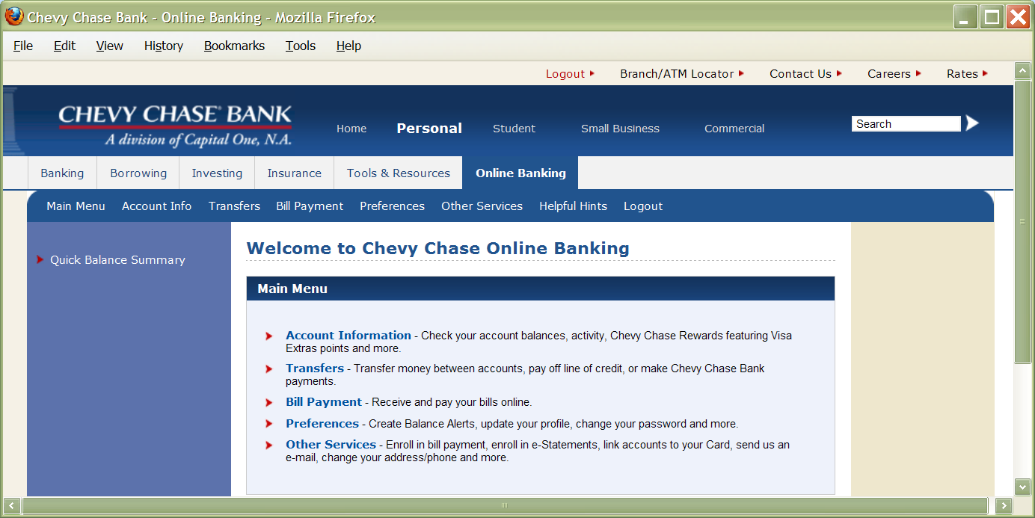
Common Conventions
Utilities
Search Box
Current
Site ID
Sections

Slide 13
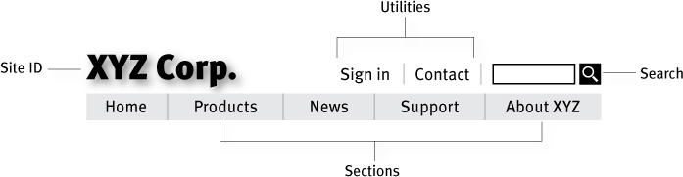
Persistent Navigation
Four elements user needs always to have on hand
Except for forms pages…

Slide 14
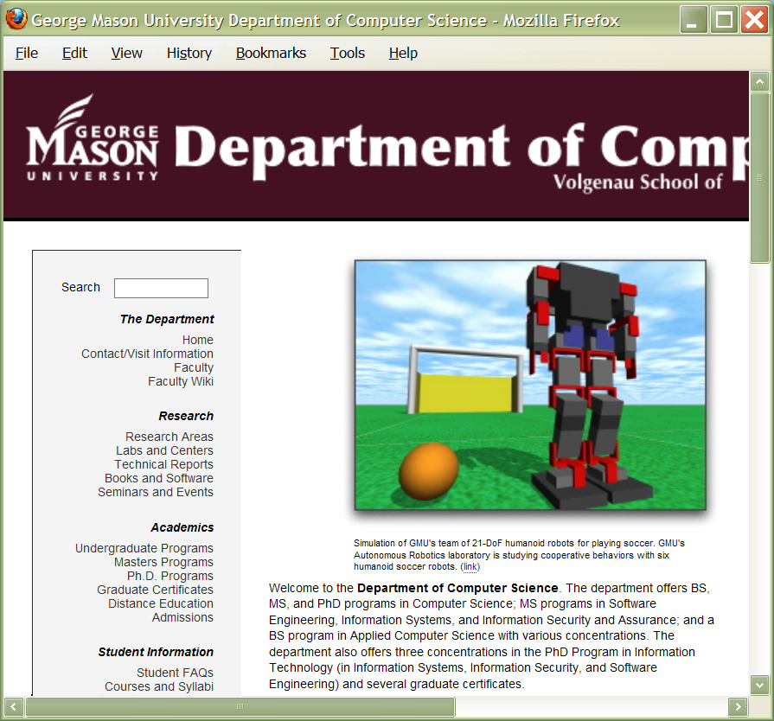
Persistent Navigation
Overly-large
banner
Persistent
navigation
menu

Slide 15
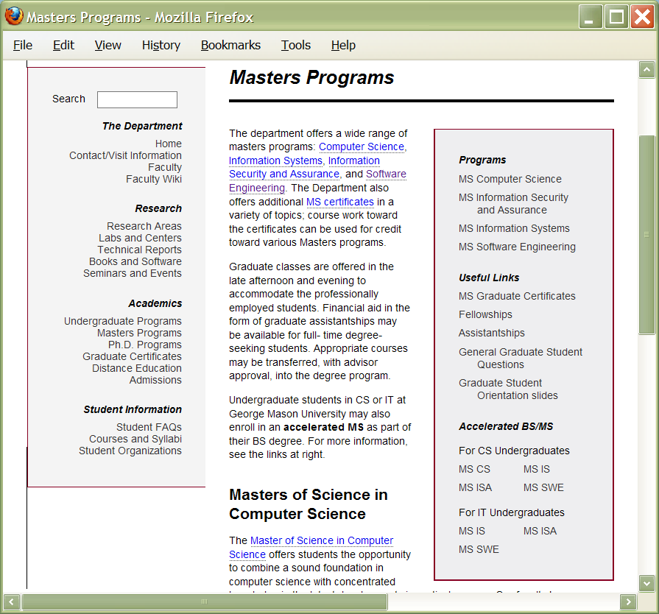
Persistent Navigation (2)
Persistent
sub-navigation

Slide 16
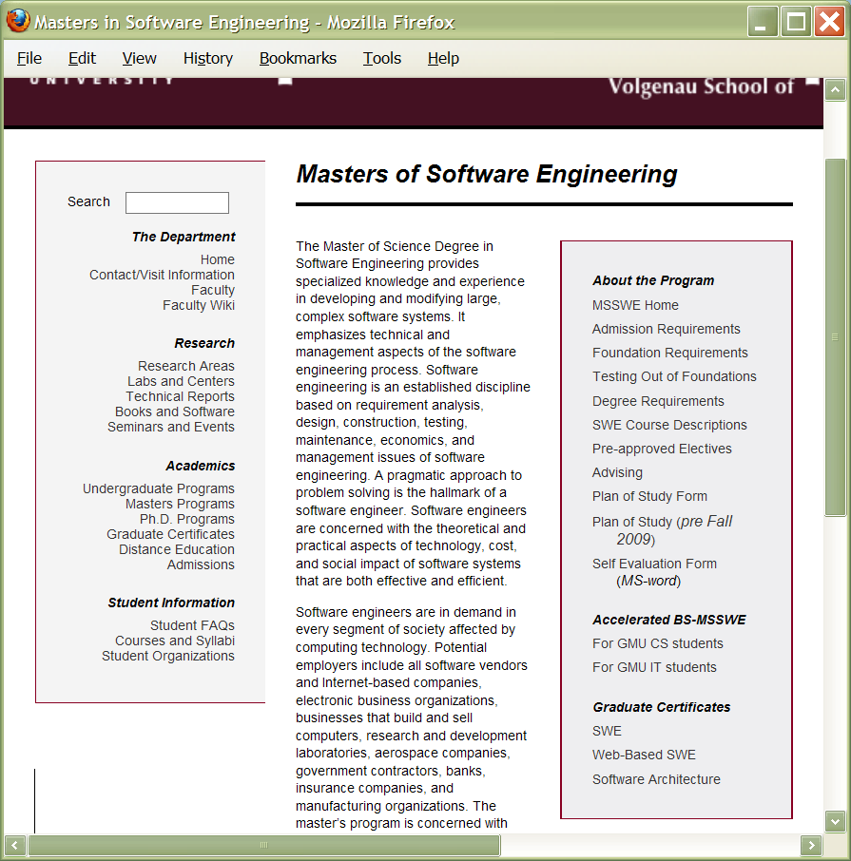
Persistent Navigation (3)
Another
persistent
sub-navigation

Slide 17
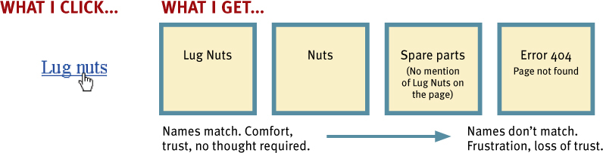
Page Names
Every page needs a name
It has to be in the right place
It has to be prominent
It has to match what I clicked

Slide 18
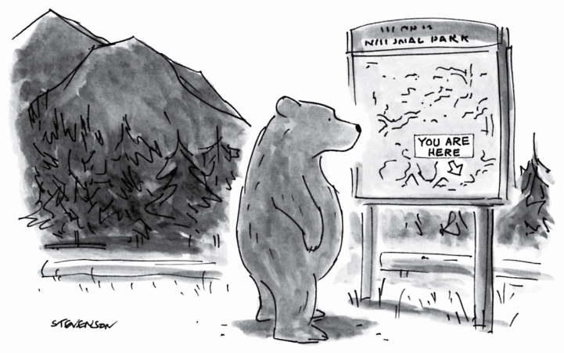
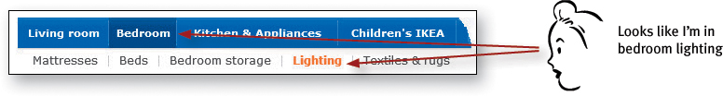
“You Are Here”
Users need to know where they are
Don’t be too subtle!

Slide 19
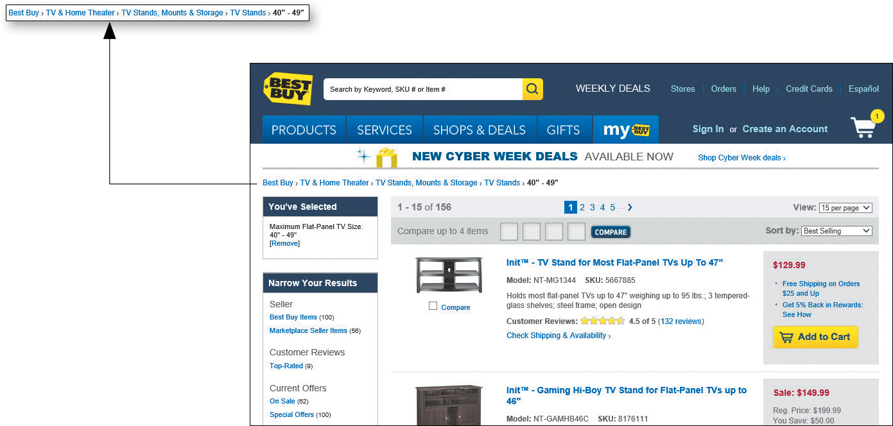
Breadcrumbs
Show the navigation path
Another implementation of “You are here”

Slide 20
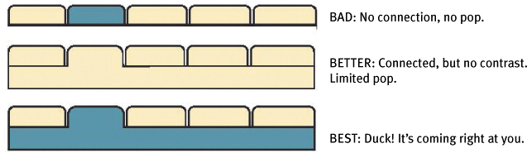
How Did We Live Without Tabs?
Self-evident
Hard to miss
Slick

Slide 21
Trunk Test
Choose a page at random
Hold it at “hard to see” range
As quickly as possible, locate and circle
Site ID
Page Name
Sections (Primary navigation)
Local Navigation
“You are here” indicators
Search

