Slide 1
Krug Chapter 9 Usability testing on 10 cents a day
Paul Ammann
https://www.cs.gmu.edu/~pammann/
SWE 205
Software Usability and Design

Slide 2
Topics
Why didn’t we do this sooner?
Usability testing vs. focus groups
Three facts about usability testing
Do-it-yourself usability testing
How to do it
Example
How to debrief

Slide 3
Why didn’t we do this sooner?
What everyone says at some point during the first usability test of their web site
Done two weeks before launch?
Disaster alert!
Done two months before launch?
Mechanism for settling internal design debates
Done as regular part of development process?
Good idea!
Process matters; Krug scales his recipe for typical web team

Slide 4
Usability testing vs. focus groups
Focus group
Small group (5-10) of people who sit around and talk
Answers the question: what does your audience want?
Usability test
Watching one person at a time try to actually do something specific
Answers the question: can your audience actually do what they want to do?
Often, it’s a surprise to developers that the answer is NO!

Slide 5
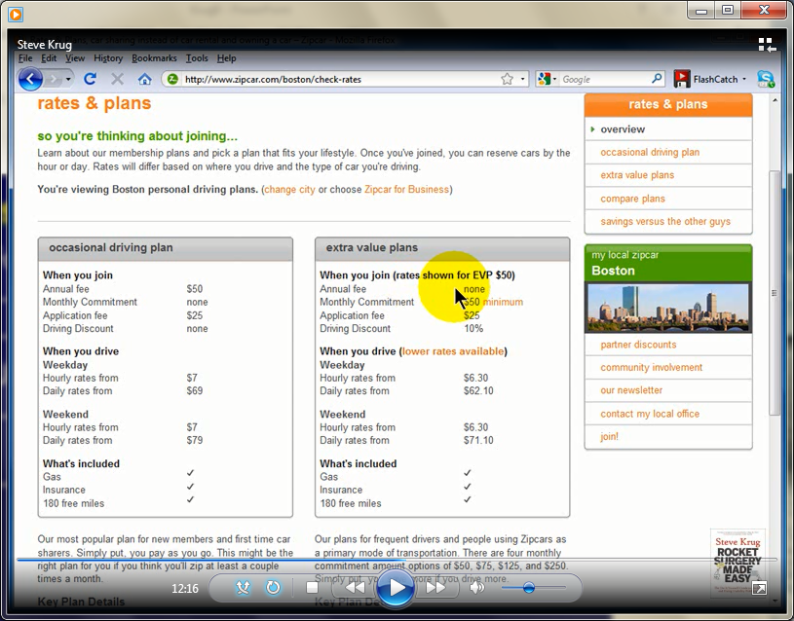
Example: Surprise to Developers
… I have no idea what that (EVP 50) means…

Slide 6
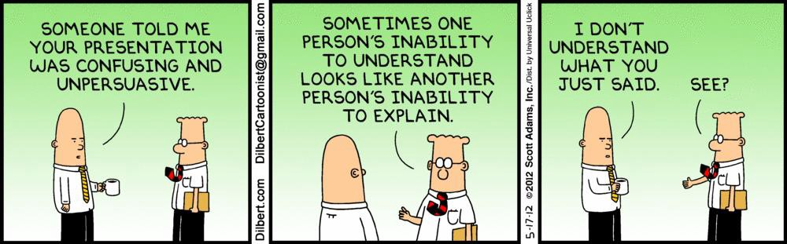
Three facts about usability testing
1) If you want a great site, you have to test
Developers simply know too much
It’s the “curse of knowledge”

Slide 7
Three facts about usability testing
2) Testing one user is 100 percent better than testing none
Even the worst test with the wrong user will reveal possible improvements to the site
3) Testing one user early in the project is better than testing 50 users near the end
You need to know the results in time to actually do something about them
Key focus: make testing cheap so that testing happens

Slide 8
Do-it-yourself usability testing
Traditional usability testing
Usability lab, professional staff, lots of participants, significance tests, lots of $$
Fact: in many organizations, this ain’t happening
Krug’s discount usability testing
Half a day per month
Not a lot of $$
Development team retains control
Trade off statistical significance for timely engineering feedback

Slide 9
How to do it
Often enough, but not too often
Krug recommends once a month.
What participants?
Recruit loosely and grade on a curve
Where? In your normal office space.
Who? Anyone on your staff can fill the roles.
What and when? As early as possible
Start with testing a competitor’s site!
No matter how good it is, it’s still broken somewhere
What tasks? What a typical user might do.

Slide 10
Example
Krug's demo test

Slide 11
How to debrief
Focus ruthlessly on fixing the most serious problems first
Collectively identify most serious problems that you actually plan to fix
Resist the impulse to add things (e.g. more instructions)
Be skeptical of new feature requests
Ignore “kayak” problems.

Slide 12
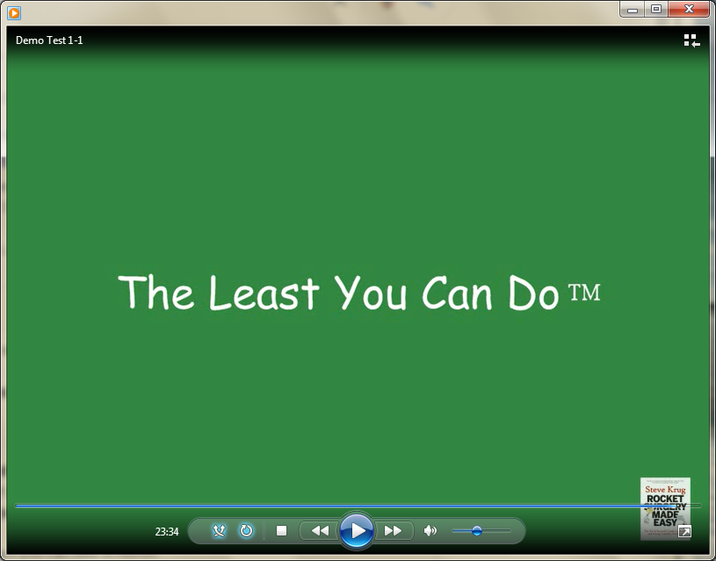
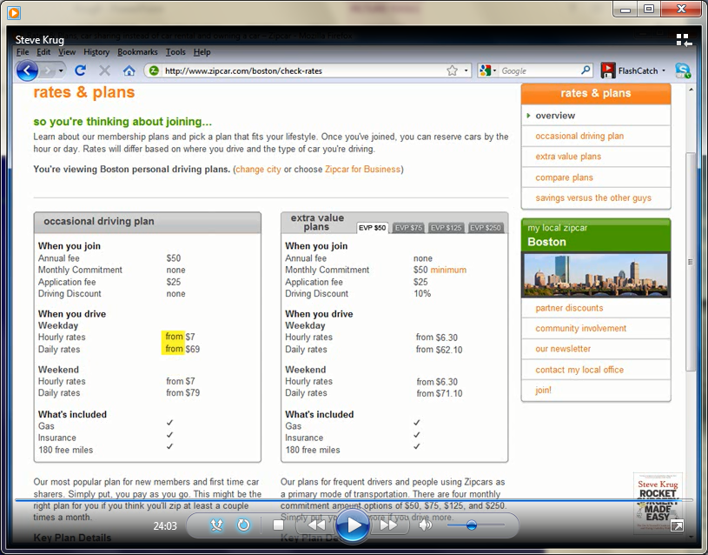
Tweaks vs. Complex Changes

Slide 13
Top 5 excuses
We don’t have the time
Usability testing will save time
We don’t have the money
Yes, you do. It’s noise level money
We don’t have the expertise
Yes, you do. Any developer can do this
We don’t have a usability lab
You don’t need one
We wouldn’t know how to interpret the results
The important lessons tend to be obvious

