Slide 1
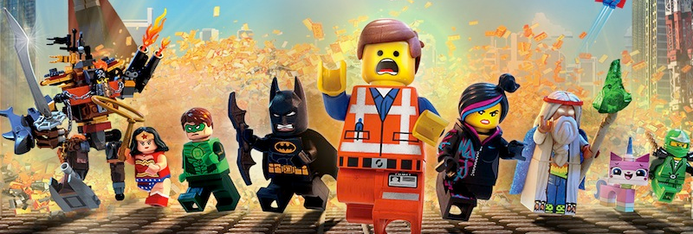
Programming Languages
Topic of Ultimate Mastery
Wes Weimer
CS 6610
http://www.cs.virginia.edu/~weimer/6610

Slide 2
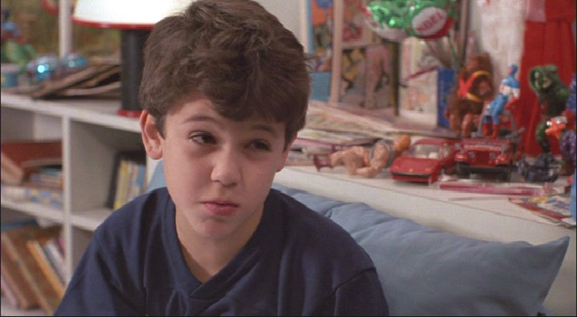
Reasonable Initial Skepticism

Slide 3
Today’s Class
Vague Historical Context
Goals For This Course
Requirements and Grading
Course Summary
Convince you that PL is useful

Slide 4
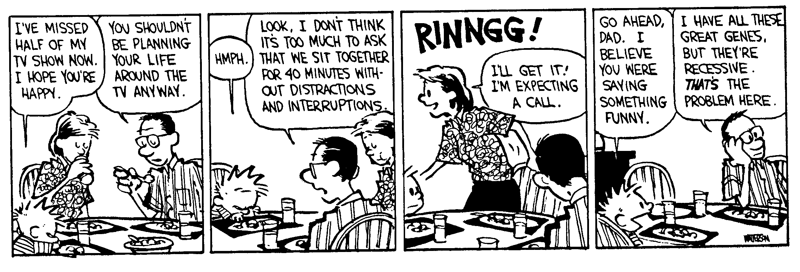
Meta-Level Information
Please interrupt at any time!
Completely cromulent queries:
  I don’t understand: please say it another way.
  Slow down, you talk too fast!
  Wait, I want to read that!
  I didn’t get joke X, please explain.

Slide 5
What Have You Done For Us Lately?
Isn’t PL a solved problem?
  PL is an old field within Computer Science
  1920’s: “computer” = “person”
  1936: Church’s Lambda Calculus (= PL!)
  1937: Shannon’s digital circuit design
  1940’s: first digital computers
  1950’s: FORTRAN (= PL!)
  1958: LISP (= PL!)
  1960’s: Unix
  1972: C Programming Language
  1981: TCP/IP
  1985: Microsoft Windows
  1992: Ultima Underworld / Wolfenstein 3D
“… a prestigious line of
work with a long and
glorious tradition.” - Vizzini

Slide 6
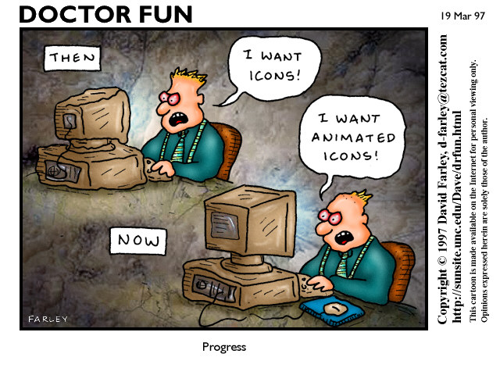
Don’t We Already Have Compilers?

Slide 7
Dismal View Of PL Research
C++
Java
or C#

Slide 8
Parts of Computer Science
CS = (Math £ Logic) + Engineering
  Science (from Latin scientia - knowledge) refers to a system of acquiring knowledge - based on empiricism, experimentation, and methodological naturalism - aimed at finding out the truth.
We rarely actually do this in CS
  “CS theory” = Math (logic)
  “Systems” = Engineering (bridge building)

Slide 9
Programming Languages
Best of both worlds: Theory and Practice!
  Only pure CS theory is more primal
Touches most other CS areas
  Theory: DFAs, PDAs, TMs, language theory (e.g., LALR)
  Systems: system calls, assembler, memory management
  Arch: compiler targets, optimizations, stack frames
  Numerics: FORTRAN, IEEE FP, Matlab, loop nest optim.
  AI: theorem proving, machine learning, search
  DB: SQL, persistent objects, modern linkers
  Networking: packet filters, protocols, even Ruby on Rails
  Graphics: OpenGL, LaTeX, PostScript, even Logo (= LISP)
  Security: buffer overruns, .net, bytecode, PCC, …
  Software Engineering: bug finding, refactoring, types, ...

Slide 10
Overarching Theme
I assert (and shall convince you) that
PL is one of the most vibrant and active areas of CS research today
  It has theoretical and practical meatiness
  It intersects most other CS areas
You will be able to use PL techniques in your own projects

Slide 11
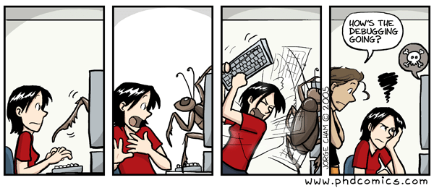
Goal #1
Learn to use advanced PL techniques

Slide 12
Useful Complex Knowledge
A proof of the fundamental theorem of calculus
A proof of the max-flow min-cut theorem
Nifty Tree node insertion (e.g., B-Trees, AVL, Red-Black)
The code for the Fast Fourier Transform
And so on …

Slide 13
No Useless Memorization
I will not waste your time with useless memorization
This course will cover complex subjects
I will teach their details to help you understand them the first time
But you will never have to memorize anything low-level
Rather, learn to apply broad concepts

Slide 14
Goal #2
When (not if) you design a language, it will avoid the mistakes of the past and you’ll be able to describe it formally

Slide 15
Story: The Clash of Two Features
Real story about bad programming language design
Cast includes famous scientists
ML (’82) is a functional language with polymorphism and monomorphic references (i.e. pointers)
Standard ML (’85) innovates by adding polymorphic reference
It took 10 years to fix the “innovation”

Slide 16
Polymorphism (Informal)
Code that works uniformly on various types of data
Examples of function signatures:
length : α list → int (takes an argument of type “list of α”, returns an integer, for any type α)
head : α list → α
Type inference:
  generalize all elements of the input type that are not used by the computation

Slide 17
References in Standard ML
Like “updatable pointers” in C
Type constructor: ptr τ
  x : ptr int === “x is a pointer to an integer”
Expressions:
alloc : τ → ptr τ (allocate a cell to store a τ)
*e : τ when e : ptr τ (read through a pointer)
*e1 := e2 with e1 : ptr τ and e2 : τ
(write through a pointer)
Works just as you might expect ...

Slide 18
Polymorphic References:
A Major Pain
Consider the following program fragment:
Code
fun id(x) = x
val c = alloc id
print (*c) (“hi”)
print (*c) (5)

Slide 19
Polymorphic References:
A Major Pain
Consider the following program fragment:
Code
fun id(x) = x
val c = alloc id
fun inc(x) = x + 1
*c := inc
print (*c) (6)

Slide 20
Polymorphic References:
A Major Pain
Consider the following program fragment:
Code
fun id(x) = x
val c = alloc id
fun inc(x) = x + 1
*c := inc
(*c) (“hi”)

Slide 21
Polymorphic References:
A Major Pain
Consider the following program fragment:
Code Type inference
fun id(x) = x id : α → α (for any α)
val c = alloc id c : ptr (α → α) (for any α)
fun inc(x) = x + 1 inc : int → int
*c := inc Ok, since c : ptr (int → int)
(*c) (“hi”) Ok, c : ptr (string → string)

Slide 22
Reconciling Polymorphism and References
Type system fails to prevent a type error!
Common solution:
  value restriction: generalize only the type of values!
    easy to use, simple proof of soundness
X Features ) X² Complication
To see what went wrong we needed to understand semantics, type systems, polymorphism and references

Slide 23
Story 2: Java Bytecode Subroutines
Java bytecode programs contain subroutines (jsr) that run in the caller’s stack frame (why?)
jsr complicates the formal semantics of bytecodes
  Several verifier bugs were in code implementing jsr
  30% of typing rules, 50% of soundness proof due to jsr
It is not worth it:
  In 650K lines of Java code, 230 subroutines, saving 2427 bytes, or 0.02%
  13 times more space could be saved by renaming the language back to Oak
    [In 1994], the language was renamed “Java” after a trademark search revealed that the name “Oak” was used by a manufacturer of video adapter cards.

Slide 24
Recall Goal #2
When (not if) you design a language, it will avoid the mistakes of the past and you’ll be able to describe it formally

Slide 25
Goal #3
Understand current PL research (PLDI, POPL, OOPSLA, TOPLAS, …) and technology transfer (MS, Intel, ...)

Slide 26
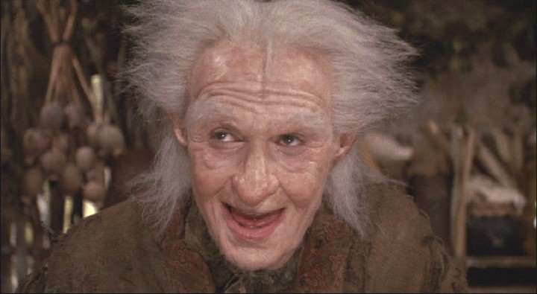
Final Goal: Fun

Slide 27
Q: Books (730 / 842)
This 1960 Daniel Keyes sci-fi novel is told as a "progris riport" from the point-of-view of Charlie Gordon as he takes an experimental intelligence-enhancing treatment. The treatment is temporary. The book won the Hugo and Nebula awards.

Slide 28
Q: Computer Science
This Sri Lanka-born, British computer scientist is best known for his development of QuickSort, a logic for verifying program correctness, the monitor approach to mutual exclusion, and the formalism of Communicating Sequential Processes. In 2009 he apologized for inventing the null reference:
  I call it my billion-dollar mistake. It was the invention of the null reference in 1965. At that time, I was designing the first comprehensive type system for references in an object oriented language (ALGOL W). My goal was to ensure that all use of references should be absolutely safe, with checking performed automatically by the compiler. But I couldn't resist the temptation to put in a null reference, simply because it was so easy to implement. This has led to innumerable errors, vulnerabilities, and system crashes, which have probably caused a billion dollars of pain and damage in the last forty years.

Slide 29
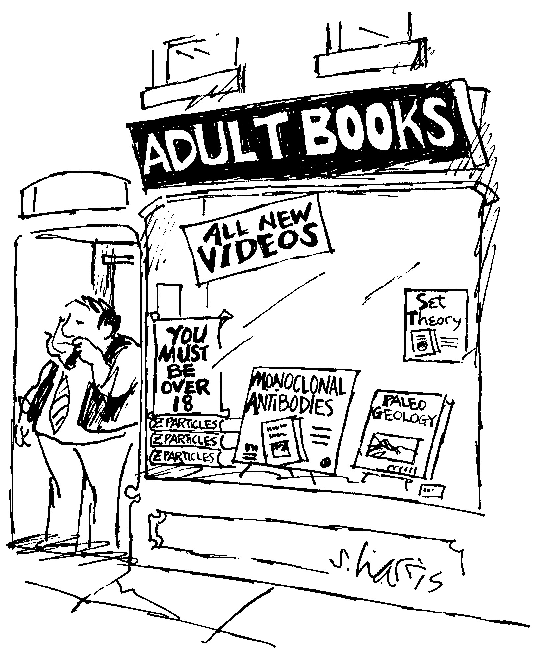
Prerequisites
Undergraduate PL/compilers course?
  No
“Mathematical maturity”

Slide 30
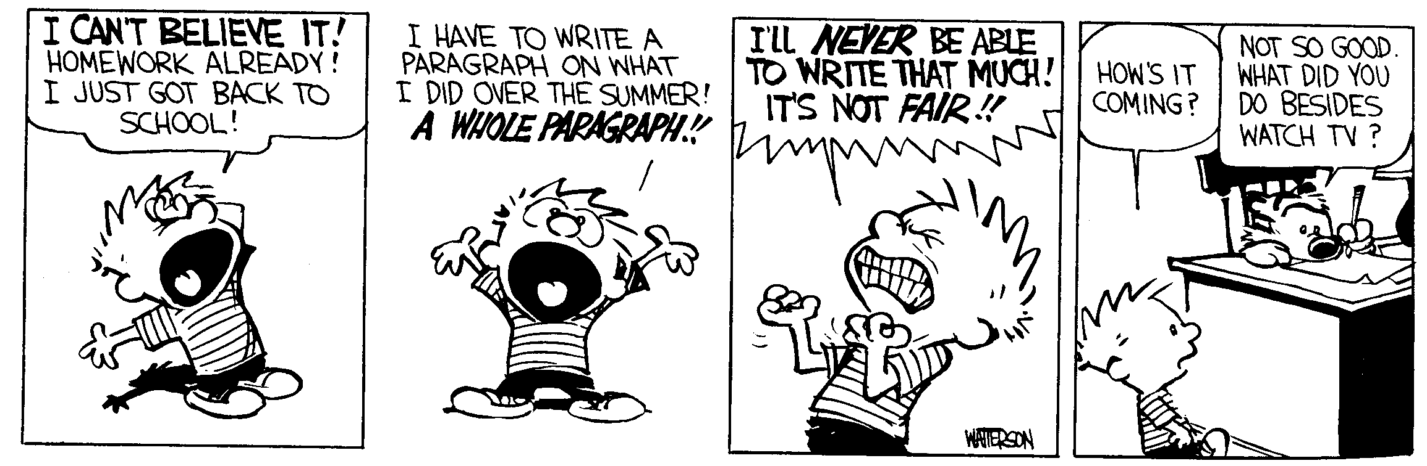
Assignments
Short Homework Assignments (5)
Long Homework Assignment (1)
Daily Reading (1-2 papers per class)
Final Project

Slide 31
Homework Problem Sets
Some material can be “mathy”
Much like Calculus, practice is handy
Short: ~3 theory + 1 coding per HW
You have one week to do each one
  Usually available in advance ...
Long: analysis of real C programs
NB: I will offer suggestions and comments on your English prose.

Slide 32
Final Project
Literature survey, implementation project, or research project
Write a 5-page paper (akin to PLDI)
Give a ~10 minute presentation
On the topic of your choice
  I will help you find a topic (many examples)
  Best: integrate PL with your current research

Slide 33
Reading Quizzes: Let's Vote!
A key problem:
  If I never check, graduate students will not do the reading.
A related desire:
  Graduate students often wish that someone would make them do the reading.
Proposal:
  “One Word” reading quizzes

Slide 34
Piazza Forum
Ask questions about assignments
Compare concerns about papers
Votes
  Alternate opt-in grading contract: you are not responsible for homeworks or reading quizzes, only the final project, but your highest possible grade is an A- or B+

Slide 35
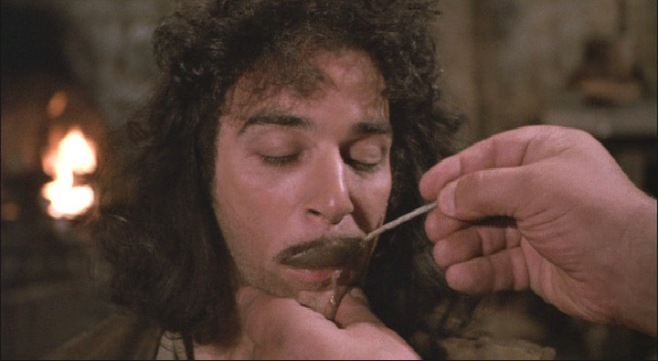
How Hard Is This Class?

Slide 36
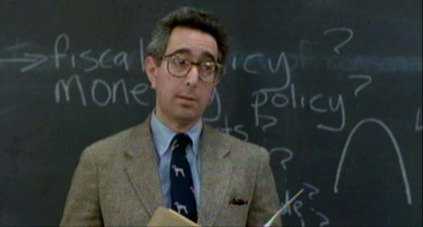
This Shall Be Avoided
In 1930, the Republican-controlled House of Representatives, in an effort to alleviate the effects of the... Anyone? Anyone? ... the Great Depression, passed the ... Anyone? Anyone? The tariff bill? The Hawley-Smoot Tariff Act? Which, anyone? Raised or lowered? ... raised tariffs, in an effort to collect more revenue for the federal government. Did it work? Anyone? Anyone know the effects?
Notes:
It did not work, and the United States sank deeper into the Great Depression.

Slide 37
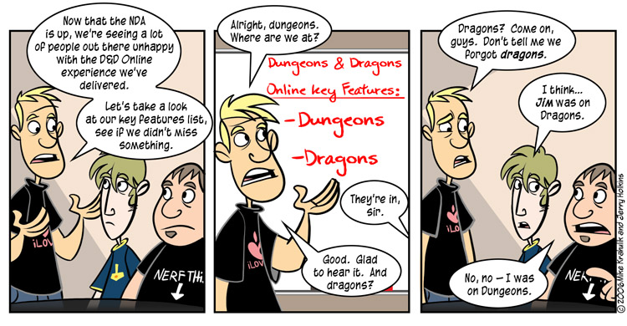
Key Features of PL

Slide 38
Programs and Languages
Programs
  What are they trying to do?
  Are they doing it?
  Are they making some other mistake?
  Were they hard to write?
  Could we make it easier?
  Should you run them?
  How should you run them?
  How can I run them faster?

Slide 39
Programs and Languages
Languages
  Why are they annoying?
  How could we make them better?
  What tasks can they make easier?
  What cool features might we add?
  Can we stop mistakes before they happen?
  Do we need new paradigms?
  How can we help out My Favorite Domain?

Slide 40
Common PL Research Tasks
Design a new language feature
Design a new type system / checker
Design a new program analysis
Find bugs in programs
(Help people to) Fix bugs in programs
Transform programs (source or assembly)
Interpret and execute programs
Prove things about programs
Optimize programs

Slide 41
Grand Unified Theory
Design a new type system
Your type-checker becomes a bug-finder
  No type errors ) proof that program is safe
  Type error ) bug may exist in program
    Fault localization and automated program repair
Design a new language feature
  To prevent the sort of mistakes you found
Write a source-to-source transform
  Your new feature now works on existing code

Slide 42
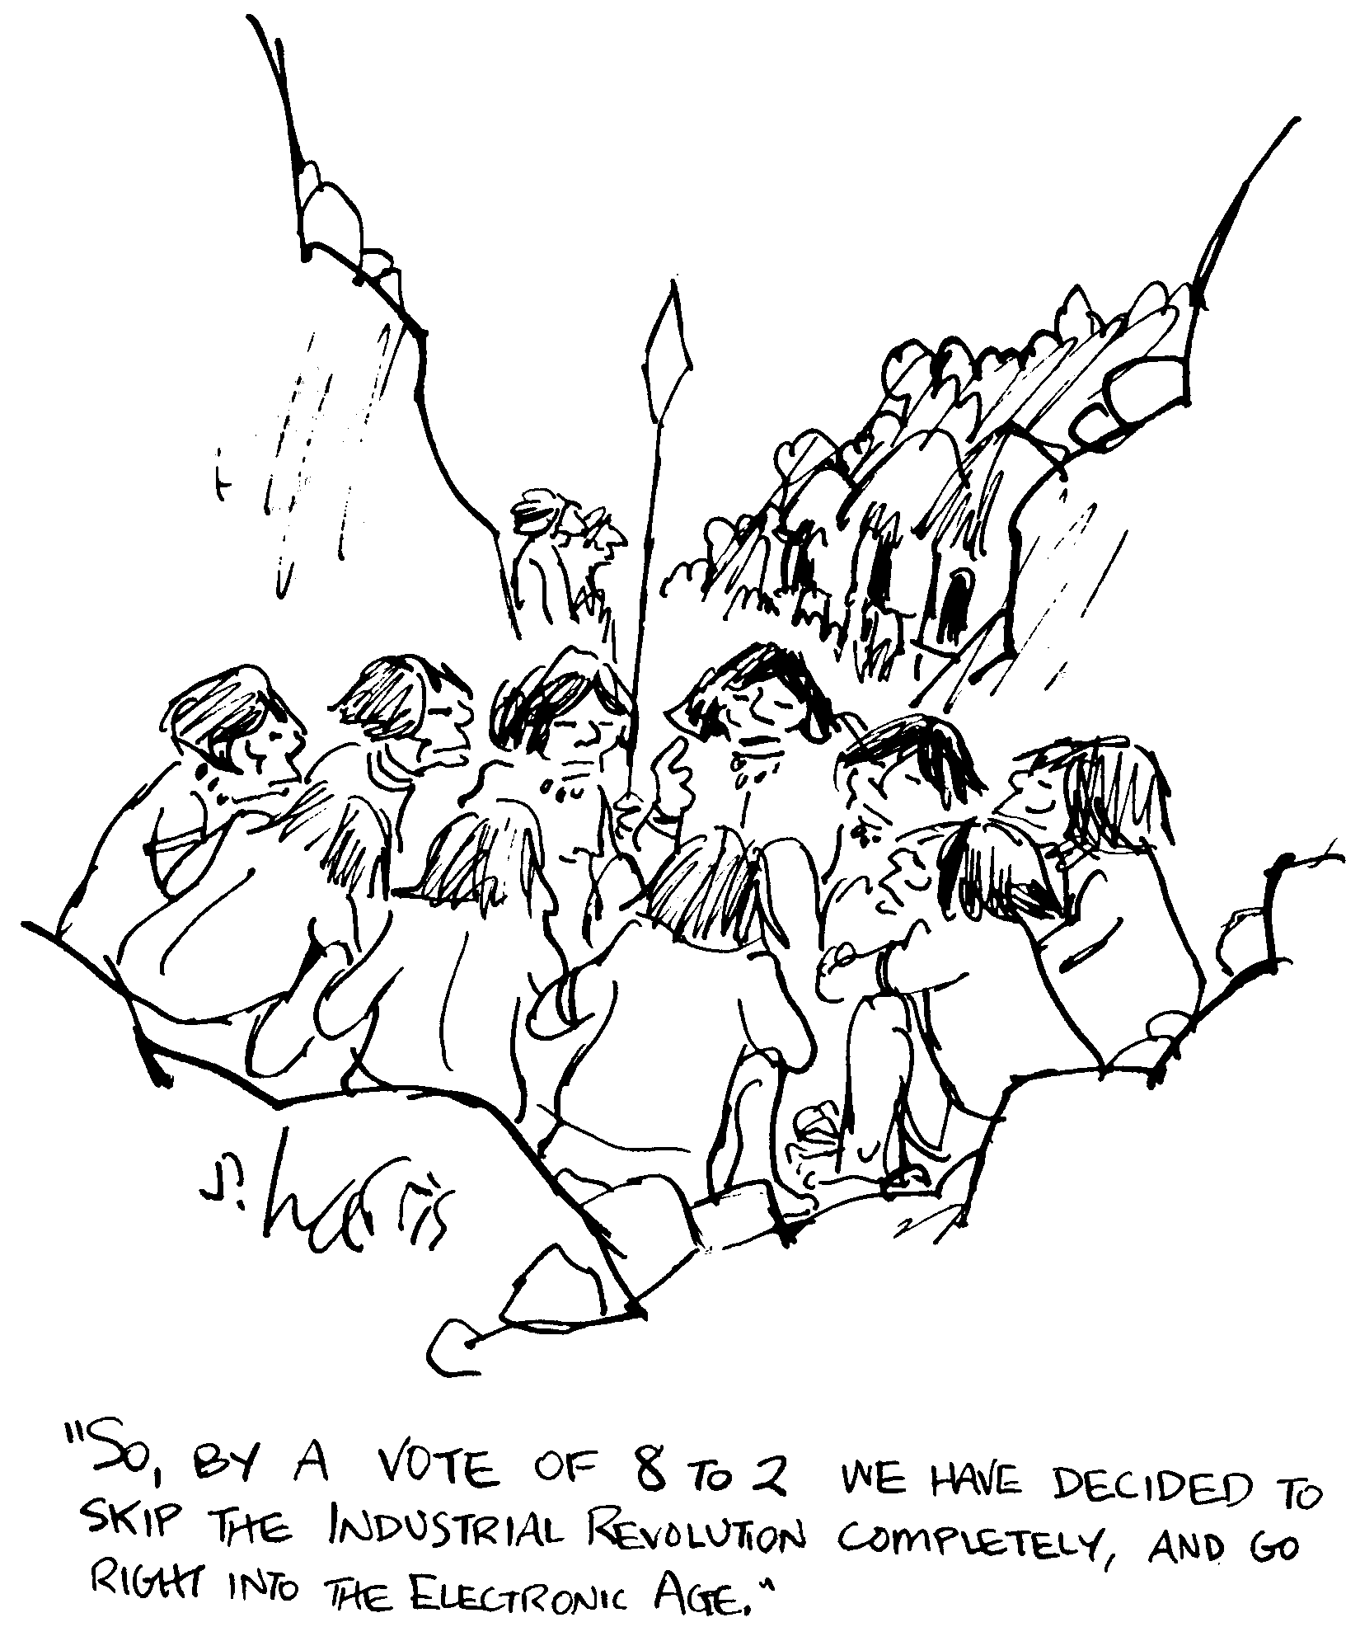
CS 6610 - Core Topics
Model Checking
Operational semantics
Provers and proofs
Type theory
Verification conditions
Symbolic Execution
Invariant Detection
Abstract interpretation
Machine Learning
Lambda Calculus

Slide 43
Special Topics
Communications and Concurrency
Fault Localization, Bug Isolation
Automated Program Repair
What do you want to hear about?

Slide 44
Weimer's Research Group
I am looking to pick up 0 or 1 new grads
  Only students who plan to get a PhD
  I have plenty of unspent funding
Take Grad PL and do well (impress me)
Pick an ambitious semester project
Expectations: 1-2 new submissions / year
  Kinga: 1 journal + 5 conf + PhD in 4 years, now professor at GMU
  Ray: 1 journal + 8 conf (1 best paper) + research internship + grant in 6 years, now at Google
  Pieter: 2 journal + 9 conf (1 best paper) + 3 research internships in 6 years, now at Facebook
  Claire: 4 journal + 7 conf (3 best papers) + research internship in 6 years, now a professor at CMU

Slide 45
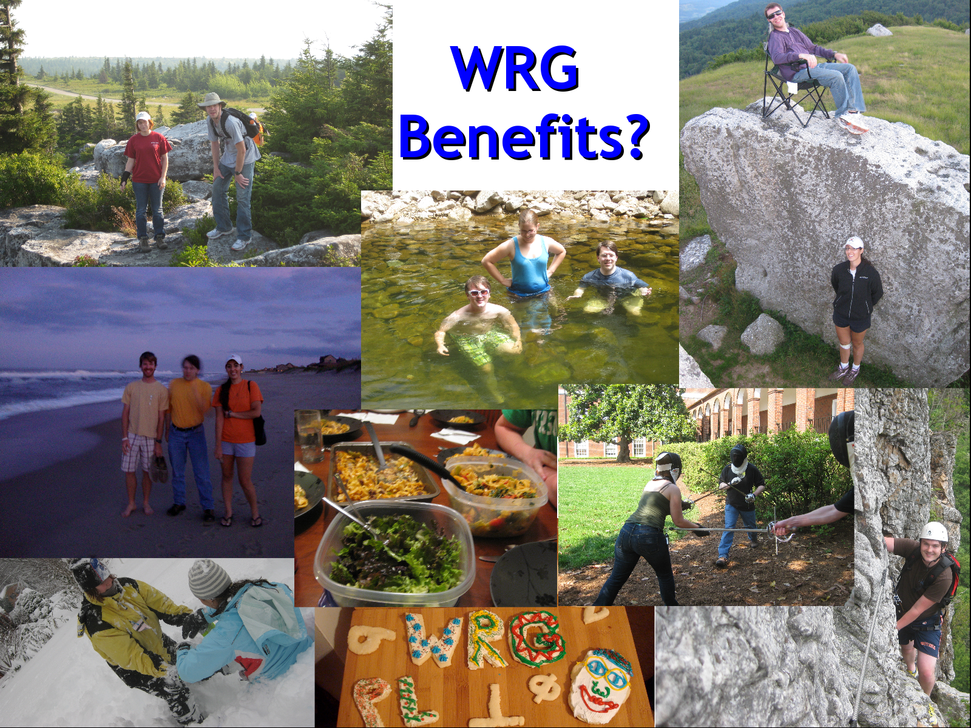

Slide 46
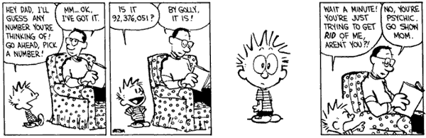
First Topic: Model Checking
Verify critical properties of software or find bugs
Take an important program (e.g., a device driver)
Merge it with a property (e.g., no deadlocks, asynchronous IRP handling, BSD sockets, database transactions, …)
Transform the result into a boolean program
  Same control flow, but only boolean variables
Use a model checker to explore the resulting state space
  Result 1: program provably satisfies property
  Result 2: program violates property right here on line 92,376!

Slide 47
Example Program
Example ( ) {
do{
lock();
old = new;
q = q->next;
if (q != NULL){
q->data = new;
unlock();
new ++;
}
} while(new != old);
unlock();
return;
}
Is this program correct?

Slide 48
Example Program
Example ( ) {
do{
lock();
old = new;
q = q->next;
if (q != NULL){
q->data = new;
unlock();
new ++;
}
} while(new != old);
unlock();
return;
}
Is this program correct?
What does correct mean?
Doing no evil?
Doing some good?
How do we determine if a program is correct?

Slide 49
Verification by Model Checking
Example ( ) {
1: do{
lock();
old = new;
q = q->next;
2: if (q != NULL){
3: q->data = new;
unlock();
new ++;
}
4: } while(new != old);
5: unlock();
return;
}
1. (Finite State) Program
2. State Transition Graph
3. Reachability
- Pgm ! Finite state model
State explosion
+ State Exploration
+ Counterexamples
[SPIN, SMV, Bandera, JPF ]
Precise

Slide 50
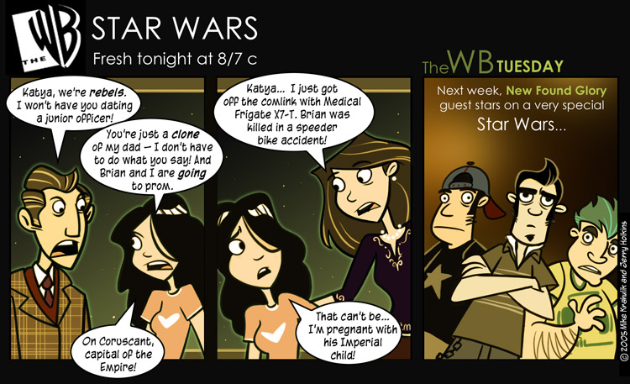
For Our Next Exciting Episode
See webpage under “Lectures”
Read the two articles
Peruse the HW and Project pages

