Slide 1
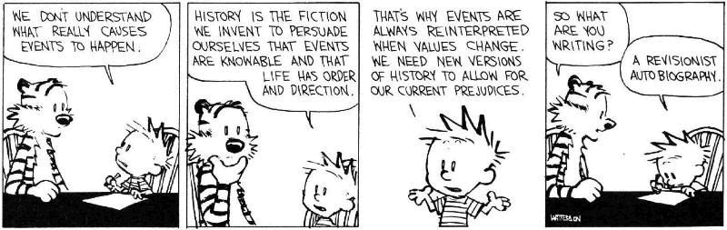
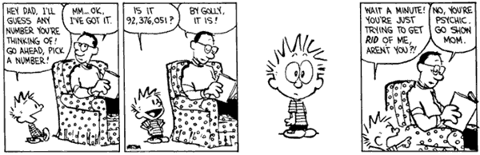
Model Checking

Slide 2
Double Header
Two Lectures
  Model Checking
  Software Model Checking
  SLAM and BLAST
“Flying Boxes”
  It is traditional to describe this stuff (especially SLAM and BLAST) with high-gloss animation.
Some Key Players:
  Model Checking: Ed Clarke, Ken McMillan, Amir Pnueli
  SLAM: Tom Ball, Sriram Rajamani
  BLAST: Ranjit Jhala, Rupak Majumdar, Tom Henzinger

Slide 3
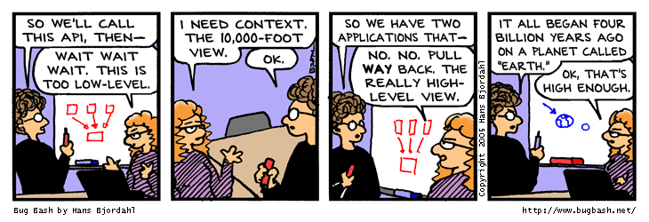
Who are we again?
We're going to find critical bugs in important bits of software
  using PL techniques!
You will be enthusiastic about this
  and thus want to learn the gritty details

Slide 4
Take-Home Message
Model checking is the exhaustive exploration of the state space of a system, typically to see if an error state is reachable. It produces concrete counter-examples.
The state explosion problem refers to the large number of states in the model.
Temporal logic allows you to specify properties with concepts like “eventually” and “always”.

Slide 5
Overarching Plan
Model Checking (Today)
  Transition Systems (Models)
  Temporal Properties
  LTL and CTL
  (Explicit State) Model Checking
  Symbolic Model Checking
Counterexample Guided Abstraction Refinement
  Safety Properties
  Predicate Abstraction (“c2bp”)
  Software Model Checking (“bebop”)
  Counterexample Feasibility (“newton”, “hw 5”)
  Abstraction Refinement (weakest pre, thrm prvr)

Slide 6
Spoiler Space
This stuff really works!
Symbolic Model Checking is a massive success in the model-checking field
  I know people who think Ken McMillan walks on water in a “ha-ha-ha only serious” way
SLAM took the PL world by storm
  Spawned multiple copycat projects
  Incorporated into Windows DDK as “static driver verifier”

Slide 7
Topic:
(Generic) Model Checking
There are complete courses in model checking; I will skim.
  Model Checking by Edmund C. Clarke, Orna Grumberg, and Doron A. Peled, MIT press
  Symbolic Model Checking by Ken McMillan

Slide 8
Model Checking
Model checking is an automated technique
Model checking verifies transition systems
Model checking verifies temporal properties
Model checking can be also used for falsification by generating counter-examples
Model Checker: A program that checks if a (transition) system satisfies a (temporal) property

Slide 9
Verification vs. Falsification
An automated verification tool
  can report that the system is verified (with a proof)
  or that the system was not verified (with ???)
When the system was not verified it would be helpful to explain why
  Model checkers can output an error counter-example: a concrete execution scenario that demonstrates the error
Can view a model checker as a falsification tool
  The main goal is to find bugs
OK, so what can we verify or falsify?

Slide 10
Temporal Properties
Temporal Property: A property with time-related operators such as “invariant” or “eventually”
Invariant(p): is true in a state if property p is true in every state on all execution paths starting at that state
  The Invariant operator has different names in different temporal logics:
    G, AG, ¤ (“goal” or “box” or “forall”)
Eventually(p): is true in a state if property p is true at some state on every execution path starting from that state
    F, AF, } (“diamond” or “future” or “exists”)

Slide 11
An Example Concurrent Program
A simple concurrent mutual exclusion program
Two processes execute asynchronously
There is a shared variable turn
Two processes use the shared variable to ensure that they are not in the critical section at the same time
Can be viewed as a “fundamental” program: any bigger concurrent one would include this one
10: while True do
11: wait(turn = 0);
// critical section
12: work(); turn := 1;
13: end while;
|| // concurrently with
20: while True do
21: wait(turn = 1);
// critical section
22: work(); turn := 0;
23: end while

Slide 12
Reachable States of the Example Program
Next: formalize
this intuition …
t=0
10,20
t=1
10,20
t=0
10,21
t=0
11,20
t=1
10,21
t=1
11,20
t=0
11,21
t=0
12,20
t=1
10,22
t=1
11,21
t=0
12,21
t=1
11,22
Each state is a valuation
of all the variables:
turn and the two program
counters for two processes

Slide 13
Transition Systems
In model checking the system being analyzed is represented as a labeled transition system
T = (S, I, R, L)
  Also called a Kripke Structure
  S = Set of states // standard FSM
  I ⊆ S = Set of initial states // standard FSM
  R ⊆ S × S = Transition relation // standard FSM
  L: S → P(AP) = Labeling function // this is new!
AP: Set of atomic propositions (e.g., “x=5”2AP)
  Atomic propositions capture basic properties
  For software, atomic props depend on variable values
  The labeling function labels each state with the set of propositions true in that state

Slide 14

What's in a Label?
We must decide in advance which facts are important.
We can have “x=5” or “x=6” but not “x”.
Similarly for relations (e.g., “x<y”, “x<z”).

Slide 15
Properties of the Program
Example: “In all the reachable states (configurations) of the system, the two processes are never in the critical section at the same time”
  Equivalently, we can say that
    Invariant(¬(pc1=12 ∧ pc2=22))
Also: “Eventually the first process enters the critical section”
    Eventually(pc1=12)
“pc1=12”, “pc2=22” are atomic properties

Slide 16
Temporal Logics
There are four basic temporal operators:
X p = Next p, p holds in the next state
G p = Globally p, p holds in every state, p is an invariant
F p = Future p, p will hold in a future state, p holds eventually
p U q = p Until q, assertion p will hold until q holds
Precise meaning of these temporal operators are defined on execution paths

Slide 17
Execution Paths
A path in a transition system is an infinite sequence of states
(s₀, s₁, s₂, ...), such that 8i≥0. (s_{i}, s_{i+1}) ∈ R
A path (s₀, s₁, s₂, ...) is an execution path if s₀ ∈ I
Given a path x = (s₀, s₁, s₂, ...)
  x_{i} denotes the i^{th} state s_{i}
  x^{i} denotes the i^{th} suffix (s_{i}, s_{i+1}, s_{i+2}, ...)
In some temporal logics one can quantify the paths starting from a state using path quantifiers
  A : for all paths
  E : there exists a path

Slide 18

Being Judgmental
We write
x ² p
“the path x makes the predicate p true”
  x is a path in a transition system
  p is a temporal logic predicate
Example:
A x. x ² G (¬(pc1=12 ∧ pc2=22))

Slide 19
Linear Time Logic (LTL)
LTL properties are constructed from atomic propositions in AP; logical operators ∧, ∨, ¬; and temporal operators X, G, F, U.
The semantics of LTL properties is defined on paths:
Given a path x:
x ² p iff L(x₀, p) // atomic prop
x ² X p iff x¹ ² p // next
x ² F p iff 9i≥0. x^{i} ² p // future
x ² G p iff 8i≥0. x^{i} ² p // globally
x ² p U q iff 9i≥0. x^{i} ² q and 8j<i. x^{j} ² p // until

Slide 20
Satisfying Linear Time Logic
Given a transition system T = (S, I, R, L) and an LTL property p, T satisfies p if all paths starting from all initial states I satisfy p
Example LTL formulas:
  Invariant(¬(pc1=12 ∧ pc2=22)):
G(¬(pc1=12 ∧ pc2=22))
  Eventually(pc1=12):
F(pc1=12)

Slide 21
Computation Tree Logic (CTL)
In CTL temporal properties use path quantifiers
  A : for all paths
  E : there exists a path
The semantics of CTL properties is defined on states:
Given a path x
s ² p iff L(s, p)
s₀ ² EX p iff 9 a path (s₀, s₁, s₂, ...). s₁ ² p
s₀ ² AX p iff 8 paths (s₀, s₁, s₂, ...). s₁ ² p
s₀ ² EG p iff 9 a path (s₀, s₁, s₂, ...). 8i≥0. s_{i} ² p
s₀ ² AG p iff 8 paths (s₀, s₁, s₂, ...). 8i≥0. s_{i} ² p

Slide 22
Linear vs. Branching Time
LTL is a linear time logic
  When determining if a path satisfies an LTL formula we are only concerned with a single path
CTL is a branching time logic
  When determining if a state satisfies a CTL formula we are concerned with multiple paths
  In CTL the computation is not viewed as a single path but as a computation tree which contains all the paths
  The computation tree is obtained by unrolling the transition relation
The expressive powers of CTL and LTL are incomparable (LTL µ CTL*, CTL µ CTL*)
  Basic temporal properties can be expressed in both logics
  Not in this lecture, sorry! (Take a class on Modal Logics)

Slide 23
Remember the Example
t=0
10,20
t=1
10,20
t=0
10,21
t=0
11,20
t=1
10,21
t=1
11,20
t=0
11,21
t=0
12,20
t=1
10,22
t=1
11,21
t=0
12,21
t=1
11,22
This is a labeled transition system.

Slide 24
Linear vs. Branching Time
One path starting at state
(turn=0,pc1=10,pc2=20)
t=0
10,20
Linear Time
View
Branching Time
View
A computation tree
starting at state
(turn=0,pc1=10,pc2=20)
t=0
10,20
t=0
10,21
t=0
10,21
t=0
11,20
t=0
10,21
t=0
11,21
t=0
10,21
t=0
11,21
t=0
11,21
t=0
12,20
.
.
.
.
.
.
.
.
.
t=0
11,21
t=0
12,21
t=1
10,20
t=0
12,21
.
.
.
.
.
.
t=1
10,21
.
.
.

Slide 25
LTL Satisfiability Examples
p does not hold
p holds
. . .
On this path: F p holds, G p does not hold, p does not hold,
X p does not hold, X (X p) holds, X (X (X p)) does not hold
. . .
On this path: F p holds, G p holds, p holds,
X p holds, X (X p) holds, X (X (X p))) holds

Slide 26
CTL Examples
p does not hold
p holds
s
s
s
.
.
.
.
.
.
.
.
.
.
.
.
.
.
.
.
.
.
.
.
.
.
.
.
.
.
.
.
.
.
.
.
.
.
.
.
At state s:
EF p, EX (EX p),
AF (¬p), ¬p holds
AF p, AG p,
AG (¬p), EX p,
EG p, p does not hold
At state s:
EF p, AF p,
EX (EX p),
EX p, EG p, p holds
AG p, AG (¬p),
AF (¬p) does not hold
At state s:
EF p, AF p,
AG p, EG p,
Ex p, AX p, p holds
EG (¬ p), EF (¬p),
does not hold

Slide 27
Q: General (468 / 842)
This country's automobile stickers use the abbreviation CH (Confederatio Helvetica). The 1957 Max Miedinger typeface Helvetica is also named for this country.

Slide 28
Q: Computer Science
This American computer scientist won the Turing Award for granular database locking and two-tier transaction commit semantics. He was reported missing while sailing in 2007.

Slide 29
Model Checking Complexity
Given a transition system T = (S, I, R, L) and a CTL formula f
  One can check if a state of the transition system satisfies the temporal logic formula f in O(|f| × (|S| + |R|)) time
Given a transition system T = (S, I, R, L) and an LTL formula f
  One can check if the transition system satisfies the temporal logic formula f in O(2^{|f|} × (|S| + |R|)) time
Model checking procedures can generate counter-examples without increasing the complexity of verification (= “for free”)

Slide 30

Which is slower?

Slide 31

State Space Explosion
The complexity of model checking increases linearly with respect to the size of the transition system (|S| + |R|)
However, the size of the transition system (|S| + |R|) is exponential in the number of variables and number of concurrent processes
This exponential increase in the state space is called the state space explosion
  Dealing with it is one of the major challenges in model checking research

Slide 32
Explicit-State Model Checking
One can show the complexity results using depth first search algorithms
  The transition system is a directed graph
  CTL model checking is multiple depth first searches (one for each temporal operator)
  LTL model checking is one nested depth first search (i.e., two interleaved depth-first-searches)
  Such algorithms are called explicit-state model checking algorithms (details on next slides)

Slide 33
Temporal Properties ≡ Fixpoints
States that satisfy AG(p) are all the states which are not in EF(¬p) (= the states that can reach ¬p)
Compute EF(¬p) as the fixpoint of Func: 2^{S} → 2^{S}
Given Z µ S,
  Func(Z) = ¬p ∪ reach-in-one-step(Z)
  or Func(Z) = ¬p ∪ EX(Z)
Actually, EF(¬p) is the least-fixpoint of Func
  smallest set Z such that Z = Func(Z)
  to compute the least fixpoint, start the iteration from Z=∅, and apply the Func until you reach a fixpoint
  This can be computed (unlike most other fixpoints)
This is called the
inverse image of Z

Slide 34
Pictoral Backward Fixpoint
Inverse Image of ¬p = EX(¬p)
Initial
states
• • •
¬p
initial states that violate AG(p)
= initial states that satisfy EF(¬p)
states that can reach ¬p = EF(¬p)
= states that violate AG(p)
This fixpoint computation can be used for:
verification of EF(¬p)
or falsification of AG(p)
… and a similar forward fixpoint handles the other cases

Slide 35
Symbolic Model Checking
Symbolic Model Checking represent state sets and the transition relation as Boolean logic formulas
  Fixpoint computations manipulate sets of states rather than individual states
  Recall: we needed to compute EX(Z), but Z µ S
Forward and backward fixpoints can be computed by iteratively manipulating these formulas
  Forward, inverse image: Existential variable elimination
  Conjunction (intersection), disjunction (union) and negation (set difference), and equivalence check
Use an efficient data structure for manipulation of Boolean logic formulas
  Binary Decision Diagrams (BDDs)

Slide 36
Binary Decision Diagrams (BDDs)
Efficient representation for boolean functions (a set can be viewed as a function, hw0)
Disjunction, conjunction complexity: at most quadratic
Negation complexity: constant
Equivalence checking complexity: constant or linear
Image computation complexity: can be exponential

Slide 37
Symbolic Model Checking
Using BDDs
SMV (Symbolic Model Verifier) was the first CTL model checker to use a BDD representation
It has been successfully used in verification
  of hardware specifications, software specifications, protocols, etc.
SMV verifies finite state systems
  It supports both synchronous and asynchronous composition
  It can handle boolean and enumerated variables
  It can handle bounded integer variables using a binary encoding of the integer variables
    It is not very efficient in handling integer variables although this can be fixed

Slide 38
Where’s the Beef
To produce the explicit counter-example, use the “onion-ring method”
  A counter-example is a valid execution path
  For each Image Ring (= set of states), find a state and link it with the concrete transition relation R
  Since each Ring is “reached in one step from previous ring” (e.g., Ring#3 = EX(Ring#4)) this works
  Each state z comes with L(z) so you know what is true at each point (= what the values of variables are)
Initial
states
• • •
3
¬p
1
4
2

Slide 39
Building Up To:
Software Model Checking via
Counter-Example Guided Abstraction Refinement
There are easily two dozen SLAM/BLAST/MAGIC papers; I will skim.

Slide 40
Key Terms
CEGAR = Counterexample guided abstraction refinement. A successful software model-checking approach. Sometimes called “Iterative Abstraction Refinement”.
SLAM = The first CEGAR project/tool. Developed at MSR.
Lazy Abstraction = A CEGAR optimization used in the BLAST tool from Berkeley.
Other terms: c2bp, bebop, newton, npackets++, MAGIC, flying boxes, etc.

Slide 41
So … what is Counterexample Guided Abstraction Refinement?
  Theorem Proving?
  Dataflow Analysis?
  Model Checking?

Slide 42
Verification by Theorem Proving
Example ( ) {
1: do{
lock();
old = new;
q = q->next;
2: if (q != NULL){
3: q->data = new;
unlock();
new ++;
}
4: } while(new != old);
5: unlock ();
return;
}
1. Loop Invariants
2. Logical formula
3. Check Validity
Invariant:
lock Æ new = old
Ç
: lock Æ new ≠ old

Slide 43
Verification by Theorem Proving
Example ( ) {
1: do{
lock();
old = new;
q = q->next;
2: if (q != NULL){
3: q->data = new;
unlock();
new ++;
}
4: } while(new != old);
5: unlock ();
return;
}
1. Loop Invariants
2. Logical formula
3. Check Validity
- Loop Invariants
Multithreaded Programs
+ Behaviors encoded in logic
+ Decision Procedures
Precise
[ESC, PCC]

Slide 44
Verification by Program Analysis
Example ( ) {
1: do{
lock();
old = new;
q = q->next;
2: if (q != NULL){
3: q->data = new;
unlock();
new ++;
}
4: } while(new != old);
5: unlock ();
return;
}
1. Dataflow Facts
2. Constraint System
3. Solve constraints
- Imprecision due to fixed facts
+ Abstraction
+ Type/Flow Analyses
[CQUAL, ESP, MC]
Scalable

Slide 45
Verification by Model Checking
Example ( ) {
1: do{
lock();
old = new;
q = q->next;
2: if (q != NULL){
3: q->data = new;
unlock();
new ++;
}
4: } while(new != old);
5: unlock ();
return;
}
1. (Finite State) Program
2. State Transition Graph
3. Reachability
- Pgm ! Finite state model
State explosion
+ State Exploration
+ Counterexamples
[SPIN, SMV, Bandera, JPF ]
Precise

Slide 46
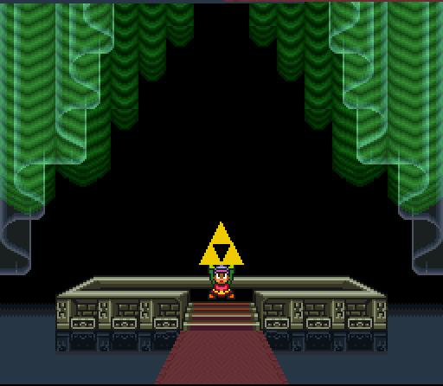
One Ring To Rule Them All?

Slide 47
Combining Strengths
Theorem Proving
- Need loop invariants
(will find automatically)
+ Behaviors encoded in logic
(used to refine abstraction)
+ Theorem provers
(used to compute successors, refine abstraction)
Program Analysis
- Imprecise
(will be precise)
+ Abstraction
(will shrink the state space we must explore)
SLAM
Model Checking
- Finite-state model, state explosion
(will find small good model)
+ State Space Exploration
(used to get a path sensitive analysis)
+ Counterexamples
(used to find relevant facts, refine abstraction)

Slide 48
Homework
Read Lazy Abstraction
Optionally read TAR

