Slide 1
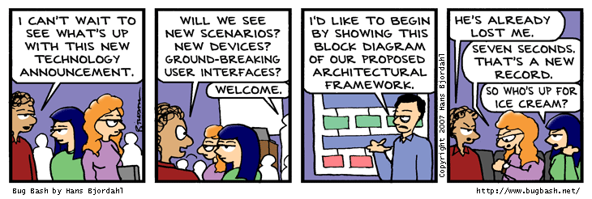
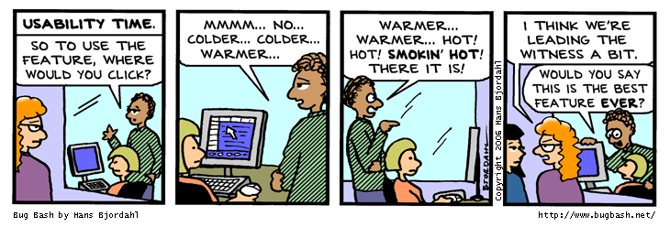
In Our Last Exciting Episode

Slide 2
Lessons From Model Checking
To find bugs, we need specifications
  What are some good specifications?
To convert a program into a model, we need predicates/invariants and a theorem prover.
  Which are the important predicates? Invariants?
  What should we track when reasoning about a program and what should we abstract?
  How does a theorem prover work?
Simple algorithms (e.g., depth first search, pushing facts along a CFG) can work well
  ... under what circumstances?

Slide 3
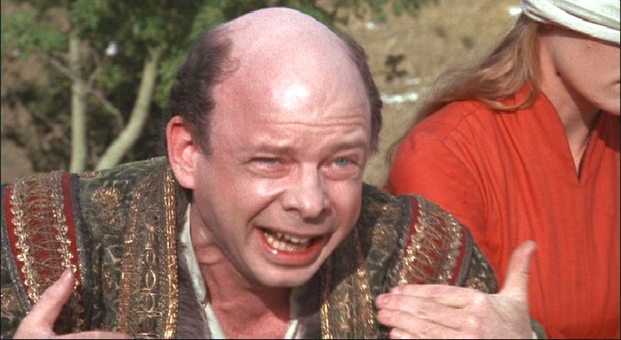
The Big Lesson
To reason about a program (= “is it doing the right thing? the wrong thing?”) we must understand what the program means!

Slide 4
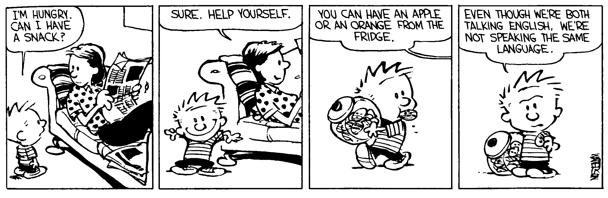
A Simple Imperative Language
Operational Semantics
(= “meaning”)

Slide 5
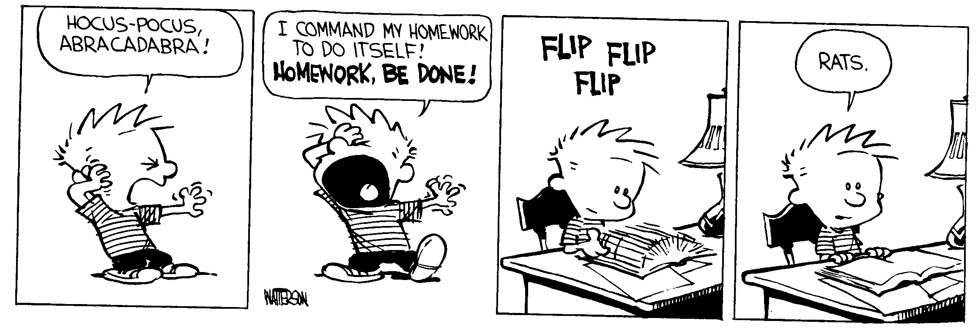
Homework #0 Due Today
Can't get BLAST to work?
  ssh to power1.cs.virginia.edu
  Plus the BLAST linux binaries
  cp all of them (e.g., csi*, pblast*, ...) to ~/bin

Slide 6
Medium-Range Plan
Study a simple imperative language IMP
  Abstract syntax (today)
  Operational semantics (today)
  Denotational semantics
  Axiomatic semantics
  … and relationships between various semantics (with proofs, peut-être)
  Today: operational semantics
    Follow along in Chapter 2 of Winskel

Slide 7
Syntax of IMP
Concrete syntax: The rules by which programs can be expressed as strings of characters
  Keywords, identifiers, statement separators vs. terminators (Niklaus!?), comments, indentation (Guido!?)
Concrete syntax is important in practice
  For readability (Larry!?), familiarity, parsing speed (Bjarne!?), effectiveness of error recovery, clarity of error messages (Robin!?)
Well-understood principles
  Use finite automata and context-free grammars
  Automatic lexer/parser generators

Slide 8

(Note On Post-LALR Advances)
If-as-and-when you find yourself making a new language, consider GLR (elkhound) instead of LALR(1) (bison)
Scott McPeak, George G. Necula: Elkhound: A Fast, Practical GLR Parser Generator. CC 2004: pp. 73-88
As fast as LALR(1), more natural, handles basically all of C++, etc.

Slide 9
Abstract Syntax
We ignore parsing issues and study programs given as abstract syntax trees
  I provide the parser in the homework …
An abstract syntax tree is (a subset of) the parse tree of the program
  Ignores issues like comment conventions
  More convenient for formal and algorithmic manipulation
  All research papers use ASTs, etc.

Slide 10
IMP Abstract Syntactic Entities
int integer constants (n ∈ Z)
bool bool constants (true, false)
L locations of variables (x, y)
Aexp arithmetic expressions (e)
Bexp boolean expressions (b)
Com commands (c)
  (these also encode the types)

Slide 11
Abstract Syntax (Aexp)
Arithmetic expressions (Aexp)
e ::= n for n ∈ Z
| x for x ∈ L
| e₁ + e₂ for e₁, e₂ ∈ Aexp
| e₁ - e₂ for e₁, e₂ ∈ Aexp
| e₁ * e₂ for e₁, e₂ ∈ Aexp
Notes:
  Variables are not declared
  All variables have integer type
  No side-effects (in expressions)

Slide 12
Abstract Syntax (Bexp)
Boolean expressions (Bexp)
b ::= true
| false
| e₁ = e₂ for e₁, e₂ ∈ Aexp
| e₁ ≤ e₂ for e₁, e₂ ∈ Aexp
| ¬ b for b ∈ Bexp
| b₁ ∧ b₂ for b₁, b₂ ∈ Bexp
| b₁ ∨ b₂ for b₁, b₂ ∈ Bexp

Slide 13
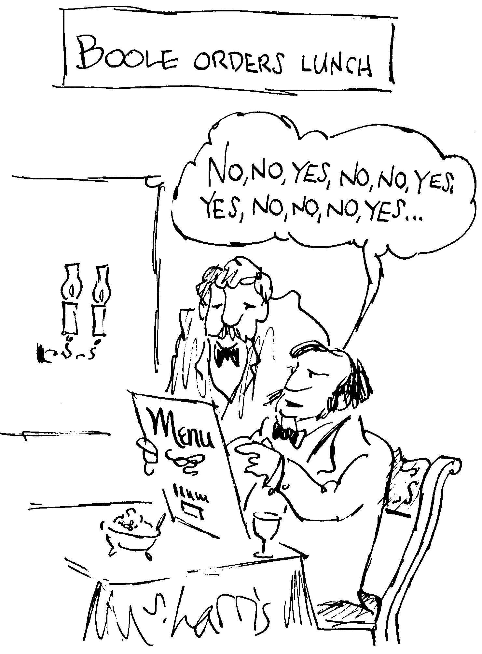
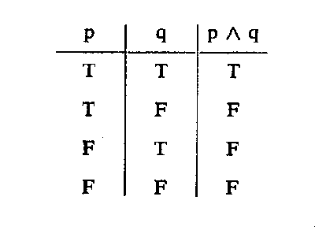
“Boolean”
George Boole
  1815-1864
I’ll assume you know boolean algebra …

Slide 14
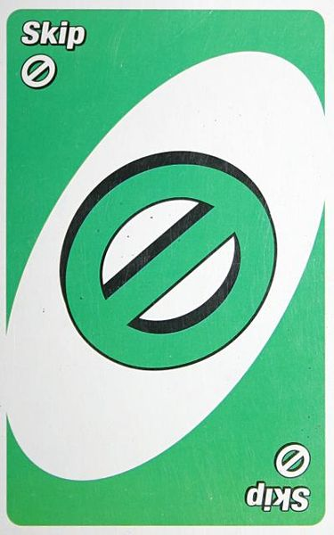
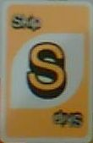
Abstract Syntax (Com)
Commands (Com)
c ::= skip
| x := e x∈L ∧ e∈Aexp
| c₁ ; c₂ c₁,c₂∈Com
| if b then c₁ else c₂ c₁,c₂∈Com ∧ b∈Bexp
| while b do c c∈Com ∧ b∈Bexp
Notes:
  The typing rules are embedded in the syntax definition
  Other parts are not context-free and need to be checked separately (e.g., all variables are declared)
  Commands contain all the side-effects in the language
  Missing: pointers, function calls, what else?

Slide 15
Why Study Formal Semantics?
Language design (denotational)
Proofs of correctness (axiomatic)
Language implementation (operational)
Reasoning about programs
Providing a clear behavioral specification
“All the cool people are doing it.”
  You need this to understand PL research
“First one’s free.”

Slide 16
Consider This Legal Java
x = 0;
try {
x = 1;
break mygoto;
} finally {
x = 2;
raise NullPointerException;
}
x = 3;
mygoto:
x = 4;
What happens when you execute this code?
Notably, which assignments are executed?

Slide 17
14.20.2 Execution of try-catch-finally
A try statement with a finally block is executed by first executing the try block. Then there is a choice:
If execution of the try block completes normally, then the finally block is executed, and then there is a choice:
  If the finally block completes normally, then the try statement completes normally.
  If the finally block completes abruptly for reason S, then the try statement completes abruptly for reason S.
If execution of the try block completes abruptly because of a throw of a value V, then there is a choice:
  If the run-time type of V is assignable to the parameter of any catch clause of the try statement, then the first (leftmost) such catch clause is selected. The value V is assigned to the parameter of the selected catch clause, and the Block of that catch clause is executed. Then there is a choice:
    If the catch block completes normally, then the finally block is executed. Then there is a choice:
      If the finally block completes normally, then the try statement completes normally.
      If the finally block completes abruptly for any reason, then the try statement completes abruptly for the same reason.
    If the catch block completes abruptly for reason R, then the finally block is executed. Then there is a choice:
      If the finally block completes normally, then the try statement completes abruptly for reason R.
      If the finally block completes abruptly for reason S, then the try statement completes abruptly for reason S (and reason R is discarded).
  If the run-time type of V is not assignable to the parameter of any catch clause of the try statement, then the finally block is executed. Then there is a choice:
    If the finally block completes normally, then the try statement completes abruptly because of a throw of the value V.
    If the finally block completes abruptly for reason S, then the try statement completes abruptly for reason S (and the throw of value V is discarded and forgotten).
If execution of the try block completes abruptly for any other reason R, then the finally block is executed. Then there is a choice:
  If the finally block completes normally, then the try statement completes abruptly for reason R.
  If the finally block completes abruptly for reason S, then the try statement completes abruptly for reason S (and reason R is discarded).

Slide 18

Can’t we just nail this somehow?

Slide 19
Ouch! Confusing.
Wouldn’t it be nice if we had some way of describing what a language (feature or program) means …
  More precisely than English
  More compactly than English
  So that you might build a compiler
  So that you might prove things about programs

Slide 20
Analysis of IMP
Questions to answer:
  What is the “meaning” of a given IMP expression/command?
  How would we go about evaluating IMP expressions and commands?
  How are the evaluator and the meaning related?

Slide 21

Three Canonical Approaches
Operational
  How would I execute this?
Axiomatic
  What is true after I execute this?
  Symbolic Execution
Denotational
  What is this trying to compute?

Slide 22
An Operational Semantics
Specifies how expressions and commands should be evaluated
Depending on the form of the expression
  0, 1, 2, . . . don’t evaluate any further.
    They are normal forms or values.
  e₁ + e₂ is evaluated by first evaluating e₁ to n₁ , then evaluating e₂ to n₂ . (post-order traversal)
    The result of the evaluation is the literal representing n₁ + n₂.
  Similarly for e₁ * e₂
Operational semantics abstracts the execution of a concrete interpreter
  Important keywords are colored & underlined in this class.

Slide 23
Semantics of IMP
The meanings of IMP expressions depend on the values of variables
  What does “x+5” mean? It depends on “x”!
The value of variables at a given moment is abstracted as a function from L to Z (a state)
  If x = 8 in our state, we expect “x+5” to mean 13
The set of all states is Σ = L → Z
We shall use σ to range over Σ
  σ, a state, maps variables to values

Slide 24
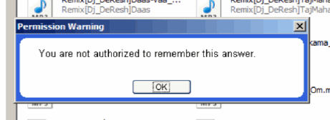
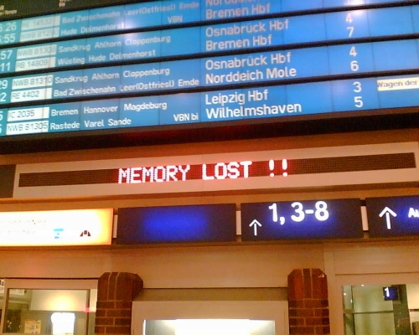

Program State
The state σ is somewhat like “memory”
  It holds the current values of all variables
  Formally, σ : L → Z

Slide 25

Q: Cartoons (682 / 842)
Why is Gargamel trying to capture the Smurfs?

Slide 26
Q: Computer Science
This American Turing Award winner is notable for his work in the theory of algorithms, a max-flow solver, a bipartite graph matcher, a string search algorithm, and “Reducibility Among Combinatorial Problems” in which he proved 21 problems to be NP-complete. He introduced the standard methodology for proving problems to be NP-complete.

Slide 27
Notation: Judgment
We write:
<e, σ> ⇓ n
To mean that e evaluates to n in state σ.
This is a judgment. It asserts a relation between e, σ and n.
In this case we can view ⇓ as a function with two arguments (e and σ).

Slide 28
Operational Semantics
This formulation is called natural operational semantics
  or big-step operational semantics
  the ⇓ judgment relates the expression and its “meaning”
How should we define
<e₁ + e₂, σ> ⇓ … ?

Slide 29
Notation: Rules of Inference
We express the evaluation rules as rules of inference for our judgment
  called the derivation rules for the judgment
  also called the evaluation rules (for operational semantics)
In general, we have one rule for each language construct:
<e₁, σ> ⇓ n₁ <e₂, σ> ⇓ n₂
This is the only
rule for e₁ + e₂
<e₁ + e₂, σ> ⇓ n₁ + n₂

Slide 30
Rules of Inference
Hypothesis₁ … Hypothesis_{N}
Conclusion
Γ ` b : bool Γ ` e1 : τ Γ ` e2 : τ
Γ ` if b then e1 else e2 : τ
For any given proof system, a finite number of rules of inference (or schema) are listed somewhere
Rule instances should be easily checked
What is the definition of “NP”?

Slide 31
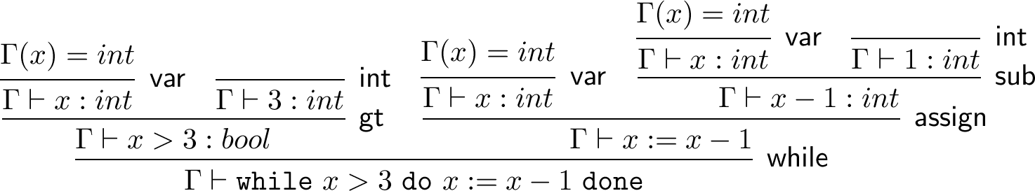
Derivation
Tree-structured (conclusion at bottom)
May include multiple sorts of rules-of-inference
Could be constructed, typically are not
Typically verified in polynomial time

Slide 32
Evaluation Rules (for Aexp)
<n, σ> ⇓ n
<x, σ> ⇓ σ(x)
<e₁, σ> ⇓ n₁ <e₂, σ> ⇓ n₂
<e₁, σ> ⇓ n₁ <e₂, σ> ⇓ n₂
<e₁ + e₂, σ> ⇓ n₁ + n₂
<e₁ - e₂, σ> ⇓ n₁ - n₂
<e₁, σ> ⇓ n₁ <e₂, σ> ⇓ n₂
<e₁ * e₂, σ> ⇓ n₁ * n₂
This is called structural operational semantics
  rules defined based on the structure of the expression
These rules do not impose an order of evaluation!

Slide 33
Evaluation Rules (for Bexp)
<e₁, σ> ⇓ n₁ <e₂, σ> ⇓ n₂
<true, σ> ⇓ true
<e₁ ≤ e₂, σ> ⇓ n₁ ≤ n₂
<e₁, σ> ⇓ n₁ <e₂, σ> ⇓ n₂
<false, σ> ⇓ false
<e₁ = e₂, σ> ⇓ n₁ = n₂
(show: candidate Ç rule)
<b₁, σ> ⇓ false
<b₂, σ> ⇓ false
<b₁ ∧ b₂, σ> ⇓ false
<b₁ ∧ b₂, σ> ⇓ false
<b₁, σ> ⇓ true <b₂, σ> ⇓ true
<b₁ ∧ b₂, σ> ⇓ true

Slide 34
How to Read the Rules?
Forward (top-down) = inference rules
  if we know that the hypothesis judgments hold then we can infer that the conclusion judgment also holds
  If we know that <e₁, σ> ⇓ 5 and <e₂ , σ> ⇓ 7, then we can infer that <e₁ + e₂ , σ> ⇓ 12

Slide 35
How to Read the Rules?
Backward (bottom-up) = evaluation rules
  Suppose we want to evaluate e₁ + e₂, i.e., find n s.t. e₁ + e₂ ⇓ n is derivable using the previous rules
  By inspection of the rules we notice that the last step in the derivation of e₁ + e₂ ⇓ n must be the addition rule
    the other rules have conclusions that would not match e₁ + e₂ ⇓ n
    this is called reasoning by inversion on the derivation rules

Slide 36
Evaluation By Inversion
Thus we must find n₁ and n₂ such that e₁ ⇓ n₁ and e₂ ⇓ n₂ are derivable
  This is done recursively
If there is exactly one rule for each kind of expression we say that the rules are syntax-directed
  At each step at most one rule applies
  This allows a simple evaluation procedure as above (recursive tree-walk)
  True for our Aexp but not Bexp. Why?

Slide 37

Evaluation of Commands
The evaluation of a Com may have side effects but has no direct result
  What is the result of evaluating a command ?
The “result” of a Com is a new state:
<c, σ> ⇓ σ’
  But the evaluation of Com might not terminate! Danger Will Robinson! (huh?)

Slide 38
Com Evaluation Rules 1
<c₁, σ> ⇓ σ’ <c₂, σ’> ⇓ σ’’
<skip, σ> ⇓ σ
<c₁ ; c₂, σ> ⇓ σ’’
<b, σ> ⇓ true <c₁, σ> ⇓ σ’
<if b then c₁ else c₂, σ> ⇓ σ’
<b, σ> ⇓ false <c₂, σ> ⇓ σ’
<if b then c₁ else c₂, σ> ⇓ σ’

Slide 39

Com Evaluation Rules 2
<e, σ> ⇓ n
Def: σ[x:= n](x) = n
σ[x:= n](y) = σ(y)
<x := e, σ> ⇓ σ[x := n]
Let’s do while together

Slide 40
Com Evaluation Rules 3
<e, σ> ⇓ n
Def: σ[x:= n](x) = n
σ[x:= n](y) = σ(y)
<x := e, σ> ⇓ σ[x := n]
<b, σ> ⇓ false
<while b do c, σ> ⇓ σ
<b, σ> ⇓ true <c; while b do c, σ> ⇓ σ’
<while b do c, σ > ⇓ σ’

Slide 41
Homework
Homework 0 Due Today
Homework 1 Due In One Week
Reading!
  If this wasn't intuitive, try some of the optional readings for more context.

