Slide 1
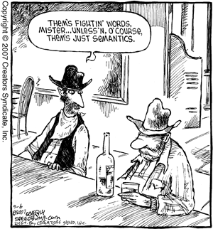

Slide 2
Today’s Cunning Plan
Review, Truth, and Provability
Large-Step Opsem Commentary
Small-Step Contextual Semantics
  Reductions, Redexes, and Contexts
Applications and Recent Research

Slide 3
Bookkeeping
Hookkeeper (wire ring that holds a fly-fishing hook in place)
Tattooee
Bookkeeper
  Subbookkeeper (!)
Sweettooth

Slide 4
60 Second Summary - Semantics
A formal semantics is a system for assigning meanings to programs.
For now, programs are IMP commands and expressions
In operational semantics the meaning of a program is “what it evaluates to”
Any opsem system gives rules of inference that tell you how to evaluate programs

Slide 5
Summary - Judgments
Rules of inference allow you to derive judgments (“something that is knowable”) like
<e, σ> ⇓ n
  In state σ, expression e evaluates to n
<c, σ> ⇓ σ’
  After evaluating command c in state σ the new state will be σ’
State σ maps variables to values (σ : L ! Z)
Inferences equivalent up to variable renaming:
<c, σ> ⇓ σ’ === <c’, σ₇> ⇓ σ₈

Slide 6
Notation: Rules of Inference
We express the evaluation rules as rules of inference for our judgment
  called the derivation rules for the judgment
  also called the evaluation rules (for operational semantics)
In general, we have one rule for each language construct:
<e₁, σ> ⇓ n₁ <e₂, σ> ⇓ n₂
This is the only
rule for e₁ + e₂
<e₁ + e₂, σ> ⇓ n₁ + n₂

Slide 7
Evaluation By Inversion
We must find n₁ and n₂ such that e₁ ⇓ n₁ and e₂ ⇓ n₂ are derivable
  This is done recursively
If there is exactly one rule for each kind of expression we say that the rules are syntax-directed
  At each step at most one rule applies
  This allows a simple evaluation procedure as above (recursive tree-walk)
  True for our Aexp but not Bexp.

Slide 8
Summary - Rules
Rules of inference list the hypotheses necessary to arrive at a conclusion
A derivation involves interlocking (well-formed) instances of rules of inference
<e₁, σ> ⇓ n₁ <e₂, σ> ⇓ n₂
<x, σ> ⇓ σ(x)
<e₁ - e₂, σ> ⇓ n₁ minus n₂
<4, σ₃> ⇓ 4 <2, σ₃> ⇓ 2
<4*2, σ₃> ⇓ 8 <6, σ₃> ⇓ 6
<(4*2) - 6, σ₃> ⇓ 2

Slide 9
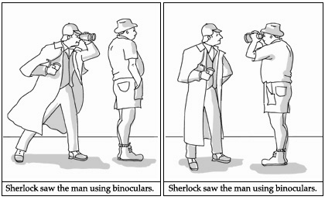
Operational Semantics
Small-Step Semantics

Slide 10

Provability
Given an opsem system, <e, σ> ⇓ n is provable if there exists a well-formed derivation with <e, σ> ⇓ n as its conclusion
  “well-formed” = “every step in the derivation is a valid instance of one of the rules of inference for this opsem system”
  “` <e, σ> ⇓ n” = “it is provable that <e, σ> ⇓ n”
We would like truth and provability to be closely related

Slide 11


Truth?
“A Vorlon said understanding is a three-edged sword. Your side, their side and
the truth.”
  Sheridan, Babylon 5, Into The Fire
We will not formally define “truth” yet
Instead we appeal to your intuition
  <2+2, σ> ⇓ 4 -- should be true
  <2+2, σ> ⇓ 5 -- should be false

Slide 12

Completeness
A proof system (like our operational semantics) is complete if every true judgment is provable.
If we replaced the subtract rule with:
Our opsem would be incomplete:
<4-2, σ> ⇓ 2 -- true but not provable
<e₁, σ> ⇓ n <e₂, σ> ⇓ 0
<e₁ - e₂, σ> ⇓ n

Slide 13
Consistency
A proof system is consistent (or sound) if every provable judgment is true.
If we replaced the subtract rule with:
Our opsem would be inconsistent (or unsound):
  <6-1, σ> ⇓ 9 -- false but provable
<e₁, σ> ⇓ n₁ <e₂, σ> ⇓ n₂
<e₁ - e₂, σ> ⇓ n₁ + 3
“A foolish consistency is the hobgoblin of little minds,
adored by little statesmen and philosophers and divines.”
-- Ralph Waldo Emerson, Essays. First Series. Self-Reliance.

Slide 14
Desired Traits
Typically a system (of operational semantics) is always complete (unless you forget a rule)
If you are not careful, however, your system may be unsound
Usually that is very bad
  A paper with an unsound type system is usually rejected
  Papers often prove (sketch) that a system is sound
  Recent research (e.g., Engler, ESP) into useful but unsound systems exists, however
In this class your work should be complete and consistent (e.g., on homework problems)
Dr. Peter Venkman: I'm a little fuzzy on the whole "good/bad" thing here.
What do you mean, "bad"?
Dr. Egon Spengler: Try to imagine all life as you know it stopping instantaneously
and every molecule in your body exploding at the speed of light.

Slide 15
With That In Mind
We now return to opsem for IMP
<e, σ> ⇓ n
Def: σ[x:= n](x) = n
σ[x:= n](y) = σ(y)
<x := e, σ> ⇓ σ[x := n]
<b, σ> ⇓ false
<while b do c, σ> ⇓ σ
<b, σ> ⇓ true <c; while b do c, σ> ⇓ σ’
<while b do c, σ > ⇓ σ’

Slide 16
Command Evaluation Notes
The order of evaluation is important
  c₁ is evaluated before c₂ in c₁; c₂
  c₂ is not evaluated in “if true then c₁ else c₂”
  c is not evaluated in “while false do c”
  b is evaluated first in “if b then c₁ else c₂”
  this is explicit in the evaluation rules
Conditional constructs (e.g., b₁ Ç b₂) have multiple evaluation rules
  but only one can be applied at one time

Slide 17
Command Evaluation Trials
The evaluation rules are not syntax-directed
  See the rules for while, Æ
  The evaluation might not terminate
Recall: the evaluation rules suggest an interpreter
Natural-style semantics has two big disadvantages (continued …)

Slide 18
Disadvantages of Natural-Style Operational Semantics
It is hard to talk about commands whose evaluation does not terminate
  When there is no σ’ such that <c, σ> ⇓ σ’
  But that is true also of ill-formed or erroneous commands (in a richer language)!
It does not give us a way to talk about intermediate states
  Thus we cannot say that on a parallel machine the execution of two commands is interleaved (= no modeling threads)

Slide 19

Semantics Solution
Small-step semantics addresses these problems
  Execution is modeled as a (possible infinite) sequence of states
Not quite as easy as large-step natural semantics, though
Contextual semantics is a small-step semantics where the atomic execution step is a rewrite of the program

Slide 20
Contextual Semantics
We will define a relation <c, σ> → <c’, σ’>
  c’ is obtained from c via an atomic rewrite step
  Evaluation terminates when the program has been rewritten to a terminal program
    one from which we cannot make further progress
  For IMP the terminal command is “skip”
  As long as the command is not “skip” we can make further progress
    some commands never reduce to skip (e.g., “while true do skip”)

Slide 21
Contextual Derivations
In small-step contextual semantics, derivations are not tree-structured
A contextual semantics derivation is a sequence (or list) of atomic rewrites:
<x+(7-3),σ> ! <x+(4),σ> ! <5+4,σ> ! <9,σ>
σ(x)=5

Slide 22
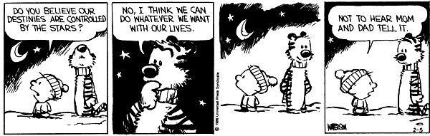
What is an Atomic Reduction?
What is an atomic reduction step?
  Granularity is a choice of the semantics designer
How to select the next reduction step, when several are possible?
  This is the order of evaluation issue

Slide 23
Q: Computer Science
This American computer scientist won the 2009 Turing award for her work on design of programming language sand software methodology that led to the development of object-oriented programming. In addition to the first high-level language to support distributed programs and notable results on Byzantine fault tolerance, she is perhaps best known for her formulation of object-oriented subtyping.

Slide 24
Correcting English Prose
4. Lizzy drank in the sight of him like a thirst craven man consumes water.
421. "I go here, silly," said Kimi with a proud expression. "And how I might ask? Your scores were not legible for this school."
312. Every member of the Thespians, or anyone who has ever acted in one of our school plays was a pre-Madonna, mellow-dramatic; over-actor and I didn't want to be one of them.
198. Nobody goes into Donovan's Layer, For they sence evil. But Livvy doesn't she see's something no one else does.

Slide 25
Redexes
A redex is a syntactic expression or command that can be reduced (transformed) in one atomic step
Redexes are defined via a grammar:
r ::= x (x 2 L)
| n₁ + n₂
| x := n
| skip; c
| if true then c₁ else c₂
| if false then c₁ else c₂
| while b do c
For brevity, we mix exp and command redexes
Note that (1 + 3) + 2 is not a redex, but 1 + 3 is

Slide 26
Local Reduction Rules for IMP
One for each redex: <r, σ> → <e, σ’>
  means that in state σ, the redex r can be replaced in one step with the expression e
<x, σ> → <σ(x), σ>
<n₁ + n₂, σ> → <n, σ> where n = n₁ plus n₂
<n₁ = n₂, σ> → <true, σ> if n₁ = n₂
<x := n, σ> → <skip, σ[x := n]>
<skip; c, σ> → <c, σ>
<if true then c₁ else c₂, σ> → <c₁, σ>
<if false then c₁ else c₂, σ> → <c₂, σ>
<while b do c, σ> →
<if b then c; while b do c else skip, σ>

Slide 27
The Global Reduction Rule
Not happy? I’ll explain with pictures soon!
General idea of contextual semantics
  Decompose the current expression into the redex-to-reduce-next and the remaining program
    The remaining program is called a context
  Reduce the redex “r” to some other expression “e”
  The resulting (reduced) expression consists of “e” with the original context

Slide 28
As A Picture (1)
(Context)
…
x := 2+2 ;
print x
Step 1: Find The Redex

Slide 29
As A Picture (2)
(Context)
…
x := ;
print x
2+2 (redex)
Step 1: Find The Redex
Step 2: Reduce The Redex

Slide 30
As A Picture (3)
(Context)
…
x := ;
print x
2+2 (redex)
4 (reduced)
Step 1: Find The Redex
Step 2: Reduce The Redex

Slide 31
As A Picture (4)
(Context)
…
x := ;
print x
4
Step 1: Find The Redex
Step 2: Reduce The Redex
Step 3: Replace It In The Context

Slide 32
Contextual Analysis
We use H to range over contexts
We write H[r] for the expression obtained by placing redex r in context H
Now we can define a small step
If <r, σ> → <e, σ’>
then <H[r], σ> → <H[e], σ’>

Slide 33
Contexts
A context is like an expression (or command) with a marker • in the place where the redex goes
Examples:
  To evaluate “(1 + 3) + 2” we use the redex 1 + 3 and the context “• + 2”
  To evaluate “if x > 2 then c₁ else c₂” we use the redex x and the context “if • > 2 then c₁ else c₂”

Slide 34
Context Terminology
A context is also called an “expression with a hole”
The marker • is sometimes called a hole
H[r] is the expression obtained from H by replacing • with the redex r
“Avoid context and specifics; generalize
and keep repeating the generalization.”
-- Jack Schwartz

Slide 35
Contextual Semantics Example
x := 1 ; x := x + 1 with initial state [x:=0]
<Comm, State>
Redex •
Context
<x := 1; x := x+1, [x := 0]>
x := 1
•; x := x+1
<skip; x := x+1, [x := 1]>
skip; x := x+1
•
<x := x+1, [x := 1]>
x
x := • + 1
What happens next?

Slide 36
Contextual Semantics Example
x := 1 ; x := x + 1 with initial state [x:=0]
<Comm, State>
Redex •
Context
<x := 1; x := x+1, [x := 0]>
x := 1
•; x := x+1
<skip; x := x+1, [x := 1]>
skip; x := x+1
•
<x := x+1, [x := 1]>
x
x := • + 1
<x := 1 + 1, [x := 1]>
1 + 1
x := •
<x := 2, [x := 1]>
x := 2
•
<skip, [x := 2]>

Slide 37
More On Contexts
Contexts are defined by a grammar:
H ::= • | n + H
| H + e
| x := H
| if H then c₁ else c₂
| H; c
A context has exactly one • marker
A redex is never a value

Slide 38
What’s In A Context?
Contexts specify precisely how to find the next redex
  Consider e₁ + e₂ and its decomposition as H[r]
  If e₁ is n₁ and e₂ is n₂ then H = • and r = n₁ + n₂
  If e₁ is n₁ and e₂ is not n₂ then H = n₁ + H₂ and e₂ = H₂[r]
  If e₁ is not n₁ then H = H₁ + e₂ and e₁ = H₁[r]
  In the last two cases the decomposition is done recursively
  Check that in each case the solution is unique

Slide 39
Unique Next Redex:
Proof By Handwaving Examples
e.g. c = “c₁; c₂” – either
  c₁ = skip and then c = H[skip; c₂] with H = •
  or c₁ ≠ skip and then c₁ = H[r]; so c = H’[r] with H’ = H; c₂
e.g. c = “if b then c₁ else c₂”
  either b = true or b = false and then c = H[r] with H = •
  or b is not a value and b = H[r]; so c = H’[r] with H’ = if H then c₁ else c₂

Slide 40
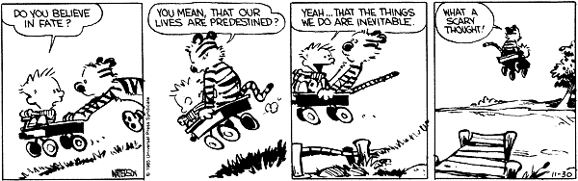
Context Decomposition
Decomposition theorem:
If c is not “skip” then there exist unique H and r such that c is H[r]
  “Exist” means progress
  “Unique” means determinism

Slide 41
Short-Circuit Evaluation
What if we want to express short-circuit evaluation of ∧ ?
  Define the following contexts, redexes and local reduction rules
H ::= ... | H ∧ b₂
r ::= ... | true ∧ b | false ∧ b
<true ∧ b, σ> → <b, σ>
<false ∧ b, σ> → <false, σ>
  the local reduction kicks in before b₂ is evaluated

Slide 42
Contextual Semantics Summary
Can view • as representing the program counter
The advancement rules for ² are non-trivial
  At each step the entire command is decomposed
  This makes contextual semantics inefficient to implement directly
The major advantage of contextual semantics: it allows a mix of local and global reduction rules
  For IMP we have only local reduction rules: only the redex is reduced
  Sometimes it is useful to work on the context too
  We’ll do that when we study memory allocation, etc.

Slide 43
Reading Real-World Examples
Cobbe and Felleisen, POPL 2005
Small-step contextual opsem for Java
Their rule for object field access:
P ` <E[obj.fd],S> ! <E[F(fd)],S>
  where F=fields(S(obj)) and fd 2 dom(F)
They use “E” for context, we use “H”
They use “S” for state, we use “σ”

Slide 44
Lost In Translation
P ` <H[obj.fd],σ> ! <H[F(fd)],σ>
  Where F=fields(σ(obj)) and fd 2 dom(F)
They have “P `”, but that just means “it can be proved in our system given P”
<H[obj.fd],σ> ! <H[F(fd)],σ>
  Where F=fields(σ(obj)) and fd 2 dom(F)

Slide 45
Lost In Translation 2
<H[obj.fd],σ> ! <H[F(fd)],σ>
  Where F=fields(σ(obj)) and fd 2 dom(F)
They model objects (like obj), but we do not (yet) – let’s just make fd a variable:
<H[fd],σ> ! <H[F(fd)],σ>
  Where F=σ and fd 2 L
Which is just our variable-lookup rule:
<H[fd],σ> ! <H[σ(fd)],σ> (when fd 2 L)

Slide 46
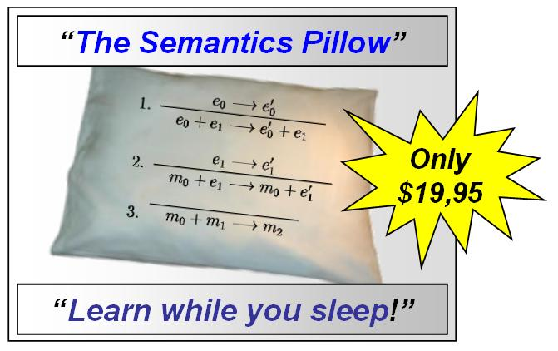
“Sleep On It”

Slide 47
Homework
Homework 1 Due soon
Reading!

