Slide 1
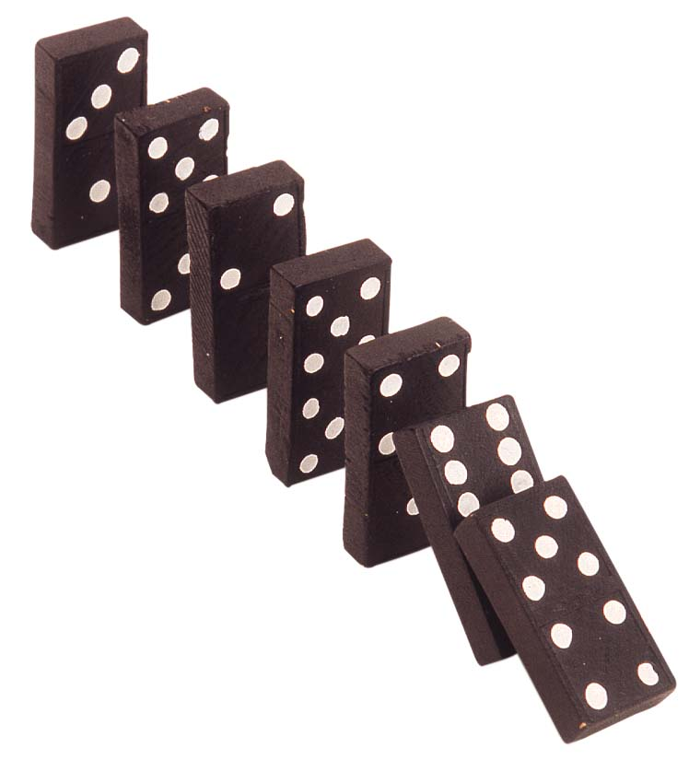
Proof Techniques for Operational Semantics

Slide 2
Small-Step
Contextual Semantics
In small-step contextual semantics, derivations are not tree-structured
A contextual semantics derivation is a sequence (or list) of atomic rewrites:
<x+(7-3),σ> ! <x+(4),σ> ! <5+4,σ> ! <9,σ>
If <r, σ> → <e, σ’>
then <H[r], σ> → <H[e], σ’>
σ(x)=5
r = redex
H = context (has hole)

Slide 3
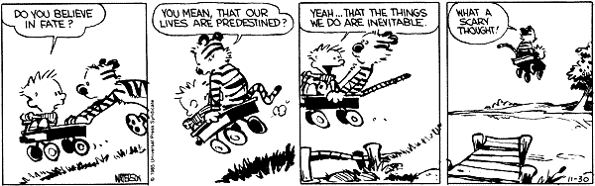
Context Decomposition
Decomposition theorem:
If c is not “skip” then there exist unique H and r such that c is H[r]
  “Exist” means progress
  “Unique” means determinism

Slide 4
Short-Circuit Evaluation
What if we want to express short-circuit evaluation of ∧ ?
  Define the following contexts, redexes and local reduction rules
H ::= ... | H ∧ b₂
r ::= ... | true ∧ b | false ∧ b
<true ∧ b, σ> → <b, σ>
<false ∧ b, σ> → <false, σ>
  the local reduction kicks in before b₂ is evaluated

Slide 5
Contextual Semantics Summary
Can view • as representing the program counter
Contextual semantics is inefficient to implement directly
The major advantage of contextual semantics: it allows a mix of local and global reduction rules
  For IMP we have only local reduction rules: only the redex is reduced
  Sometimes it is useful to work on the context too
  We’ll do that when we study memory allocation, etc.

Slide 6
Cunning Plan for
Proof Techniques
Why Bother?
Mathematical Induction
Well-Founded Induction
Structural Induction
  “Induction On The Structure Of The Derivation”

Slide 7
One-Slide Summary
Mathematical Induction is a proof technique: If you can prove P(0) and you can prove that P(n) implies P(n+1), then you can conclude that for all natural numbers n, P(n) holds.
Induction works because the natural numbers are well-founded: there are no infinite descending chains n > n-1 > n-2 > ... > ... .
Structural induction is induction on a formal structure, like an AST. The base cases use the leaves, the inductive steps use the inner nodes.
Induction on a derivation is structural induction applied to a derivation D (e.g., D::<c, σ> ⇓ σ’).

Slide 8
Why Bother?
I am loathe to teach you anything that I think is a waste of your time.
Thus I must convince you that inductive opsem proof techniques are useful.
  Recall class goals: understand PL research techniques and apply them to your research
This motivation should also highlight where you might use such techniques in your own research.

Slide 9

Never Underestimate
“Any counter-example posed by the Reviewers against this proof would be a useless gesture, no matter what technical data they have obtained. Structural Induction is now the ultimate proof technique in the universe. I suggest we use it.” --- Admiral Motti, A New Hope

Slide 10
Classic Example (Schema)
“A well-typed program cannot go wrong.”
  Robin Milner
When you design a new type system, you must show that it is safe (= that the type system is sound with respect to the operational semantics).
A Syntactic Approach to Type Soundness. Andrew K. Wright, Matthias Felleisen, 1992.
  Type preservation: “if you have a well-typed program and apply an opsem rule, the result is well-typed.”
  Progress: “a well-typed program will never get stuck in a state with no applicable opsem rules”
Done for real languages: SML/NJ, SPARK ADA, Java
  PL/I, plus basically every toy PL research language ever.

Slide 11
Classic Examples
CCured Project (Berkeley)
  A program that is instrumented with CCured run-time checks (= “adheres to the CCured type system”) will not segfault (= “the x86 opsem rules will never get stuck”).
Vault Language (Microsoft Research)
  A well-typed Vault program does not leak any tracked resources and invokes tracked APIs correctly (e.g., handles IRQL correctly in asynchronous Windows device drivers, cf. Capability Calculus)
RC – Reference-Counted Regions For C (Intel Research)
  A well-typed RC program gains the speed and convenience of region-based memory management but need never worry about freeing a region too early (run-time checks).
Typed Assembly Language (Cornell)
  Reasonable C programs (e.g., device drivers) can be translated to TALx86. Well-typed TALx86 programs are type- and memory-safe.
Secure Information Flow (Many, e.g,. Volpano et al. ‘96)
  Lattice model of secure flow analysis is phrased as a type system, so type soundness = noninterference.

Slide 12
Recent Examples
“We prove soundness (Theorem 6.8) by mutual induction on the derivations of ...”
  An Operational and Axiomatic Semantics for Non-determinism and Sequence Points in C, POPL 2014
“The proof goes by induction on the structure of p.”
  NetKAT: Semantic Foundations of Networks, POPL 2014
“The operational semantics is given as a big-step relation, on which our compiler correctness proofs can all proceed by induction ...”
  CakeML: A Verified Implementation of ML, POPL 2014
Method: Chose 4 papers from POPL 2014, 3 of them use structural induction.

Slide 13
Decade-Old Examples
“The proof proceeds by rule induction over the target term producing translation rules.”
  Chakravarty et al. ’05
“Type preservation can be proved by standard induction on the derivation of the evaluation relation.”
  Hosoya et al. ’05
“Proof: By induction on the derivation of N + W.”
  Sumi and Pierce ’05
Method: chose four POPL 2005 papers at random, the three above mentioned structural induction.
(emphasis mine)

Slide 14
Induction
Most important technique for studying the formal semantics of prog languages
  If you want to perform or understand PL research, you must grok this!
Mathematical Induction (simple)
Well-Founded Induction (general)
Structural Induction (widely used in PL)

Slide 15

Mathematical Induction
Goal: prove ∀n ∈ N. P(n)
Base Case: prove P(0)
Inductive Step:
  Prove 8 n>0. P(n) ) P(n+1)
  “Pick arbitrary n, assume P(n), prove P(n+1)”
Why does induction work?

Slide 16
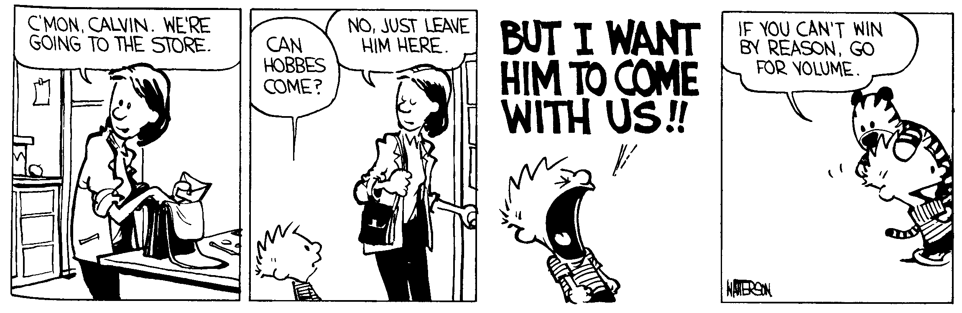
Why Does It Work?
There are no infinite descending chains of natural numbers
For any n, P(n) can be obtained by starting from the base case and applying n instances of the inductive step

Slide 17
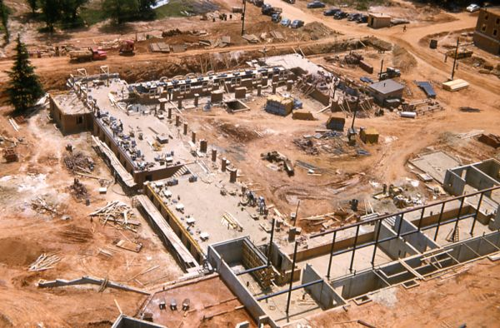
Well-Founded Induction
A relation ¹ ⊆ A £ A is well-founded if there are no infinite descending chains in A
  Example: <₁ = { (x, x +1) | x ∈ N }
    aka the predecessor relation
  Example: < = { (x, y) | x, y ∈ N and x < y }
Well-founded induction:
  To prove ∀x ∈ A. P(x) it is enough to prove
∀x ∈ A. [∀y ¹ x ⇒ P(y)] ⇒ P(x)
If ¹ is <₁ then we obtain mathematical induction as a special case

Slide 18
Structural Induction
Recall e ::= n | e₁ + e₂ | e₁ * e₂ | x
Define ¹ ⊆ Aexp £ Aexp such that
e₁ ¹ e₁ + e₂ e₂ ¹ e₁ + e₂
e₁ ¹ e₁ * e₂ e₂ ¹ e₁ * e₂
  no other elements of Aexp £ Aexp are ¹-related
To prove ∀e ∈ Aexp. P(e)
  ` ∀n ∈ Z. P(n)
  ` ∀x ∈ L. P(x)
  ` ∀e₁, e₂ ∈ Aexp. P(e₁) ∧ P(e₂) ⇒ P(e₁ + e₂)
  ` ∀e₁, e₂ ∈ Aexp. P(e₁) ∧ P(e₂) ⇒ P(e₁ * e₂)

Slide 19
Notes on Structural Induction
Called structural induction because the proof is guided by the structure of the expression
One proof case per form of expression
  Atomic expressions (with no subexpressions) are all base cases
  Composite expressions are the inductive case
This is the most useful form of induction in the study of PL

Slide 20
Example of Induction on Structure of Expressions
Let
  L(e) be the # of literals and variable occurrences in e
  O(e) be the # of operators in e
Prove that ∀e ∈ Aexp. L(e) = O(e) + 1
Proof: by induction on the structure of e
  Case e = n. L(e) = 1 and O(e) = 0
  Case e = x. L(e) = 1 and O(e) = 0
  Case e = e₁ + e₂.
    L(e) = L(e₁) + L(e₂) and O(e) = O(e₁) + O(e₂) + 1
    By induction hypothesis L(e₁) = O(e₁) + 1 and L(e₂) = O(e₂) + 1
    Thus L(e) = O(e₁) + O(e₂) + 2 = O(e) + 1
  Case e = e₁ * e₂. Same as the case for +

Slide 21
Other Proofs by Structural Induction on Expressions
Most proofs for Aexp sublanguage of IMP
Small-step and natural semantics obtain equivalent results:
∀e ∈ Exp. ∀n ∈ N. e →* n ⇔ e ⇓ n
Structural induction on expressions works here because all of the semantics are syntax directed

Slide 22
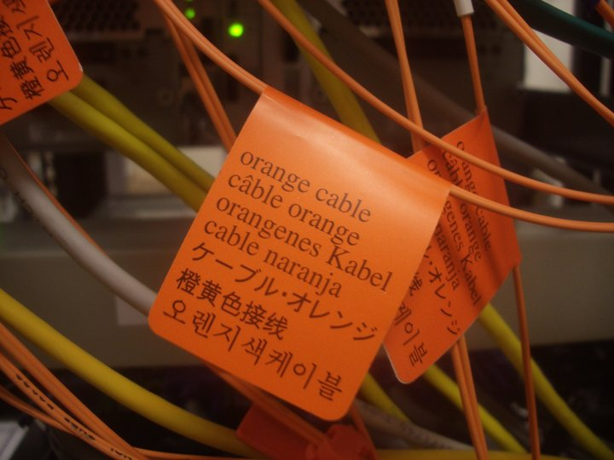
Stating The Obvious
(With a Sense of Discovery)
You are given a concrete state σ.
You have ` <x + 1, σ> ⇓ 5
You also have ` <x + 1, σ> ⇓ 88
Is this possible?

Slide 23
Why That Is Not Possible
Prove that IMP is deterministic
∀e ∈ Aexp. ∀σ ∈ Σ. ∀n, n’ ∈ N. <e, σ> ⇓ n ∧ <e, σ> ⇓ n’ ⇒ n = n’
∀b ∈ Bexp. ∀σ ∈ Σ. ∀t, t’ ∈ B. <b, σ> ⇓ t ∧ <b, σ> ⇓ t’ ⇒ t = t’
∀c ∈ Comm. ∀σ, σ’,σ’’ ∈ Σ. <c, σ> ⇓ σ’ ∧ <c, σ> ⇓ σ’’ ⇒ σ’ = σ’’
No immediate way to use mathematical induction
For commands we cannot use induction on the structure of the command
  while’s evaluation does not depend only on the evaluation of its strict subexpressions
<b, σ> ⇓ true <c, σ> ⇓ σ’ <while b do c, σ’> ⇓ σ’’
<while b do c, σ> ⇓ σ’’

Slide 24
Q: Movies (292 / 842)
From the 1981 movie Raiders of the Lost Ark, give either the protagonist's phobia xor the composer of the musical score.

Slide 25
Computer Science
This Dutch Turing-award winner is famous for the semaphore, “THE” operating system, the Banker's algorithm, and a shortest path algorithm. He favored structured programming, as laid out in the 1968 article Go To Statement Considered Harmful. He was a strong proponent of formal verification and correctness by construction. He also penned On The Cruelty of Really Teaching Computer Science, which argues that CS is a branch of math and relates provability to correctness.

Slide 26

Recall Opsem
Operational semantics assigns meanings to programs by listing rules of inference that allow you to prove judgments by making derivations.
A derivation is a tree-structured object made up of valid instances of inference rules.

Slide 27
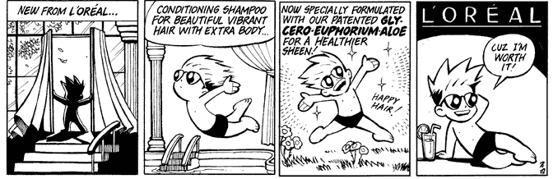
We Need Something New
Some more powerful form of induction …
With all the bells and whistles!

Slide 28
Induction on the
Structure of Derivations
Key idea: The hypothesis does not just assume a c ∈ Comm but the existence of a derivation of <c, σ> ⇓ σ’
Derivation trees are also defined inductively, just like expression trees
A derivation is built of subderivations:
Adapt the structural induction principle to work on the structure of derivations
<x + 1, σ_{i+1}> ⇓ 6 - i
<x, σ_{i+1}> ⇓ 5 - i 5 - i ≤ 5
<x:=x+1, σ_{i+1}> ⇓ σ_{i} <W, σ_{i}> ⇓ σ₀
<x ≤ 5, σ_{i+1}> ⇓ true <x:=x+1; W, σ_{i+1}> ⇓ σ₀
<while x ≤ 5 do x := x + 1, σ_{i+1}> ⇓ σ₀

Slide 29
Induction on Derivations
To prove that for all derivations D of a judgment, property P holds
For each derivation rule of the form
Assume P holds for derivations of H_{i} (i = 1..n)
Prove the the property holds for the derivation obtained from the derivations of H_{i} using the given rule
H₁ … H_{n}
C

Slide 30
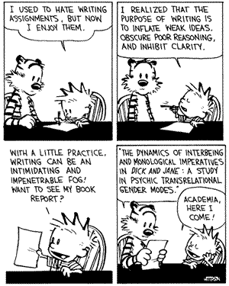
New Notation
Write D :: Judgment to mean “D is the derivation that proves Judgment”
Example:
D :: <x+1, σ> ⇓ 2

Slide 31
Induction on Derivations (2)
Prove that evaluation of commands is deterministic:
<c, σ> ⇓ σ’ ⇒ ∀σ’’ ∈ Σ. <c, σ> ⇓ σ’’ ⇒ σ’ = σ’’
Pick arbitrary c, σ, σ’ and D :: <c, σ> ⇓ σ’
To prove: ∀σ’’ ∈ Σ. <c, σ> ⇓ σ’’ ⇒ σ’ = σ’’
  Proof: by induction on the structure of the derivation D
Case: last rule used in D was the one for skip
  This means that c = skip, and σ’ = σ
  By inversion <c, σ> ⇓ σ’’ uses the rule for skip
  Thus σ’’ = σ
  This is a base case in the induction
D ::
<skip, σ> ⇓ σ

Slide 32
Induction on Derivations (3)
Case: the last rule used in D was the one for sequencing
Pick arbitrary σ’’ such that D’’ :: <c₁; c₂, σ> ⇓ σ’’.
  by inversion D’’ uses the rule for sequencing
  and has subderivations D’’₁ :: <c₁, σ> ⇓ σ’’₁ and D’’₂ :: <c₂, σ’’₁> ⇓ σ’’
By induction hypothesis on D₁ (with D’’₁): σ₁ = σ’’₁
  Now D’’₂ :: <c₂, σ₁> ⇓ σ’’
By induction hypothesis on D₂ (with D’’₂): σ’’ = σ’
This is a simple inductive case
D₁ :: <c₁, σ> ⇓ σ₁ D₂ :: <c₂, σ₁> ⇓ σ’
D ::
<c₁; c₂, σ> ⇓ σ’

Slide 33
Induction on Derivations (4)
Case: the last rule used in D was while true
Pick arbitrary σ’’ s.t. D’’::<while b do c, σ> ⇓ σ’’
  by inversion and determinism of boolean expressions, D’’ also uses the rule for while true
  and has subderivations D’’₂ :: <c, σ> ⇓ σ’’₁ and D’’₃ :: <W, σ’’₁> ⇓ σ’’
By induction hypothesis on D₂ (with D’’₂): σ₁ = σ’’₁
  Now D’’₃ :: <while b do c, σ₁> ⇓ σ’’
By induction hypothesis on D₃ (with D’’₃): σ’’ = σ’
D₁ :: <b, σ> ⇓ true D₂ :: <c, σ> ⇓ σ₁ D₃ :: <while b do c, σ₁> ⇓ σ’
D ::
<while b do c, σ> ⇓ σ’

Slide 34
What Do You,
The Viewers At Home, Think?
Let’s do if true together!
Case: the last rule in D was if true
Try to do this on a piece of paper. In a few minutes I’ll have some lucky winners come on down.
D₁ :: <b, σ> ⇓ true D₂ :: <c1, σ> ⇓ σ₁
D ::
<if b do c1 else c2, σ> ⇓ σ₁

Slide 35
Induction on Derivations (5)
Case: the last rule in D was if true
Pick arbitrary σ’’ such that D’’ :: <if b do c1 else c2, σ> ⇓ σ’’
  By inversion and determinism, D’’ also uses if true
  And has subderivations D’’₁ :: <b, σ> ⇓ true and D’’₂ :: <c1, σ> ⇓ σ’’
By induction hypothesis on D₂ (with D’’₂): σ’ = σ’’
D₁ :: <b, σ> ⇓ true D₂ :: <c1, σ> ⇓ σ’
D ::
<if b do c1 else c2, σ> ⇓ σ’

Slide 36
Induction on Derivations
Summary
If you must prove ∀x ∈ A. P(x) ⇒ Q(x)
  with A inductively defined and P(x) rule-defined
  we pick arbitrary x ∈ A and D :: P(x)
  we could do induction on both facts
    x ∈ A leads to induction on the structure of x
    D :: P(x) leads to induction on the structure of D
  Generally, the induction on the structure of the derivation is more powerful and a safer bet
Sometimes there are many choices for induction
  choosing the right one is a trial-and-error process
  a bit of practice can help a lot

Slide 37
Equivalence
Optional
Material
Begins
Two expressions (commands) are equivalent if they yield the same result from all states
e₁ ≈ e₂ iff
∀σ ∈ Σ. ∀n ∈ N.
<e₁, σ> ⇓ n iff <e₂, σ> ⇓ n
and for commands
c₁ ≈ c₂ iff
∀σ, σ’ ∈ Σ.
<c₁, σ> ⇓ σ’ iff <c₂, σ> ⇓ σ’

Slide 38
Notes on Equivalence
Equivalence is like logical validity
  It must hold in all states (= all valuations)
  2 ≈ 1 + 1 is like “2 = 1 + 1 is valid”
  2 ≈ 1 + x might or might not hold.
    So, 2 is not equivalent to 1 + x
Equivalence (for IMP) is undecidable
  If it were decidable we could solve the halting problem for IMP. How?
Equivalence justifies code transformations
  compiler optimizations
  code instrumentation
  abstract modeling
Semantics is the basis for proving equivalence

Slide 39
Equivalence Examples
skip; c ≈ c
while b do c ≈ if b then c; while b do c else skip
If e₁ ≈ e₂ then x := e₁ ≈ x := e₂
while true do skip ≈ while true do x := x + 1
Let c be
while x ≠ y do
if x ≥ y then x := x - y else y := y - x
then (x := 221; y := 527; c) ≈ (x := 17; y := 17)

Slide 40
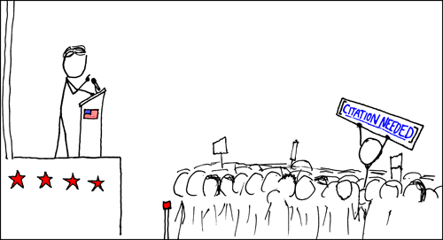
Potential Equivalence
(x := e₁; x := e₂) ≈ x := e₂
Is this a valid equivalence?
`

Slide 41
Not An Equivalence
(x := e₁; x := e₂) ¿ x := e₂
Iie. Chigau yo. Dame desu!
Not a valid equivalence for all e₁, e₂.
Consider:
  (x := x+1; x := x+2) ¿ x := x+2
But for n₁, n₂ it’s fine:
  (x := n₁; x := n₂) ≈ x := n₂

Slide 42
Proving An Equivalence
Prove that “skip; c ≈ c” for all c
Assume that D :: <skip; c, σ> ⇓ σ’
By inversion (twice) we have that
Thus, we have D₁ :: <c,σ> ⇓ σ’
The other direction is similar
<skip, σ> ⇓ σ D₁ :: <c, σ> ⇓ σ’
D ::
<skip; c, σ> ⇓ σ’

Slide 43
Proving An Inequivalence
Prove that x := y ¿ x := z when y≠z
It suffices to exhibit a σ in which the two commands yield different results
Let σ(y) = 0 and σ(z) = 1
Then
<x := y, σ> ⇓ σ[x := 0]
<x := z, σ> ⇓ σ[x := 1]
Optional
Material
Ends

Slide 44
Summary of
Operational Semantics
Precise specification of dynamic semantics
  order of evaluation (or that it doesn’t matter)
  error conditions (sometimes implicitly, by rule applicability; “no applicable rule” = “get stuck”)
Simple and abstract (vs. implementations)
  no low-level details such as stack and memory management, data layout, etc.
Often not compositional (see while)
Basis for many proofs about a language
  Especially when combined with type systems!
Basis for much reasoning about programs
Point of reference for other semantics

Slide 45
Homework
Don't Neglect Your Homework
Read DPLL(T) and Simplex

