Slide 1


Introduction to
Denotational Semantics

Slide 2





Fireside Chat
with …
Thursday, Sept 22
5:00 pm
Thornton E303
Malathi
Veeraraghavan
Meet and ask them questions in a non-academic setting.
Learn what they wish they had known when they were students, and what their lives are like outside of the office.
Ask them anything!
All are welcome.
Mark Sherriff
ACM-W

Slide 3
Gone in Sixty Seconds
Denotation semantics is a formal way of assigning meanings to programs. In it, the meaning of a program is a mathematical object.
Denotation semantics is compositional: the meaning of an expression depends on the meanings of subexpressions.
Denotational semantics uses ? (“bottom”) to mean non-termination.
DS uses fixed points and domains to handle while.

Slide 4
Recall:
Induction on Derivations Summary
If you must prove ∀x ∈ A. P(x) ⇒ Q(x)
  A is some structure (e.g., AST), P(x) is some property
  we pick arbitrary x ∈ A and D :: P(x)
  we could do induction on both facts
    x ∈ A leads to induction on the structure of x
    D :: P(x) leads to induction on the structure of D
  Generally, the induction on the structure of the derivation is more powerful and a safer bet
Sometimes there are many choices for induction
  choosing the right one is a trial-and-error process
  a bit of practice can help a lot

Slide 5
Overall Summary of
Operational Semantics
Precise specification of dynamic semantics
  order of evaluation (or that it doesn’t matter)
  error conditions (sometimes implicitly, by rule applicability; “no applicable rule” = “get stuck”)
Simple and abstract (vs. implementations)
  no low-level details such as stack and memory management, data layout, etc.
Often not compositional (see while)
Basis for many proofs about a language
  Especially when combined with type systems!
Basis for much reasoning about programs
Point of reference for other semantics

Slide 6
Dueling Semantics
Operational semantics is
  simple
  of many flavors (natural, small-step, more or less abstract)
  not compositional
  commonly used in the real (modern research) world
Denotational semantics is
  mathematical (the meaning of a syntactic expression is a mathematical object)
  compositional
Denotational semantics is also called: fixed-point semantics, mathematical semantics, Scott-Strachey semantics

Slide 7

Typical Student Reaction To
Denotation Semantics

Slide 8
Denotational Semantics
Learning Goals
DS is compositional (!)
When should I use DS?
In DS, meaning is a “math object”
DS uses ? (“bottom”) to mean non-termination
DS uses fixed points and domains to handle while
  This is the tricky bit

Slide 9
DS In The Real World
ADA was formally specified with it
Handy when you want to study non-trivial models of computation
  e.g., “actor event diagram scenarios”, process calculi
Nice when you want to compare a program in Language 1 to a program in Language 2

Slide 10
Foreshadowing
Denotational semantics assigns meanings to programs
The meaning will be a mathematical object
  A number a 2 Z
  A boolean b 2 {true, false}
  A function c : Σ ! (Σ [ {non-terminating})
The meaning will be determined compositionally
  Denotation of a command is based on the denotations of its immediate sub-commands (= more than merely syntax-directed)

Slide 11
New Notation
‘Cause, why not?
« ¬ = “means” or “denotes”
Example:
«foo¬ = “denotation of foo”
«3 < 5¬ = true
«3 + 5¬ = 8
Sometimes we write A«¢¬ for arith, B«¢¬ for boolean, C«¢¬ for command

Slide 12
Rough Idea of
Denotational Semantics
The meaning of an arithmetic expression e in state σ is a number n
So, we try to define A«e¬ as a function that maps the current state to an integer:
A«¢¬ : Aexp ! (Σ ! Z)
The meaning of boolean expressions is defined in a similar way
B«¢¬ : Bexp ! (Σ ! {true, false})
All of these denotational function are total
  Defined for all syntactic elements
  For other languages it might be convenient to define the semantics only for well-typed elements

Slide 13
Denotational Semantics of Arithmetic Expressions
We inductively define a function
A«¢¬ : Aexp ! (Σ ! Z)
A«n¬ σ = the integer denoted by literal n
A«x¬ σ = σ(x)
A«e₁+e₂¬ σ = A«e₁¬σ + A«e₂¬σ
A«e₁-e₂¬ σ = A«e₁¬σ - A«e₂¬σ
A«e₁*e₂¬ σ = A«e₁¬σ * A«e₂¬σ
This is a total function (= defined for all expressions)

Slide 14
Denotational Semantics of Boolean Expressions
We inductively define a function
B«¢¬ : Bexp ! (Σ ! {true, false})
B«true¬σ = true
B«false¬σ = false
B«b₁ Æ b₂¬σ = B«b₁¬ σ Æ B«b₂¬ σ
B«e₁ = e₂¬σ = if A«e₁¬ σ = A«e₂¬ σ
then true else false

Slide 15
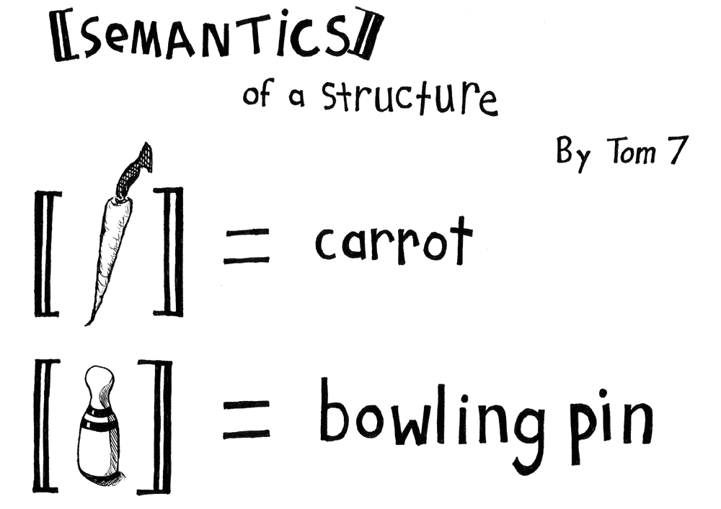
Seems Easy So Far

Slide 16
Denotational Semantics for Commands
Running a command c starting from a state σ yields another state σ’
So, we try to define C«c¬ as a function that maps σ to σ’
C«¢¬ : Comm ! (Σ ! Σ)
Will this work? Bueller?

Slide 17
? = Non-Termination
We introduce the special element ? (“bottom”) to denote a special resulting state that stands for non-termination
For any set X, we write
X? to denote X [ {?}
Convention:
whenever f 2 X ! X? we extend f to X? ! X? so that f(?) = ?
  This is called strictness

Slide 18
Denotational Semantics of Commands
We try:
C«¢¬ : Comm ! (Σ ! Σ?)
C«skip¬ σ = σ
C«x := e¬ σ = σ[x := A«e¬ σ]
C«c₁; c₂¬ σ = C«c₂¬ (C«c₁¬ σ)
C«if b then c₁ else c₂¬ σ =
if B«b¬σ then C«c₁¬σ else C«c₂¬σ
C«while b do c¬ σ = ? (later)

Slide 19
Examples
C«x:=2; x:=1¬ σ =
σ[x := 1]
C«if true then x:=2; x:=1 else …¬ σ =
σ[x := 1]
The semantics does not care about intermediate states (cf. “big-step”)
We haven’t used ? yet

Slide 20
Q: Theatre (012 / 842)
Name the author or the 1953 play about McCarthyism that features John Proctor's famous cry of "More weight!" .

Slide 21
Q: Games (557 / 842)
Name the company that manufactures Barbie (a $1.9 billion dollar a year industry in 2005 with two dolls being bought every second).

Slide 22
English Prose
43. I think its amusing fact that most people think that my earcuffs are just some kind of excentrick decoration.
113. They might have been the two youngest advisors, (both 17), but they were her most trust.
118. He sunk so lo as to go after some blonde bimbo names Tracie.
389. Her book was really a one of a kind item, she could not make one the same. As she passed a more freighting prospect came to her, St. John, had in his possession, her very thoughts, desires, and loves, or recorded for him in one book, John had the equivalent of her sole.

Slide 23
Denotational Semantics of WHILE
Notation: W = C«while b do c¬
Idea: rely on the equivalence (see end of notes)
while b do c ≈ if b then c; while b do c else skip
Try
W(σ) = if B«b¬σ then W(C«c¬σ) else σ
This is called the unwinding equation
It is not a good denotation of W because:
  It defines W in terms of itself
  It is not evident that such a W exists
  It does not describe W uniquely
  It is not compositional

Slide 24
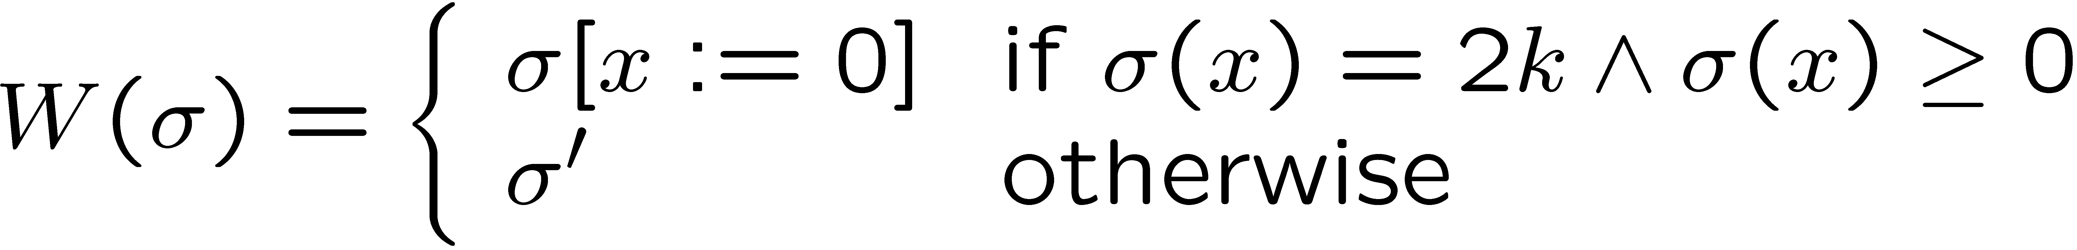
More on WHILE
The unwinding equation does not specify W uniquely
Take C«while true do skip¬
The unwinding equation reduces to W(σ) = W(σ), which is satisfied by every function!
Take C«while x ≠ 0 do x := x – 2¬
The following solution satisfies equation (for any σ’)

Slide 25
Denotational Game Plan
Since WHILE is recursive
  always have something like: W(σ) = F(W(σ))
Admits many possible values for W(σ)
We will order them
  With respect to non-termination = “least”
And then find the least fixed point
LFP W(σ)=F(W(σ)) == meaning of “while”

Slide 26
WHILE k-steps Semantics
Define W_{k}: Σ ! Σ? (for k 2 N) such that
We can define the W_{k} functions as follows:
W_{k}(σ) =
σ’
if “while b do c” in state σ terminates in fewer than k iterations in state σ’
?
otherwise
W₀(σ) =
?
W_{k}(σ) =
W_{k-1}(C«c¬σ)
if B«b¬σ for k ¸ 1
σ
otherwise

Slide 27
WHILE Semantics
How do we get W from W_{k}?
This is a valid compositional definition of W
  Depends only on C«c¬ and B«b¬
Try the examples again:
  For C«while true do skip¬
W_{k}(σ) = ? for all k, thus W(σ) = ?
  For C«while x ≠ 0 do x := x – 2¬
W(σ) =
σ’
if 9k.W_{k}(σ) = σ’ ≠ ?
?
otherwise
W(σ) =
σ[x:=0]
if σ(x) = 2n Æ σ(x) ¸ 0
?
otherwise

Slide 28
More on WHILE
The solution is not quite satisfactory because
  It has an operational flavor (= “run the loop”)
  It does not generalize easily to more complicated semantics (e.g., higher-order functions)
However, precisely due to the operational flavor this solution is easy to prove sound w.r.t operational semantics

Slide 29
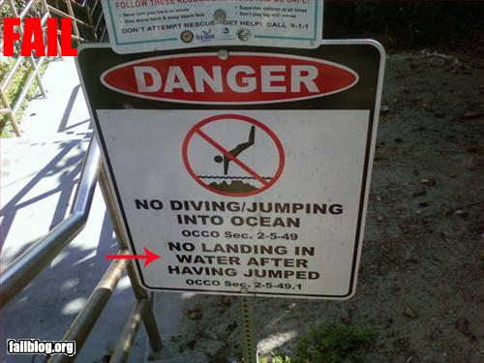
That Wasn’t Good Enough!?

Slide 30
Simple Domain Theory
Consider programs in an eager, deterministic language with one variable called “x”
  All these restrictions are just to simplify the examples
A state σ is just the value of x
  Thus we can use Z instead of Σ
The semantics of a command give the value of final x as a function of input x
C« c ¬ : Z ! Z?

Slide 31
Examples - Revisited
Take C«while true do skip¬
  Unwinding equation reduces to W(x) = W(x)
  Any function satisfies the unwinding equation
  Desired solution is W(x) = ?
Take C«while x ≠ 0 do x := x – 2¬
  Unwinding equation:
W(x) = if x ≠ 0 then W(x – 2) else x
  Solutions (for all values n, m 2 Z?):
W(x) = if x ¸ 0 then
if x even then 0 else n
else m
  Desired solution: W(x) = if x ¸ 0 Æ x even then 0 else ?

Slide 32
An Ordering of Solutions
The desired solution is the one in which all the arbitrariness is replaced with non-termination
  The arbitrary values in a solution are not uniquely determined by the semantics of the code
We introduce an ordering of semantic functions
Let f, g 2 Z ! Z?
Define f v g as
8x 2 Z. f(x) = ? or f(x) = g(x)
  A “smaller” function terminates at most as often, and when it terminates it produces the same result

Slide 33
Alternative Views of
Function Ordering
A semantic function f 2 Z ! Z? can be written as S_{f} µ Z £ Z as follows:
S_{f} = { (x, y) | x 2 Z, f(x) = y ≠ ? }
  set of “terminating” values for the function
If f v g then
  S_{f} µ S_{g} (and vice-versa)
  We say that g refines f
  We say that f approximates g
  We say that g provides more information than f

Slide 34
The “Best” Solution
Consider again C«while x ≠ 0 do x := x – 2¬
  Unwinding equation:
W(x) = if x ≠ 0 then W(x – 2) else x
Not all solutions are comparable:
W(x) = if x ¸ 0 then if x even then 0 else 1 else 2
W(x) = if x ¸ 0 then if x even then 0 else ? else 3
W(x) = if x ¸ 0 then if x even then 0 else ? else ?
(last one is least and best)
Is there always a least solution?
How do we find it?
If only we had a general framework for answering these questions …

Slide 35

A Recursive Labyrinth

Slide 36
Fixed-Point Equations
Consider the general unwinding equation for while
while b do c ≡ if b then c; while b do c else skip
We define a context C (command with a hole)
C = if b then c; ² else skip
while b do c ≡ C[while b do c]
  The grammar for C does not contain “while b do c”
We can find such a (recursive) context for any looping construct
  Consider: fact n = if n = 0 then 1 else n * fact (n – 1)
  C(n) = if n = 0 then 1 else n * ² (n – 1)
  fact = C [ fact ]

Slide 37
Fixed-Point Equations
The meaning of a context is a semantic functional
F : (Z ! Z?) ! (Z ! Z?) such that
F «C[w]¬ = F «w¬
For “while”: C = if b then c; ² else skip
F w x = if «b¬ x then w («c¬ x) else x
  F depends only on «c¬ and «b¬
We can rewrite the unwinding equation for while
  W(x) = if «b¬ x then W(«c¬ x) else x
  or, W x = F W x for all x,
  or, W = F W (by function equality)

Slide 38
Fixed-Point Equations
The meaning of “while” is a solution for W = F W
Such a W is called a fixed point of F
We want the least fixed point
  We need a general way to find least fixed points
Whether such a least fixed point exists depends on the properties of function F
  Counterexample: F w x = if w x = ? then 0 else ?
  Assume W is a fixed point
  F W x = W x = if W x = ? then 0 else ?
  Pick an x, then if W x = ? then W x = 0 else W x = ?
  Contradiction. This F has no fixed point!

Slide 39
Can We Solve This?
Good news: the functions F that correspond to contexts in our language have least fixed points!
The only way F w x uses w is by invoking it
If any such invocation diverges, then F w x diverges!
It turns out: F is monotonic, continuous
  Not shown here!

Slide 40
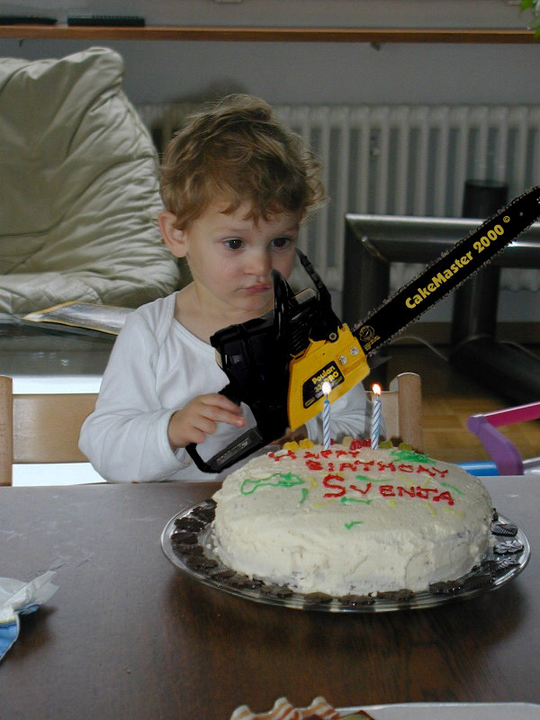
We need more power!

Slide 41
New Notation: λ
λx. e
  an anonymous function with body e and argument x
Example: double(x) = x+x
double = λx. x+x
Example: allFalse(x) = false
allFalse = λx. false
Example: multiply(x,y) = x*y
multiply = λx. λy. x*y

Slide 42
The Fixed-Point Theorem
If F is a semantic function corresponding to a context in our language
  F is monotonic and continuous (we assert)
  For any fixed-point G of F and k 2 N
F^{k}(λx.? ) v G
  The least of all fixed points is
t_{k} F^{k}(λx.?)
Proof (not detailed in the lecture):
  By mathematical induction on k.
Base: F⁰(λx.? ) = λx.? v G
Inductive: F^{k+1}(λx.? ) = F(F^{k}(λx.? )) v F(G) = G
  Suffices to show that t_{k} F^{k}(λx.? ) is a fixed-point
F(t_{k} F^{k}(λx.? )) = t_{k} F^{k+1}(λx.? ) = t_{k} F^{k}(λx.? )

Slide 43
WHILE Semantics
We can use the fixed-point theorem to write the denotational semantics of while:
«while b do c¬ = t_{k} F^{k} (λx.?)
where F f x = if «b¬ x then f («c¬ x) else x
Example: «while true do skip¬ = λx.?
Example: «while x ≠ 0 then x := x – 1¬
  F (λx.?) x = if x = 0 then x else ?
  F² (λx.?) x = if x = 0 then x else if x–1 = 0 then x–1 else ?
= if 1 ¸ x ¸ 0 then 0 else ?
  F³ (λx.?) x = if 2 ¸ x ¸ 0 then 0 else ?
  LFP_{F} = if x ¸ 0 then 0 else ?
Not easy to find the closed form for general LFPs!

Slide 44
Discussion
We can write the denotational semantics but we cannot always compute it.
  Otherwise, we could decide the halting problem
  H is halting for input 0 iff «H¬ 0 ≠ ?
We have derived this for programs with one variable
  Generalize to multiple variables, even to variables ranging over richer data types, even higher-order functions: domain theory

Slide 45

Can You Remember?
You just survived the hardest lecture.
It’s all downhill from here.

Slide 46
Recall: Learning Goals
DS is compositional
When should I use DS?
In DS, meaning is a “math object”
DS uses ? (“bottom”) to mean non-termination
DS uses fixed points and domains to handle while
  This is the tricky bit

Slide 47
Homework
Homework 2
Start Homework 3
  Not as long as it looks – separated out every exercise sub-part for clarity.
  Your denotational answers must be compositional (e.g., W_{k}(σ) or LFP)
Read!

Slide 49
Equivalence
Two expressions (commands) are equivalent if they yield the same result from all states
e₁ ≈ e₂ iff
∀σ ∈ Σ. ∀n ∈ N.
<e₁, σ> ⇓ n iff <e₂, σ> ⇓ n
and for commands
c₁ ≈ c₂ iff
∀σ, σ’ ∈ Σ.
<c₁, σ> ⇓ σ’ iff <c₂, σ> ⇓ σ’

Slide 50
Notes on Equivalence
Equivalence is like logical validity
  It must hold in all states (= all valuations)
  2 ≈ 1 + 1 is like “2 = 1 + 1 is valid”
  2 ≈ 1 + x might or might not hold.
    So, 2 is not equivalent to 1 + x
Equivalence (for IMP) is undecidable
  If it were decidable we could solve the halting problem for IMP. How?
Equivalence justifies code transformations
  compiler optimizations
  code instrumentation
  abstract modeling
Semantics is the basis for proving equivalence

Slide 51
Equivalence Examples
skip; c ≈ c
while b do c ≈ if b then c; while b do c else skip
If e₁ ≈ e₂ then x := e₁ ≈ x := e₂
while true do skip ≈ while true do x := x + 1
If c is
while x ≠ y do
if x ≥ y then x := x - y else y := y - x
then (x := 221; y := 527; c) ≈ (x := 17; y := 17)

Slide 52
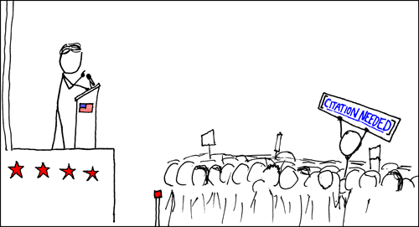
Potential Equivalence
(x := e₁; x := e₂) ≈ x := e₂
Is this a valid equivalence?
`

Slide 53
Not An Equivalence
(x := e₁; x := e₂) ¿ x := e₂
Iie. Chigau yo. Dame desu!
Not a valid equivalence for all e₁, e₂.
Consider:
  (x := x+1; x := x+2) ¿ x := x+2
But for n₁, n₂ it’s fine:
  (x := n₁; x := n₂) ≈ x := n₂

Slide 54
Proving An Equivalence
Prove that “skip; c ≈ c” for all c
Assume that D :: <skip; c, σ> ⇓ σ’
By inversion (twice) we have that
Thus, we have D₁ :: <c,σ> ⇓ σ’
The other direction is similar
<skip, σ> ⇓ σ D₁ :: <c, σ> ⇓ σ’
D ::
<skip; c, σ> ⇓ σ’

Slide 55
Proving An Inequivalence
Prove that x := y ¿ x := z when y ≠z
It suffices to exhibit a σ in which the two commands yield different results
Let σ(y) = 0 and σ(z) = 1
Then
<x := y, σ> ⇓ σ[x := 0]
<x := z, σ> ⇓ σ[x := 1]

