Slide 1
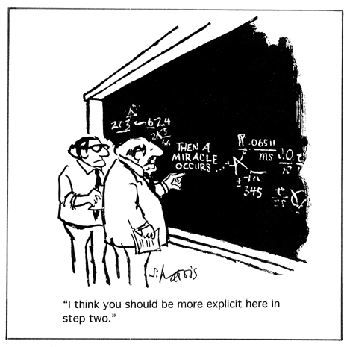
Introduction to
Axiomatic Semantics
(1/2)

Slide 2
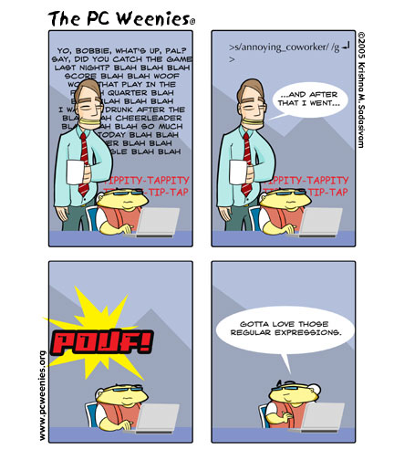
How’s The Homework Going?
Remember: just do the “counter-example guided abstraction refinement” part of DPLL(T).
If you notice any other errors, those are good things to mention in your text. :-)

Slide 3
Review via Class Participation
Tell Me About Operational Semantics
Tell Me About Structural Induction
Tell Me About Satisfiability Modulo Theories
We would also like a semantics that is appropriate for arguing program correctness
“Axiomatic Semantics”, we’ll call it.

Slide 4
Aujourd’hui, nous ferons …
History
Assertions
Validity
Derivation Rules
Soundness
Completeness

Slide 5
Axiomatic Semantics
An axiomatic semantics consists of:
  A language for stating assertions about programs,
  Rules for establishing the truth of assertions
Some typical kinds of assertions:
  This program terminates
  If this program terminates, the variables x and y have the same value throughout the execution of the program
  The array accesses are within the array bounds
Some typical languages of assertions
  First-order logic
  Other logics (temporal, linear, pointer-assertion)
  Special-purpose specification languages (SLIC, Z, Larch)

Slide 6
History
Program verification is almost as old as programming (e.g., Checking a Large Routine, Turing 1949)
In the late ’60s, Floyd had rules for flow-charts and Hoare for structured languages
Since then, there have been axiomatic semantics for substantial languages, and many applications
  ESC/Java, SLAM, PCC, SPARK Ada, …

Slide 7
Tony Hoare Quote
“Thus the practice of proving programs would seem to lead to solution of three of the most pressing problems in software and programming, namely, reliability, documentation, and compatibility. However, program proving, certainly at present, will be difficult even for programmers of high caliber; and may be applicable only to quite simple program designs.”
-- C.A.R Hoare, An Axiomatic Basis for Computer Programming,1969

Slide 8
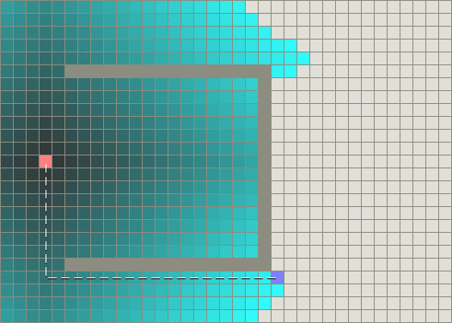
Edsger Dijkstra Quote
“Program testing can be used to show the presence of bugs, but never to show their absence!”
Qu’est-ce que c’est?

Slide 9
Tony Hoare Quote, Mark 2
“It has been found a serious problem to define these languages [ALGOL, FORTRAN, COBOL] with sufficient rigor to ensure compatibility among all implementations. ... one way to achieve this would be to insist that all implementations of the language shall satisfy the axioms and rules of inference which underlie proofs of properties of programs expressed in the language. In effect, this is equivalent to accepting the axioms and rules of inference as the ultimately definitive specification of the meaning of the language.”

Slide 10
Other Applications of Axiomatic Semantics
The project of defining and proving everything formally has not succeeded (at least not yet)
Proving has not replaced testing and debugging
Applications of axiomatic semantics:
  Proving the correctness of algorithms (or finding bugs)
  Proving the correctness of hardware descriptions (or finding bugs)
  “extended static checking” (e.g., checking array bounds)
  Proof-carrying code
  Documentation of programs and interfaces

Slide 11
Assertion Notation
{A} c {B}
with the meaning that:
  if A holds in state σ and if <c, σ> ⇓ σ’
  then B holds in σ’
A is the precondition
B is the postcondition
For example:
{ y · x } z := x; z := z +1 { y < z }
is a valid assertion
These are called Hoare triples or Hoare assertions

Slide 12
Assertions for IMP
{A} c {B} is a partial correctness assertion.
  Does not imply termination (= it is valid if c diverges)
[A] c [B] is a total correctness assertion meaning that
If A holds in state σ
Then there exists σ’ such that <c, σ> ⇓ σ’
and B holds in state σ’
Now let us be more formal (we all love it!)
  Formalize the language of assertions, A and B
  Say when an assertion holds in a state
  Give rules for deriving Hoare triples

Slide 13
The Assertion Language
We use first-order predicate logic on top of IMP expressions
A :: = true | false | e₁ = e₂ | e₁ ¸ e₂
| A₁ Æ A₂ | A₁ Ç A₂ | A₁ ) A₂ | 8x.A | 9x.A
Note that we are somewhat sloppy in mixing logical variables and the program variables
All IMP variables implicitly range over integers
All IMP boolean expressions are also assertions

Slide 14
Assertion Judgment ²
We need to assign meanings to our assertions
New judgment σ ² A to say that an assertion holds in a given state (= “A is true in σ”)
  This is well-defined when σ is defined on all variables occurring in A
The ² judgment is defined inductively on the structure of assertions (surprise!)
It relies on the operational semantics of arithmetic expressions from IMP

Slide 15
Semantics of Assertions
Formal definition
σ ² true always
σ ² e₁ = e₂ iff <e₁,σ>⇓ = <e₂,σ>⇓
σ ² e₁ ¸ e₂ iff <e₁,σ>⇓ ¸ <e₂,σ>⇓
σ ² A₁ Æ A₂ iff σ ² A₁ and σ ² A₂
σ ² A₁ Ç A₂ iff σ ² A₁ or σ ² A₂
σ ² A₁ ) A₂ iff σ ² A₁ implies σ ² A₂
σ ² 8x.A iff 8n2Z. σ[x:=n] ² A
σ ² 9x.A iff 9n2Z. σ[x:=n] ² A

Slide 16
Hoare Triple Semantics
Now we can define formally the meaning of a partial correctness assertion ² { A } c { B }
8σ2Σ. 8σ’2Σ. (σ ² A Æ <c,σ> ⇓ σ’) ) σ’ ² B
… and a total correctness assertion ² [A] c [B]
8σ2Σ. σ ² A ) 9σ’2Σ. <c,σ> ⇓ σ’ Æ σ’ ² B
or even better yet: (explain this to me!)
8σ2Σ. 8σ’2Σ. (σ ² A Æ <c,σ> ⇓ σ’) ) σ’ ² B
Æ
8σ2Σ. σ ² A ) 9σ’2Σ. <c,σ> ⇓ σ’

Slide 17
Q: Movie Music (420 / 842)
In a 1995 Disney movie that has been uncharitably referred to as "Hokey-Hontas", the Stephen Schwartz lyrics "what I love most about rivers is: / you can't step in the same river twice" refer to the ideas of which Greek philosopher?

Slide 18
Computer Science
This American Turing-award winner is known for his work on formal semantics of programming languages, automata theory, modal logic, topology, and category theory. His 1959 paper with Rabin, Finite Automata and Their Decision Problem, introduced the idea of nondeterministic machines to automata and complexity theory.

Slide 19
Q: Movies (267 / 842)
Name the movie described below, its heroine and its star. This 1979 Ridley Scott movie began the first major American film series with a female action hero. Famously, it is the original movie to pass the Bechdel Test.

Slide 20
Deriving Assertions
Have a formal mechanism to decide ² { A } c { B }
  But it is not satisfactory
  Because ² {A} c {B} is defined in terms of the operational semantics, we practically have to run the program to verify an assertion
  It is impossible to effectively verify the truth of a 8x. A assertion (check every integer?)
Plan: define a symbolic technique for deriving valid assertions from others that are known to be valid
  We start with validity of first-order formulas

Slide 21
Derivation Rules
We write ` A when A can be derived from basic axioms (` A === “we can prove A”)
The derivation rules for ` A are the usual ones from first-order logic with arithmetic:
` A ) B ` A
` A ` B
` B
` A Æ B
` [a/x]A (a is fresh)
` A
…
` B
` [a/x]A
…
` 8x.A
` 8x.A
` [e/x]A
` 9x.A
` B
` A ) B
` [e/x]A
` 9x.A
` B

Slide 22
Derivation Rules for Hoare Triples
Similarly we write ` {A} c {B} when we can derive the triple using derivation rules
There is one derivation rule for each command in the language
Plus, the evil rule of consequence
` A’ ) A ` {A} c {B} ` B ) B’
` {A’} c {B’}

Slide 23
Derivation Rules for Hoare Logic
One rule for each syntactic construct:
` {A} skip {A}
` {[e/x]A} x := e {A}
` {A} c₁ {B} ` {B} c₂ {C}
` {A} c₁; c₂ {C}
` {A Æ b} c₁ {B} ` {A Æ : b} c₂ {B}
` {A} if b then c₁ else c₂ {B}
` {A Æ b} c {A}
` {A} while b do c {A Æ : b}

Slide 24
Alternate Hoare Rules
For some constructs multiple rules are possible:
(Exercise: these rules can be derived from the previous ones using the consequence rules)
` {A} x := e {9x₀.[x₀/x]A Æ x = [x₀/x]e}
(This one is called the “forward” axiom for assignment)
` A Æ b ) C ` {C} c {A} ` A Æ : b ) B
` {A} while b do c {B}
(C is the loop invariant)

Slide 25
Example: Assignment
(Assuming that x does not appear in e)
Prove that {true} x := e { x = e }
Assignment Rule:
because [e/x](x = e) ! e = e
Use Assignment + Consequence:
` {e = e} x := e {x = e}
` true ) e = e
` {e = e} x := e {x = e}
` {true} x := e {x = e}

Slide 26
The Assignment Axiom (Cont.)
“Assignment is undoubtedly the most characteristic feature of programming a digital computer, and one that most clearly distinguishes it from other branches of mathematics. It is surprising therefore that the axiom governing our reasoning about assignment is quite as simple as any to be found in elementary logic.” - Tony Hoare
Caveats are sometimes needed for languages with aliasing (the strong update problem):
  If x and y are aliased then
{ true } x := 5 { x + y = 10}
is true

Slide 27
Example: Conditional
D₁ and D₂ were obtained by consequence and assignment. D₁ details:
D₁ :: ` {true Æ y · 0} x := 1 {x > 0}
D₂ :: ` {true Æ y > 0} x := y {x > 0}
` {true} if y · 0 then x := 1 else x := y {x > 0}
` {1 > 0} x := 1 {x > 0} ` true Æ y · 0 ) 1 > 0
` D₁ :: {true Æ y · 0} x := 1 {x > 0}

Slide 28
Example: Loop
We want to derive that
` {x · 0} while x · 5 do x := x + 1 { x = 6}
Use the rule for while with invariant x · 6
Then finish-off with consequence
` x · 6 Æ x · 5 ) x+1 · 6
` {x+1 · 6} x := x+1 { x · 6 }
` {x · 6 Æ x · 5 } x := x+1 {x · 6}
` {x · 6} while x · 5 do x := x+1 { x · 6 Æ x > 5}
` x · 0 ) x · 6
` x · 6 Æ x > 5 ) x = 6
` {x · 6} while … { x · 6 Æ x > 5}
` {x · 0} while … {x = 6}

Slide 29
Using Hoare Rules
Hoare rules are mostly syntax directed
There are three wrinkles:
  What invariant to use for while? (fix points, widening)
  When to apply consequence? (theorem proving)
  How do you prove the implications involved in consequence? (theorem proving)
This is how theorem proving gets in the picture
  This turns out to be doable!
  The loop invariants turn out to be the hardest problem!
(Should the programmer give them? See Dijkstra, ESC.)

Slide 30
Where Do We Stand?
We have a language for asserting properties of programs
We know when such an assertion is true
We also have a symbolic method for deriving assertions
meaning
A
{A} c {B}
σ ² A
² {A} c {B}
soundness
symbolic
derivation
(theorem proving)
completeness
` A
` { A} c {B}

Slide 31
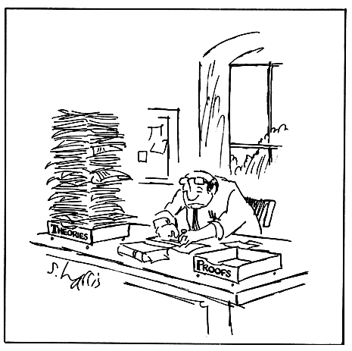
Soundness and Completeness

Slide 32
Soundness of Axiomatic Semantics
Formal statement of soundness:
if ` { A } c { B } then ² { A } c { B }
or, equivalently
For all σ, if σ ² A
and Op :: <c, σ> ⇓ σ’
and Pr :: ` { A } c { B }
then σ’ ² B
“Op” === “Opsem Derivation”
“Pr” === “Axiomatic Proof”
How shall we prove this, oh class?

Slide 33
Not Easily!
By induction on the structure of c?
  No, problems with while and rule of consequence
By induction on the structure of Op?
  No, problems with while
By induction on the structure of Pr?
  No, problems with consequence
By simultaneous induction on the structure of Op and Pr
  Yes! New Technique!

Slide 34
Simultaneous Induction
Consider two structures Op and Pr
  Assume that x < y iff x is a substructure of y
Define the ordering
(o, p) Á (o’, p’) iff
o < o’ or o = o’ and p < p’
  Called lexicographic (dictionary) ordering
This Á is a well founded order and leads to simultaneous induction
If o < o’ then p can actually be larger than p’!
It can even be unrelated to p’!

Slide 35
Soundness of the While Rule
(Indiana Proof and the Slide of Doom)
Case: last rule used in Pr : ` {A} c {B} was the while rule:
Two possible rules for the root of Op (by inversion)
  We’ll only do the complicated case:
Assume that σ ² A
To show that σ’’ ² A Æ : b
By soundness of booleans and Op₁ we get σ ² b
  Hence σ ² A Æ b
By IH on Pr₁ and Op₂ we get σ’ ² A
By IH on Pr and Op₃ we get σ’’ ² A Æ : b, q.e.d. (tricky!)
Pr₁ :: ` {A Æ b} c {A}
` {A} while b do c {A Æ : b}
Op₁ :: <b, σ> ⇓ true Op₂ :: <c,σ> ⇓ σ’ Op₃ :: <while b do c, σ’ > ⇓ σ’’
<while b do c, σ > ⇓ σ’’

Slide 36
Soundness of the While Rule
Note that in the last use of IH the derivation Pr did not decrease
But Op₃ was a sub-derivation of Op
See Winskel, Chapter 6.5, for a soundness proof with denotational semantics
To be continued ...

Slide 37
Homework
HW 3 Due Soon
Axiomatic Reading

