Slide 1

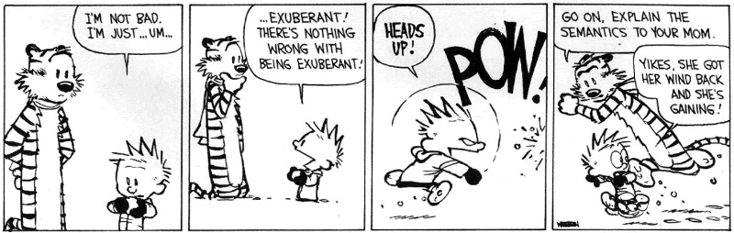
Symbolic
Execution

Slide 2
One-Slide Summary
Verification Conditions make axiomatic semantics practical. We can compute verification conditions forward for use on unstructured code (= assembly language). This is sometimes called symbolic execution.
We can add extra invariants or drop paths (dropping is unsound) to help verification condition generation scale.
We can model exceptions, memory operations and data structures using verification condition generation.

Slide 3
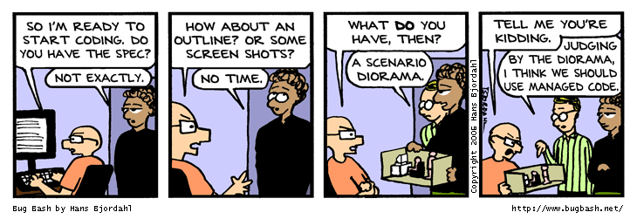
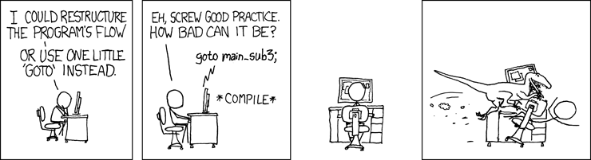
Symbolic Execution

Slide 4
Not Quite Weakest Preconditions
Recall what we are trying to do:
false
)
true
Pre(s, B)
strong
weak
weakest
precondition: WP(c, B)
A
verification
condition: VC(c, B)
Construct a verification condition: VC(c, B)
  Our loops will be annotated with loop invariants!
  VC is guaranteed to be stronger than WP
  But still weaker than A: A ) VC(c, B) ) WP(c, B)

Slide 5
Groundwork
Factor out the hard work
  Loop invariants
  Function specifications (pre- and post-conditions)
Assume programs are annotated with such specs
  Good software engineering practice anyway
  Requiring annotations = Kiss of Death?
New form of while that includes a loop invariant:
while_{Inv} b do c
  Invariant formula Inv must hold every time before b is evaluated
A process for computing VC(annotated_command, post_condition) is called VCGen

Slide 6
Verification Condition Generation
Mostly follows the definition of the wp function:
VC(skip, B) = B
VC(c₁; c₂, B) = VC(c₁, VC(c₂, B))
VC(if b then c₁ else c₂, B) =
b ) VC(c₁, B) Æ :b ) VC(c₂, B)
VC(x := e, B) = [e/x] B
VC(let x = e in c, B) = [e/x] VC(c, B)
VC(while_{Inv} b do c, B) = ?

Slide 7
VCGen for WHILE
VC(while_{Inv} e do c, B) =
Inv Æ (8x₁…x_{n}. Inv ) (e ) VC(c, Inv) Æ : e ) B) )
Inv is the loop invariant (provided externally)
x₁, …, x_{n} are all the variables modified in c
The 8 is similar to the 8 in mathematical induction:
P(0) Æ 8n 2 N. P(n) ) P(n+1)
Inv holds
on entry
Inv is preserved in
an arbitrary iteration
B holds when the
loop terminates
in an arbitrary iteration

Slide 8
Example VCGen Problem
Let’s compute the VC of this program with respect to post-condition x ≠ 0
x = 0;
y = 2;
while_{x+y=2} y > 0 do
y := y - 1;
x := x + 1
First, what do we expect? What pre-condition do we need to ensure x≠0 after this?

Slide 9
Example of VC
By the sequencing rule, first we do the while loop (call it w):
while_{x+y=2} y > 0 do
y := y - 1;
x := x + 1
VCGen(w, x ≠ 0) = x+y=2 Æ
8x,y. x+y=2 ) (y>0 ) VC(c, x+y=2) Æ y·0 ) x ≠ 0)
VCGen(y:=y-1 ; x:=x+1, x+y=2) =
(x+1) + (y-1) = 2
w Result: x+y=2 Æ
8x,y. x+y=2 ) (y>0 ) (x+1)+(y-1)=2 Æ y·0 ) x ≠ 0)
Preserve loop invariant
Ensure post on exit

Slide 10
Example of VC (2)
VC(w, x ≠ 0) = x+y=2 Æ
8x,y. x+y=2 )
(y>0 ) (x+1)+(y-1)=2 Æ y·0 ) x ≠ 0)
VC(x := 0; y := 2 ; w, x ≠ 0) = 0+2=2 Æ
8x,y. x+y=2 )
(y>0 ) (x+1)+(y-1)=2 Æ y·0 ) x ≠ 0)
So now we ask an automated theorem prover to prove it.

Slide 11
Thoreau, Thoreau, Thoreau
$ ./Simplify
> (AND (EQ (+ 0 2) 2)
(FORALL ( x y ) (IMPLIES (EQ (+ x y) 2)
(AND (IMPLIES (> y 0)
(EQ (+ (+ x 1)(- y 1)) 2))
(IMPLIES (<= y 0) (NEQ x 0))))))
1: Valid.
Huzzah!
Simplify is a non-trivial five megabytes
Z3 is 15+ megabytes

Slide 12
Can We Mess Up VCGen?
The invariant is from the user (= the adversary, the untrusted code base)
Let’s use a loop invariant that is too weak, like “true”.
VC = true Æ 8x,y. true )
(y>0 ) true Æ y·0 ) x ≠ 0)
Let’s use a loop invariant that is false, like “x ≠ 0”.
VC = 0 ≠ 0 Æ 8x,y. x ≠ 0 )
(y>0 ) x+1 ≠ 0 Æ y·0 ) x ≠ 0)

Slide 13
Emerson, Emerson, Emerson
$ ./Simplify
> (AND TRUE
(FORALL ( x y ) (IMPLIES TRUE
(AND (IMPLIES (> y 0) TRUE)
(IMPLIES (<= y 0) (NEQ x 0))))))
Counterexample: context:
(AND
(EQ x 0)
(<= y 0)
)
1: Invalid.
OK, so we won’t be fooled.

Slide 14
Soundness of VCGen
Simple form
² { VC(c,B) } c { B }
Or equivalently that
² VC(c, B) ) wp(c, B)
Proof is by induction on the structure of c
  Try it!
Soundness holds for any choice of invariant!
Next: extensions to Symbolic Execution

Slide 15
Where Are We?
Axiomatic Semantics: the meaning of a program is what is true after it executes
Hoare Triples: {A} c {B}
Weakest Precondition: { WP(c,B) } c {B}
Verification Condition: A)VC(c,B))WP(c,b)
  Requires Loop Invariants
  Backward VC works for structured programs
  Here we are today …
  Forward VC (Symbolic Exec) works for assembly

Slide 16
Today’s Cunning Plan
Symbolic Execution & Forward VCGen
Handling Exponential Blowup
  Invariants
  Dropping Paths
VCGen For Exceptions (double trouble)
VCGen For Memory (McCarthyism)
VCGen For Structures (have a field day)
VCGen For “Dictator For Life”

Slide 17
VC and Invariants
Consider the Hoare triple:
{x ≤ 0} while_{I(x)} x ≤ 5 do x := x + 1 {x = 6}
The VC for this is:
x ≤ 0 ⇒ I(x) ∧ ∀x. (I(x) ⇒ (x > 5 ⇒ x = 6 ∧
x ≤ 5 ⇒ I(x+1) ))
Requirements on the invariant:
  Holds on entry ∀x. x ≤ 0 ⇒ I(x)
  Preserved by the body ∀x. I(x) ∧ x ≤ 5 ⇒ I(x+1)
  Useful ∀x. I(x) ∧ x > 5 ⇒ x = 6
Check that I(x) = x ≤ 6 satisfies all constraints

Slide 18
Forward VCGen
Traditionally the VC is computed backwards
  That’s how we’ve been doing it in class
  Backwards works well for structured code
But it can also be computed forward
  Works even for un-structured languages (e.g., assembly language)
  Uses symbolic execution, a technique that has broad applications in program analysis
    e.g., the PREfix tool (Intrinsa, Microsoft) does this
    Test input generation, document generation, specification mining, security analyses, ...

Slide 19
Forward VC Gen Intuition
Consider the sequence of assignments
x₁ := e₁; x₂ := e₂
The VC(c, B) = [e₁/x₁]([e₂/x₂]B)
= [e₁/x₁, e₂[e₁/x₁]/x₂] B
We can compute the substitution in a forward way using symbolic execution (aka symbolic evaluation)
  Keep a symbolic state that maps variables to expressions
  Initially, Σ₀ = { }
  After x₁ := e₁, Σ₁ = { x₁ ! e₁ }
  After x₂ := e₂, Σ₂ = {x₁ ! e₁, x₂ ! e₂[e₁/x₁] }
  Note that we have applied Σ₁ as a substitution to right-hand side of assignment x₂ := e₂

Slide 20
Simple Assembly Language
Consider the language of instructions:
I ::= x := e | f() | if e goto L | goto L |
L: | return | inv e
The “inv e” instruction is an annotation
  Says that boolean expression e is true at that point
Each function f() comes with Pre_{f} and Post_{f} annotations (pre- and post-conditions)
New Notation (yay!): I_{k} is the instruction at address k

Slide 21
Symex States
We set up a symbolic execution state:
Σ : Var ! SymbolicExpressions
Σ(x) = the symbolic value of x in state Σ
Σ[x:=e] = a new state in which x’s value is e
We use states as substitutions:
Σ(e) - obtained from e by replacing x with Σ(x)
Much like the opsem so far …

Slide 22
Symex Invariants
The symbolic executor tracks invariants passed
A new part of symex state: Inv µ {1…n}
If k 2 Inv then I_{k} is an invariant instruction that we have already executed
Basic idea: execute an inv instruction only twice:
  The first time it is encountered
  Once more time around an arbitrary iteration

Slide 23
Symex Rules
Define a VC function as an interpreter:
VC : Address £ SymbolicState £ InvariantState ! Assertion
VC(k, Σ, Inv) =
VC(L, Σ, Inv)
if I_{k} = goto L
e ) VC(L, Σ, Inv) Æ
: e ) VC(k+1, Σ, Inv)
if I_{k} = if e goto L
VC(k+1, Σ[x:=Σ(e)], Inv)
if I_{k} = x := e
Σ(Post_{current-function})
if I_{k} = return
Σ(Pre_{f}) Æ
8a₁..a_{m}.Σ’(Post_{f}) )
VC(k+1, Σ’, Inv)
(where y₁, …, y_{m} are modified by f)
and a₁, …, a_{m} are fresh parameters
and Σ’ = Σ[y₁ := a₁, …, y_{m} := a_{m}]
if I_{k} = f()
Recall: Inv =
“invariants
visited so far”

Slide 24
Symex Invariants (2a)
Two cases when seeing an invariant instruction:
1. We see the invariant for the first time
  I_{k} = inv e
  k ∉ Inv (= “not in the set of invariants we’ve seen”)
  Let {y₁, …, y_{m}} = the variables that could be modified on a path from the invariant back to itself
  Let a₁, …, a_{m} be fresh new symbolic parameters
VC(k, Σ, Inv) =
Σ(e) Æ 8a₁…a_{m}. Σ’(e) ) VC(k+1, Σ’, Inv [ {k}])
with Σ’ = Σ[y₁ := a₁, …, y_{m} := a_{m}]
(like a function call)

Slide 25
Symex Invariants (2b)
We see the invariant for the second time
  I_{k} = inv E
  k 2 Inv
VC(k, Σ, Inv) = Σ(e)
(like a function return)
Some tools take a more simplistic approach
  Do not require invariants
  Iterate through the loop a fixed number of times
  PREfix, versions of ESC (DEC/Compaq/HP SRC)
  Sacrifice completeness for usability

Slide 26
Symex Summary
  Let x₁, …, x_{n} be all the variables and a₁, …, a_{n} fresh parameters
  Let Σ₀ be the state [x₁ := a₁, …,x_{n} :=a_{n}]
  Let ; be the empty Inv set
For all functions f in your program, prove:
8a₁…a_{n}. Σ₀(Pre_{f}) ) VC(f_{entry}, Σ₀, ∅)
If you start the program by invoking any f in a state that satisfies Pre_{f}, then the program will execute such that
  At all “inv e” the e holds, and
  If the function returns then Post_{f} holds
Can be proved w.r.t. a real interpreter (operational semantics)
Or via a proof technique called co-induction (or, assume-guarantee)

Slide 27
Forward VCGen Example
Consider the program
Precondition: x · 0
Loop: inv x · 6
if x > 5 goto End
x := x + 1
goto Loop
End: return Postconditon: x = 6

Slide 28
Forward VCGen Example (2)
8x.
x · 0 )
x · 6 Æ
8x’.
(x’ · 6 )
x’ > 5 ) x’ = 6
Æ
x’ · 5 ) x’ + 1 · 6 )
VC contains both proof obligations and assumptions about the control flow

Slide 29
VCs Can Be Large
Consider the sequence of conditionals
(if x < 0 then x := - x); (if x ≤ 3 then x += 3)
  With the postcondition P(x)
The VC is
x < 0 Æ -x ≤ 3 ⇒ P(-x + 3) Æ
x < 0 Æ -x > 3 ⇒ P(-x) Æ
x ≥ 0 Æ x ≤ 3 ⇒ P(x + 3) Æ
x ≥ 0 Æ x > 3 ⇒ P(x )
There is one conjunct for each path
) exponential number of paths!
  Conjuncts for infeasible paths have un-satisfiable guards!
Try with P(x) = x ≥ 3

Slide 30
English Prose
341. Van and Hitomi walked an inaudible distance from those guy's Van was hanging out with.
253. However, when he got into his chamber and sat down with a blank canvas propped up on its easel, his vision vanished as if it were nothing but a floating dust moat.
352. "Good evening my league." He picked her up by the wrist. "I think that you and I have some talking to do, actually I have a preposition"

Slide 31
Computer Science
This American Turing award winner is known for the “law” that “Adding humans to a late software project makes it later.” The Turing Award citation notes landmark contributions to operating systems, software engineering and computer architecture. Notable works include No Silver Bullet: Essence and Accidents of Software Engineering and The ___ ___ ___.

Slide 32
Q: Theatre (019 / 842)
Name the composer or the title of the 1937 musical that includes the lyrics: "O Fortuna, velut luna statu variabilis, semper crescis aut decrescis; vita detestabilis nunc obdurat et tunc curat ludo mentis aciem, egestatem, potestatem dissolvit ut glaciem."

Slide 33
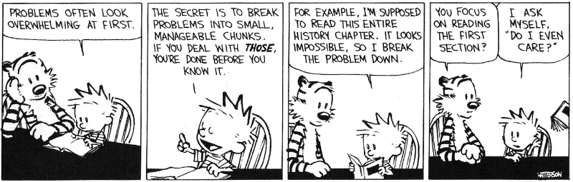
VCs Can Be Exponential
VCs are exponential in the size of the source because they attempt relative completeness:
  Perhaps the correctness of the program must be argued independently for each path
Unlikely that the programmer wrote a program by considering an exponential number of cases
  But possible. Any examples? Any solutions?

Slide 34
VCs Can Be Exponential
VCs are exponential in the size of the source because they attempt relative completeness:
  Perhaps the correctness of the program must be argued independently for each path
Standard Solutions:
  Allow invariants even in straight-line code
  And thus do not consider all paths independently!

Slide 35
Invariants in Straight-Line Code
Purpose: modularize the verification task
Add the command “after c establish Inv”
  Same semantics as c (Inv is only for VC purposes)
VC(after c establish Inv, P) =_{def}
VC(c,Inv) ∧ ∀x_{i}. Inv ⇒ P
    where x_{i} are the ModifiedVars(c)
Use when c contains many paths
after if x < 0 then x := - x establish x ≥ 0;
if x ≤ 3 then x += 3 { P(x) }
VC is now:
(x < 0 ⇒ - x ≥ 0) Æ (x ≥ 0 ⇒ x ≥ 0) Æ
∀x. x ≥ 0 ⇒ (x ≤ 3 ⇒ P(x+3) Æ x > 3 ⇒ P(x))

Slide 36
Dropping Paths
In absence of annotations, we can drop some paths
VC(if E then c₁ else c₂, P) = choose one of
  E ⇒ VC(c₁, P) ∧ ¬E ⇒ VC(c₂, P) (drop no paths)
  E ⇒ VC(c₁, P) (drops “else” path!)
  ¬E ⇒ VC(c₂, P) (drops “then” path!)
We sacrifice soundness! (we are now unsound)
  No more guarantees
  Possibly still a good debugging aid
Remarks:
  A recent trend is to sacrifice soundness to increase usability (e.g., Metal, ESP, even ESC)
  The PREfix tool considers only 50 non-cyclic paths through a function (almost at random)

Slide 37
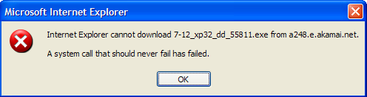
VCGen for Exceptions
We extend the source language with exceptions without arguments (cf. HW2):
  throw throws an exception
  try c₁ catch c₂ executes c₂ if c₁ throws
Problem:
  We have non-local transfer of control
  What is VC(throw, P) ?

Slide 38
VCGen for Exceptions
We extend the source language with exceptions without arguments (cf. HW2):
  throw throws an exception
  try c₁ catch c₂ executes c₂ if c₁ throws
Problem:
  We have non-local transfer of control
  What is VC(throw, P) ?
Standard Solution: use 2 postconditions
  One for normal termination
  One for exceptional termination

Slide 39
VCGen for Exceptions (2)
VC(c, P, Q) is a precondition that makes c either not terminate, or terminate normally with P or throw an exception with Q
Rules
VC(skip, P, Q) = P
VC(c₁; c₂, P, Q) = VC(c₁, VC(c₂, P, Q), Q)
VC(throw, P, Q) = Q
VC(try c₁ catch c₂, P, Q) = VC(c₁, P, VC(c₂, P, Q))
VC(try c₁ finally c₂, P, Q) = ?

Slide 40
VCGen Finally
Given these:
VC(c₁; c₂, P, Q) = VC(c₁, VC(c₂, P, Q), Q)
VC(try c₁ catch c₂, P, Q) = VC(c₁, P, VC(c₂, P, Q))
Finally is somewhat like “if”:
VC(try c₁ finally c₂, P, Q) =
VC(c₁, VC(c₂, P, Q), true) Æ
VC(c₁, true, VC(c₂, Q, Q))
Which reduces to:
VC(c₁, VC(c₂, P, Q), VC(c₂, Q, Q))

Slide 41
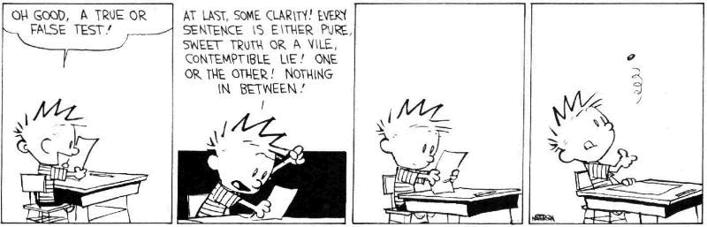
Hoare Rules and the Heap
When is the following Hoare triple valid?
{ A } *x := 5 { *x + *y = 10 }
A should be “*y = 5 or x = y”
The Hoare rule for assignment would give us:
  [5/*x](*x + *y = 10) = 5 + *y = 10 =
  *y = 5 (we lost one case)
Why didn’t this work?

Slide 42
Handling The Heap
We do not yet have a way to talk about memory (the heap, pointers) in assertions
Model the state of memory as a symbolic mapping from addresses to values:
  If A denotes an address and M is a memory state then:
  sel(M,A) denotes the contents of the memory cell
  upd(M,A,V) denotes a new memory state obtained from M by writing V at address A

Slide 43
More on Memory
We allow variables to range over memory states
  We can quantify over all possible memory states
Use the special pseudo-variable μ (mu) in assertions to refer to the current memory
Example:
∀i. i ≥ 0 ∧ i < 5 ⇒ sel(μ, A + i) > 0
says that entries 0..4 in array A are positive

Slide 44
Hoare Rules: Side-Effects
To model writes we use memory expressions
  A memory write changes the value of memory
{ B[upd(μ, A, E)/μ] } *A := E {B}
Important technique: treat memory as a whole
And reason later about memory expressions with inference rules such as (McCarthy Axioms, ~‘67):
sel(upd(M, A₁, V), A₂) =
V
if A₁ = A₂
sel(M, A₂)
if A₁ ≠ A₂

Slide 45
Memory Aliasing
Consider again: { A } *x := 5 { *x + *y = 10 }
We obtain:
A = [upd(μ, x, 5)/μ] (*x + *y = 10)
= [upd(μ, x, 5)/μ] (sel(μ, x) + sel(μ, y) = 10)
(1) = sel(upd(μ, x, 5), x) + sel(upd(μ, x, 5), y) = 10
= 5 + sel(upd(μ, x, 5), y) = 10
= if x = y then 5 + 5 = 10 else 5 + sel(μ, y) = 10
(2) = x = y or *y = 5
Up to (1) is theorem generation
From (1) to (2) is theorem proving

Slide 46
Alternative Handling for Memory
Reasoning about aliasing can be expensive
  It is NP-hard (and/or undecideable)
Sometimes completeness is sacrificed with the following (approximate) rule:
sel(upd(M, A₁, V), A₂) =
V
if A₁ = (obviously) A₂
sel(M, A₂)
if A₁ ≠ (obviously) A₂
P
otherwise (p is a fresh new parameter)
The meaning of “obviously” varies:
  The addresses of two distinct globals are ≠
  The address of a global and one of a local are ≠
PREfix and GCC use such schemes

Slide 47
VCGen Overarching Example
Consider the program
  Precondition: B : bool ∧ A : array(bool, L)
1: I := 0
R := B
3: inv I ≥ 0 ∧ R : bool
if I ≥ L goto 9
assert saferd(A + I)
T := *(A + I)
I := I + 1
R := T
goto 3
9: return R
  Postcondition: R : bool

Slide 48
VCGen Overarching Example
8A. 8B. 8L. 8μ
B : bool Æ A : array(bool, L) )
0 ¸ 0 Æ B : bool Æ
8I. 8R.
I ¸ 0 Æ R : bool )
I ¸ L ) R : bool
Æ
I < L ) saferd(A + I) Æ
I + 1 ¸ 0 Æ
sel(μ, A + I) : bool
VC contains both proof obligations and assumptions about the control flow

Slide 49
Mutable Records - Two Models
Let r : RECORD { f1 : T1; f2 : T2 } END
For us, records are reference types
Method 1: one “memory” for each record
  One index constant for each field
  r.f1 is sel(r,f1) and r.f1 := E is r := upd(r,f1,E)
Method 2: one “memory” for each field
  The record address is the index
  r.f1 is sel(f1,r) and r.f1 := E is f1 := upd(f1,r,E)
Only works in strongly-typed languages like Java
  Fails in C where &r.f2 = &r + sizeof(T1)

Slide 50
VC as a “Semantic Checksum”
Weakest preconditions are an expression of the program’s semantics:
  Two equivalent programs have logically equivalent WPs
  No matter how different their syntax is!
VC are almost as powerful

Slide 51
VC as a “Semantic Checksum” (2)
Consider the “assembly language” program to the right
x := 4
x := (x == 5)
assert x : bool
x := not x
assert x
High-level type checking is not appropriate here
The VC is: ((4 == 5) : bool) ∧ (not (4 == 5))
No confusion from reuse of x with different types

Slide 52
Invariance of VC Across Optimizations
VC is so good at abstracting syntactic details that it is syntactically preserved by many common optimizations
  Register allocation, instruction scheduling
  Common subexp elim, constant and copy propagation
  Dead code elimination
We have identical VCs whether or not an optimization has been performed
  Preserves syntactic form, not just semantic meaning!
This can be used to verify correctness of compiler optimizations (Translation Validation)

Slide 53
VC Characterize a Safe Interpreter
Consider a fictitious “safe” interpreter
  As it goes along it performs checks (e.g. “safe to read from this memory addr”, “this is a null-terminated string”, “I have not already acquired this lock”)
  Some of these would actually be hard to implement
The VC describes all of the checks to be performed
  Along with their context (assumptions from conditionals)
  Invariants and pre/postconditions are used to obtain a finite expression (through induction)
VC is valid ) interpreter never fails
  We enforce same level of “correctness”
  But better (static + more powerful checks)

Slide 54
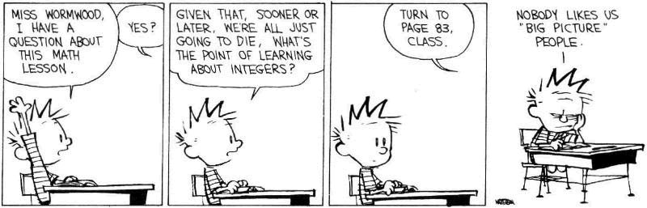
VC Big Picture
Verification conditions
  Capture the semantics of code + specifications
  Language independent
  Can be computed backward/forward on structured/unstructured code
  Make Axiomatic Semantics practical

Slide 55
Invariants Are Not Easy
Consider the following code from QuickSort
int partition(int *a, int L₀, int H₀, int pivot) {
int L = L₀, H = H₀;
while(L < H) {
while(a[L] < pivot) L ++;
while(a[H] > pivot) H --;
if(L < H) { swap a[L] and a[H] }
}
return L
}
Consider verifying only memory safety
What is the loop invariant for the outer loop ?

Slide 56

Done!
Questions?

