Slide 1
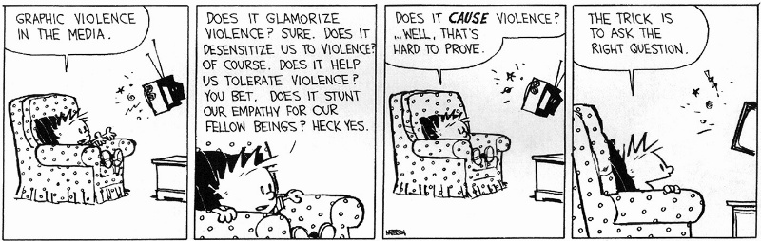
Abstract Interpretation
(Non-Standard Semantics) a.k.a.
“Picking The Right Abstraction”

Slide 2
Reading Quiz
All answers are one to three words.
Write your UVA ID in big block letters.
In Reflections on Trusting Trust, Ken Thompson describes a trojan horse in what general piece of software?
In Abramski's Abstract Interpretation, an “immediate and spectacular payoff” is the Theorem that if f: D ! D is continuous, it has a ____ ____ ____ d in D, such that:
  f(d) = d
  8 e 2 E. f(e) = e ) d · e

Slide 3
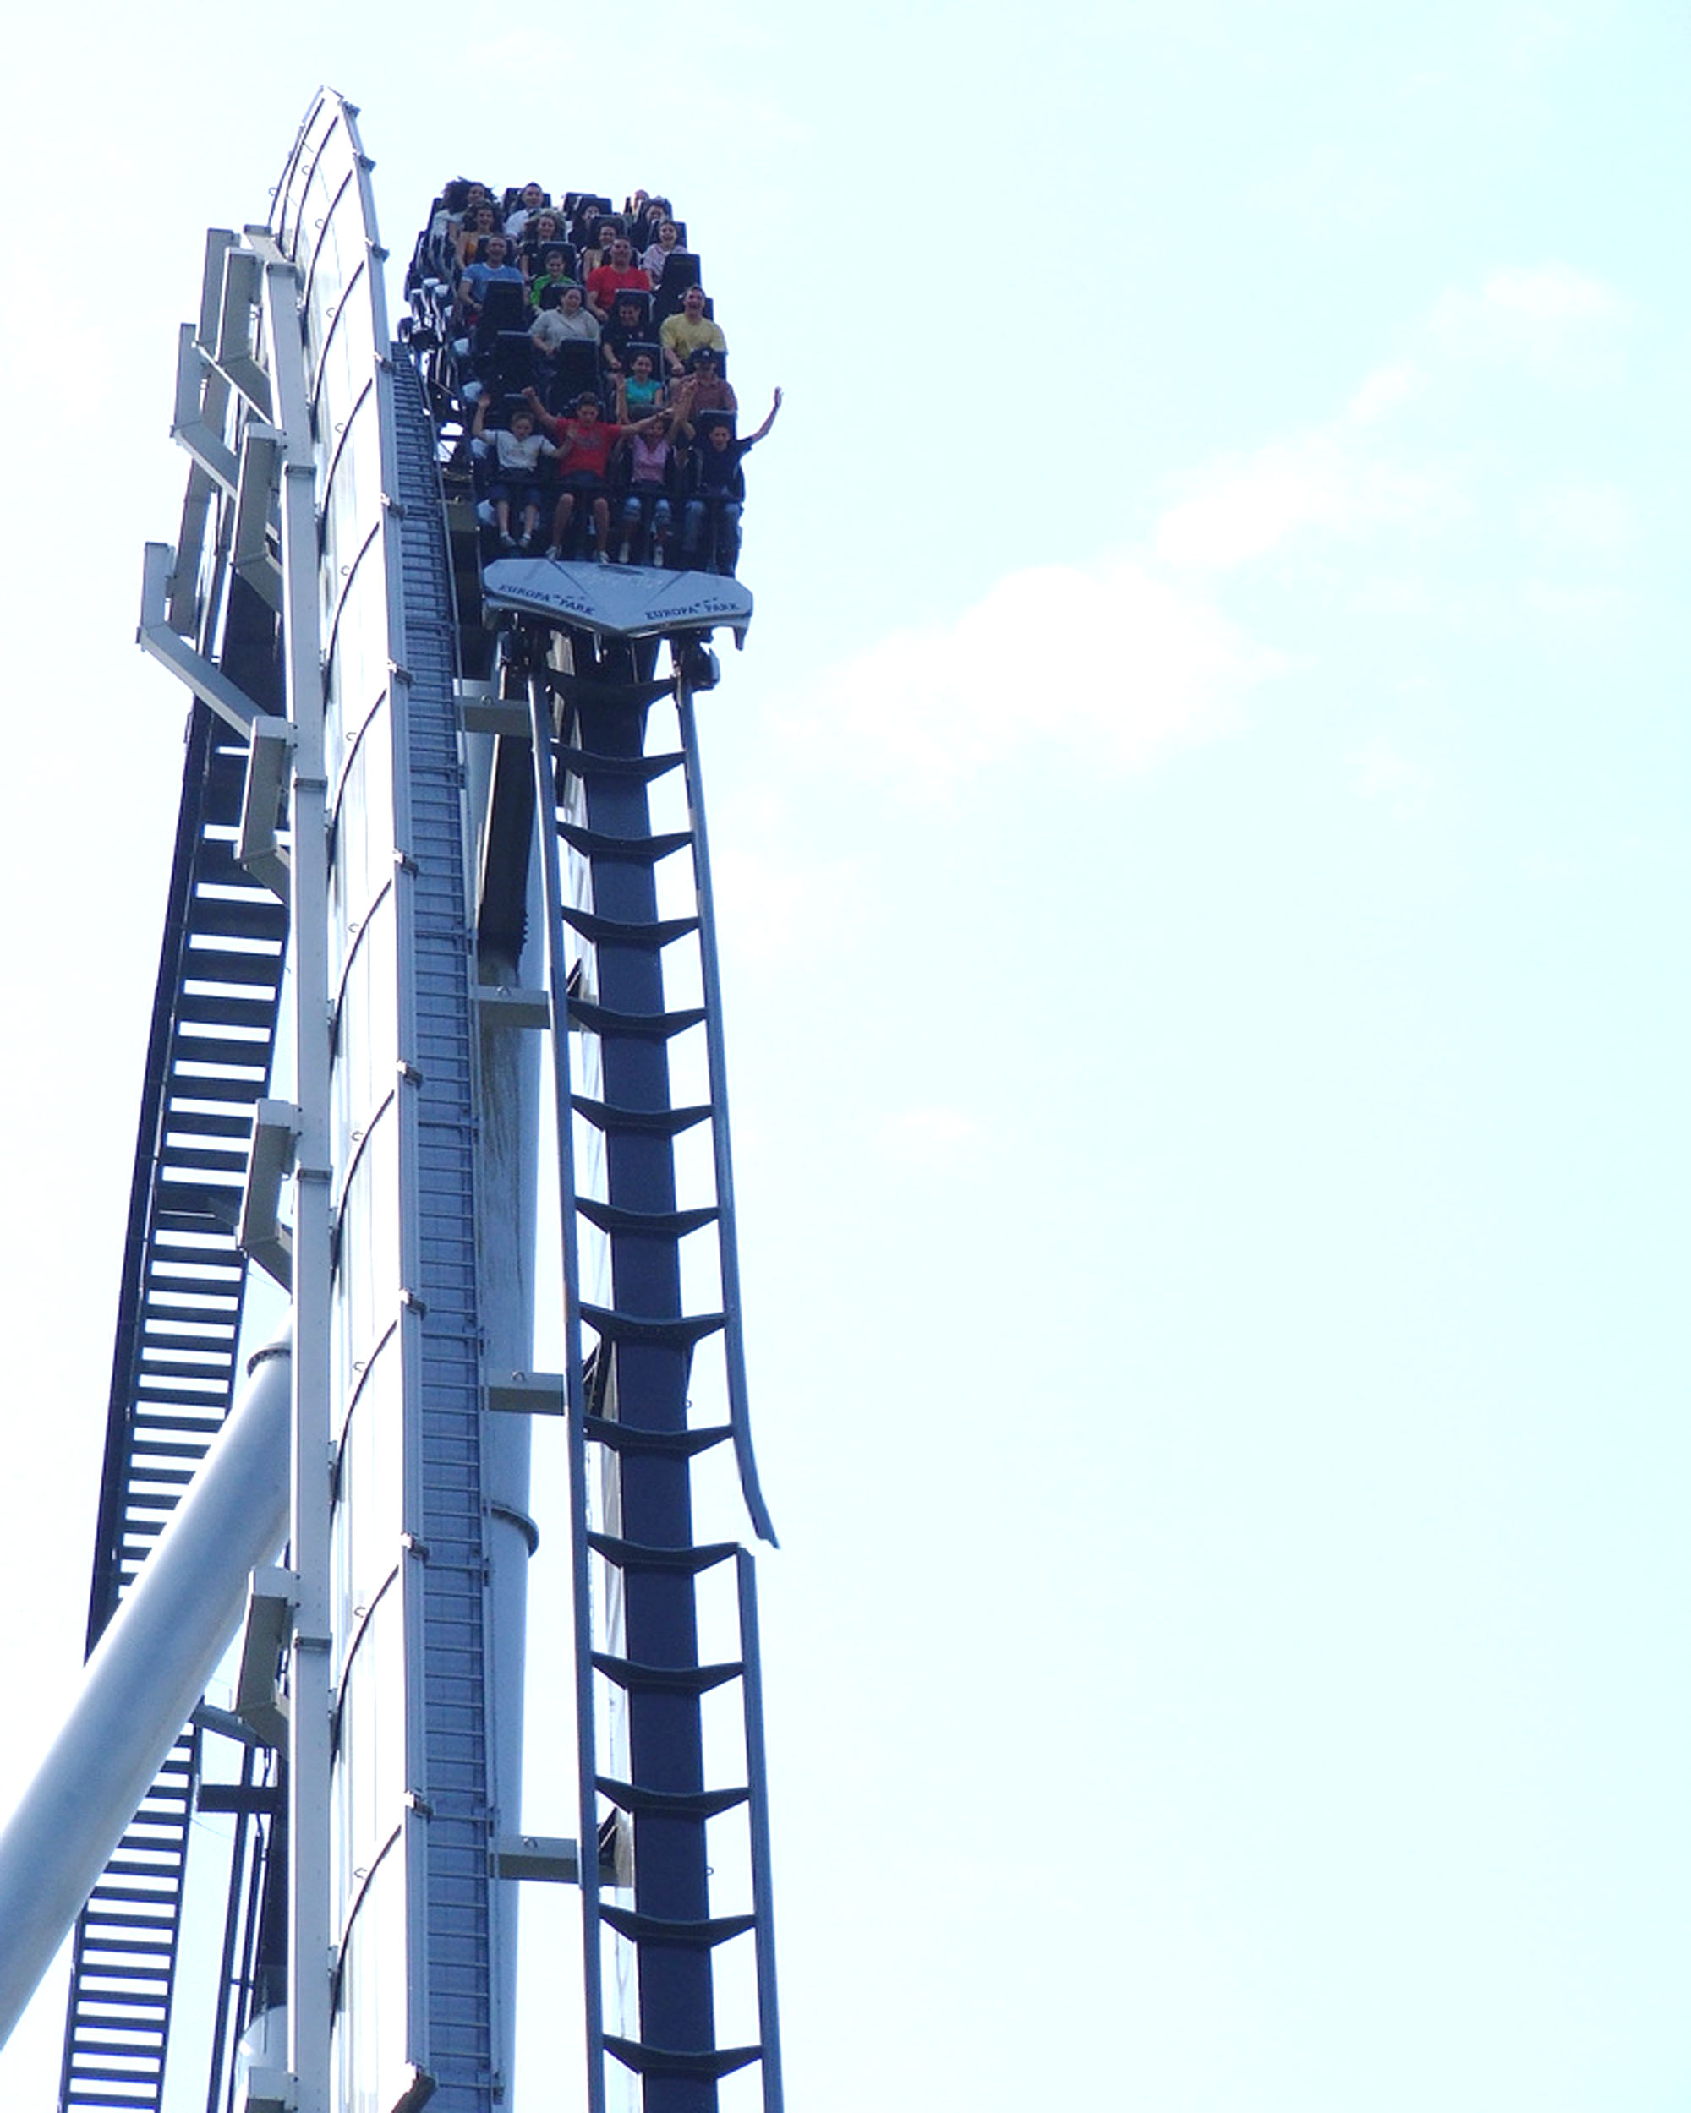
Why analyze programs statically?

Slide 4
The Problem
It is extremely useful to predict program behavior statically (= without running the program)
  For optimizing compilers, program analyses, software engineering tools, finding security flaws, etc.
The semantics we studied so far give us the precise behavior of a program
However, precise static predictions are impossible
  The exact semantics is not computable
We must settle for approximate, but correct, static analyses (e.g. VC vs. WP)

Slide 5
The Plan
We will introduce abstract interpretation by example
Starting with a miniscule language we will build up to a fairly realistic application
Along the way we will see most of the ideas and difficulties that arise in a big class of applications

Slide 6
A Tiny Language
Consider the following language of arithmetic (“shrIMP”?)
e ::= n | e₁ * e₂
The operational semantics of this language
n ⇓ n
e₁ * e₂ ⇓ = e₁⇓ £ e₂⇓
We’ll take opsem as the “ground truth”
For this language the precise semantics is computable (but in general it’s not)

Slide 7
An Abstraction
Assume that we are interested not in the value of the expression, but only in its sign:
  positive (+), negative (-), or zero (0)
We can define an abstract semantics that computes only the sign of the result
σ: Exp ! {-, 0, +}
σ(n) = sign(n)
σ(e₁ * e₂) = σ(e₁) ­ σ(e₂)
­
-
0
+
-
+
0
-
0
0
0
0
+
-
0
+

Slide 8

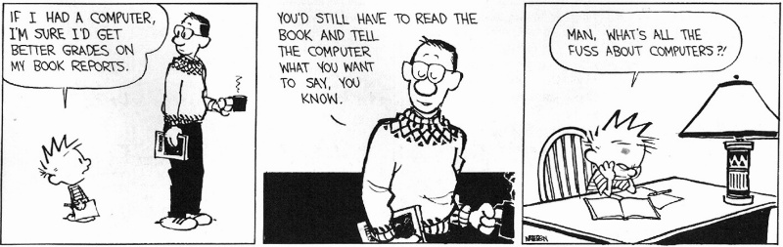
I Saw the Sign
Why did we want to compute the sign of an expression?
  One reason: no one will believe you know abstract interpretation if you haven’t seen the sign example :-)
What could we be computing instead?
  Alex Aiken was here …

Slide 9
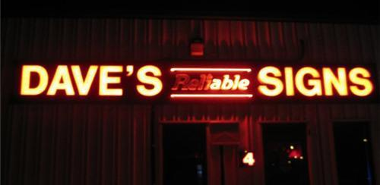
Correctness of Sign Abstraction
We can show that the abstraction is correct in the sense that it predicts the sign
e⇓ > 0 , σ(e) = +
e⇓ = 0 , σ(e) = 0
e⇓ < 0 , σ(e) = -

Slide 10
Correctness of Sign Abstraction
We can show that the abstraction is correct in the sense that it predicts the sign
e⇓ > 0 , σ(e) = +
e⇓ = 0 , σ(e) = 0
e⇓ < 0 , σ(e) = -
Our semantics is abstract but precise
Proof is by structural induction on the expression e
  Each case repeats similar reasoning

Slide 11
Another View of Soundness
Link each concrete value to an abstract one:
β : Z ! { -, 0, + }
This is called the abstraction function (β)
  This three-element set is the abstract domain
Also define the concretization function (γ):
γ : {-, 0, +} ! P(Z)
γ(+) = { n 2 Z | n > 0 }
γ(0) = { 0 }
γ(-) = { n 2 Z | n < 0 }

Slide 12
Another View of Soundness 2
Soundness can be stated succinctly
8e 2 Exp. e⇓ 2 γ(σ(e))
(the real value of the expression is among the concrete values represented by the abstract value of the expression)
Let C be the concrete domain (e.g. Z) and A be the abstract domain (e.g. {-, 0, +})
Commutative diagram:
σ
Exp
A
⇓
γ
2
C
P(C)

Slide 13
Another View of Soundness 3
Consider the generic abstraction of an operator
σ(e₁ op e₂) = σ(e₁) op σ (e₂)
This is sound iff
8a₁8a₂. γ(a₁ op a₂) ¾ {n₁ op n₂ | n₁ 2 γ(a₁), n₂ 2 γ(a₂)}
e.g. γ(a₁ ­ a₂) ¾ { n₁ * n₂ | n₁ 2 γ(a₁), n₂ 2 γ(a₂) }
This reduces the proof of correctness to one proof for each operator

Slide 14
Abstract Interpretation
This is our first example of an abstract interpretation
We carry out computation in an abstract domain
The abstract semantics is a sound approximation of the standard semantics
The concretization and abstraction functions establish the connection between the two domains

Slide 15
Adding Unary Minus and Addition
We extend the language to
e ::= n | e₁ * e₂ | - e
We define σ(- e) = ª σ(e)
Now we add addition:
e ::= n | e₁ * e₂ | - e | e₁ + e₂
We define σ(e₁ + e₂) = σ(e₁) © σ(e₂)
-
0
+
ª
+
0
-
©
-
0
+
-
-
-
?
0
-
0
+
+
?
+
+

Slide 16
Adding Addition
The sign values are not closed under addition
What should be the value of “+ © –”?
Start from the soundness condition:
γ(+ © –) ¾ { n₁ + n₂ | n₁ > 0, n₂ < 0} = Z
We don’t have an abstract
value whose concretization
includes Z, so we add one:
> (“top” = “don’t know”)
©
-
0
+
>
-
-
-
>
>
0
-
0
+
>
+
>
+
+
>
>
>
>
>
>

Slide 17
Loss of Precision
Abstract computation may lose information:
«(1 + 2) + -3¬ = 0
but: σ((1+2) + -3) =
(σ(1) © σ(2)) © σ(-3) =
(+ © +) © - = >
We lost some precision
But this will simplify the computation of the abstract answer in cases when the precise answer is not computable

Slide 18
Adding Division
Straightforward except for division by 0
  We say that there is no answer in that case
  γ(+ ® 0) = { n | n = n₁ / 0 , n₁ > 0 } = ;
Introduce ? to be the abstraction of the ;
  We also use the same
abstraction for
non-termination!
? = “nothing”
> = “something unknown”
®
-
0
+
>
?
-
+
0
-
>
?
0
?
?
?
?
?
+
-
0
+
>
?
>
>
>
>
>
?
?
?
?
?
?
?

Slide 19
Q: Books (750 / 842)
This 1962 Newbery Medal-winning novel by Madeleine L'Engle includes Charles Wallace, Mrs. Who, Mrs. Whatsit, Mrs. Which and the space-bending Tesseract.

Slide 20
Computer Science
This American Turing-award winner is known for developing Speedcoding and FORTRAN (the first two high-level languages), as well creating a way to express the formal syntax of a language and using that approach to specify ALGOL. He later focused on function-level (as opposed to value-level) programming. His first major programming project calculated the positions of the Moon. Oh, and he studied at UVA as an undergrad (but quit).

Slide 21
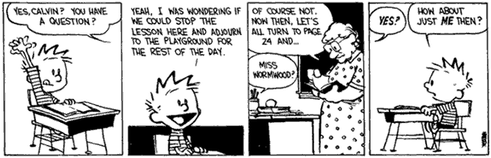
The Abstract Domain
>
Our abstract domain forms a lattice
A partial order is induced by γ
a₁ · a₂ iff γ(a₁) µ γ(a₂)
  We say that a₁ is more precise than a₂!
Every finite subset has a least-upper
bound (lub) and a greatest-lower bound (glb)
-
0
+
?

Slide 22
Lattice Facts
A lattice is complete when every subset has a lub and a gub
  Even infinite subsets!
Every finite lattice is (trivially) complete
Every complete lattice is a complete partial order (recall: proof techniques: induction!)
  Since a chain is a subset
Not every CPO is a complete lattice
  Might not even be a lattice at all

Slide 23

Lattice History
Early work in denotational semantics used lattices (instead of what?)
  But only chains need to have lubs
  And there was no need for > and glb

Slide 24
Lattice History
Early work in denotational semantics used lattices (instead of what?)
  But only chains need to have lubs
  And there was no need for > and glb
In abstract interpretation we’ll use > to denote “I don’t know”.
  Corresponds to all values in the concrete domain

Slide 25
From One, Many
We can start with the abstraction function β
β : C ! A
(maps a concrete value to the best abstract value)
  A must be a lattice
We can derive the concretization function γ
γ : A ! P(C)
γ(a) = { x 2 C | β(x) · a }
And the abstraction for sets α
α : P(C) ! A
α(S) = lub { β(x) | x 2 S }

Slide 26
Example
Consider our sign lattice
+ if n > 0
β(n) = 0 if n = 0
- if n < 0
α(S) = lub { β(x) | x 2 S}
  Example: α ({1, 2}) = lub { + } = +
α ({1, 0}) = lub { +, 0} = >
α ({}) = lub ; = ?
γ(a) = { n | β(n) · a }
  Example: γ (+) = { n | β(n) · +} =
{ n | β(n) = +} = { n | n > 0 }
γ (>) = { n | β(n) · > } = Z
γ (?) = { n | β(n) · ?} = ;

Slide 27
Galois Connections
We can show that
  γ and α are monotonic (with µ ordering on P(C))
  α (γ (a)) = a for all a 2 A
  γ (α(S)) ¾ S for all S 2 P(C)
Such a pair of functions is called a Galois connection
  Between the lattices A and P(C)
S
C
γ(α(S))

Slide 28
Correctness Condition
In general, abstract interpretation satisfies the following (amazingly common) diagram
σ
abstract semantics
Exp
A
abstract domain
means
⇓
γ
α (·)
abstraction
function for sets
concrete domain
C
P(C)
2
concretization
function

Slide 29

Three Little Correctness Conditions
Three conditions define a correct abstract interpretation
α and γ are monotonic
α and γ form a Galois connection
= “α and γ are almost inverses”
Abstraction of operations is correct
a₁ op a₂ = α(γ(a₁) op γ(a₂))

Slide 30
On The Board Questions
What is the VC for:
for i = e_{low} to e_{high} do c done
This axiomatic rule is unsound. Why?
` {A Æ p} c_{then} {B_{then}}
` {A Æ :p} c_{else} {B_{else}}
` {A} if p then c_{then} else c_{else} {B_{then} Ç B_{else}}

Slide 31
Homework
Read Cousot & Cousot Article

