Slide 1
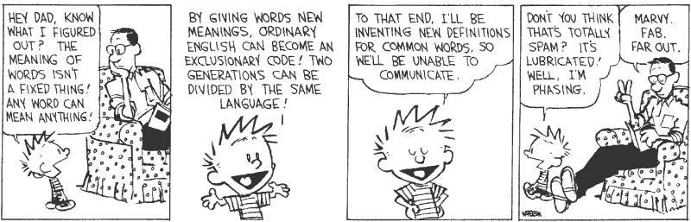
Abstract Interpretation
(Galois, Collections, Widening)

Slide 2
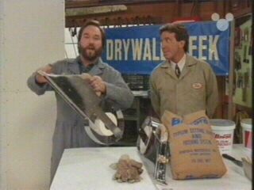



Tool Time
Homework 5 Reminder
You've already started ...
Compilation problems?
  See FAQ
(trivia: what tool brand is this?)

Slide 3
One Slide Summary
In abstract interpretation, the abstraction function β and concretization function γ form a Galois connection: they are almost inverses.
To abstract the state σ at each program point we use a collecting semantics (the abstract domain holds sets of states). This shows the link between abstract interpretation and model checking.
This will result in recursively-defined equations. We use the fixed point theorem to solve them. This shows the link between abstract interpretation and dataflow analysis.
Widening operators help accelerate convergence.

Slide 4
Abstract Interpretation
We have an abstract domain A
  e.g., A = { positive, negative, zero }
  An abstraction function β : Z ! A
    Z is our concrete domain
  A concretization function γ : A ! P(Z)
Positive + Positive = ???
Positive + Negative = ???
Positive / Zero = ???

Slide 5
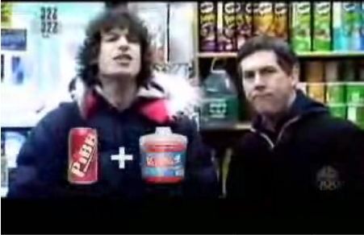
We don't want security to get suspicious ...

Slide 6
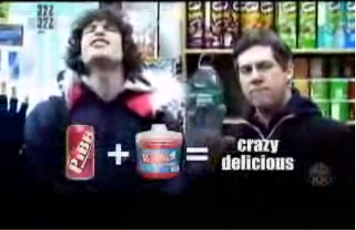

Slide 7
Review
We introduced abstract interpretation
An abstraction mapping from concrete to abstract values
  Has a concretization mapping which forms a Galois connection
We’ll look a bit more at Galois connections
We’ll lift AI from expressions to programs
… and we’ll discuss the mythic “widening”

Slide 8
Why Galois Connections?
We have an abstract domain A
  An abstraction function β : Z ! A
  Induces α : P(Z) ! A and γ : A ! P(Z)
We argued that for correctness
γ(a₁ op a₂) ¾ γ(a₁) op γ(a₂)
  We wish for the set on the left to be as small as possible
  To reduce the loss of information through abstraction
For each set S µ C, define α(S) as follows:
  Pick smallest S’ that includes S and is in the image of γ
  Define α(S) = γ⁻¹(S’)
  Then we define: a₁ op a₂ = α(γ(a₁) op γ(a₂))
Then α and γ form a Galois connection

Slide 9
Galois Connections
A Galois connection between complete lattices A and P(C) is a pair of functions α and γ such that:
  γ and α are monotonic
    (with the µ ordering on P(C))
  α (γ (a)) = a for all a 2 A
  γ (α(S)) ¾ S for all S 2 P(C)
>
C
1,2
1
S
3
γ α
1
2
3
4
2
4
?

Slide 10

More on Galois Connections
All Galois connections are monotonic
In a Galois connection one function uniquely and absolutely determines the other

Slide 11
Abstract Interpretation for Imperative Programs
So far we abstracted the value of expressions
Now we want to abstract the state at each point in the program
First we define the concrete semantics that we are abstracting
  We’ll use a collecting semantics

Slide 12
Collecting Semantics
Recall
  A state σ 2 Σ. Any state σ has type Var ! Z
  States vary from program point to program point
We introduce a set of program points: labels
We want to answer questions like:
  Is x always positive at label i?
  Is x always greater or equal to y at label j?
To answer these questions we’ll construct
C 2 Contexts. C has type Labels ! P(Σ)
  For each label i, C(i) = all possible states at label i
  This is called the collecting semantics of the program
  This is basically what SLAM (and BLAST, ESP, …) approximate (using BDDs to store P(Σ) efficiently)

Slide 13
Defining the Collecting Semantics
We first define relations between the collecting semantics at different labels
  We do it for unstructured CFGs (cf. HW5!)
  Can do it for IMP with careful notion of program points
Define a label on each edge in the CFG
For assignment
C_{j} = {σ[x := n] | σ 2 C_{i} Æ e⇓σ = n}
i
x := e
j

Slide 14
Defining the Collecting Semantics
For conditionals
C_{else} = { σ | σ 2 C_{in} Æ b⇓σ = false}
C_{then} = { σ | σ 2 C_{in} Æ b⇓σ = true}
Assumes b has no side effects (as in IMP or HW5)
in
false
true
b
else
then

Slide 15

Defining the Collecting Semantics
For a join
i
j
out

Slide 16
Defining the Collecting Semantics
For a join
C_{out} = C_{i} [ C_{j}
Verify that these relations are monotonic
  If we increase a C_{x} all other C_{y} can only increase
i
j
out

Slide 17
Collecting Semantics: Example
Assume x ¸ 0 initially (explain this?)
1
C₁ = {σ | σ(x) ¸ 0}
y := 1
2
F
T
3
x == 0
5
y := y * x
4
x := x - 1

Slide 18
Collecting Semantics: Example
Assume x ¸ 0 initially
1
C₁ = {σ | σ(x) ¸ 0}
C₂ = { σ[y:=1] | σ 2 C₁}
y := 1
2
F
T
3
x == 0
5
y := y * x
4
x := x - 1

Slide 19
Collecting Semantics: Example
Assume x ¸ 0 initially
1
C₁ = {σ | σ(x) ¸ 0}
C₂ = { σ[y:=1] | σ 2 C₁}
C₃ = C₂ Å {σ | σ(x) ≠ 0}
y := 1
2
F
T
3
x == 0
5
y := y * x
4
x := x - 1

Slide 20
Collecting Semantics: Example
Assume x ¸ 0 initially
1
C₁ = {σ | σ(x) ¸ 0}
C₂ = { σ[y:=1] | σ 2 C₁}
C₃ = C₂ Å {σ | σ(x) ≠ 0}
C₄ = {σ[y:=σ(y)*σ(x)] |
σ 2 C₃}
y := 1
2
F
T
3
x == 0
5
y := y * x
4
x := x - 1

Slide 21
Collecting Semantics: Example
Assume x ¸ 0 initially
1
C₁ = {σ | σ(x) ¸ 0}
C₂ = { σ[y:=1] | σ 2 C₁}
[ {σ[x:=σ(x)-1] | σ2C₄}
C₃ = C₂ Å {σ | σ(x) ≠ 0}
C₄ = {σ[y:=σ(y)*σ(x)] |
σ 2 C₃}
y := 1
2
F
T
3
x == 0
5
y := y * x
4
x := x - 1

Slide 22
Collecting Semantics: Example
Assume x ¸ 0 initially
1
C₁ = {σ | σ(x) ¸ 0}
C₂ = { σ[y:=1] | σ 2 C₁}
[ {σ[x:=σ(x)-1] | σ2C₄}
C₃ = C₂ Å {σ | σ(x) ≠ 0}
C₄ = {σ[y:=σ(y)*σ(x)] |
σ 2 C₃}
C₅ = C₂ Å {σ | σ(x) = 0}
y := 1
2
F
T
3
x == 0
5
y := y * x
4
x := x - 1

Slide 23
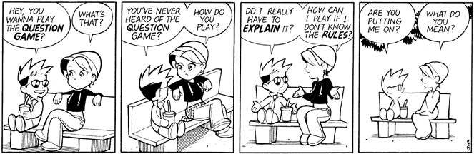
Why Does This Work?
We just made a system of recursive equations that are defined largely in terms of themselves
  e.g., C₂ = F(C₄), C₄ = G(C₃), C₃ = H(C₂)
Why do we have any reason to believe that this will get us what we want?

Slide 24
The Collecting Semantics
We have an equation with the unknown C
  The equation is defined by a monotonic and continuous function on domain Labels ! P(Σ)
We can use the least fixed-point theorem
  Start with C⁰(L)=; (aka C⁰ = λL.;)
  Apply the relations between C_{i} and C_{j} to get C¹_{i} from C⁰_{j}
  Stop when all C^{k} = C^{k-1}
  Problem: we’ll go on forever for most programs
  But we know the fixed point exists

Slide 25
Collecting Semantics: Example
(assume x ¸ 0 initially)
1
;
y := 1
;
2
;
;
F
T
3
x == 0
5
C₁ = {σ | σ(x) ¸ 0}
C₂ = { σ[y:=1] | σ 2 C₁}
[ {σ[x:=σ(x)-1] | σ 2 C₄}
C₃ = C₂ Å {σ | σ(x) ≠ 0}
C₅ = C₂ Å {σ | σ(x) = 0}
C₄ = {σ[y:=σ(y)*σ(x) | σ 2 C₃}
;
y := y * x
4
;
x := x - 1

Slide 26
Collecting Semantics: Example
(assume x ¸ 0 initially)
1
{ x ¸ 0 }
y := 1
;
2
;
;
F
T
3
x == 0
5
C₁ = {σ | σ(x) ¸ 0}
C₂ = { σ[y:=1] | σ 2 C₁}
[ {σ[x:=σ(x)-1] | σ 2 C₄}
C₃ = C₂ Å {σ | σ(x) ≠ 0}
C₅ = C₂ Å {σ | σ(x) = 0}
C₄ = {σ[y:=σ(y)*σ(x) | σ 2 C₃}
;
y := y * x
4
;
x := x - 1

Slide 27
Collecting Semantics: Example
(assume x ¸ 0 initially)
1
{ x ¸ 0 }
y := 1
;
2
{x ¸ 0, y = 1}
;
F
T
3
x == 0
5
C₁ = {σ | σ(x) ¸ 0}
C₂ = { σ[y:=1] | σ 2 C₁}
[ {σ[x:=σ(x)-1] | σ 2 C₄}
C₃ = C₂ Å {σ | σ(x) ≠ 0}
C₅ = C₂ Å {σ | σ(x) = 0}
C₄ = {σ[y:=σ(y)*σ(x) | σ 2 C₃}
;
y := y * x
4
;
x := x - 1

Slide 28
Collecting Semantics: Example
(assume x ¸ 0 initially)
1
{ x ¸ 0 }
y := 1
;
2
{x ¸ 0, y = 1}
{x>0,y=1}
F
T
3
x == 0
5
C₁ = {σ | σ(x) ¸ 0}
C₂ = { σ[y:=1] | σ 2 C₁}
[ {σ[x:=σ(x)-1] | σ 2 C₄}
C₃ = C₂ Å {σ | σ(x) ≠ 0}
C₅ = C₂ Å {σ | σ(x) = 0}
C₄ = {σ[y:=σ(y)*σ(x) | σ 2 C₃}
{x=0,y=1}
y := y * x
4
;
x := x - 1

Slide 29
Collecting Semantics: Example
(assume x ¸ 0 initially)
1
{ x ¸ 0 }
y := 1
;
2
{x ¸ 0, y = 1}
{x>0,y=1}
F
T
3
x == 0
5
C₁ = {σ | σ(x) ¸ 0}
C₂ = { σ[y:=1] | σ 2 C₁}
[ {σ[x:=σ(x)-1] | σ 2 C₄}
C₃ = C₂ Å {σ | σ(x) ≠ 0}
C₅ = C₂ Å {σ | σ(x) = 0}
C₄ = {σ[y:=σ(y)*σ(x) | σ 2 C₃}
{x=0,y=1}
y := y * x
4
{x>0,y=x}
x := x - 1

Slide 30
Collecting Semantics: Example
(assume x ¸ 0 initially)
1
{ x ¸ 0 }
{x¸ 0, y=x+1}
y := 1
2
{x ¸ 0, y = 1}
{x>0,y=1}
F
T
3
x == 0
5
C₁ = {σ | σ(x) ¸ 0}
C₂ = { σ[y:=1] | σ 2 C₁}
[ {σ[x:=σ(x)-1] | σ 2 C₄}
C₃ = C₂ Å {σ | σ(x) ≠ 0}
C₅ = C₂ Å {σ | σ(x) = 0}
C₄ = {σ[y:=σ(y)*σ(x) | σ 2 C₃}
{x=0,y=1}
y := y * x
4
{x>0,y=x}
x := x - 1

Slide 31
Collecting Semantics: Example
(assume x ¸ 0 initially)
1
{ x ¸ 0 }
{x¸ 0, y=x+1}
y := 1
2
{x ¸ 0, y = 1 Ç y = x + 1}
{x>0,y=1}
F
T
3
x == 0
5
C₁ = {σ | σ(x) ¸ 0}
C₂ = { σ[y:=1] | σ 2 C₁}
[ {σ[x:=σ(x)-1] | σ 2 C₄}
C₃ = C₂ Å {σ | σ(x) ≠ 0}
C₅ = C₂ Å {σ | σ(x) = 0}
C₄ = {σ[y:=σ(y)*σ(x) | σ 2 C₃}
{x=0,y=1}
y := y * x
4
{x>0,y=x}
x := x - 1

Slide 32
Computer Science
This American Turing-award winner is known for work on the B and C programming languages, the Unix and Plan 9 operating systems, regular expressions in text editors, UTF-8, and chess endgames. Almost all programs that use regular expressions today use his notation for them.

Slide 33
Sanskrit Epics
This Sanskrit epic is one of the two great canon stories of India, and is attributed to the Hindu sage Valmiki. It covers dharma and human values while explaining the protagonist's attempt to recover his wife, Sita, who has been taken by the demons of Lanka. It is heavy on allegory and philosophy. Archery, including an epic use of the brahmastra, is often involved.

Slide 34
Abstract Interpretation
Pick a complete lattice A (abstractions for P(Σ) )
  Along with a monotonic abstraction α : P(Σ) ! A
  Alternatively, pick β : Σ ! A
  This uniquely defines its Galois connection γ
Take the relations between C_{i} and move them to the abstract domain:
a : Label ! A
Assignment
Concrete: C_{j} = {σ[x := n] | σ 2 C_{i} Æ e⇓σ = n}
Abstract: a_{j} = α {σ[x := n] | σ 2 γ(a_{i}) Æ e⇓σ = n}

Slide 35
Abstract Interpretation
Conditional
Concrete: C_{j} = { σ | σ 2 C_{i} Æ b⇓σ = false} and
C_{k} = { σ | σ 2 C_{i} Æ b⇓σ = true}
Abstract: a_{j} = α { σ | σ 2 γ(a_{i}) Æ b⇓σ = false} and
a_{k} = α { σ | σ 2 γ(a_{i}) Æ b⇓σ = true}
Join
Concrete: C_{k} = C_{i} [ C_{j}
Abstract: a_{k} = α (γ(a_{i}) [ γ(a_{j})) = lub {a_{i}, a_{j}}

Slide 36
Least Fixed Points
In The Abstract Domain
We have a recursive equation with unknown “a”
  Defined by a monotonic and continuous function on the domain Labels ! A
We can use the least fixed-point theorem:
  Start with a⁰ = λL.? (aka: a⁰(L) = ?)
  Apply the monotonic function to compute a^{k+1} from a^{k}
  Stop when a^{k+1} = a^{k}
Exactly the same computation as for the collecting semantics
  What is new?
  “There is nothing new under the sun but there are lots of old things we don't know.” – Ambrose Bierce

Slide 37
Least Fixed Points
In The Abstract Domain
We have a hope of termination!
Classic setup: A has only uninteresting chains (finite number of elements in each chain)
  A has finite height h (= “finite-height lattice”)
The computation takes O(h £ |Labels|²) steps
  At each step “a” makes progress on at least one label
  We can only make progress h times
  And each time we must compute |Labels| elements
This is a quadratic analysis: good news
  This is exactly the same as Kildall’s 1973 analysis of dataflow’s polynomial termination given a finite-height lattice and monotonic transfer functions.

Slide 38
Abstract Interpretation: Example
Consider the following program, x>0
1
y := 1
2
F
T
3
x == 0
5
y := y * x
We want to do the
sign analysis on it.
4
x := x - 1

Slide 39
Abstract Domain for Sign Analysis
Invent the complete sign lattice
S = { ?, -, 0, +, > }
Construct the complete lattice
A = {x, y} ! S
  With the usual point-wise ordering
  Abstract state gives the sign for x and y
We start with a⁰ = λL.λv2{x,y}.?
  aka: a⁰(L,v) = ?

Slide 40
Let’s Do It!
Label
Iterations !
1
x
+
y
>
2
x
?
y
?
3
x
?
y
?
4
x
?
y
?
5
x
?
y
?

Slide 41
Let’s Do It!
Label
Iterations !
1
x
+
+
y
>
>
2
x
?
+
>
>
y
?
+
>
>
3
x
?
+
>
>
y
?
+
>
>
4
x
?
+
>
>
y
?
+
>
>
5
x
?
0
0
y
?
+
>
>

Slide 42
Notes, Weaknesses, Solutions
We abstracted the state of each variable independently
A = {x, y } ! {?, -, 0, +, > }
We lost relationships between variables
  e.g., at a point x and y may always have the same sign
  In the previous abstraction we get {x := >, y := >} at label 2 (when in fact y is always positive!)
We can also abstract the state as a whole
A = P({?, -, 0, +, >} £ {?, -, 0, +, >})

Slide 43
Other Abstract Domains
Range analysis
  Lattice of ranges: R ={ ?, [n..m], (-1, m], [n, +1), > }
  It is a complete lattice
    [n..m] t [n’..m’] = [min(n, n’)..max(m,m’)]
    [n..m] u [n’..m’] = [max(n, n’)..min(m, m’)]
    With appropriate care in dealing with 1
  β : Z ! R such that β(n) = [n..n]
  α : P(Z) ! R such that α(S) = lub {β(n) | n 2 S} = [min(S)..max(S)]
  γ : R ! P(Z) such that γ(r) = { n | n 2 r }
This lattice has infinite-height chains
  So the abstract interpretation might not terminate!

Slide 44
Example of Non-Termination
Consider this (common) program fragment
1
z := 1
2
T
F
3
z · n
4
We want to do range
analysis on it.
z := z + 1

Slide 45
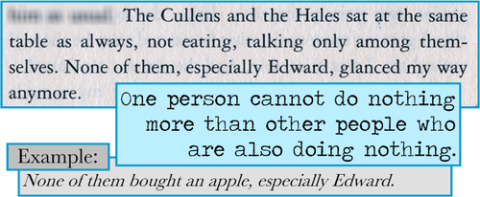
Example of Non-Termination
Consider the sequence of abstract states at point 2
  [1..1], [1..2], [1..3], …
  The analysis never terminates
  Or terminates very late if the loop bound is known statically

Slide 46
Example of Non-Termination
Consider the sequence of abstract states at point 2
  [1..1], [1..2], [1..3], …
  The analysis never terminates
  Or terminates very late if the loop bound is known statically
It is time to approximate even more: widening
We redefine the join (lub) operator of the lattice to ensure that from [1..1] upon union with [2..2] the result is [1..+1) and not [1..2]
Now the sequence of states is
  [1..1], [1, +1), [1, +1) Done (no more infinite chains)

Slide 47
Formal Definition of Widening
(Cousot 16.399 “Abstract Interpretation”, 2005)
A widening 5 : (P £ P) ! P on a poset hP,vi satisfies:
  8 x, y 2 P . x v (x 5 y) Æ y v (x 5 y)
  For all increasing chains x⁰ v x¹ v … the increasing chain y⁰ =^{def} x⁰, …, y^{n+1} =^{def} y^{n} 5 x^{n+1}, … is not strictly increasing.
Two different main uses:
  Approximate missing lubs. (Not for us.)
  Convergence acceleration. (This is the real use.)
    A widening operator can be used to effectively compute an upper approximation of the least fixpoint of F 2 L 5 L starting from below when L is computer-representable but does not satisfy the ascending chain condition.

Slide 48
Formal Widening Example
[1,1]5[1,2] = [1,+1)
Range Analysis on z:
L0: z := 1 ;
L1: while z<99 do
L2: z := z+1
L3: done /* z ¸ 99 */
L4:
Original x^{i}
Widened y^{i}
x^{L0}₀ = ?
y^{L0}₀ = ?
x^{L1}₀ = [1,1]
y^{L1}₀ = [1,1]
x^{L2}₀ = [1,1]
y^{L2}₀ = [1,1]
x^{L3}₀ = [2,2]
y^{L3}₀ = [2,2]
x^{L2}₁ = [1,2]
y^{L2}₁ = [1,+1)
x^{L3}₁ = [2,+1)
y^{L3}₁ = [2,+1)
x^{Li}_{j} =^{def} the jth iterative attempt
to compute an abstract value for
z at label Li
x^{L4}₀ = [99,+1)
y^{L4}₀ = [99,+1)
stable (fewer than 99 iterations!)
Recall lub S = [min(S)..max(S)]
lub {[2,+1),[1,+1)} = {[1,+1)}

Slide 49
Other Abstract Domains
Linear relationships between variables
  A convex polyhedron is a subset of Z^{k} whose elements satisfy a number of inequalities:
a₁x₁ + a₂x₂ + … + a_{k}x_{k} ¸ c_{i}
  This is a complete lattice; linear programming methods compute lubs
Linear relationships with at most two variables
  Convex polyhedra but with · 2 variables per constraint
  Octagons (x + y ¸ c) have efficient algorithms
Modulus constraints (e.g. even and odd)

Slide 50
Abstract Chatter
AI, Dataflow and Software Model Checking
  The big three (aside from flow-insensitive type systems) for program analyses
Are in fact quite related:
  David Schmidt. Data flow analysis is model checking of abstract interpretation. POPL ’98.
AI is usually flow-sensitive (per-label answer)
AI can be path-sensitive (if your abstract domain includes Ç, for example), which is just where model checking uses BDD’s
Metal, SLAM, ESP, … can all be viewed as AI

Slide 51
Abstract Interpretation Conclusions
AI is a very powerful technique that underlies a large number of program analyses
  Including Dataflow Analysis and Model Checking
AI can also be applied to functional and logic programming languages
There are a few success stories
  Strictness analysis for lazy functional languages
  PolySpace for linear constraints
In most other cases however AI is still slow
When the lattices have infinite height and widening heuristics are used the result becomes unpredictable

