Slide 1
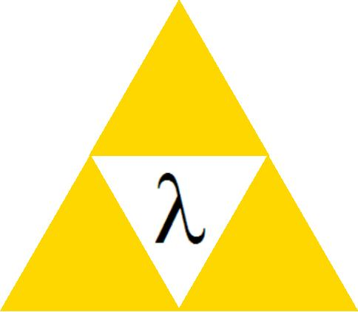

Lambda Calculus

Slide 2

Plan
Introduce lambda calculus
  Syntax
  Substitution
  Operational Semantics (… with contexts!)
  Evaluations strategies
  Equality
Later:
  Relationship to programming languages
  Study of types and type systems

Slide 3
Lambda Background
Developed in 1930’s by Alonzo Church
Subsequently studied by many people
  Still studied today!
Considered the “testbed” for procedural and functional languages
  Simple
  Powerful
  Easy to extend with new features of interest
  Lambda:PL :: Turning Machine:Complexity
  Somewhat like a crowbar …
“Whatever the next 700 languages turn out to be, they will surely be variants of lambda calculus.”
(Landin ’66)

Slide 4
Lambda Syntax
The λ-calculus has 3 kinds of expressions (terms)
e ::= x Variables
| λx. e Functions (abstractions)
| e₁ e₂ Application
λx. e is a one-argument anonymous function with body e
e₁ e₂ is a function application
Application associates to the left
x y z === (x y) z
Abstraction extends far to the right
λx. x λy. x y z === λx. (x [λy. {(x y) z}])

Slide 5
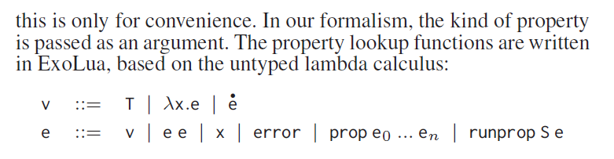
Why Should I Care?
A language with 3 expressions? Woof!
DeVito et al. First-class Runtime Generation of High-performance Types using Exotypes. PLDI ’14
  Just one example of a recent PL/security paper

Slide 6
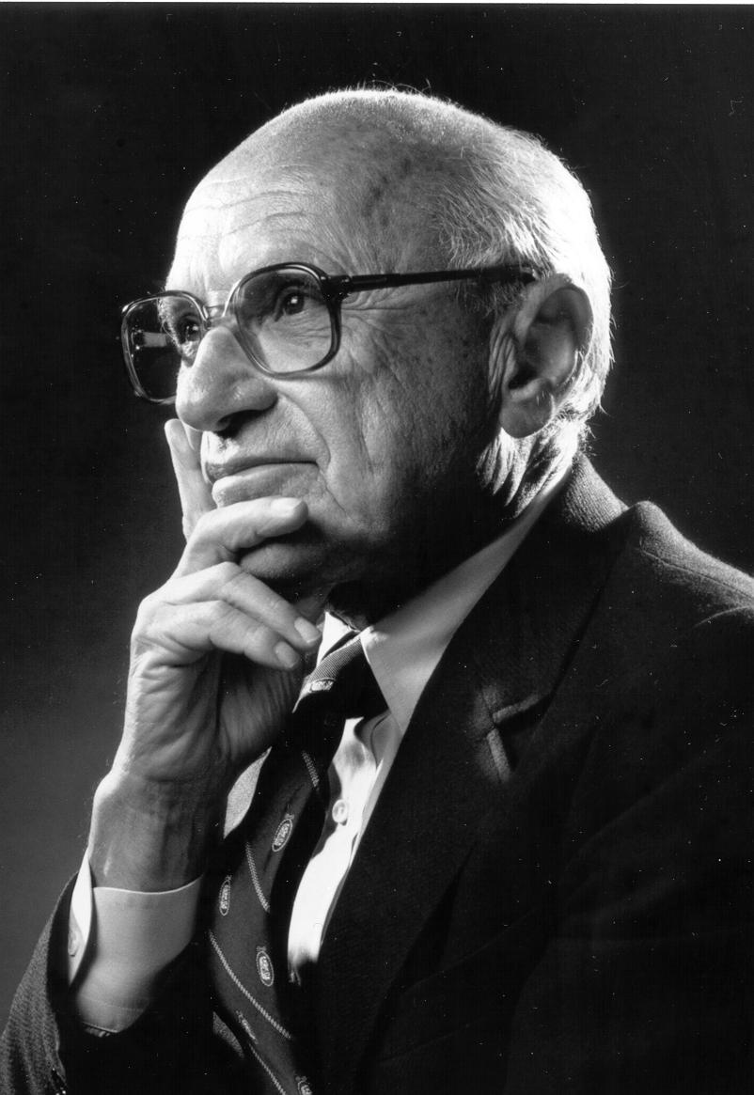
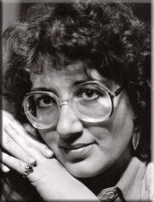
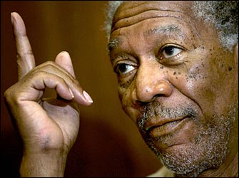
Lambda Celebrity Representative
Milton Friedman?
Morgan Freeman?
C. S. Friedman?

Slide 7


Gordon Freeman
Best-selling PC FPS to date …

Slide 8

Examples of Lambda Expressions
The identity function:
I =_{def} λx. x
A function that, given an argument y, discards it and yields the identity function:
λy. (λx. x)
A function that, given an function f, invokes it on the identity function:
λf. f (λx. x)
“There goes our
grant money.”

Slide 9
Scope of Variables
As in all languages with variables, it is important to discuss the notion of scope
  The scope of an identifier is the portion of a program where the identifier is accessible
An abstraction λx. E binds variable x in E
  x is the newly introduced variable
  E is the scope of x (unless x is shadowed)
  We say x is bound in λx. E
  Just like formal function arguments are bound in the function body

Slide 10

Free and Bound Variables
A variable is said to be free in E if it has occurrences that are not bound in E
We can define the free variables of an expression E recursively as follows:
  Free(x) = {x}
  Free(E₁ E₂) = Free(E₁) [ Free(E₂)
  Free(λx. E) = Free(E) – {x}
Example: Free(λx. x (λy. x y z)) = {z}
Free variables are (implicitly or explicitly) declared outside the expression

Slide 11
Free Your Mind!
Just as in any language with statically-nested scoping we have to worry about variable shadowing
  An occurrence of a variable might refer to different things in different contexts
Example in IMP with locals:
let x = 5 in x + (let x = 9 in x) + x
In λ-calculus:
λx. x (λx. x) x

Slide 12
Renaming Bound Variables
λ-terms that can be obtained from one another by renaming bound variables are considered identical
This is called α-equivalence
Renaming bound vars is called α-renaming
Ex: λx. x is identical to λy. y and to λz. z
Intuition:
  By changing the name of a formal argument and all of its occurrences in the function body, the behavior of the function does not change
  In λ-calculus such functions are considered identical

Slide 13

Make It Easy On Yourself
Convention: we will always try to rename bound variables so that they are all unique
  e.g., write λx. x (λy.y) x instead of λx. x (λx.x) x
This makes it easy to see the scope of bindings and also prevents confusion!

Slide 14
Substitution
The substitution of F for x in E (written [F/x]E)
  Step 1. Rename bound variables in E and F so they are unique
  Step 2. Perform the textual substitution of f for X in E
Called capture-avoiding substitution
Example: [y (λx. x) / x] λy. (λx. x) y x
  After renaming: [y (λx. x) / x] λz. (λu. u) z x
  After substitution: λz. (λu. u) z (y (λx. x))
If we are not careful with scopes we might get:
λy. (λx. x) y (y (λx. x)) Ã wrong!

Slide 15
The De Bruijn Notation
An alternative syntax that avoids naming of bound variables (and the subsequent confusions)
The De Bruijn index of a variable occurrence is that number of lambda that separate the occurrence from its binding lambda in the abstract syntax tree
The De Bruijn notation replaces names of occurrences with their De Bruijn indices
Examples:
  λ x. x λ. 0
  λ x. λ x. x λ. λ. 0
  λ x. λ y. y λ. λ. 0
  (λ x. x x) (λ z. z z) (λ. 0 0) (λ. 0 0)
  λ x. (λ x. λ y. x) x λ. (λ. λ. 1) 0
Identical terms
have identical
representations!

Slide 16
Combinators
A λ-term without free variables is closed or a combinator
Some interesting combinators:
I = λ x. x
K = λ x. λ y. x
S = λ f. λ g. λ x. f x (g x)
D = λ x. x x
Y = λ f. (λ x. f (x x)) (λ x. f (x x))
Theorem: any closed term is equivalent to one written with just S, K and I
  Example: D =_{β} S I I
  (we’ll discuss this form of equivalence later)

Slide 17
Q: Music (241 / 842)
Name the singer and his crossover 1982 album that holds (as of 2014) the record of being the best-selling album of all-original material in the US (29 times platinum, 37 weeks as Billboard #1). Much of that success was the result of the singer's use of the MTV music video.

Slide 18

Q: Class Archives
This is the largest city proper in the world (over 24 million in 2014), located on the Yangtze river delta. Its name means “upper sea” or “upon the sea”.

Slide 19
Q: Class Archives
This recreational activity is the world's most popular sport (over 250 million players in 200 countries). It is governed by the Laws of the Game. For fouls, players are cautioned with yellow cards and ejected with red cards.

Slide 20
Q: Class Archive
This Prarie State has a reputation as a predictor and model of the US as a whole. Barack Obama was a senator from this state before being elected president. It is also known as the Land of Lincoln.

Slide 21
Q: Class Archives
This king of Uruk reigned around 2500 BCE and is the eponymous protagonist of an Epic, the greatest surviving work of Mesopotamian literature. In it, he and his wild companion Enkidu kill the Bull of Heaven sent by Ishtar. Sadly, Enkidu dies.

Slide 22
Q: Class Archives
This space-themed MMORPG has been uncharitably described as a “rousing game of combat spreadsheets”. Characters train skills in real time, even when players are not logged into the game. Players can create in-game Ponzi schemes and illegal banks if they choose, and philosophies battle it out in a microcosm of society.

Slide 23
Q: Class Archives
In cryptography, this is an attack involving information gained from the physical reification of a cryptosystem, rather than via brute force or algorithmic flaws. Power consumption and EM leaks are classic examples.

Slide 24
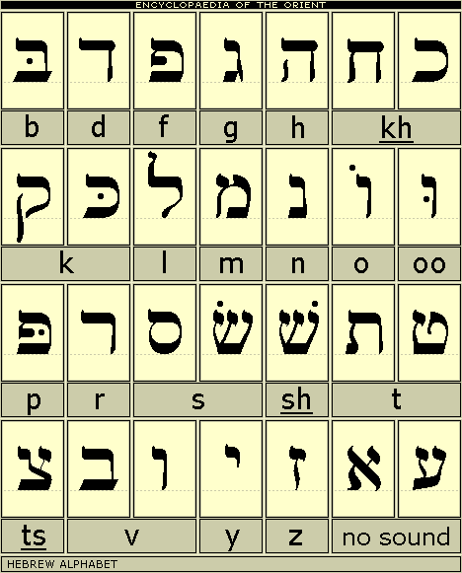
Q: General (452 / 842)
Name any 3 of the 22 letters in the Hebrew alphabet.

Slide 25
Informal Semantics
We consider only closed terms
The evaluation of
(λ x. e) f
  Binds x to f
  Evaluates e with the new binding
  Yields the result of this evaluation
Like a function call, or like “let x = f in e”
Example:
(λ f. f (f e)) g evaluates to g (g e)

Slide 26
Operational Semantics
Many operational semantics for the λ-calculus
All are based on the equation
(λ x. e) f =_{β} [f/x]e
usually read from left to right
This is called the β-rule and the evaluation step a β-reduction
The subterm (λ x. e) f is a β-redex
We write e !_{β} g to say that e β-reduces to g in one step
We write e !_{β}* g to say that e β-reduces to g in 0 or more steps
  Remind you of the small-step opsem term rewriting?

Slide 27

Examples of Evaluation
The identity function:
(λ x. x) E ! [E / x] x = E
Another example with the identity:
(λ f. f (λ x. x)) (λ x. x) !
[λ x. x / f] f (λ x. x)) =
[λ x. x / f] f (λ y. y)) =
(λ x. x) (λ y. y) !
[λ y. y / x] x = λ y. y
A non-terminating evaluation:
(λ x. xx) (λ y. yy) !
[λ y. yy / x] xx = (λ y. yy) (λ y. yy) ! …
Try T T, where T = λx. x x x

Slide 28
Evaluation and the Static Scope
The definition of substitution guarantees that evaluation respets static scoping:
(λ x. (λ y. y x)) (y (λ x. x)) !_{β} λ z. z (y (λ v. v))
(y remains free, i.e., defined externally)
If we forget to rename the bound y:
(λ x. (λ y. y x)) (y (λ x. x)) !_{β}* λ y. y (y (λ v. v))
(y was free before but is bound now)

Slide 29


Another View of Reduction
The application
Becomes:
(terms can grow substantially through β-reduction!)
I am g!
λ x. e
e
x x x
g
Not one g, but three!
e
g
g
g

Slide 30
Normal Forms
A term without redexes is in normal form
A reduction sequence stops at a normal form
If e is in normal form and e !_{β}* f then e is identical to f
K = λ x. λ y. x is in normal form
K I is not in normal form

Slide 31
Nondeterministic Evaluation
We define a small-step reduction relation
This is a non-deterministic semantics
Note that we evaluate under λ (where?)
(λ x. e) f ! [f/x]e
e₁ ! e₂
f₁ ! f₂
e₁ f ! e₂ f
e f₁ ! e f₂
e ! f
λ x. e ! λ x. f

Slide 32
Lambda Calculus Contexts
Define contexts with one hole
H ::= ² | λ x. H | H e | e H
Write H[e] to denote the filling of the hole in H with the expression e
Example:
H = λ x. x ² H[λ y. y] = λ x. x (λ y. y)
Filling the hole allows variable capture!
H = λ x. x ² H[x] = λ x. x x

Slide 33
Contextual Opsem
e ! f
(λ x. e) f ! [f/x]e
H[e] ! H[f]
Contexts allow concise formulations of congruence rules (application of local reduction rules on subterms)
Reduction occurs at a β-redex that can be anywhere inside the expression
The latter rule is called a congruence or structural rule
The above rules to not specify which redex must be reduced first

Slide 34
The Order of Evaluation
In a λ-term there could be more than one instance of (λ x. e) f, as in:
(λ y. (λ x. x) y) E
  Could reduce the inner or outer λ
  Which one should we pick?
(λ y. (λ x. x) y) E
inner outer
(λ y. [y/x] x) E = (λ y. y) E [E/y] (λ x. x) y = (λ x. x) E
E

Slide 35
The Diamond Property
A relation R has the diamond property if whenever e R e₁ and e R e₂ then there exists e₃ such that e₁ R e₃ and e₂ R e₃
!_{β} does not have the diamond property
!_{β}* has the diamond property
Also called the confluence property
E
R R
e₁ e₂
R R
E₃

Slide 36
A Diamond In The Rough
Languages defined by non-deterministic sets of rules are common
  Logic programming languages
  Expert systems
  Constraint satisfaction systems
    And thus most pointer analyses …
  Dataflow systems
  Makefiles
It is useful to know whether such systems have the diamond property

Slide 37
(Beta) Equality
Let =_{β} be the reflexive, transitive and symmetric closure of !_{β}
=_{β} is (!_{β} [ Ã_{β})*
That is, e =_{β} f if e converts to f via a sequence of forward and backward !_{β}
² ²
e ² f

Slide 38
The Church-Rosser Theorem
If e₁ =_{β} e₂ then there exists e₃ such that e₁ !_{β}* e₃ and e₂ !_{β}* e₃
² ²
e₁ ² e₂
² ²
e₃
Proof (informal): apply the diamond property as many times as necessary

Slide 39
Corollaries
If e₁ =_{β} e₂ and e₁ and e₂ are normal forms then e₁ is identical to e₂
  From C-R we have 9e₃. e₁ !_{β}* e₃ and e₂ !_{β}* e₃
  Since e₁ and e₂ are normal forms they are identical to e₃
If e !_{β}* e₁ and e !_{β}* e₂ and e₁ and e₂ are normal forms then e₁ is identical to e₂
  “All terms have a unique normal form.”

Slide 40
Evaluation Strategies
Church-Rosser theorem says that independent of the reduction strategy we will find ·1 normal form
But some reduction strategies might find 0
(λ x. z) ((λ y. y y) (λ y. y y)) !
(λ x. z) ((λ y. y y) (λ y. y y)) ! …
(λ x. z) ((λ y. y y) (λ y. y y)) ! z
There are three traditional strategies
  normal order (never used, always works)
  call-by-name (rarely used, cf. TeX or Haskell)
  call-by-value (amazingly popular)

Slide 41
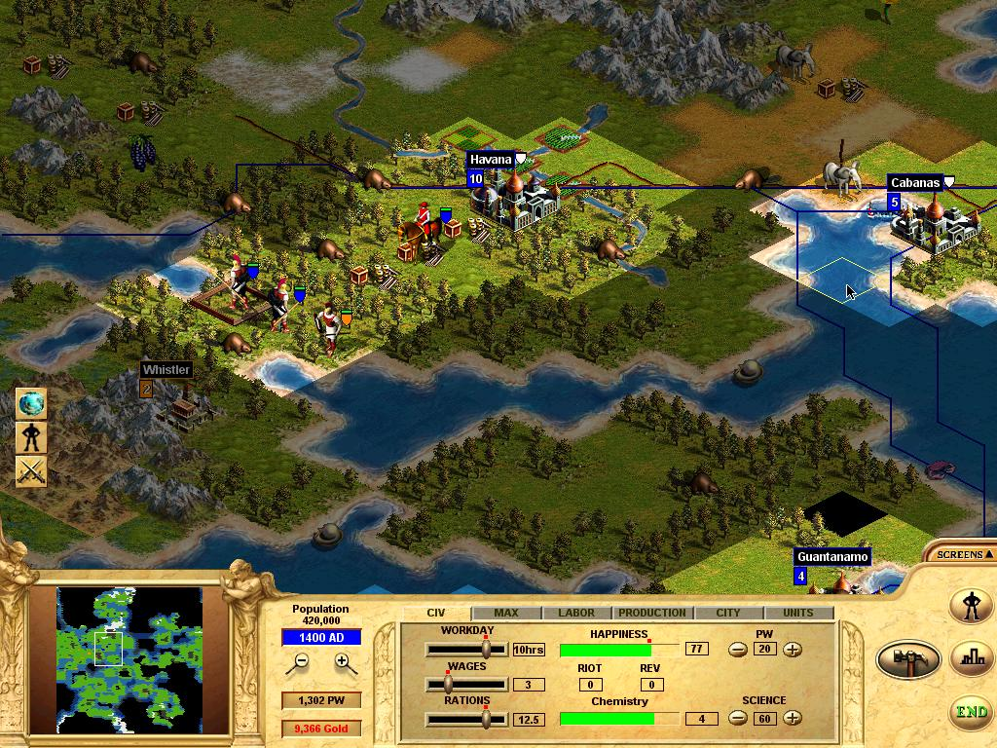
Civilization: Call By Value
Normal Order
  Evaluates the left-most redex not contained in another redex
  If there is a normal form, this finds it
  Not used in practice: requires partially evaluating function pointers and looking “inside” functions
Call-By-Name (“lazy”)
  Don’t reduce under λ, don’t evaluate a function argument (until you need to)
  Does not always evaluate to a normal form
Call-By-Value (“eager” or “strict”)
  Don’t reduce under λ, do evaluate a function’s argument right away
  Finds normal forms less often than the other two

Slide 42

Endgame
This time: λ syntax, semantics, reductions, equality, …
Next time: encodings, real programs, type systems, and all the fun stuff!
Wisely done, Mr. Freeman. I will see you up ahead.

Slide 43

Homework
Homework 5 Due Later
Final Project?

Slide 44
Tricksy On The Board Answer
Is this rule from lectures ago unsound?
Nope: it’s our basic rule plus 2x consequence
Note that B_{then} ) B_{then} Ç B_{else}
` {A Æ p} c_{then} {B_{then}}
` {A Æ :p} c_{else} {B_{else}}
` {A} if p then c_{then} else c_{else} {B_{then} Ç B_{else}}
` {A Æ p} c₁ {B} ` {A Æ : p} c₂ {B}
` {A} if p then c₁ else c₂ {B}
` A’ ) A ` {A} c {B} ` B ) B’
` {A’} c {B’}

