Slide 1
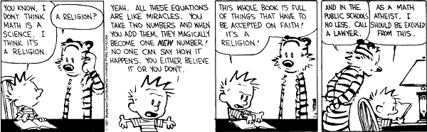
More Lambda Calculus and
Intro to Type Systems

Slide 2
One Slide Summary
The lambda calculus is a model of computation or a programming language that is as expressive as a Turing machine.
The lambda calculus centers on function definition and function application. The meaning of function application is given by substitution (beta reduction).
We can encode the booleans (and, or, not, if) and the numbers (zero, successor, add, multiply, equality, looping) via lambdas.

Slide 3
Plan
Heavy Class Participation
  Thus, wake up! (not actually kidding)
Lambda Calculus
  How is it related to real life?
  Encodings
  Fixed points
Type Systems
  Overview
  Static, Dyamic
  Safety, Judgments, Derivations, Soundness

Slide 4
Lambda Review
λ-calculus is a calculus of functions
e := x | λx. e | e₁ e₂
Several evaluation strategies exist based on β-reduction
(λx.e) e’ !_{β} [e’/x] e
How does this simple calculus relate to real programming languages?

Slide 5
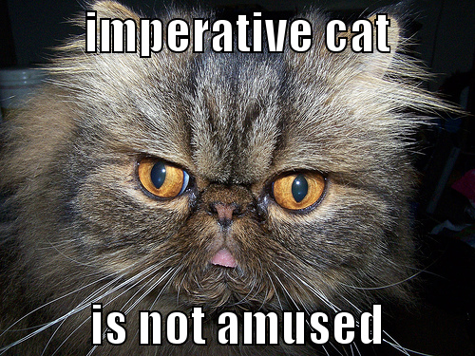
Functional Programming
The λ-calculus is a prototypical functional language with:
  no side effects
  several evaluation strategies
  lots of functions
  nothing but functions (pure λ-calculus does not have any other data type)
How can we program with functions?
How can we program with only functions?

Slide 6
Programming With Functions
Functional programming is a programming style that relies on lots of functions
A typical functional paradigm is using functions as arguments or results of other functions
  Called “higher-order programming”
Some “impure” functional languages permit side-effects (e.g., Lisp, Scheme, ML, Python)
  references (pointers), in-place update, arrays, exceptions
  Others (and by “others” we mean “Haskell”) use monads to model state updates

Slide 7
Variables in Functional Languages
We can introduce new variables:
let x = e₁ in e₂
  x is bound by let
  x is statically scoped in (a subset of) e₂
This is pretty much like (λx. e₂) e₁
In a functional language, variables are never updated
  they are just names for expressions or values
  e.g., x is a name for the value denoted by e₁ in e₂
This models the meaning of “let” in math (proofs)

Slide 8
Referential Transparency
In “pure” functional programs, we can reason equationally, by substitution
  Called “referential transparency”
let x = e₁ in e₂ === [e₁/x]e₂
In an imperative language a side-effect in e₁ might invalidate the above equation
The behavior of a function in a “pure” functional language depends only on the actual arguments
  Just like a function in math
  This makes it easier to understand and to reason about functional programs

Slide 9
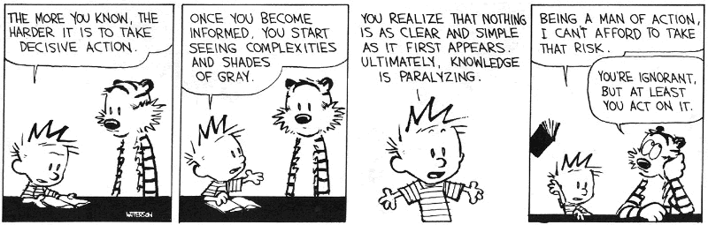
How Tough Is Lambda?
Given e₁ and e₂, how complex (a la CS theory) is it to determine if:
e₁ !_{β}* e and e₂ !_{β}* e

Slide 10
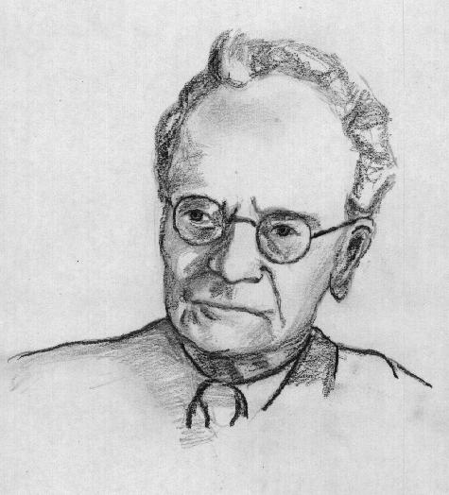
Expressiveness of λ-Calculus
The λ-calculus is a minimal system but can express
  data types (integers, booleans, lists, trees, etc.)
  branching
  recursion
This is enough to encode Turing machines
  We say the lambda calculus is Turing-complete
Corollary: e₁ =_{β} e₂ is undecidable
Still, how do we encode all these constructs using only functions?
Idea: encode the “behavior” of values and not their structure

Slide 11
Encoding Booleans in λ-Calculus
What can we do with a boolean?
  we can make a binary choice (= “if” statement)
A boolean is a function that, given two choices, selects one of them:
  true =_{def} λx. λy. x
  false =_{def} λx. λy. y
  if E₁ then E₂ else E₃ =_{def} E₁ E₂ E₃
Example: “if true then u else v” is
(λx. λy. x) u v !_{β} (λy. u) v !_{β} u

Slide 12
More Boolean Encodings
Let’s try to do boolean or together
Recall:
  true =_{def} λx. λy. x
  false =_{def} λx. λy. y
  if E₁ then E₂ else E₃ =_{def} E₁ E₂ E₃
We want or to take in two booleans and yield a result that is a boolean
How can we do this?

Slide 13
A Trying Ordeal
Recall:
  true =_{def} λx. λy. x
  false =_{def} λx. λy. y
  if E₁ then E₂ else E₃ =_{def} E₁ E₂ E₃
Intution:
  or a b = if a then true else b
Either of these will work:
  or =_{def} λa. λb. a true b
  or =_{def} λa. λb. λx. λy. a x (b x y)

Slide 14
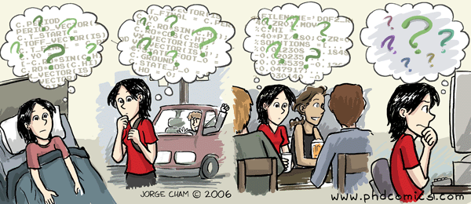
Final Boolean Encodings
Think about how to do and and not
Without peeking! Now come up and do it!

Slide 15
Another Demand
How to do and and not
and a b = if a then b else false
  and =_{def} λa. λb. a b false
  and =_{def} λa. λb. λx. λy. a (b x y) y
not a = if a then false else true
  not =_{def} λa. a false true
  not =_{def} λa. λx. λy. a y x

Slide 16
Encoding Pairs in λ-Calculus
What can we do with a pair?
  we can access one of its elements (= “.field access”)
A pair is a function that, given a boolean, returns the first or second element
mkpair x y =_{def} λb. b x y
fst p =_{def} p true
snd p =_{def} p false
fst (mkpair x y) !_{β} (mkpair x y) true
!_{β} true x y !_{β} x

Slide 17
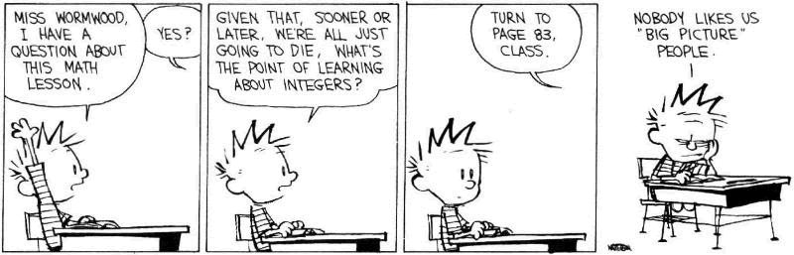
Encoding Numbers in λ−Calculus
What can we do with a natural number?
  What do you, the viewers at home, think?

Slide 18
Encoding Numbers λ-Calculus
What can we do with a natural number?
  we can iterate a number of times over some function (= “for loop”)
A natural number is a function that given an operation f and a starting value s, applies f a number of times to s:
0 =_{def} λf. λs. s
1 =_{def} λf. λs. f s
2 =_{def} λf. λs. f (f s)
  Very similar to List.fold_left and friends
These are numerals in a unary representation
Called Church numerals

Slide 19
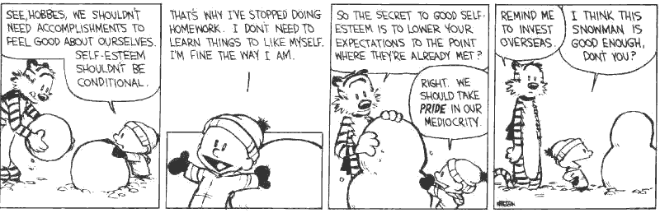
Test Time!
How would you encode the successor function (succ x === x+1)?
How would you encode more general addition?
Recall: 4 =_{def} λf. λs. f f f (f s)

Slide 20
Computing with Natural Numbers
The successor function
succ n =_{def} λf. λs. f (n f s)
or succ n =_{def} λf. λs. n f (f s)
Addition
add n₁ n₂ =_{def} n₁ succ n₂
Multiplication
mult n₁ n₂ =_{def} n₁ (add n₂) 0
Testing equality with 0
iszero n =_{def} n (λb. false) true
Subtraction
  Is not instructive, but makes a fun exercise …

Slide 21
Computation Example
What is the result of the application add 0?
(λn₁. λn₂. n₁ succ n₂) 0 !_{β}
λn₂. 0 succ n₂ =
λn₂. (λf. λs. s) succ n₂ !_{β}
λn₂. n₂ =
λx. x
By computing with functions we can express some optimizations
  But we need to reduce under the lambda
  Thus this “never” happens in practice

Slide 22
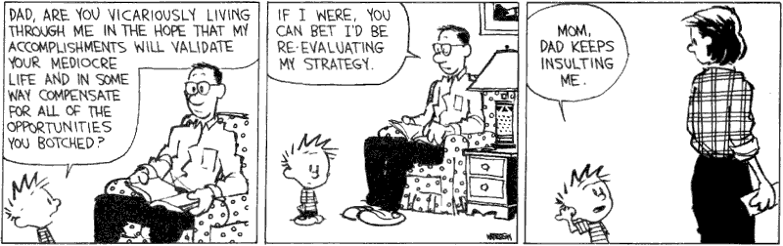
Toward Recursion
Given a predicate P, encode the function “find” such that “find P n” is the smallest natural number which is larger than n and satisfies P
Claim: with find we can encode all recursion
Intuitively, why is this true?

Slide 23
Encoding Recursion
Given a predicate P encode the function “find” such that “find P n” is the smallest natural number which is larger than n and satisfies P
find satisfies the equation
find p n = if p n then n else find p (succ n)
Define
F = λf.λp.λn.(p n) n (f p (succ n))
We need a fixed point of F
find = F find
or
find p n = F find p n

Slide 24
The Fixed-Point Combinator Y
Let Y = λF. (λy.F(y y)) (λx. F(x x))
  This is called the fixed-point combinator
  Verify that Y F is a fixed point of F
Y F !_{β} (λy.F (y y)) (λx. F (x x)) !_{β} F (Y F)
  Thus Y F =_{β} F (Y F)
Given any function in λ-calculus we can define its fixed-point (w00t! why do we not win here?)
Thus we can define “find” as the fixed-point of the function F from the previous slide
Essence of recursion is the self-application “y y”

Slide 25
Expressiveness of Lambda Calculus
Encodings are fun
  Yes! Yes they are!
But programming in pure λ-calculus is painful
So we will add constants (0, 1, 2, …, true, false, if-then-else, etc.)
Next we will add types

Slide 26

Still Going!
One minute break
Stretch!

Slide 27
Q: Books (711 / 842)
In this 1943 Antoine de Saint-Exupery novel the title character lives on an asteroid with a rose but eventually travels to Earth.

Slide 28
Springfield, Illinois
Animaniacs
Two player game
Players take turns naming State Capitals until one player says “Springfield, Illinois”
The player to say “Springfield, Illinois” receives points equal to the number of previously-named Capitals
Why is this game interesting?

Slide 29
Q: Computer Science (姚期智)
This Shanghai-born Turing Award winner is known for contributions to the theory of computation. He formulated the Millionaire's Problem and stated this minimax principle: “the expected cost of any randomized algorithm for solving a given problem, on the worst case input for that algorithm, can be no better than the expected cost, for a worst-case random probability distribution on the inputs, of the deterministic algorithm that performs best against that distribution.”

Slide 30
Types
A program variable can assume a range of values during the execution of a program
An upper bound of such a range is called a type of the variable
  A variable of type “bool” is supposed to assume only boolean values
  If x has type “bool” then the boolean expression “not(x)” has a sensible meaning during every run of the program

Slide 31
Typed and Untyped Languages
Untyped languages
  Do not restrict the range of values for a given variable
  Operations might be applied to inappropriate arguments. The behavior in such cases might be unspecified
  The pure λ-calculus is an extreme case of an untyped language (however, its behavior is completely specified)
(Statically) Typed languages
  Variables are assigned (non-trivial) types
  A type system keeps track of types
  Types might or might not appear in the program itself
  Languages can be explicitly typed or implicitly typed

Slide 32
The Purpose Of Types
The foremost purpose of types is to prevent certain types of run-time execution errors
Traditional trapped execution errors
  Cause the computation to stop immediately
  And are thus well-specified behavior
  Usually enforced by hardware
  e.g., Division by zero, floating point op with a NaN
  e.g., Dereferencing the address 0 (on most systems)
Untrapped execution errors
  Behavior is unspecified (depends on the state of the machine = this is very bad!)
  e.g., accessing past the end of an array
  e.g., jumping to an address in the data segment

Slide 33
Execution Errors
A program is deemed safe if it does not cause untrapped errors
  Languages in which all programs are safe are safe languages
For a given language we can designate a set of forbidden errors
  A superset of the untrapped errors, usually including some trapped errors as well
    e.g., null pointer dereference
Modern Type System Powers:
  prevent race conditions (e.g., Flanagan TLDI ‘05)
  prevent insecure information flow (e.g., Li POPL ’05)
  prevent resource leaks (e.g., Vault, Weimer)
  help with generic programming, probabilistic languages, …
  … are often combined with dynamic analyses (e.g., CCured)

Slide 34
Preventing Forbidden Errors - Static Checking
Forbidden errors can be caught by a combination of static and run-time checking
Static checking
  Detects errors early, before testing
  Types provide the necessary static information for static checking
  e.g., ML, Modula-3, Java
  Detecting certain errors statically is undecidable in most languages

Slide 35
Preventing Forbidden Errors - Dynamic Checking
Required when static checking is undecidable
  e.g., array-bounds checking
Run-time encodings of types are still used (e.g. Lisp)
Should be limited since it delays the manifestation of errors
Can be done in hardware (e.g. null-pointer)

Slide 36
Safe Languages
There are typed languages that are not safe (“weakly typed languages”)
All safe languages use types (static or dynamic)
We focus on statically typed languages
Typed
Untyped
Static
Dynamic
Safe
ML, Java, Ada, C#, Haskell, ...
Lisp, Scheme, Ruby, Perl, Smalltalk, PHP, Python, …
λ-calculus
Unsafe
C, C++, Pascal, ...
?
Assembly

Slide 37
Why Typed Languages?
Development
  Type checking catches early many mistakes
  Reduced debugging time
  Typed signatures are a powerful basis for design
  Typed signatures enable separate compilation
Maintenance
  Types act as checked specifications
  Types can enforce abstraction
Execution
  Static checking reduces the need for dynamic checking
  Safe languages are easier to analyze statically
    the compiler can generate better code

Slide 38
Homework
Read Cardelli article
Read Wright & Matthias article
Homework 5 Due Soon

