Slide 1
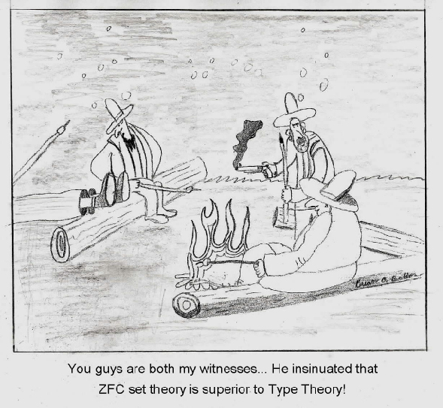
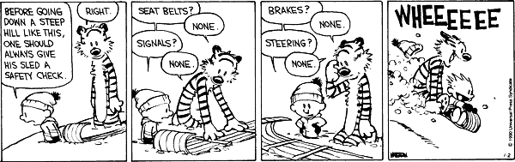
Simply-Typed
Lambda Calculus

Slide 2
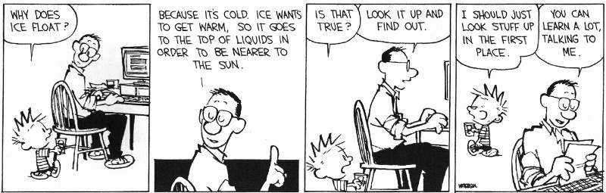
Back to School
What is operational semantics? When would you use contextual (small-step) semantics?
What is denotational semantics?
What is axiomatic semantics? What is a verification condition?

Slide 3
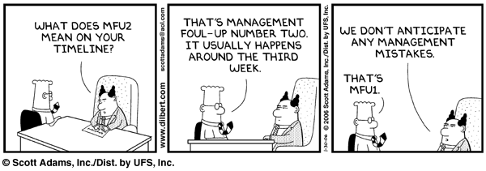
Today’s (Short?) Cunning Plan
Type System Overview
First-Order Type Systems
Typing Rules
Typing Derivations
Type Safety

Slide 4
Types
A program variable can assume a range of values during the execution of a program
An upper bound of such a range is called a type of the variable
  A variable of type “bool” is supposed to assume only boolean values
  If x has type “bool” then the boolean expression “not(x)” has a sensible meaning during every run of the program

Slide 5
Typed and Untyped Languages
Untyped languages
  Do not restrict the range of values for a given variable
  Operations might be applied to inappropriate arguments. The behavior in such cases might be unspecified
  The pure λ-calculus is an extreme case of an untyped language (however, its behavior is completely specified)
(Statically) Typed languages
  Variables are assigned (non-trivial) types
  A type system keeps track of types
  Types might or might not appear in the program itself
  Languages can be explicitly typed or implicitly typed

Slide 6
The Purpose Of Types
The foremost purpose of types is to prevent certain types of run-time execution errors
Traditional trapped execution errors
  Cause the computation to stop immediately
  And are thus well-specified behavior
  Usually enforced by hardware
  e.g., Division by zero, floating point op with a NaN
  e.g., Dereferencing the address 0 (on most systems)
Untrapped execution errors
  Behavior is unspecified (depends on the state of the machine = this is very bad!)
  e.g., accessing past the end of an array
  e.g., jumping to an address in the data segment

Slide 7
Execution Errors
A program is deemed safe if it does not cause untrapped errors
  Languages in which all programs are safe are safe languages
For a given language we can designate a set of forbidden errors
  A superset of the untrapped errors, usually including some trapped errors as well
    e.g., null pointer dereference
Modern Type System Powers:
  prevent race conditions (e.g., Flanagan TLDI ‘05)
  prevent insecure information flow (e.g., Li POPL ’05)
  prevent resource leaks (e.g., Vault, Weimer)
  help with generic programming, probabilistic languages, …
  … are often combined with dynamic analyses (e.g., CCured)

Slide 8
Preventing Forbidden Errors - Static Checking
Forbidden errors can be caught by a combination of static and run-time checking
Static checking
  Detects errors early, before testing
  Types provide the necessary static information for static checking
  e.g., ML, Modula-3, Java
  Detecting certain errors statically is undecidable in most languages

Slide 9
Preventing Forbidden Errors - Dynamic Checking
Required when static checking is undecidable
  e.g., array-bounds checking
Run-time encodings of types are still used (e.g. Lisp)
Should be limited since it delays the manifestation of errors
Can be done in hardware (e.g. null-pointer)

Slide 10
Why Typed Languages?
Development
  Type checking catches early many mistakes
  Reduced debugging time
  Typed signatures are a powerful basis for design
  Typed signatures enable separate compilation
Maintenance
  Types act as checked specifications
  Types can enforce abstraction
Execution
  Static checking reduces the need for dynamic checking
  Safe languages are easier to analyze statically
    the compiler can generate better code

Slide 11
Why Not Typed Languages?
Static type checking imposes constraints on the programmer
  Some valid programs might be rejected
  But often they can be made well-typed easily
  Hard to step outside the language (e.g. OO programming in a non-OO language, but cf. Ruby, OCaml, etc.)
Dynamic safety checks can be costly
  50% is a possible cost of bounds-checking in a tight loop
    In practice, the overall cost is much smaller
  Memory management must be automatic ) need a garbage collector with the associated run-time costs
  Some applications are justified in using weakly-typed languages (e.g., by external safety proof)

Slide 12
Safe Languages
There are typed languages that are not safe (“weakly typed languages”)
All safe languages use types (static or dynamic)
We focus on statically typed languages
Typed
Untyped
Static
Dynamic
Safe
ML, Java, Ada, C#, Haskell, ...
Lisp, Scheme, Ruby, Perl, Smalltalk, PHP, Python, …
λ-calculus
Unsafe
C, C++, Pascal, ...
?
Assembly

Slide 13
Properties of Type Systems
How do types differ from other program annotations?
  Types are more precise than comments
  Types are more easily mechanizable than program specifications
Expected properties of type systems:
  Types should be enforceable
  Types should be checkable algorithmically
  Typing rules should be transparent
    Should be easy to see why a program is not well-typed

Slide 14
Why Formal Type Systems?
Many typed languages have informal descriptions of the type systems (e.g., in language reference manuals)
A fair amount of careful analysis is required to avoid false claims of type safety
A formal presentation of a type system is a precise specification of the type checker
  And allows formal proofs of type safety
But even informal knowledge of the principles of type systems help

Slide 15
Formalizing a Language
Syntax
  Of expressions (programs)
  Of types
  Issues of binding and scoping
Static semantics (typing rules)
  Define the typing judgment and its derivation rules
Dynamic Semantics (e.g., operational)
  Define the evaluation judgment and its derivation rules
Type soundness
  Relates the static and dynamic semantics
  State and prove the soundness theorem

Slide 16
Typing Judgments
Judgment (recall)
  A statement J about certain formal entities
  Has a truth value ² J
  Has a derivation ` J (= “a proof”)
A common form of typing judgment:
Γ ` e : τ(e is an expression and τ is a type)
Γ (Gamma) is a set of type assignments for the free variables of e
  Defined by the grammar Γ ::= ¢ | Γ, x : τ
  Type assignments for variables not free in e are not relevant
  e.g, x : int, y : int ` x + y : int

Slide 17
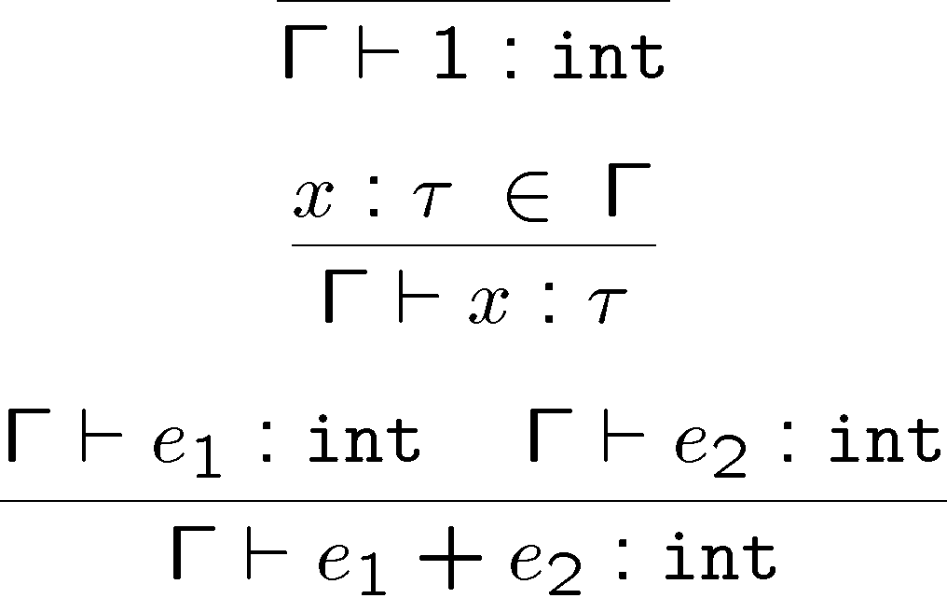
Typing rules
Typing rules are used to derive typing judgments
Examples:

Slide 18
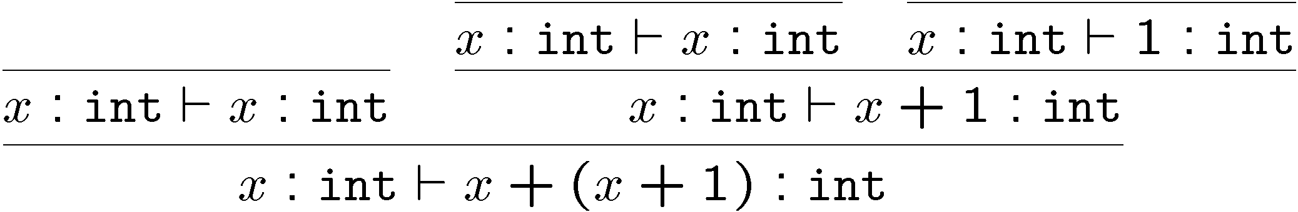
Typing Derivations
A typing derivation is a derivation of a typing judgment (big surprise there …)
Example:
We say Γ ` e : τ to mean there exists a derivation of this typing judgment (= “we can prove it”)
Type checking: given Γ, e and τ find a derivation
Type inference: given Γ and e, find τ and a derivation

Slide 19
Proving Type Soundness
A typing judgment is either true or false
Define what it means for a value to have a type
v 2 k τ k
(e.g. 5 2 k int k and true 2 k bool k )
Define what it means for an expression to have a type
e 2 j τ j iff 8v. (e ⇓ v ) v 2 k τ k)
Prove type soundness
If ¢ ` e : τ then e 2 j τ j
or equivalently
If ¢ ` e : τ and e ⇓ v then v 2 k τ k
This implies safe execution (since the result of a unsafe execution is not in k τ k for any τ)

Slide 20
Upcoming Exciting Episodes
We will give formal description of first-order type systems (no type variables)
  Function types (simply typed λ-calculus)
  Simple types (integers and booleans)
  Structured types (products and sums)
  Imperative types (references and exceptions)
  Recursive types (linked lists and trees)
The type systems of most common languages are first-order
Then we move to second-order type systems
  Polymorphism and abstract types

Slide 21
Q: Movies (378 / 842)
This 1988 animated movie written and directed by Isao Takahata for Studio Ghibli was considered by Roger Ebert to be one of the most powerful anti-war films ever made. It features Seita and his sister Setsuko and their efforts to survive outside of society during the firebombing of Tokyo.

Slide 22
Computer Science
This American-Canadian Turing-award winner is known for major contributions to the fields of complexity theory and proof complexity. He is known for formalizing the polynomial-time reduction, NP-completeness, P vs. NP, and showing that SAT is NP-complete. This was all done in the seminal 1971 paper “The Complexity of Theorem Proving Procedures.”

Slide 23
Q: Games (504 / 842)
This 1985 falling-blocks computer game was invented by Alexey Pajitnov (Алексей Пажитнов) and inspired by pentominoes.

Slide 24
Simply-Typed Lambda Calculus
Notice :τ
Syntax:
Terms e ::= x | λx:τ. e | e₁ e₂
| n | e₁ + e₂ | iszero e
| true | false | not e | if e₁ then e₂ else e₃
Types τ ::= int | bool | τ₁ ! τ₂
τ₁ ! τ₂ is the function type
! associates to the right
Arguments have typing annotations :τ
This language is also called F₁

Slide 25
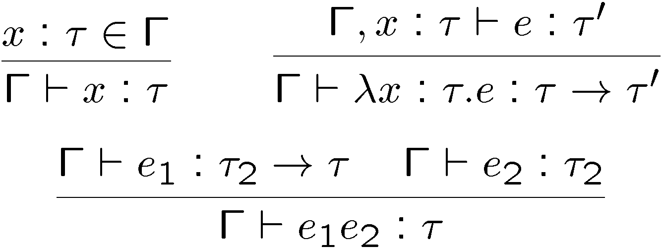
Static Semantics of F₁
The typing judgment
Γ ` e : τ
Some (simpler) typing rules:

Slide 26
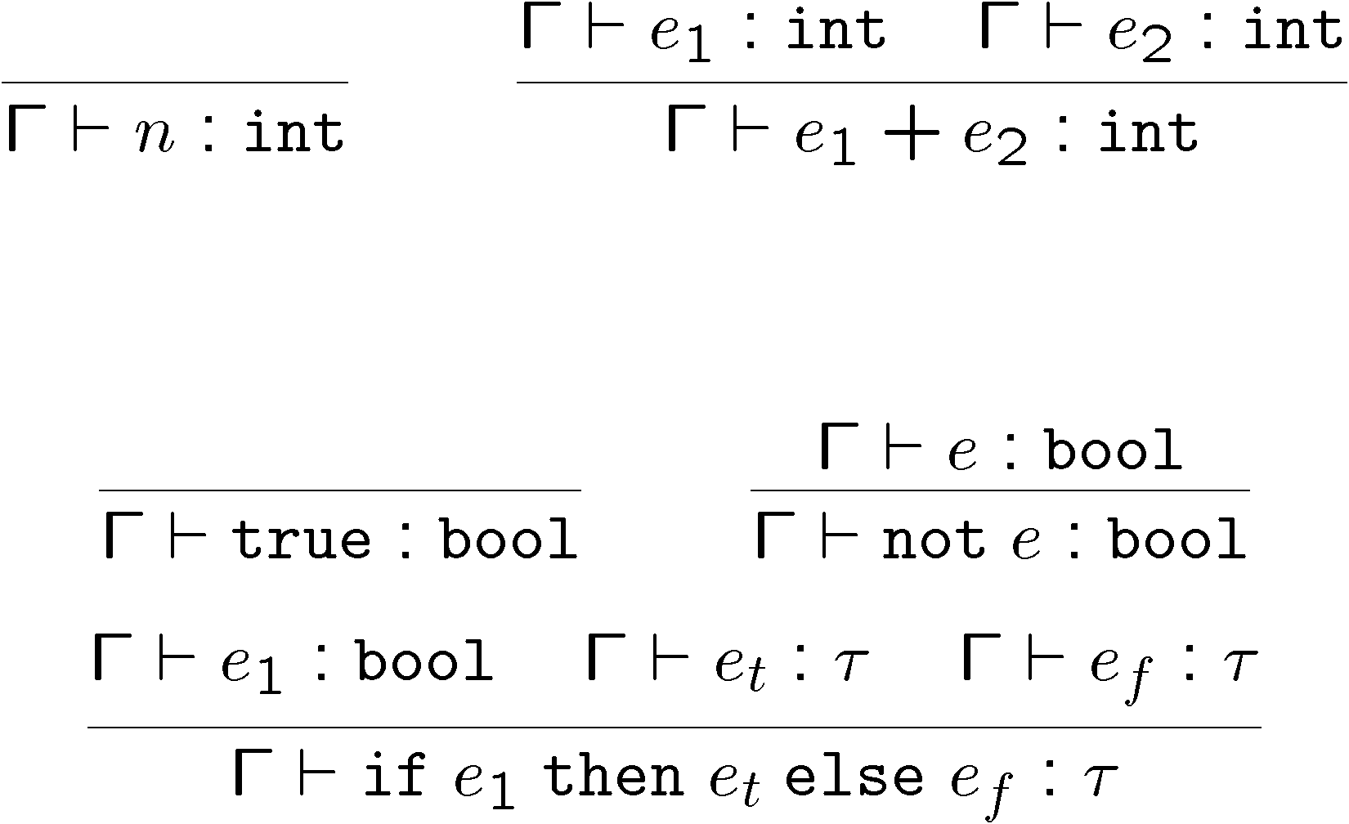
More Static Semantics of F₁
Why do we have this mysterious gap? I don’t know either!

Slide 27
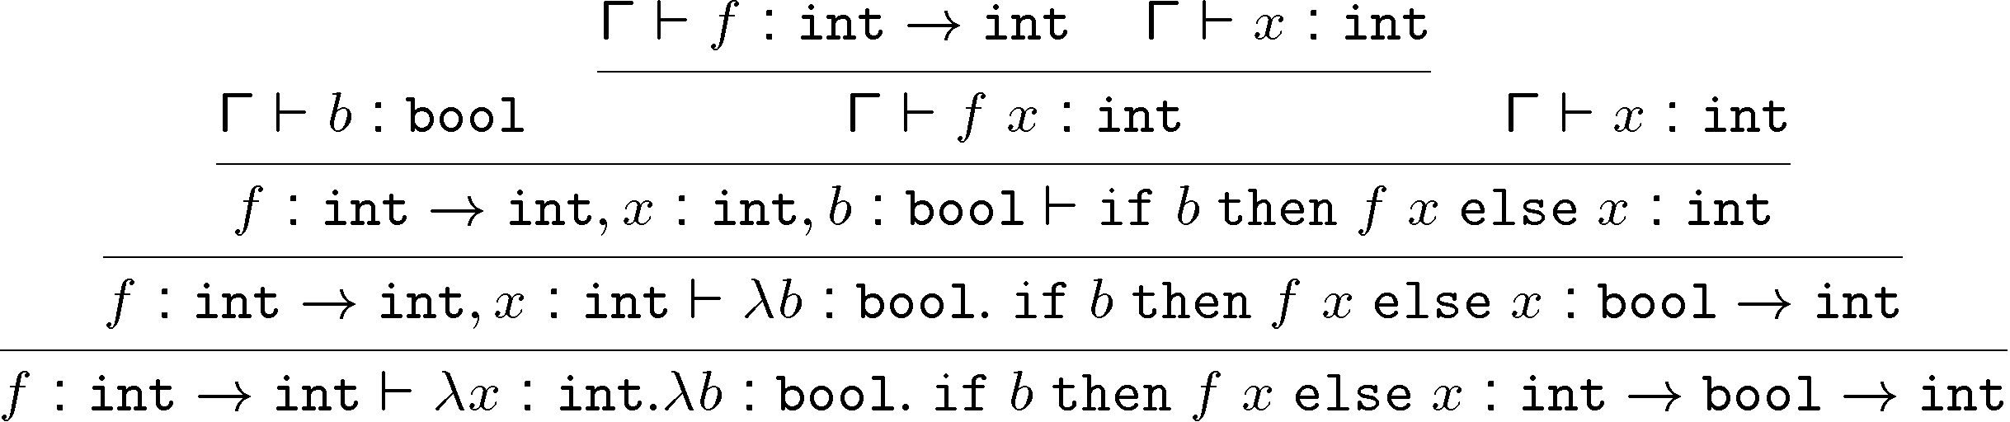
Typing Derivation in F₁
Consider the term
λx : int. λb : bool. if b then f x else x
  With the initial typing assignment f : int ! Int
  Where Γ = f : int ! int, x : int, b : bool

Slide 28
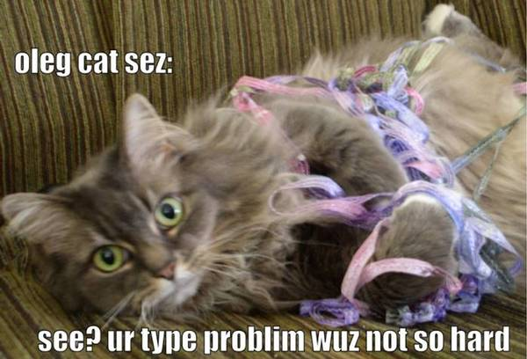
Type Checking in F₁
Type checking is easy because
  Typing rules are syntax directed
  Typing rules are compositional (what does this mean?)
  All local variables are annotated with types
In fact, type inference is also easy for F₁
Without type annotations an expression may have no unique type
¢ ` λx. x : int ! int
¢ ` λx. x : bool ! bool

Slide 29
Operational Semantics of F₁
Judgment:
e ⇓ v
Values:
v ::= n | true | false | λx:τ. e
The evaluation rules …
  Audience participation time: raise your hand and give me an evaluation rule.

Slide 30
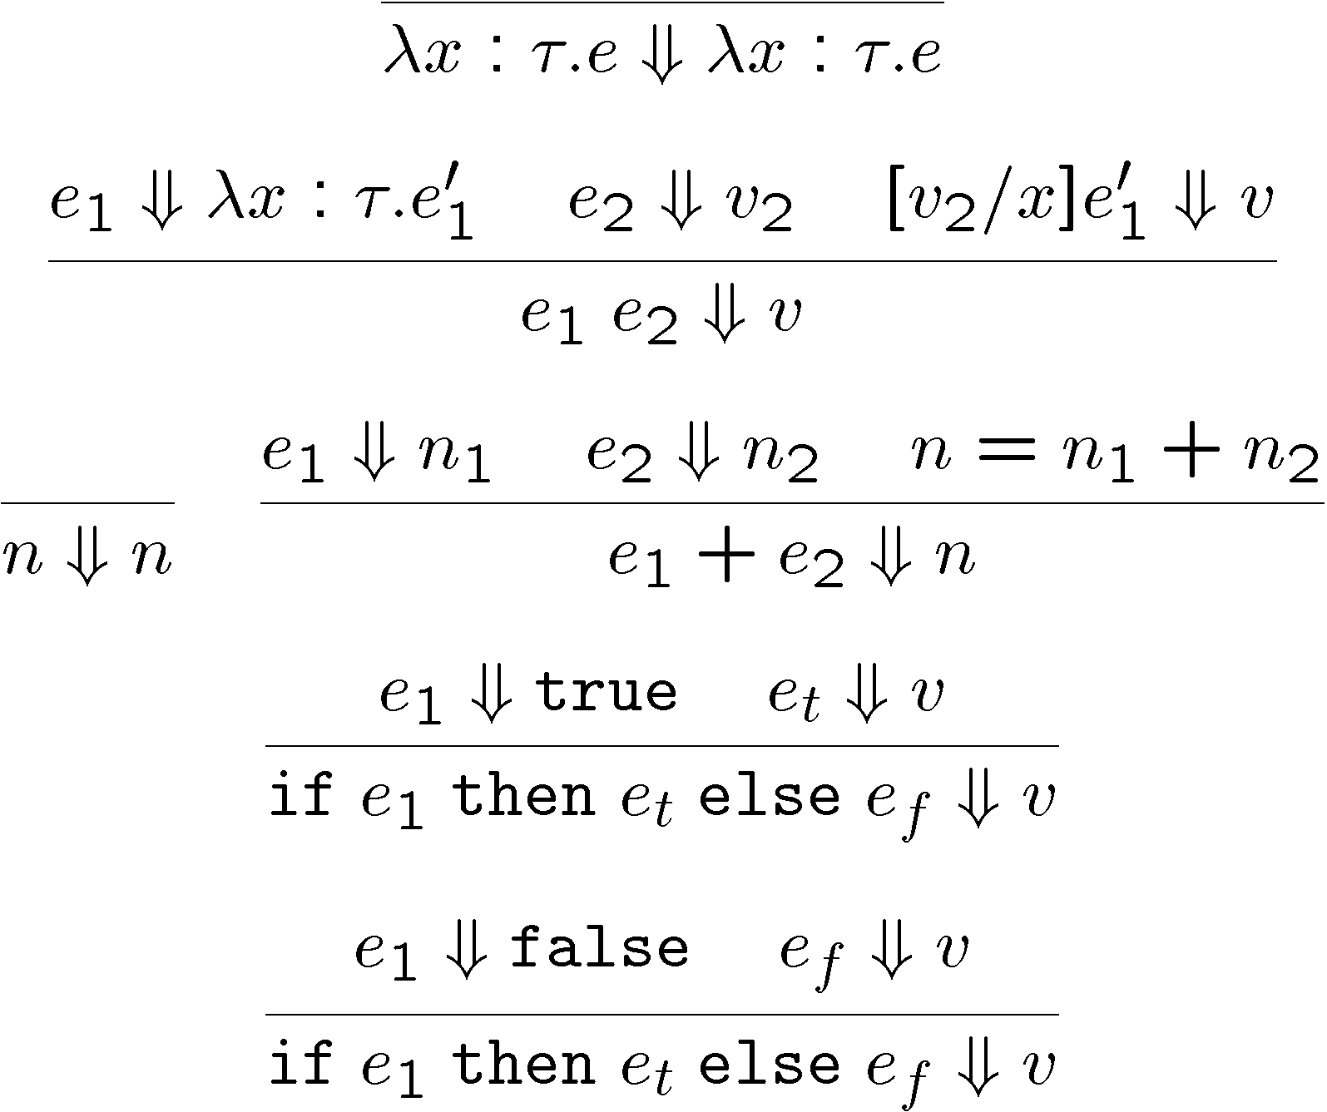
Opsem of F₁ (Cont.)
Call-by-value evaluation rules (sample)
Where is the
Call-By-Value?
How might we change it?
Evaluation is undefined for ill-typed programs !

Slide 31
Type Soundness for F₁
Thm: If ¢ ` e : τ and e ⇓ v then ¢ ` v : τ
  Also called, subject reduction theorem, type preservation theorem
This is one of the most important sorts of theorems in PL
Whenever you make up a new safe language you are expected to prove this
  Examples: Vault, TAL, CCured, …
Proof: next time!

Slide 32
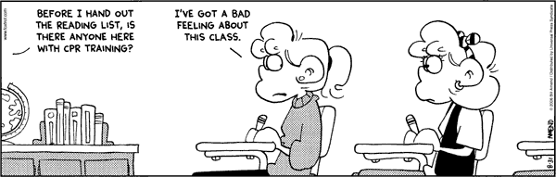
Homework
Read actually-exciting Leroy paper
Finish Homework 5?
Work on your projects!
  Status Update Due

