Slide 1
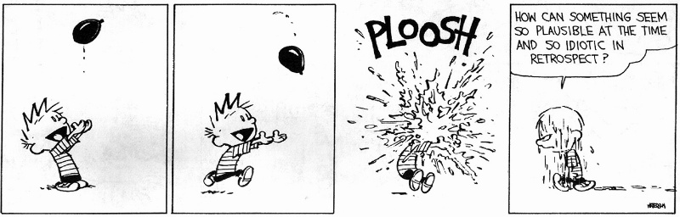
Monomorphic Type Systems

Slide 2
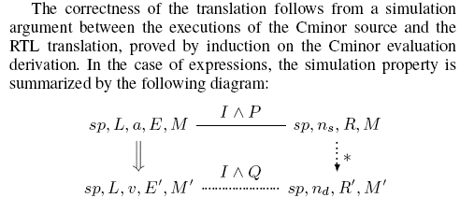
The Reading
Explain the Xavier Leroy article to me …
How did he do register allocation?

Slide 3
One-Slide Summary
The simply-typed lambda calculus is an important tool for studying and designing new programming language features.
Soundness is a critical property of any type system (if ¢ ` e : τ and e ⇓ v then ¢ ` v : τ). We can prove it by induction.
We can extend the type system to handle tuples, unions, and imperative references. We model meaning with contextual operational semantics.

Slide 4
Type Soundness for F₁
What does this mean?
Theorem: If ¢ ` e : τ and e ⇓ v then ¢ ` v : τ
  Also called, subject reduction theorem, type preservation theorem
This is one of the most important sorts of theorems in PL
Whenever you make up a new safe language you are expected to prove this
  Examples: Vault, TAL, CCured, …

Slide 5
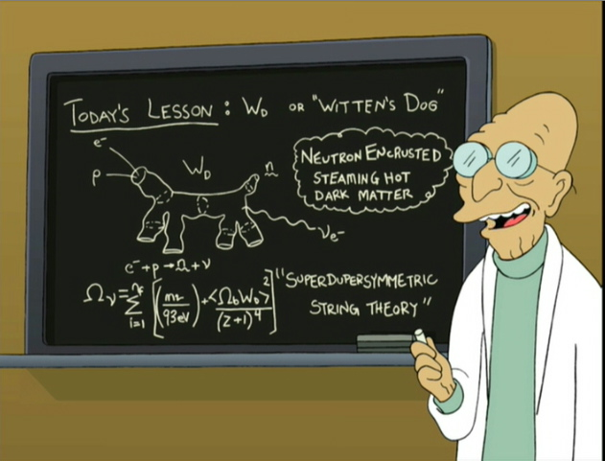
How Might We Prove It?
Theorem: If ¢ ` e : τ and e ⇓ v then ¢ ` v : τ

Slide 6
Proof Approaches To Type Safety
Theorem: If ¢ ` e : τ and e ⇓ v then ¢ ` v : τ
Try to prove by induction on e
  Won’t work because [v₂/x]e’₁ in the evaluation of e₁ e₂
  Same problem with induction on ¢ ` e : τ
Try to prove by induction on τ
  Won’t work because e₁ has a “bigger” type than e₁ e₂
???

Slide 7
Proof Approaches To Type Safety
Theorem: If ¢ ` e : τ and e ⇓ v then ¢ ` v : τ
Try to prove by induction on e
  Won’t work because [v₂/x]e’₁ in the evaluation of e₁ e₂
  Same problem with induction on ¢ ` e : τ
Try to prove by induction on τ
  Won’t work because e₁ has a “bigger” type than e₁ e₂
Try to prove by induction on e ⇓ v
  To address the issue of [v₂/x]e’₁
  This is it!

Slide 8
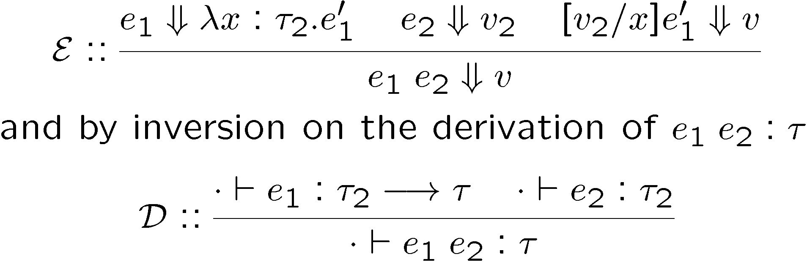
Type Soundness Proof
Consider the function application case
From IH on e₁ ⇓ … we have ¢, x : τ₂ ` e₁’ : τ
From IH on e₂ ⇓ … we have ¢ ` v₂ : τ₂
Need to infer that ¢ ` [v₂/x]e₁’ : τ and use the IH
  We need a substitution lemma (by induction on e₁’)

Slide 9
Significance of Type Soundness
The theorem says that the result of an evaluation has the same type as the initial expression
The theorem does not say that
  The evaluation never gets stuck (e.g., trying to apply a non-function, to add non-integers, etc.), nor that
  The evaluation terminates
Even though both of the above facts are true of F₁
What formal system of semantics do we use to reason about programs that might not terminate?

Slide 10
Significance of Type Soundness
The theorem says that the result of an evaluation has the same type as the initial expression
The theorem does not say that
  The evaluation never gets stuck (e.g., trying to apply a non-function, to add non-integers, etc.), nor that
  The evaluation terminates
Even though both of the above facts are true of F₁
We need a small-step semantics to prove that the execution never gets stuck
I Assert: the execution always terminates in F₁
  When does the base lambda calculus ever not terminate?

Slide 11
Small-Step Contextual Semantics for F₁
We define redexes
r ::= n₁ + n₂ | if b then e₁ else e₂ | (λx:τ.e₁) v₂
and contexts
H ::= H₁ + e₂ | n₁ + H₂ | if H then e₁ else e₂ | H₁ e₂ | (λx:τ. e₁) H₂ | ²
and local reduction rules
n₁ + n₂ ! n₁ plus n₂
if true then e₁ else e₂ ! e₁
if false then e₁ else e₂ ! e₂
(λx:τ. e₁) v₂ ! [v₂/x]e₁
and one global reduction rule
H[r] ! H[e] iff r ! e

Slide 12
Decomposition Lemmas for F₁
If ¢ ` e : τ and e is not a (final) value then there exist (unique) H and r such that e = H[r]
  any well typed expression can be decomposed
  any well-typed non-value can make progress
Furthermore, there exists τ’ such that ¢ ` r : τ’
  the redex is closed and well typed
Furthermore, there exists e’ such that r ! e’ and ¢ ` e’ : τ’
  local reduction is type preserving
Furthermore, for any e’, ¢ ` e’ : τ’ implies ¢ ` H[e’] : τ
  the expression preserves its type if we replace the redex with an expression of same type

Slide 13
Type Safety of F₁
Type preservation theorem
  If ¢ ` e : τ and e ! e’ then ¢ ` e’ : τ
  Follows from the decomposition lemma
Progress theorem
  If ¢ ` e : τ and e is not a value then there exists e’ such that e can make progress: e ! e’
Progress theorem says that execution can make progress on a well typed expression
From type preservation we know the execution of well typed expressions never gets stuck
  This is a (very!) common way to state and prove type safety of a language

Slide 14

What’s Next?
We’ve got the basic simply-typed monomorphic lambda calculus
Now let’s make it more complicated …
By adding features!

Slide 15
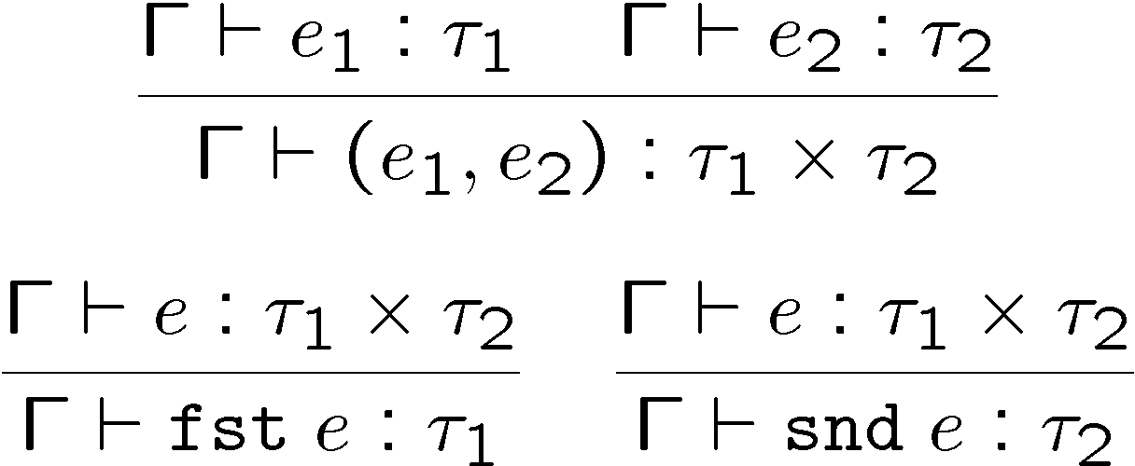
Product Types: Static Semantics
Extend the syntax with (binary) tuples
e ::= ... | (e₁, e₂) | fst e | snd e
τ ::= ... | τ₁ £ τ₂
  This language is sometimes called F₁£
Same typing judgment Γ ` e : τ

Slide 16
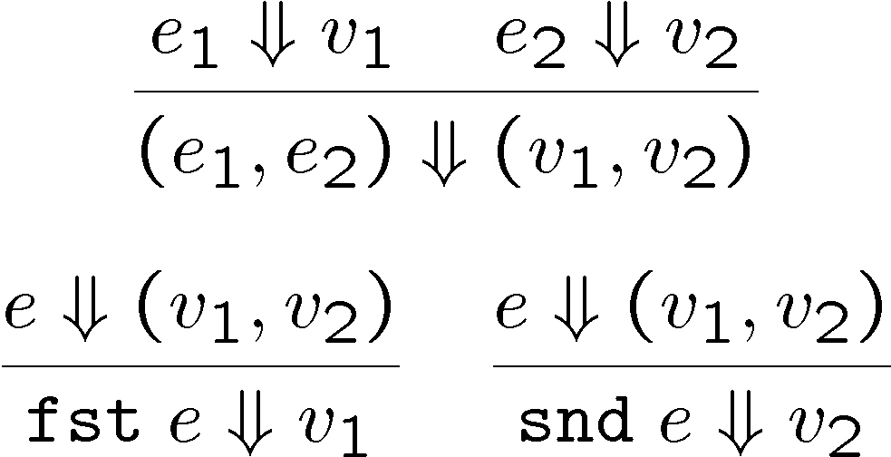
Dynamic Semantics and Soundness
New form of values: v ::= ... | (v₁, v₂)
New (big step) evaluation rules:
New contexts: H ::= ... | (H₁, e₂) | (v₁, H₂) | fst H | snd H
New redexes:
fst (v₁, v₂) ! v₁
snd (v₁, v₂) ! v₂
Type soundness holds just as before

Slide 17
Q: General (454 / 842)
In traditional logic this is an inference in which one proposition (the conclusion) necessarily follows from two others (the premises). An overused example is: "All humans are mortal. Socrates is a human. Therefore, Socrates is a mortal."

Slide 18
Q: General (473 / 842)
Which of the following chemical processes or reactions would be the most difficult to conduct in a high school chemistry lab?
  Hall-Heroult (Aluminum Extraction) Process
  Making Nitrocellulose (Guncotton)
  Making Slime (disodium tetraborate)
  Thermite Reaction (which reaches 5000(F))

Slide 19
Q: Games (534 / 842)
Each face of this 1974 six-sided plastic puzzle is subdivided into nine smaller faces, each of which can be one of six colors.

Slide 20
Computer Science
This American Turing award winner is known for foundational work in data structures and algorithms. Examples include off-line least common ancestors, strongly connected components, the Fibonacci heap, the splay tree, and the disjoint-set data structure. This prolific author has over 228 refereed journal and book chapters.

Slide 21
Q: Games (547 / 842)
This viscoelastic silicone plastic "clay" came out of efforts to find a rubber substitute in World War II. It is now sold in plastic eggs as a toy for children. It bounces and can absorb the ink from newsprint. It was also used by the crew of Apollo 8 to secure tools in zero gravity.

Slide 22
General PL Feature Plan
The general plan for language feature design
You invent a new feature (tuples)
You add it to the lambda calculus
You invent typing rules and opsem rules
You extend the basic proof of type safety
You declare moral victory, and milling throngs of cheering admirers wait to carry you on their shoulders to be knighted by the Queen, etc.

Slide 23
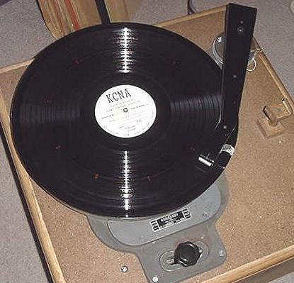
Records
Records are like tuples with labels (w00t!)
New form of expressions
e ::= ... | {L₁ = e₁, ..., L_{n} = e_{n}} | e.L
New form of values
v ::= {L₁ = v₁, ..., L_{n} = v_{n}}
New form of types
τ ::= ... | {L₁ : τ₁, ..., L_{n} : τ_{n}}
... follows the model of F₁£
  typing rules
  derivation rules
  type soundness
On the board!

Slide 24
Sum Types
We need disjoint union types of the form:
  either an int or a float
  either 0 or a pointer
  either a (binary tree node with two children) or a (leaf)
New expressions and types
e ::= ... | injl e | injr e |
case e of injl x ! e₁ | injr y ! e₂
τ ::= ... | τ₁ + τ₂
  A value of type τ₁ + τ₂ is either a τ₁ or a τ₂
  Like union in C or Pascal, but safe
    distinguishing between components is under compiler control
  case is a binding operator (like “let”): x is bound in e₁ and y is bound in e₂ (like OCaml’s “match … with”)

Slide 25
Examples with Sum Types
Consider the type unit with a single element called * or ()
The type integer option defined as “unit + int”
  Useful for optional arguments or return values
    No argument: injl * ( OCaml’s “None”)
    Argument is 5: injr 5 ( OCaml’s “Some(5)”)
  To use the argument you must test the kind of argument
  case arg of injl x ) “no_arg_case” | injr y ) “...y...”
  injl and injr are tags and case is tag checking
bool is the union type “unit + unit”
  true is injl *
  false is injr *
  if e then e₁ else e₂ is case e of injl x ) e₁ | injr y ) e₂

Slide 26
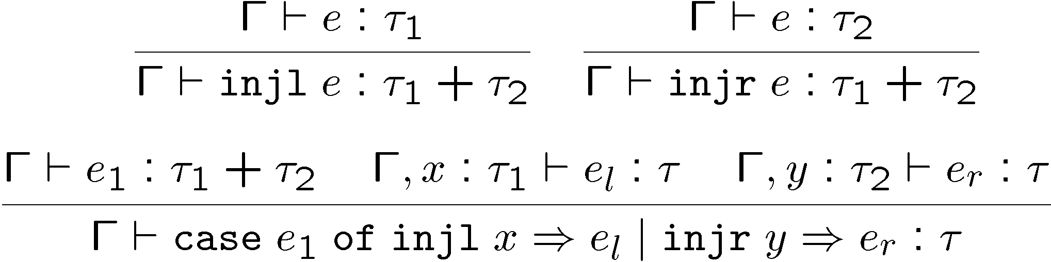
Static Semantics of Sum Types
New typing rules
Types are not unique anymore
injl 1 : int + bool
injl 1 : int + (int ! int)
  this complicates type checking, but it is still doable

Slide 27
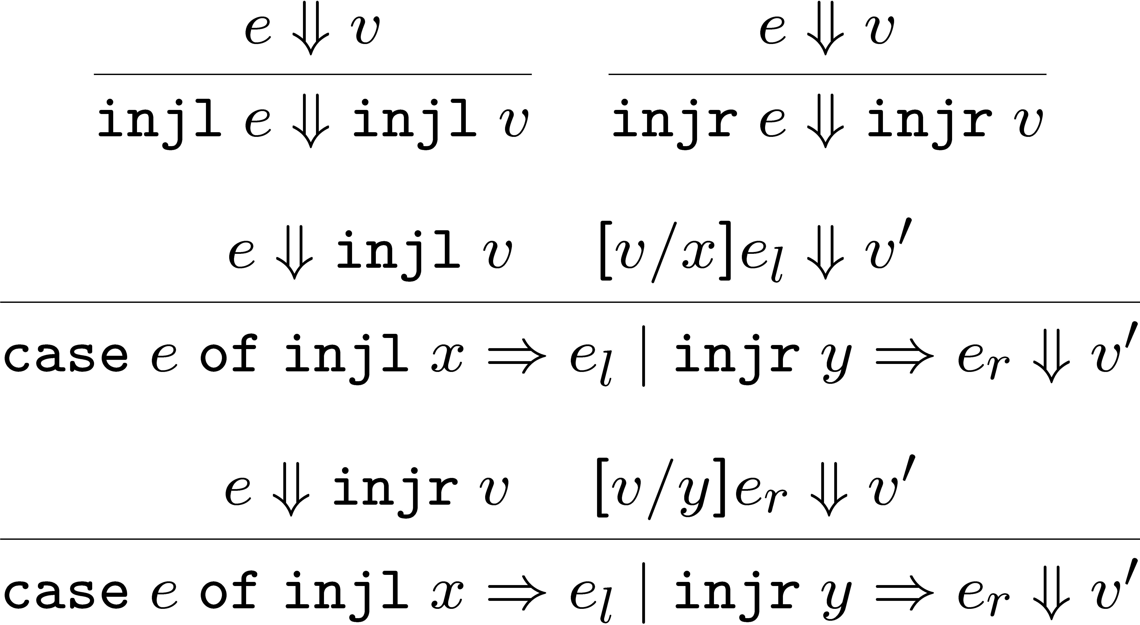
Dynamic Semantics of Sum Types
New values v ::= ... | injl v | injr v
New evaluation rules

Slide 28
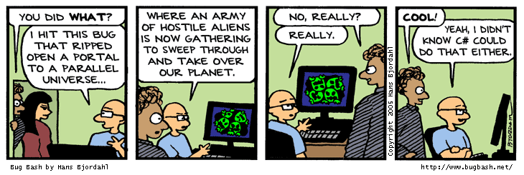
Type Soundness for F₁⁺
Type soundness still holds
No way to use a τ₁ + τ₂ inappropriately
The key is that the only way to use a τ₁ + τ₂ is with case, which ensures that you are not using a τ₁ as a τ₂
In C or Pascal checking the tag is the responsibility of the programmer!
  Unsafe

Slide 29
Types for Imperative Features
So far: types for pure functional languages
Now: types for imperative features
Such types are used to characterize non-local effects
  assignments
  exceptions
  typestate
Contextual semantics is useful here
  Just when you thought it was safe to forget it …

Slide 30
Reference Types
Such types are used for mutable memory cells
Syntax (as in ML)
e ::= ... | ref e : τ | e₁ := e₂ | ! e
τ ::= ... | τ ref
  ref e : τ - evaluates e, allocates a new memory cell, stores the value of e in it and returns the address of the memory cell
    like malloc + initialization in C, or new in C++ and Java
  e₁ := e₂, evaluates e₁ to a memory cell and updates its value with the value of e₂
  ! e - evaluates e to a memory cell and returns its contents
Why do I need : τ ?

Slide 31
Global Effects, Reference Cells
A reference cell can escape the static scope where it was created
(λf:int ! int ref. !(f 5)) (λx:int. ref x : int)
The value stored in a reference cell must be visible from the entire program
The “result” of an expression must now include the changes to the heap that it makes (cf. IMP’s opsem)
To model reference cells we must extend the evaluation model

Slide 32
Modeling References
A heap is a mapping from addresses to values
h ::= ¢ | h, a Ã v : τ
  a 2 Addresses (Addresses ≠ Z ?)
  We tag the heap cells with their types
  Types are useful only for static semantics. They are not needed for the evaluation ) are not a part of the implementation
We call a program an expression with a heap
p ::= heap h in e
  The initial program is “heap ¢ in e”
  Heap addresses act as bound variables in the expression
  This is a trick that allows easy reuse of properties of local variables for heap addresses
    e.g., we can rename the address and its occurrences at will

Slide 33
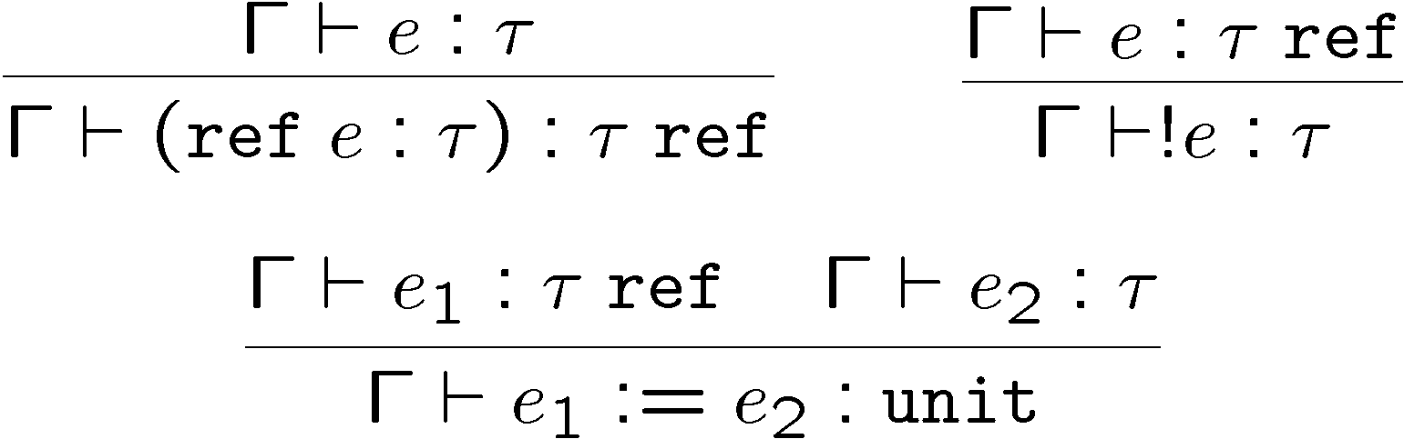
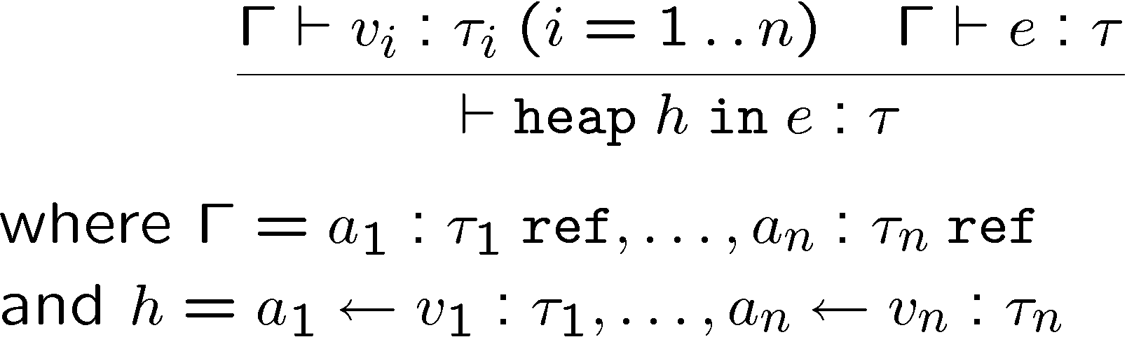
Static Semantics of References
Typing rules for expressions:
and for programs

Slide 34
Contextual Semantics for References
Addresses are values: v ::= ... | a
New contexts: H ::= ref H | H₁ := e₂ | a₁ := H₂ | ! H
No new local reduction rules
But some new global reduction rules
  heap h in H[ref v : τ] ! heap h, a Ã v : τ in H[a]
    where a is fresh (this models allocation – the heap is extended)
  heap h in H[! a] ! heap h in H[v]
    where a Ã v : τ 2 h (heap lookup – can we get stuck?)
  heap h in H[a := v] ! heap h[a Ã v] in H[*]
    where h[a Ã v] means a heap like h except that the part “a Ã v₁ : τ” in h is replaced by “a Ã v : τ” (memory update)
Global rules are used to propagate the effects of a write to the entire program (eval order matters!)

Slide 35
Example with References
Consider these (the redex is underlined)
  heap ¢ in (λf:int ! int ref. !(f 5)) (λx:int. ref x : int)
  heap ¢ in !((λx:int. ref x : int) 5)
  heap ¢ in !(ref 5 : int)
  heap a = 5 : int in !a
  heap a = 5 : int in 5
The resulting program has a useless memory cell
An equivalent result would be
heap ¢ in 5
This is a simple way to model garbage collection

Slide 36

Homework
HW 5 due Today
Project Status Update Due Today

