Slide 1
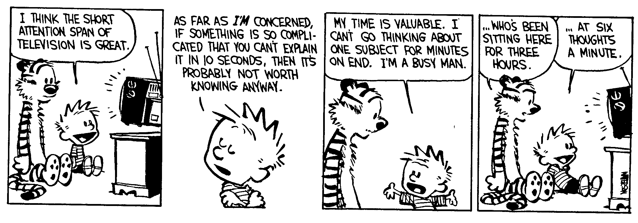
Type Systems For:
Exceptions,
Continuations, and Recursive Types

Slide 2
One-Slide Summary
Exceptions are like non-local gotos; they are used to propagate errors. We will use contextual semantics to model them.
Continuations allow you to take a snapshot of the current execution and store it for later use. They are often used for threads or backtracking. We will use contextual semantics to model them.
Recursive types describe recursive data structures. F₁ with them, F₁^{μ}, is as powerful as the untyped lambda calculus.

Slide 3
Exceptions
A mechanism that allows non-local control flow
  Useful for implementing the propagation of errors to caller
Exceptions ensure* that errors are not ignored
  Compare with the manual error handling in C
Languages with exceptions:
  C++, ML, Modula-3, Java, C#, …
We assume that there is a special type exn of exceptions
  exn could be int to model error codes
  In Java or C++, exn is a special object types
* Supposedly.

Slide 4
Modeling Exceptions
Syntax
e ::= ... | raise e | try e₁ handle x ) e₂
τ ::= ... | exn
We ignore here how exception values are created
  In examples we will use integers as exception values
The handler binds x in e₂ to the actual exception value
The “raise” expression never returns to the immediately enclosing context
  1 + raise 2 is well-typed
  if (raise 2) then 1 else 2 is also well-typed
  (raise 2) 5 is also well-typed
  What should be the type of raise?

Slide 5

Example with Exceptions
A (strange) factorial function
let f = λx:int.λres:int. if x = 0 then
raise res
else
f (x - 1) (res * x)
in try f 5 1 handle x ) x
The function returns in one step from the recursion
The top-level handler catches the exception and turns it into a regular result

Slide 6
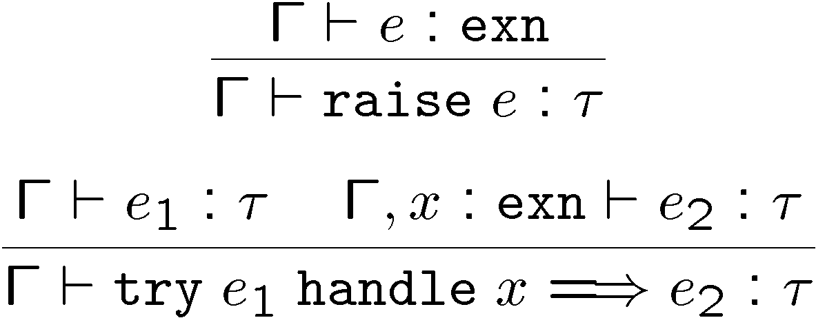
Typing Exceptions
New typing rules
A raise expression has an arbitrary type
  This is a clear sign that the expression does not return to its evaluation context
The type of the body of try and of the handler must match
  Just like for conditionals

Slide 7
Dynamics of Exceptions
The result of evaluation can be an uncaught exception
  Evaluation answers: a ::= v | uncaught v
  “uncaught v” has an arbitrary type
Raising an exception has global effects
It is convenient to use contextual semantics
  Exceptions propagate through some contexts but not through others
  We distinguish the handling contexts that intercept exceptions (this will be new)

Slide 8
Contexts for Exceptions
Contexts
  H :: = ² | H e | v H | raise H | try H handle x ) e
Propagating contexts
  Contexts that propagate exceptions to their own enclosing contexts
  P ::= ² | P e | v P | raise P
(New) Decomposition theorem
  If e is not a value and e is well-typed then it can be decomposed in exactly one of the following ways:
    H[(λx:τ. e) v] (normal lambda calculus)
    H[try v handle x ) e] (handle it or not)
    H[try P[raise v] handle x ) e] (propagate!)
    P[raise v] (uncaught exception)

Slide 9
Contextual Semantics for Exceptions
Small-step reduction rules
H[(λx:τ. e) v] ! H[[v/x] e]
H[try v handle x ) e] ! H[v]
H[try P[raise v] handle x ) e] ! H[[v/x] e]
P[raise v] ! uncaught v
The handler is ignored if the body of try completes normally
A raised exception propagates (in one step) to the closest enclosing handler or to the top of the program

Slide 10
Exceptional Commentary
The addition of exceptions preserves type soundness
Exceptions are like non-local goto
However, they cannot be used to implement recursion
  Thus we still cannot write (well-typed) non-terminating programs
There are a number of ways to implement exceptions (e.g., “zero-cost” exceptions)

Slide 11
Continuations
Some languages have a mechanism for taking a snapshot of the execution and storing it for later use
  Later the execution can be reinstated from the snapshot
  Useful for implementing threads, for example
  Examples: Scheme, LISP, ML, C (yes, really!)
Consider the expression: e₁ + e₂ in a context C
  How to express a snapshot of the execution right after evaluating e₁ but before evaluating e₂ and the rest of C ?
  Idea: as a context C₁ = C [ ² + e₂ ]
    Alternatively, as λx₁. C [ x₁ + e₂ ]
  When we finish evaluating e₁ to v₁, we fill the context and continue with C[v₁ + e₂]
  But the C₁ continuation is still available and we can continue several times, with different replacements for e₁

Slide 12

Continuation Uses in “Real Life”
You’re walking and come to a fork in the road
You save a continuation “right” for going right
But you go left (with the “right” continuation in hand)
You encounter Bender. Bender coerces you into joining his computer dating service.
You save a continuation “bad-date” for going on the date.
You decide to invoke the
“right” continuation
So, you go right (no evil date
obligation, but with the “bad-
date” continuation in hand)
A train hits you!
On your last breath, you invoke
the “bad-date” continuation

Slide 13
Continuations
Syntax:
e ::= callcc k in e | throw e₁ e₂
τ ::= … | τ cont
τ cont - the type of a continuation that expects a τ
callcc k in e - sets k to the current context of the execution and then evaluates expression e
  when e terminates, the whole callcc terminates
  e can invoke the saved continuation (many times even)
  when e invokes k it is as if “callcc k in e” returns
  k is bound in e
throw e₁ e₂ - evaluates e₁ to a continuation, e₂ to a value and invokes the continuation with the value of e₂ (just wait, we’ll explain it!)

Slide 14
Example with Continuations
Example: another strange factorial
callcc k in
let f = λx:int.λres:int. if x = 0 then throw k res
else f (x - 1) (x * res)
in f 5 1
First we save the current context
  This is the top-level context
  A throw to k of value v means “pretend the whole callcc evaluates to v”
This simulates exceptions
Continuations are strictly more powerful that exceptions
  The destination is not tied to the call stack

Slide 15

Q: Movies (364 / 842)
According to Vizzini in the movie The Princess Bride, what are two classic blunders?

Slide 16
Logic in Prose
148. Except living with others our whole life, we are both alone, solitary.
211. It was an uncomfortable silence. It was as if they were both as ease with each other.
270. He probably does know me but he where's a mask, so illogically he could be a number of people that I know.
426. Though her grades proved otherwise, Maeby wasn't an idiot.
313. Hermione Granger was head girl, and to everyone's surprise, so was Draco Malfoy.

Slide 17
Computer Science
This American Turing-award winner is known as the DARPA program manager in charge of funding groups developing TCP/IP. He funded and founded ICANN and the Internet Society. He helped develop the first commercial email system connectived to the internet.

Slide 18
Q: Books (702 / 842)
This 1953 dystopian novel by Ray Bradbury has censorship as a major theme. The main character, Guy Montag, is a fireman.

Slide 19
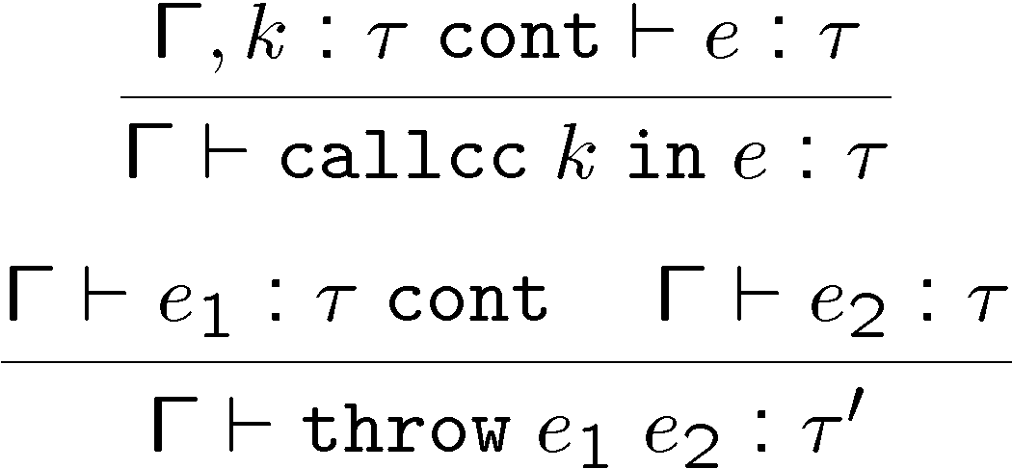
Static Semantics of Continuations
Note that the result of callcc is of type τ
“callcc k in e” returns in two possible situations
  e throws to k a value of type τ, or
  e terminates normally with a value of type τ
Note that throw has any type τ’
  Since it never returns to its enclosing context

Slide 20
Dynamic Semantics of Continuations
Use contextual semantics (wow, again!)
  Contexts are now manipulated directly
  Contexts are values of type τ cont
Contexts
H ::= ² | H e | v H | throw H₁ e₂ | throw v₁ H₂
Evaluation rules
  H[(λx.e) v] ! H[[v/x] e]
  H[callcc k in e] ! H[[H/k] e]
  H[throw H₁ v₂] ! H₁[v₂]
callcc duplicates the current continuation
Note that throw abandons its own context

Slide 21
Implementing Coroutines with Continuations
Example:
let client = λk. let res = callcc k’ in throw k k’ in
print (fst res);
client (snd res)
  “client k” will invoke “k” to get an integer and a continuation for obtaining more integers (for now, assume the list & recursion work)
let getnext =
λL.λk. if L = nil then raise 999
else getnext (cdr L) (callcc k’ in throw k (car L, k’))
  “getnext L k” will send to “k” the first element of L along with a continuation that can be used to get more elements of L
getnext [0;1;2;3;4;5] (callcc k in client k)

Slide 22
Continuation Comments
In our semantics the continuation saves the entire context: program counter, local variables, call stack, and the heap!
In actual implementations the heap is not saved!
Saving the stack is done with various tricks, but it is expensive in general
Few languages implement continuations
  Because their presence complicates the whole compiler considerably
  Unless you use a continuation-passing-style of compilation (more on this next)

Slide 23
Continuation Passing Style
A style of compilation where evaluation of a function never returns directly: instead the function is given a continuation to invoke with its result.
Instead of f(int a) { return h(g(e); }
we write f(int a, cont k) { g(e, λr. h(r, k) ) }
Advantages:
  interesting compilation scheme (supports callcc easily)
  no need for a stack, can have multiple return addresses (e.g., for an error case)
  fast and safe (non-preemptive) multithreading

Slide 24
Continuation Passing Style
Let e ::= x | n | e₁ + e₂ | if e₁ then e₂ else e₃
| λx.e | e₁ e₂
Define cps(e, k) as the code that computes e in CPS and passes the result to continuation k
cps(x, k) = k x
cps(n, k) = k n
cps(e₁ + e₂, k) =
cps(e₁, λn₁.cps(e₂,λn₂.k (n₁ + n₂)))
cps(λx.e, k) = k (λxλk’. cps(e,k’))
cps(e₁ e₂, k) = cps(e₁, λf₁.cps(e₂,λv₂. f₁ v₂ k))
Example: cps (h(g(5)), k) = g(5, λx.h x k)
  Notice the order of evaluation is made explicit

Slide 25
Recursive Types: Lists
Big Transition!
We want to define recursive data structures
Example: lists
  A list of elements of type τ (a τ list) is either empty or it is a pair of a τ and a τ list
τ list = unit + (τ £ τ list)
  This is a recursive equation. We take its solution to be the smallest set of values L that satisfies the equation
L = { * } [ (T £ L)
where T is the set of values of type τ
  Another interpretation is that the recursive equation is taken up-to (modulo) set isomorphism

Slide 26
Recursive Types
We introduce a recursive type constructor μ (mu):
μt. τ
  The type variable t is bound in τ
  This stands for the solution to the equation
t ' τ (t is isomorphic with τ)
  Example: τ list = μt. (unit + τ £ t)
  This also allows “unnamed” recursive types
We introduce syntactic (sugary) operations for the conversion between μt.τ and [μt.τ/t]τ
e.g. between “τ list” and “unit + (τ £ τ list)”
e ::= … | fold_{μt.τ} e | unfold_{μt.τ} e
τ ::= … | t | μt.τ

Slide 27
Example with Recursive Types
Lists
τ list = μt. (unit + τ £ t)
nil_{τ} = fold_{τ list} (injl *)
cons_{τ} = λx:τ.λL:τ list. fold_{τ list} injr (x, L)
A list length function
length_{τ} = λL:τ list.
case (unfold_{τ list} L) of injl x ) 0
| injr y ) 1 + length_{τ} (snd y)
(At home …) Verify that
  nil_{τ} : τ list
  cons_{τ} : τ ! τ list ! τ list
  length_{τ} : τ list ! int

Slide 28
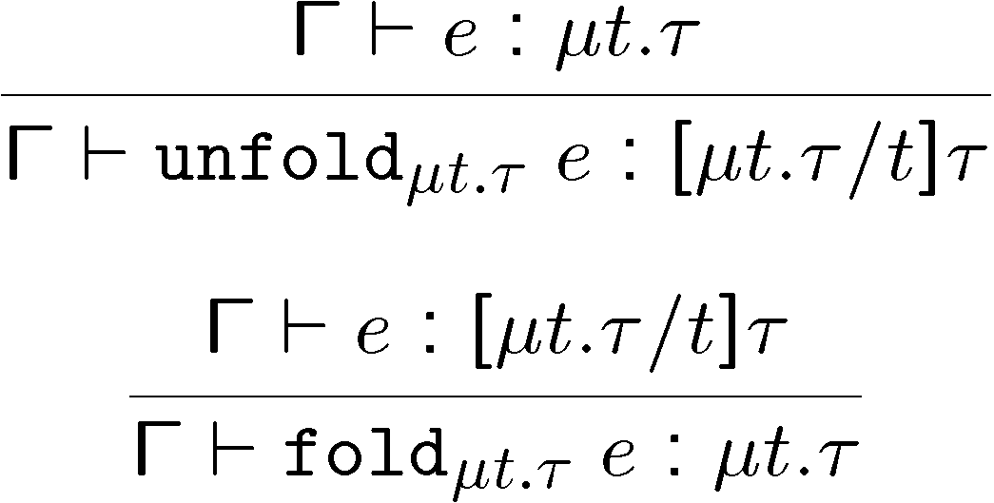
Type Rules for Recursive Types
The typing rules are syntax directed
Often, for syntactic simplicity, the fold and unfold operators are omitted
  This makes type checking somewhat harder

Slide 29
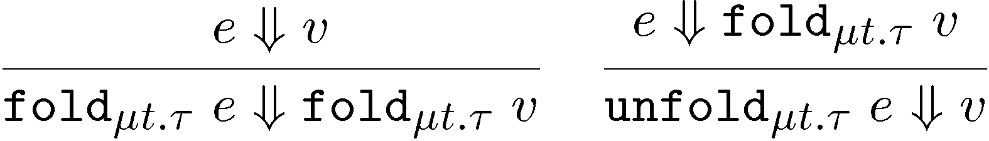
Dynamics of Recursive Types
We add a new form of values
v ::= … | fold_{μt.τ} v
  The purpose of fold is to ensure that the value has the recursive type and not its unfolding
The evaluation rules:
The folding annotations are for type checking only
They can be dropped after type checking

Slide 30
Recursive Types in ML
The language ML uses a simple syntactic trick to avoid having to write the explicit fold and unfold
In ML recursive types are bundled with union types
type t = C₁ of τ₁ | C₂ of τ₂ | ... | C_{n} of τ_{n} (* t can appear in τ_{i} *)
  e.g., “type intlist = Nil of unit | Cons of int * intlist”
When the programmer writes Cons (5, l)
  the compiler treats it as fold_{intlist} (injr (5, l))
When the programmer writes
  case e of Nil ) ... | Cons (h, t) ) ...
the compiler treats it as
  case unfold_{intlist} e of Nil ) ... | Cons (h,t) ) ...

Slide 31
Encoding Call-by-Value λ-calculus in F₁^{μ}
So far, F₁ was so weak that we could not encode non-terminating computations
  Cannot encode recursion
  Cannot write the λx.x x (self-application)
The addition of recursive types makes typed λ-calculus as expressive as untyped λ-calculus!
We could show a conversion algorithm from call-by-value untyped λ-calculus to call-by-value F₁^{μ}

Slide 32
Untyped Programming in F₁^{μ}
We write e for the conversion of the term e to F₁^{μ}
  The type of e is V = μt. t ! t
The conversion rules
x = x
λx. e = fold_{V} (λx:V. e)
e₁ e₂ = (unfold_{V} e₁) e₂
Verify that
  ¢ ` e : V
  e ⇓ v if and only if e ⇓ v
We can express non-terminating computation
D = (unfold_{V} (fold_{V} (λx:V. (unfold_{V} x) x))) (fold_{V} (λx:V. (unfold_{V} x) x)))
or, equivalently
D = (λx:V. (unfold_{V} x) x) (fold_{V} (λx:V. (unfold_{V} x) x)))

Slide 33
Homework
Read Wikipedia articles
Work on your projects!

