Slide 1
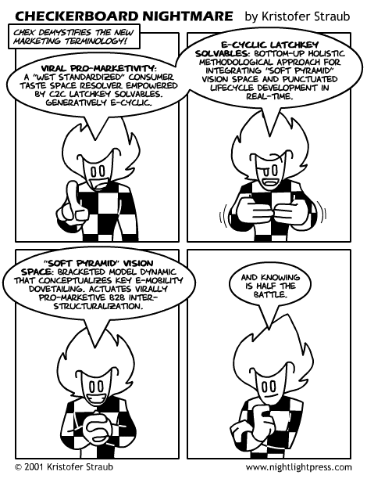
Second-Order Type Systems

Slide 2
One-Slide Summary
A polymorphic type system is flexible: it allows one functions to be applied to many types of arguments.
Parametric impredicative polymorphism allows any type to be used polymorphically: simple syntax, complicated expressive semantics, type reconstruction is undecidable.
Parametric predicative polymorphism allows only monomorphic types as type variables.
Prenex predicative polymorphism and the value restriction are two constrained, weaker versions of predicative polymorphism.

Slide 3
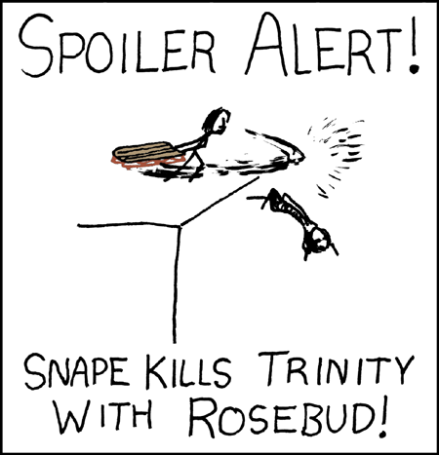
Upcoming Lectures
We’re now reaching the point where you have all of the tools and background to understand advanced topics.
Upcoming Topics:
  Dependent Types + Data Abstraction
  Communication and Concurrency
  Machine Learning + PL
  Cooperative Bug Isolation
  Automated Program Repair

Slide 4
Modeling References
A heap is a mapping from addresses to values
h ::= ¢ | h, a Ã v : τ
  a 2 Addresses (Addresses ≠ Z ?)
  We tag the heap cells with their types
  Types are useful only for static semantics. They are not needed for the evaluation ) are not a part of the implementation
We call a program an expression with a heap
p ::= heap h in e
  The initial program is “heap ¢ in e”
  Heap addresses act as bound variables in the expression
  This is a trick that allows easy reuse of properties of local variables for heap addresses
    e.g., we can rename the address and its occurrences at will

Slide 5
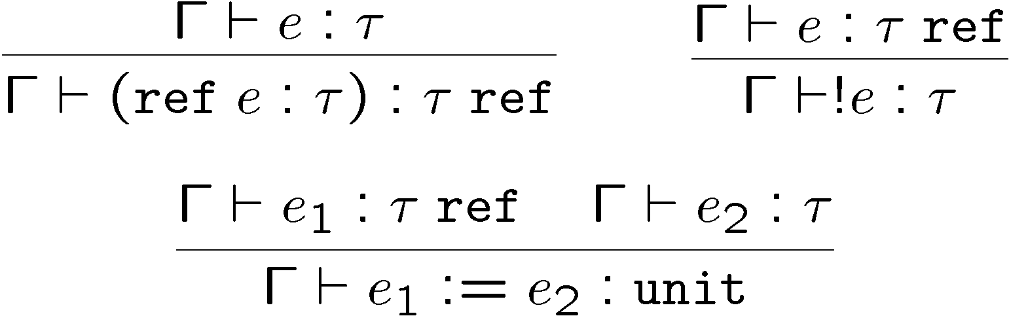
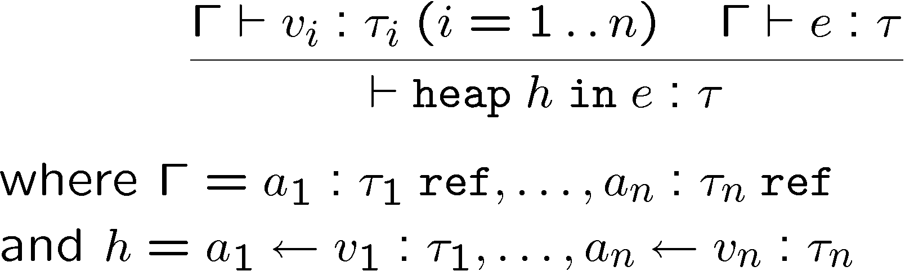
Static Semantics of References
Typing rules for expressions:
and for programs

Slide 6
Contextual Semantics for References
Addresses are values: v ::= ... | a
New contexts: H ::= ref H | H₁ := e₂ | a₁ := H₂ | ! H
No new local reduction rules
But some new global reduction rules
  heap h in H[ref v : τ] ! heap h, a Ã v : τ in H[a]
    where a is fresh (this models allocation – the heap is extended)
  heap h in H[! a] ! heap h in H[v]
    where a Ã v : τ 2 h (heap lookup – can we get stuck?)
  heap h in H[a := v] ! heap h[a Ã v] in H[*]
    where h[a Ã v] means a heap like h except that the part “a Ã v₁ : τ” in h is replaced by “a Ã v : τ” (memory update)
Global rules are used to propagate the effects of a write to the entire program (eval order matters!)

Slide 7
Example with References
Consider these (the redex is underlined)
  heap ¢ in (λf:int ! int ref. !(f 5)) (λx:int. ref x : int)
  heap ¢ in !((λx:int. ref x : int) 5)
  heap ¢ in !(ref 5 : int)
  heap a = 5 : int in !a
  heap a = 5 : int in 5
The resulting program has a useless memory cell
An equivalent result would be
heap ¢ in 5
This is a simple way to model garbage collection

Slide 8
The Limitations of F₁
In F₁ a function works exactly for one type
Example: the identity function
  id = λx:τ. x : τ ! τ
  We need to write one version for each type
  Worse: sort : (τ ! τ ! bool) ! τ array ! τ array
The various sorting functions differ only in typing
  At runtime they perform exactly the same operations
  We need different versions only to keep the type checker happy
Two alternatives:
  Circumvent the type system (see C, Java, ...), or
  Use a more flexible type system that lets us write only one sorting function (but use it on many types of objs)

Slide 9
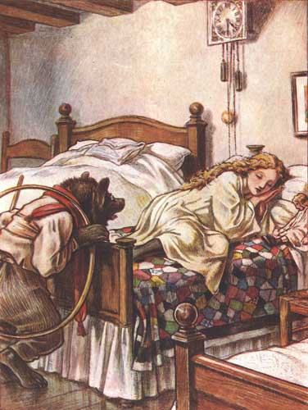
Cunning Plan
Introduce Polymorphism (much vocab)
It’s Strong: Encode Stuff
It’s Too Strong: Restrict
  Still too strong … restrict more
Final Answer:
  Polymorphism works “as expect”
  All the good stuff is handled
  No tricky decideability problems
Done early?

Slide 10
Polymorphism
Informal definition
A function is polymorphic if it can be applied to “many” types of arguments
Various kinds of polymorphism depending on the definition of “many”
  subtype polymorphism (aka bounded polymorphism)
    “many” = all subtypes of a given type
  ad-hoc polymorphism
    “many” = depends on the function
    choose behavior at runtime (depending on types, e.g. sizeof)
  parametric predicative polymorphism
    “many” = all monomorphic types
  parametric impredicative polymorphism
    “many” = all types

Slide 11
Parametric Polymorphism:
Types as Parameters
We introduce type variables and allow expressions to have variable types
We introduce polymorphic types
τ ::= b | τ₁ ! τ₂ | t | 8t. τ
e ::= x | λx:τ.e | e₁ e₂ | Λt. e | e[τ]
  Λt. e is type abstraction (or generalization, “for all t”)
  e[τ] is type application (or instantiation)
Examples:
  id = Λt.λx:t. x : 8t.t ! t
  id[int] = λx:int. x : int ! int
  id[bool] = λx:bool. x : bool ! bool
  “id 5” is invalid. Use “id[int] 5” instead

Slide 12
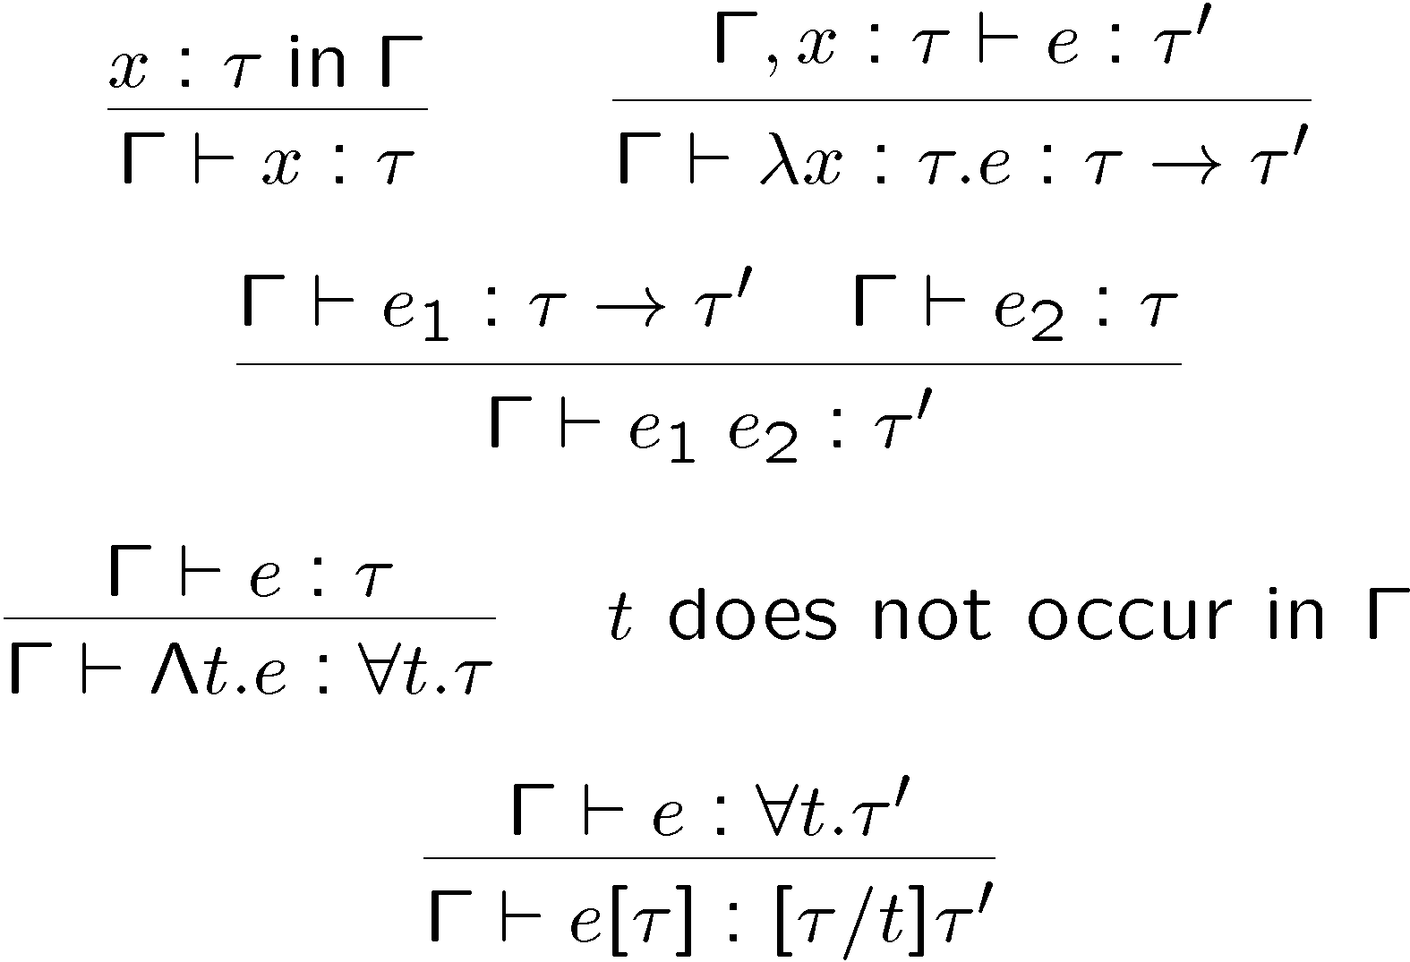
Impredicative Typing Rules
The typing rules:

Slide 13
Impredicative Polymorphism
Verify that “id[int] 5” has type int
Note the side-condition in the rule for type abstraction
  Prevents ill-formed terms like: λx:t.Λt.x
The evaluation rules are just like those of F₁
  This means that type abstraction and application are all performed at compile time (no run-time cost)
  We do not evaluate under Λ (Λt. e is a value)
  We do not have to operate on types at run-time
  This is called phase separation: type checking is separate from execution

Slide 14
(Aside:) Parametricity or
“Theorems for Free” (P. Wadler)
Can prove properties of a term just from its type
There is only one value of type 8t.t!t
  The identity function
There is no value of type 8t.t
Take the function reverse : 8t. t List ! t List
  This function cannot inspect the elements of the list
  It can only return a list of “original list elements”
  If L₁ and L₂ have the same length and let “match” be a function that compares two lists element-wise according to an arbitrary predicate
  then “match L₁ L₂” ) “match (reverse L₁) (reverse L₂)” !

Slide 15
Expressiveness of
Impredicative Polymorphism
This calculus is called
  F₂
  system F
  second-order λ-calculus
  polymorphic λ-calculus
Polymorphism is extremely expressive
We can encode many base and structured types in F₂

Slide 16
Encoding Base Types in F₂
Booleans
  bool = 8t.t ! t ! t (given any two things, select one)
  There are exactly two values of this type!
  true = Λt. λx:t.λy:t. x
  false = Λt. λx:t.λy:t. y
  not = λb:bool. Λt.λx:t.λy:t. b [t] y x
Naturals
  nat = 8t. (t ! t) ! t ! t (given a successor and a zero element, compute a natural number)
  0 = Λt. λs:t! t.λz:t. z
  n = Λt. λs:t! t.λz:t. s (s (s...s(n)))
  add = λn:nat. λm:nat. Λt. λs:t! t.λz:t. n [t] s (m [t] s z)
  mul = λn:nat. λm:nat. Λt. λs:t! t.λz:t. n [t] (m [t] s) z

Slide 17
Expressiveness of F₂
We can encode similarly:
  τ₁ + τ₂ as 8t. (τ₁ ! t) ! (τ₂ ! t) ! t
  τ₁ £ τ₂ as 8t. (τ₁ ! τ₂ ! t) ! t
  unit as 8t. t ! t
We cannot encode full recursion (μt.τ)
  We can encode primitive recursion but not full recursion
  All terms in F₂ have a termination proof in second-order Peano arithmetic (Girard, 1971)
    This is the set of naturals defined using zero, successor, induction along with quantification both over naturals and over sets of naturals

Slide 18
Computer Science, Mathematics
This American mathematician did not win the Turing award, but developed in 1936, independently of Alan Turing, a model of computation that was equivalent to Turing Machines. The unsolvability of the Entscheidung-sproblem was exactly what was needed to obtain unsolvability results in the theory of formal languages.

Slide 19
More Prose Logic
281. She couldn't exactly say that he looked different, although there was the possibility that she could pass him on the street without recognizing him. But, upon closer inspection, he was exactly the same.
94. She found her mother where she would always be, behind the bar, cooking food only the sober would eat.
126. It all starts six years after the end of it all.
222. He is just as powerful as myself, but not equally so.
378. "Are you alright?" His voice sounded scared but his voice looked calm.

Slide 20
What’s Wrong with F₂
Simple syntax but very complicated semantics
  id can be applied to itself: “id [8t. t ! t] id”
  This can lead to paradoxical situations in a pure set-theoretic interpretation of types
  e.g., the meaning of id is a function whose domain contains a set (the meaning of 8t.t! t) that contains id!
  This suggests that giving an interpretation to impredicative type abstraction is tricky
Complicated termination proof (Girard)
Type reconstruction (typeability) is undecidable
  If the type application and abstraction are missing
How to fix it?
  Restrict the use of polymorphism

Slide 21
Predicative Polymorphism
Restriction: type variables can be instantiated only with monomorphic types
This restriction can be expressed syntactically
τ ::= b | τ₁ ! τ₂ | t // monomorphic types
σ ::= τ | 8t. σ | σ₁ ! σ₂ // polymorphic types
e ::= x | e₁ e₂ | λx:σ. e | Λt.e | e [τ]
  Type application is restricted to mono types
  Cannot apply “id” to itself anymore
Same great typing rules
Simple semantics and termination proof

Slide 22
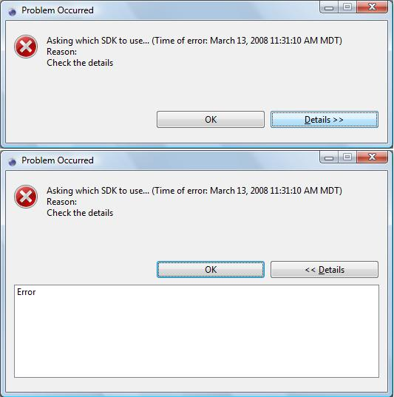
Was that good enough?
Type reconstruction still undecidable
Must. Restrict. Further!

Slide 23
Prenex Predicative Polymorphism
Restriction: polymorphic type constructor at top level only
This restriction can also be expressed syntactically
τ ::= b | τ₁ ! τ₂ | t
σ ::= τ | 8t. σ
e ::= x | e₁ e₂ | λx:τ. e | Λt.e | e [τ]
  Type application is predicative
  Abstraction only on mono types
  The only occurrences of 8 are at the top level of a type
(8t. t ! t) ! (8t. t ! t) is not a valid type
Same typing rules (less filling!)
Simple semantics and termination proof
Decidable type inference!

Slide 24
Expressiveness of
Prenex Predicative F₂
We have simplified too much!
Not expressive enough to encode nat, bool
  But such encodings are only of theoretical interest anyway (cf. time wasting)
Is it expressive enough in practice? Almost!
  Cannot write something like
(λs:8t.τ. ... s [nat] x ... s [bool] y)
(Λt. ... code for sort)
  Formal argument s cannot be polymorphic

Slide 25
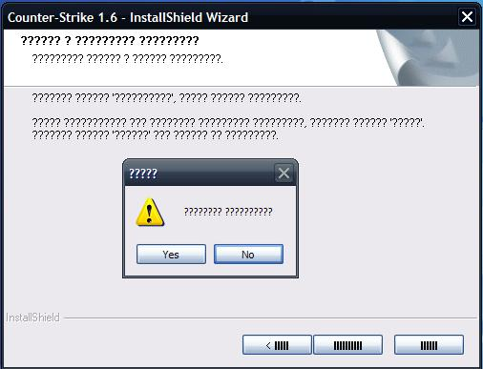
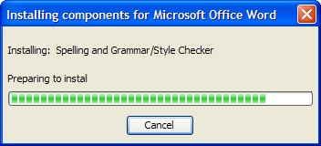
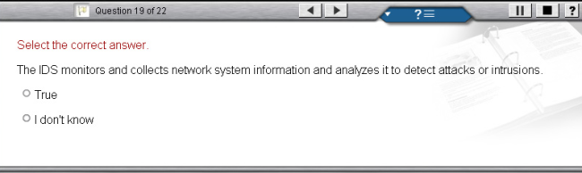
What are we trying to do again?

Slide 26
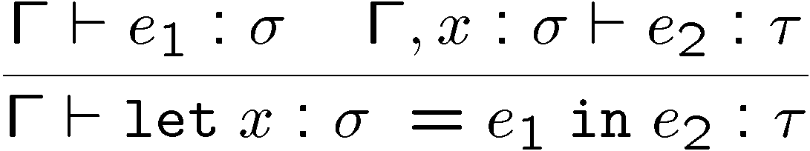
ML and the Amazing
Polymorphic Let-Coat
ML solution: slight extension of the predicative F₂
  Introduce “let x : σ = e₁ in e₂”
  With the semantics of “(λx : σ.e₂) e₁”
  And typed as “[e₁/x] e₂” (result: “fresh each time”)
This lets us write the polymorphic sort as
let
s : 8t.τ = Λt. ... code for polymorphic sort ...
in
... s [nat] x .... s [bool] y
We have found the sweet spot!

Slide 27
ML and the Amazing
Polymorphic Let-Coat
ML solution: slight extension of the predicative F₂
  Introduce “let x : σ = e₁ in e₂”
  With the semantics of “(λx : σ.e₂) e₁”
  And typed as “[e₁/x] e₂” (result: “fresh each time”)
This lets us write the polymorphic sort as
let
s : 8t.τ = Λt. ... code for polymorphic sort ...
in
... s [nat] x .... s [bool] y
Surprise: this was a major ML design flaw!

Slide 28
ML Polymorphism and References
let is evaluated using call-by-value but is typed using call-by-name
  What if there are side effects?
Example:
let x : 8t. (t ! t) ref = Λt.ref (λx : t. x)
in
x [bool] := λx: bool. not x ;
(! x [int]) 5
  Will apply “not” to 5
  Recall previous lectures: invariant typing of references
  Similar examples can be constructed with exceptions
It took 10 years to find and agree on a clean solution

Slide 29
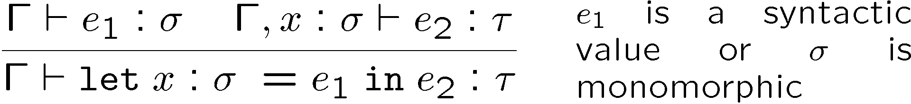
The Value Restriction in ML
A type in a let is generalized only for syntactic values
Since e₁ is a value, its evaluation cannot have side-effects
In this case call-by-name and call-by-value are the same
In the previous example ref (λx:t. x) is not a value
This is not too restrictive in practice!

Slide 30
Subtype Bounded Polymorphism
We can bound the instances of a given type variable
8t < τ. σ
Consider a function f : 8t < τ. t ! σ
How is f different than g : τ ! σ ?
One Answer: can invoke f on any subtype of τ
Another: They are different if t appears in σ
  e.g, let f : 8t<τ.t ! t and g : τ ! τ both be the identity function
  Take x : τ’ where τ’ < τ
  f [τ’] x has static type τ’
  g x (using subsumption) has static type τ
  Since both have dynamic type τ’, we have lost information with g

Slide 31
Homework
Final Project!

