Slide 1
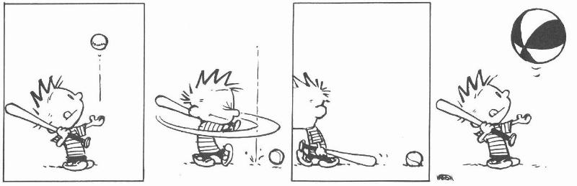
Recursive Types and Subtyping

Slide 2
One-Slide Summary
Recursive types (e.g., τ list) make the typed lambda calculus as powerful as the untyped lambda calculus.
If τ is a subtype of σ then any expression of type τ can be used in a context that expects a σ; this is called subsumption.
A conversion is a function that converts between types.
A subtyping system should be coherent.

Slide 3
Recursive Types: Lists
We want to define recursive data structures
Example: lists
  A list of elements of type τ (a τ list) is either empty or it is a pair of a τ and a τ list
τ list = unit + (τ £ τ list)
  This is a recursive equation. We take its solution to be the smallest set of values L that satisfies the equation
L = { * } [ (T £ L)
where T is the set of values of type τ
  Another interpretation is that the recursive equation is taken up-to (modulo) set isomorphism

Slide 4
Recursive Types
We introduce a recursive type constructor μ (mu):
μt. τ
  The type variable t is bound in τ
  This stands for the solution to the equation
t ' τ (t is isomorphic with τ)
  Example: τ list = μt. (unit + τ £ t)
  This also allows “unnamed” recursive types
We introduce syntactic (sugary) operations for the conversion between μt.τ and [μt.τ/t]τ
e.g. between “τ list” and “unit + (τ £ τ list)”
e ::= … | fold_{μt.τ} e | unfold_{μt.τ} e
τ ::= … | t | μt.τ

Slide 5
Example with Recursive Types
Lists
τ list = μt. (unit + τ £ t)
nil_{τ} = fold_{τ list} (injl *)
cons_{τ} = λx:τ.λL:τ list. fold_{τ list} injr (x, L)
A list length function
length_{τ} = λL:τ list.
case (unfold_{τ list} L) of injl x ) 0
| injr y ) 1 + length_{τ} (snd y)
(At home …) Verify that
  nil_{τ} : τ list
  cons_{τ} : τ ! τ list ! τ list
  length_{τ} : τ list ! int

Slide 6
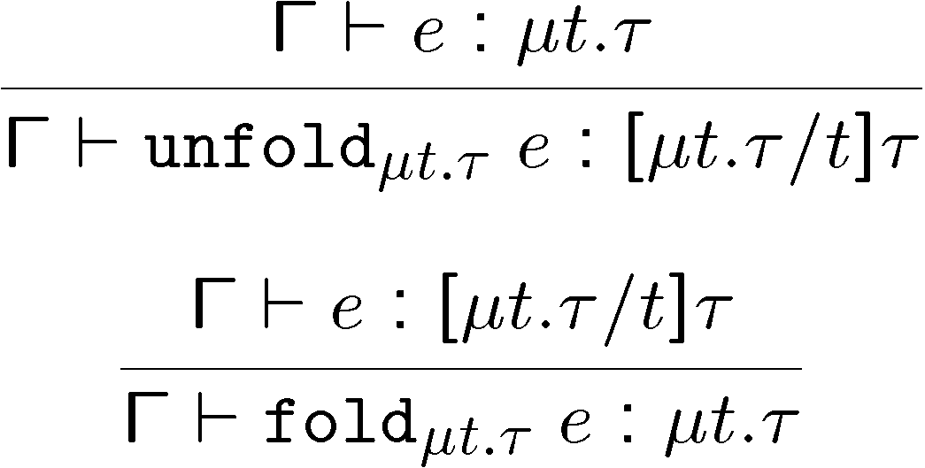
Type Rules for Recursive Types
The typing rules are syntax directed
Often, for syntactic simplicity, the fold and unfold operators are omitted
  This makes type checking somewhat harder

Slide 7
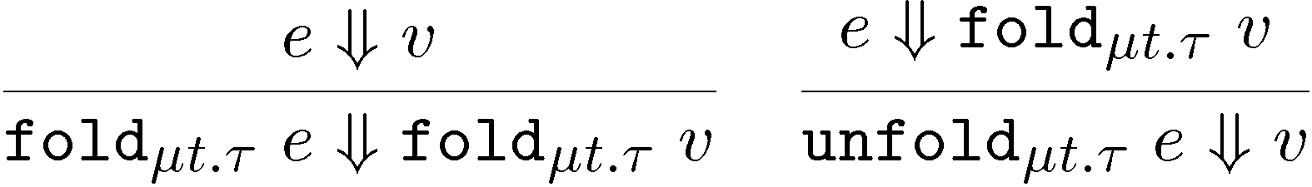
Dynamics of Recursive Types
We add a new form of values
v ::= … | fold_{μt.τ} v
  The purpose of fold is to ensure that the value has the recursive type and not its unfolding
The evaluation rules:
The folding annotations are for type checking only
They can be dropped after type checking

Slide 8
Recursive Types in ML
The language ML uses a simple syntactic trick to avoid having to write the explicit fold and unfold
In ML recursive types are bundled with union types
type t = C₁ of τ₁ | C₂ of τ₂ | ... | C_{n} of τ_{n} (* t can appear in τ_{i} *)
  e.g., “type intlist = Nil of unit | Cons of int * intlist”
When the programmer writes Cons (5, l)
  the compiler treats it as fold_{intlist} (injr (5, l))
When the programmer writes
  case e of Nil ) ... | Cons (h, t) ) ...
the compiler treats it as
  case unfold_{intlist} e of Nil ) ... | Cons (h,t) ) ...

Slide 9
Encoding Call-by-Value λ-calculus in F₁^{μ}
So far, F₁ was so weak that we could not encode non-terminating computations
  Cannot encode recursion
  Cannot write the λx.x x (self-application)
The addition of recursive types makes typed λ-calculus as expressive as untyped λ-calculus!
We could show a conversion algorithm from call-by-value untyped λ-calculus to call-by-value F₁^{μ}

Slide 10
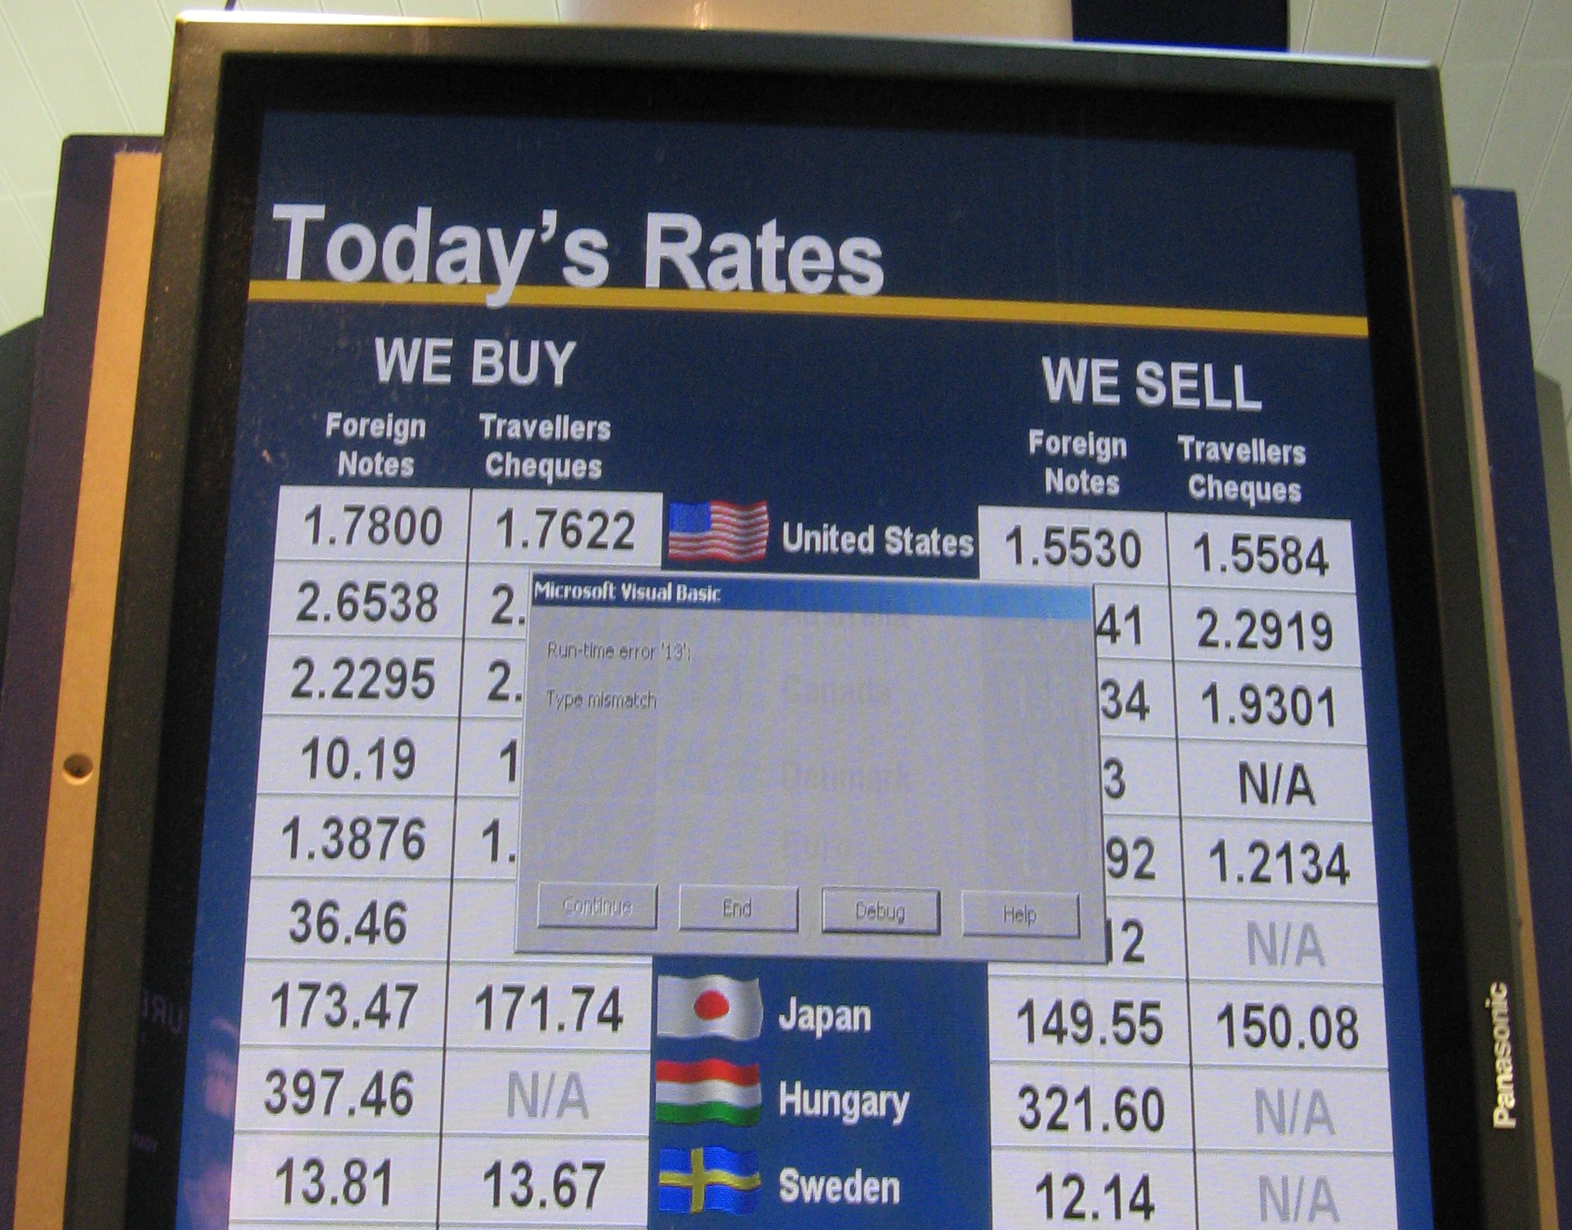
Smooth Transition
And now, on to subtyping ...

Slide 11
Introduction to Subtyping
We can view types as denoting sets of values
Subtyping is a relation between types induced by the subset relation between value sets
Informal intuition:
  If τ is a subtype of σ then any expression with type τ also has type σ (e.g., Z µ R, 12Z ) 12R)
  If τ is a subtype of σ then any expression of type τ can be used in a context that expects a σ
  We write τ < σ to say that τ is a subtype of σ
  Subtyping is reflexive and transitive

Slide 12
Cunning Plan For Subtyping
Formalize Subtyping Requirements
  Subsumption
Create Safe Subtyping Rules
  Pairs, functions, references, etc.
  Most easy thing we try will be wrong
Subtyping Coercions
  When is a subtyping system correct?

Slide 13
Subtyping Examples
FORTRAN introduced int < real
  5 + 1.5 is well-typed in many languages
PASCAL had [1..10] < [0..15] < int
Subtyping is a fundamental property of object-oriented languages
  If S is a subclass of C then an instance of S can be used where an instance of C is expected
  “subclassing ) subtyping” philosophy

Slide 14
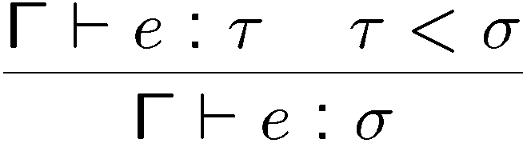
Subsumption
Formalize the requirements on subtyping
Rule of subsumption
  If τ < σ then an expression of type τ has type σ
But now type safety may be in danger:
  If we say that int < (int ! int)
  Then we can prove that “11 8” is well typed!
There is a way to construct the subtyping relation to preserve type safety

Slide 15
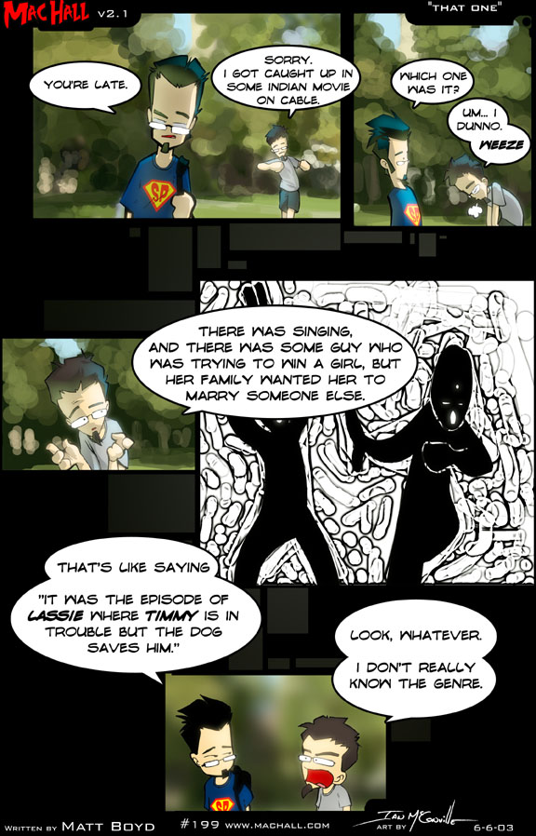
Subtyping in POPL/PLDI 14
Backpack: Retrofitting Haskell with Interfaces
Getting F-Bounded Polymorphism into Shape
Optimal Inference of Fields in Row-Polymorphic Records
Polymorphic Functions with Set-Theoretic Types (Part 1: Syntax, Semantics, and Evaluation)
… (out of space on slide)

Slide 16
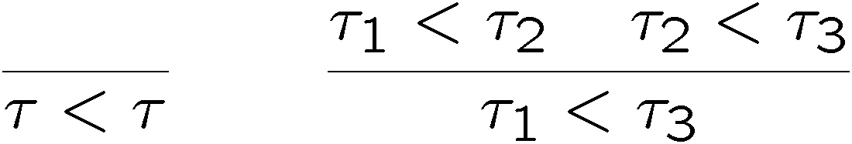
Defining Subtyping
The formal definition of subtyping is by derivation rules for the judgment τ < σ
We start with subtyping on the base types
  e.g. int < real or nat < int
  These rules are language dependent and are typically based directly on types-as-sets arguments
We then make subtyping a preorder (reflexive and transitive)
Then we build-up subtyping for “larger” types

Slide 17
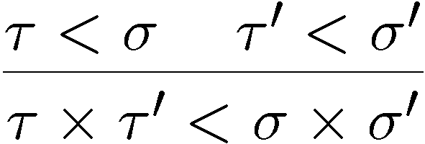
Subtyping for Pairs
Try
Show (informally) that whenever a s £ s’ can be used, a t £ t’ can also be used:
Consider the context H = H’[fst ²] expecting a s £ s’
  Then H’ expects a s
  Because t < s then H’ accepts a t
  Take e : t £ t’. Then fst e : t so it works in H’
  Thus e works in H
The case of “snd ²” is similar

Slide 18
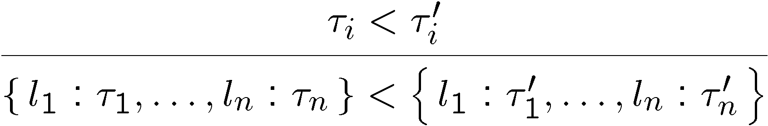
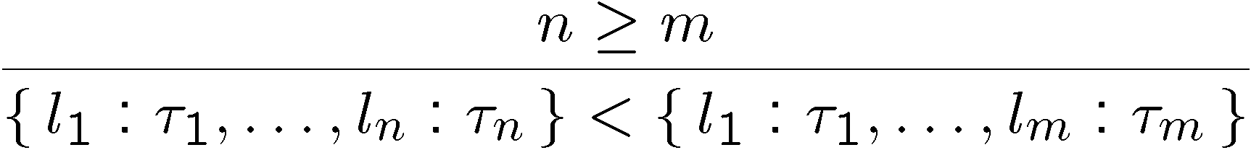
Subtyping for Records
Several subtyping relations for records
Depth subtyping
  e.g., {f1 = int, f2 = int} < {f1 = real, f2 = int}
Width subtyping
  E.g., {f1 = int, f2 = int} < {f2 = int}
  Models subclassing in OO languages
Or, a combination of the two

Slide 19
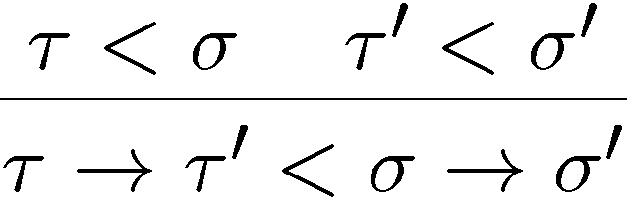
Subtyping for Functions
Example Use:
rounded_sqrt : R ! Z
actual_sqrt : R ! R
Since Z < R, rounded_sqrt < actual_sqrt
So if I have code like this:
float result = rounded_sqrt(5); // 2
… I can replace it like this:
float result = actual_sqrt(5); // 2.23
… and everything will be fine.

Slide 20
Q: General (455 / 842)
This numerical technique for finding solutions to boundary-value problems was initially developed for use in structural analysis in the 1940's. The subject is represented by a model consisting of a number of linked simplified representations of discrete regions. It is often used to determine stress and displacement in mechanical systems.

Slide 21
Computer Science
This American Turing-award winner is known for his visionary and pioneering contributions to Computer Graphics, and for Sketchpad, an early predecessor to the GUI. He created the first virtual reality display, and a graphics line clipping algorithm. His students include Alan Kay (Smalltalk), Henri Gouraud (shading), Frank Crow (anti-aliasing), and Edwin Catmull (Pixar). When asked, "How could you possibly have done the first interactive graphics program, the first non-procedural programming language, the first object oriented software system, all in one year?" He replied: "Well, I didn't know it was hard."

Slide 22

Subtyping for Functions
What do you think of this rule?

Slide 23
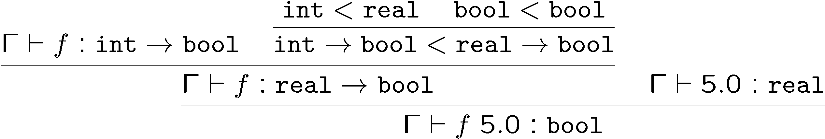
Subtyping for Functions
This rule is unsound
  Let Γ = f : int ! bool (and assume int < real)
  We show using the above rule that Γ ` f 5.0 : bool
  But this is wrong since 5.0 is not a valid argument of f

Slide 24
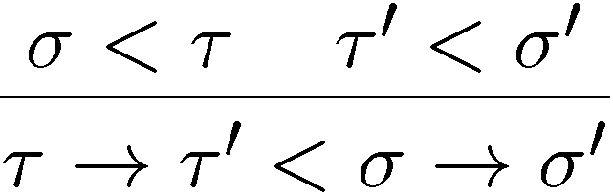
Correct Function Subtyping
We say that ! is covariant in the result type and contravariant in the argument type
Informal correctness argument:
  Pick f : τ ! τ’
  f expects an argument of type τ
  It also accepts an argument of type σ < τ
  f returns a value of type τ’
  Which can also be viewed as a σ’ (since τ’ < σ’)
  Hence f can be used as σ ! σ’

Slide 25
More on Contravariance
Consider the subtype relationships:
int ! real
real ! real
int ! int
real ! int
In what sense (f 2 real ! int) ) (f 2 int ! int) ?
  “real ! int” has a larger domain!
  (recall the set theory (arg,result) pair encoding for functions)
This suggests that “subtype-as-subset” interpretation is not straightforward
  We’ll return to this issue (after these commercial messages …)

Slide 26
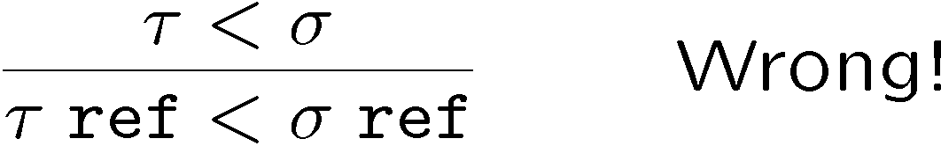
Subtyping References
Try covariance
  Example: assume τ < σ
  The following holds (if we assume the above rule):
x : σ, y : τ ref, f : τ ! int ` y := x; f (! y)
  Unsound: f is called on a σ but is defined only on τ
  Java has covariant arrays!
If we want covariance of references we can recover type safety with a runtime check for each y := x
  The actual type of x matches the actual type of y
  But this is generally considered a bad design

Slide 27
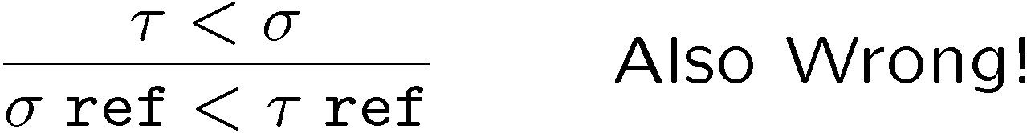
Subtyping References (Part 2)
Contravariance?
  Example: assume τ < σ
  The following holds (if we assume the above rule):
x : σ, y : σ ref, f : τ ! int ` y := x; f (! y)
  Unsound: f is called on a σ but is defined only on τ
References are invariant
  No subtyping for references (unless we are prepared to add run-time checks)
  hence, arrays should be invariant
  hence, mutable records should be invariant

Slide 28
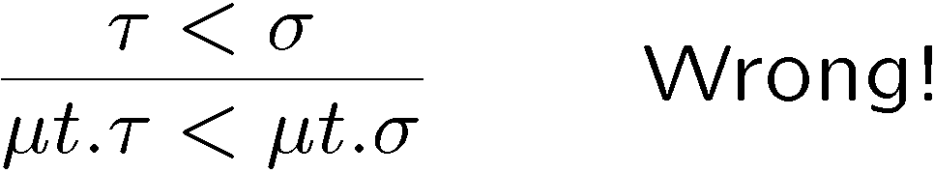
Subtyping Recursive Types
Recall τ list = μt.(unit + τ£t)
  We would like τ list < σ list whenever τ < σ
Covariance?
This is wrong if t occurs contravariantly in τ
Take τ = μt.t!int and σ = μt.t!real
Above rule says that τ < σ
We have τ'τ!int and σ'σ!real
τ<σ would mean covariant function type!
How can we get safe subtyping for lists?

Slide 29
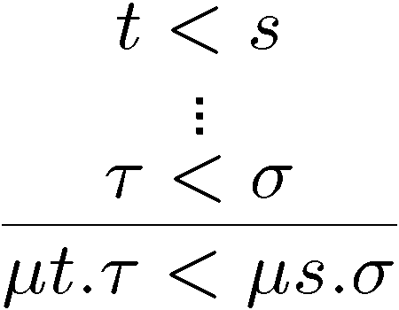
Subtyping Recursive Types
Means assume t < s
and use that to
prove τ < σ
The correct rule
We add as an assumption that the type variables stand for types with the desired subtype relationship
  Before we assumed they stood for the same type!
Verify that now subtyping works properly for lists
There is no subtyping between μt.t!int and μt.t!real (recall:

Slide 30
Conversion Interpretation
The subset interpretation of types leads to an abstract modeling of the operational behavior
  e.g., we say int < real even though an int could not be directly used as a real in the concrete x86 implementation (cf. IEEE 754 bit patterns)
  The int needs to be converted to a real
We can get closer to the “machine” with a conversion interpretation of subtyping
  We say that τ < σ when there is a conversion function that converts values of type τ to values of type σ
  Conversions also help explain issues such as contravariance
  But: must be careful with conversions

Slide 31
Conversions
Examples:
  nat < int with conversion λx.x
  int < real with conversion 2’s comp ! IEEE
The subset interpretation is a special case when all conversions are identity functions
Write “τ < σ ) C(τ, σ)” to say that C(τ,σ) is the conversion function from subtype τ to σ
  If C(τ, σ) is expressed in F₁ then C(τ,σ) : τ ! σ

Slide 32
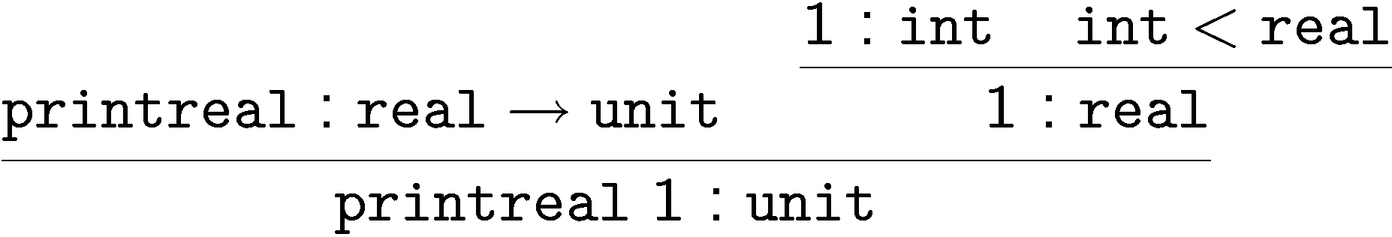
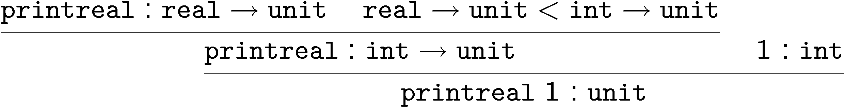
Issues with Conversions
Consider the expression “printreal 1” typed as follows:
we convert 1 to real: printreal (C(int,real) 1)
But we can also have another type derivation:
with conversion “(C(real -> unit, int -> unit) printreal) 1”
Which one is right? What do they mean?

Slide 33
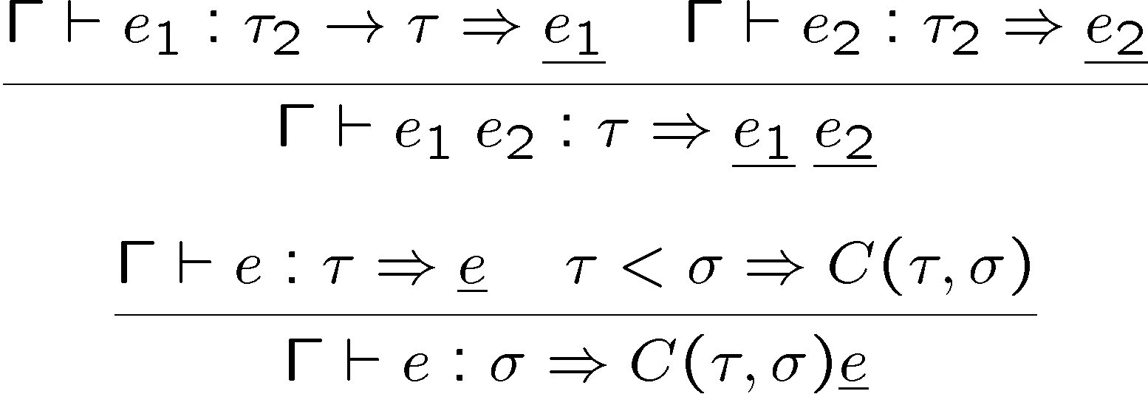
Introducing Conversions
We can compile a language with subtyping into one without subtyping by introducing conversions
The process is similar to type checking
Γ ` e : τ ) e
  Expression e has type τ and its conversion is e
Rules for the conversion process:

Slide 34
Coherence of Conversions
Questions and Concerns:
  Can we build arbitrary subtype relations just because we can write conversion functions?
  Is real < int just because the “floor” function is a conversion?
  What is the conversion from “real!int” to “int!int”?
What are the restrictions on conversion functions?
A system of conversion functions is coherent if whenever we have τ < τ’ < σ then
    C(τ, τ) = λx.x
    C(τ,σ) = C(τ’, σ) ○ C(τ, τ’) (= composed with)
    Example: if b is a bool then (float)b == (float)((int)b)
  otherwise we end up with confusing uses of subsumption

Slide 35
Example of Coherence
We want the following subtyping relations:
  int < real ) λx:int. toIEEE x
  real < int ) λx:real. floor x
For this system to be coherent we need
  C(int, real) ○ C(real, int) = λx.x, and
  C(real, int) ○ C(int, real) = λx.x
This requires that
  8x : real . ( toIEEE (floor x) = x )
  which is not true

Slide 36
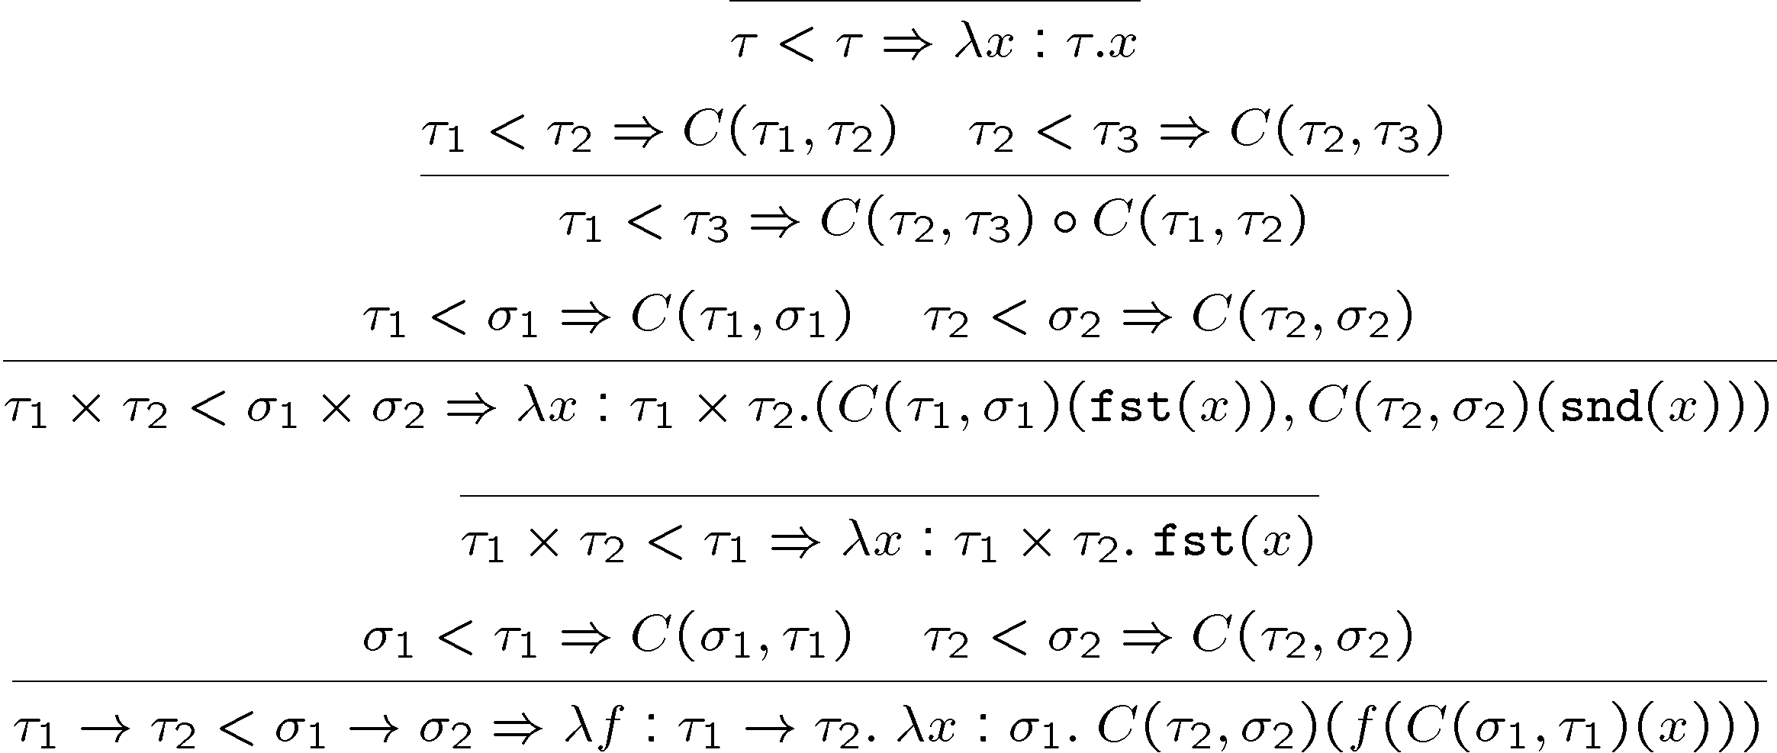
Building Conversions
We start from conversions on basic types

Slide 37
Comments
With the conversion view we see why we do not necessarily want to impose antisymmetry for subtyping
  Can have multiple representations of a type
  We want to reserve type equality for representation equality
  τ < τ’ and also τ’ < τ (are interconvertible) but not necessarily τ = τ’
  e.g., Modula-3 has packed and unpacked records
We’ll encounter subtyping again for object-oriented languages
  Serious difficulties there due to recursive types

Slide 38
Homework
How's that project going?

