Slide 1
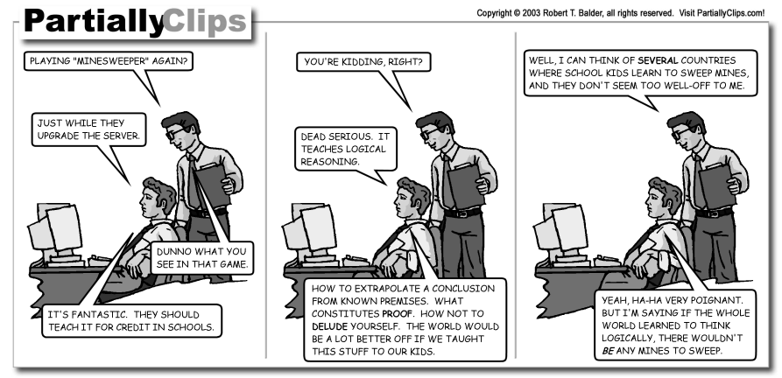
Automated Theorem Proving and
Proof Checking

Slide 2
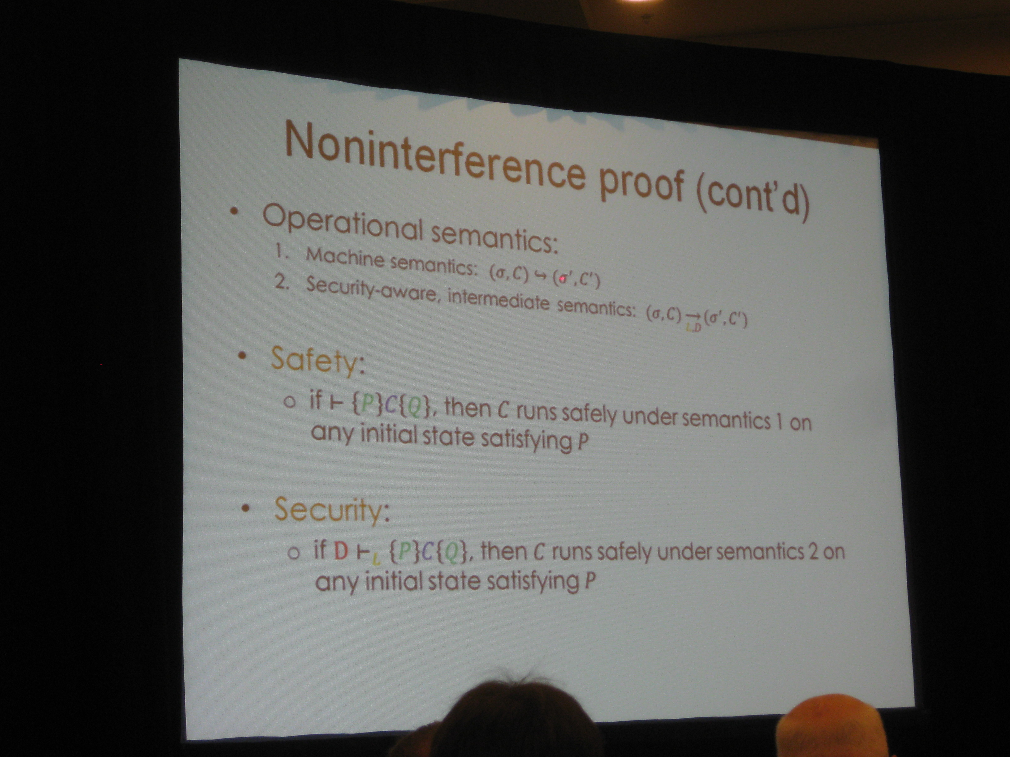

Slide 3
Cunning Theorem-Proving Plan
There are full-semester courses on automated deduction; we will elide details.
Logic Syntax
Theories
Satisfiability Procedures
Mixed Theories
Theorem Proving
Proof Checking
SAT-based Theorem Provers (cf. Engler paper)

Slide 4
One-Slide Summary
An automated theorem prover mechanically performs deduction, producing proofs for true propositions.
Theorem provers are built atop decision procedures for individual theories (e.g., theory of arithmetic, theory of uninterpreted functions).
Two common theorem prover architectures are Cooperating Decision Procedures, which broadcast discovered equalities, and SAT-Based Theorem Provers, which use SAT solvers to decompose the problem.
Proof Checking is equivalent to type checking in a dependent type system.

Slide 5
Motivation
Can be viewed as “decidable AI”
  Would be nice to have a procedure to automatically reason from premises to conclusions …
Used to rule out the exploration of infeasible paths (model checking, dataflow)
Used to reason about the heap (McCarthy, symbolic execution)
Used to automatically synthesize programs from specifications (e.g. Leroy, Engler optional papers)
Used to discover proofs of conjectures (e.g., Tarski conjecture proved by machine in 1996, efficient geometry theorem provers)
Generally under-utilized

Slide 6
History
Automated deduction is logical deduction performed by a machine
Involves logic and mathematics
One of the oldest and technically deepest fields of computer science
  Some results are as much as 75 years old
  “Checking a Large Routine”, Turing 1949
  Automation efforts are about 40 years old
  Floyd-Hoare axiomatic semantics
Still experimental (even after 40 years)

Slide 7
Standard Architecture
Semantics
Program
Meets Spec
Or
Found A Bug
Specification
Validity
Verification
Condition
Generation
Provability
Automated
Theorem
Proving
Theorem
In A Logic

Slide 8
Logic Grammar
We’ll use the following logic:
Goals: G ::= L | true |
G₁ Æ G₂ | H ) G | 8x. G
Hypotheses: H ::= L | true | H₁ Æ H₂
Literals: L ::= p(E₁, …, E_{k})
Expressions: E ::= n | f(E₁, …, E_{m})
This is a subset of first-order logic
  Intentionally restricted: no Ç so far
  Predicate functions p: <, =, …
  Expression functions f: +, *, sel, upd,

Slide 9
Theorem Proving Problem
Write an algorithm “prove” such that:
If prove(G) = true then ² G
  Soundness (must have)
If ² G then prove(G) = true
  Completeness (nice to have, optional)
prove(H,G) means prove H ) G
Architecture: Separation of Concerns
  #1. Handle Æ, ), 8, =
  #2. Handle ·, *, sel, upd, =

Slide 10
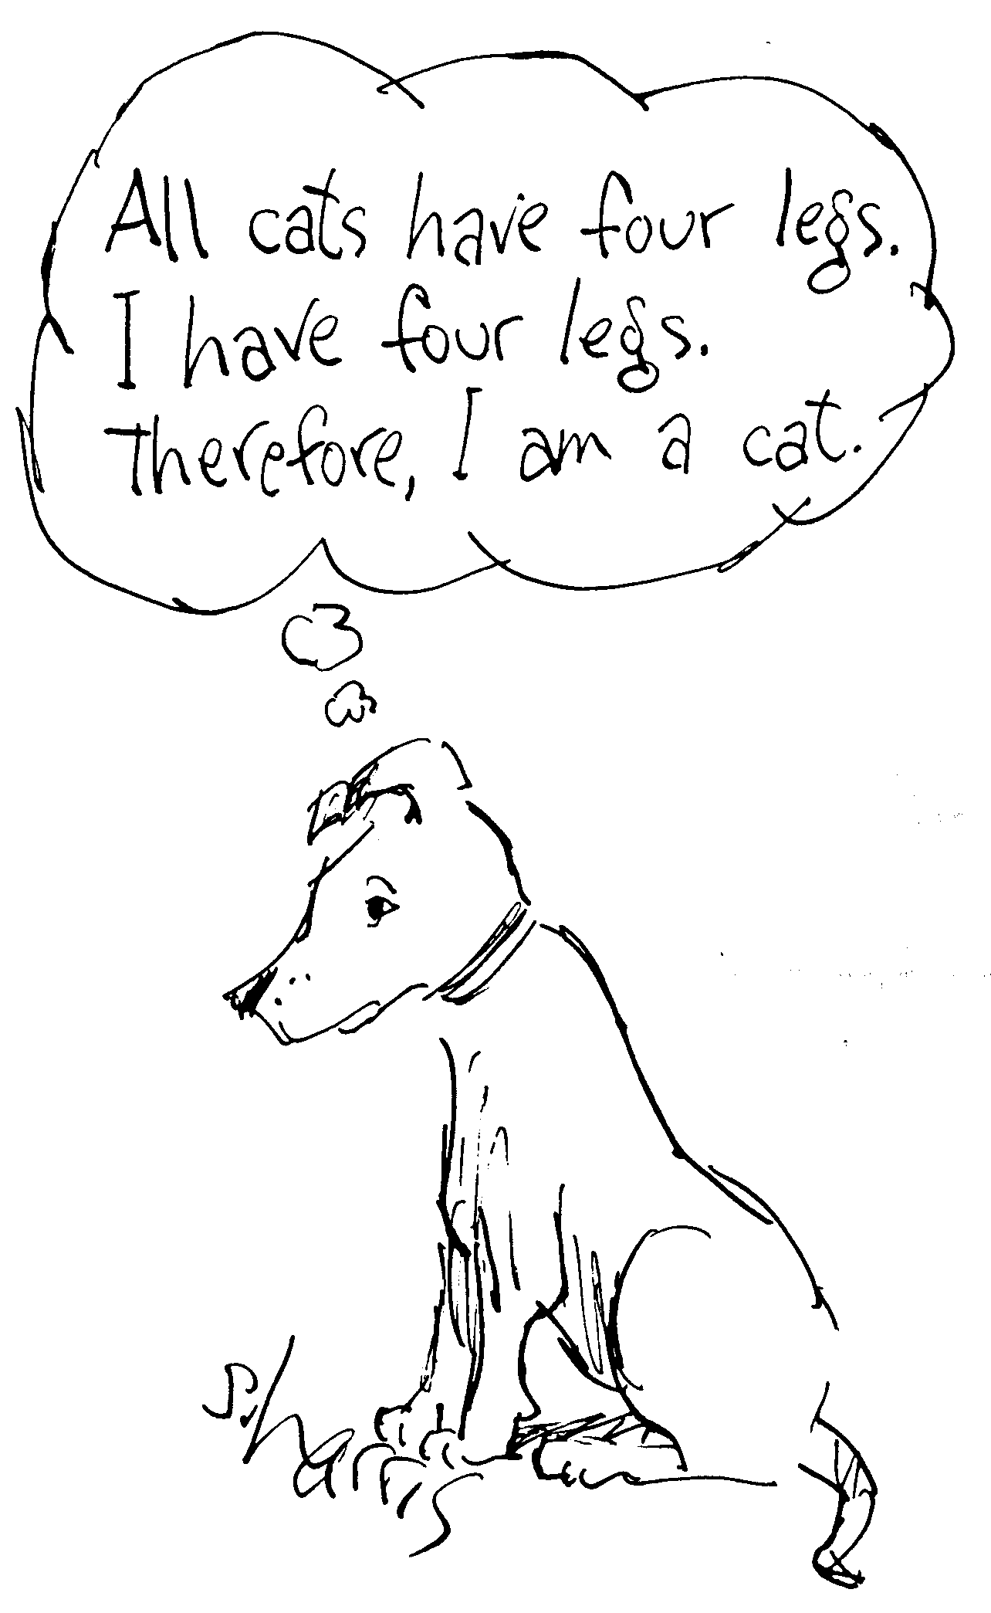
Theorem Proving
Want to prove true things
Avoid proving false things
We’ll do proof-checking later to rule out the “cat proof” shown here
For now, let’s just get to the point where we can prove something

Slide 11
Basic Symbolic Theorem Prover
Let’s define prove(H,G) …
prove(H, true) = true
prove(H, G₁ Æ G₂) = prove(H,G₁) &&
prove(H, G₂)
prove(H₁, H₂ ) G) = prove(H₁ Æ H₂, G)
prove(H, 8x. G) = prove(H, G[a/x])
(a is “fresh”)
prove(H, L) = ???

Slide 12
Theorem Prover for Literals
We have reduced the problem to
prove(H,L)
But H is a conjunction of literals L₁ Æ … Æ L_{k}
Thus we really have to prove that
L₁ Æ … Æ L_{k} ) L
Equivalently, that L₁ Æ … Æ L_{k} Æ : L is unsatisfiable
  For any assignment of values to variables the truth value of the conjunction is false
Now we can say
prove(H,L) = Unsat(H Æ : L)

Slide 13
Theory Terminology
A theory consists of a set of functions and predicate symbols (syntax) and definitions for the meanings of those symbols (semantics)
Examples:
  0, 1, -1, 2, -3, …, +, -, =, < (usual meanings; “theory of integers with arithmetic” or “Presburger arithmetic”)
  =, · (axioms of transitivity, anti-symmetry, and 8x. 8y. x · y Ç y · x ; “theory of total orders”)
  sel, upd (McCarthy’s “theory of lists”)

Slide 14
Decision Procedures for Theories
The Decision Problem
  Decide whether a formula in a theory with first-order logic is true
Example:
  Decide “8x. x>0 ) (9y. x=y+1)” in {N, +, =, >}
A theory is decidable when there is an algorithm that solves the decision problem
  This algorithm is the decision procedure for that theory

Slide 15
Satisfiability Procedures
The Satisfiability Problem
  Decide whether a conjunction of literals in the theory is satisfiable
  Factors out the first-order logic part
  The decision problem can be reduced to the satisfiability problem
    Parameters for 8, skolem functions for 9, negate and convert to DNF (sorry; I won’t explain this here)
“Easiest” Theory = Propositional Logic = SAT
  A decision procedure for it is a “SAT solver”

Slide 16
Theory of Equality
Theory of equality with uninterpreted functions
Symbols: =, ≠, f, g, …
Axiomatically defined (A,B,C 2 Expressions):
Example satisfiability problem:
g(g(g(x)))=x Æ g(g(g(g(g(x)))))=x Æ g(x)≠x
B=A
A=B B=C
A=B
A=A
A=B
A=C
f(A) = f(B)

Slide 17

More Satisfying Examples
Theory of Linear Arithmetic
  Symbols: ¸, =, +, -, integers
  Example: y > 2x + 1, x > 1, y < 0 is unsat
  Satisfiability problem is in P (loosely, no multiplication means no tricky encodings)
Theory of Lists
  Symbols: cons, head, tail, nil
  Theorem: head(x) = head(y) Æ tail(x) = tail(y) ) x = y
head(cons(A,B)) = A
tail(cons(A,B) = B

Slide 18
Computer Science
This algorithmic strategy is applicable to decomposable problems that exhibit the optimal substructure property (in which the optimal solution to a problem P can be constructed from the optional solutions to its overlapping subproblems). The term was coined in the 1940's by Richard Bellman. Problems as diverse as “shortest path”, “sequence alignment” and “CFG parsing” use this approach.

Slide 19
Mixed Theories
Often we have facts involving symbols from multiple theories
  E’s symbols =, ≠, f, g, … (uninterp function equality)
  R’s symbols =, ≠, +, -, ·, 0, 1, … (linear arithmetic)
  Running Example (and Fact):
² x · y Æ y + z · x Æ 0 · z ) f(f(x) – f(y)) = f(z)
  To prove this, we must decide:
Unsat(x · y, y + z · x, 0 · z, f(f(x) – f(y)) ≠ f(z))
We may have a sat procedure for each theory
  E’s sat procedure by Ackermann in 1924
  R’s proc by Fourier
The sat proc for their combination is much harder
  Only in 1979 did we get E+R

Slide 20
Satisfiability of Mixed Theories
Unsat(x · y, y + z · x, 0 · z, f(f(x) – f(y)) ≠ f(z))
Can we just separate out the terms in Theory 1 from the terms in Theory 2 and see if they are separately satisfiable?
  No, unsound, equi-sat ≠ equivalent.
The problem is that the two satisfying assignments may be incompatible
Idea (Nelson and Oppen): Each sat proc announces all equalities between variables that it discovers

Slide 21
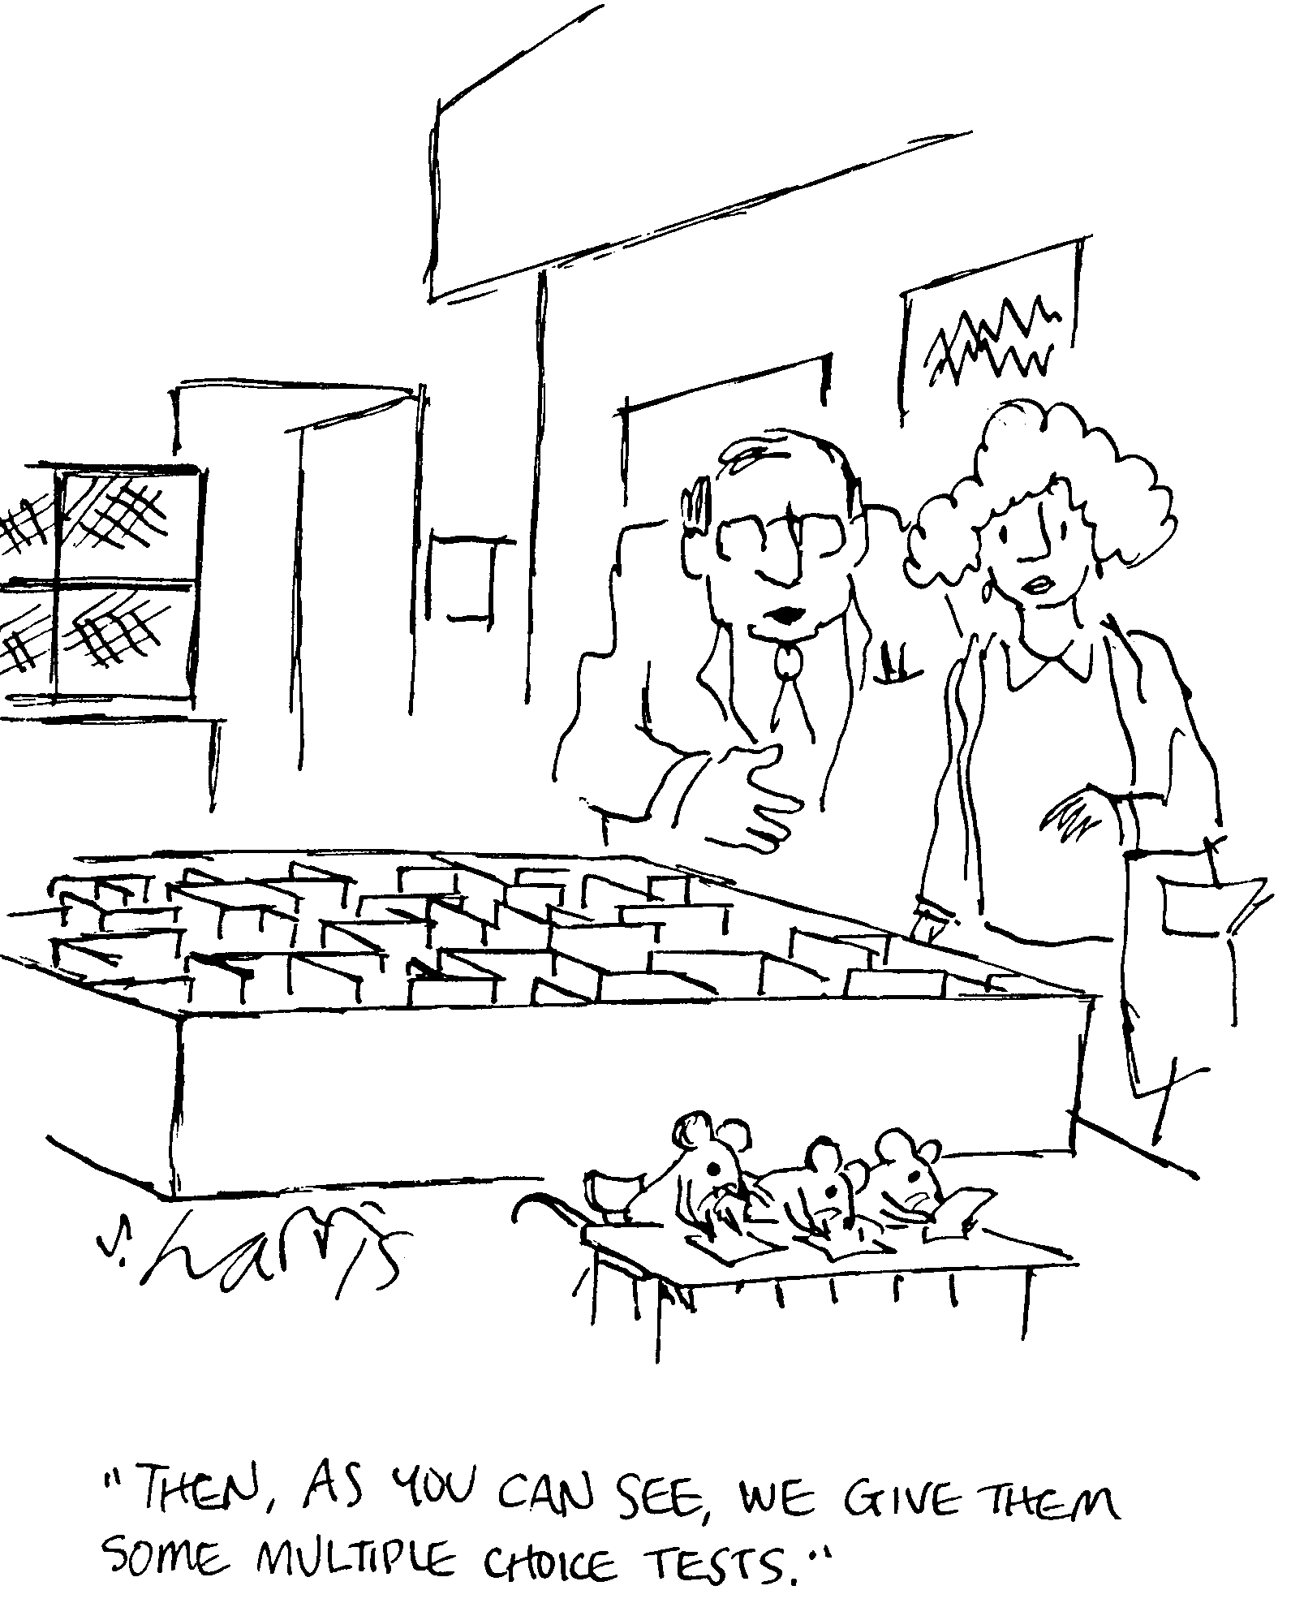
Handling Multiple Theories
We’ll use cooperating decision procedures
Each sat proc works on the literals it understands
Sat procs share information (equalities)

Slide 22
Consider Equality and Arith
f(f(x) – f(y) ≠ f(z)
x · y
y + z · x
0 · z
x = y
y · x
f(x) = f(y)
0 = z
f(x) – f(y) = z
How can we do this in our prover?
f(f(x) – f(y)) = f(z)
false

Slide 23
Nelson-Oppen: The E-DAG
Represent all terms in one Equivalence DAG
  Node names act as variables shared between theories!
f(f(x) – f(y)) ≠ f(z) Æ y ¸ x Æ x ¸ y + z Æ z ¸ 0
f
-
¸
f
¸
f
f
·
+
x
y
z
0

Slide 24
Nelson-Oppen: Processing
Run each sat proc
  Report all contradictions (as usual)
  Report all equalities between nodes (key idea)
Implementation details: Use union-find to track node equivalence classes in E-DAG. When merging A=B, also merge f(A)=f(B).
f
-
¸
f
¸
f
f
·
+
x
y
z
0

Slide 25
Nelson-Oppen: Processing
Broadcast all discovered equalities
  Rerun sat procedures
  Until no more equalities or a contradiction
Contradiction
X
f
-
¸
f
¸
f
f
·
+
x
y
z
0

Slide 26
Does It Work?
If a contradiction is found, then unsat
  This is sound if sat procs are sound
  Because only sound equalities are ever found
If there are no more equalities, then sat
  Is this complete? Have they shared enough info?
  Are the two satisfying assignments compatible?
  Yes!
  (Countable theories with infinite models admit isomorphic models, convex theories have necessary interpretations, etc.)

Slide 27
SAT-Based Theorem Provers
Recall separation of concerns:
  #1 Prover handles connectives (8, Æ, ))
  #2 Sat procs handle literals (+, ·, 0, head)
Idea: reduce proof obligation into propositional logic, feed to SAT solver (CVC)
  To Prove: 3*x=9 ) (x = 7 Æ x · 4)
  Becomes Prove: A ) (B Æ C)
  Becomes Unsat: A Æ :(B Æ C)
  Becomes Unsat: A Æ (:B Ç :C)

Slide 28
SAT-Based Theorem Proving
To Prove: 3*x=9 ) (x = 7 Æ x · 4)
  Becomes Unsat: A Æ (:B Ç :C)
  SAT Solver Returns: A=1, C=0
  Ask sat proc: unsat(3*x=9, : x·4) = true
  Add constraint: :(A Æ :C)
  Becomes Unsat: A Æ (:B Ç :C) Æ :(A Æ :C)
  SAT Solver Returns: A=1, B=0, C=1
  Ask sat proc: unsat(3*x=9, : x=7, x·4) = false
    (x=3 is a satisfying assignment)
  We’re done! (original to-prove goal is false)
  If SAT Solver returns “no satisfying assignment” then original to-prove goal is true

Slide 29

Proofs
“Checking proofs ain’t like dustin’ crops, boy!”

Slide 30
Proof Generation
We want our theorem prover to emit proofs
  No need to trust the prover
  Can find bugs in the prover
  Can be used for proof-carrying code
  Can be used to extract invariants
  Can be used to extract models (e.g., in SLAM)
Implements the soundness argument
  On every run, a soundness proof is constructed

Slide 31
Proof Representation
Proofs are trees
  Leaves are hypotheses/axioms
  Internal nodes are inference rules
Axiom: “true introduction”
  Constant: truei : pf
  pf is the type of proofs
Inference: “conjunction introduction”
  Constant: andi : pf ! pf ! pf
Inference: “conjunction elimination”
  Constant: andel : pf ! Pf
Problem:
  “andel truei : pf” but does not represent a valid proof
  Need a more powerful type system that checks content
truei
` true
` A ` B
andi
` A Æ B
` A Æ B
andel
` A

Slide 32
Dependent Types
Make pf a family of types indexed by formulas
  f : Type (type of encodings of formulas)
  e : Type (type of encodings of expressions)
  pf : f ! Type (the type of proofs indexed by formulas: it is a proof that f is true)
Examples:
  true : f
  and : f ! f ! f
  truei : pf true
  andi : pf A ! pf B ! pf (and A B)
  andi : ΠA:f. ΠB:f. pf A ! pf B ! pf (and A B)
  (ΠA:f.X means “forall A of type f, dependent type X”, see next lecture)

Slide 33
Proof Checking
Validate proof trees by type-checking them
Given a proof tree X claiming to prove A Æ B
Must check X : pf (and A B)
We use “expression tree equality”, so
  andel (andi “1+2=3” “x=y”) does not have type pf (3=3)
  This is already a proof system! If the proof-supplier wants to use the fact that 1+2=3 , 3=3, she can include a proof of it somewhere!
Thus Type Checking = Proof Checking
  And it’s quite easily decidable! ¤

Slide 34
Parametric Judgment (Time?)
Universal Introduction Rule of Inference
We represent bound variables in the logic using bound variables in the meta-logic
  all : (e ! f) ! f
  Example: 8x. x=x represented as (all (λx. eq x x))
  Note: 8y. y=y has an α-equivalent representation
  Substitution is done by β-reduction in meta-logic
    [E/x](x=x) is (λx. eq x x) E
` [a/x]A (a is fresh)
` 8x. A

Slide 35
Parametric 8 Proof Rules (Time?)
Universal Introduction
  alli: ΠA:(e ! f). (Πa:e. pf (A a)) ! pf (all A)
Universal Elimination
  alle: ΠA:(e ! f). ΠE:e. pf (all A) ! pf (A E)
` [a/x]A (a is fresh)
` 8x. A
` 8x. A
` [E/x]A

Slide 36
Parametric 9 Proof Rules (Time?)
` [E/x]A
Existential Introduction
  existi: ΠA:(e ! f). ΠE:e. pf (A E) ! pf (exists A)
Existential Elimination
  existe: ΠA:(e ! f). ΠB:f.
pf (exists A) ! (Πa:e. pf (A a) ! pf B) ! pf B
` 9x. A
` [a/x]A
…
` 9x. A ` B
` B

Slide 37
Homework
Project
  Need help? Stop by my office or send email.

