Slide 1
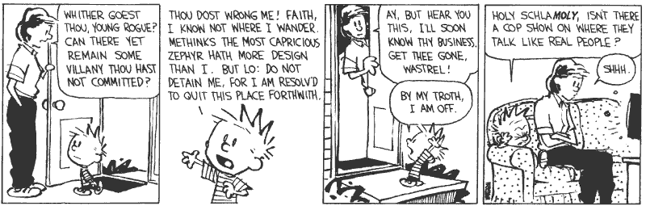

Communication and Concurrency

Slide 2
Preliminary Definition
A calculus is a method or system of calculation
The early Greeks used pebbles arranged in patterns to learn arithmetic and geometry
The Latin word for pebble is “calculus” (diminutive of calx/calcis)
Popular flavors:
  differential, integral, propositional, predicate, lambda, pi, join, of communicating systems

Slide 3
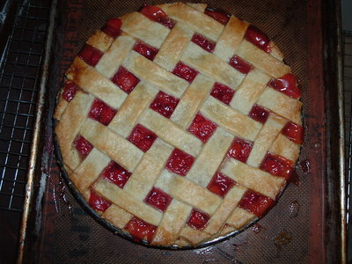
Cunning Plan
Types of Concurrency
Modeling Concurrency
Pi Calculus
Channels and Scopes
Semantics
Security
Real Languages

Slide 4
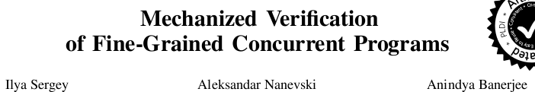


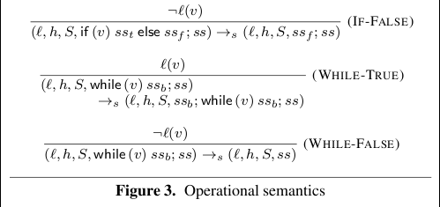
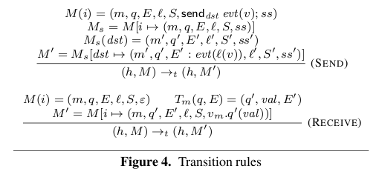
Relevance – PLDI 2015

Slide 5

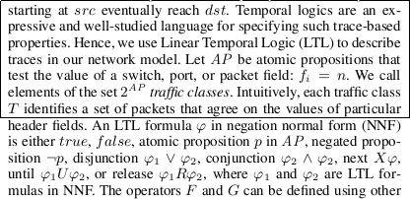
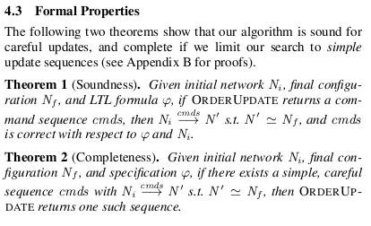
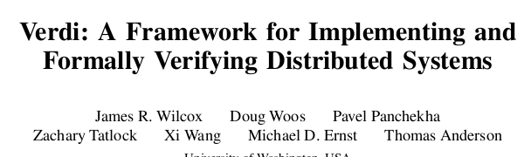
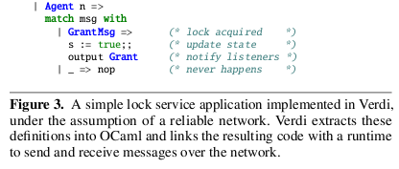

Relevance – PLDI 2015

Slide 6
Take-Home Message
The pi calculus is a formal system for modeling concurrency in which “communication channels” take center stage.
Key concerns include non-determinism and security. The pi calculus models synchronous communication. Can someone eavesdrop on my channel?

Slide 7
Possible Concurrency
No Concurrency
Threads and Shared Variables
  A language mechanism for specifying interleaving computations; often run on a single processor
Parallel (SIMD)
  A single program with simultaneous operations on multiple data (high-perf physics, science, …)
Distributed processes
  Code running at multiple sites (e.g., internet agents, DHT, Byzantine fault tolerance, Internet routing)
Different research communities ) different notions

Slide 8
(There Must Be) Fifty Ways to
Describe Concurrency
No Concurrency
  Sequential processes are modeled by the λ-calculus. Natural way to observe an algorithm: examine its output for various inputs ) functions
Threads and Shared Variables
  Small-step opsem with contextual semantics (e.g., callcc), or special type systems (e.g., [FF00])
Parallel (SIMD)
  Not in this class (e.g., Titanium, etc.)
Distributed processes
  ???

Slide 9
Modeling Concurrency
Concurrent systems are naturally non-deterministic
  Interleaving of atomic actions from different processes
  New concurrent scheduling possibly yields new result
Concurrent processes can be observed in many ways
  When are two concurrent systems equivalent?
  Intra-process behavior vs. inter-process behavior
Concurrency can be described in many ways
  Process creation: fork/wait, cobegin/coend, data parallelism
  Process communication: shared memory, message passing
  Process synchronization: monitors, semaphores, transactions

Slide 10
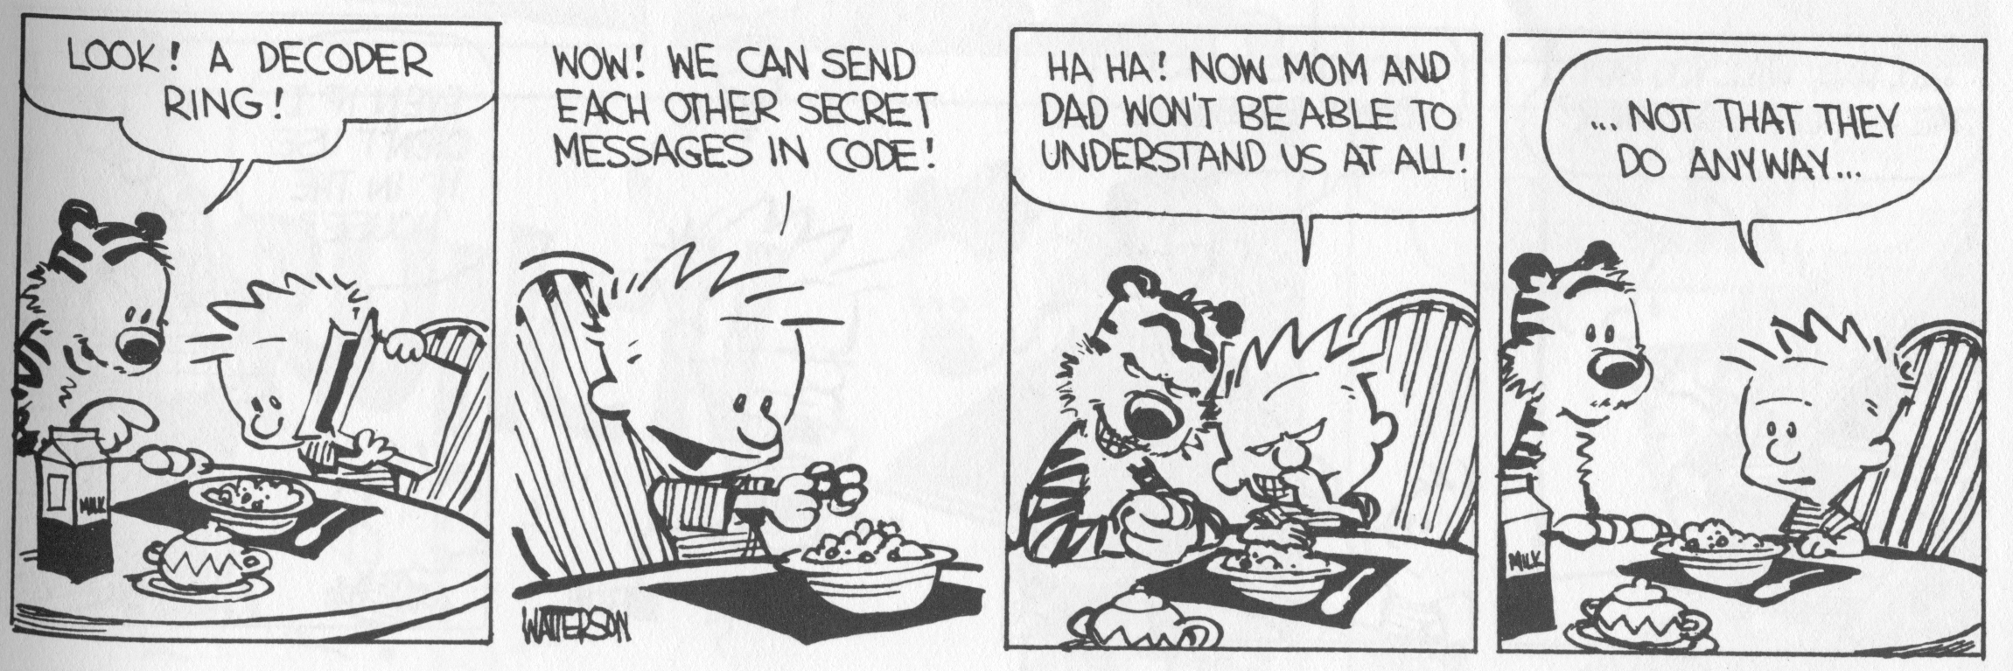
Message Passing
These “many ways” lead to a variety of process calculi
We will focus on message passing!

Slide 11
Communication and Messages
Communication is a fundamental concept
  But not for everything (e.g., not much about parallel or scientific computing in this lecture)
Communication through message passing
  synchronous or asynchronous
  static or dynamic communication topology
  first-order or high-order data
Historically: Weak treatment of communication
  I/O often not considered part of the language
Even “modern” languages have primitive I/O
  First-class messages are rare
  Higher-level remote procedure call is rare

Slide 12
Calculi and Languages
Many calculi and languages use message-passing
  Communicating Sequential Processes (CSP) (Hoare, 1978)
  Occam (Jones)
  Calculus of Communicating Systems (CCS) (Milner, 1980)
  The Pi Calculus (Milner, 1989 and others)
  Pict (Pierce and Turner)
  Concurrent ML (Reppy)
  Java RMI
Messaging is built in some higher-level primitives
  Remote procedure call
  Remote method invocation

Slide 13
The Pi Calculus
The pi calculus is a process algebra
  Each process runs a different program
  Processes run concurrently
  But they can communicate
Communication happens on channels
  channels are first-class objects
    channel names can be sent on channels
  can have access restrictions for channels
In λ-calculus everything is a function
In Pi calculus everything is a process

Slide 14
Pi Calculus Grammar
Processes communicate on channels
  c<M> send message M on channel c
  c(x) receives message value x from channel c
Sequencing
  c<M>.p sends message M on c, then does p
  c(x).p receives x on c, then does p with x (x is bound in p)
Concurrency
  p | q is the parallel composition of p and q
Replication
  ! p creates an infinite number of replicas of p

Slide 15
Examples
For example we might define
Speaker = air<M> // send msg M over air
Phone = air(x).wire<x> // copy air to wire
ATT = wire(x).fiber<x> // copy wire to fiber
System = Speaker | Phone | ATT
Communication between processes is modeled by reduction:
Speaker | Phone ! wire<M> // send msg M to wire
wire<M> | ATT ! fiber<M> // send msg M to fiber
Composing these reductions we get
Speaker | Phone | ATT ! fiber<M> // send msg M to fiber

Slide 16
Channel Visibility
Anybody can monitor an unrestricted channel!
Modeling such snooping:
WireTap = wire(x).wire<x>.NSA<x>
  Copies the messages from the wire to NSA
  Possible since the name “wire” is globally visible
Now the composition:
WireTap | wire<M> | ATT !
wire<M>.NSA<M> | ATT !
NSA<M> | fiber<M> // OOPS !

Slide 17
Restriction
The restriction operator (νc) p makes a fresh channel c within process p
  ν is the Greek letter “nu”
  The name c is local (bound) in p
  c is not known outside of p
Restricted channels cannot be monitored
wire(x) … | (ν wire)(wire<M> | ATT) !
wire(x) … | fiber<M>
The scope of the name wire is restricted
There is no conflict with the global wire

Slide 18
Restriction and Scope
Restriction
  is a binding construct (like λ, 8, 9, ...)
  is lexically scoped
  allocates a new object (a new channel)
  somewhat like Unix pipe(2) system call
(νc)p is like let c = new Channel() in p
c can be sent outside its initial scope
  But only if p decides so (intentional leak)

Slide 19
First-Class Channels
Channel c can leave its scope of declaration
  via a message d<c> from within p
  d is some other channel known to p
  Intentional with “friend” processes (e.g., send my IM handle=c to a buddy via email=d)
Allowing channels to be sent as messages means communication topology is dynamic
  If channels are not sent as messages (or stored in the heap) then the communication topology is static
  This differentiates Pi-calculus from CCS

Slide 20
Example of First-Class Channels
y will be
bound to cell!
Consider:
MobilePhone = air(x).cell<x>
ATT1 = wire<cell>
ATT2 = wire(y).y(x).fiber<x>
in
(ν cell)( MobilePhone | ATT1) | ATT2
ATT1 passes cell out of the static scope of the restriction ν cell

Slide 21
Q: Books (734 / 842)
Name either the Martian protagonist or the Martian word for "to drink" in Robert Heinlein's 1961 sci-fi novel Stranger in a Strange Land. The novel won the Hugo award and the word has entered the OED.

Slide 22
Q: General (485 / 842)
In the works Treatise on the Human Being and Discourse on the Method (1637) Descartes considers a theory in which the soul is like a little person that sits inside the brain to observe and direct. Name the little person or the gland most closely associated with this theory. Optionally, translate “je pense, donc je suis”, which first appears in DoTM.

Slide 23
Scope Extrusion
A channel is just a name
  First-class names must be usable in any scope
The pi calculus restrictions distribute:
((ν c) p) | q = (ν c)(p | q) if c not free in q
Renaming is needed in general:
((ν c) p) | q = ((ν d) [d/c] p) | q
= (ν d)([d/c] p| q)
where “d” is fresh (does not appear in p or q)
This scope extrusion distinguishes the pi calculus from other process calculi

Slide 24
Syntax of the Pi Calculus
There are many versions of the Pi calculus
A basic version:
p,q ::= (p and q are processes)
nil nil process (sometimes written 0)
x<y>.p sending data y on channel x
x(y).p receiving data y from channel x
p | q parallel composition
!p replication
(ν x)p restriction (new channel x used in p)
Note that only variables can be channels and messages

Slide 25
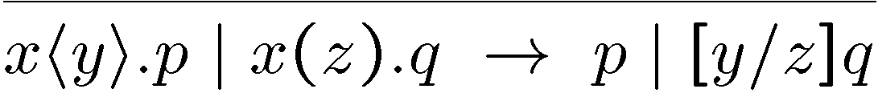
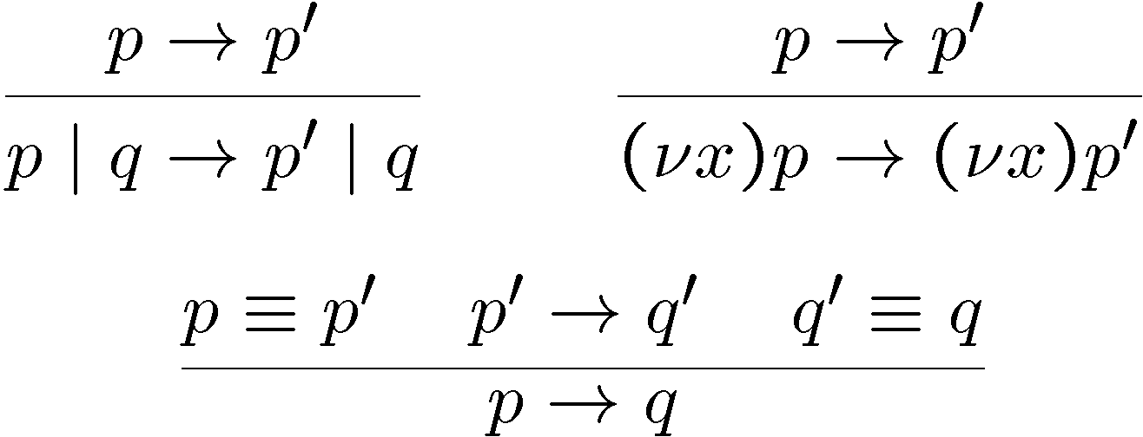
Operational Semantics
One basic rule of computation: data transfer
  Synchronous communication: 1 sender, 1 receiver
  Both the sender and the receiver proceed afterwards
Rules for local (non-communicating) progress:

Slide 26
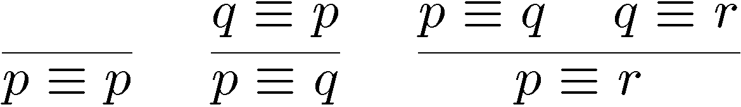
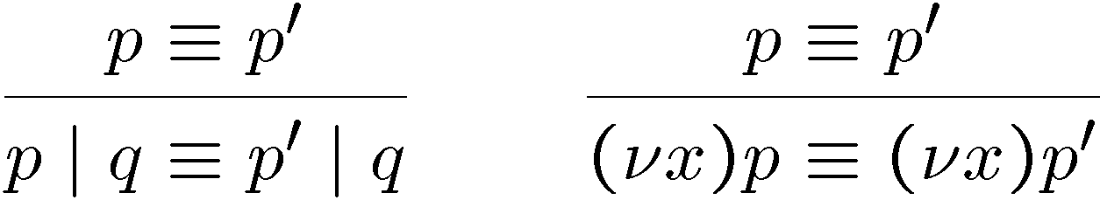
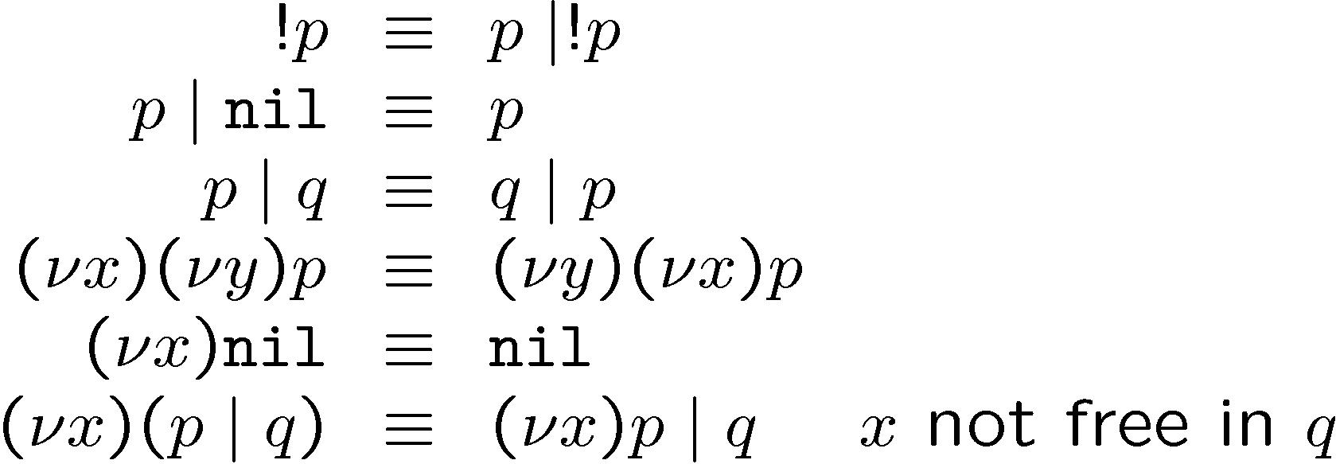
Structural Congruence

Slide 27
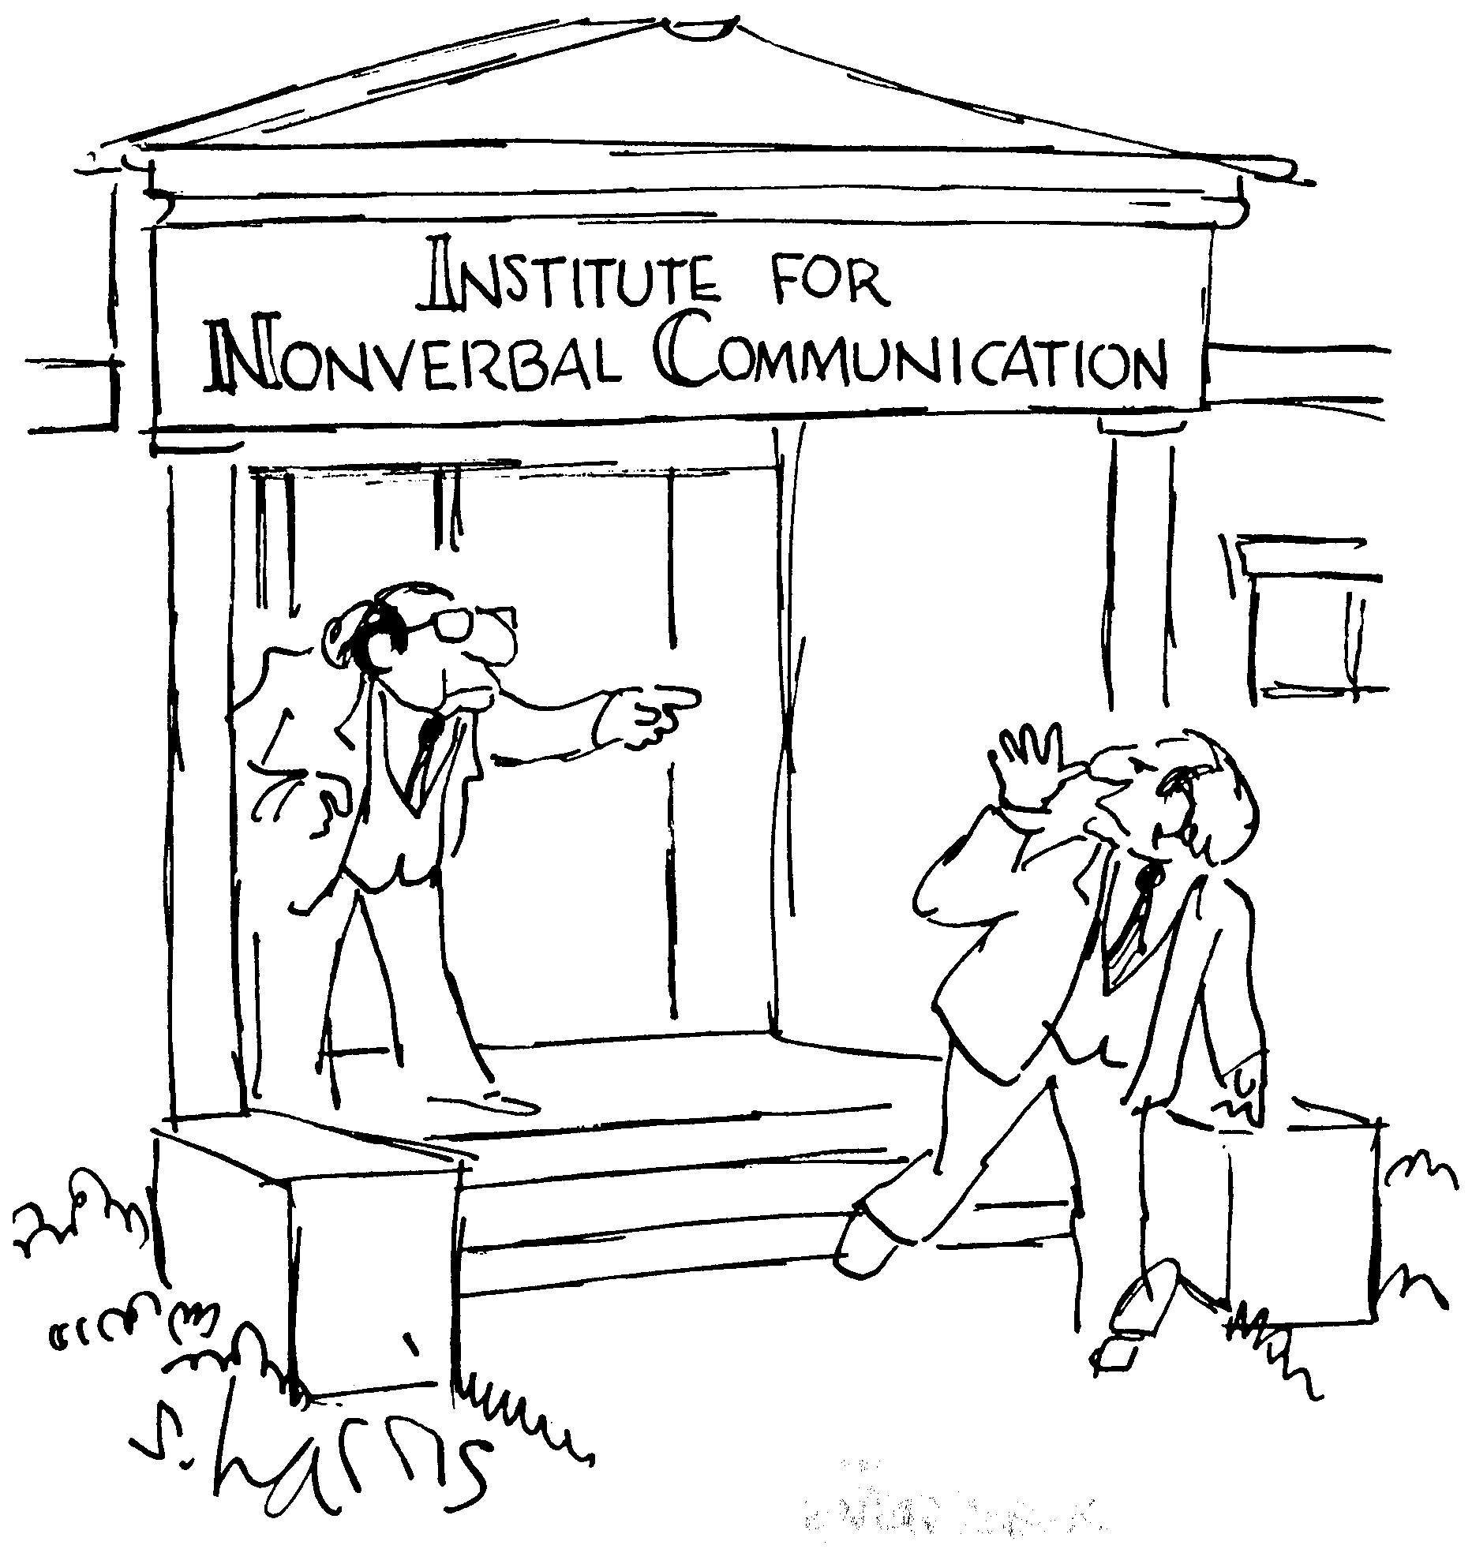
Semantics and Evaluation
IMP opsem has the “diamond property”
Does the Pi Calculus? Why or why not?
1+2+3
3+3
1+5
6

Slide 28
Theory of Pi Calculus
The Pi calculus does not have the Church-Rosser property
  Recall: WireTap | wire<M> | ATT !* NSA<M> | fiber<M>
  Also: WireTap | wire<M> | ATT !* WireTap | fiber<M>
  This captures the non-deterministic nature of concurrency
For Pi-calculus there are
  Type systems
  Equivalences and logics
  Expressiveness results, through encodings of numbers, lists, procedures, objects

Slide 29
Pi Calculus Applications
A number of languages are based on Pi
  e.g., Pict (Pierce and Turner)
Specification and verification
  mobile phone protocols, security protocols
Pi channels have nice built-in properties, such as:
  integrity
  confidentiality (with ν)
  exactly-once semantics
  mobility (channels as first-class values)
These properties are useful in high-level descriptions of security protocols
More detailed descriptions are possible in the spi calculus (= pi calculus + cryptography)

Slide 30
A Typical Security Protocol
Establishment and use of a secret channel:
A and B are two clients
S is an authentication server
c_{AS} and c_{BS} are existing private channels with server
c_{AB} is a new channel for the clients
S
New channel c_{AB}
Same new channel c_{AB}
c_{AS}
c_{BS}
c_{AB}
A
B
Data

Slide 31
That Security Protocol in Pi
That protocol is described as follows:
A(M) = (ν c_{AB}) c_{AS}<c_{AB}>. c_{AB} <M>
S = ! (c_{AS}(x). c_{BS}<x> | c_{BS}(x). c_{AS}<x>)
B = c_{BS}(x). x(y). Work(y)
System(M) = (ν c_{AS})(ν c_{BS}) A(M) | S | B
  Where Work(y) represents what B does with the message M (bound to y) that it receives
  The | c_{BS}(x). c_{AS}<x> makes the server symmetric

Slide 32
Some Security Properties
An authenticity property
  For all N, if B receives N then A sent N to B
A secrecy property
  An outsider cannot tell System(M) apart from System(N), unless B reveals some part of A’s message
Both of these properties can be formalized and proved in the Pi calculus
The secrecy property can be treated via a simple type system

Slide 33
Mainstream Languages
Communication channels are not found in popular languages
  sockets in C are reminiscent of channels
  STREAMS (never used) are even closer
  ML has exactly what we’ve described (surprise)
More popular is remote procedure call or (for OO languages) remote method invocation

Slide 34
Concurrent ML
Concurrent ML (CML) extends of ML with:
  threads
  typed channels
  pre-emptive scheduling
  garbage collection for threads and channels
  synchronous communication
  events as first-class values
OCaml has it (Event, Thread), etc.
  “First-class synchronous communication. This module implements synchronous inter-thread communications over channels. As in John Reppy's Concurrent ML system, the communication events are first-class values: they can be built and combined independently before being offered for communication.”

Slide 35
Threads and Channels in CML
val spawn : (unit ! unit) ! thread (* create a new thread *)
val channel : unit ! ‘a chan (* create a new typed channel *)
val accept : ‘a chan ! ‘a (* message passing operations *)
val send : (‘a chan * ‘a) ! unit
So one can write, for example:
fun serverLoop () = let request = accept recCh in
send (replyCh, workOn request);
serverLoop ()

Slide 36
Basic Events in Concurrent ML
val sync : ‘a event ! ‘a (* force synchronization on an event, block until this communication succeeds *)
val transmit : (‘a chan * ‘a) ! unit event (* nonblocking; promises to do the send at some point *)
val receive : ‘a chan ! ‘a event (* sets up the rendezvous, but you don’t actually get the value until you sync *)
val choose : ‘a event list ! ‘a event (* succeeds when one of the events in the list succeeds *)
val wrap : (‘a event * (‘a ! ‘b)) ! ‘b event (* do an action after synchronization on an event *)
So you can write, as in Unix syscall select(2):
select (mylist : ‘a event list) : ‘a = sync (choose mylist)

Slide 37
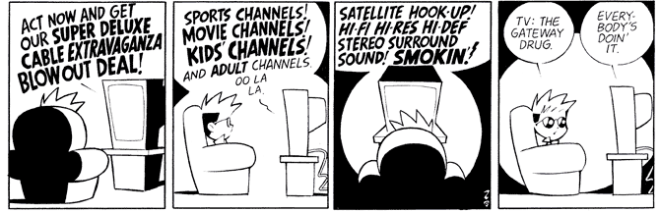
Java Remote Method Invocation
Java RMI is a Java extension with
  Java method invocation syntax
  similar semantics
  static checks
  distributed garbage collection
  exceptions for failures

Slide 38
RMI notes
Compare RMI with pure message passing
  RMI is weaker, but OK for many purposes
RMI not a perfect fit into Java:
  non-remote objects are passed by copy in RMI
  clients use remote interfaces, not remote classes
  clients must handle RemoteException
  using same syntax for MI and RMI leads to hidden performance costs
But it is not an unreasonable design!

Slide 39
Homework
Project
  Need help? Stop by my office or send email.

