Slide 1
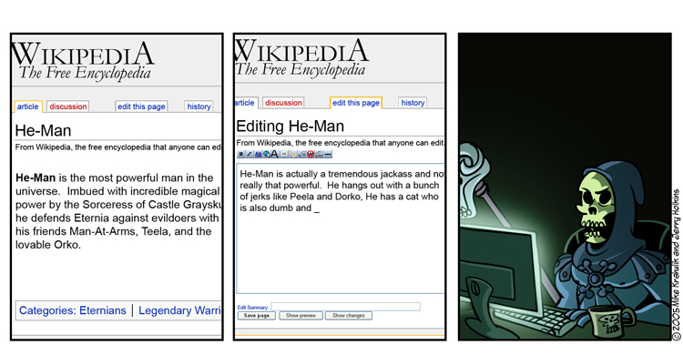
Cooperative Bug Isolation
Ben Liblit et al.

Slide 2

What’s This?
Today, we'll talk about the work that won the 2005 ACM Doctoral Dissertation Award.

Slide 3
Sic Transit Gloria Raymondi
Eric S. Raymond: “Given enough eyeballs, all bugs are shallow.”
Bugs experienced by users matter.
We can use information from user runs of programs to find bugs.
Random sampling keeps the overhead of doing this low.
Large public deployments exist.

Slide 4
Today’s Goal: Measure Reality
We measure bridges, airplanes, cars…
  Where is ight data recorder for software?
Users are a vast, untapped resource
  60 million XP licenses in first year; 2/second
  1.9M Kazaa downloads per week in 2004; 3/s
  Users know what matters most
    Nay, users define what matters most!
Opportunity for reality-directed debugging
  Implicit bug triage for an imperfect world
Notes:
Users define what matters most.
Office XP: 60 million licenses in first year; nearly 2 per second
Kazaa: “over 1.9 million downloaded last week”; more than 3 per second

Slide 5

Bug Isolation Architecture
No annotation required; just pick what to instrument.
Guesses
Program
Source
Shipping
Application
Sampler
Compiler
Top bugs with
likely causes
Statistical
Debugging
Prole
& ☺/☹
Notes:
Note: no programmer annotation required! Just pick which instrumentation schemes to activate.
Review of instrumentation strategy
Engineering challenges & solutions
Deployment status
Preliminary results

Slide 6
Why Will This Work?
Good News: Users can help!
Important bugs happen often, to many users
  User communities are big and growing fast
  User runs vastly exceed testing runs
  Users are networked
We can do better, with help from users!
  cf. crash reporting (Microsoft, Netscape)
  Today: research efforts

Slide 7
“There are no significant
bugs in our released software
that any significant number
of users want fixed.”
-- Bill Gates in 1995

Slide 8
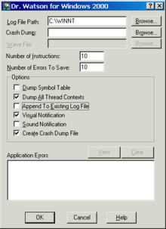
Crash Reports
In use since the mid 1990s
Stack trace, memory address, details about host configuration, ...
Advantage: fast and easy
Limitations:
  Crashes don't always occur “near” the defect
  Hard to tell which crashes correspond to the same bug

Slide 9
Let’s Use Randomness
How do
profilers work?
Problem: recording everything is too expensive!
Idea: each user records 0.1% of everything
Generic sparse sampling framework
  Adaptation of Arnold & Ryder
Suite of instrumentations / analyses
  Sharing the cost of assertions
  Isolating deterministic bugs
  Isolating non-deterministic bugs

Slide 10
Sampling Blocks
Consider this code:
  check(p != NULL);
  p = p -> next;
  check(i < max);
  total += sizes[i];
We want to sample 1/100 of these checks

Slide 11
Global Counter
Solution?
  Maintain a global counter modulo 100
  for (i=0; i<n; i++) {
  check(p != NULL);
  p = p -> next;
  check(i < max);
  total += sizes[i];
  }

Slide 12
Global Counter
Solution?
  Maintain a global counter modulo 100
  for (i=0; i<n; i++) {
  check(p != NULL);
  p = p -> next;
  check(i < max);
  total += sizes[i];
  }
Records the first
check 1/50 times.
Never records
the other.

Slide 13
Random Number Generator
Solution? Use random number generator.
  if (rand(100)==0) check(p != NULL);
  p = p -> next;
  if (rand(100)==0) check(i < max);
  total += sizes[i];

Slide 14
Random Number Generator
Solution? Use random number generator.
  if (rand(100)==0) check(p != NULL);
  p = p -> next;
  if (rand(100)==0) check(i < max);
  total += sizes[i];
Calling rand()
is more expensive
than the check!

Slide 15
Sampling the Bernoulli Way
Identify the points of interest
Decide to examine or ignore each site…
  Randomly
  Independently
  Dynamically
Cannot use clock interrupt: no context
Cannot be periodic: unfair
Cannot toss coin at each site: too slow

Slide 16
Anticipating the Next Sample
Randomized global countdown
Selected from geometric distribution
  Inter-arrival time for biased coin toss
  Stores: How many tails before next head?
    i.e., how many sampling points to skip before we write down the next piece of data?
Mean of distribution = expected sample rate

Slide 17
Amortized Coin Tossing
Each acyclic region:
  Finite number of paths
  Finite max number of instrumentation sites
  Shaded nodes represent instrumentation sites
4
3
1
2
1
X
2
1
1

Slide 18
Amortized Coin Tossing
Each acyclic region:
  Finite number of paths
  Finite max number of instrumentation sites
Clone each region
  “Fast” variant
  “Slow” sampling variant
Choose at run time
>4?

Slide 19
Two Code Paths
Fast Code Path
if (counter > 2) {
p = p -> next;
total += sizes[i];
counter -= 2;
}
Slow Code Path
if (counter-- == 0)
check(p != NULL);
p = p -> next;
if (counter-- == 0)
check(i < max);
total += sizes[i];

Slide 20
Optimizations
Cache global countdown in local variable
  Global → local at func entry & after each call
  Local → global at func exit & before each call
Identify and ignore “weightless” functions
Avoid cloning
  Instrumentation-free prefix or suffix
  Weightless or singleton regions
Static branch prediction at region heads
Partition sites among several binaries
Many additional possibilities …

Slide 21
Q. Computer Science
Along with Shamir and Adleman, this American Turing-award winner is credited with revolutionizing public key cryptography. He is also responsible for the RC5 symmetric key encryption algorithm (“RC” stands for “his Cypher”) and the MD5 cryptographic hash function. He is also a co-author of Introduction to Algorithms (aka CLRS).

Slide 22
Q. Philosophy and History
This Greek (Macedonian) philosopher and scientist is known for writings on many subjects (physics, biology, logic, ethics, rhetoric, etc.). His works form the first comprehensive Western philosophy. Encyclopaedia Britannica claims he, “was the first genuine scientist in history ... [and] every scientist is in his debt.” He is credited with the earliest study of formal logic. Kant said that his theory of logic completely accounted for the core of deductive inference. His Rhetoric has been called “the most important single work on persuasion ever written.”

Slide 23
Sharing the Cost of Assertions
Now we know how to sample things.
Does this work in practice?
  Let’s do a series of experiments.
First: microbenchmark for sampling costs!
What to sample: assert() statements
Identify (for debugging) assertions that
  Sometimes fail on bad runs
  But always succeed on good runs

Slide 24
Case Study: CCured Safety Checks
Assertion-dense C code
Worst-case scenario for us
  Each assertion extremely fast
No bugs here; purely performance study
  Unconditional: 55% average overhead
  ¹/₁₀₀ sampling: 17% average overhead
  ¹/₁₀₀₀ sampling: 10% average; half below 5%

Slide 25
Isolating a Deterministic Bug
Guess predicates on scalar function returns
(f() < 0) (f() == 0) (f() > 0)
Count how often each predicate holds
  Client-side reduction into counter triples
Identify differences in good versus bad runs
  Predicates observed true on some bad runs
  Predicates never observed true on any good run
Function return triples aren’t the only things we can sample.

Slide 26
Case Study: ccrypt Crashing Bug
570 call sites
3 × 570 = 1710 counters
Simulate large user community
  2990 randomized runs; 88 crashes
Sampling density ¹/₁₀₀₀
  Less than 4% performance overhead
Recall goal: sampled predicates should make it easier to debug the code …

Slide 27
Winnowing Down to the Culprits
1710 counters
1569 are always zero
  141 remain
139 are nonzero on some successful run
Not much left!
file_exists() > 0
xreadline() == 0
How do these pin down the bug? You’ll see in a second.

Slide 28
Isolating a Non-Deterministic Bug
Guess: at each direct scalar assignment
x = …
For each same-typed in-scope variable y
Guess predicates on x and y
(x < y) (x == y) (x > y)
Compare: DIG, Daikon (invariant detection)
Count how often each predicate holds
  Client-side reduction into counter triples

Slide 29
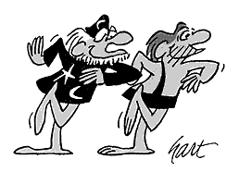
Case Study: bc Crashing Bug
Hunt for intermittent crash in bc-1.06
  Stack traces suggest heap corruption
2729 runs with 9MB random inputs
30,150 predicates on 8910 lines of code
Sampling key to performance
  13% overhead without sampling
  0.5% overhead with ¹/₁₀₀₀ sampling

Slide 30
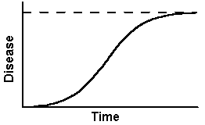
Statistical Debugging via Regularized Logistic Regression
failure = 1
success = 0
count
S-shaped cousin to linear regression
Predict success/failure as function of counters
Penalty factor forces most coefficients to zero
  Large coefficient ⇒ highly predictive of failure

Slide 31
Top-Ranked Predictors
void more_arrays ()
{
…
/* Copy the old arrays. */
for (indx = 1; indx < old_count; indx++)
arrays[indx] = old_ary[indx];
/* Initialize the new elements. */
for (; indx < v_count; indx++)
arrays[indx] = NULL;
…
}
#1: indx > scale
#1: indx > scale
#2: indx > use_math

Slide 32
Top-Ranked Predictors
void more_arrays ()
{
…
/* Copy the old arrays. */
for (indx = 1; indx < old_count; indx++)
arrays[indx] = old_ary[indx];
/* Initialize the new elements. */
for (; indx < v_count; indx++)
arrays[indx] = NULL;
…
}
#1: indx > scale
#1: indx > scale
#2: indx > use_math
#1: indx > scale
#2: indx > use_math
#3: indx > opterr
#4: indx > next_func
#5: indx > i_base

Slide 33
Bug Found: Buffer Overrun
void more_arrays ()
{
…
/* Copy the old arrays. */
for (indx = 1; indx < old_count; indx++)
arrays[indx] = old_ary[indx];
/* Initialize the new elements. */
for (; indx < v_count; indx++)
arrays[indx] = NULL;
…
}

Slide 34
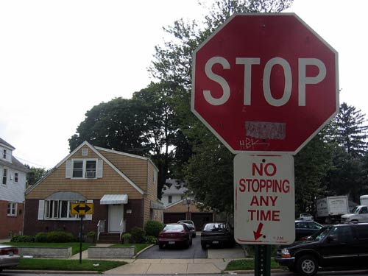
Moving To The Real World
Pick instrumentation scheme
Automatic tool instruments program
Sampling yields low overhead
Many users run program
Many reports ) find bug
So let’s do it!

Slide 35
Multithreaded Programs
Global next-sample countdown
  High contention, small footprint
  Want to use registers for performance
  Thread-local: one countdown per thread
Global predicate counters
  Low contention, large footprint
  Optimistic atomic increment

Slide 36
Multi-Module Programs
Forget about global static analysis
  Plug-ins, shared libraries
  Instrumented & uninstrumented code
Self-management at compile time
  Locally derive identifying object signature
  Embed static site information within object le
Self-management at run time
  Report feedback state on normal object unload
  Signal handlers walk global object registry

Slide 37
Native Compiler Integration
Instrumentor must mimic native compiler
  You don’t have time to port & annotate by hand
This approach: source-to-source, then native
Hooks for GCC:
  Stage wrapping via scripts
  Flag management via specles
Guesses
Sampler
Program
Source
Shipping
Application
Compiler

Slide 38
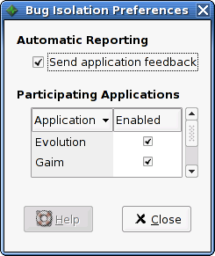
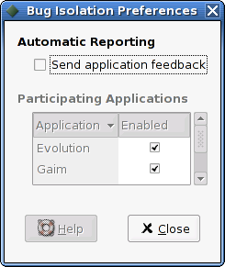
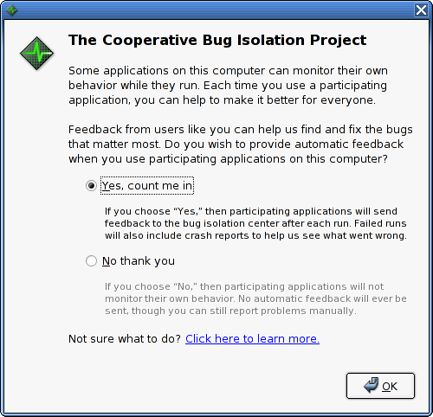
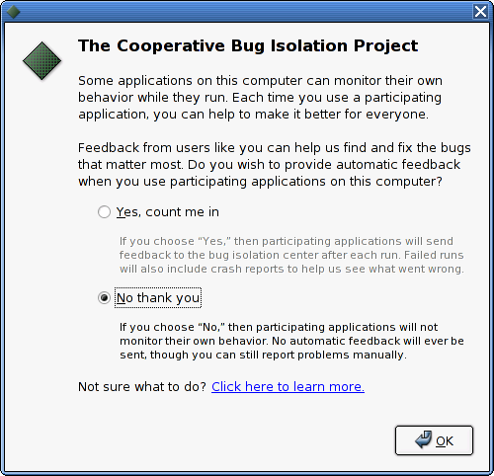


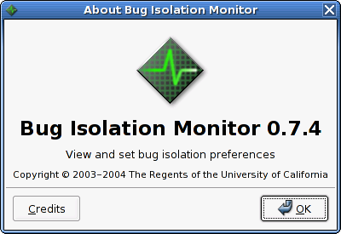
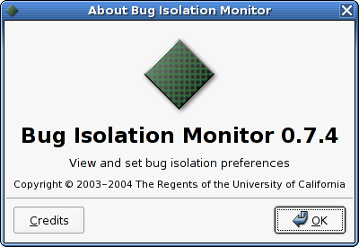
Keeping the User In Control

Slide 39
Public Deployment 2004

Slide 40
Public Deployment 2004

Slide 41
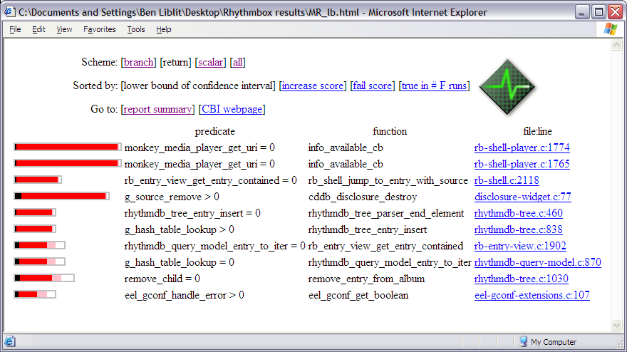
Sneak Peak: Data Exploration
Notes:
Entire band: total number of runs in which the predicate is observed to be true
Black segment: P(fail | line of code on which the predicate occurs is reached)
White segment: P(succeed | predicate is observed to be true)
Red + pink segments: increase in P(crash | predicate is observed to be true) beyond P(crash line of code on which the predicate occurs is reached)
Red segment only: increase for which we are 95% confident

Slide 42
Summary: Putting it All Together
Flexible, fair, low overhead sampling
Predicates probe program behavior
  Client-side reduction to counters
  Most guesses are uninteresting or meaningless
Seek behaviors that co-vary with outcome
  Deterministic failures: process of elimination
  Non-deterministic failures: statistical modeling

Slide 43
Conclusions
Bug triage that directly reflects reality
  Learn the most, most quickly, about the bugs that happen most often
Variability is a benefit rather than a problem
  Results grow stronger over time
Find bugs while you sleep!
Public deployment is challenging
  Real world code pushes tools to their limits
  Large user communities take time to build
But the results are worth it:
“Thanks to Ben Liblit and the Cooperative
Bug Isolation Project, this version of
Rhythmbox should be the most stable yet.”

Slide 44

Homework
Projects!

