Slide 1

Dependent
Type Systems
(saying what you are)
Data Abstraction
(hiding what you are)

Slide 2
Review
We studied a variety of type systems
We repeatedly made the type system more expressive to enable the type checker to catch more errors
But we have steered clear of undecidable systems
  Thus there must still be many errors that are not caught
Now we explore more complex type systems that bring type checking closer to program verification

Slide 3
Proximate Cause
Theorem proving is quite useful and can determine if things are true or false: “your file system can segfault” or “this formula is satisfiable”
However, we also want theorem provers to provide checkable proofs to back up what they decide
Fortunately, “proof checking is equivalent to type checking in a dependent type system”

Slide 4
A dependent type is a type that depends on a value.

Slide 5
Dependent Types
Say that we have the functions
zero : nat ! vector (creates vector of requested length)
dotprod : vector ! vector ! real (dot product)
The types do not prevent using dotprod on vectors of different length
let v1 = zero 5 in
let v2 = zero 15 in
print (dotprod v1 v2)

Slide 6
Dependent Types
Say that we have the functions
zero : nat ! vector (creates vector of requested length)
dotprod : vector ! vector ! real (dot product)
The types do not prevent using dotprod on vectors of different length
  If they did, we could catch more bugs!
Idea: Make “vector” a type family annotated by a natural number
“vector n” is the type of vectors of length n
dotprod: vector n ! vector n ! real (where is n bound?)
zero : nat ! vector ?
Need a way to refer to the value of the first argument in the type!

Slide 7
Dependent Type Notation
How to write the type of zero : nat ! vector ?
Given two sets A and B verify the isomorphism
A ! B ' Π_{x 2 A} B
  The latter is the cartesian product of B with itself as many times as there are elements in A
  Also written as Πx:A.B (x plays no role so far!)
  But now we can make B depend on x!
Definition: Πx:A.B is the type of functions with argument in A and with the result type B (possibly depending on the value of the argument x in A)
  We write “zero : Πx:nat. vector x”
  Special case when x∉B we abbreviate as A ! B
  We play “fast and loose” with the binding of Π

Slide 8
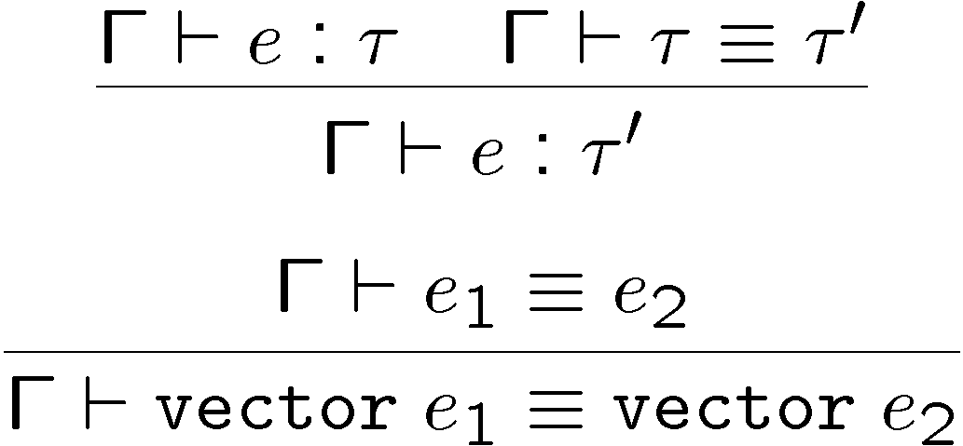
Dependent Typing Rules
  Note that expressions are now part of types
  Have types like “vector 5” and “vector (2 + 3)”
  We need type equivalence

Slide 9
Dependent Types and Program Specifications
Types act as specifications
With dependent types we can specify any property!
For example, define the following types:
“eq e” - the type of values equal to “e”.
Also named “sng e” (the singleton type)
“ge e” – the type of values larger or equal to “e”
“lt e” – the type of values smaller than “e”
“and τ₁ τ₂” – the type of values having both type τ₁ and τ₂
Need appropriate typing rules for the new types
The precondition for vector-accessing (cf. HW5)
  read: Πn:nat.vector n ! (and (ge 0) (lt n)) ! int
The type checker must do program verification

Slide 10
Dependent Type Commentary
Type checking with Π types can be as hard as full program verification
Type equivalence can be undecidable
  If types are dependent on expressions drawn from a powerful language (“powerful” = “arithmetic”)
  Then even type checking will be undecidable
Dependent types play an important role in the formalization of logics
  Started with Per Martin-Lof
  Proof checking via type checking
  Proof-carrying code uses a dependent type checker to check proofs
  There are program specification tools based on Π types

Slide 11
Dependent Sum Types
We want to pack a vector with its length
  e = (n, v) where “v : vector n”
  The type of an element of a pair depends on the value of another element
  This is another form of dependency
  The type of e is “nat £ vector ?”
Given two sets A and B verify the isomorphism
A £ B ' Σ_{x 2 A} B
  The latter is the disjoint union of B with itself as many times as there are elements in A
  Also written as Σx:A.B (x here plays no role)
  But now we can make B depend on x!

Slide 12
Dependent Sum Types
Definition: Σx:A.B is the type of pairs with first element of type A and second element of type B (possibly depending on the value of first element x)
  Now we can write e : Σx:nat. vector x
Old functions that compute the length of a vector
  vlength : Πn:nat.vector n ! nat
    (the result is not constrained)
  slength : Πn:nat.vector n ! sng n
    “sng n” is a dependent type that contains only n
    called the singleton type (recall from 3 slides ago …)
What if the vector is packed with its length?
  pvlength : Σn:nat.vector n ! nat
  pslength : Σn:nat.vector n ! sng n

Slide 13
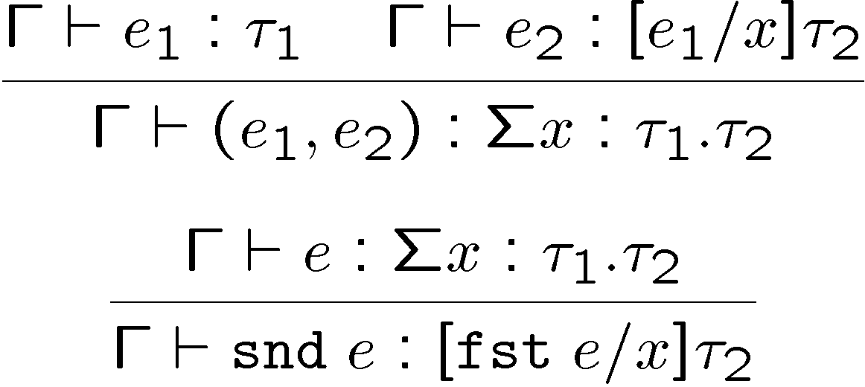
Dependent Sum Types
Static Semantics
  Note how this rule reduces to the usual rules for tuples when there is no dependency
The evaluation rules are unchanged

Slide 14
Weimeric Commentary
Dependant types seem obscure: why care?
Grand Unified Theory
  Type Checking = Verification (= Model Checking = Proof Checking = Abstract Interpretation …)
CCured Project
  Rumor has it this project was successful
  The whole thing is dependant sum types
    SEQ = (pointer + lower bound + upper bound)
    FSEQ = (pointer + upper bound)
    WILD = (pointer + lower bound + upper bound + rtti)

Slide 15
Proof Generation
We want our theorem prover to emit proofs
  No need to trust the prover
  Can find bugs in the prover
  Can be used for proof-carrying code
  Can be used to extract invariants
  Can be used to extract models (e.g., in SLAM)
Implements the soundness argument
  On every run, a soundness proof is constructed

Slide 16
Proof Representation
Proofs are trees
  Leaves are hypotheses/axioms
  Internal nodes are inference rules
Axiom: “true introduction”
  Constant: truei : pf
  pf is the type of proofs
Inference: “conjunction introduction”
  Constant: andi : pf ! pf ! pf
Inference: “conjunction elimination”
  Constant: andel : pf ! Pf
Problem:
  “andel truei : pf” but does not represent a valid proof
  Need a more powerful type system that checks content
truei
` true
` A ` B
andi
` A Æ B
` A Æ B
andel
` A

Slide 17
Proofs and Dependent Types
Make pf a family of types indexed by formulas
  f : Type (type of encodings of formulas)
  e : Type (type of encodings of expressions)
  pf : f ! Type (the type of proofs indexed by formulas: it is a proof that f is true)
Examples:
  true : f
  and : f ! f ! f
  truei : pf true
  andi : pf A ! pf B ! pf (and A B)
  andi : ΠA:f. ΠB:f. pf A ! pf B ! pf (and A B)
  (ΠA:f.X means “forall A of type f, dependent type X uses value A”)

Slide 18
Proof Checking
Validate proof trees by type-checking them
Given a proof tree X claiming to prove A Æ B
Must check X : pf (and A B)
We use “expression tree equality”, so
  andel (andi “1+2=3” “x=y”) does not have type pf (3=3)
  This is already a proof system! If the proof-supplier wants to use the fact that 1+2=3 , 3=3, she can include a proof of it somewhere!
Thus Type Checking = Proof Checking
  And it’s quite easily decidable! ¤

Slide 19

Types for Data Abstraction
What’s inside the implementation?
We don’t know!

Slide 20
Q: Games (540 / 842)
This seminal 1991 turn-based strategy computer game by Sid Meier of Microprose spawned an entire genre about micromanaging exploration, expansion and conflict.

Slide 21
Q: Books (754 / 842)
Name the factory owner, the workers, and the newly-developed form of unending suckable candy in the 1964 children's book that features the title character finding a golden ticket and visiting the title chocolate factory.

Slide 22
Turing Award Winners
This Ron-bearing golden trio is known best not for defeating Voldemort but for making one of the first practical public-key cryptosystems. A user publishes a public key based on two large, secret prime numbers. Anyone can use the public key to encrypt a message, but (ideally) only someone who knows the two secret prime numbers can decrypt it.

Slide 23
An abstract data type has a public name, a hidden representation, and operations to create, combine, and observe values of the abstraction.

Slide 24
Data Abstraction
Ability to hide (abstract) concrete implementation details
Modularity builds on data abstraction
Improves program structure and minimizes dependencies
One of the most influential developments of the 1970’s
Key element for much of the success of object orientation in the 1980’s

Slide 25
Example of Abstraction
Cartesian points (gotta love it!)
Introduce the “abstype” language construct:
abstype point implements
mk : real £ real ! point
xc : point ! real
yc : point ! real
is
< point = real £ real,
mk = λx. x,
xc = fst,
yc = snd >
Shows a concrete implementation
Allows the rest of the program to access the implementation through an abstract interface
Only the interface need to be publicized
Allows separate compilation

Slide 26
Data Abstraction
It is useful to separate the creation of the abstract type and its use (newsflash …)
Extend the syntax (t = imp, σ = interface):
Terms ::= … | < t = τ, e : σ > | open e_{a} as t, x : σ in e_{b}
Types ::= … | 9t. σ
The expression <t=τ, e : σ> takes the concrete implementation e and “packs it” as a value of an abstract type
  Alternative notation: “pack e as 9t. σ with t = τ”
  “existential types” – used to model the stack, etc.
The “open” expression allows e_{b} to access the abstract type expression e_{a} using the name x, the unknown type of the concrete implementation “t” and the interface σ

Slide 27
Example with Abstraction
C = {mk = λx.x, xc = fst, yc = snd } is a concrete implementation of points as real £ real
We want to hide the type of the representation
σ is the following type:
{ mk : real £ real ! point,
xc : point ! real, yc : point ! real}
Note that C : [real£real/point]σ
A = <point=real£real, C : σ> is an expression of the abstract type 9point.σ
We want clients to access only the second component of A and just use the abstract name “point” for the first component:
open A as point, P : σ in … P.xc(P.mk(1.0, 2.0)) …

Slide 28
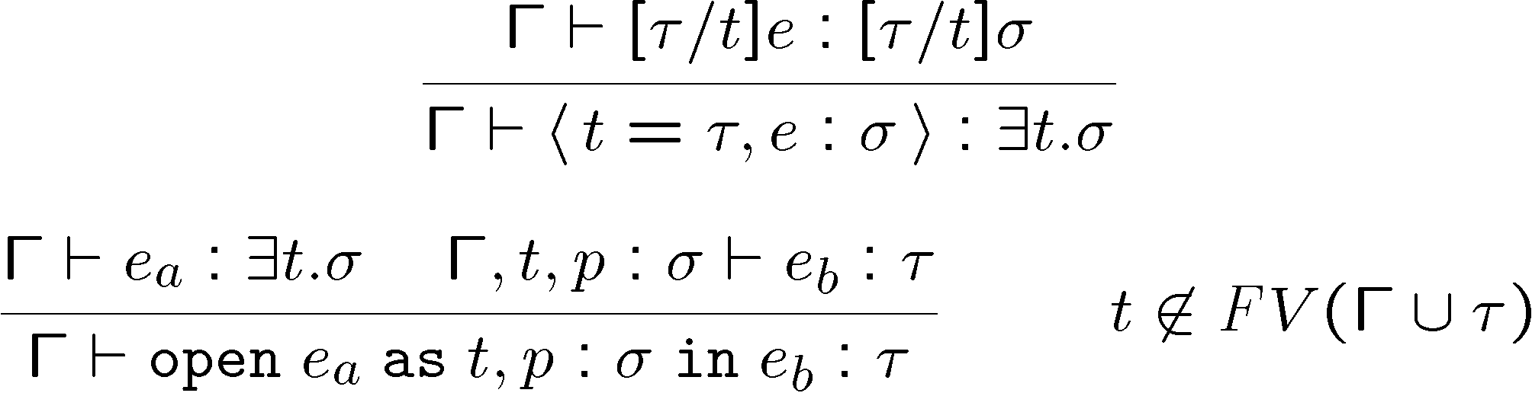
Typing Rules for Existential Types
We add the following typing rules:
The restriction in the rule for “open” ensures that t does not escape its scope

Slide 29
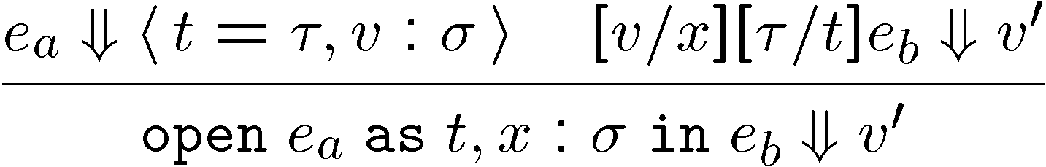
Evaluation Rules for Abstract Types
We add a new form of value
v ::= … | <t=τ, v : σ>
  This is just like v but with some type decorations that make it have an existential type
At the time e_{b} is evaluated, abstract-type variables are replaced with concrete values
  If we ignore the type issues “open e_{a} as t, x : σ in e_{b}” is like “let x : σ = e_{a} in e_{b}”
  Difference: e_{b} cannot know statically what is the concrete type of x so it cannot take advantage of it

Slide 30
Abstract Types as a Specification Mechanism
Just like polymorphism, existential types are mostly a type checking mechanism
A function of type 8t. t List ! int does not know statically what is the type of the list elements. Therefore no operations are allowed on them
  But it will have at run-time the actual value of t
  “There are no type variables at run-time”
Same goes for existentials
These type mechanisms are a very powerful (and widely used!) form of static checking
  Recall Wadler’s “Theorems for Free”

Slide 31
Data Abstraction and the Real World
Example: file descriptors
Solution 1:
  Represent file descriptors as “int” and export the interface {open:string!int, read:int! data}
An untrusted client of the interface calls “read”
How can we know that “read” is invoked with a file descriptor that was obtained from “open”? Anyone?

Slide 32
Data Abstraction and the Real World
Example: file descriptors
Solution 1:
  Represent file descriptors as “int” and export the interface {open:string!int, read:int! data}
An untrusted client of the interface calls “read”
How can we know that “read” is invoked with a file descriptor that was obtained from “open”?
  We must keep track of all integers that represent file descriptors
  We design the interface such that all such integers are small integers and we can essentially keep a bitmap
  This becomes expensive with more complex (e.g. pointer-based) representations

Slide 33
Data Abstraction, Static Checking
Solution 2: Use the same representation but export an abstraction of it.
  9fd. File or
  9fd. {open : string ! fd, read : fd ! data}
  A possible value:
  Fd = < fd = int, { open = …, read = …} : File> : 9fd. File
Now the untrusted client e
open Fd as fd, x : File in e
At run-time “e” can see that file descriptors are integers
  But cannot cast 187 as a file descriptor.
  Static checking with no run-time costs!
  Catch: you must be able to type check e!

Slide 34
Modularity
A module is a program fragment along with visibility constraints
Visibility of functions and data
  Specify the function interface but hide its implementation
Visibility of type definitions
  More complicated because the type might appear in specifications of the visible functions and data
  Can use data abstraction to handle this
A module is represented as a type component and an implementation component
<t = τ, e : σ> (where t can occur in e and σ)
  even though the specification (σ) refers to the implementation type we can still hide the latter
  But there are problems ...

Slide 35
Problems with Existentialists
Existentialist types
  Assert that truth is subjectivity
  Oppose the rational tradition and positivism
  Are subject to an “absurd” universe
Problems:
  "In so far as Existentialism is a philosophical doctrine, it remains an idealistic doctrine: it hypothesizes specific historical conditions of human existence into ontological and metaphysical characteristics. Existentialism thus becomes part of the very ideology which it attacks, and its radicalism is illusory." (Herbert Marcuse, "Sartre's Existentialism", p. 161)

Slide 36
Problems with Existentials
Existential types
  Allow representation (type) hiding
  Allow separate compilation. Need to know only the type of a module to compile its client
  First-class modules. They can be selected at run-time. (cf. OO interface subtyping)
Problems:
  Closed scope. Must open an existential before using it!
  Poor support for module hierarchies

Slide 37
Problems with Existentials (Cont.)
There is an inherent tension between handling modules in isolation (good for separate compilation, interchangeability) and the need to integrate them
Solution 1: open “point” at top level
  Inversion of program structure
  The most basic construct has the widest scope
point
rect
circle
(the arrow means “depends on”)
geometry

Slide 38
Give Up Abstraction?
Solution 2: incorporate point in rect and circle
R = < point = …, <rect = point £ point, …> … >
C = < point = …, <circle = point £ real, …> … >
When we open R and C we get two distinct notions of point!
  And we will not be able to combine them
Another option is to allow the type checker to see the representation type
  and thus give up representation hiding

Slide 39
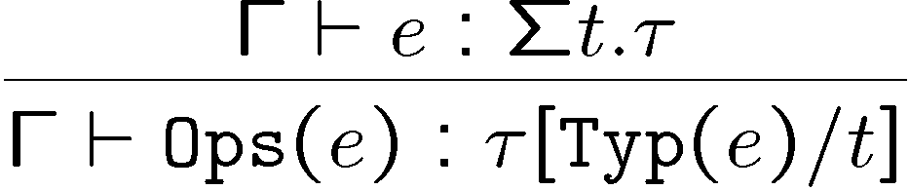
Strong Sums
New way to open a package
Terms e ::= ... | Ops(e)
Types τ ::= ... Σt.τ | Typ(e)
  Use Typ and Ops to decompose the module
  Operationally, they are just like “fst” and “snd”
  Σt.τ is the dependent sum type
  It is like 9t.τ except we can look at the type

Slide 40
Modularity with Strong Sums
Consider the R and C defined as before:
Pt = <point = real £ real, ...> : Σpoint. τ_{P}
R = <point = Typ(Pt),
< rect = point £ point, ...> : Σrect. τ_{R}
C = <point = Typ(Pt),
< circle = point £ real, ...> : Σcircle. τ_{C}
Since we use strong-sums the type checker sees that the two point types are the same

Slide 41
Modules with Strong Sums
ML’s module system is based on strong sums
Problems:
Poorer data abstraction
Expressions appear in types (Typ(e))
  Types might not be known until at run time
  Lost separate compilation
  Trouble if e has side-effects (but we can use a value restriction – e.g., “IntSet.t”)
Second-class modules (because of value restriction)
We can combine existentials with strong sums
  Translucent sums: partially visible

Slide 42
Homework
Project!
  You have ~22 days (including holidays) to complete it.
  Need help? Stop by my office or send email.

