Slide 1
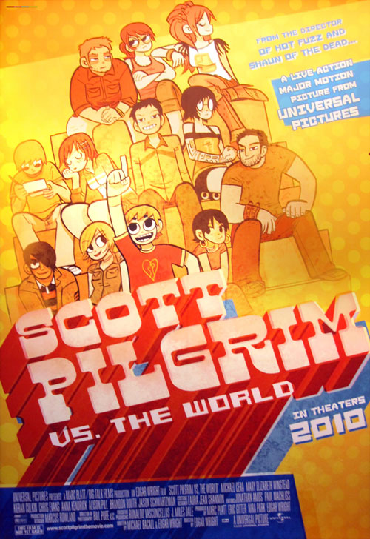
Grad PL vs.
The World

Slide 2
Grad PL Conclusions
You are now equipped to read the most influential papers in PL.
You can also recognize PL concepts and will know what to do when they come up in your research.

Slide 3
Questions
Model Checking, Abstraction Refinement, SLAM, Large-Step Opsem, Contextual Opsem, Structural Induction, Theorem Proving, Simplex, Proof Checking, Axiomatic Semantics, VCGen, Symbolic Execution, Invariant Detection, Abstract Interpretation, Lambda Calculus, Monomorphic and Polymorphic Type Systems, Recursive and Dependent Types, Pi Calculus, Machine Learning, Fault Localization, Program Repair, Instructor.

Slide 4
ACM SIGPLAN
Most Influential Paper Awards
SIGPLAN presents these awards to the author(s) of a paper presented at ICFP, OOPSLA, PLDI, and POPL held 10 years prior to the award year. The award includes a prize of $1,000 to be split among the authors of the winning paper. The papers are judged by their influence over the past decade. Each award is presented at the respective conference.

Slide 5
2008 (POPL 1998): From System F to Typed Assembly Language, Greg Morrisett, David Walker, Karl Crary, and Neal Glew.
... began a major development in the application of type system ideas to low level programming. The paper shows how to compile a high-level, statically typed language into TAL, a typed assembly language defined by the authors. The type system for the assembly language ensures that source-level abstractions like closures and polymorphic functions are enforced at the machine-code level while permitting aggressive, low-level optimizations such as register allocation and instruction scheduling. This infrastructure provides the basis for ensuring the safety of untrusted low-level code artifacts, regardless of their source. A large body of subsequent work has drawn on the ideas in this paper, including work on proof-carrying code and certifying compilers.

Slide 6
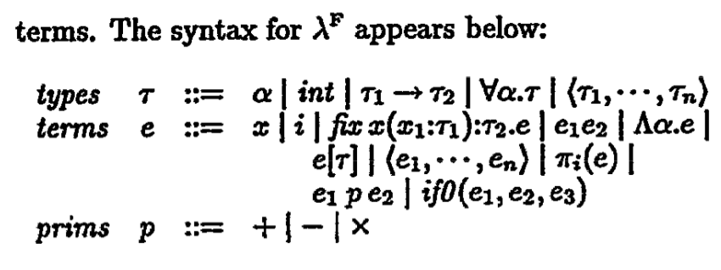
From System F to Typed Assembly Language
Polymorphic
Function Type
Tuple Type
Tuple Field
Selection
Polymorphic Function
Type Application
Polymorphic Function
Creation

Slide 7
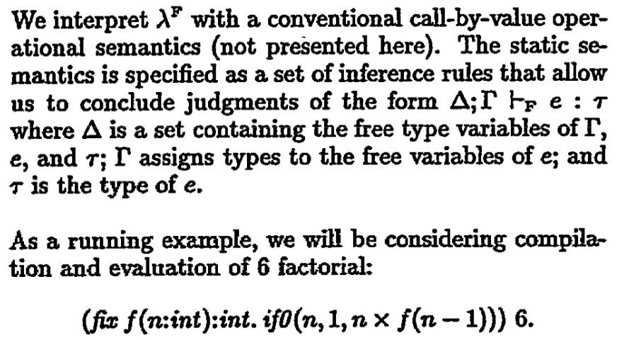
From System F to Typed Assembly Language
... but you know it.
Typing Judgment
What is “fix” like?

Slide 8
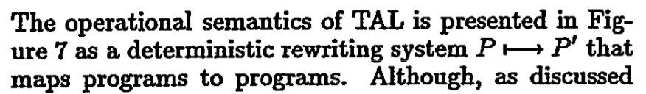
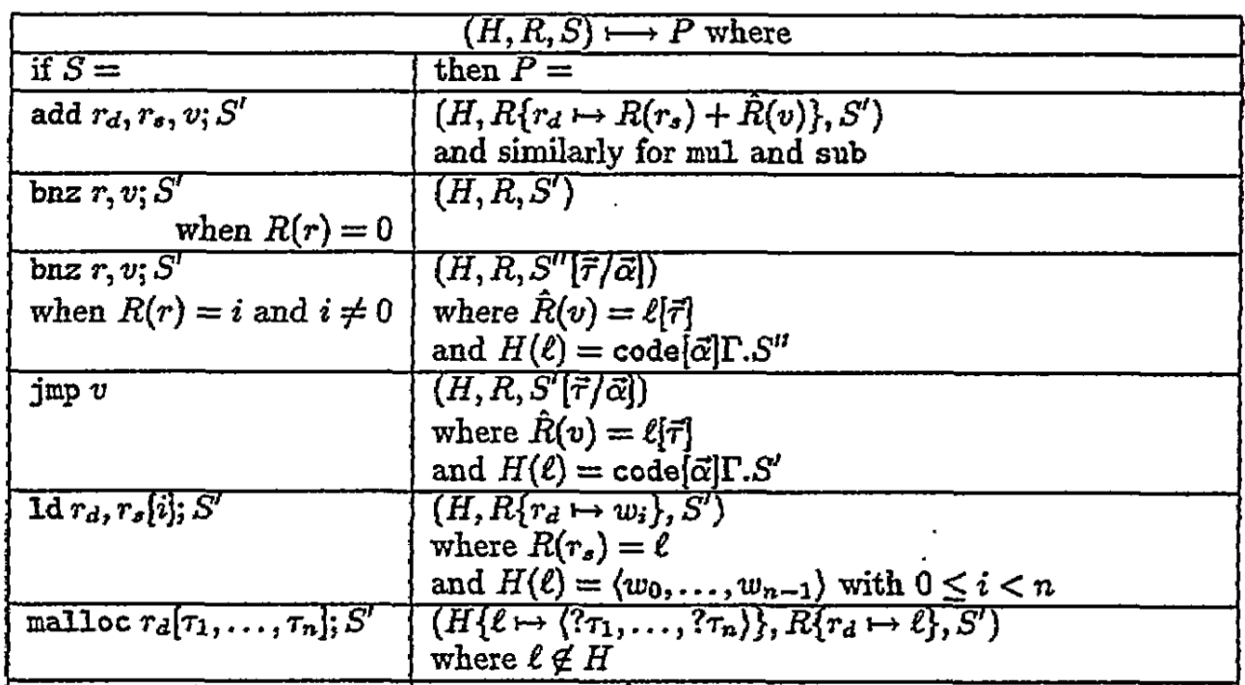
Operational Semantics,
Forward Symex
“ if false ... ; S' ”
“L” is fresh.
Small-step opsem
For allocation.

Slide 9
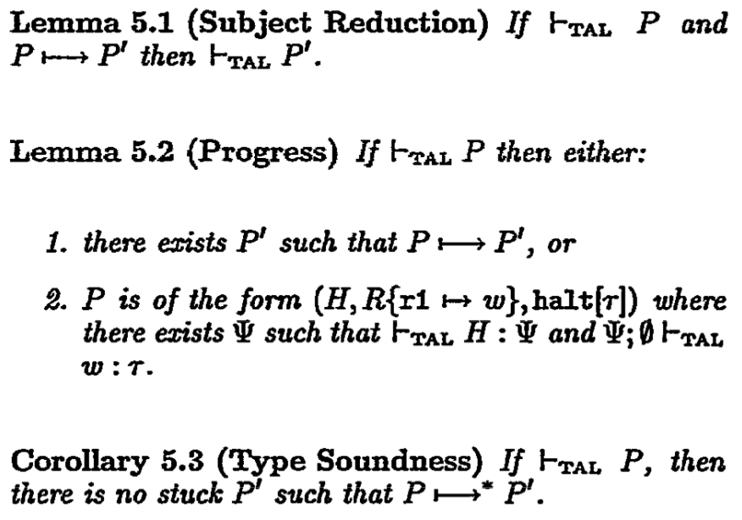
From System F to Typed Assembly Language
Type Preservation
cf. Decomposition

Slide 10
2011 (POPL 2001): Anytime, Anywhere: Modal Logics for Mobile Ambients, Luca Cardelli and Andrew D. Gordon.
... helped spur a flowering of work in the area of process calculi that continues today. The paper focused on modal logics for reasoning about both temporal and spacial modalities for ambient behaviours, demonstrating techniques that also apply to other process calculi (even those without an explicit notion of location), so contributing to excitement in an area that was growing at that time and continues. The work has led to application of concurrency theory in fields as diverse as security, safety critical applications, query languages for semistructured data, and systems biology.

Slide 11
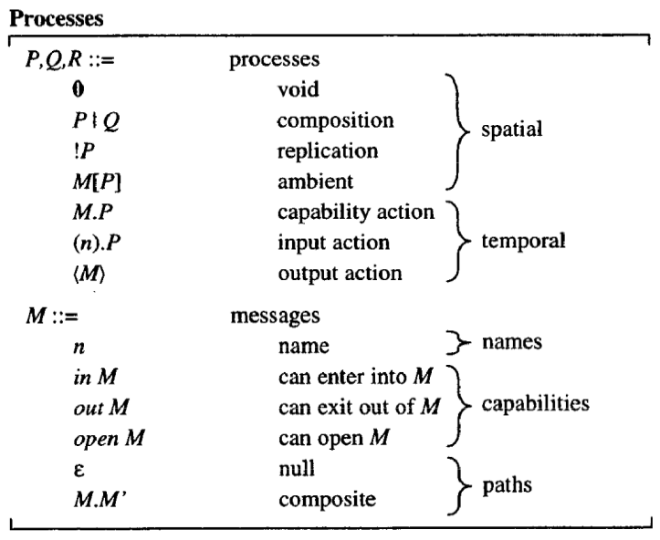
Anytime, Anywhere: Modal Logics for Mobile Ambients
“Pi Calculus”-esque
cf. pi send and receive

Slide 12
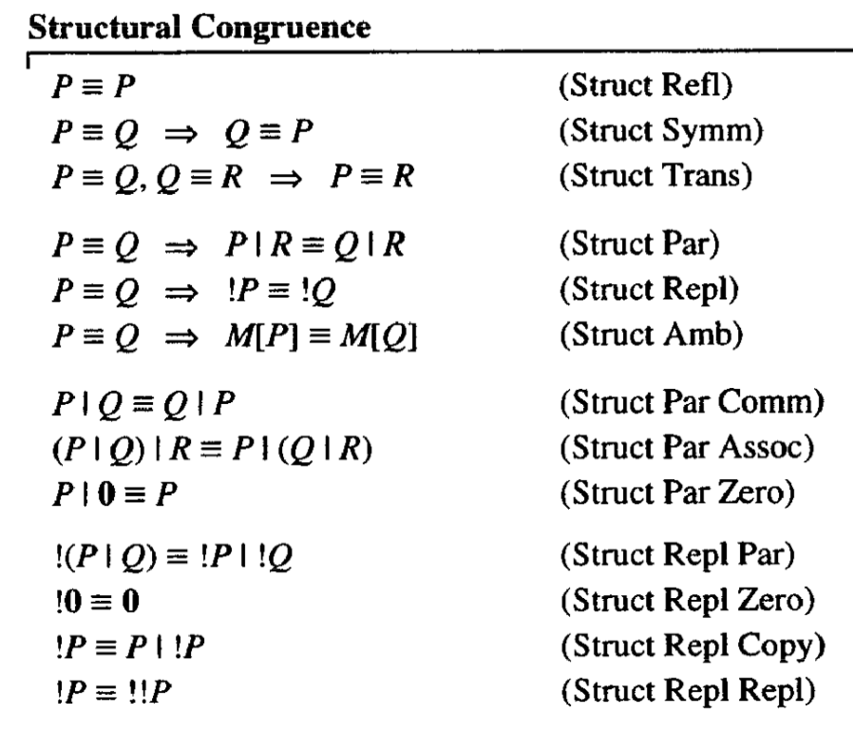
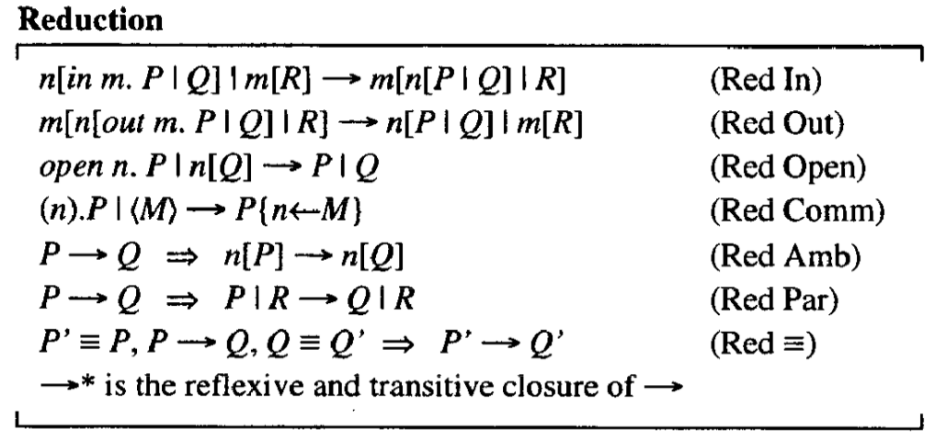
Anytime, Anywhere: Modal Logics for Mobile Ambients
Pi Calculus
Synchronous Rendezvous

Slide 13
2011 (PLDI 2001): Automatic predicate abstraction of C programs, Thomas Ball, Rupak Majumdar, Todd Millstein, Sriram K. Rajamani.
... presented the underlying predicate abstraction technology of the SLAM project for checking that software satisfies critical behavioral properties of the interfaces it uses and to aid software engineers in designing interfaces and software that ensure reliable and correct execution. The technology is now part of Microsoft's Static Driver Verifier in the Windows Driver Development Kit. This is one of the earliest examples of automation of software verification on a large scale and the basis for numerous efforts to expand the domains that can be verified.

Slide 14
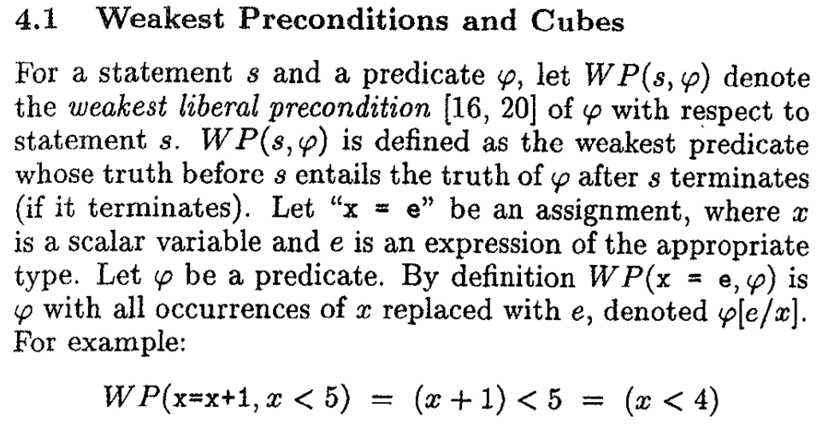
Automatic predicate abstraction of C programs
Axiomatic
Semantics

Slide 15
2009 (PLDI 1999): A Fast Fourier Transform Compiler, Matteo Frigo
... describes the implementation of genfft, a special-purpose compiler that produces the performance critical code for a library, called FFTW (the “Fastest Fourier Transform in the West”), that computes the discrete Fourier transform. FFTW is the predominant open fast Fourier transform package available today, as it has been since its introduction a decade ago. genfft demonstrated the power of domain-specific compilation—FFTW achieves the best or close to best performance on most machines, which is remarkable for a single package. By encapsulating expert knowledge from the FFT algorithm domain and the compiler domain, genfft and FFTW provide a tremendous service to the scientific and technical community by making highly efficient FFTs available to everyone on any machine. As well as being the fastest FFT in the West, FFTW may be the last FFT in the West as the quality of this package and the maturity of the field may mean that it will never be superseded, at least for computer architectures similar to past and current ones.

Slide 16
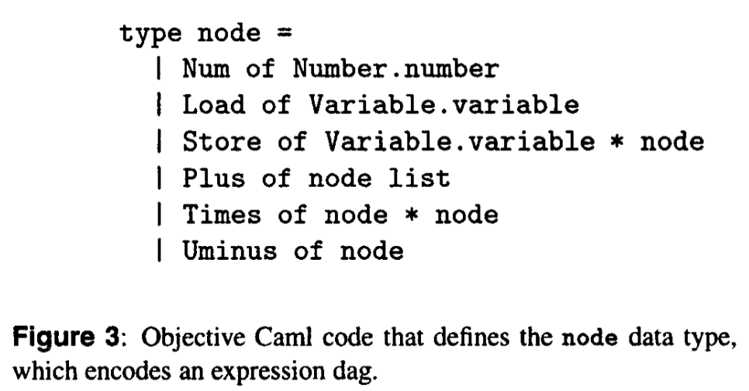
A Fast Fourier
Transform Compiler
No joke. cf. HW5

Slide 17
2014 (POPL 2004): Abstractions from proofs, Thomas Henzinger, Ranjit Jhala, Rupak Majumdar, and Kenneth McMillan.
... the authors demonstrated a fundamental generalization of Craig interpolation to program analysis by predicate abstraction, opening the door for interpolation to be applied to abstraction refinement of infinite-state systems. This work showed how interpolation offers a fundamental way to explain abstraction refinement in a logical framework and has led to many extensions to increase the power of abstraction in program analysis.

Slide 18
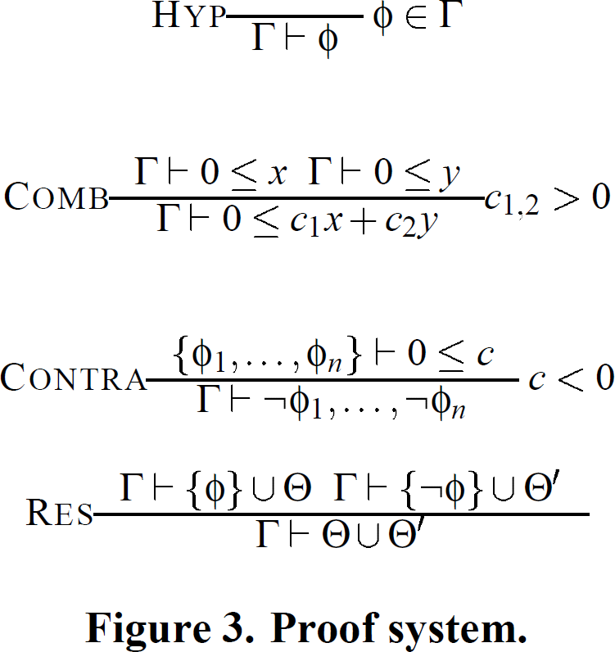
Side
Condition
Proof Checking,
Abstract
Interpretation
P -> False
---------------
!P
P -> X, !P -> Y
---------------------
X || Y

Slide 19
2012 (PLDI 2002): Extended Static Checking for Java, Cormac Flanagan, K. Rustan M. Leino, Mark Lillibridge, Greg Nelson, James B. Saxe, Raymie Stata
... marks a turning point in the field of static checking, describing pragmatic design decisions that promote practicality over completeness. Pioneered in ESC/Modula-3, techniques from ESC/Java are now widely used in various forms in Microsoft’s development tools, notably as part of Code Contracts which ships with VisualStudio. Recent innovations strongly influenced by ESC/Java include refinement types for Haskell, and verification of Eiffel programs.

Slide 20
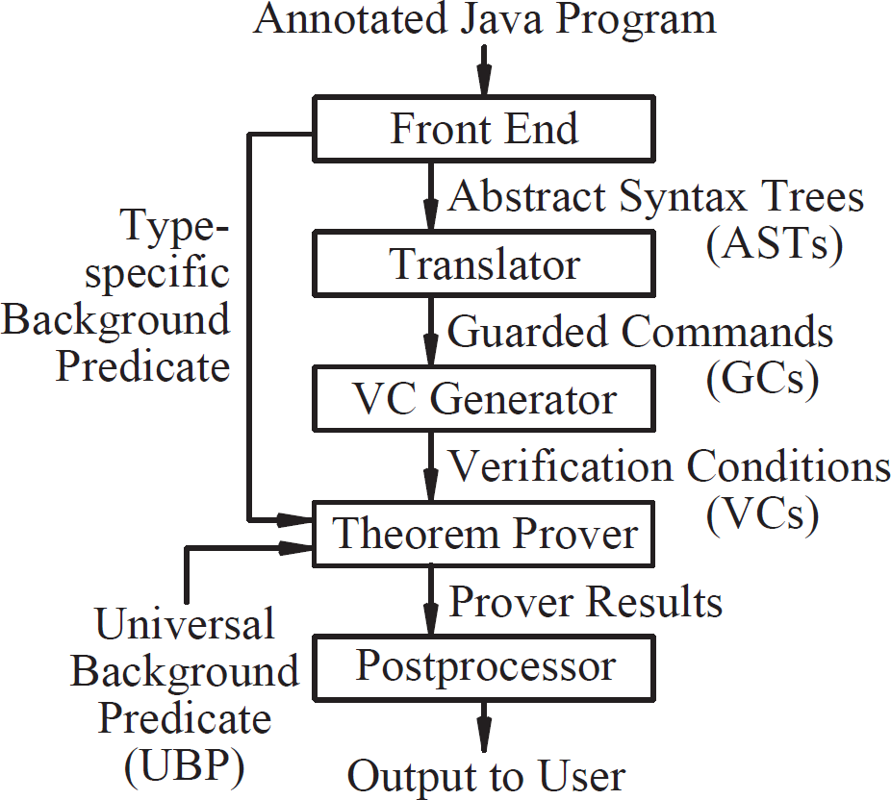
Invariant
Generation
HW5
(Path Enum)
Axiomatic
Semantics
Automated
Theorem Proving

Slide 21
2014 (POPL 2004): Abstractions from proofs, Thomas Henzinger, Ranjit Jhala, Rupak Majumdar, and Kenneth McMillan.
... the authors demonstrated a fundamental generalization of Craig interpolation to program analysis by predicate abstraction, opening the door for interpolation to be applied to abstraction refinement of infinite-state systems. This work showed how interpolation offers a fundamental way to explain abstraction refinement in a logical framework and has led to many extensions to increase the power of abstraction in program analysis.

Slide 22
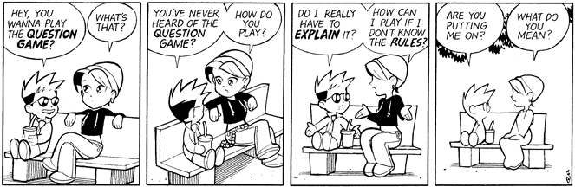
Your Questions

Slide 23
Grad PL Conclusions
You are now equipped to read the most influential papers in PL.
You can also recognize PL concepts and will know what to do when they come up in your research.

