Slide 1
Automated Program Repair

Slide 2
Motivation
Software maintenance is expensive
  Up to 90% of the cost of software
    [Seacord]
  Up to $70 Billion per year in US
    [Jorgensen, Sutherland]
  Bug repair is the majority of maintenance
    [Erlikh, Ramamoothy, Williamson]
Bugs are ubiquitous
  Outstanding bugs exceed the resources available to address them
    [Anvik, Liblit]

Slide 3
Fixing Bugs Early Would Help
The cost of a defect is $25 during the coding phase, $100 during the build phase, $450 during the QA/testing phase, and $16,000 once released as a product.
  Leigh Williamson, IBM Distinguished Engineer
On average, a software vendor loses 0.63% of its market value on the day of any vulnerability announcement.
  [Telang and Wattal]

Slide 4
Fixing Many Bugs Would Help
“Everyday, almost 300 bugs appear ... far too much for only the Mozilla programmers to handle.”
  Mozilla Developer [Anvik]

Slide 5
Central Claim
We can automatically repair certain classes of bugs in off-the-shelf, unannotated legacy software.
  We can automatically repair many types of high-impact security bugs.
  We can automatically repair many “general software engineering” bugs.

Slide 6
Insights
Given a buggy program, search the space of nearby programs until a valid repair is found.
Use test cases to encode the program specification and the defect
Find nearby programs by mimicking human edits and leveraging existing human insight
Reduce the search space by restricting attention to areas likely to contain the bug
Genetic programming guides the search, tolerating noise and admitting parallelism

Slide 7
Correctness
Testing gives confidence that a program implementation adheres to its specification (as refined from its requirements).
Loosely, in the Oracle-Comparator model, a test case includes:
  A Test Input
  An Oracle Answer (expected answer)
  A Comparator (is an answer close enough?)
The current bug is demonstrated by a test case that currently fails

Slide 8
Fault Localization
Even in large programs, not every component is equally likely to contribute to a given fault
Given a program, a bug, and a test suite, fault localization produces a mapping from program components to weights
  “High weight” means “likely related to the bug”
Many techniques exist
  [Renieris and Reiss, Jones and Harrold]
Loosely: print statement debugging, note all statements only visited on bug test case

Slide 9
Fix Localization
There are a large number of ways to change a given statement
  e.g., deleting it, adding more code to it, replacing it with something completely different, etc.
When inserting, we leverage human insight by using code from elsewhere in the program
  Program is probably correct elsewhere [Engler]
Simple Operations: Insert, Replace, Delete
Fix localization is the set of things to insert

Slide 10
Genetic Algorithm Overview
Genetic Programming is a search heuristic
  Based on a computational analog of biology
  Represent solutions to the problem (genotypes)
  Uses a population of variant solutions
  Applies simple mutations
  Evaluate the fitness of a variant (phenotype)
  High-fitness variants survive and mate (crossover)
  Repeat until a solution is found

Slide 11
Patch Representation
A patch is represented as a list of edits
Edits are statement-level operations
  Example: < Delete(5), Insert(33,2) >
Mutation: add to edit list
  Choose a statement X from Fault Localization
  Choose: Delete X or Insert(X,FixLocalization(X)) or Replace(X,FixLocalization(X))
Crossover: random sublist of parent lists
Fitness: print out patched program, run tests

Slide 12
Overall Repair Algorithm
Input: Program P, Test Suite T
Loc := Compute Fault and Fix Localizations
Population := n random mutants of P
Repeat Until Solution Found:
  HighFit := Select(Population, n, T)
  Offspring := Crossover(HighFit)
  Population := Mutate(HighFit + Offspring, Loc)

Slide 13
Example: GCD
void print_gcd(int a, int b) {
if (a == 0)
printf(“%d”, b);
while (b != 0) {
if (a > b)
a = a – b;
else
b = b – a;
}
printf(“%d”, a);
return;
}
Bug: when
a==0 and b>0,
it loops forever!

Slide 14
Example: Representation
{ block }
if (a==0)
while
(b != 0)
printf(... a)
return
{ block }
{ block }
{ block }
if
(isLeapYear)
printf(... b)
if
(a > b)
{ block }
{ block }
a = a - b
b = b - a

Slide 15
Example: Fault Location
{ block }
if (a==0)
while
(b != 0)
printf(... a)
return
{ block }
{ block }
{ block }
if
(isLeapYear)
printf(... b)
if
(a > b)
{ block }
{ block }
Fault Localization:
(printf ...b)
a = a - b
b = b - a

Slide 16
Example: Mutation (1/2)
{ block }
if (a==0)
while
(b != 0)
printf(... a)
return
{ block }
{ block }
{ block }
if
(isLeapYear)
printf(... b)
if
(a > b)
{ block }
{ block }
a = a - b
b = b - a

Slide 17
Example: Mutation (2/2)
{ block }
if (a==0)
while
(b != 0)
printf(... a)
return
{ block }
{ block }
{ block }
if
(isLeapYear)
printf(... b)
return
if
(a > b)
{ block }
{ block }
a = a - b
b = b - a

Slide 18
Example: Final Repair
{ block }
if (a==0)
while
(b != 0)
printf(... a)
return
{ block }
{ block }
{ block }
if
(isLeapYear)
printf(... b)
return
if
(a > b)
{ block }
{ block }
a = a - b
b = b - a

Slide 19
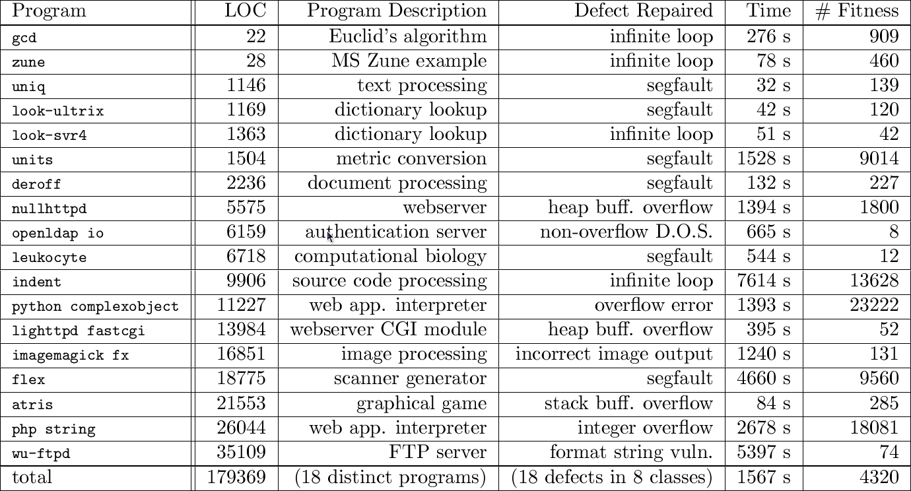
Initial Program Repair Results

Slide 20
Research Questions
Your results may not generalize to my situation because the programs and bugs I deal with ...
  Have huge, long-running test suites (scalability)
  Require high quality repairs (expressive power, overfitting)
  Do not have source code (input assumptions, expressive power)
  Are large and indicative (overfitting)
  Require an economic business case

Slide 21
Large Test Suites and Fitness
Thus far, test cases both
  Validate a variant as a final repair
  and also Determine which variants are retained
What if there are 100+ test cases?
Idea:
  Use all tests to validate final repairs
  Sample some tests to decide which variants are retained into the next iteration

Slide 22
Large Test Suites
Use test suite selection techniques
  Or random sampling
Sampling reduces repair time by 81%
  First evaluation on 10 bugs, 1200+ test cases
“leukocyte was repaired in 6 minutes instead of over 90 minutes ... and imagemagick was repaired in 3 minutes instead of 36”
Helps performance and correctness

Slide 23
Repair Quality
Produced repairs pass all tests + minimization
Objective measures
  Retains required functionality
  Does not introduce new bugs
  Is not a “fragile memorization” of buggy input
Subjective measures
  Code review
  Assurance argument

Slide 24
Repair Quality Benchmarks
Two webservers with buffer overflows
  nullhttpd, lighttpd
  138,226 held-out requests from 12,743 clients
One web app language interpreter
  php (integer overflow vulnerability)
  15 kLOC secure reservation system web app
  12,375 requests (held out)

Slide 25
Repair Quality Experiments
Conduct repairs
  Using ~10 test cases
Evaluate repairs
  Using all held-out test cases
  Need same result bit-for-bit in same time or less
  Also evaluate using held-out fuzz testing

Slide 26
Repair Quality Results

Slide 27
Repair Quality Results

Slide 28
Repair Quality Results

Slide 29
Cherry Picking
Thus far, all repaired programs were chosen arbitrarily by the authors
  That is, the benchmark set may not be a representative sample of real-world programs
Let's address that and program size concerns in one fell swoop with a systematic study
  Use version control, take entire ranges of versions
  Find all reproducible bugs within that range
  Must be important enough for devs to fix and test
  Try to repair them all

Slide 30
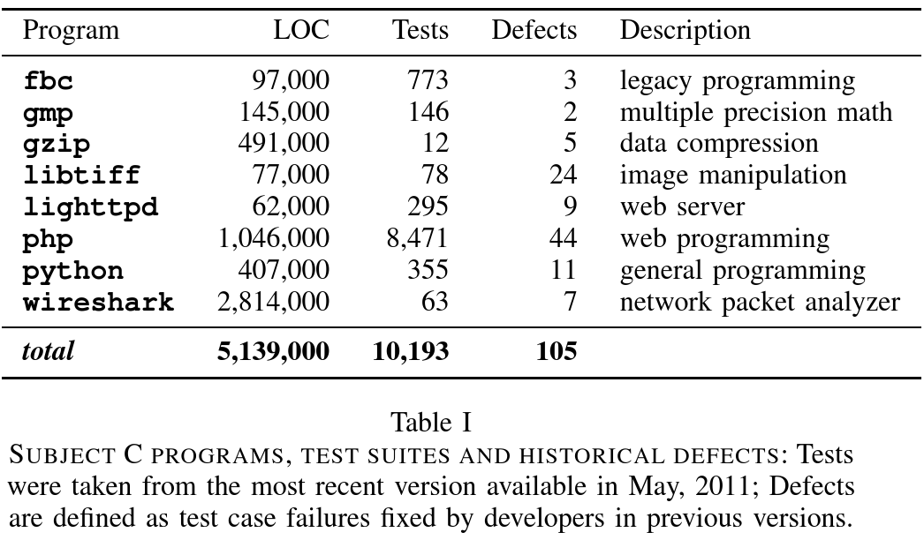
“Many Bugs” Benchmarks

Slide 31
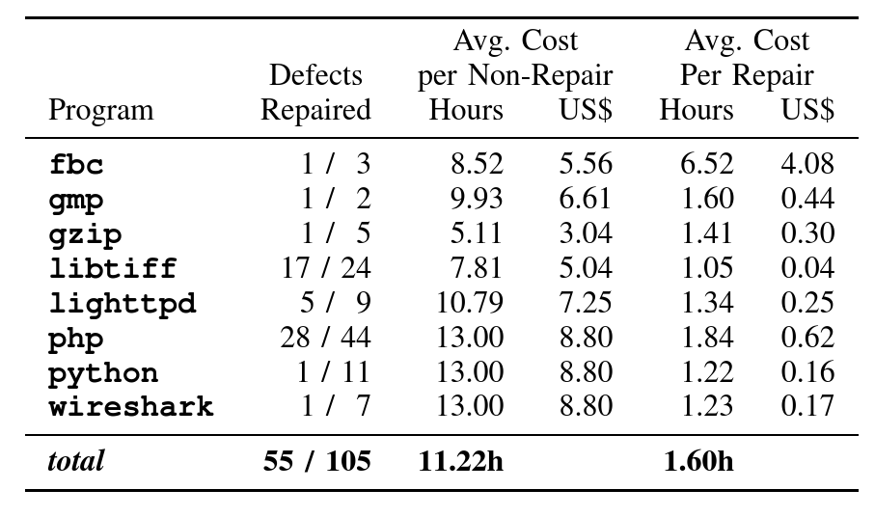
“Many Bugs” Results
Results can be reproduced for $403; successful repairs cost $7.32 on average.

Slide 32
Repair Quality and Bug Bounties
All patches pass all available tests (e.g., 8471)
Humans can still inspect patches [Weimer]
  If this cuts developer time in half, the economic argument still holds ($25 vs. $25/2 + $7.32)
One commercial developer paid $1,625 for
    63 repairs to “harmless” severity bugs
    11 repairs to “minor” severity bugs, 1 repair to “major”
    125 “false positive” candidate patches
    Avg: $21 per non-trivial repair, one every 40 hours
    “Worth the money? Every penny.”
    http://www.daemonology.net/blog/2011-08-26-1265-dollars-of-tarsnap-bugs.html

Slide 33
Project Scope
Two workshop paper (FoSER, SBST)
Two journal paper (TSE, Comm. ACM)
Four conference papers (ASE, ASE, GECCO, ICSE)
Three best paper awards (ICSE, GECCO, SBST)
Some associated papers (SIGGRAPH, etc.)
IFIP TC2 Manfred Paul Award (1024 Euros)
Gold Human Competitive Award ($5000)
Four grant proposal awards
... since 2009.

Slide 34
Discussion Section
Possible stories:
Boring grant meeting
Fail Early
Bug finding fatigue
Early experimental result problems
Don't be all things to all people
Dagstuhl Seminar
Tom Ball predictions

Slide 35
Homework
Project Writeup Due!
  Need help? Stop by my office or send email.
Project Presentation Due

