Slide 1
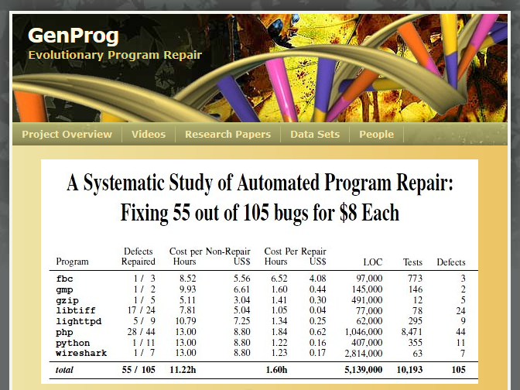
Automated
Program Repair

Slide 2
Lecture Outline
Automated Program Repair
Historical Context, Recent Advances
Mistakes
Opportunities

Slide 3
Speculative Fiction
What if large, trusted
companies paid strangers
to find and fix their
normal and critical bugs?

Slide 4
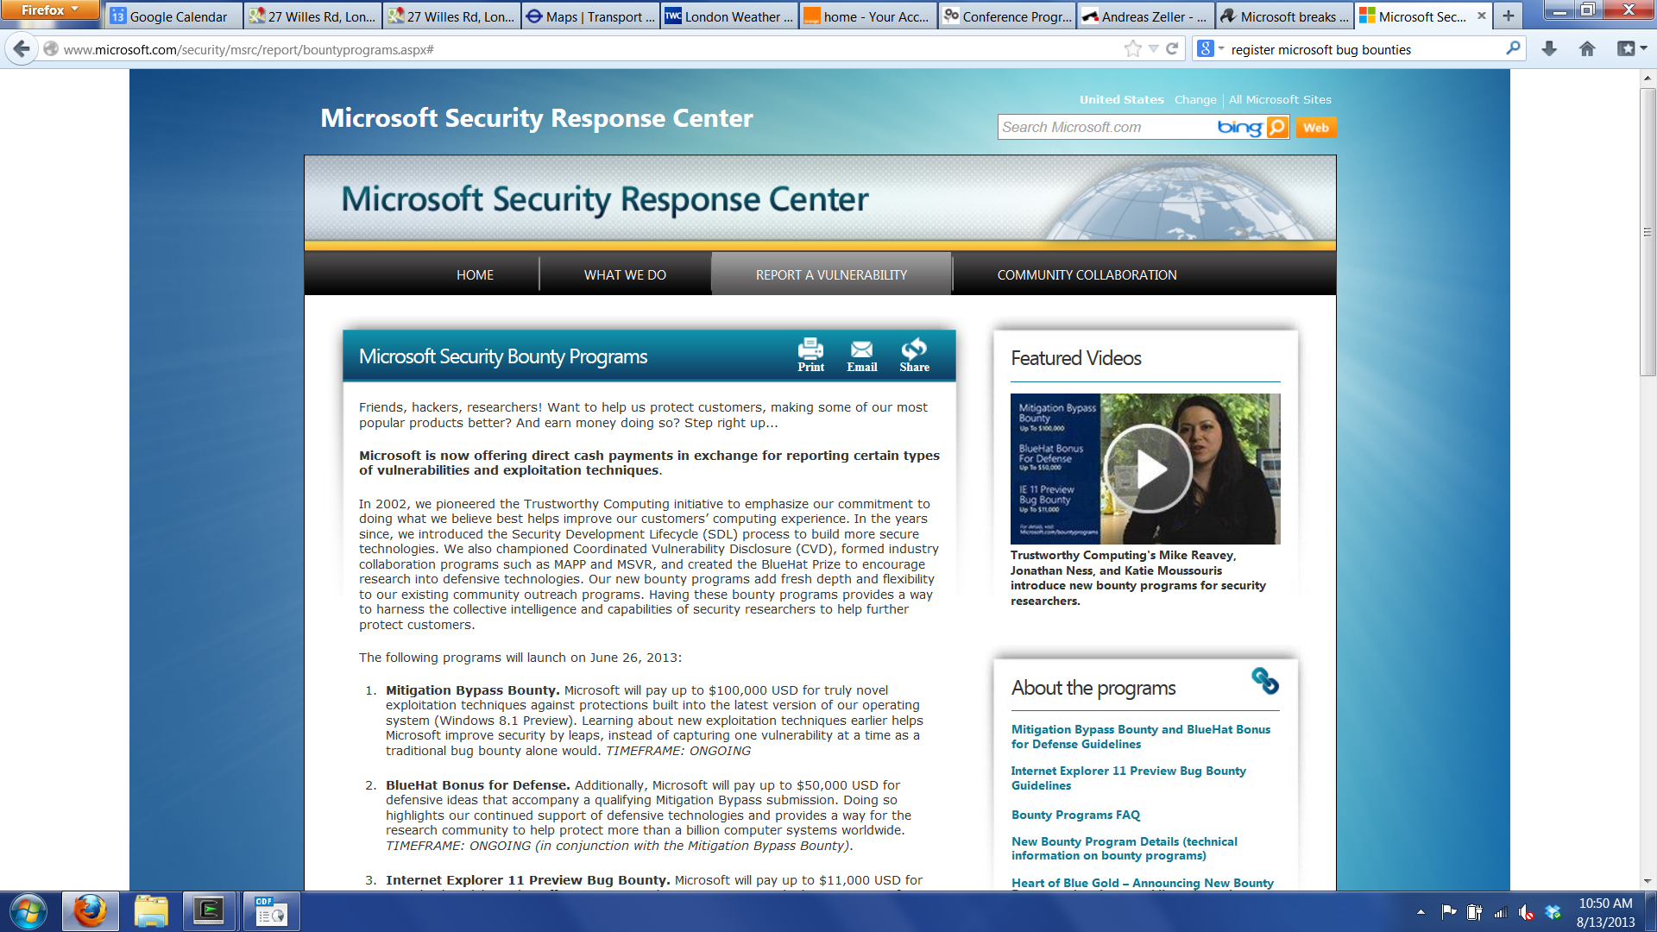

Slide 5


Slide 6
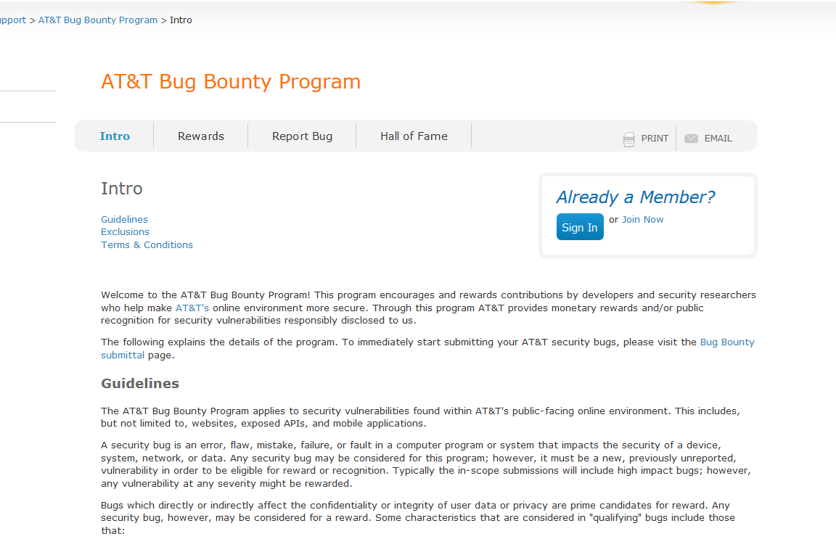

Slide 7
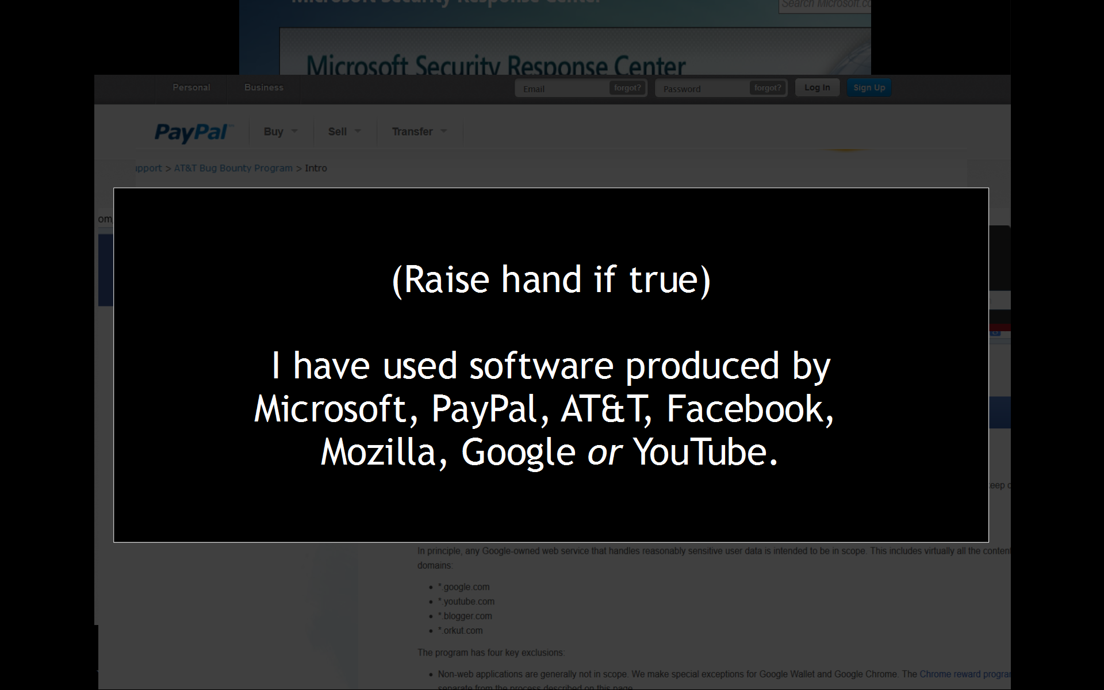

Slide 8
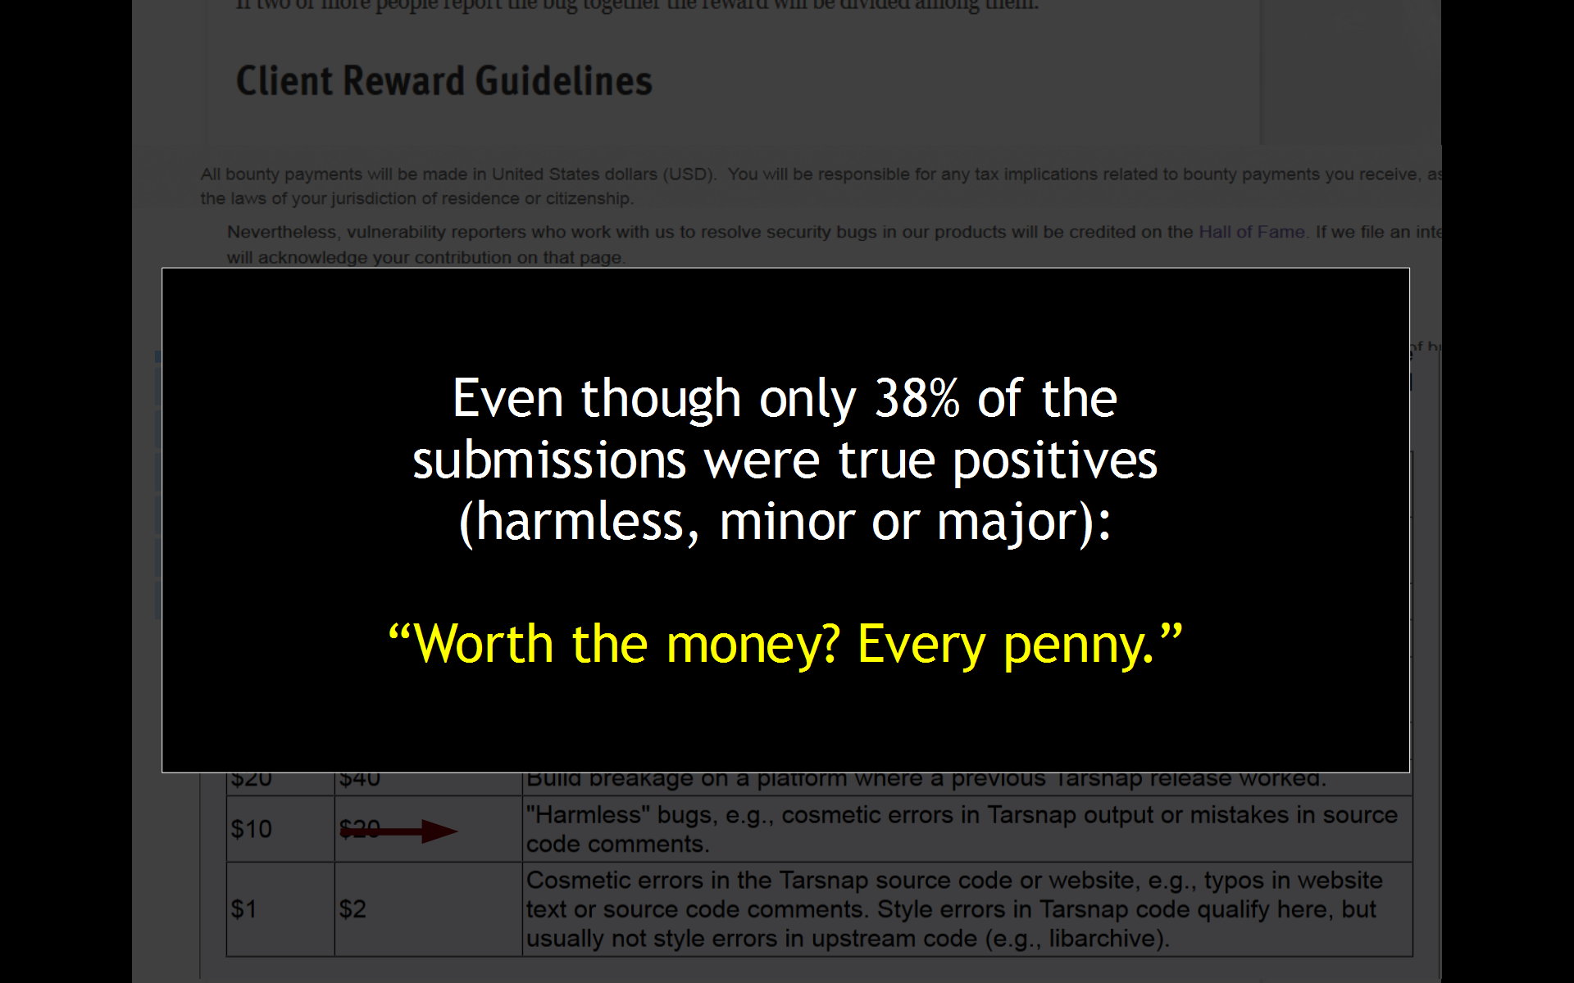

Slide 9
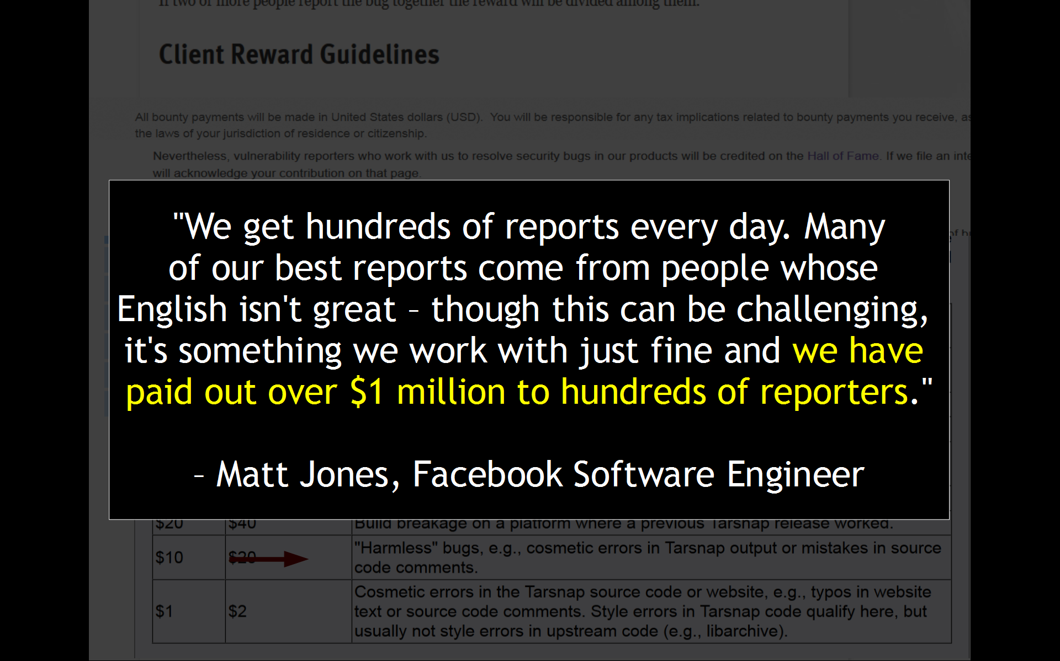

Slide 10
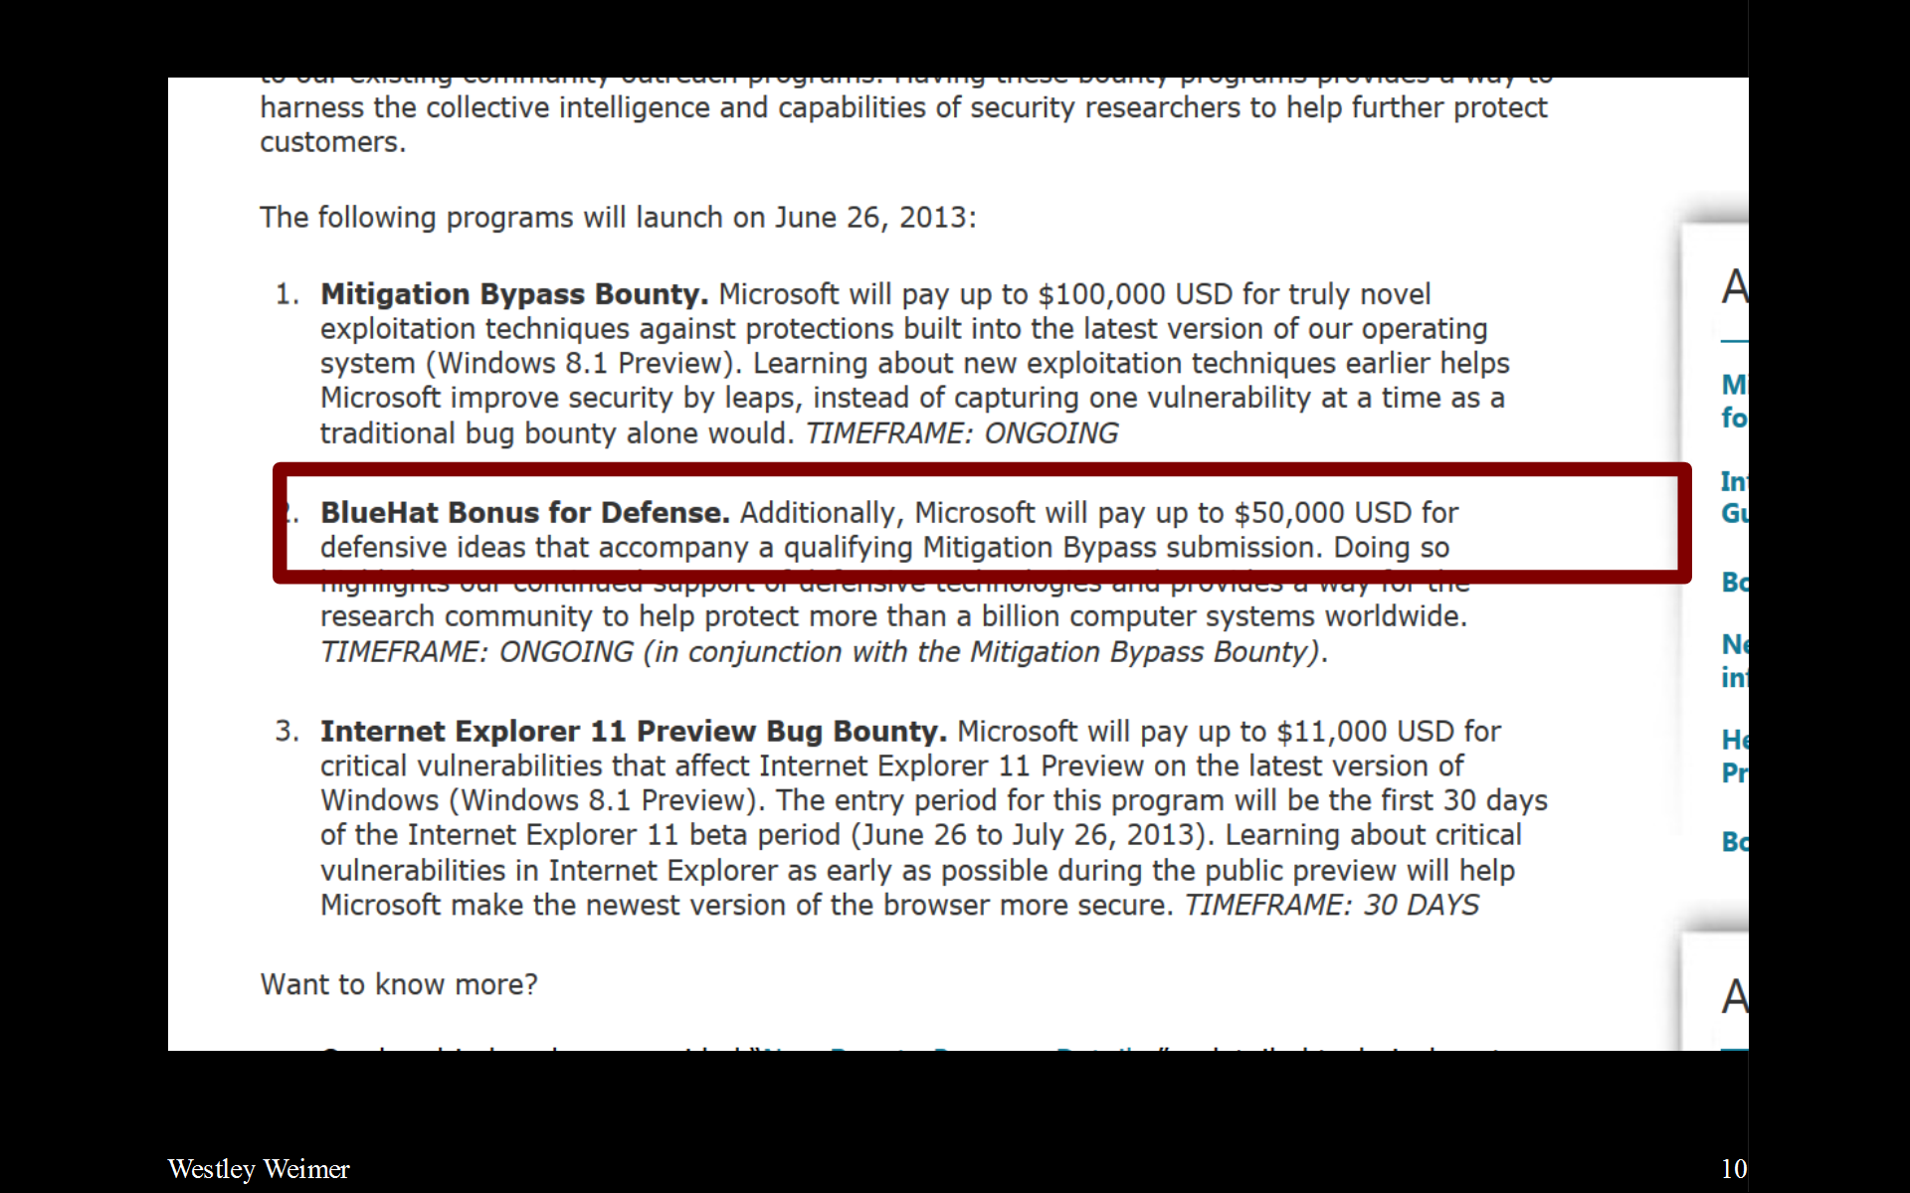

Slide 11
A vision of the future present
Finding, fixing and ignoring
bugs are all so expensive
that it is now economical
to pay untrusted strangers
to submit candidate defect reports and patches.

Slide 12
A Modest Proposal
Automatically find and fix defects (rather than, or in addition to, paying strangers).

Slide 13
Outline
Automated Program Repair
The State of the Art
  Scalability and Recent Growth
  Recent GenProg Advances
GenProg Lessons Learned (the fun part)
Challenges & Opportunities

Slide 14

Historical Context

Slide 15
“We are moving to a new era where software systems are open, evolving and not owned by a single organization. Self-* systems are not just a nice new way to deal with software, but a necessity for the coming systems. The big new challenge of self-healing systems is to guarantee stability and convergence: we need to be able to master our systems even without knowing in advance what will happen to them.”
– Mauro Pezzè, Milano Bicocca / Lugano

Slide 16
Historical Context
<= 1975 “Software fault tolerance”
  Respond with minimal disruption to an unexpected software failure. Often uses isolation, mirrored fail-over, transaction logging, etc.
~1998: “Repairing one type of security bug”
  [ Cowan, Pu, Maier, Walpole, Bakke, Beattie, Grier, Wagle, Zhang, Hinton. StackGuard: Automatic adaptive detection and prevention of buffer-overflow attacks. USENIX Security 1998. ]
~2002: “Self-healing (adaptive) systems”
  Diversity, redundancy, system monitoring, models
  [ Garlan, Kramer, Wolf (eds). First Workshop on Self-Healing Systems, 2002. ]

Slide 17
Why not just restart?
Imagine two types of problems:
  Non-deterministic (e.g., environmental): A network link goes down, send() raises an exception
  Deterministic (e.g., algorithmic): The first line of main() dereferences a null pointer
Failure-transparent or transactional approaches usually restart the same code
  What if there is a deterministic bug in that code?

Slide 18

Checkpoint and Restart
[ Lowell, Chandra, Chen: Exploring Failure Transparency and the Limits of Generic Recovery. OSDI 2000. ]

Slide 19

Groundhog Day
[ Lowell, Chandra, Chen: Exploring Failure Transparency and the Limits of Generic Recovery. OSDI 2000. ]

Slide 20
Early “Proto” Program Repair Work
1999: Delta debugging [ Zeller: Yesterday, My Program Worked. Today, It Does Not. Why? ESEC / FSE 1999. ]
2001: Search-based software engineering [ Harman, Jones. Search based software engineering. Information and Software Technology, 43(14) 2001 ]
2003: Data structure repair
  Run-time approach based on constraints [ Demsky, Rinard: Automatic detection and repair of errors in data structures. OOPSLA 2003. ]
2006: Repairing safety policy violations
  Static approach using formal FSM specifications [ Weimer: Patches as better bug reports. GPCE 2006. ]
2008: Genetic programming proposal [ Arcuri: On the automation of fixing software bugs. ICSE Companion 2008. ]

Slide 21
General Automated Program Repair
Given a program …
  Source code, assembly code, binary code
… and evidence of a bug …
  Passing and failing test cases, implicit specifications and crashes, preconditions and invariants, normal and anomalous runs
… fix that bug.
  A textual patch, a dynamic jump to new code, run-time modifications to variables

Slide 22
How could that work?
Many faults can be localized to a small area
  [ Jones, Harrold. Empirical evaluation of the Tarantula automatic fault-localization technique. ASE 2005. ]
  [ Qi, Mao, Lei, Wang. Using Automated Program Repair for Evaluating the Effectiveness of Fault Localization Techniques. ISSTA 2013. ]
Many defects can be fixed with small changes
  [ Park, Kim, Ray, Bae: An empirical study of supplementary bug fixes. MSR 2012. ]
Programs can be robust to such changes
  “Only attackers and bugs care about unspecified, untested behavior.”
  [ Schulte, Fry, Fast, Weimer, Forrest: Software Mutational Robustness. J. GPEM 2013. ]

Slide 23
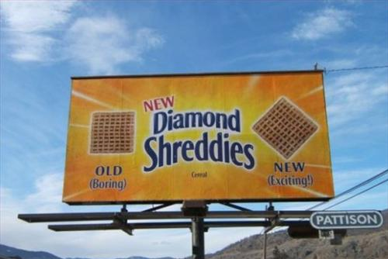
Scalability
and
Recent Growth

Slide 24
2009: A Banner Year
GenProg
  Genetic programming evolves source code until it passes the rest of a test suite. [ Weimer, Nguyen, Le Goues, Forrest: Automatically finding patches using genetic programming. ICSE May 2009. ]
ClearView
  Detects normal workload invariants and anomalies, deploying binary repairs to restore invariants. [ Perkins, Kim, Larsen, Amarasinghe, Bachrach, Carbin, Pacheco, Sherwood, Sidiroglou, Sullivan, Wong, Zibin, Ernst, Rinard: Automatically patching errors in deployed software. SOSP Oct 2009. ]
PACHIKA
  Summarizes test executions to behavior models, generating fixes based on the differences. [ Dallmeier, Zeller, Meyer: Generating Fixes from Object Behavior Anomalies. ASE Nov 2009. ]

Slide 25
















INPUT
EVALUATE FITNESS
DISCARD
ACCEPT
X
GenProg
MUTATE
OUTPUT

Slide 26
2009 In A Nutshell
Given a program and tests (or a workload)
  Normal observations: A B C or A B C D
A problem is detected
  Failing observations: A B X C
The difference yields candidate repairs
  { “Don't do X”, “Always do D” }
One repair passes all tests
  Report “Don't do X” as the patch

Slide 27
Two Broad Repair Approaches
Single Repair or “Correct by Construction”
  Careful consideration (constraint solving, invariant reasoning, lockset analysis, type systems, etc.) of the problem produces a single good repair.
Generate-and-Validate
  Various techniques (mutation, genetic programming, invariant reasoning, etc.) produce multiple candidate repairs.
  Each candidate is evaluated and a valid repair is returned.

Slide 28
Name | Subjects | Tests | Bugs | Notes
AFix | 2 Mloc | – | 8 | Concurrency, guarantees
ARC | – | – | – | Concurrency, SBSE
ARMOR | 6 progs. | – | 3 + – | Identifies workarounds
Axis | 13 progs. | – | – | Concurrency, guarantees, Petri nets
AutoFix-E | 21 Kloc | 650 | 42 | Contracts, guarantees
CASC | 1 Kloc | – | 5 | Co-evolves tests and programs
ClearView | Firefox | 57 | 9 | Red Team quality evaluation
Coker Hafiz | 15 Mloc | – | 7 / – | Integer bugs only, guarantees
Debroy Wong | 76 Kloc | 22,500 | 135 | Mutation, fault localization focus
Demsky et al. | 3 progs. | – | – | Data struct consistency, Red Team
FINCH | 13 tasks | – | – | Evolves unrestricted bytecode
GenProg | 5 Mloc | 10,000 | 105 | Human-competitive, SBSE
Gopinath et al. | 2 methods. | – | 20 | Heap specs, SAT
Jolt | 5 progs. | – | 8 | Escape infinite loops at run-time
Juzi | 7 progs. | – | 20 + – | Data struct consistency, models
PACHIKA | 110 Kloc | 2,700 | 26 | Differences in behavior models
PAR | 480 Kloc | 25,000 | 119 | Human-based patches, quality study
SemFix | 12 Kloc | 250 | 90 | Symex, constraints, synthesis
Sidiroglou et al. | 17 progs. | – | 17 | Buffer overflows

Slide 29
Name | Subjects | Tests | Bugs | Notes
AFix | 2 Mloc | – | 8 | Concurrency, guarantees
ARC | – | – | – | Concurrency, SBSE
ARMOR | 6 progs. | – | 3 + – | Identifies workarounds
Axis | 13 progs. | – | – | Concurrency, guarantees, Petri nets
AutoFix-E | 21 Kloc | 650 | 42 | Contracts, guarantees
CASC | 1 Kloc | – | 5 | Co-evolves tests and programs
ClearView | Firefox | 57 | 9 | Red Team quality evaluation
Coker Hafiz | 15 Mloc | – | 7 / – | Integer bugs only, guarantees
Debroy Wong | 76 Kloc | 22,500 | 135 | Mutation, fault localization focus
Demsky et al. | 3 progs. | – | – | Data struct consistency, Red Team
FINCH | 13 tasks | – | – | Evolves unrestricted bytecode
GenProg | 5 Mloc | 10,000 | 105 | Human-competitive, SBSE
Gopinath et al. | 2 methods. | – | 20 | Heap specs, SAT
Jolt | 5 progs. | – | 8 | Escape infinite loops at run-time
Juzi | 7 progs. | – | 20 + – | Data struct consistency, models
PACHIKA | 110 Kloc | 2,700 | 26 | Differences in behavior models
PAR | 480 Kloc | 25,000 | 119 | Human-based patches, quality study
SemFix | 12 Kloc | 250 | 90 | Symex, constraints, synthesis
Sidiroglou et al. | 17 progs. | – | 17 | Buffer overflows

Slide 30
Name | Subjects | Tests | Bugs | Notes
AFix | 2 Mloc | – | 8 | Concurrency, guarantees
ARC | – | – | – | Concurrency, SBSE
ARMOR | 6 progs. | – | 3 + – | Identifies workarounds
Axis | 13 progs. | – | – | Concurrency, guarantees, Petri nets
AutoFix-E | 21 Kloc | 650 | 42 | Contracts, guarantees
CASC | 1 Kloc | – | 5 | Co-evolves tests and programs
ClearView | Firefox | 57 | 9 | Red Team quality evaluation
Coker Hafiz | 15 Mloc | – | 7 / – | Integer bugs only, guarantees
Debroy Wong | 76 Kloc | 22,500 | 135 | Mutation, fault localization focus
Demsky et al. | 3 progs. | – | – | Data struct consistency, Red Team
FINCH | 13 tasks | – | – | Evolves unrestricted bytecode
GenProg | 5 Mloc | 10,000 | 105 | Human-competitive, SBSE
Gopinath et al. | 2 methods. | – | 20 | Heap specs, SAT
Jolt | 5 progs. | – | 8 | Escape infinite loops at run-time
Juzi | 7 progs. | – | 20 + – | Data struct consistency, models
PACHIKA | 110 Kloc | 2,700 | 26 | Differences in behavior models
PAR | 480 Kloc | 25,000 | 119 | Human-based patches, quality study
SemFix | 12 Kloc | 250 | 90 | Symex, constraints, synthesis
Sidiroglou et al. | 17 progs. | – | 17 | Buffer overflows

Slide 31
Name | Subjects | Tests | Bugs | Notes
AFix | 2 Mloc | – | 8 | Concurrency, guarantees
ARC | – | – | – | Concurrency, SBSE
ARMOR | 6 progs. | – | 3 + – | Identifies workarounds
Axis | 13 progs. | – | – | Concurrency, guarantees, Petri nets
AutoFix-E | 21 Kloc | 650 | 42 | Contracts, guarantees
CASC | 1 Kloc | – | 5 | Co-evolves tests and programs
ClearView | Firefox | 57 | 9 | Red Team quality evaluation
Coker Hafiz | 15 Mloc | – | 7 / – | Integer bugs only, guarantees
Debroy Wong | 76 Kloc | 22,500 | 135 | Mutation, fault localization focus
Demsky et al. | 3 progs. | – | – | Data struct consistency, Red Team
FINCH | 13 tasks | – | – | Evolves unrestricted bytecode
GenProg | 5 Mloc | 10,000 | 105 | Human-competitive, SBSE
Gopinath et al. | 2 methods. | – | 20 | Heap specs, SAT
Jolt | 5 progs. | – | 8 | Escape infinite loops at run-time
Juzi | 7 progs. | – | 20 + – | Data struct consistency, models
PACHIKA | 110 Kloc | 2,700 | 26 | Differences in behavior models
PAR | 480 Kloc | 25,000 | 119 | Human-based patches, quality study
SemFix | 12 Kloc | 250 | 90 | Symex, constraints, synthesis
Sidiroglou et al. | 17 progs. | – | 17 | Buffer overflows

Slide 32
Name | Subjects | Tests | Bugs | Notes
AFix | 2 Mloc | – | 8 | Concurrency, guarantees
ARC | – | – | – | Concurrency, SBSE
ARMOR | 6 progs. | – | 3 + – | Identifies workarounds
Axis | 13 progs. | – | – | Concurrency, guarantees, Petri nets
AutoFix-E | 21 Kloc | 650 | 42 | Contracts, guarantees
CASC | 1 Kloc | – | 5 | Co-evolves tests and programs
ClearView | Firefox | 57 | 9 | Red Team quality evaluation
Coker Hafiz | 15 Mloc | – | 7 / – | Integer bugs only, guarantees
Debroy Wong | 76 Kloc | 22,500 | 135 | Mutation, fault localization focus
Demsky et al. | 3 progs. | – | – | Data struct consistency, Red Team
FINCH | 13 tasks | – | – | Evolves unrestricted bytecode
GenProg | 5 Mloc | 10,000 | 105 | Human-competitive, SBSE
Gopinath et al. | 2 methods. | – | 20 | Heap specs, SAT
Jolt | 5 progs. | – | 8 | Escape infinite loops at run-time
Juzi | 7 progs. | – | 20 + – | Data struct consistency, models
PACHIKA | 110 Kloc | 2,700 | 26 | Differences in behavior models
PAR | 480 Kloc | 25,000 | 119 | Human-based patches, quality study
SemFix | 12 Kloc | 250 | 90 | Symex, constraints, synthesis
Sidiroglou et al. | 17 progs. | – | 17 | Buffer overflows

Slide 33
State of the Art Woes
GenProg uses test case results for guidance
  But ~99% of candidates have identical test results
Sampling tests improves GenProg performance
  But GenProg cost models do not account for it
Not all tests are equally important
  But we could not learn a better weighting

Slide 34
Desired Solution
Informative Cost Model
  Captures observed behavior
Efficient Algorithm
  Exploits redundancy
Theoretical Relationships
  Explain potential successes

Slide 35
New Since The Papers You've Read
Informative Cost Model
  Highlights “two searches”, “redundancy”
Efficient Algorithm
  Exploits cost model, “adaptive equality”
Theoretical Relationships
  Duality with mutation testing

Slide 36
Cost Model
GenProg at a high level:
  “Pick a fault-y spot in the program, insert a fix-y statement there.”
  Dominating factor: cost of running tests.
Search space of repairs = |Fault| x |Fix|
  |Fix| can depend on |Fault|
    Can only insert “x=1” if “x” is in scope, etc.
Each repair must be validated, however
  Run against |Suite| test cases
    |Suite| can depend on repair (impact analysis, etc.)

Slide 37
Cost Model Insights
Suppose there are five candidate repairs.
  Can stop when a valid repair is found.
  Suppose three are invalid and two are valid:
CR1 CR2 CR3 CR4 CR5
The order of repair consideration matters.
  Worst case: |Fault| x |Fix| x |Suite| x (4/5)
  Best case: |Fault| x |Fix| x |Suite| x (1/5)
Let |R-Order| represent this cost factor

Slide 38
Cost Model Insights (2)
Suppose we have a candidate repair.
  If it is valid, we must run all |Suite| tests.
  If it is invalid, it fails at least one test.
  Suppose there are four tests and it fails one:
T1 T2 T3 T4
The order of test consideration matters:
  Best case: |Fault| x |Fix| x |Suite| x (1/4)
  Worst case: |Fault| x |Fix| x |Suite| x (4/4)
Let |T-Order| represent this cost factor.

Slide 39
Cost Model
|Fault| x |Fix| x |Suite| x |R-Order| x |T-Order|
Fault localization
Fix localization
Size of validating test Suite
Order (Strategy) for considering Repairs
Order (Strategy) for considering Tests
  Each factor depends on all previous factors.

Slide 40
Induced Algorithm
The cost model induces a direct nested search algorithm:
For every repair, in order
For every test, in order
Run the repair on the test
Stop inner loop early if a test fails
Stop outer loop early if a repair validates

Slide 41
Induced Algorithm
The cost model induces a direct nested search algorithm:
For every repair, in order
For every test, in order
Run the repair on the test
Stop inner loop early if a test fails
Stop outer loop early if a repair validates
Order can vary
adaptively based
on observations.

Slide 42
Algorithm: Can We Avoid Testing?
If P1 and P2 are semantically equivalent they must have the same test case behavior.

Slide 43
Algorithm: Can We Avoid Testing?
If P1 and P2 are semantically equivalent they must have the same test case behavior.
Consider this insertion:
C=99;

Slide 44
Algorithm: Can We Avoid Testing?
If P1 and P2 are semantically equivalent they must have the same test case behavior.
Consider this insertion:
A=1;
B=2;
C=3;
D=4;
print A,B,C,D
C=99;

Slide 45
Algorithm: Can We Avoid Testing?
If P1 and P2 are semantically equivalent they must have the same test case behavior.
Consider this insertion:
A=1;
B=2;
C=3;
D=4;
print A,B,C,D
C=99;

Slide 46
Algorithm: Can We Avoid Testing?
If P1 and P2 are semantically equivalent they must have the same test case behavior.
Consider this insertion:
A=1;
B=2;
C=3;
D=4;
print A,B,C,D
C=99;

Slide 47
Formal Equality Idea
Quotient the space of possible patches with respect to a conservative approximation of program equivalence
  Conservative: P ≈ Q implies P is equivalent to Q
  “Quotient” means “make equivalence classes”
Only test one representative of each class
Wins if computing P ≈ Q is cheaper than tests
  Oh audience, how might we decide this?
  Formal semantics (dead code, instruction sched.)

Slide 48
Adaptive Equality Algorithm
For every repair, ordered by observations

Slide 49
Adaptive Equality Algorithm
For every repair, ordered by observations
Skip repair if equivalent to older repair

Slide 50
Adaptive Equality Algorithm
For every repair, ordered by observations
Skip repair if equivalent to older repair
For every test, ordered by observations

Slide 51
Adaptive Equality Algorithm
For every repair, ordered by observations
Skip repair if equivalent to older repair
For every test, ordered by observations
Run the repair on the test, update obs.

Slide 52
Adaptive Equality Algorithm
For every repair, ordered by observations
Skip repair if equivalent to older repair
For every test, ordered by observations
Run the repair on the test, update obs.
Stop inner loop early if a test fails

Slide 53
Adaptive Equality Algorithm
For every repair, ordered by observations
Skip repair if equivalent to older repair
For every test, ordered by observations
Run the repair on the test, update obs.
Stop inner loop early if a test fails
Stop outer loop early if a repair validates

Slide 54
Adaptive Equality Algorithm
Test Cases or Invariants +
Bug Example +
Fault Localization +
Formal Semantics +
AST Substitutions +
Machine Learning
=
Automated Program Repair
For every repair, ordered by observations
Skip repair if equivalent to older repair
For every test, ordered by observations
Run the repair on the test, update obs.
Stop inner loop early if a test fails
Stop outer loop early if a repair validates

Slide 55
Theoretical Relationship
The generate-and-validate program repair problem is a dual of mutation testing
  This suggests avenues for cross-fertilization and helps explain some of the successes and failures of program repair.
Very informally:
  PR Exists M in Mut. Forall T in Tests. M(T)
  MT Forall M in Mut. Exists T in Tests. Not M(T)

Slide 56
Idealized Formulation
Ideally, mutation testing takes a program that passes its test suite and requires that all mutants based on human mistakes from the entire program that are not equivalent fail at least one test.
By contrast, program repair takes a program that fails its test suite and requires that one mutant based on human repairs from the fault localization only be found that passes all tests.

Slide 57
Idealized Formulation
Ideally, mutation testing takes a program that passes its test suite and requires that all mutants based on human mistakes from the entire program that are not equivalent fail at least one test.
For mutation testing, the
Equivalent Mutant Problem
is an issue of correctness
(or the adequacy score is
not meaningful).
For program repair,
it is purely an issue of
performance.
By contrast, program repair takes a program that fails its test suite and requires that one mutant based on human repairs from the fault localization only be found that passes all tests.

Slide 58
GenProg Improvement Results
Evaluated on 105 defects in 5 MLOC guarded by over 10,000 tests
Adaptive Equality reduces GenProg's test case evaluations by 10x and monetary cost by 3x
  Adaptive T-Order is within 6% of optimal
  “GenProg – GP ≥ GenProg” ?
Cost Model (expressive)
Efficient Algorithm (adaptive equality)
Theoretical Relationships (mutation testing)

Slide 59
State of the Art
2009: 15 papers on auto program repair
  (Manual search/review of ACM Digital Library)
2011: Dagstuhl on Self-Repairing Programs
2012: 30 papers on auto program repair
  At least 20+ different approaches, 3+ best paper awards, etc.
2013: ICSE has a “Program Repair” session
So now let's talk about the seamy underbelly.

Slide 60
Computer Scientists
Often dubbed “the first programmer”, this English mathematician is known for work involving the early general-purpose computer known as the Analytical Engine. The first such published algorithm (lecture notes for an 1842 seminar at Turin) was designed to compute Bernoulli Numbers:
  B0 = 1, B1 = ±1⁄2, B2 = 1⁄6, B3 = 0, B4 = −1⁄30, B5 = 0, B6 = 1⁄42, B7 = 0, B8 = −1⁄30, etc.
“[The Analytical Engine] might act upon other things besides number, were objects found whose mutual fundamental relations could be expressed by those of the abstract science of operations, and which should be also susceptible of adaptations to the action of the operating notation and mechanism of the engine...”

Slide 61
“Trivia”
Rank these causes of death in the US for 2010-2011 (most recent CDC data available):
  Accidents (unintentional injuries)
  Assault (inc. homicide)
  Heart disease
  Influenza and pneumonia
Extra credit: One of these is 37 times more common than another. Identify that pairing.

Slide 62
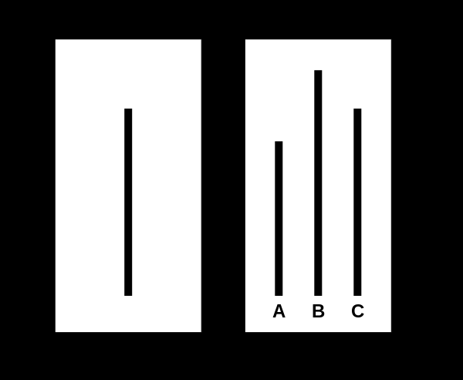
Social Psychology
Each participant was placed with seven "confederates". Participants were shown a card with a line on it, followed by a card with three lines on it. Participants were then asked to say aloud which line matched first line in length. Confederates unanimously gave the correct response or unanimously gave the incorrect response. For the first two trials the confederates gave the obvious, correct answer. On the third trial, the confederates would all give the same wrong answer, placing the participant in a dilemma.
In the control group, with no pressure to conform to confederates, the error rate was less than 1%. An examination of all critical trials in the experimental group revealed that one-third of all responses were incorrect. These incorrect responses often matched the incorrect response of the majority group (i.e., confederates). Overall, in the experimental group, 75% of the participants gave an incorrect answer to at least one question.

Slide 63
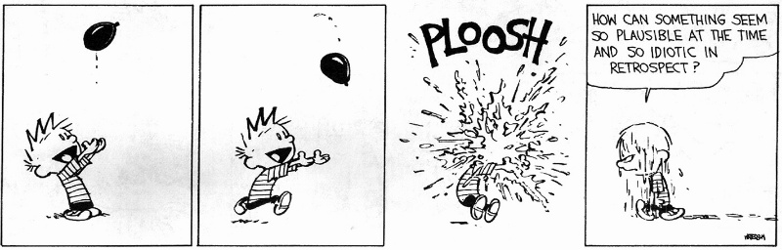
Lessons Learned

Slide 64
Lessons Learned: Test Quality
Automated program repair is a whiny child:
  “You only said I had get into the bathtub, you didn't say I had to wash.”

Slide 65
Lessons Learned: Test Quality
Automated program repair is a whiny child:
  “You only said I had get into the bathtub, you didn't say I had to wash.”
GenProg Day 1: gcd, nullhttpd
  5 tests for nullhttpd (GET index.html, etc.)
  1 bug (POST → remote exploit)
  GenProg's fix: remove POST functionality
  (Adding a 6th test yields a high-quality repair.)

Slide 66
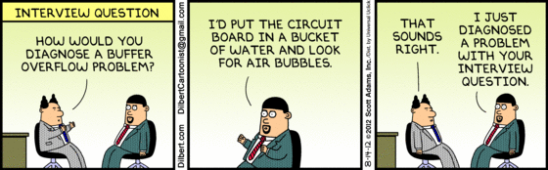
Lessons Learned: Test Quality (2)
MIT Lincoln Labs test of GenProg: sort
  Tests: “the output of sort is in sorted order”
  GenProg's fix: “always output the empty set”
  (More tests yield a higher quality repair.)

Slide 67

Lessons Learned: Test Framework
GenProg: binary / assembly repairs
  Tests: “compare your-output.txt to trusted-output.txt”
  GenProg's fix: “delete trusted-output.txt, output nothing”
“Garbage In, Garbage Out”

Slide 68
Lessons Learned: Integration
Integrating GenProg with a real program's test suite is non-trivial
Example: spawning a child process
  system(“run test cmd 1 ...”); wait();
wait() returns the error status
  Can fail because the OS ran out of memory or because the child process ran out of memory
  Unix answer: bit shifting and masking!

Slide 69
Lessons Learned: Integration (2)
We had instances where PHP's test harness and GenProg's test harness wrapper disagreed on this bit shifting
  GenProg's fix: “always segfault, which will mistakenly register as 'test passed' due to mis-communicated bit shifting”
Think of deployment at a company:
  Whose “fault” or “responsibility” is this?

Slide 70
Lessons Learned: Integration (3)
GenProg has to be able to compile candidate patches
  Just run “make”, right?
Some programs, such as language interpreters, bootstrap or self-host.
  We expected and handled infinite loops in tests
  We did not expect infinite loops in compilation

Slide 71
Lessons Learned: Sandboxing
GenProg has created …
  Programs that kill the parent shell
  Programs that “sleep forever” to avoid CPU-usage tests for infinite loops
  Programs that allocate memory in an infinite loop, causing the Linux OOM killer to randomly kill GenProg
  Programs that email developers so often that Amazon EC2 gave us the “we think you're a spammer” warning

Slide 72
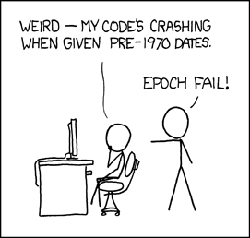
Lessons Learned: Poor Tests
Large open source programs have tests like:
  Pass if today is less than December 31, 2012

Slide 73
Lessons Learned: Poor Tests
Large open source programs have tests like:
  Pass if today is less than December 31, 2012
  Check that the modification times of files in this directory are equal to my hard-coded values
  Generate a random ID with prefix “999”, check to see if result starts with “9996” (dev typo)

Slide 74
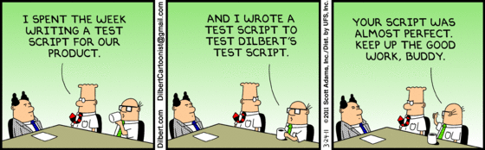
Lessons Learned: Sanity
Our earliest concession to reality was the addition of a “sanity check” to GenProg:
  Does the program actually compile? Pass all non-bug tests? Fail all bug tests?
A large fraction of our early reproduction difficulties were caught at this stage.

Slide 75
Challenges and Opportunities
Test Suite Quality & Oracles
Benchmarking & Reproducible Research
Human Studies
Repair Quality

Slide 76

Challenge:
Test Suite Quality
and Oracles

Slide 77
“A generated repair is the ultimate diagnosis in automated debugging – it tells the programmer where to fix the bug, what to fix, and how to fix it as to minimize the risk of new errors. A good repair depends on a good specification, though; and maybe the advent of good repair tools will entice programmers in improving their specifications in the first place.”
– Andreas Zeller, Saarland University

Slide 78
Test Suite Quality & Oracles
Repair_Quality = min(Technique, Test Suite)
Currently, we trust the test suppliers
What if we spent time on writing good specifications instead of on debugging?
Charge: measure the suites we are using or generate high-quality suites to use
Analogy: Formal Verification
  Difficulty depends on more than program size

Slide 79
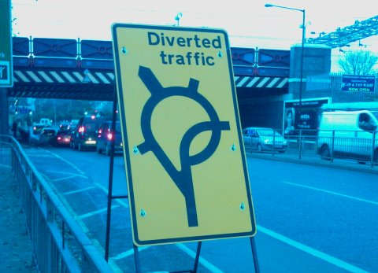
Test Data Generation
We have all agreed to believe that we can create high-coverage test inputs

Slide 80
Test Data Generation
We have all agreed to believe that we can create high-coverage test inputs
  DART, CREST, CUTE, KLEE, AUSTIN, SAGE, PEX …
  Randomized, search-based, constraint-based, concrete and symbolic execution, ...
  [ Cadar, Sen: Symbolic execution for software testing: three decades later. Commun. ACM 56(2), 2013. ]

Slide 81
Test Data Generation
We have all agreed to believe that we can create high-coverage test inputs
  DART, CREST, CUTE, KLEE, AUSTIN, SAGE, PEX …
  Randomized, search-based, constraint-based, concrete and symbolic execution, ...
  [ Cadar, Sen: Symbolic execution for software testing: three decades later. Commun. ACM 56(2), 2013. ]
“And if it crashes on that input, that's bad.”

Slide 82
Test Oracle Generation
What should the program be doing?
μTEST [ Fraser, Zeller: Mutation-Driven Generation of Unit Tests and Oracles. IEEE Trans. Software Eng. 38(2), 2012 ]
  Great combination: Daikon + mutation analysis
  Generate a set of candidate invariants
    Running the program removes non-invariants
    Retain only the useful ones: those killed by mutants
[ Staats, Gay, Heimdahl: Automated oracle creation support, or: How I learned to stop worrying about fault propagation and love mutation testing. ICSE 2012. ]
[ Nguyen, Kapur, Weimer, Forrest: Using dynamic analysis to discover polynomial and array invariants. ICSE 2012. ]

Slide 83
Specification Mining
Given a program (and possibly an indicative workload), generate partial-correctness specifications that describe proper behavior. [ Ammons, Bodík, Larus: Mining specifications. POPL 2002. ]
  “Learn the rules of English grammar by reading student essays.”
Problem: common behavior need not be correct behavior.
Mining is most useful when the program deviates from the specification.

Slide 84
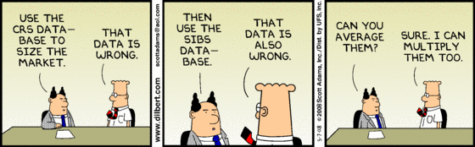
Challenge:
Benchmarking

Slide 85
“One of the challenges will be to identify the situations when and where automated program repair can be applied. I don't expect that program repair will work for every bug in the universe (otherwise thousands of developers will become unemployed), but if we can identify the areas where it works in advance there is lots of potential.”
– Thomas Zimmermann, Microsoft

Slide 86
Benchmarking
Reproducible research, results that generalize
“Benchmarks set standards for innovation, and can encourage or stifle it.” [ Blackburn et al.: The DaCapo benchmarks: Java benchmarking development and analysis. OOPSLA 2006. ]
We desire:
  Latitudinal studies: many bugs and programs
  Longitudinal studies: many bugs in one program
  Comparative studies: many tools on the same bugs

Slide 87
Test Guidelines
Test desiderata, from a program repair perspective:
  Can the empty program pass it?
  Can an infinite loop pass it?
  Can an always-segfault program pass it?
“if it completes in 10 seconds then pass”
“if not grep(output,bad_string) then pass”

Slide 88
Charge
As reviewers, acknowledge benchmark creation as a scientific contribution
As researchers, create benchmarks
It does not have to be a sacrifice:
  Siemens benchmarks paper >600 citations
  DaCapo benchmarks paper >600 citations
  PARSEC benchmark paper >1000 citations

Slide 89
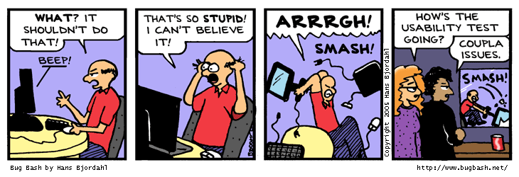
Challenge:
Human Studies

Slide 90
One Way To Turn Good Into Great
With all papers considered, those with user evaluations do not have higher citation counts overall. However, when attention is restricted to highly-cited works, user evaluations are relevant: for example, among the top quartile of papers by citation count, papers with user evaluations are cited 40% more often than papers without. Highly-selective conferences accept a larger proportion of papers with user evaluations than do less-selective conferences.
(3,000+ papers from ASE, ESEC/FSE, ICSE, ISSTA, OOPSLA, etc., 2000-2010)

Slide 91
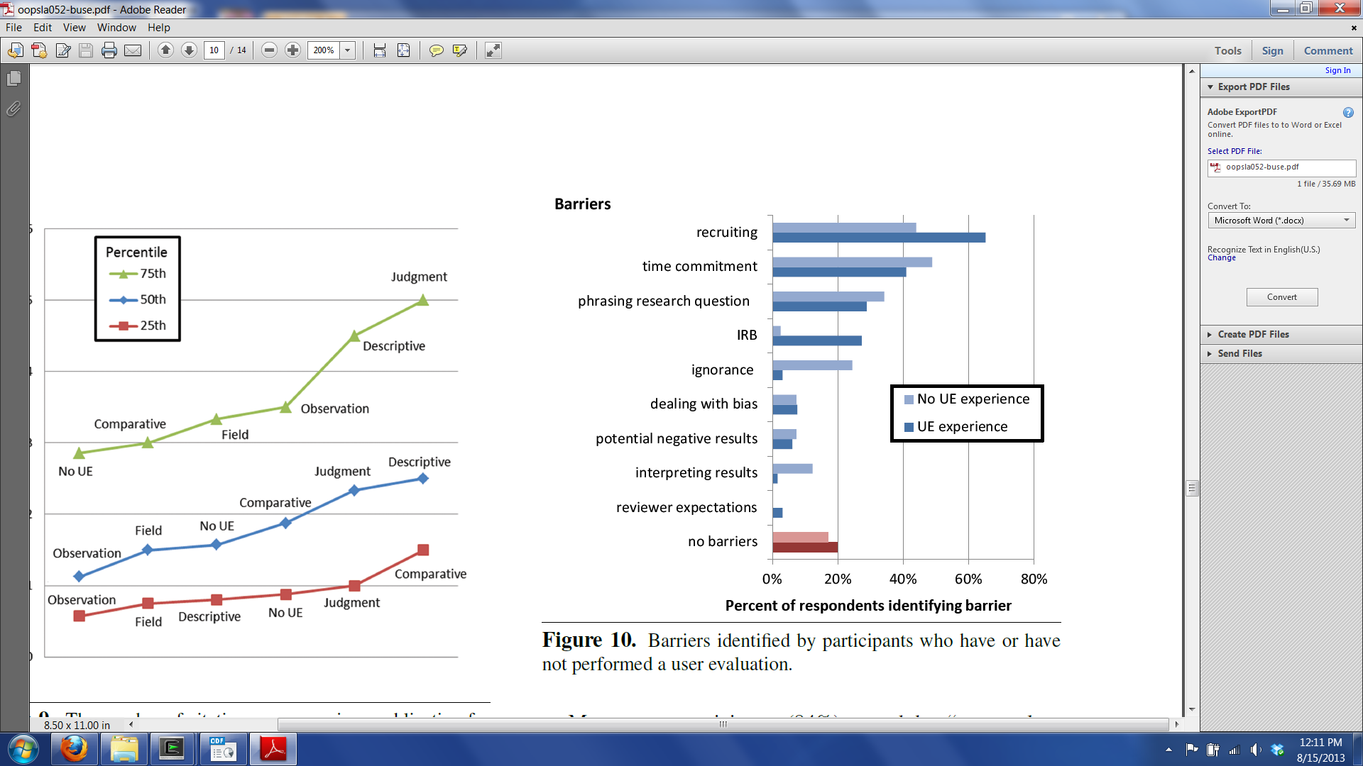
Why Not Have a User Evaluation?
(n=107)

Slide 92
Hope
Is an automated repair of high quality?
  [ Kim, Nam, Song, Kim: Automatic patch generation learned from human-written patches. ICSE 2013. ]
From 2000-2010, the number of human studies grew 500% at top SE conferences [ Buse, Sadowski, Weimer: Benefits and barriers of user evaluation in software engineering research. OOPSLA 2011.]
Two new sources of participants are available
  Massive Open Online Courses (MOOCs)
  Amazon's Mechanical Turk (crowdsourcing market)

Slide 93
One Source: MOOCs
Popular: Udacity, Coursera, edX, ...
Laurie Williams, Alex Orso, Andreas Zeller, Westley Weimer, Alex Aiken, John Regehr, …
Simple: course is unrelated
  I asked my MOOC students to participate in a human study and received 5,000+ responses (over 1,000 of which had 5+ years in industry) for $0
Complex: course uses your new tool
  [ Fast, Lee, Aiken, Koller, Smith. Crowd-scale Interactive Formal Reasoning and Analytics. UIST 2013. ]

Slide 94
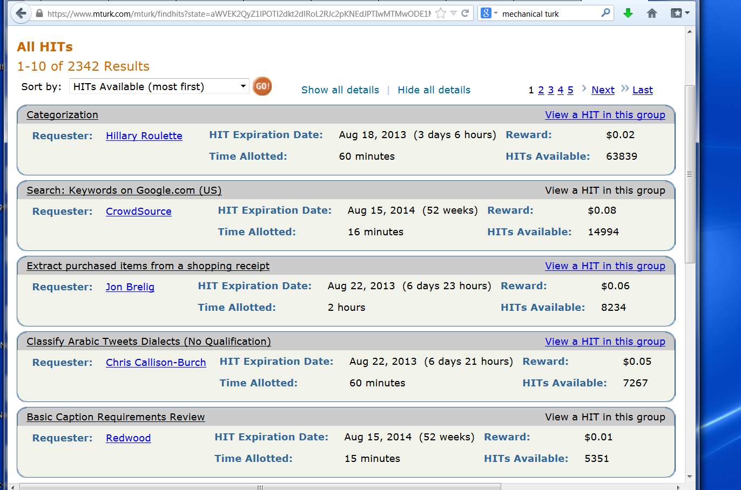
One Source: Mechanical Turk

Slide 95
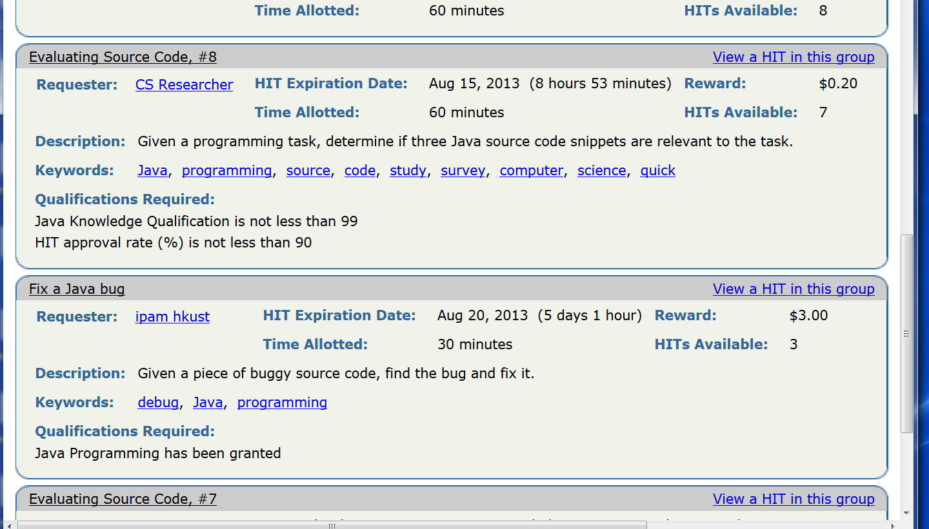
MTurk Has Programmers

Slide 96
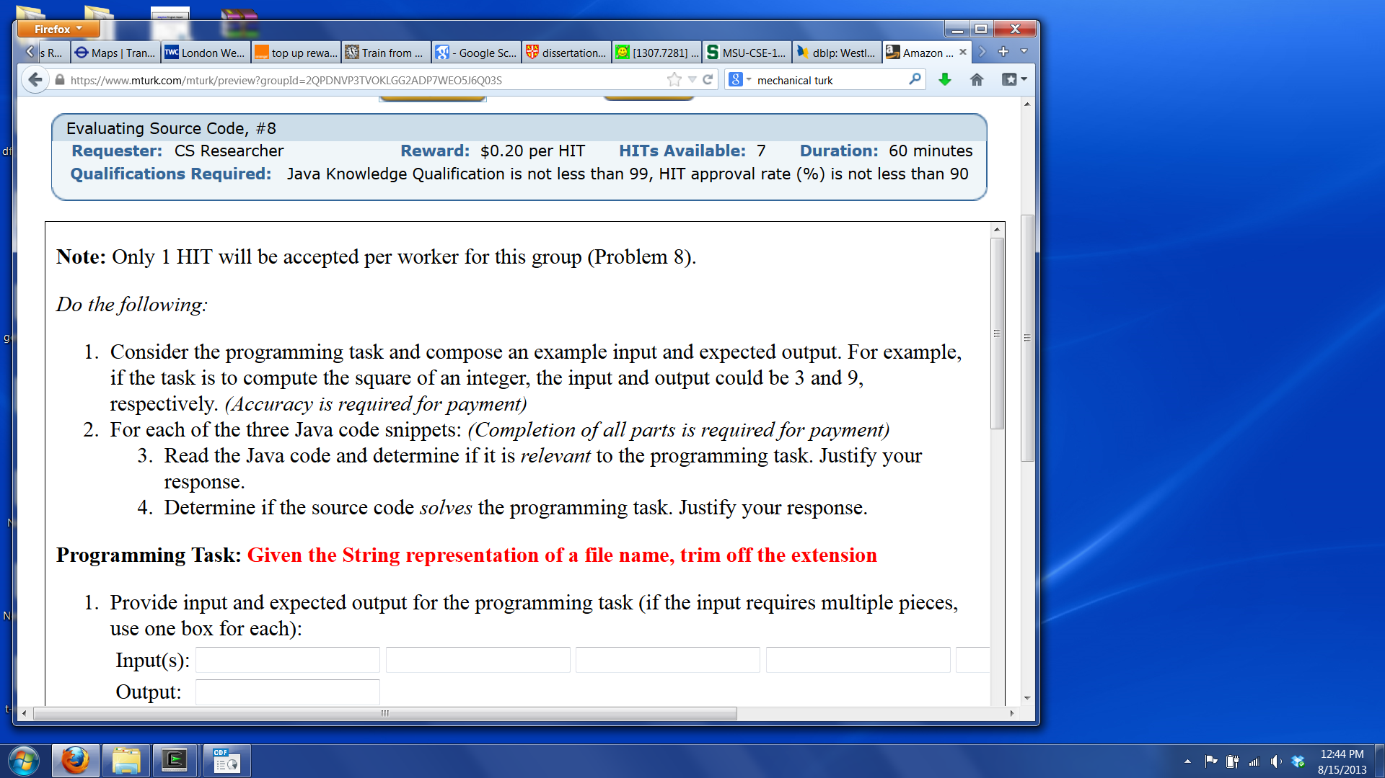
Using MTurk
Register, link your credit card, say you have $100 for HITs (Human Intelligence Tasks)
Write a little boilerplate text:

Slide 97

Using MTurk (2)
Make a simple webpage that records user selections or responses
Include a survey at the end, and print out a randomly generated completion code
Amazon workers use the code when asking for the money: you only give money to accurate workers!

Slide 98
Zeno's Paradox
Many MTurk workers will try to game the system.
  100 participants → 50 are usable
However, the average fill time for 100 30-minute CS tasks at $2 each is only a few hours.
[ Kittur, Chi, Suh. Crowdsourcing user studies with Mechanical Turk. CHI, 2008. ]
[ Snow, O’Connor, Jurafsky, Ng. Cheap and fast—but is it good?: evaluating non-expert annotations for natural language tasks. EMNLP, 2008. ]

Slide 99
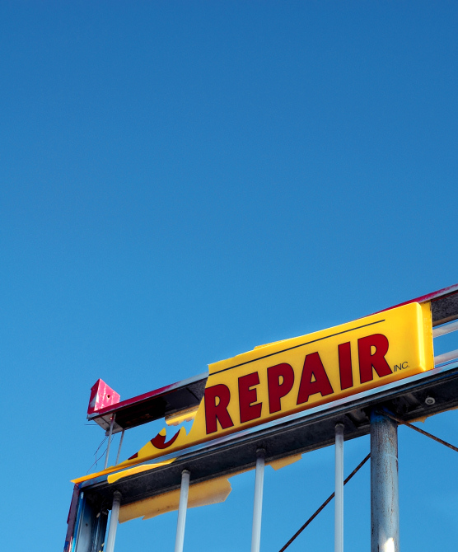
Challenge:
Repair Quality

Slide 100
Repair Quality
Low-quality repairs may well be useless
There are typically infinite ways to pass a test or implement a specification
State of the art:
  Report all repairs that meet the minimum requirements
Charge:
  Program repair papers should report on repair quality just as they report on quantity

Slide 101
A Pointed Fable
[ Das: Unification-based pointer analysis with directional assignments. PLDI 2000. ]
  “analyze a 1.4 MLOC program in two minutes”
[ Heintze, Tardieu: Ultra-fast Aliasing Analysis using CLA: A Million Lines of C Code in a Second. PLDI 2001. ]

Slide 102
A Pointed Fable
[ Das: Unification-based pointer analysis with directional assignments. PLDI 2000. ]
  “analyze a 1.4 MLOC program in two minutes”
[ Heintze, Tardieu: Ultra-fast Aliasing Analysis using CLA: A Million Lines of C Code in a Second. PLDI 2001. ]
[ Hind: Pointer analysis: haven't we solved this problem yet? PASTE 2001. ]

Slide 103
A Pointed Fable
[ Das: Unification-based pointer analysis with directional assignments. PLDI 2000. ]
  “analyze a 1.4 MLOC program in two minutes”
[ Heintze, Tardieu: Ultra-fast Aliasing Analysis using CLA: A Million Lines of C Code in a Second. PLDI 2001. ]
[ Hind: Pointer analysis: haven't we solved this problem yet? PASTE 2001. ]
??? [ L. Regression: Analyzing 0.6 Million Lines of C Code in -119 Seconds. PLDI 2002. ] ???

Slide 104

Pointer Analysis Lessons
Common metrics:
  Analyze X million lines of code
  Analyze it in Y seconds
  Answer's average “points-to set” size is Z
Pushback:
  “Points-to set size” is
  not a good metric.

Slide 105
You Can't Improve
What You Can't Measure
Cost to produce (time, money)
Input required
Functional Correctness
  Addresses the “root of the problem”
  Introduces no new defects
Non-Functional Properties
  Readable
  Maintainable
  Other?

Slide 106
Conclusion

Slide 107
Conclusion
Industry is already paying untrusted strangers
Automated Program Repair is a hot research area with rapid growth in the last few years
  (Lesson: “saying what you mean” is hard.)
Challenges & Opportunities:
  Test Suites and Oracles (spec mining)
  Benchmarking (reproducible)
  Human Studies (crowdsourcing)
  Repair Quality (???)

Slide 108
Adaptive Equality Algorithm
For every repair, ordered by observations
Skip repair if equivalent to older repair
For every test, ordered by observations
Run the repair on the test, update obs.
Stop inner loop early if a test fails
Stop outer loop early if a repair validates

