Slide 1
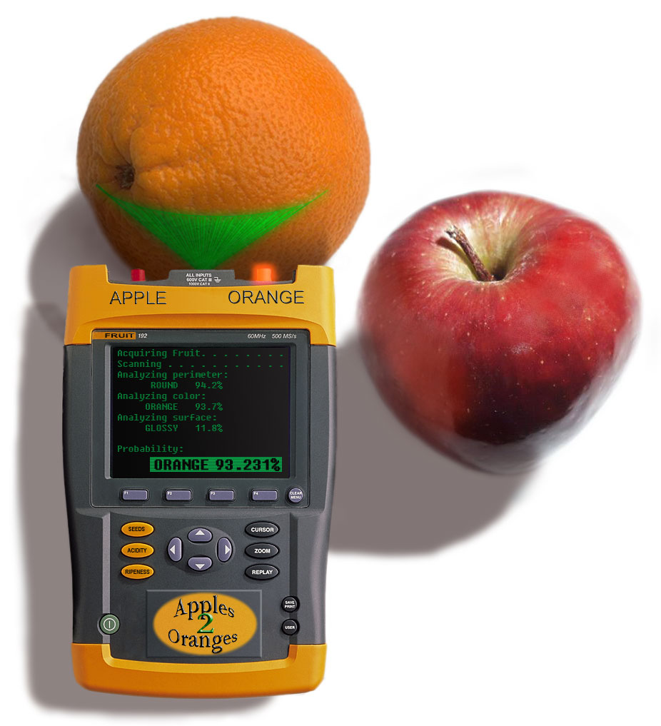
Machine Learning
(1/2)

Slide 2
Outline
This Lecture
  Intro to Machine Learning
  Relationship to Programming Languages
  Taxonomy of ML Approaches
  Basic Clustering
  Basic Linear Models
Take a machine learning class!

Slide 3
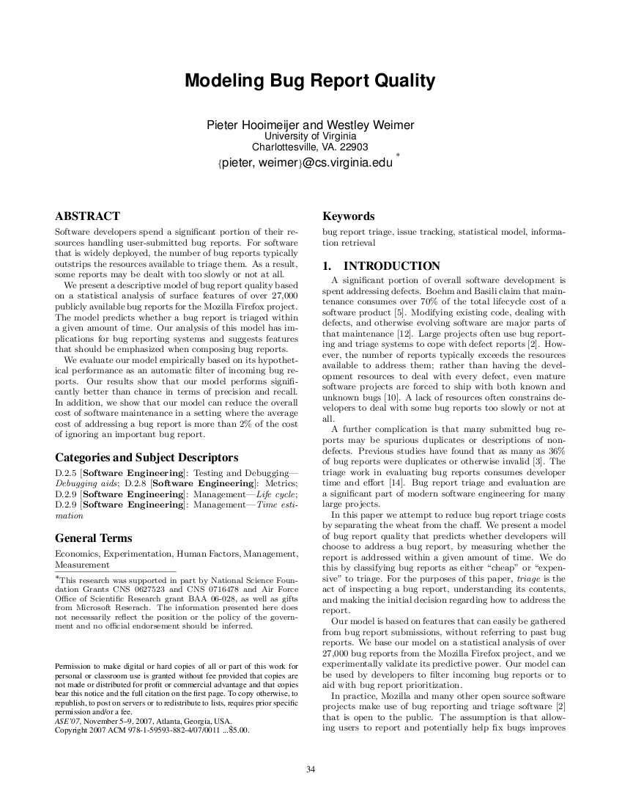

Slide 4
Machine Learning Defined
Machine learning is a subfield of AI concerned with algorithms that allow computers to learn. There are two types of learning:
  Deductive learning uses axioms and rules of inference to construct new true judgments. See “Automated Theorem Proving” lecture.
  Inductive learning method extract rules and patterns out of massive datasets. Given many examples, they attempt to generalize. We'll discuss this now.

Slide 5
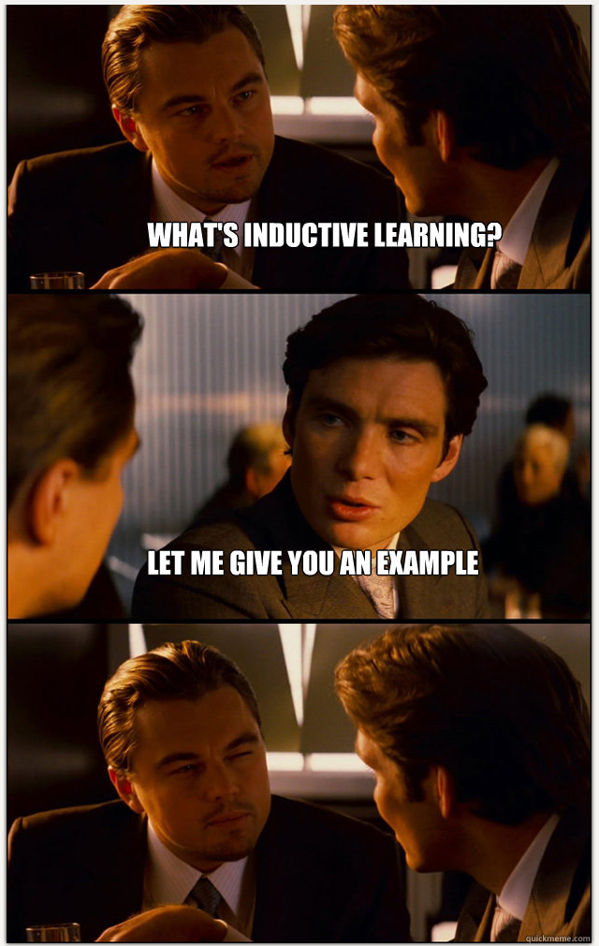

Slide 6
Machine Learning in Context
Machine Learning is sometimes called the part of AI that works in practice. (cf. “AI complete”)
ML combines statistics and data mining with algorithms and theory
Successful applications of ML:
  detecting credit card fraud; stock market prediction; speech and handwriting recognition; medical diagnosis; market basket analysis; ...

Slide 7
ML in PL?
Why does ML belong in a PL course?
Westley Weimer, George C. Necula: Mining Temporal Specifications for Error Detection. Conference on Tools and Algorithms for the Construction and Analysis of Systems (TACAS) 2005: 461-476
Pieter Hooimeijer, Westley Weimer: Modeling bug report quality. Conference on Automated Software Engineering (ASE) 2007: 34-43
Westley Weimer, Nina Mishra: Privately Finding Specifications. IEEE Trans. Software Engineering 34(1): 21-32 (2008)
Nicholas Jalbert, Westley Weimer: Automated Duplicate Detection for Bug Tracking Systems. Conference on Dependable Systems and Networks (DSN) 2008
Raymond P.L. Buse, Westley Weimer: Automatic Documentation Inference for Exceptions. International Symposium on Software Testing and Analysis (ISSTA) 2008: 273-281
Raymond P.L. Buse, Westley Weimer: A Metric for Software Readability. International Symposium on Software Testing and Analysis (ISSTA) 2008: 121-130 (best paper award)
Raymond P.L. Buse, Westley Weimer: The Road Not Taken: Estimating Path Execution Frequency Statically. Submitted to International Conference on Software Engineering (ICSE) 2009 on September 5.
Elizabeth Soechting, Kinga Dobolyi, Westley Weimer: Semantic Regression Testing for Tree-Structured Output. Submitted to International Conference on Software Engineering (ICSE) 2009 on September 5.
Claire Le Goues, Westley Weimer: Specification Mining With Few False Positives. Submitted to Tools and Algorithms for the Construction and Analysis of Systems (TACAS) 2009 on October 9.
Elizabeth Soechting, Kinga Dobolyi, Westley Weimer. Syntactic Regression Testing for Tree-Structured Output. International Symposium on Web Systems Evolution (WSE) 2009
Kinga Dobolyi, Westley Weimer. Harnessing Web-based Application Similarities to Aid in Regression Testing. International Symposium on Software Reliability Engineering (ISSRE) 2009: 71-80
Raymond P.L. Buse, Westley Weimer: Learning a Metric for Code Readability. IEEE Trans. Software Engineering Vol. 36 No. 4, 546-558, July/Aug 2010.
Kinga Dobolyi, Westley Weimer. Modeling Consumer-Perceived Web Application Fault Severities for Testing. International Symposium on Software Testing and Analysis (ISSTA) 2010: 97-106
Zachary P. Fry, Westley Weimer: A Human Study of Fault Localization Accuracy. International Conference on Software Maintenance (ICSM) 2010
Kinga Dobolyi, Elizabeth Soechting, Westley Weimer: Automating regression testing using web-based application similarities. Journal on Software Tools for Technology Transfer 13(2): 111-129
Claire Le Goues, Westley Weimer: Measuring Code Quality to Improve Specification Mining. IEEE Trans. Software Engineering 38(1): 175-190 (January/February 2012)
Raymond P.L. Buse, Westley Weimer: Synthesizing API Usage Examples. International Conference on Software Engineering (ICSE) 2012: 782-792
Zachary P. Fry, Bryan Landau, Westley Weimer: A Human Study of Patch Maintainability. International Symposium on Software Testing and Analysis (ISSTA) 2012: 177-187
Zachary P. Fry, Westley Weimer: Clustering Static Analysis Defect Reports to Reduce Maintenance Costs. IEEE Working Conference on Reverse Engineering (WCRE) 2013: 282-291

Slide 8
ML in PL?
Often in PL we try to form judgments about complex human-related phenomena
ML can help form the basis of an analysis:
  e.g., readability, bug reports, path frequency, ...
or ML can help automate an action:
  e.g., specification mining, documentation, regression testing ...
PL is often concerned with scalable analyses, which give rise to huge data sets
  ML helps us to make sense of them

Slide 9

Today's Programming
Sumit Gulwani:
Automating String Processing in Spreadsheets using Input-Output Examples
POPL 2011 (Austin, Texas)
Invited to CACM Research Highlights
Shipped as “Flash Fill Feature” in Excel 2013
http://portal.acm.org/citation.cfm?id=1926385&preflayout=flat

Slide 10
Discussion
Is this machine learning?
How does this approach relate to other AI techniques?
What are the inputs and outputs for this approach?

Slide 11
What You'll Learn
What kinds of problems can & can't it solve?
What should you know about ML?
  How to cast a problem in ML terms (e.g., creating a descriptive model)
  How to pick the right ML algorithm
  How to evaluate the results
    Relevant statistics (e.g., precision, recall)
    Relative feature importance
    Practical details

Slide 12
No Silver Bullet
ML can be handy, but using it takes practice
Researchers often incorrectly apply ML without understanding its principles
  “They threw machine learning at it ...”
ML rarely gives guarantees about performance
ML takes creativity
  Forming the model (e.g., picking features)
  Interpreting the results

Slide 13
ML Algorithm Types
Output Types
  Numeric. Examples: How tall will you be, based on your birth weight? How much will you charge to your credit card this month, based on last month?
    ML example: linear regression
  Binary. Example: Does this image contain a human face or not? Is calling A() after B() a bug or not?
    ML example: decision tree
  Discrete. Example: Is this office, game or system software? How many sorts of computer intrusions are there, based on attacker behavior?
    ML example: k-means clustering

Slide 14
ML Algorithm Types
Input Types
  Supervised. Some provided training examples are labeled with the right answer. Example: here are five images with faces and five without to get you started, now tell me if this next image has a face or not; here are five resolved bug reports and five that were never resolved, now tell me if this next report will get resolved or not.
  Unsupervised. No labeled answers. Example: here are ten network intrusions: how would you organize them? Here's some seismic data: notice anything?

Slide 15
Clustering
Clustering is the classification of objects into different groups
Clustering partitions a dataset into subsets such that elements of each subset share common traits
  Most commonly: proximity in some distance metric
Clustering is an unsupervised learning method
Hierarchical clustering finds successive clusters using previously-established clusters
  Top-down = divisive. Bottom-up = agglomerative.

Slide 16
Clustering Example
Hierarchical agglomerative clustering, Euclidean distance
A
B
C
D

Slide 17
Clustering Example
Hierarchical agglomerative clustering, Euclidean distance
A
B
C
D

Slide 18
Clustering Example
Hierarchical agglomerative clustering, Euclidean distance
A
B
C
D

Slide 19
Clustering Example
Hierarchical agglomerative clustering, Euclidean distance
A
B
C
D

Slide 20
Clustering Intuition
Why is {A,C} {B,D} a bad clustering?
A
B
C
D

Slide 21
K-Means Clustering
The objects in a cluster should be close to each other
Given a cluster C and its mean point m, the badness (i.e., error or intra-cluster variance) of the cluster is the sum, over all objects x in C, of distance(x,m).
The objective of the k-means algorithm is to partition objects into k clusters such that the sum of the intra-cluster variances is minimized

Slide 22
K-Means Algorithm
make k initial mean points somehow
each one is (will be) the center of a cluster!
assign each object to a cluster randomly
while you're not done
put each object in the cluster it is closest to
(i.e., in the cluster with the mean point it is closest to)
for each cluster, calculate where the mean point is
(i.e., average all the objects now in the cluster)

Slide 23
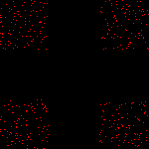
K-Means Example (01/10)

Slide 24
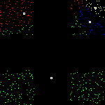
K-Means Example (02/10)

Slide 25
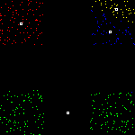
K-Means Example (03/10)

Slide 26

K-Means Example (04/10)

Slide 27
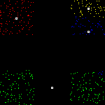
K-Means Example (05/10)

Slide 28
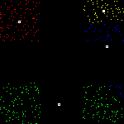
K-Means Example (06/10)

Slide 29
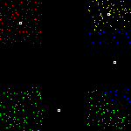
K-Means Example (07/10)

Slide 30
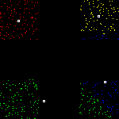
K-Means Example (08/10)

Slide 31
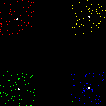
K-Means Example (09/10)

Slide 32
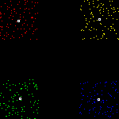
K-Means Example (10/10)

Slide 33



K-Means is Usually Decent

Slide 34



But What If You Don't Know K?

Slide 35
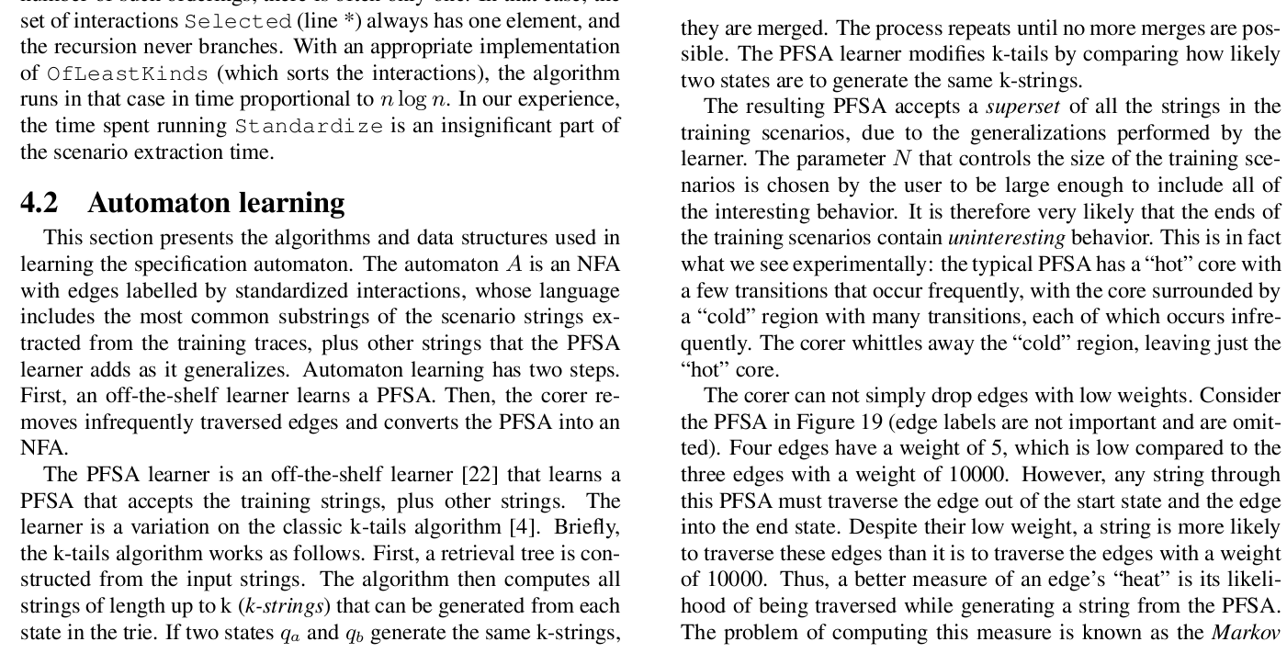
Parameter Selection
Glenn Ammons, Rastislav Bodík, James R. Larus: Mining specifications. POPL 2002: 4-16

Slide 36
Pieter Hooimeijer Memorial Trivia
In the long-running Canadian science fiction show Stargate SG-1, which character was known to utter phrases such as: “Undomesticated equines could not keep me away?”

Slide 37
Turing Award Winners
This British computer scientist received a Turing award for: (1) LCF, the first tool for automated theorem program; (2) ML, the first language to include polymorphic type inference with safe exceptions; and (3) CCS and the Pi calculus, theoretical frameworks for analyzing concurrent systems.

Slide 38
Linear Regression
If only we could get something to pick those parameters for us!
  Let's look at an algo that doesn't need them.
Linear regression models the relationship between a dependent variable (what you want to predict) and a number of independent variables (features you can already measure) as a linear combination:
  Dep = c0 + c1×Indep1 + ... + cn×Indepn
  Linear regression finds c0 ... cn for you

Slide 39
Linear Regression as
Machine Learning
Linear regression is a supervised learning task
  You provide labeled training data, consisting of the values of the features and the dependent variable associated with a number of instances
The output is a linear model
  A function that, given values for all the features, produces a numeric value for the dependent variable
How is this model produced?
  Call SAS, Minitab, Matlab, R, take a Stats course ...

Slide 40
Regression Case Study:
Bug Reports
Software maintenance accounts for over $70 billion each year and is centered around bug reports. Unfortunately, 26-36% of bug reports are invalid or duplicates and must manually triaged and removed by developers. This takes time and money.
If we could separate valid from invalid bug reports, we could save time and money.
Goal: highlight some design decisions when using ML in practice

Slide 41
Regression Case Study:
Bug Reports Preliminaries
Dependent Variable: We want to know how long (in minutes) it will take a bug report to be resolved.
  Low quality or invalid reports that take more than 30 days to resolve (say) are an expensive use of developer time. If we could predict this, we'd win!
Independent Variables:
  self-reported severity, readability, daily load, submitter reputation, comment count, attachment count, operating system used, ...

Slide 42
Regression Case Study:
Bug Reports Instances
Gather all 27,984 non-empty bug reports between 01/01/2003 and 07/31/2005 (Firefox 1.5).
  Each report is an instance (or feature vector)
  Note the indep features (e.g., priority, readability)
  Note the dependent feature (minutes to resolved)
Feed to Linear Regression, get out coeffs
  Are we done?
  Let's look at some design decisions in using ML.

Slide 43
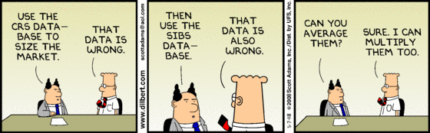
Regression Case Study:
Input Dataset Threats
Can I cherry-pick random bug reports?
What if I take all reports 1 month after a beta release?
What is the purpose of having a larger dataset?

Slide 44
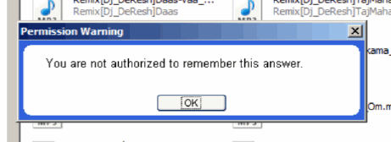
Regression Case Study:
Independent Variables
All features for linear regression are real-valued (see next lecture for discrete features)
  Comment count is easy enough
  1-bit saturating comment count
How to encode “high/medium/low priority”?
How to encode “operating system used”?

Slide 45

Regression Case Study:
Dependent Variable
How would these be different:
  Resolved in X minutes
  Resolved in X days
  Resolved within 30 days => 1, otherwise => 0
Linear Models give continuous output!
  If you want a binary classifier, may need to pick a cutoff (e.g., model < 0.7 => 0, otherwise => 1)

Slide 46
Regression Case Study:
Evaluation
You have a binary classifier for “will this report be resolved in <= 30 days”
You have 27,984 reports with known answers
  C = correct set of reports resolved in 30 days
  R = set of reports the model returns
Precision = |C∩R| / |R|
Recall = |C∩R| / |C|
F-Measure = (2 × Prec × Rec) / (Prec + Rec)

Slide 47
Regression Case Study:
Evaluation Baselines
Say you have 100 instances
50 yes instances, 50 no instances, at random
  “Flip Fair Coin”: Prec=0.5, Rec=0.5, F=0.5
  “Always Guess Yes”: Prec=0.5, Rec=1.0, F=0.66
70 yes instances, 30 no instances, at random
  “Flip Fair Coin”: Prec=0.7, Rec=0.5, F=0.58
  “Flip Biased Coin”: Prec=0.7, Rec=0.7, F=0.7
  “Always Guess Yes”: Prec=0.7, Rec=1.0, F=0.82
May want to subsample to 50-50 split for evaluation purposes

Slide 48
Regression Case Study:
Threats To Validity
Overfitting occurs when you have learned a model that is too complex with respect to the data.
  i.e., no actual abstraction has occurred
  e.g., “memorize all input instances”
N-Fold Cross-Validation can mitigate or detect the threat of overfitting
  Partition instances into n subsets
  Train on 2..n and test on 1
  Train on 1, 3..n and test on 2, etc.

Slide 49
Regression Case Study:
Final Results
Given one day's worth of features, our best F-Measure for predicting “resolved within 30 days” was 0.76, and the industrial practice baseline was 0.73.
F-Measure assumes false positives and false negatives are equally bad
  For bug reports, missing a bug report is much worse than triaging an invalid one
IR metrics are good, but relating your results back to the real world is key:
  “For the purposes of comparison, however, if Triage is $30 and Miss is $1000, using our model as a filter saves between five and six percent of the development costs for this data set.”

Slide 50

ML Course
How to design features!
Which features mattered?
More exotic ML algorithms!
How should we pick parameters?
Practical information!
And much more!

