Slide 1
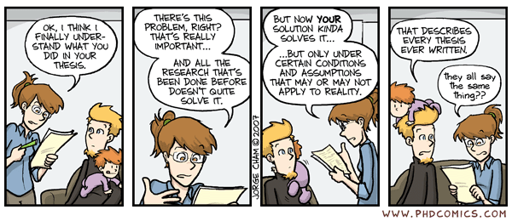
Program Synthesis
“is”
Program Reachability

Slide 2
One-Slide Summary
The template-based program synthesis problem asks if values can be found for template parameters such that the instantiated program passes all tests.
The program reachability problem asks if values can be found for a set of program variables such that program execution reaches a given label.
There is a constructive, polytime reduction between synthesis and reachability.

Slide 3
Program Repair via Synthesis
Suppose we have a buggy program
  It passes some tests and fails others
Suppose we have localized the bug
  We know which line is buggy
Suppose we have a repair template
  Fix is of the form “x = □ + □(y, □);”
Can we fill in the template so that the program passes all of the tests?

Slide 4
Templated Program Syntax
cmd ::= skip
| cmd1 ; cmd2
| v := aexp
| …
aexp ::= aexp1 + aexp2
| aexp1 – aexp2
| ci
| …
Called a template parameter

Slide 5
Template Instantation
Given a templated program with template parameters c1 … cn, and given template values v = v1 … vn (expressions or constants), we can instantiate, yielding a non-templated program.
inst(skip, v) → skip
inst(cmd1; cmd2, v) → inst(cmd1, v) ; inst(cmd2, v)
inst(x = aexp, v) → x = inst(aexp, v)
inst( ci , v) → vi

Slide 6
Template-Based Program Synthesis
Given a templated program P with template parameters c1 … cn, and a set T of input-output pairs (tests)
do there exist template values v = v1 … vn such that for all <input, output> pairs in T, (inst(P, v))(input) = output ?

Slide 7
Analysis
How hard is it to solve program synthesis in general?
  “Can you find values for these template variables such that this program passes all of its tests?”

Slide 8
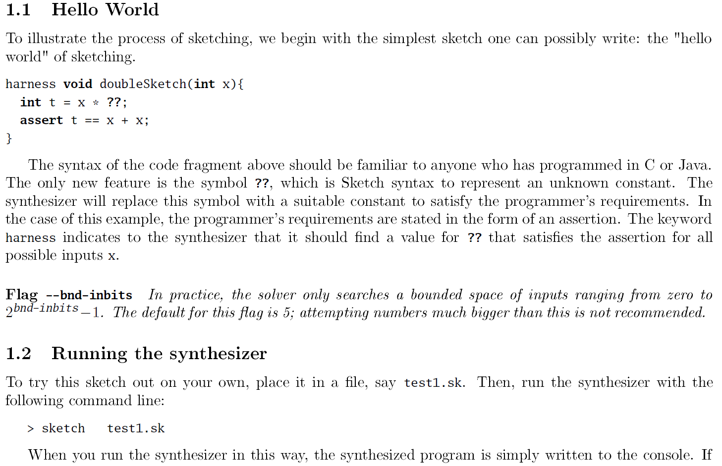
Tools Exist: sketch
Armando Solar-Lezama: The Sketching Approach to Program Synthesis. APLAS 2009: 4-13.

Slide 9
Tools Exist: sketch
Armando Solar-Lezama: The Sketching Approach to Program Synthesis. APLAS 2009: 4-13.

Slide 10
Program Synthesis as Repair
A program synthesis algorithm can be used to solve program repair
Conceptually: replace the buggy line with
If you can synthesize XYZ to fill in that hole, the patch is “delete that line and replace it with XYZ”
In practice, template: □ = □ + □*a + □*b + □*c;
  where a, b, c are all in-scope variables
  cf. Linear Regression. cf. Daikon.

Slide 11
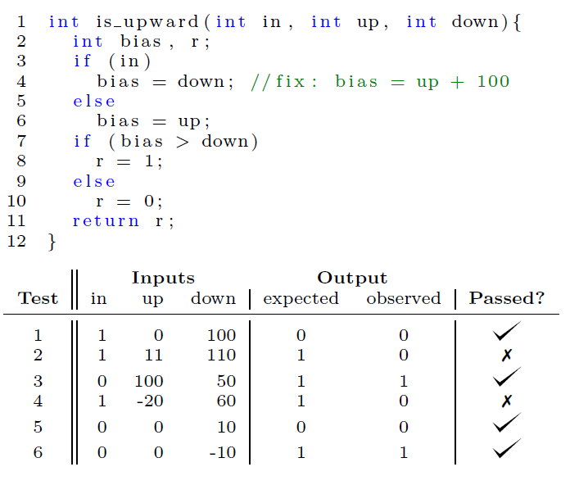
Program Repair Example

Slide 12
Program Repair Example

Slide 13
Program Repair Example
c0 = 100
c1 = 0
c2 = 0
c3 = 1
c4 = 0
“bias = up + 100;”

Slide 14
Program Reachability
Given a program P and a set of program variables x1 … xn and a program label L, do there exist values c1 … cn such that P with xi set to ci reaches label L in finite time?
This is what SLAM and BLAST do (repeatedly).
  L is the error label, ci is the counterexample.
This is what H5 does (repeatedly).
  L is the end of a path, ci is the test input.

Slide 15
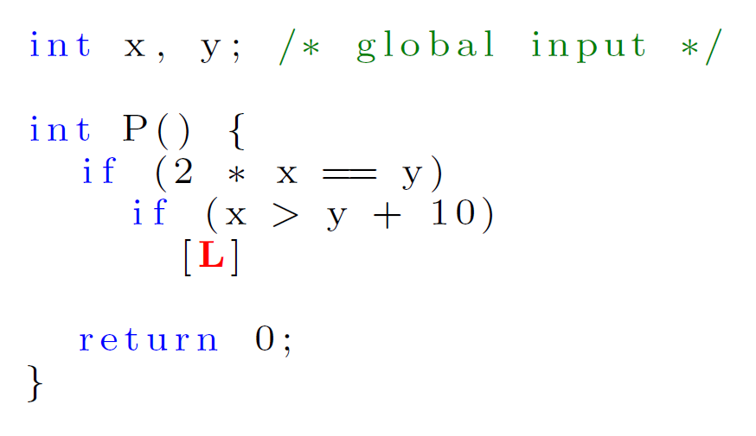
Reachability Example

Slide 16
Reachability Example
x = -20
y = -40

Slide 17
Reachability Analysis
How hard is it to solve reachability in general?
  “Can you find values for these variables such that this program reaches this label?”
Many tools exist, including some that are quite mature:
  DART, KLEE, SLAM, BLAST, PEX, CREST, CUTE, AUSTIN, “tigen”

Slide 18
Comparative Analysis
Program synthesis and program reachability are both undecidable in general
The “heart” of reachability is solving all path constraints
  Each “if” makes it harder to find a single consistent set of values
The “heart” of synthesis is handling all tests
  Each new test makes it harder to find a single consistent set of values

Slide 19
Reductions
Problem A is reducible to Problem B if an efficient algorithm for B could be used as a subroutine to solve A efficiently.
A gadget is a subset of a problem instance that simulates the behavior of one of the fundamental units of a different problem.
  Gadgets are hard to come up with the first time (e.g., when you are doing your Algo homework)
  Gadgets often look simple once presented

Slide 20
Reduction Recipe
Given an instance I of problem X
Assume an oracle that can solve Y
Transform I into f(I), verify f is polytime
Let J = Y(f(I))
Transform J into g(J), verify g is polytime
Verify g(J) = X(I)
Return g(J)

Slide 21
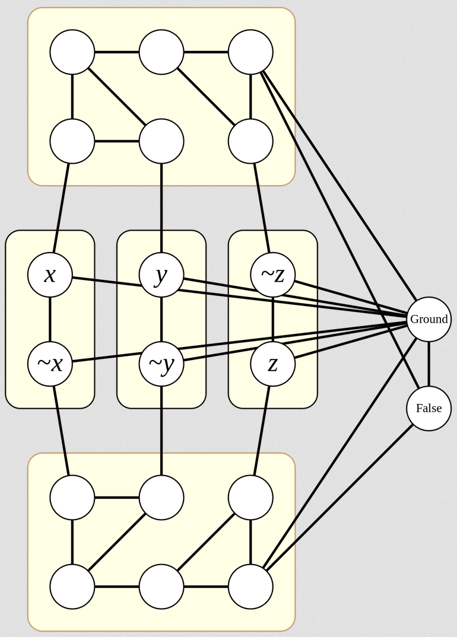
Gadget Example
Use Graph 3-Colorability to solve 3-SAT
Instance shown:
(x || y || !z) &&
(!x || !y || z)

Slide 22
Gadget Example
Use Graph 3-Colorability to solve 3-SAT
Instance shown:
(x || y || !z) &&
(!x || !y || z)

Slide 23
Gadget Example
Use Graph 3-Colorability to solve 3-SAT
Instance shown:
(x || y || !z) &&
(!x || !y || z)

Slide 24
Gadget Example
Use Graph 3-Colorability to solve 3-SAT
Instance shown:
(x || y || !z) &&
(!x || !y || z)

Slide 25
Gadget Example
Use Graph 3-Colorability to solve 3-SAT
Instance shown:
(x || y || !z) &&
(!x || !y || z)

Slide 26
Gadget Example
Use Graph 3-Colorability to solve 3-SAT
Instance shown:
(x || y || !z) &&
(!x || !y || z)

Slide 27
Gadget Example
Use Graph 3-Colorability to solve 3-SAT
Instance shown:
(x || y || !z) &&
(!x || !y || z)

Slide 28
Gadget Example
Use Graph 3-Colorability to solve 3-SAT
Instance shown:
(x || y || !z) &&
(!x || !y || z)

Slide 29
Gadget Example
Use Graph 3-Colorability to solve 3-SAT
Instance shown:
(x || y || !z) &&
(!x || !y || z)

Slide 30
Gadget Example
Use Graph 3-Colorability to solve 3-SAT
Instance shown:
(x || y || !z) &&
(!x || !y || z)

Slide 31
Gadget Example
Use Graph 3-Colorability to solve 3-SAT
Instance shown:
(x || y || !z) &&
(!x || !y || z)

Slide 32
Gadget Example
Use Graph 3-Colorability to solve 3-SAT
Instance shown:
(x || y || !z) &&
(!x || !y || z)

Slide 33
Gadget Example
Use Graph 3-Colorability to solve 3-SAT
Instance shown:
(x || y || !z) &&
(!x || !y || z)
X = true
Y = false
Z = true

Slide 34
Trivia
The this-Howard Isomorphism establishes a direct relationship between computer program and proofs. It shows a correspondence between proof calculi and type systems for models of computation.
  Logic side Programming side
  axiom variable
  introduction rule constructor
  elimination rule destructor
  normal deduction normal form
  normalisation of deductions weak normalisation
  provability type inhabitation problem
  intuitionistic tautology inhabited type

Slide 35
Physics
This 1909 experiment involved tiny charged droplets of a fluid falling between two horizontal electrodes. With the electrodes uncharged, the drops reach terminal velocity while falling. By varying the voltage in the electrode plates and inducing an electromagnetic field, the drops could be perfectly suspended (electric force = gravitational force). Using the mass of the drops and the voltage, they solved for the electric charge, finding it to be always a small integer multiple of a basic constant (1.6 * 10^-19 C): the charge of a single electron. Name the experimenter or the fluid.

Slide 36
Reducing Synthesis To Reachability
Given an instance of a synthesis (repair) problem, and assuming we have an oracle that can solve reachability, let us convert the synthesis instance into a reachability instance.
If we can do this efficiently, any existing reachability tool (e.g., DART, KLEE, SLAM) could be used to repair programs.

Slide 37
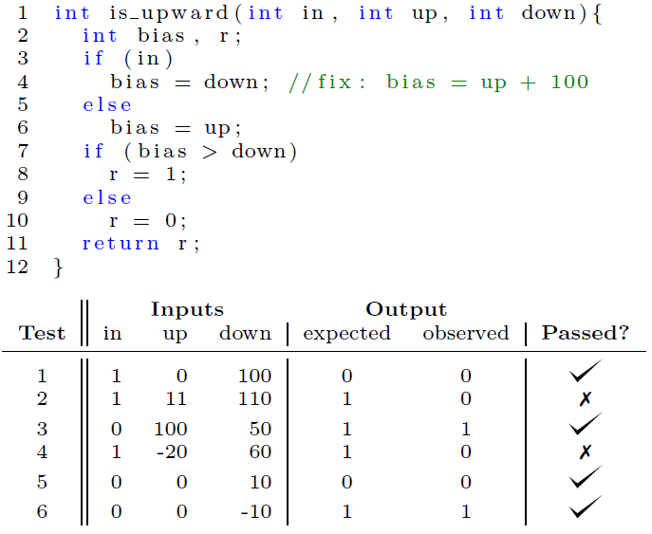

Slide 38
???

Slide 39
“Heart” insights:
Multiple tests make
Synthesis difficult.
Multiple path conditions
make Reachability
difficult.
???

Slide 40
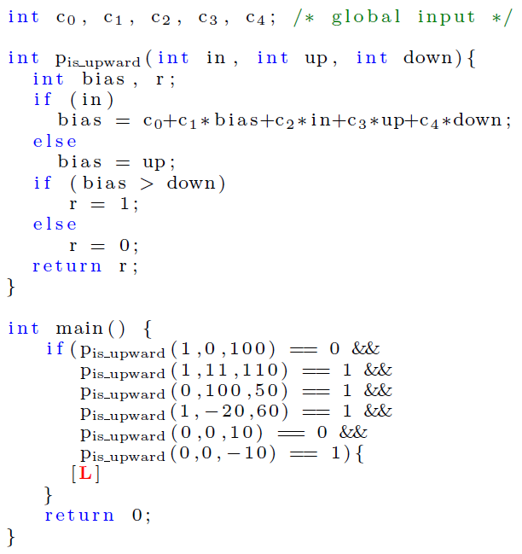
Convert

Slide 41
Proving Correctness
We must show that the constructed reachability instance is solvable (with values c1 … cn) iff the original synthesis instance is solvable (with values c1 … cn).
The reachability instance is solved if those values cause execution to reach L.
The synthesis instance is solved if those values cause every test to pass.

Slide 42
High-Level Proof Structure
Lemma 1. The reachability instance method and the synthesis instance method agree on all (non-template) variables.
Lemma 2. If the reachability instance reaches L from a state S (with values c1 … cn), then that state and values model the weakest precondition of the synthesis instance method passing each test.
Theorem 1. The synthesis instance is solvable iff the reachability instance is solvable (with the same values).

Slide 43
Lemma 1:
“Method Executions
Agree On Variables”
Lemma 2:
“Reaching L Corresponds
To Passing All Tests”

Slide 44
Lemma 1 (Agree on Vars)
Let Q be the input synthesis instance method with template variables v1 … vn.
Let P = Gadget(Q) be the reachability instance corresponding to method P.
For all states σ1, σ2, σ3, all values c1 ...cn, all inputs values x, it holds that
If σ1(vi) = ci, then <P(x), σ1> ↓ S2 iff <inst(Q,c), σ1> ↓ σ3 and for all y ≠ vi, σ2(y) = σ3(y).

Slide 45
Lemma 1 Proof
If σ1(vi) = ci, then <P(x), σ1> ↓ S2 iff <inst(Q,c), σ1> ↓ σ3 and for all y ≠ vi, σ2(y) = σ3(y).
How shall we prove it? What proof technique should we use?

Slide 46
Lemma 1 Proof
If σ1(vi) = ci, then D1 :: <P(x), σ1> ↓ S2 iff D2 :: <inst(Q,c), σ1> ↓ σ3 and for all y ≠ vi, σ2(y) = σ3(y).
The proof proceeds by induction on the structure of the operational semantics derivation D1. By inversion, the structure of D1 corresponds exactly to the structure of D2 except for template variables.

Slide 47
Lemma 1 Case: Template Variable
Case. Suppose D1 (reachability instance) is:
σ2 = σ1 [ a → σ1(vi) ]
< a := vi, σ1 > ↓ σ2
By inversion and the construction of P, D2 is:
σ3 = σ1 [ a → ci ]
< a := exp, σ1 > ↓ σ3
where exp = inst( ci , c) = ci

Slide 48
Lemma 1 Case: Template Variable
Have: σ2 = σ1 [ a → σ1(vi) ]
Have: σ3 = σ1 [ a → ci ]
To show: “for all y ≠ vi, σ2(y) = σ3(y)”
Sub-Case 1. y ≠ a. Then σ2(y) = σ3(y).
Sub-Case 2. y = a. To show: σ1(vi) = ci. This was actually one of the assumptions in the statement of the lemma. (Intuitively, it means the reachability analysis assigned ci to each variable vi to reach the label L.)

Slide 49
Lemma 1 (Agree on Vars)
Let Q be the input synthesis instance method with template variables v1 … vn.
Let P = Gadget(Q) be the reachability instance corresponding to method P.
For all states σ1, σ2, σ3, all values c1 ...cn, all inputs values x, it holds that
If σ1(vi) = ci, then <P(x), σ1> ↓ S2 iff <inst(Q,c), σ1> ↓ σ3 and for all y ≠ vi, σ2(y) = σ3(y).

Slide 50
Lemma 2 (Reach L = Pass Tests)
Let Q be the input synthesis instance method with template variables v1 … vn and tests <input1, outputn>.
Let P = Gadget(Q) be the reachability instance method main.
The execution of P reaches L starting from state σ1 iff σ1 |= wp(result = inst(Q,c)(input1), result = output1) && … wp(result = inst(Q,c)(inputn), result = outputn) where σ1(vi) = ci.

Slide 51
Lemma 2 Proof
By gadget construction there is only one label L in P, “if e then [L]” where e is of the form f(input1) = output1 && … f(intputn) = outputn.
By standard weakest precondition definitions for if, conjunction, equality and function calls, we have that L is reachable iff σ1 |= wp(result = f(input1), result = output1) && … wp(result = f(inputn), result = outputn).

Slide 52
Lemma 2 Proof
Have: L is reachable iff σ1 |= wp(result = f(input1), result = output1) && … wp(result = f(inputn), result = outputn).
Want: L is reachable iff σ1 |= wp(result = inst(Q, c)(input1), result = output1) && … wp(result = inst(Q, c)(inputn), result = outputn)
To show: σ1 |= wp(result = f(inputi), result = outputi) iff σ1|= wp(result = inst(Q, c)(inputi), result = outputi)

Slide 53
Lemma 2 Proof
To show: σ1 |= wp(result = f(inputi), result = outputi) iff σ1|= wp(result = inst(Q, c)(inputi), result = outputi)
… where f is the method from Gadget(Q)
By the soundness and completeness of weakest preconditions with respect to operational semantics, we have < result = f(inputi) , σ1 > ↓ σ2 iff σ2 |= result = outputi.

Slide 54
Lemma 2 Proof
Have: < result = f(inputi) , σ1 > ↓ σ2 iff σ2 |= result = outputi.
By Lemma 1, we have < result = inst(Q, c)(inputi) , σ1 > ↓ σ3 iff σ1(y) = σ3(y) for all y ≠ vi.
Since “result” ≠ vi, σ1(result) = σ1(result) = outputi.
So running the template program Q instantiated with ci = vi on a test input produces the required output.

Slide 55
Correctness Theorem
Let Q be the input synthesis instance method with template variables v1 … vn and tests <input1, outputn>.
Let P = Gadget(Q) be the reachability instance method main.
There exist parameter values ci such that for all <input,output>, inst(Q,c)(input) = output iff there exist input values ti such that the execution of P with vi → ti reaches L.
Proof: From Lemma 2 with ti = ci.

Slide 56
Reducing Reachability To Synthesis
We can also carry out a constructive reduction going the other direction.
Suppose we are given an instance of program reachability. Can we convert it into a program synthesis instance to solve it?

Slide 57
Reachability to Synthesis Example
???

Slide 58
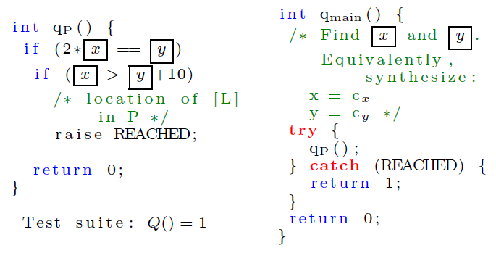
Reachability to Synthesis Example
Convert

Slide 59
Implications
Program reachability tools are much more mature than program repair tools.
CETI Program Repair Algorithm
  For each buggy line, in ranked order
    For every repair template, in ranked order
      Convert repair instance to reachability instance
      Call off-the-shelf reachability tool (e.g., SMT solver / KLEE)
      If reachable, return parameters as patch

Slide 60
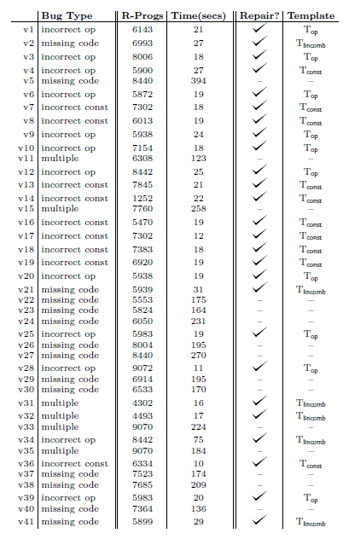
Prototype CETI Evaluation
Considered 41 bugs and simple one-line templates
Fixed 100% of bugs admitting one-line fixes
22 seconds each, average
Debroy & Wong (random mutation): 9 repairs
GenProg: 11 repairs
Forensic (concolic execution): 23 repairs
CETI: 26 repairs

Slide 61
Concluding Thoughts
PL Theory almost always translates into useful PL Practice (just with an X year lag time)
There is plenty of scope for insight and creativity (cf. whence these gadgets?)
Techniques like structural induction, SMT solving, fault localization, substitution, axiomatic semantics, etc., remain relevant!
HW0 (BLAST), HW5 (tigen), FlashFill (Gulwani Excel) and GenProg (last lecture) are all “secretly the same thing”
  = “statically reason about dynamic execution”

