Slide 1

Invariant Detection

Slide 2
One-Slide Summary
An invariant is a logical formula that is always true at a particular program location.
Given a program and a program location, invariant detection learns an invariant that is true whenever execution reaches that location. Dynamic invariant detect uses execution traces to learn invariants.
The Daikon algorithm for dynamic invariant detection enumerates simple candidate invariants and retains only those that hold on all traces.
The Dig algorithm for dynamic invariant detection generates nonlinear polynomial and linear array invariants via SMT, polyhedra, and equations.

Slide 3
Motivation
Backward axiomatic semantics requires loop invariants for verification conditions.
Forward axiomatic semantics (symbolic execution) requires loop invariants for all backward branch targets.
Recursive functions may also require pre- and post-conditions in these frameworks.
How many have you seen in real life?

Slide 4
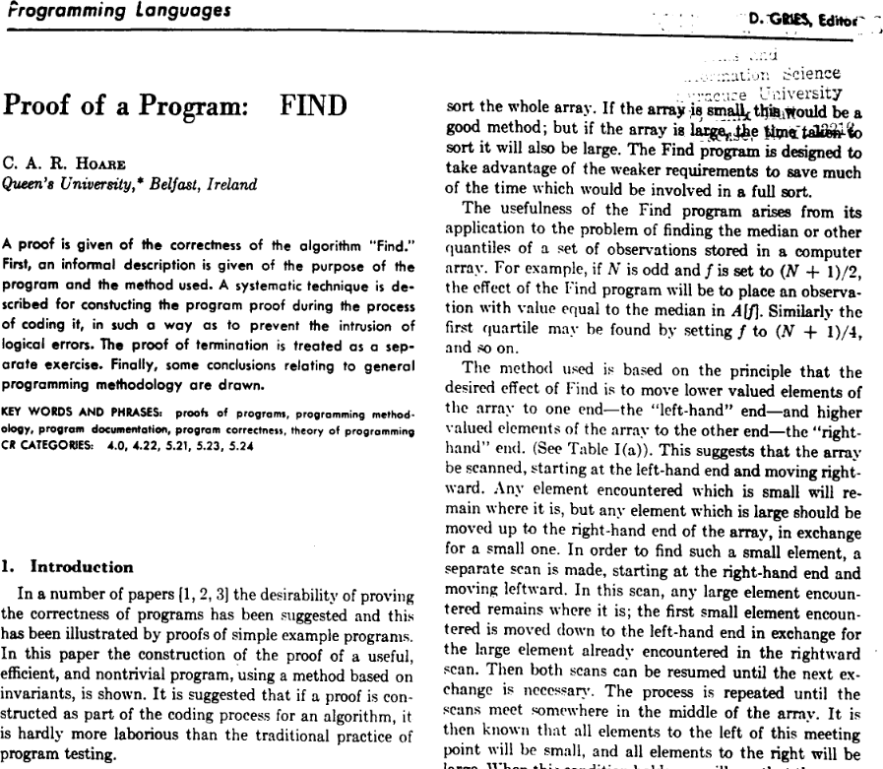
Finding Invariants Manually

Slide 5

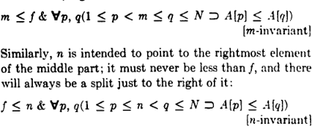
Finding Invariants Manually
Hoare's post-condition:
Some intermediate invariants:

Slide 6
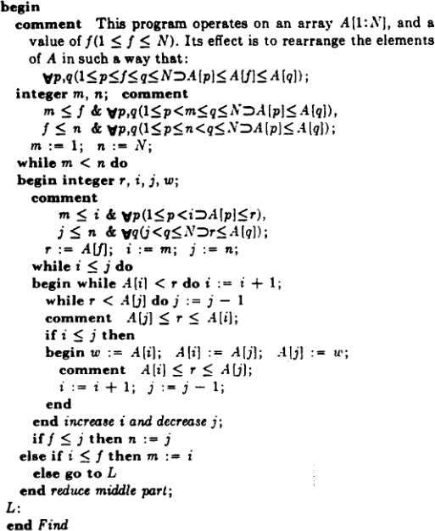
Final Result

Slide 7

“Reading Quiz”
What is “FIND” all about?
Why did it take seven pages?
What program was Hoare actually proving?
  Roman à clef

Slide 8

Cunning Plan
Given a program location, if we could infer an invariant for that location, we could have …
  Loop invariants (location = loop head)
  Function pre-conditions (location = entry)
  Function post-conditions (location = exit)
Can we do this automatically?
Two insights:
  An invariant always holds on all executions
  We can detect spurious false invariants

Slide 9
Dynamic Invariant Detection
What if we require that the program come equipped with inputs?
  An indicative workload
  High-coverage test cases
Since an invariant holds on every execution (by definition), any candidate invariant that fails even once can be tossed out!
Plan: generate many candidate invariants, filter out the false ones!

Slide 10


I could while away the hours …
Given:
  while b do c
Instrument:
  while b do (print Inv1; print Inv2; … ; c)
  Run on all tests, filter out on false
How many candidate invariants are there?

Slide 11
Invariant Templates
Given program variables x, y, and z
  x = c constant
  x != 0 non-zero
  x >= c bounds
  y = ax + b linear
  x < y ordering
  (x + y) % b = a math functions
  z = ax + by + c linear
At most three variables at a time: finite!

Slide 12

Daikon
The Daikon invariant detection algorithm
  For every program location
    For all triples of in-scope variables
      Instantiate invariant templates to obtain candidate invariants
      Instrument program
  For every test case
    Run instrumented program
    Filter out any falsified candidate invariant
Running time: cubic in in-scope variables, linear in test suite, linear in program

Slide 13
Daikon Weaknesses
What could go wrong?

Slide 14
Daikon Weaknesses
False Negatives
  If your invariant does not fit a template, Daikon cannot find it
  Example: l + u – 1 <= 2p <= l + u (bsearch pivot)
  Example:
Nothing prevents Daikon from finding these
But each increase in the language of candidate invariants bloats the runtime

Slide 15
Daikon Weaknesses
False Positives from limited input
  If you only test your sorting program on one input, [4;2;3], Daikon will learn output[0] = 2
  But making high-coverage, high-adequacy tests is easy, no? That's why we're doing formal verification. Oh, right.
False Positives from linguistic coincidence
  Ex: ptr % 4 == 0
  Ex: x <= MAX_INT
  Not false, but not related to correctness.

Slide 16
Dynamic Invariant Detection
Daikon is ill-suited for richer languages of invariants (e.g., non-linear relations, array relations, etc.) because all candidate invariants must be listed and considered.
Idea:
  Instead of listing invariants, list values, and induce invariants via constraint solving
  Ex: instead of printing x>y, x<y, x>=y, etc., just print out x and y and figure out which is true later

Slide 17

Dig
Apply three techniques we've already learned to learn rich invariants
Nonlinear Equalities of Polynomials
  via Equation Solving
Nonlinear Inequalities of Polynomials
  via Convex Polyhedra
Linear Equalities of Arrays
  via SMT Solving

Slide 18
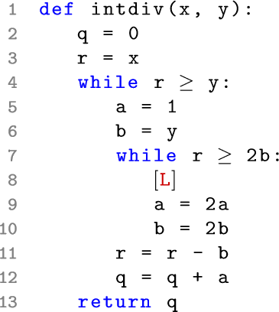
Dig Example: Cohen's Division
// quotient
// remainder
// loop invariant

Slide 19
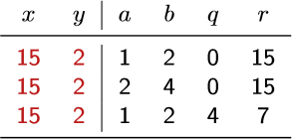
Cohen's Division on input (15,2)
// quotient
// remainder
// loop invariant

Slide 20

Cohen's Division on input (4,1)
// quotient
// remainder
// loop invariant

Slide 21
Cohen's Division Desires
// quotient
// remainder
// loop invariant

Slide 22

Nonlinear Equalities
Division example: x = qy + r (qy+r-x = 0)
GCD example: g = iA + jB (iA+jB-g = 0)
Goal:
Approach:
  Pick a maximum Degree
  Generate Terms
  Equation Solving (ex: x + y = 2, x – y = 4)

Slide 23
Terms, Equations, Solutions
Terms and Degrees
Equation Template
Systems of Equations
Solve for coefficients

Slide 24
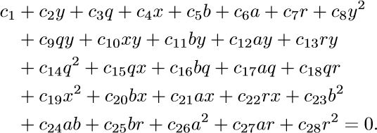
How?
Six variables (xyabqr) at deg 2 is 28 terms:
Use trace values for (xyabqr), find solutions
  28 terms + 5 traces = underconstrained!
  c4 = -V c5 = T c7 = c9 = V
  c12 = -T c16 = c27 = -U c21 = U cother = 0

Slide 25
How Now?
Solutions:
  c4 = -V c5 = T c7 = c9 = V
  c12 = -T c16 = c27 = -U c21 = U cother = 0
Try T=0, U=0, V=1 (V alone → related vars)
That gives c4 = -1 c7 = c9 = 1
-x + r + qy = 0
aka
x = qy + r

Slide 26
Q: Computer Science
This American computer scientist graduated with a BA in Mathematics from the University of Virginia. He received the Turing award for “developing Model-Checking into a highly effective verification technology that is widely adopted in the hardware and software industries.” He recognized that, unlike Hoare's annotation-heavy logical approach, Pnueli's temporal logics could be checked mechanically. With his student Ken McMillan he addressed the state space explosion problem via symbolic model checking (BDDs).

Slide 27

Nonlinear Inequalities
Sqrt Example: x + err >= y*y >= x – err
Goal:
Approach:
  Pick maximum Degree
  Represent trace values as polyhedra points
  Build bounded convex polyhedron
  Deduce new invariants from loop guard

Slide 28
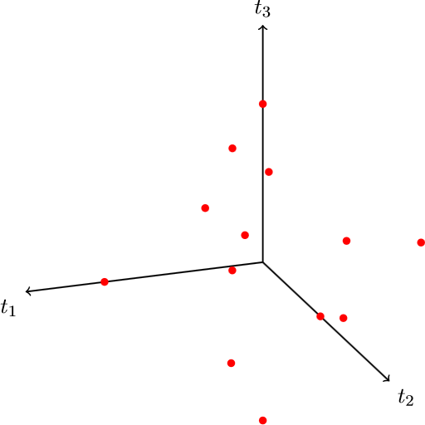
Polyhedra From Trace Points

Slide 29
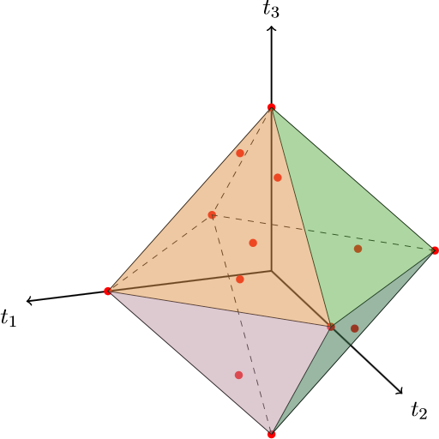
Polyhedra

Slide 30
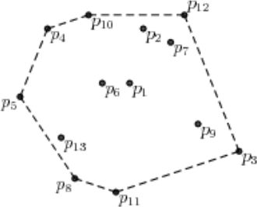
Polyhedra Facets
Facets of polyhedra correspond to inequalities
Think Simplex!
Given k points in n dimensions, can build the enclosing bounded convex polyhedron in k^{n/2}
First trace from example before gives point: (1,15,2,1,30,15,2,225,4,1)
One of the facets: r – 2ya >= 0

Slide 31
Comparison
Simplex:
  Given more than enough facets (edges, inequalities), find the convex space and enumerate the points
Dig's Polyhedra Approach:
  Given more than enough points, find the convex space and enumerate the facets (edges, inequalities)

Slide 32

Dig Deduction
Given a loop:
  while (r >= 2b) { [L] … }
Obtain equality relations at location L:
  b = ay qy + r = x
Add loop guard to each one and simplify:
  r >= 2b && b = ay → r >= 2ay
  r >= 2b && qy + r = x → x – yq >= 2b

Slide 33

Linear Array Relations
AES Examples
  block2State r[i][j] = t[4i + j]
  keySetupEnc8 r[i][j] = cypherKey[8i + j]
Goal:
Approach:
  Flatten array elements into variables
  Learn relations among elements, lift to indices

Slide 34
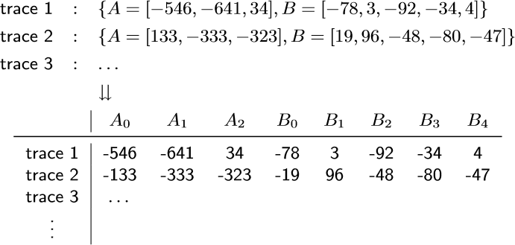

Array Encoding
Represent array elements with new variables
Find relations:

Slide 35


Simple Array Relations
Hypothesize: A[i] = l B[j] + k
Find j:
  Write relation between A[i] and B[j] as j=ip+q
  Solve for p and q:
Find l and k:

Slide 36
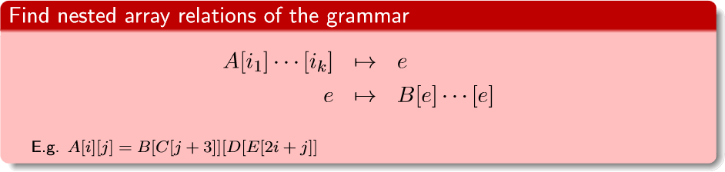
Nested Array Relations
AES Example: invSubBytes R[i][j] = S[T[i][j]]
Goal:
Approach:
  Reachability finds possible nesting relations
  Reduce to satisfiability problem, use SMT

Slide 37
Finding Nested Array Relations
Example. Given (from traces):
Generate candidate nestings:
Validate nestings:
Let's do A[i] = B[C[j]] as an example …

Slide 38
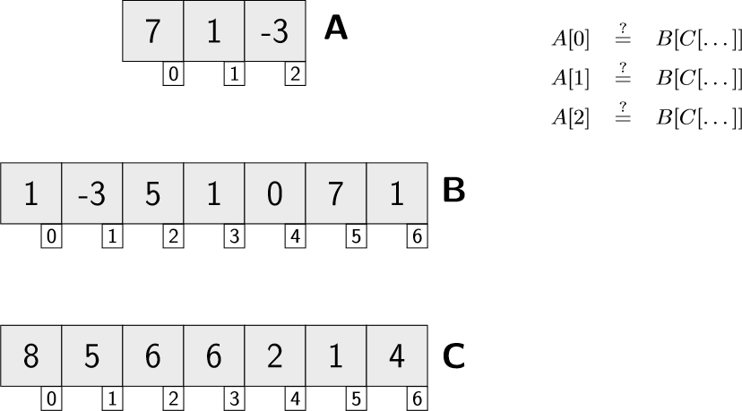
Reachability Analysis Example

Slide 39
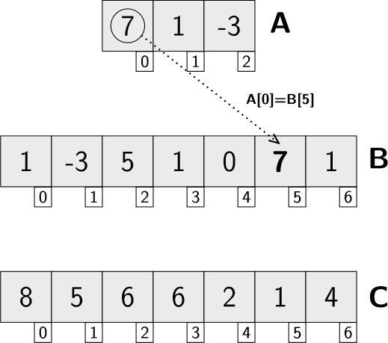
Reachability, A[0]=B[5]

Slide 40
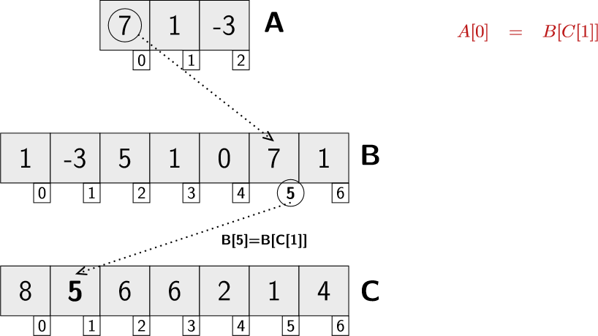
Reachability, A[0]=B[C[1]]

Slide 41
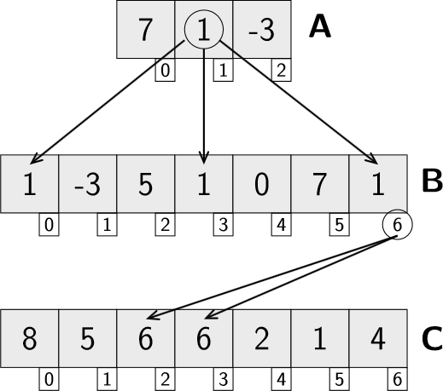
Reachability, A[1] = B[C[...]]

Slide 42
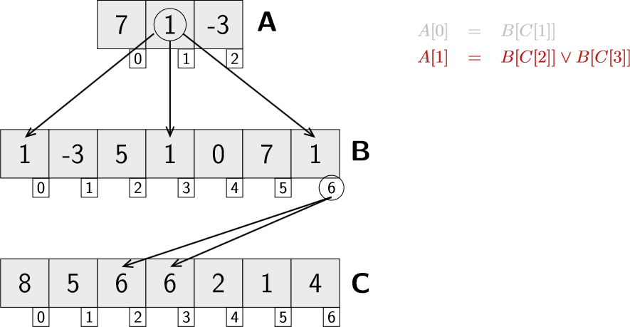
Reachability Example

Slide 43
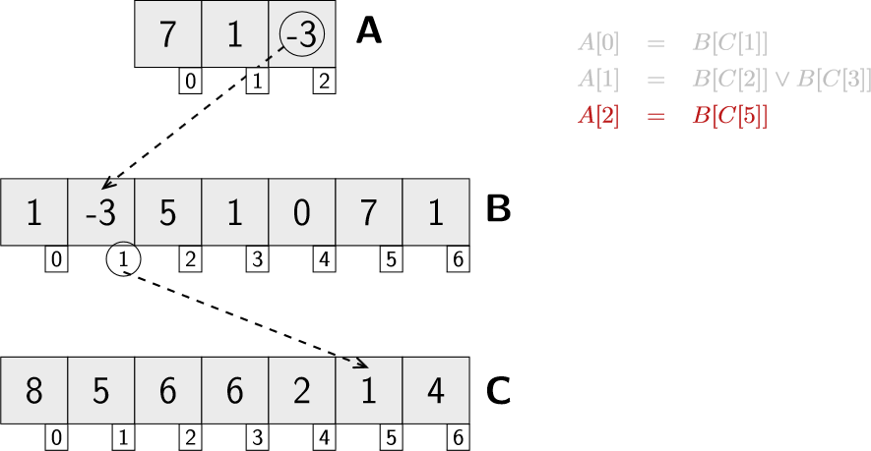
Reachability, A[2] = B[C[5]]

Slide 44
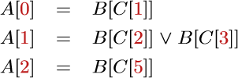
Equation Solving
Express relation A[i]=B[C[j]] via j = ip + q
Handle all disjunctions
  We'll do “left” first

Slide 45
Equation Solving
Express relation A[i]=B[C[j]] via j = ip + q
Solve for p, q:
  No solution
Backtrack, try “right” disjunction

Slide 46

Equation Solving
Express relation A[i]=B[C[j]] via j = ip + q
Solve for p, q:

Slide 47
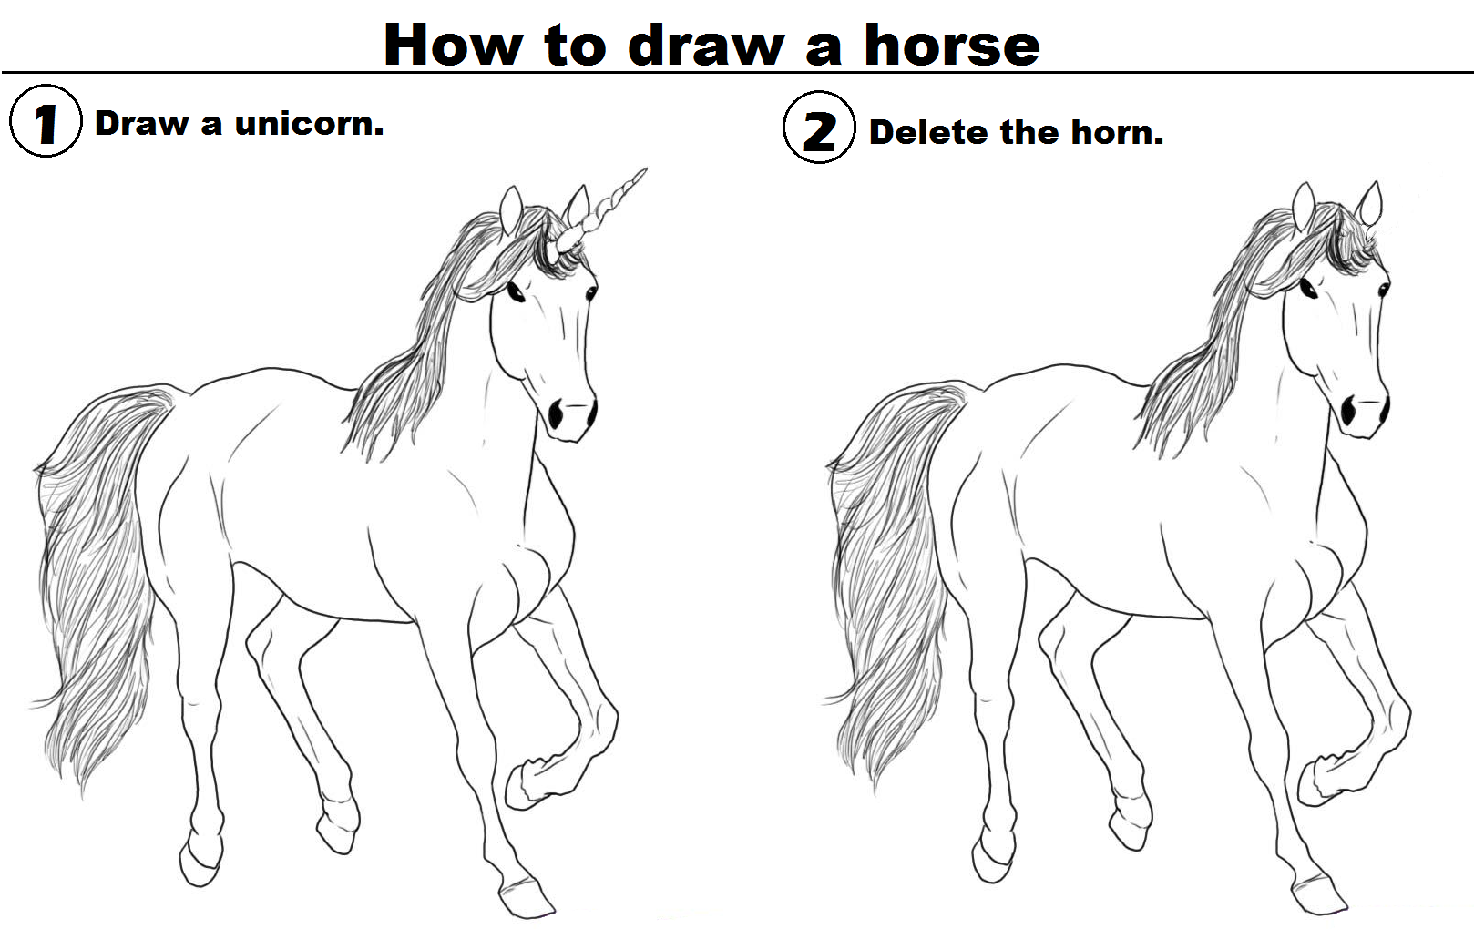
Ugh, Backtracking.
Why should we have to do backtracking to deal with disjunctions?
We have SAT and SMT solvers to do that!
We'll just reduce solving the difficult problem of invariant generation to solving SAT

Slide 48
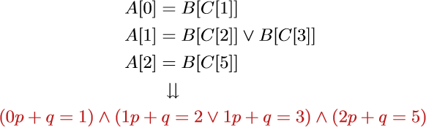
SMT Solving
(after reachability)
Recall: A[i]=B[C[j]] via j = ip + q
Just ask SMT to solve for p and q!

Slide 49
What about false positives?
Given candidate invariants …
  Just try to prove them using axiomatic semantics.
  Recall: you can't be fooled by false invariants.
See subsequent papers
  “Using Dynamic Analysis to Generate Disjunctive Invariants”, ICSE 2014

Slide 50


"When you have the golden claw, the solution is in the palm of your hands."
Why cover invariant detection?
  It is necessary for axiomatic semantics to be practical.
Reinforces recurring theme:
  The techniques you are learning are the backbone of modern PL research.
  Simplex → Nonlinear Equalities, Inequalities
  Model Checking, SMT Solving → Array Invariants
  Invariants → Symbolic Execution

Slide 51
Homework
HW4 Due
Reading AI Papers for Monday

