Slide 1
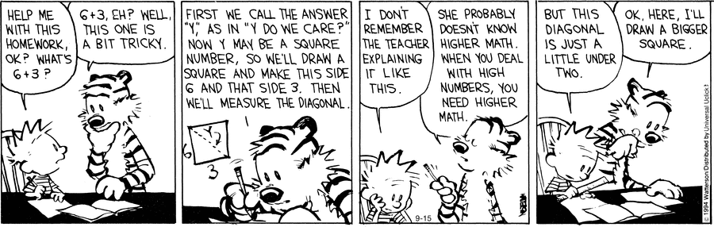
Automated Theorem Proving:
DPLL and Simplex

Slide 2
One-Slide Summary
An automated theorem prover is an algorithm that determines whether a mathematical or logical proposition is valid (satisfiable).
A satisfying or feasible assignment maps variables to values that satisfy given constraints. A theorem prover typically produces a proof or a satisfying assignment (e.g., a counter-example backtrace).
The DPLL algorithm uses efficient heuristics (involving “pure” or “unit” variables) to solve Boolean Satisfiability (SAT) quickly in practice.
The Simplex algorithm uses efficient heuristics (involving visiting feasible corners) to solve Linear Programming (LP) quickly in practice.

Slide 3
Why Bother?
I am loathe to teach you anything that I think is a waste of your time.
The use of “constraint solvers” or “SMT solvers” or “automated theorem provers” is becoming endemic in PL, SE and Security research, among others.
Many high-level analyses and transformations call Chaff, Z3 or Simplify (etc.) as a black box single step.

Slide 4
Recent Examples
“VeriCon uses first-order logic to specify admissible network topologies and desired network-wide invariants, and then implements classical Floyd-Hoare-Dijkstra deductive verification using Z3.”
  VeriCon: Towards Verifying Controller Programs in Software-Defined Networks, PLDI 2014
“However, the search strategy is very different: our synthesizer fills in the holes using component-based synthesis (as opposed to using SAT/SMT solvers).”
  Test-Driven Synthesis, PLDI 2014
“If the terms l, m, and r were of type nat, this theorem is solved automatically using Isabelle/HOL's built-in auto tactic.”
  Don't Sweat the Small Stuff: Formal Verification of C Code Without the Pain, PLDI 2014

Slide 5
Desired Examples
SLAM
  Given “new = old” and “new++”, can we conclude “new = old”?
  (new0 = old0) ^ (new1 = new0 + 1) ^ (old1 = old0) ) (new1 = old1)
Division By Zero
  IMP: “print x/((x*x)+1)”
  (n1 = (x * x) + 1) ) (n1 ≠ 0)

Slide 6
Incomplete
Unfortunately, we can't have nice things.
Theorem (Godel, 1931). No consistent system of axioms whose theorems can be listed by an algorithm is capable of proving all truths about relations of the natural numbers.
But we can profitably restrict attention to some relations about numbers.

Slide 7
Desired Examples
To make progress,
we will treat “pure logic”
and “pure math”
separately.
SLAM
  Given “new = old” and “new++”, can we conclude “new = old”?
  (new0 = old0) ^ (new1 = new0 + 1) ^ (old1 = old0) ) (new1 = old1)
Division By Zero
  IMP: “print x/((x*x)+1)”
  (n1 = (x * x) + 1) ) (n1 ≠ 0)

Slide 8
Overall Plan
Satisfiability
Simple SAT Solving
Practical Heuristics
DPLL algorithm for SAT
Linear programming
Graphical Interpretation
Simplex algorithm
Logic
Math

Slide 9
Boolean Satisfiability
Start by considering a simpler problem: propositions involving only boolean variables
bexp := x
| bexp ^ bexp
| bexp _ bexp
| : bexp
| bexp ) bexp
| true | false
Given a bexp, return a satisfying assignment or indicate that it cannot be satisfied

Slide 10
Satisfying Assignment
A satisfying assignment maps boolean variables to boolean values.
Suppose σ(x) = true and σ(y) = false
σ ² x // ² = “models” or “makes
σ ² x _ y // true” or “satisfies”
σ ² y ) :x
σ ² x ) (x ) y)
σ ² :x _ y

Slide 11
Cook-Levin Theorem
Theorem (Cook-Levin). The boolean satisfiability problem is NP-complete.
In '71, Cook published “The complexity of theorem proving procedures”. Karp followed up in '72 with “Reducibility among combinatorial problems”.
  Cook and Karp received Turing Awards.
SAT is in NP: verify the satisfying assignment
SAT is NP-Hard: we can build a boolean expression that is satisfiable iff a given nondeterministic Turing machine accepts its given input in polynomial time

Slide 12
Conjunctive Normal Form
Let's make it easier (but still NP-Complete)
A literal is “variable” or “negated variable”
  x :y
A clause is a disjunction of literals
  (x _ y _ :z) (:x)
Conjunctive normal form (CNF) is a conjunction of clauses
  (x _ y _ :z) ^ (:x _ :y) ^ (z)
Must satisfy all clauses at once
  “global” constraints!

Slide 13
SAT Solving Algorithms
9σ. σ ² (x _ y _ :z) ^ (:x _ :y) ^ (z)
So how do we solve it?
Ex: σ(x) = σ(z) = true, σ(y) = false
Expected running time?

Slide 14
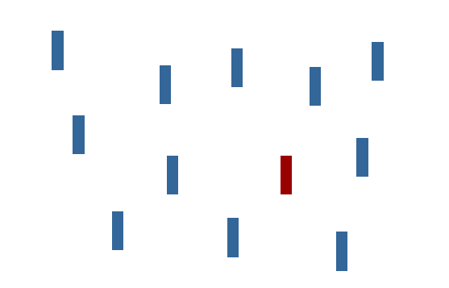
Analogy: Human Visual Search
“Find The Red Vertical Bar”

Slide 15
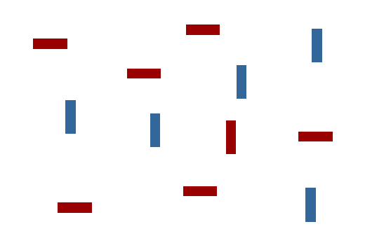
Human Visual Search
“Find The Red Vertical Bar”

Slide 16
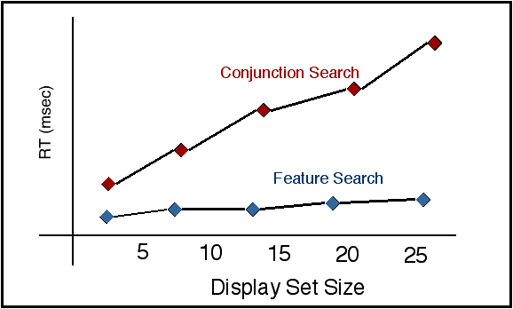
Some Visual Features
Admit O(1) Detection

Slide 17
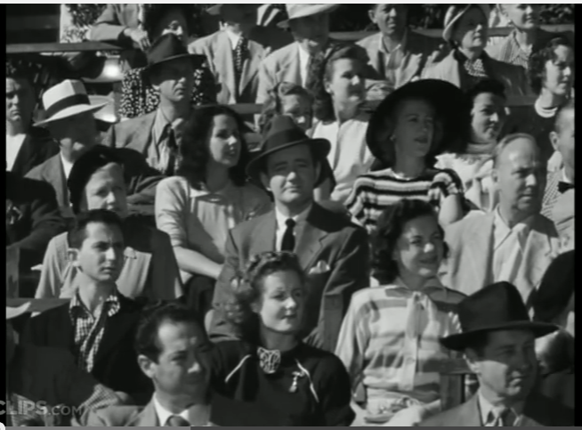
Strangers On A Train
https://www.youtube.com/watch?v=_tVFwhoeQVM

Slide 18
Think Fast: Partial Answer?
(:a _ :b _ :c _ d _ e _ :f _ g _ :h _ :i)
^ (:a _ b _ :c _ d _ :e _ f _ :g _ h _ :i)
^ (a _ :b _ :c _ :d _ e _ :f _ :g _ :h _ i)
^ (:b)
^ (a _ :b _ c _ :d _ e _ :f _ :g _ :h _ i)
^ (:a _ b _ :c _ d _ :e _ f _ :g _ h _ :i)
If this instance is satisfiable, what must part of the satisfying assignment be?

Slide 19
Think Fast: Partial Answer?
(:a _ :b _ :c _ d _ e _ :f _ g _ :h _ :i)
^ (:a _ b _ :c _ d _ :e _ f _ :g _ h _ :i)
^ (a _ :b _ :c _ :d _ e _ :f _ :g _ :h _ i)
^ (:b)
^ (a _ :b _ c _ :d _ e _ :f _ :g _ :h _ i)
^ (:a _ b _ :c _ d _ :e _ f _ :g _ h _ :i)
If this instance is satisfiable, what must part of the satisfying assignment be? b = false

Slide 20
Need For Speed 2
(:a _ c _ :d _ e _ f _ :g _ :h _ :i)
^ (:a _ b _ :c _ d _ :e _ f _ g _ h _ i)
^ (:a _ :b _ c _ e _ f _ g _ :h _ i)
^ (:a _ b _ c _ d _ e _ :f _ :g _ h _ :i)
^ (b _ :c _ :d _ e _ :f _ g _ h _ :i)
^ (:a _ b _ c _ d _ :g _ :h _ :i)
If this instance is satisfiable, what must part of the satisfying assignment be?

Slide 21
Need For Speed 2
(:a _ c _ :d _ e _ f _ :g _ :h _ :i)
^ (:a _ b _ :c _ d _ :e _ f _ g _ h _ i)
^ (:a _ :b _ c _ e _ f _ g _ :h _ i)
^ (:a _ b _ c _ d _ e _ :f _ :g _ h _ :i)
^ (b _ :c _ :d _ e _ :f _ g _ h _ :i)
^ (:a _ b _ c _ d _ :g _ :h _ :i)
If this instance is satisfiable, what must part of the satisfying assignment be? a = false

Slide 22
Unit and Pure
A unit clause contains only a single literal.
  Ex: (x) (:y)
  Can only be satisfied by making that literal true.
  Thus, there is no choice: just do it!
A pure variable is either “always : negated” or “never : negated”.
  Ex: (:x _ y _ :z) ^ (:x _ :y) ^ (z)
  Can only be satisfied by making that literal true.
  Thus, there is no choice: just do it!

Slide 23
Unit Propagation
If X is a literal in a unit clause, add X to that satisfying assignment and replace X with “true” in the input, then simplify:
1. (:x _ y _ :z) ^ (:x _ :z) ^ (z)
2. identify “z” as a unit clause
3. σ += “z = true”

Slide 24
Unit Propagation
If X is a literal in a unit clause, add X to that satisfying assignment and replace X with “true” in the input, then simplify:
1. (:x _ y _ :z) ^ (:x _ :z) ^ (z)
2. identify “z” as a unit clause
3. σ += “z = true”
4. (:x _ y _ :true) ^ (:x _ :true) ^ (true)

Slide 25
Unit Propagation
If X is a literal in a unit clause, add X to that satisfying assignment and replace X with “true” in the input, then simplify:
1. (:x _ y _ :z) ^ (:x _ :z) ^ (z)
2. identify “z” as a unit clause
3. σ += “z = true”
4. (:x _ y _ :true) ^ (:x _ :true) ^ (true)
5. (:x _ y) ^ (:x)
Profit! Let's keep going ...

Slide 26
Unit Propagation FTW
5. (:x _ y) ^ (:x)
6. Identify “:x” as a unit clause
7. σ += “:x = true”
8. (true _ y) ^ (true)
9. done!
{z,:x} ² (:x _ y _ :z) ^ (:x or :z) ^ (z)

Slide 27
Pure Variable Elimination
If V is a variable that is always used with one polarity, add it to the satisfying assignment and replace V with “true”, then simplify.
1. (:x _ :y _ :z) ^ (x _ :y _ z)
2. identify “:y” as a pure literal

Slide 28
Pure Variable Elimination
If V is a variable that is always used with one polarity, add it to the satisfying assignment and replace V with “true”, then simplify.
1. (:x _ :y _ :z) ^ (x _ :y _ z)
2. identify “:y” as a pure literal
3. (:x _ true _ :z) ^ (x _ true _ z)
4. Done.

Slide 29
DPLL
The Davis-Putnam-Logemann-Loveland (DPLL) algorithm is a complete decision procedure for CNF SAT based on:
  Identify and propagate unit clauses
  Identify and propagate pure literals
  If all else fails, exhaustive backtracking search
It builds up a partial satisfying assignment over time.
DP '60: “A Computing Procedure for Quantification Theory”
DLL '62: “A Machine Program for Theorem Proving”

Slide 30
DPLL Algorithm
let rec dpll (c : CNF) (σ : model) : model option =
if σ ² c then (* polytime *)
return Some(σ) (* we win! *)
else if ( ) in c then (* empty clause *)
return None (* unsat *)
let u = unit_clauses_of c in
let c, σ = fold unit_propagate (c, σ) u in
let p = pure_literals_of c in
let c, σ = fold pure_literal_elim (c, σ) p in
let x = choose ((literals_of c) – (literals_of σ)) in
return (dpll (c ^ x) σ) or (dpll (c ^ :x) σ)

Slide 31
DPLL Example
(x _ :z) ^ (:x _ :y _ z) ^ (w) ^ (w _ y)
Unit clauses: (w)
(x _ :z) ^ (:x _ :y _ z)
Pure literals: :y
(x _ :z)
Choose unassigned: x (recursive call)
(x _ :z) ^ (x)
Unit clauses: (x)
Done! σ={w, :y, x}

Slide 32
SAT Conclusion
DPLL is commonly used by award-winning SAT solvers such as Chaff and MiniSAT
Not explained here: how you “choose” an unassigned literal for the recursive call
  This “branching literal” is the subject of many papers on heuristics
Very recent: specialize a MiniSAT solver to a particular problem class
  Justyna Petke, Mark Harman, William B. Langdon, Westley Weimer: Using Genetic Improvement & Code Transplants to Specialise a C++ Program to a Problem Class. European Conference on Genetic Programming (EuroGP) 2014 (silver human competitive award)

Slide 33
Q: Computer Science
This American mathematician and scientist developed the simplex algorithm for solving linear programming problems. In 1939 he arrived late to a graduate stats class at UC Berkeley where Professor Neyman had written two famously unsolved problems on the board. The student thought the problems “seemed a little harder than usual” but a few days later handed in complete solutions, believing them to be homework problems overdue. This real-life story inspired the introductory scene in Good Will Hunting.

Slide 34
Linear Programming
Example Goal:
  Find X such that X > 5 ^ X < 10 ^ 2X = 16
Let x1 ... xn be real-valued variables
A satisfying assignment (or feasible solution) is a mapping from variables to reals satisfying all available constraints
Given a set of linear constraints and a linear objective function to maximize, Linear Programming (LP) finds a feasibile solution that maximizes the objective function.

Slide 35
Linear Programming Instance
Maximize c1x1 + c2x2 + ... + cnxn
Subject to a11x1 + a12x2 + ... ≤ b1
a21x1 + a22x2 + ... ≤ b2
an1x1 + an2x2 + ... ≤ bn
x1 ≥ 0, ..., xn ≥ 0
Don't “need” the objective function
Don't “need” x1 ≥ 0

Slide 36
2D Running Example
Maximize 4x + 3y
Subject to 2x +3y ≤ 6 (1)
2y ≤ 5 (2)
2x +1y ≤ 4 (3)
x ≥ 0, y ≥ 0
Feasible: (1,1) or (0,0)
Infeasible: (1,-1) or (1,2)

Slide 37
Key Insight
Each linear constraint (e.g., 2x+3y ≤ 6) corresponds to a half-plane
  A feasible half-plane and an infeasible one
y
3
2
1
2x+3y≤6
(feasible)
0
1
2
3
x

Slide 38
Key Insight
Each linear constraint (e.g., 2y ≤ 5) corresponds to a half-plane
  A feasible half-plane and an infeasible one
y
3
2y≤5
2
1
2x+3y≤6
(feasible)
0
1
2
3
x

Slide 39
Key Insight
Each linear constraint (e.g., 2x+3y ≤ 6) corresponds to a half-plane
y
2x+y≤4
3
2y≤5
2
1
2x+3y≤6
(feasible)
0
1
2
3
x

Slide 40
Feasible Region
The region that is on the “correct” side of all of the lines is the feasible region
If non-empty, it is always a convex polygon
  Convex, for our purposes: if A and B are points in a convex set, then the points on the line segment between A and B are also in that convex set
Optimality: “Maximize 4x + 3y”
For any c, 4x+3y=c is a line with the same slope
Corner points of the feasible region must maximize
  Why? Linear objective function + convex polygon

Slide 41
Objective Function
Maximize 4x+3y
y
3
2
1
(feasible)
4x+3y=12
0
1
2
3
x

Slide 42
Objective Function
Maximize 4x+3y
4x+3y=10
y
3
2
1
(feasible)
4x+3y=12
0
1
2
3
x

Slide 43
Objective Function
Maximize 4x+3y
4x+3y=10
y
4x+3y=9
3
2
Optimal Corner Point (1.5, 1)
It's the feasible point that
maximizes the objective function!
1
(feasible)
4x+3y=12
0
1
2
3
x

Slide 44
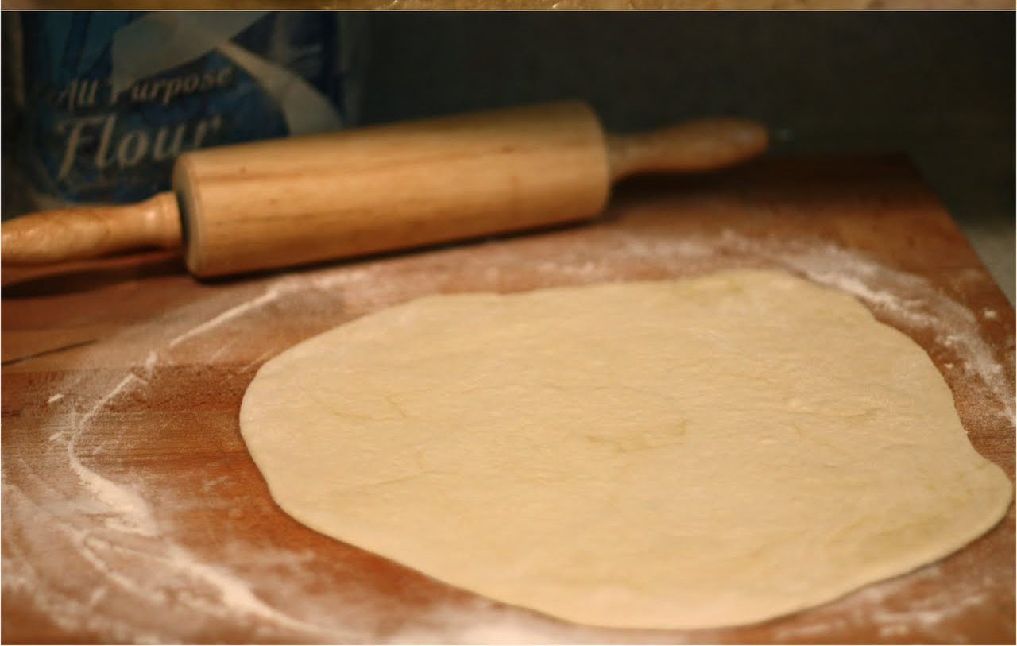
Analogy: Rolling Pin, Pizza Dough

Slide 45
Analogy: Rolling Pin, Pizza Dough

Slide 46
Analogy: Rolling Pin, Pizza Dough

Slide 47
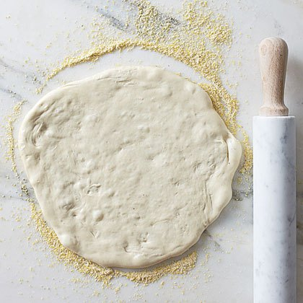
Any Convex Pizza and
Any Linear Rolling Pin Approach

Slide 48
Any Convex Pizza and
Any Linear Rolling Pin Approach

Slide 49
Linear Programming Solver
Three Step Process
  Identify the coordinates of all feasible corners
  Evaluate the objective function at each one
  Return one that maximizes the objective function
This totally works! We're done.
The trick: how can we find all of the coordinates of the corners without drawing the picture of the graph?

Slide 50
Finding Corner Points
A corner point (extreme point) lies at the intersection of constraints.
Recall our running example:
Subject to 2x +3y ≤ 6 (1)
2y ≤ 5 (2)
2x +1y ≤ 4 (3)
x ≥ 0, y ≥ 0
Take just (1) and (3) as defining equations

Slide 51
Visually
2x +3y ≤ 6 and 2x +1y ≤ 4
  Hard to see with the whole graph ...
y
2x+y≤4
3
2y≤5
2
1
2x+3y≤6
(feasible)
0
1
2
3
x

Slide 52
Visually
2x +3y ≤ 6 and 2x +1y ≤ 4
  But easy if we only look at those two!
2x+y≤4
2x+3y≤6

Slide 53
Mathematically
2x +3y ≤ 6
2x +1y ≤ 4
Recall linear algebra: Gaussian Elimination
  Subtract the second row from the first
0x +2y ≤ 2
  Yields “y = 1”
Substitute “y=1” back in
2x + 3 ≤ 6
  Yields “x = 1.5”

Slide 54
Infeasible Corners
2x +3y ≤ 6 and 2y ≤ 5
y
2x+y≤4
3
2y≤5
2
1
2x+3y≤6
(feasible)
0
1
2
3
x

Slide 55
Infeasible Corners
2x +3y ≤ 6 and 2y ≤ 5
  (-0.75,2.5) solves the equations but it does not satisfy our “x ≥ 0” constraint: infeasible!
y
3
2y≤5
2
1
2x+3y≤6
(feasible)
0
1
2
3
x

Slide 56
Solving Linear Programming
Identify the coordinates of all corners
  Consider all pairs of constraints, solve each pair
  Filter to retain points satisfying all constraints
Evaluate the objective function at each point
Return the point that maximizes
With 5 equations, the number of pairs is “6 choose 2” = 5!/(2!3!) = 10.
  Only 4 of those 10 are feasible.

Slide 57
Feasible Corners
In our running example, there are four feasible corners
y
2x+y≤4
3
2y≤5
2
1
2x+3y≤6
(feasible)
0
1
2
3
x

Slide 58
Road Trip!
Suppose we start in one feasible corner (0,0)
  And we know our objective function 4x+3y
  Do we move to corner (0,2) or (2,0) next, or should we stay here?
y
2x+y≤4
3
2y≤5
2
1
2x+3y≤6
(feasible)
0
1
2
3
x

Slide 59
Road Trip!
We're now in (2,0)
  And we know our objective function 4x+3y
  Do we move to corner (1.5,1) or stay here?
y
2x+y≤4
3
2y≤5
2
1
2x+3y≤6
(feasible)
0
1
2
3
x

Slide 60
Road Trip!
We're now in (1.5,1)
  We're done! We have considered all of our neighbors and we're the best.
y
2x+y≤4
3
2y≤5
2
1
2x+3y≤6
(feasible)
0
1
2
3
x

Slide 61

Analogy: Don't Sink!

Slide 62
Reach Highest Point Greedily

Slide 63

Not A Counter-Example
Why Not?

Slide 64
Simplex Insight
The Simplex algorithm encodes this “gradient ascent” insight: if there are many corners, we may not even need to enumerate or visit them all.
Instead, just walk from feasible corner to adjacent feasible corner, maximizing the objective function every time.
  It's linear and convex: you can't be “tricked” into a local maximum that's not also global.
In a high-dimensional case, this is a huge win because there are many corners.

Slide 65
Simplex Algorithm
George Dantzig published the Simplex algorithm in 1947.
  John von Neumann theory prize, US National Medal of Science, “one of the top 10 algorithms of the 20th century”, etc.
Phase 1: find any feasible corner
  Ex: solve two constraints until you find one
Phase 2: walk to best adjacent corner
  Ex: “pivot” row operations between the “leaving” variable and the “entering” variable
Repeat until no adjacent corner is better

Slide 66
Simplex Running Time
Despite the “gradient ascent heuristic”, the official worst-case complexity of Simplex is Exponential time
  Open question: is there a strongly polytime algorithm for linear programming?
Simplex is quite efficient in practice.
  In a formal sense, “most” LP instances can be solved by Simplex in polytime. “Hard” instances are “not dense” in the set of all instances (akin to: the Integers are “not dense” in the Reals).
0-1 Integer Linear Programming is NP-Hard.

Slide 67
Next Time
DPLL(T) combines DPLL + Simplex into one grand unified theorem prover

Slide 68
Homework
HW2 Due for Next Time
Reading for Monday

