Slide 1
Unsupervised Learning
Fraud Dectection on Bank Transactions
Nguyen Thien Toan

Slide 2
Outline:
Introduction
2. Models
3. Idea to improve models

Slide 3
Part 1: Introduction

Slide 4
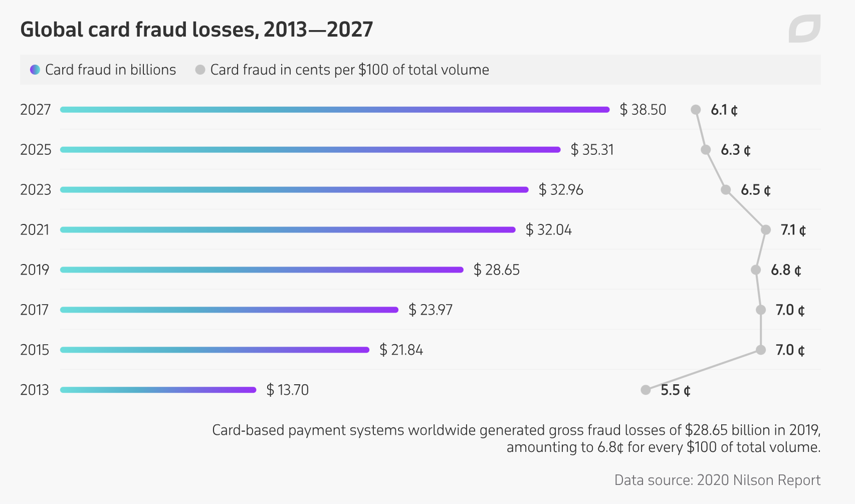
Problem
Card fraud is one of the biggest threats to organizations
today. Card fraud is simply defined as unauthorized,
deliberate deception to secure unfair or unlawful access
to a victim‟s transaction card in order to defraud him
(Salem, 2012).
A fraud detection system usually comes to play when
the fraudsters outwit the fraud prevention mechanism and
initiate fraudulent transactions. In the business world, the
application of data mining technique to fraud detection is
of special interest as a result of the great losses
companies suffer due to such fraudulent activities. This
work describes data mining technique and its application
to card fraud detection.

Slide 5
Why unsupervised learning?
Unsupervised learning are models that don’t take the y(target) as an argument. It does not fit the data so you don’t need the ground truth to make predictions. Banks are in a similar situation where they don’t know if a transaction is fraud when the transaction is happening.
The unsupervised models will take a feature matrix X and make labels based on unseen structures and hidden correlations within the feature space.

Slide 6
What we should consider when using unsupervised learning models?
You cannot get precise information regarding data sorting, and the output as data used in unsupervised learning is labeled and not known
Less accuracy of the results is because the input data is not known and not labeled by people in advance. This means that the machine requires to do this itself.
The spectral classes do not always correspond to informational classes.
The user needs to spend time interpreting and label the classes which follow that classification.
Spectral properties of classes can also change over time so you can’t have the same class information while moving from one image to another.

Slide 7
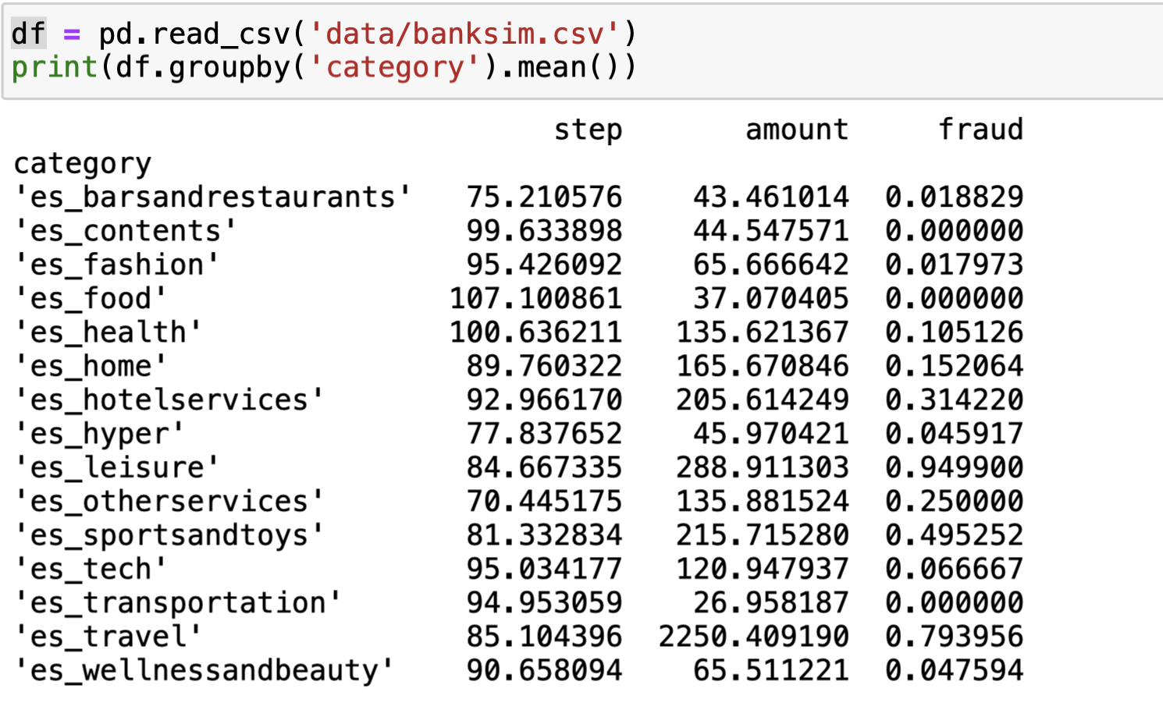
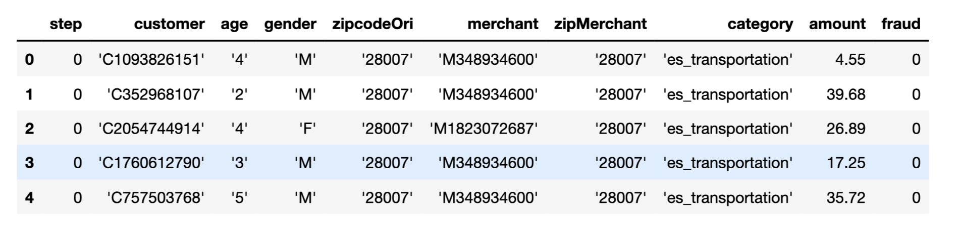
Describe data
Leisure and travel related transactions have high rates of fraud

Slide 8
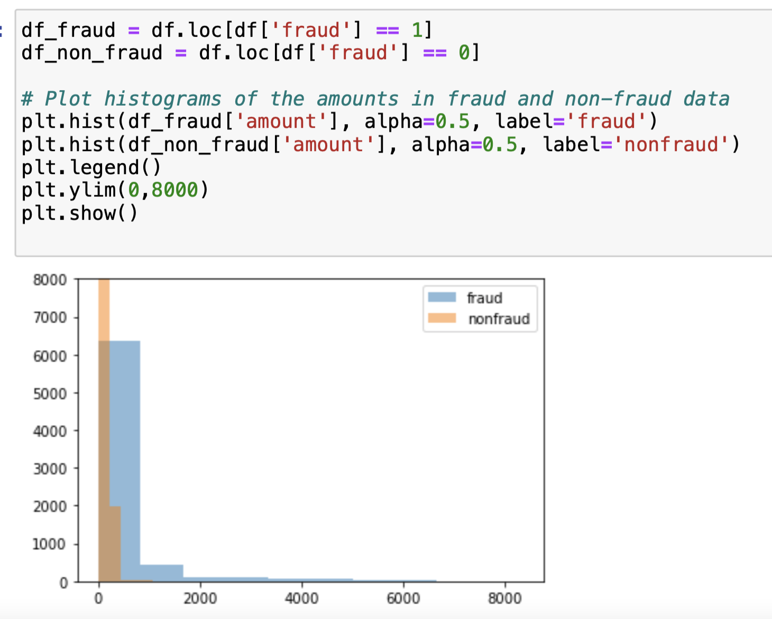
Fraud transactions tend to be for large amounts

Slide 9
Part 2: Models

Slide 10
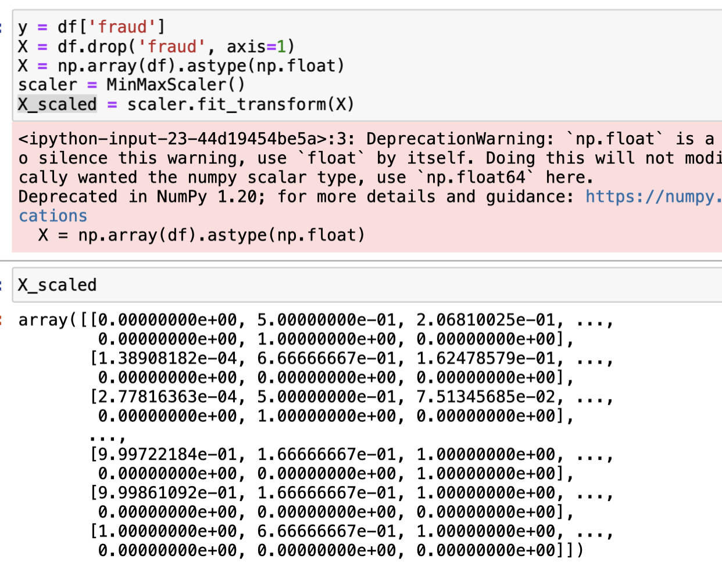
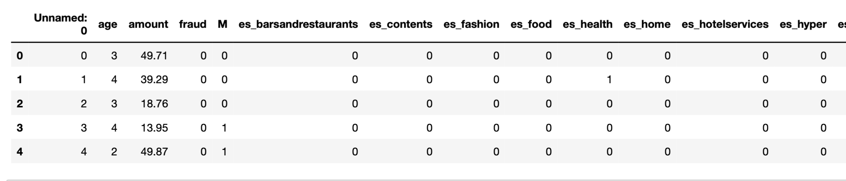
Preprocessing data
One-Hot Encoding
MinMaxScaler

Slide 11
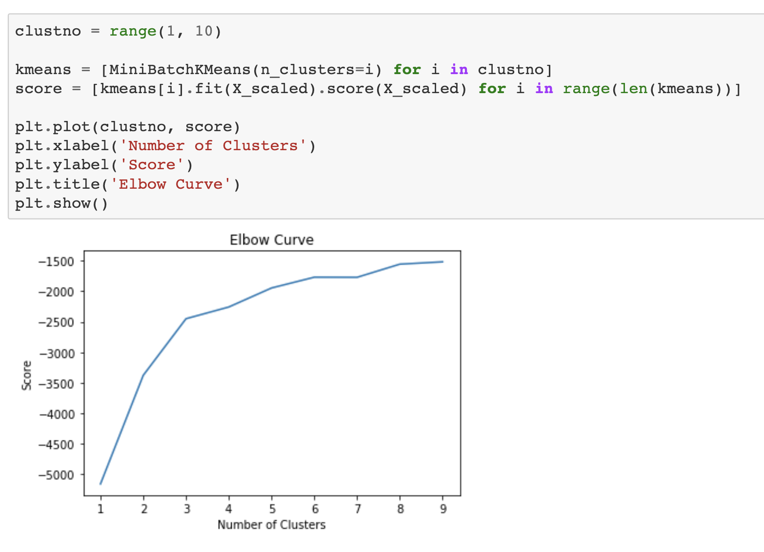
Elbow method points out that 4 cluster is the best
Kmean Method

Slide 12
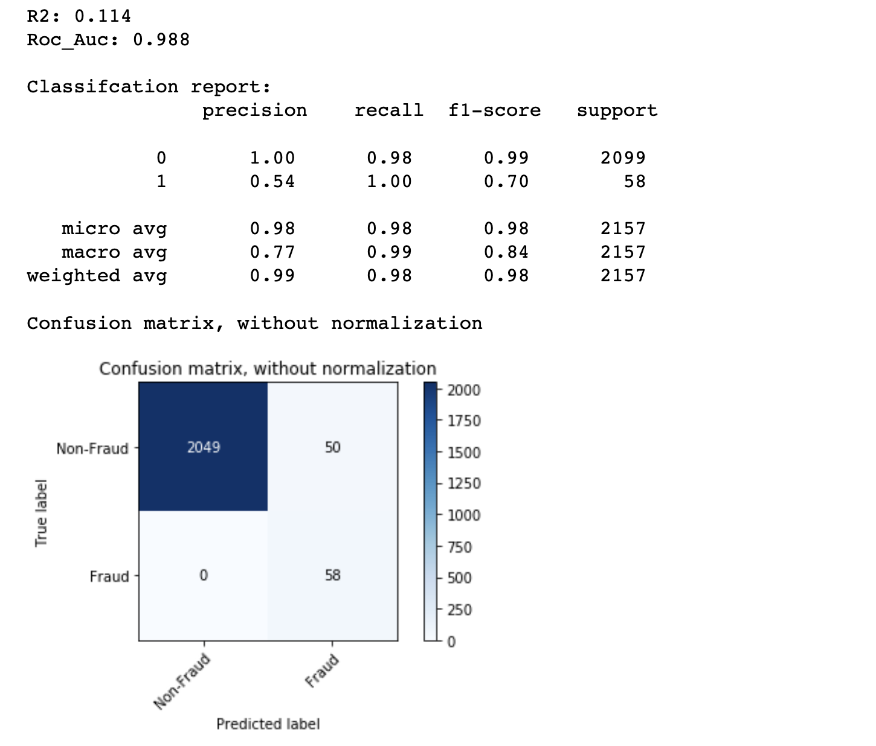
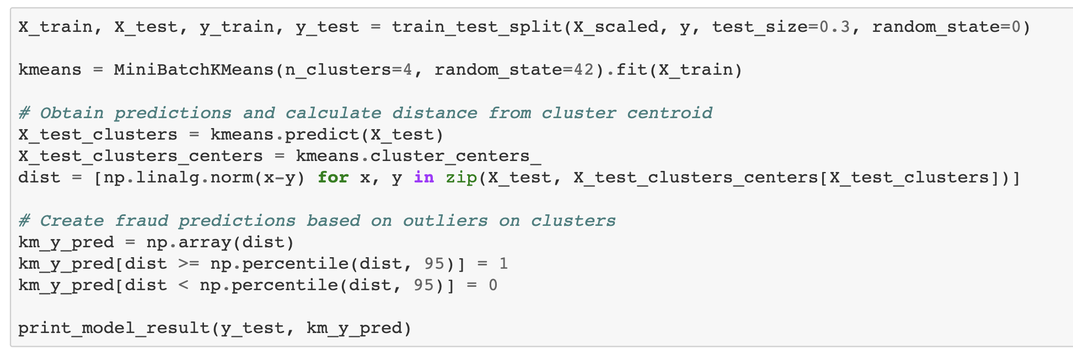

Slide 13
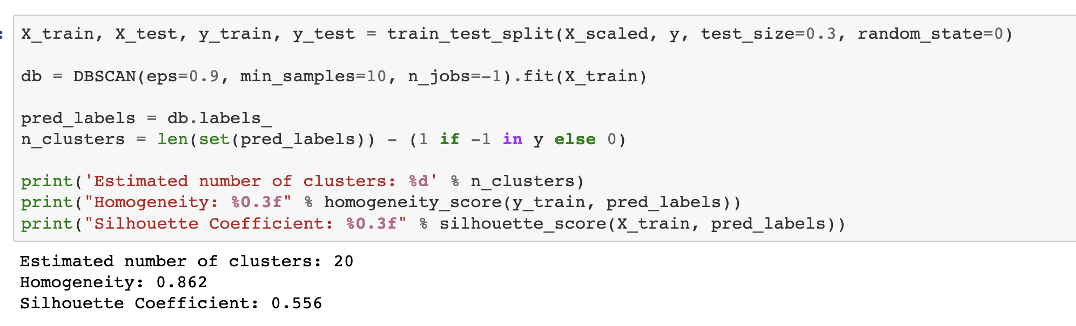
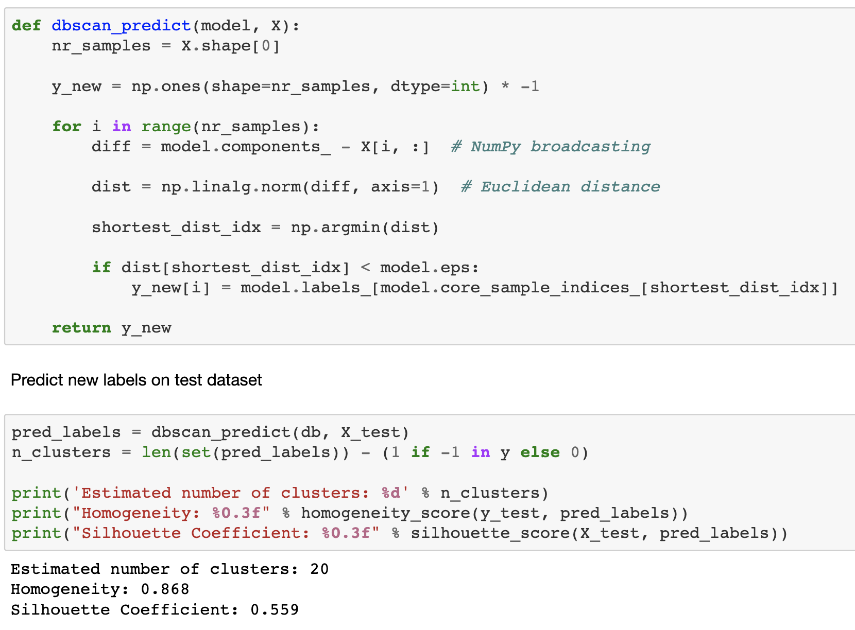
DBSCAN METHOD

Slide 14
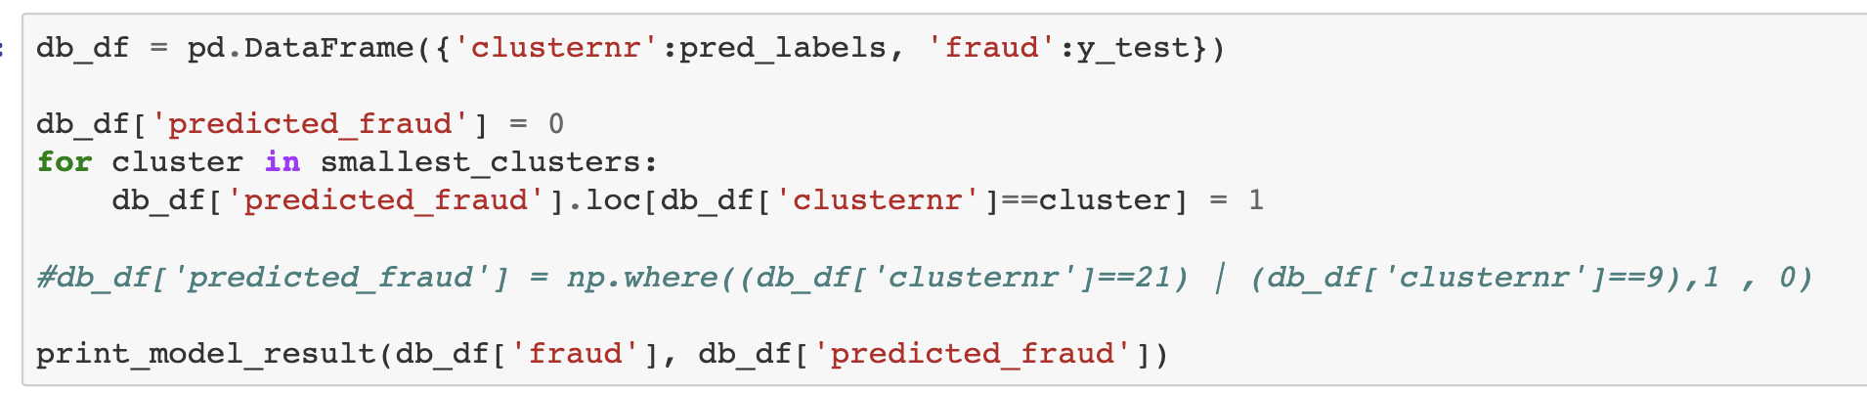
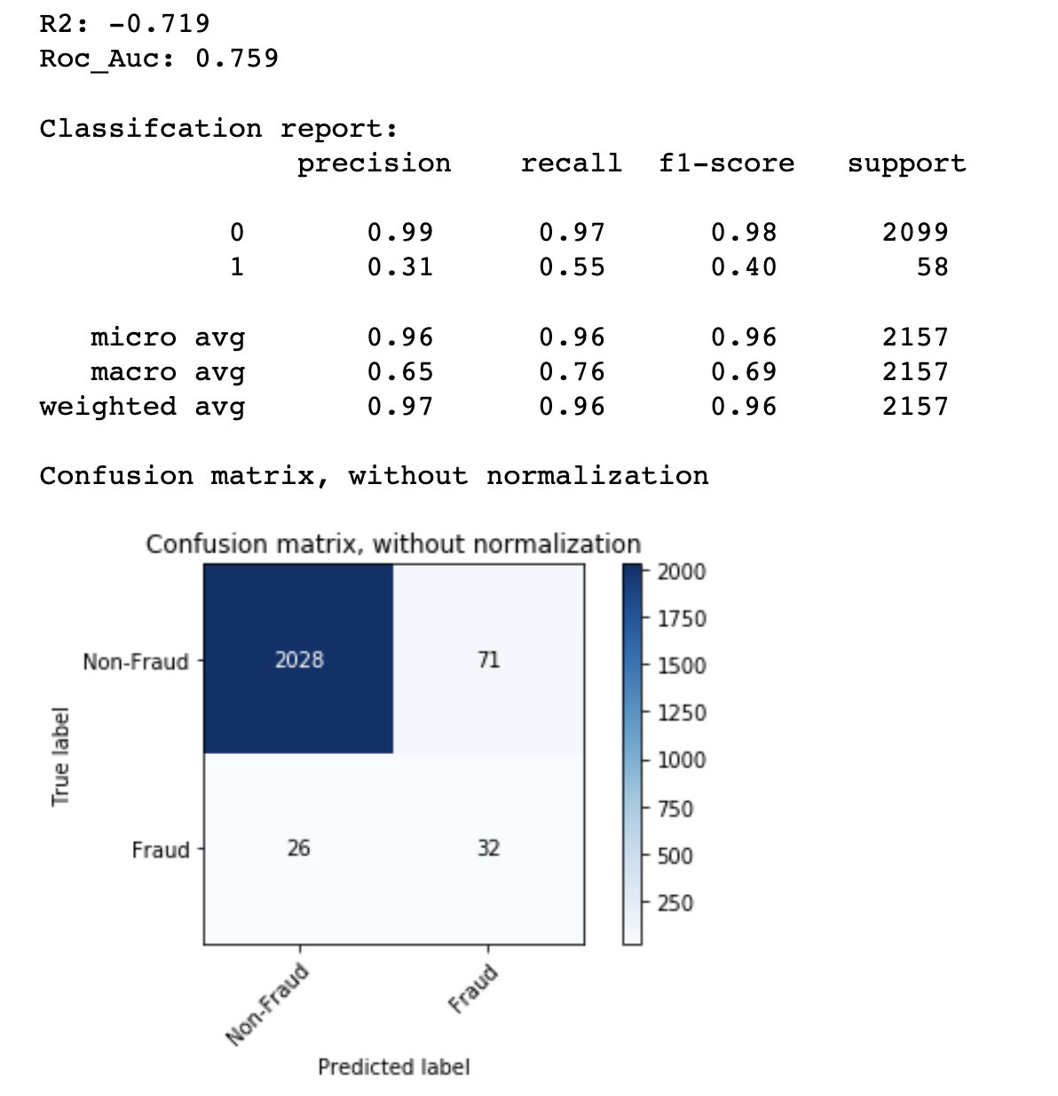

Slide 15
Part 3: Idea to improve models

Slide 16
No models are perfect. We need to improve it everyday
Since the sihoullet score in both KMean and DBSCAN were not good, just around 0.5 meaning they were not seperated perfectly, it is good to clean data deeply(exclude some reduntdant points).
I found a paper (link below), their technique can improve DBSCAN model. It improve the accuracy of the cluster and decrease the execute time. https://www.ijraset.com/research-paper/techniques-to-enhance-the-performance-of-dbscan-clustering-algorithm

