Slide 1

Just audio nfts
project 3 team members: Jas pinglia, Angela Richter, Neil Mendelow, Thuy Nguyen

Slide 2

The opportunity:
As new digital media has been adopted, attention spans are decreasing over time. Some research has indicated that in just 15 years (2000-2015) the average attention span has been reduced from 12 seconds down to 8.25 seconds¹
1 https://www.wyzowl.com/human-attention-span/

Slide 3
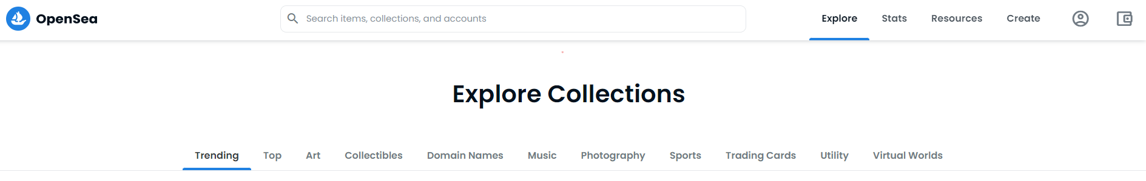
NFT Competitive Landscape
OpenSea is the world’s first and largest digital marketplace for crypto collectibles and non-fungible tokens (NFTs).
There are no audio-only NFTs (apart from music) currently available on OpenSea

Slide 4
JANT NFT Platform Structure
Login
Minting
IPFS
Collection
Playback
Trading
Appraisal

Slide 5
NFT Data flow
Metadata and audio files sent to IFPS via Pinata
Audio file uploaded to website
Hash returned from IPFS
IPFS manages storage of files and data
Hash created
User is able to play owned NFTs
Streamlit displays owned tokens
Metadata collected
New NFT Minted
Connect to OpenSea
Technologies/Libraries used:
Solidity
Remix-IDE
Python
Streamlit
Piñata
IPFS
QRcode
Pillow
Base64
Streamlit-Authenticator
Aggrid

Slide 6

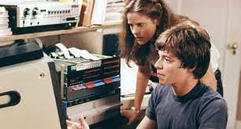
Streamlit Demonstration

Slide 7

Conclusions
Created sound-based NFTs
Hosted a Streamlit-based platform for creating, storing, viewing, playing, and collecting NFTs
Gained familiarity with new libraries: Pillow, Base64, QRCode, Streamlit-Authenticator among others

Slide 8
Future Development
Host our own website
Deploy to Ethereum Mainnet
Hard limit to length of files uploaded to 5 seconds
Ability to filter by category
Build connection to OpenSea to enable trading

Slide 9
Projected Infrastructure costs
Increased IPFS storage
$1.80/GB²
Prices are per year of storage beyond the first Gigabyte of storage used
Smart Contract Deployment
$400 – 2000 USD³
This will depend on the exchange rate of ETH/USD and the prevailing gas price of the Ethereum network at the time of deployment
Web hosting
$54 – 2900 USD¹
Costs are annual figures and reflect cloud based hosting to ensure uptime
Based on the average file size, you’d get 2000 Audio NFTs per GB of storage
Estimated infrastructure spending
Web Hosting | $ 2,000.00
Smart Contract Deployment | $ 1,200.00
Storage fees | $ 100.00
Total | $ 3,300.00
1 https://www.websitebuilderexpert.com/web-hosting/cost-to-host-a-website/
2 https://medium.com/pinata/whats-the-real-cost-of-ipfs-3623f274cfaa
3 https://techfastly.com/how-to-eliminate-nft-deployment-costs-and-smart-contract-hassles/

Slide 10
Projected Labor costs
UI/UX Developer
Avg Yearly Salary Range: $69-149k²; (Hourly rate - $35.67)
User Interface developer is tasked with rolling out the full-needed functionality of the Streamlit web portal, and potential full migration to HTML based website.
Solidity Developer
Avg Yearly Salary Range: $60–160k³; (Hourly Rate - $48.08)
Solidity Developer is tasked with creating/maintaining the smart contract and ensuring security measures are in place and NFTs are meeting ERC721 standards
Full Stack Developer
Avg Yearly Salary Range: $113-167k⁴; (Hourly Rate - $67.94)
Full Stack Developer to work on seamless integration of front and back end code
Project Manager
Avg Yearly Salary Range: $80-155K¹; (Hourly rate - $45.40)
Coordinate development among team members. Keeps project within scope, on time, and within budget
 | Rate | Hours | Total
Current Development
Project Manager | $ 45.40 | 50 | $ 2,270.00
UI Dev | $ 35.67 | 25 | $ 891.75
Solidity Dev | $ 48.08 | 25 | $ 1,202.00
Full Stack Dev | $ 67.94 | 50 | $ 3,397.00
Development Cost to Date |  | 150 | $ 7,760.75
Full-Feature Rollout
Project Manager | $ 45.40 | 1040 | $ 47,216.00
UI Dev | $ 35.67 | 1040 | $ 37,096.80
Solidity Dev | $ 48.08 | 1040 | $ 50,003.20
Full Stack Dev | $ 67.94 | 1040 | $ 70,657.60
Additional Development Costs |  | 4160 | $ 204,973.60
1 Salary Information sourced from glassdoor.com/Salaries/houston-software-project-manager-salary-SRCH_IL.0,7_IM394_KO8,32.htm
2 Salary information sourced from glassdoor.com/Salaries/ui-ux-designer-salary-SRCH_KO0,14.htm
3 Salary information sourced from web3.career/web3-salaries/solidity-developer
4 Salary information sourced from randstadusa.com/salary/full-stack-web-developer-salaries/houston-Texas/

Slide 11

Total Projected costs
 | Rate | Hours | Total
Current Development
Project Manager | $ 45.40 | 50 | $ 2,270.00
UI Dev | $ 35.67 | 25 | $ 891.75
Solidity Dev | $ 48.08 | 25 | $ 1,202.00
Full Stack Dev | $ 67.94 | 50 | $ 3,397.00
Development Cost to Date |  | 150 | $ 7,760.75
Full-Feature Rollout
Project Manager | $ 45.40 | 1040 | $ 47,216.00
UI Dev | $ 35.67 | 1040 | $ 37,096.80
Solidity Dev | $ 48.08 | 1040 | $ 50,003.20
Full Stack Dev | $ 67.94 | 1040 | $ 70,657.60
Additional Development Costs |  |  | $ 204,973.60
Infrastructure Spend |  |  | $ 3,300.00
Total projected development cost |  |  | $ 208,273.60

Slide 12

Thank You
Questions?

